Slide 1
UIFCW R2O2R on EPIC
Collaborative effort between - Community Collaborators slide attached
Special Acknowledgments: Jong Kim, Dr. Mark Potts Dr. Stylianos Flampouris

Slide 2
Agenda
Partners/EPIC Overview
R2O
Repeatable to SRW, RRFS, LandDA, HAFS, and future applications
CI/CD stages and gates

Slide 3
Partners

Slide 4
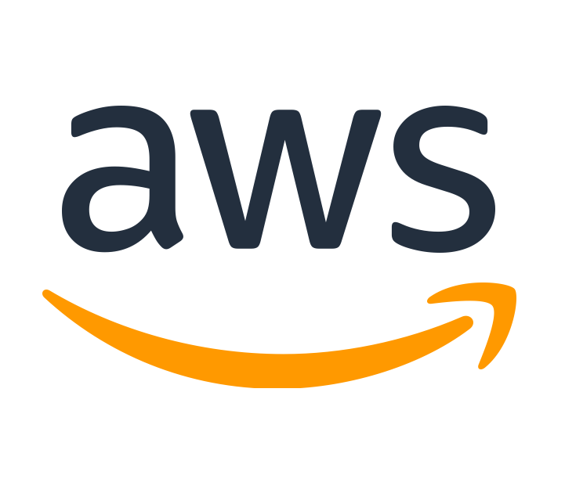
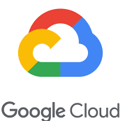
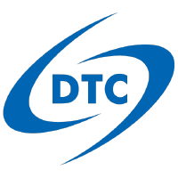
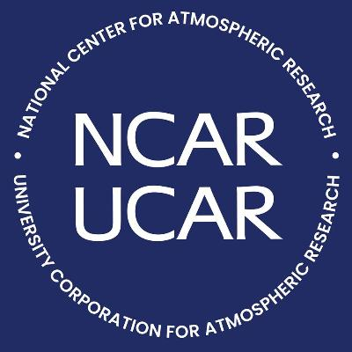
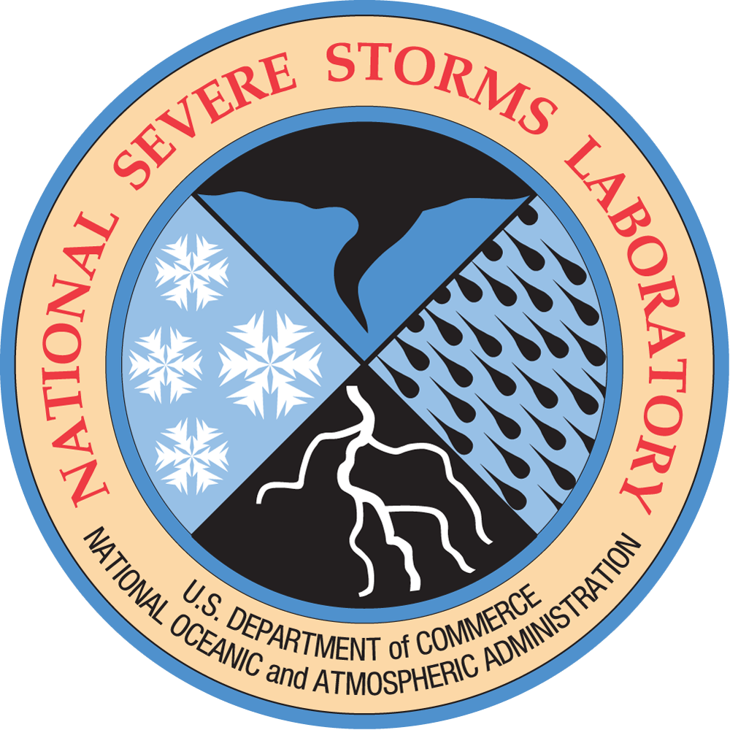
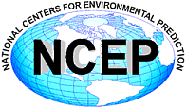
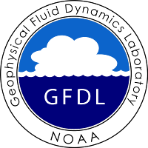
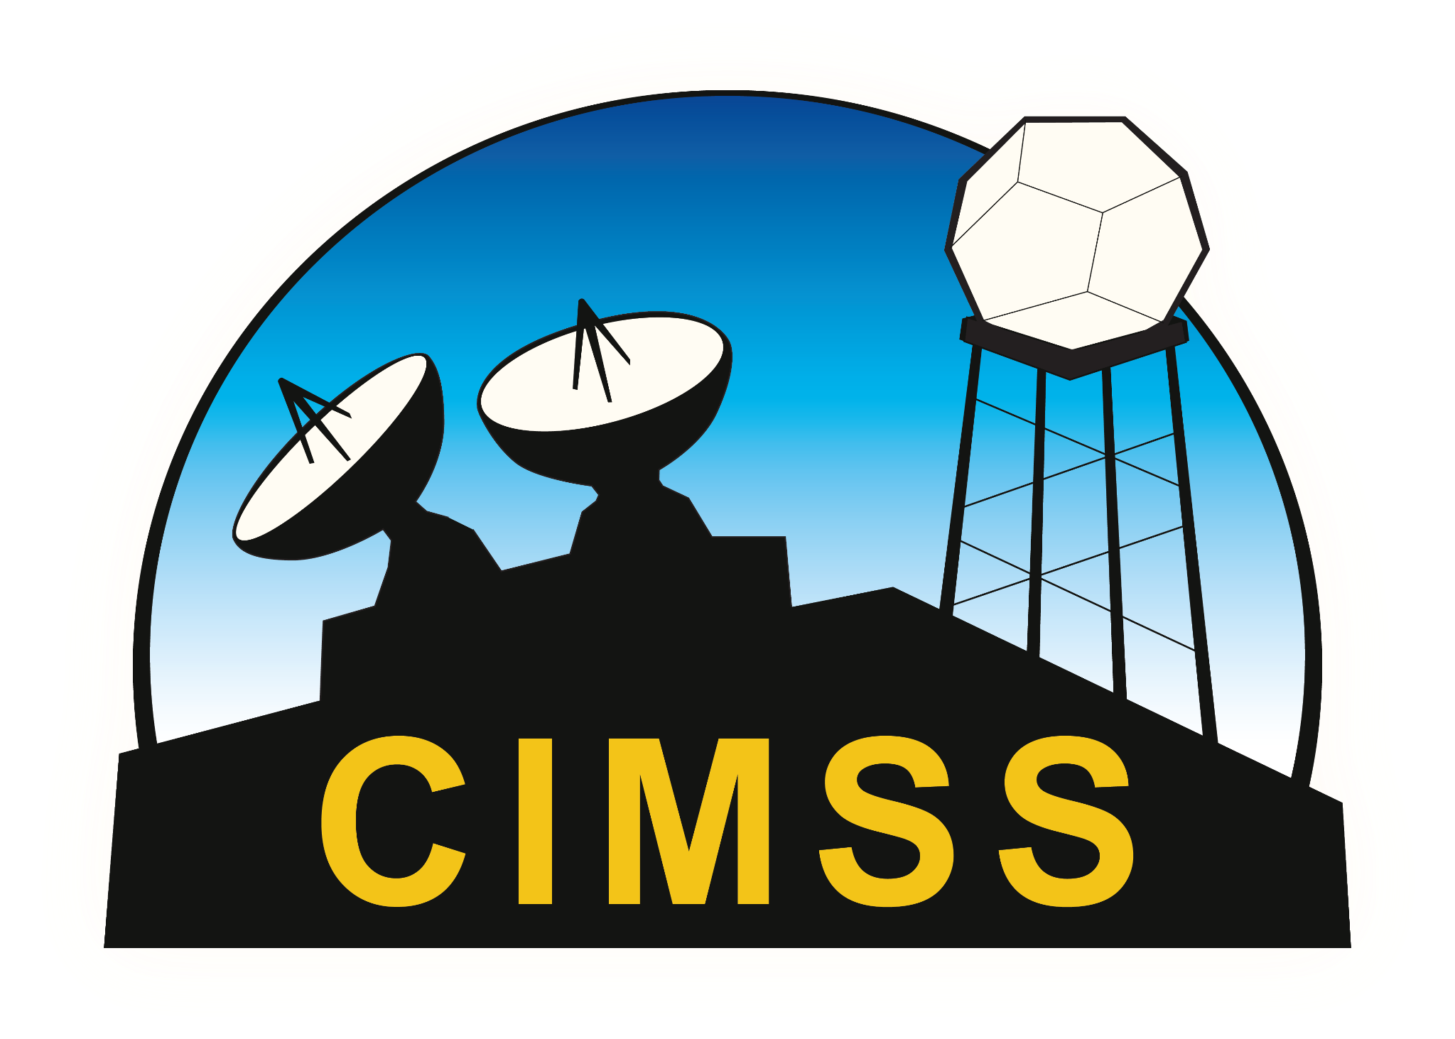
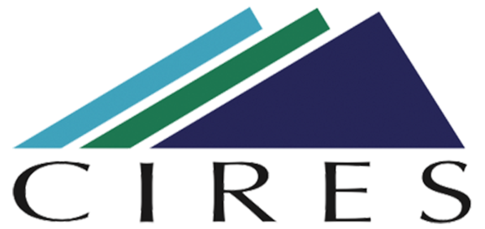
Community Collaborators/Partners
Acknowledgement
NOAA OAR: WPO, GSL, PSL, NSSL, CSL, AOML, GFDL
NOAA Open Data Dissemination (NODD) Program
NWS: EMC, OSTI
DTC
UCAR: CGD, JCSDA
Academia: George Mason University, Oklahoma University, University of Michigan
CSPs: AWS, Azure, and Google Cloud
Cooperative Institutes: CIRES, CIMSS

Slide 5
R2O

Slide 6
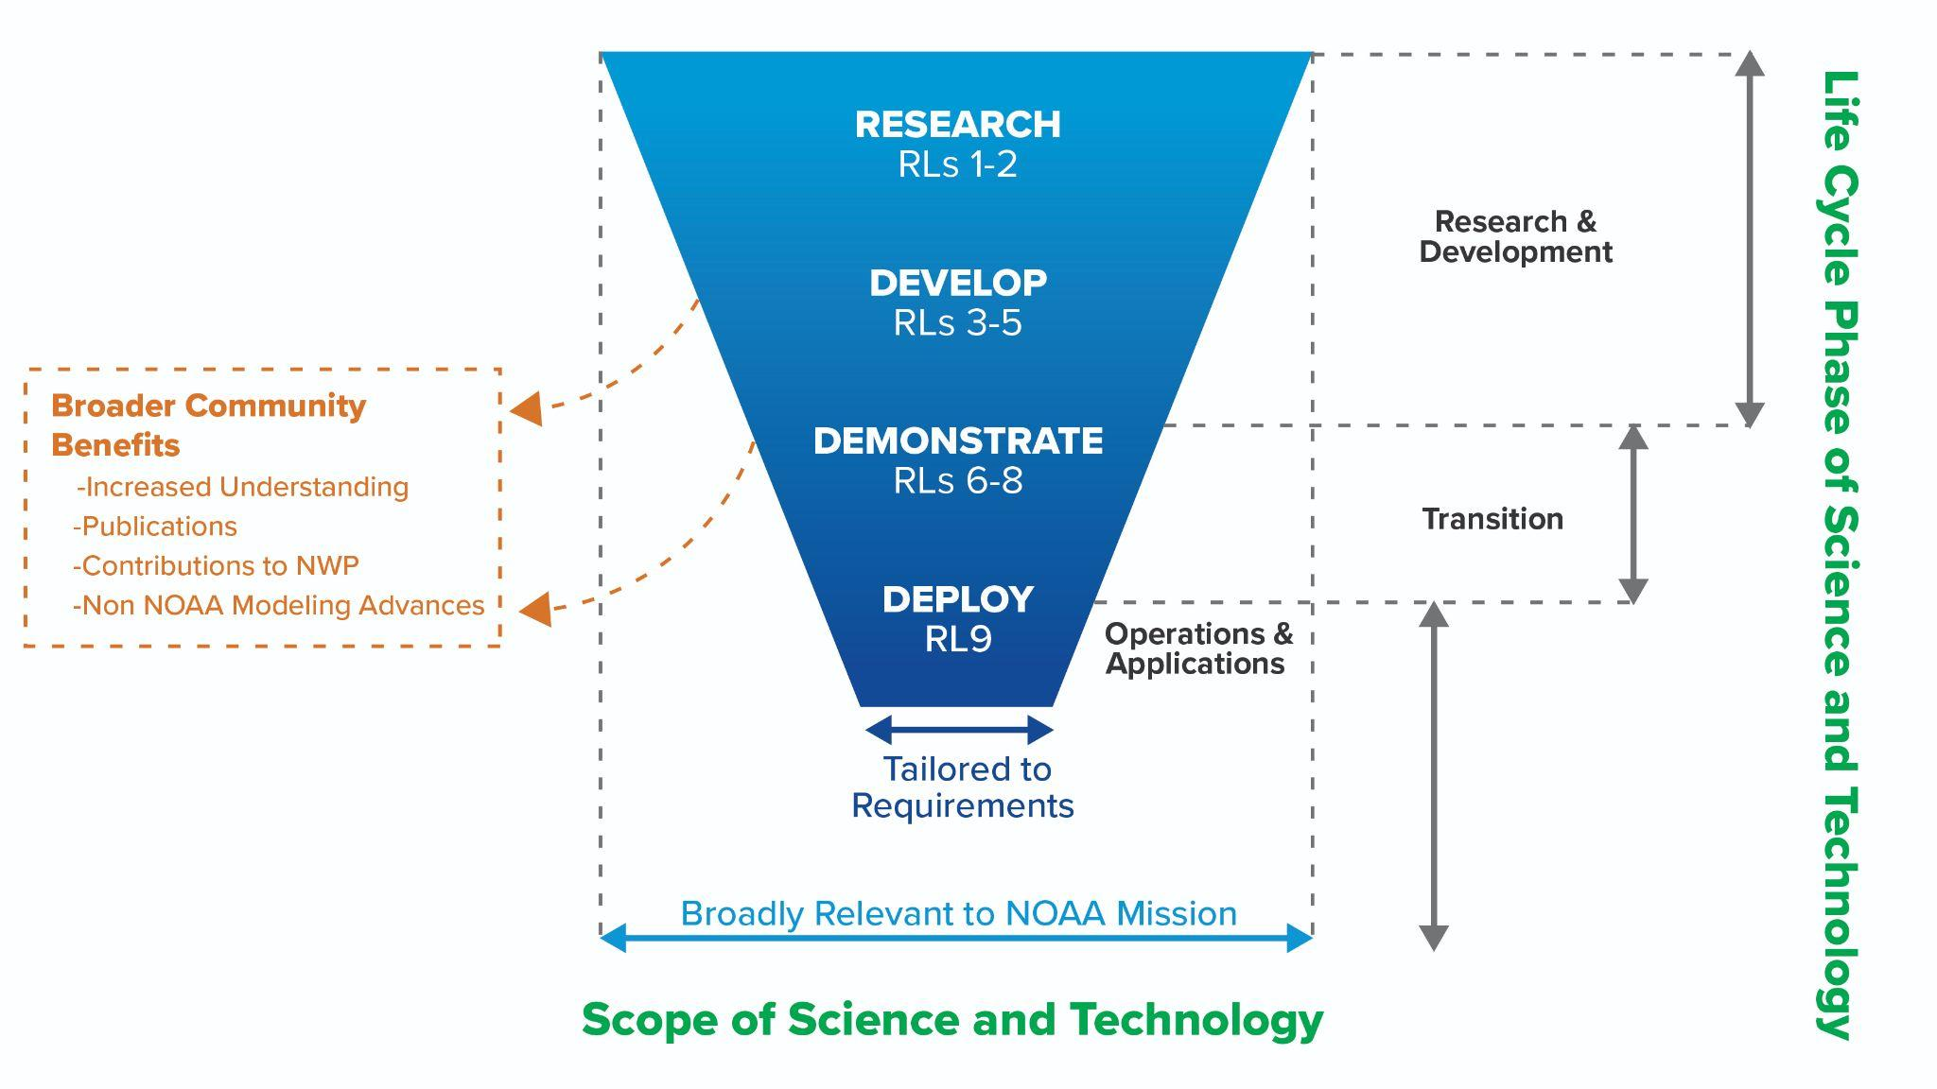

Slide 7
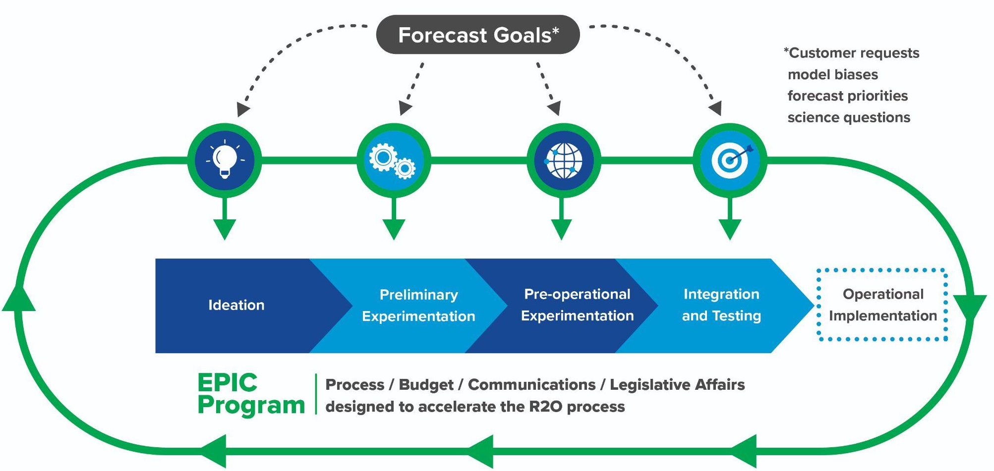
Forecast Goals
Computational Performance

Slide 8
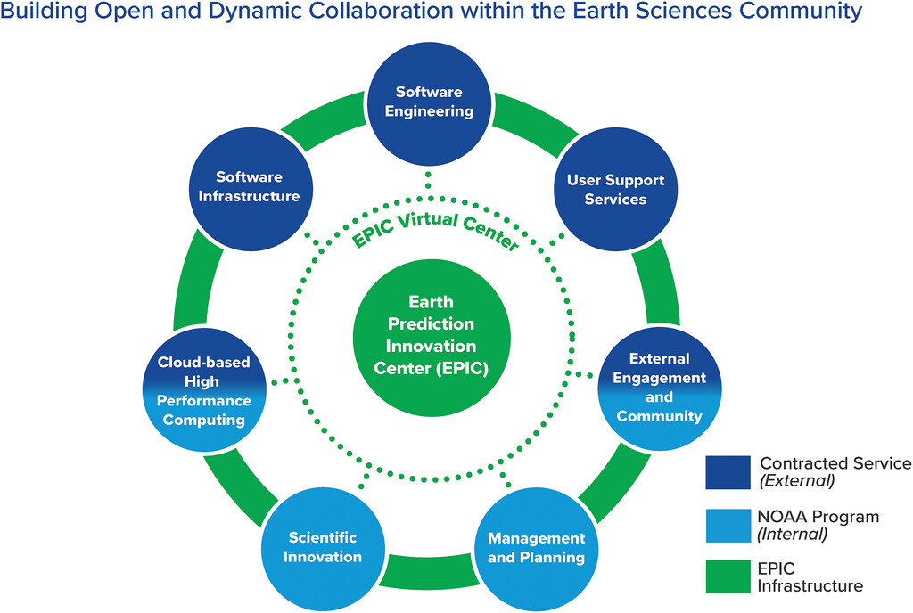
Future Plans:
CI/CD
Repeatable Application runs
Fail Quickly
Enhanced testing frameworks
Advanced User Support
Configuration Management
Cloud configuration scripts
Community Tools
Unified Workflow
Community Events

Slide 9
CI/CD Pipeline - Repeatable Innovation

Slide 10
Pipeline Gates
Checkout Source Code | Pull source code from GitHub and stage the data for analysis before deploying the code.
Unit Testing | Run available unit tests for projects and ensure that the tests run as expected. Collect code coverage metrics for the available baselines.
Lint (Flake 8) | Perform static code analysis that enforces style consistencies across programming languages.
Dependency Check | Scan third-party libraries and modules for current vulnerabilities.
Build the Cloud Stack | Terraform/Cloudformation scripts will create a repeatable process for deploying applications.
Lint Cloud Stack | Examine the cloud stack template and return various suggestions.
Nag Cloud Stack | Pinpoint security vulnerabilities in cloud stack templates.
Scan Secrets | Scan for any improper use of security passwords or credentials.
Static Code Analysis | Scan code in all programming languages using SonarQube to determine current vulnerabilities, maintenance issues, and defects. Note: SonarQube also has the ability to utilize architectural metrics such as cyclomatic complexity and maintainability metrics. Cyclomatic complexity as the example infers is a value that tells the ability that a new engineer will be able to come in and maintain the baseline. If the number is high, then you have an application that is tough to upkeep, so tracking this number over time will make sure that your application is easy to maintain, which in turn reduces technical debt costs.
Package/Pull Artifacts/Deploy | This gate sequence will package up the artifacts and the application and deploy the application as needed after completing all quality gate checks.
Run Regression Tests | Run a list of regression tests to test the overall end-to-end functionality.
Average Build time
Average time per gate
Average build time per platform
Code Coverage
Forecast Skill

Slide 11
CI/CD Pipeline
Master Pipeline:
No-Integration Pipeline:

Slide 12
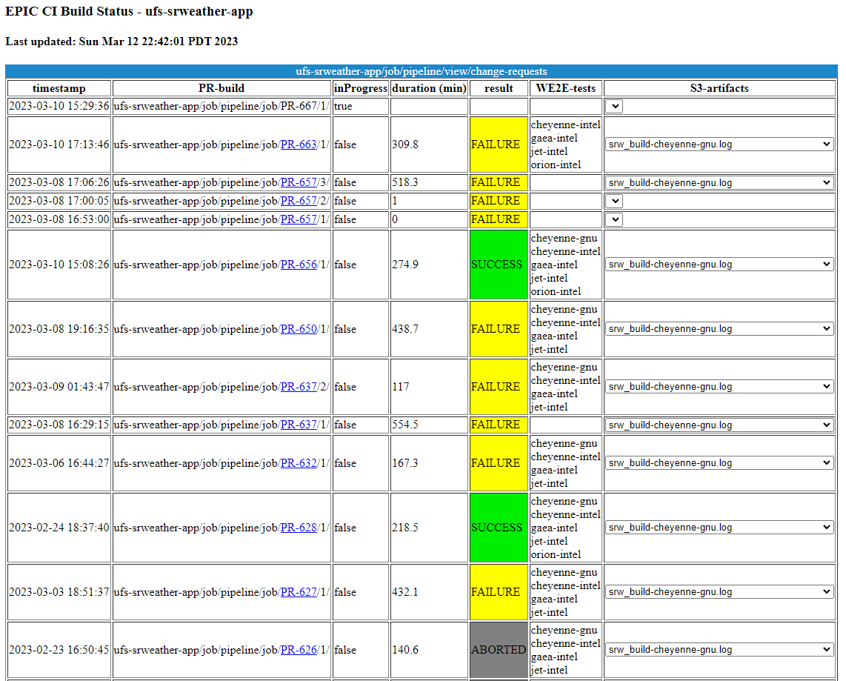
EPIC Dashboard - Pipeline

