Slide 1
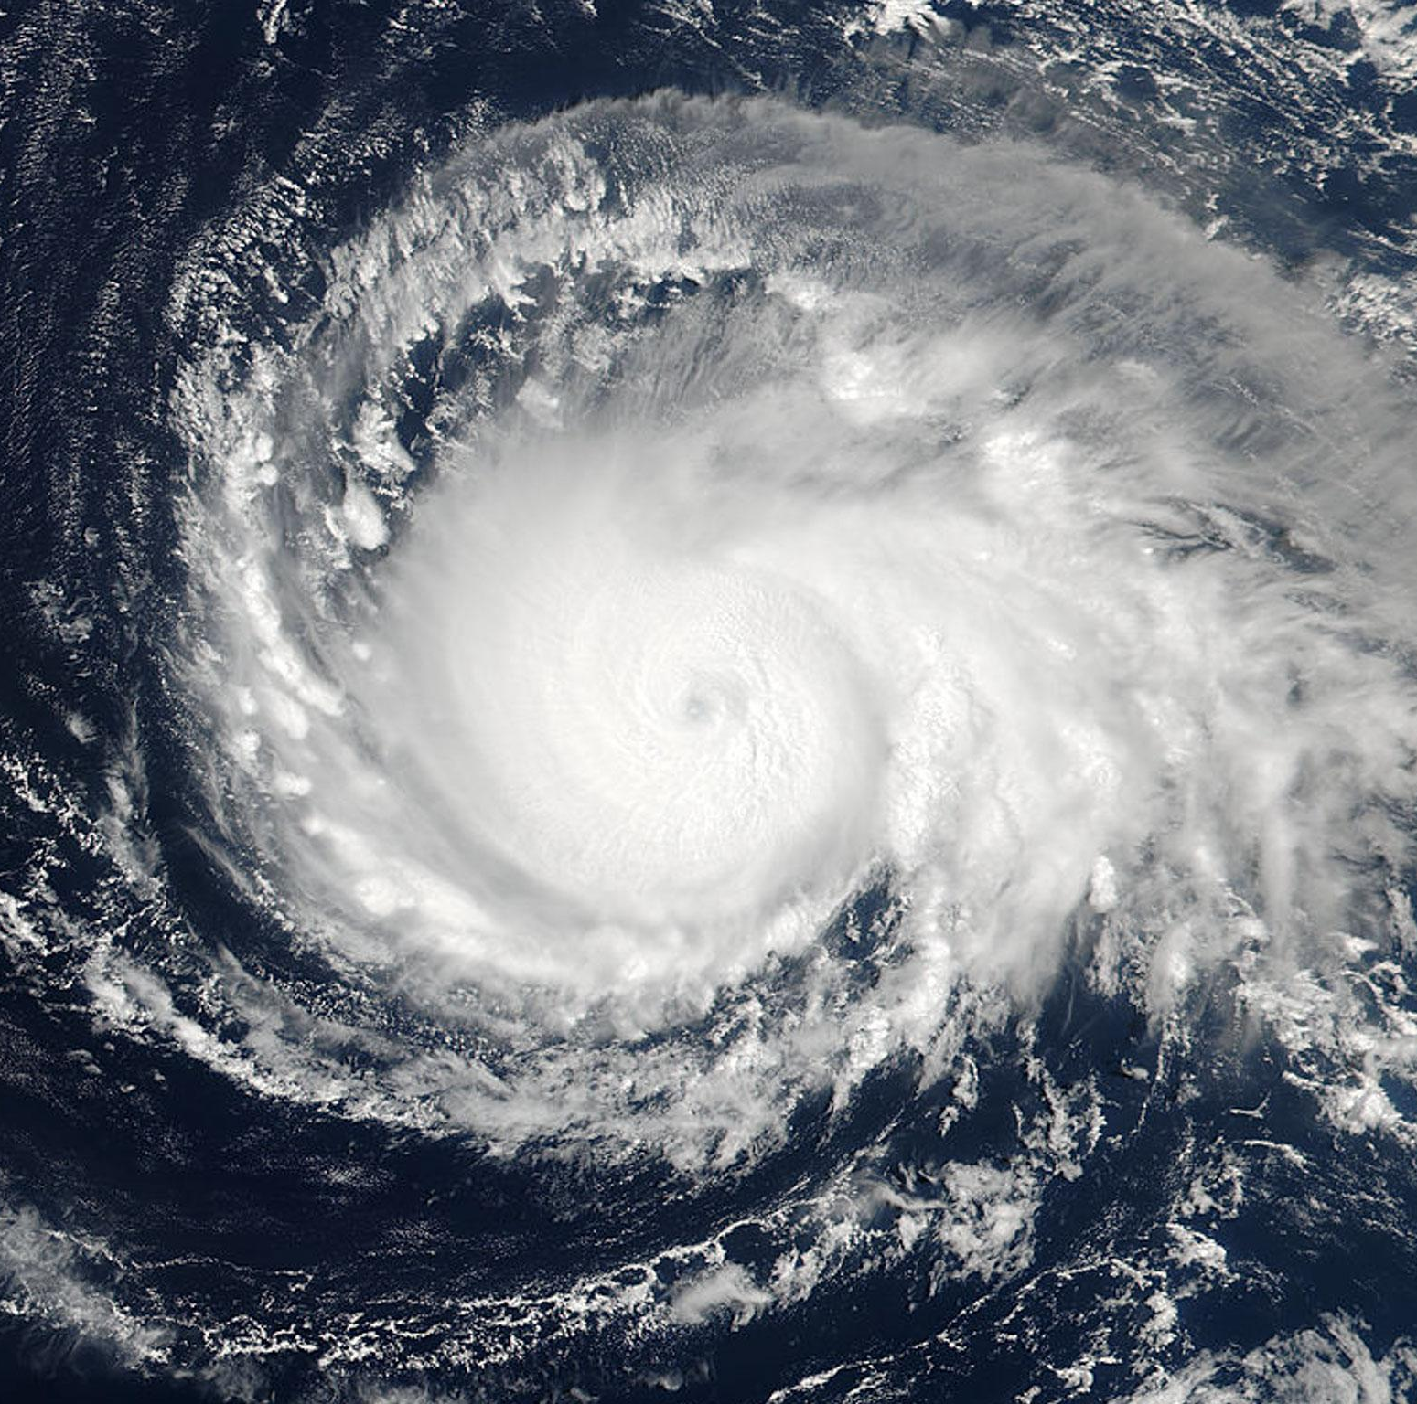
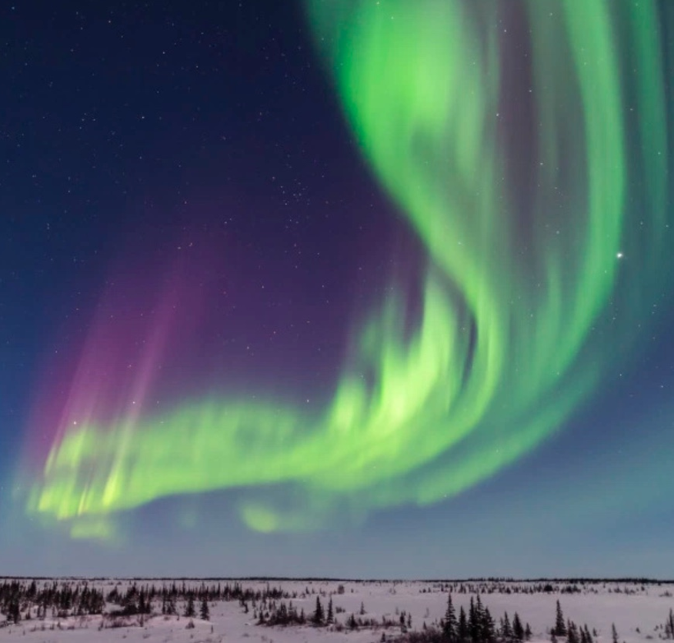
Development of WACCM-X as the SIMA Geospace Component
Han-Li Liu, SIMA Science Co-Lead, High Altitude Observatory
Mary Barth, SIMA Science Lead, Atmospheric Chemistry Observations and Modeling
Adam Herrington, SIMA Science Co-Lead, Climate and Global Dynamics
Bill Skamarock, SIMA Science Co-Lead, Mesoscale and Microscale Meteorology
National Center for Atmospheric Research

Slide 2
Outline
What is SIMA: Motivation and Project Goal
WACCM-X: SIMA-Geospace Component.
Current Developments.

Slide 3
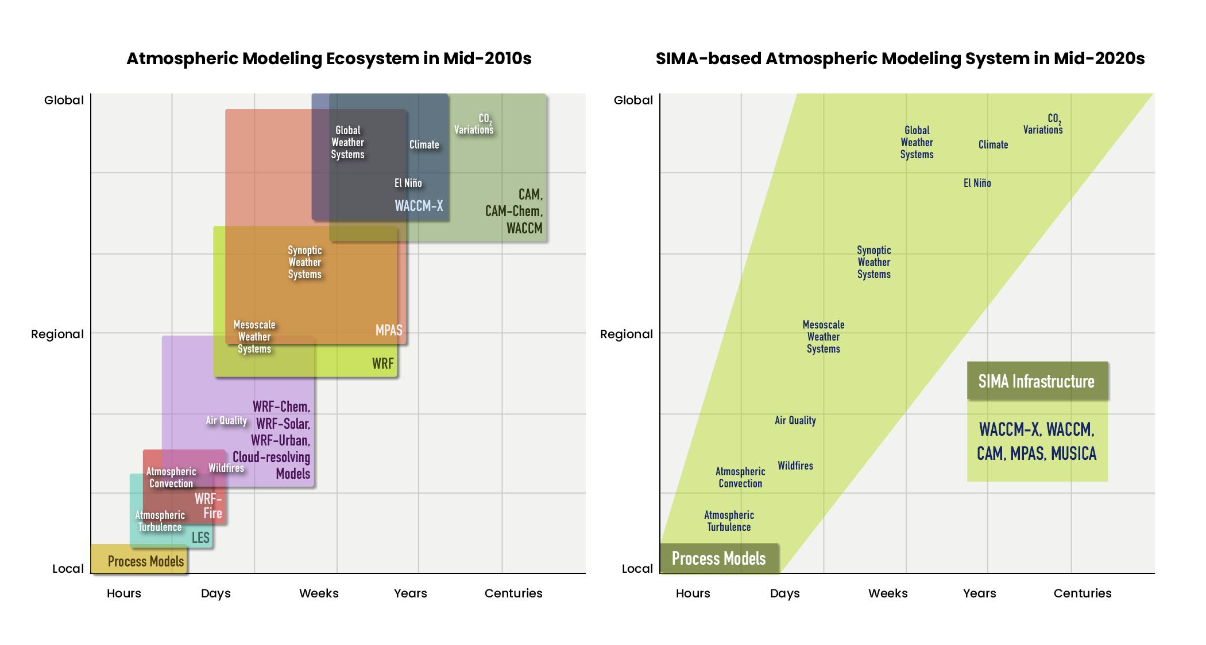
SIMA PROJECT AIMS TO UNIFY THE NCAR ATMOSPHERIC MODELING SYSTEM
NCAR atmospheric modeling ecosystem in the mid-2010s (left) and desired structure in mid-2020s (right)
Notes:
Our modeling ecosystem has become complex as the pic on the left shows
A desire and need to reduce this complexity is driving the unification of our modeling ecosystem
Example: for space weather research and applications, it’s desirable to for WACCM-X to resolve down to mesoscales with minute time scales, including representation of weather systems that generate disturbances important for the upper atmosphere.

Slide 4
SIMA will enhance frontier science simulations in climate, weather, atmospheric chemistry, geospace, and cross-discipline research with one modeling system
MOTIVATION
Examples:
How do urban centers or biomass burning or deep convection impact atmospheric chemistry and meteorology from local to global scales?
How do chemistry and aerosol processes affect S2S predictability?
How do multiscale processes and interactions affect geospace-atmosphere coupling and space weather?
What is the predictability of tropical cyclone formation from short (1 day) to extended range (30 days)?
How will extreme weather events change regionally under climate change?
What processes in the Earth system control predictability in the Arctic?
Many more – geoengineering, atmospheric rivers, ….

Slide 5
ADDITIONAL BENEFITS
Broader range of atmospheric/geospace scientists using the same tool
Increases interdisciplinary interaction, fostering collaborations
Benefits from diverse perspectives
Exchange of knowledge and tools
Accelerates scientific progress
Centralized and efficient model development, maintenance, and support
Opportunity to modernize underlying software
Object-oriented structures
Generic interfaces
Greater runtime configuration control
Code refactoring for GPUs or other computing architectures

Slide 6
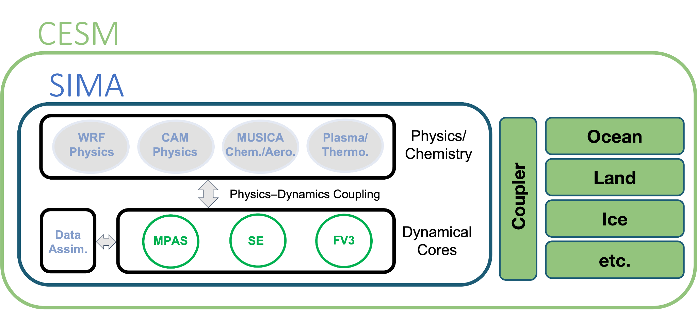
GOAL
SIMA is a framework in one modeling system allowing configurations for climate, weather, atmospheric chemistry, and geospace simulations.
CAM-SIMA
(CCPP)
MUSICA = Multiscale Infrastructure for Chemistry and Aerosols, MPAS = Model for Prediction Across Scales, SE = Spectral Element dynamical core, FV3 = Finite Volume dynamical core on cubed sphere.

Slide 7
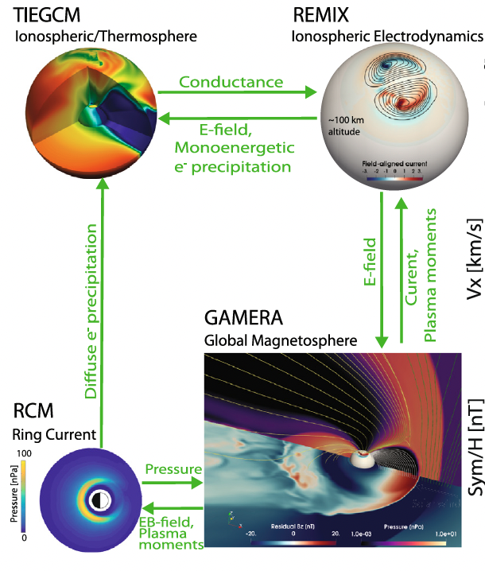
Geospace and Space Weather: SIMA/WACCM-X and MAGE
SIMA Geospace
WRF Physics
CAM Physics
MUSICA
Chem/Aero
Plasma/
Thermo
Physics/
Chemistry
Physics–Dynamics Coupling
Data Assim.
MPAS
SE
FV3
Dynamical
Cores
Multiscale Atmosphere-Geospace Environment (MAGE) Model

Slide 8
Current Developments of SIMA-Geospace
High-resolution SIMA/WACCM-X.
WACCM-X/GAMERA coupling.
WACCM/WACCM-X with non-hydrostatic dynamical core MPAS-A.

Slide 9
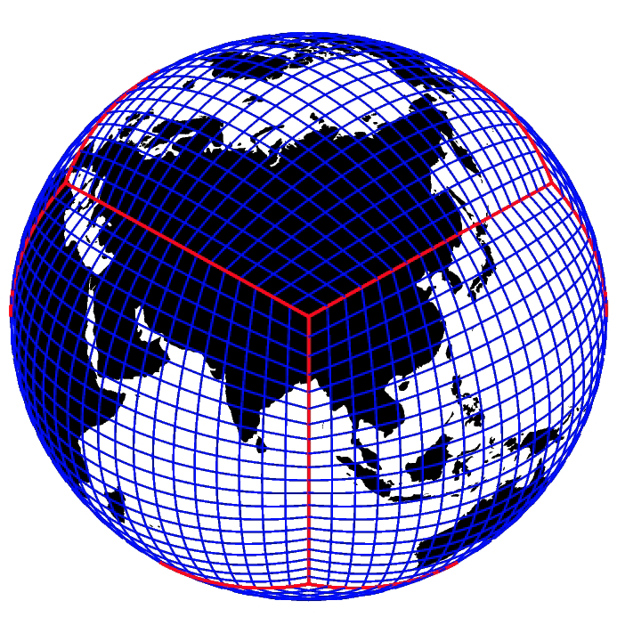
SIMA WACCM-X SE with High-Resolution Capability
Neutral dynamics and physics
WACCM-X Species Dependent Spectral Element Dynamical core with CSLAM transport
Cubed sphere grid (no polar singularity)
Molecular viscosity/diffusion in horizontal direction.
Regridding between physics mesh and geomagnetic grid.
Interactive ionospheric dynamo, transport, and energetics.
High resolution configuration:
~25km horizontal, 0.1 scale height vertical

Slide 10
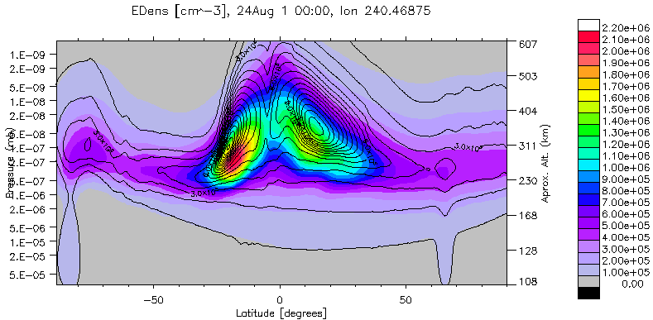
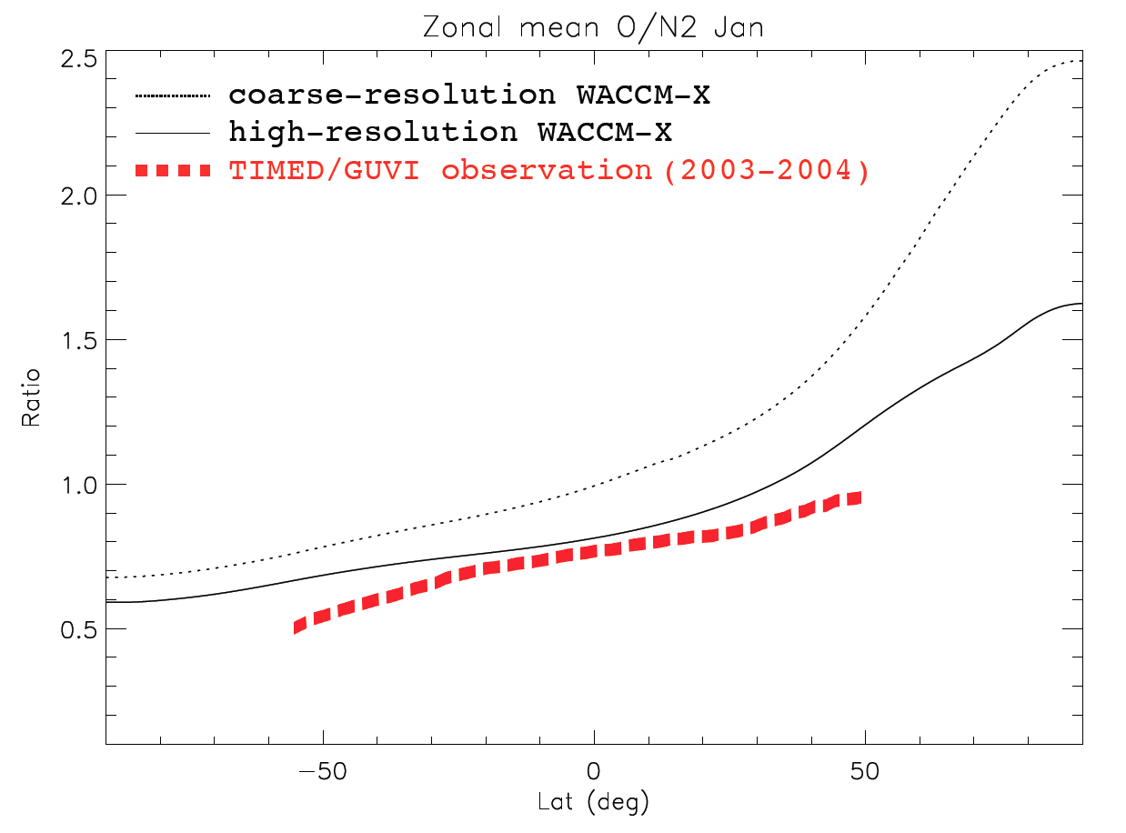
Improved thermospheric circulation, composition, and variability
Gravity Wave Resolving

Slide 11
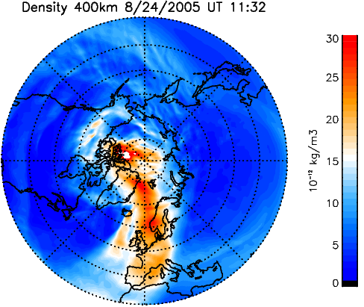
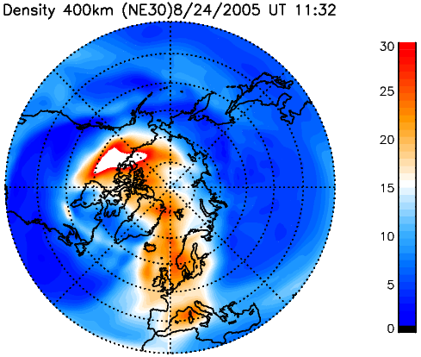
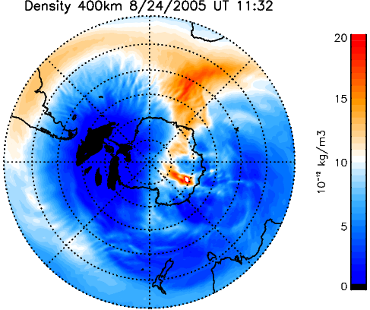
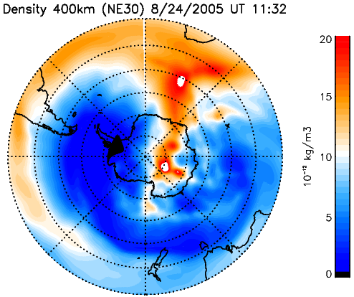
WACCM-X/GAMERA

Slide 12
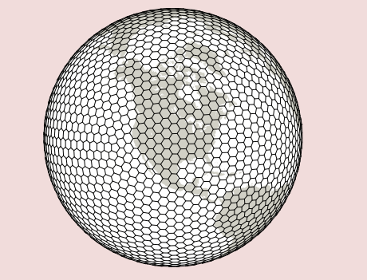
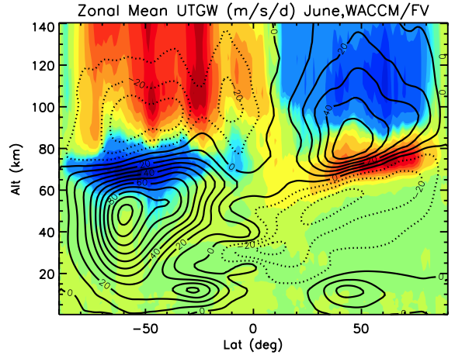
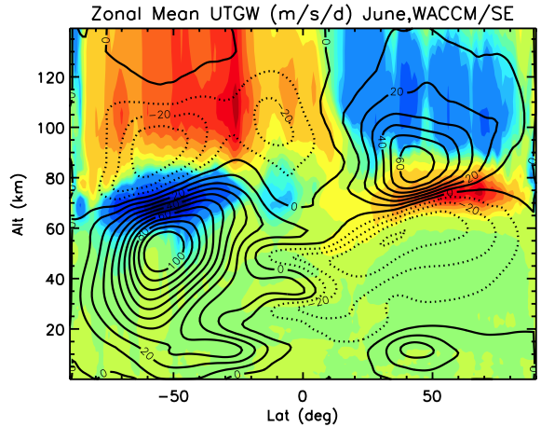
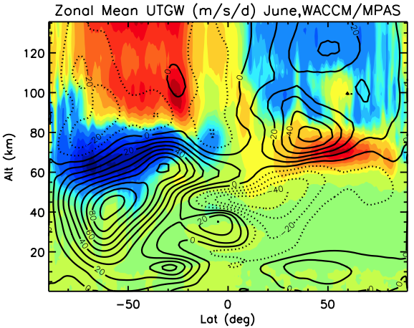
Non-hydrostatic Dynamical Core: MPAS-A in WACCM-X
MPAS-A brings non-hydrostatic modeling capabilities to CESM.
Centroidal Voronoi mesh
Finite-volume, C-grid staggering
Hybrid terrain-following height vertical coordinate
Finite Volume (FV)
Spectral Element (SE)
MPAS-A
Kamali et al. (2023)

Slide 13
Summary
SIMA will enhance frontier science simulations in climate, weather, atmospheric chemistry, geospace, and cross-discipline research with one modeling system
SIMA hopes to move NCAR atmospheric modeling to a single atmospheric modeling system
High resolution simulations (geospace, Arctic, convection) show improved representation of multiscale processes
The Subseasonal to Seasonal, Sun to Soil cross-disciplinary science application project will establish workflows for ensemble simulations and address multiscale processes in two extreme weather events

