Slide 1
Collaborative Efforts Towards Advancing Aerosol Assimilation and Prediction in Unified Forecast System at NOAA
Bo Huang and Mariusz Pagowski (CU/CIRES and NOAA/OAR/GSL)
Cory Martin (NOAA/NWS/NCEP/EMC)
Andrew Tangborn (SAIC @ NOAA/NWS/NCEP/EMC)
Maryam Abdi-Oskouei and Jérôme Barré (UCAR/JCSDA)
Jun Wang and Meng Zhou (University of Iowa)
Georg Grell and Ligia Bernardet (NOAA/OAR/GSL)
Gregory Frost (NOAA/OAR/CSL)
Session of Emerging Applications 3 - Air Quality, July 26, 2023

Slide 2
Outline
Near-real-time (NRT) evaluation of JEDI-based 3D-EnVar aerosol assimilation system using intermediate CCPP-based GEFS-Aerosols at NOAA/OAR/GSL
Extension of JEDI-based 3D-EnVar aerosol assimilation system for NOAA’s future operational UFS-Aerosols
Ongoing collaborations to enhance JEDI-based aerosol assimilation system

Slide 3
Near-real-time (NRT) evaluation of JEDI-based 3D-EnVar aerosol assimilation system using intermediate CCPP-based GEFS-Aerosols at NOAA/OAR/GSL funded by
“Development of the National Global Data Assimilation Ensemble-based System for Forecasting of Aerosols” funded by NOAA/WPO/Air Quality program (2019-2022)
“Joint NOAA-NASA Development of a Data Assimilation System for Aerosol Reanalysis and Forecasting” funded by NOAA/CPO/MAPP (2018-2022)

Slide 4
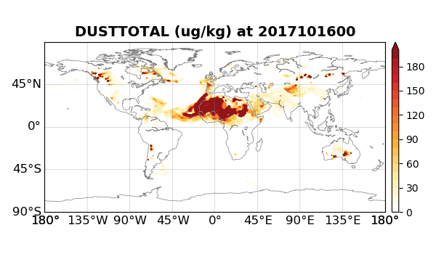
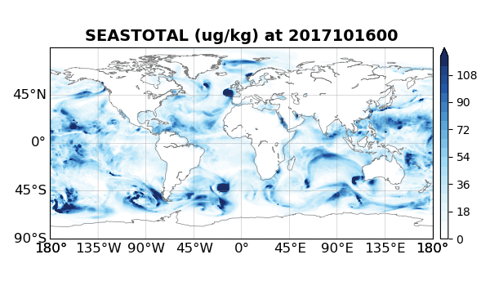
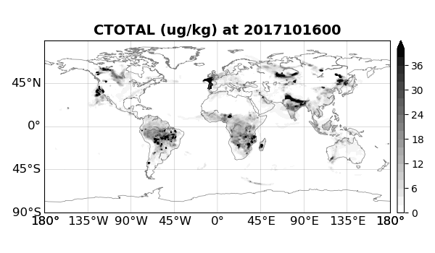
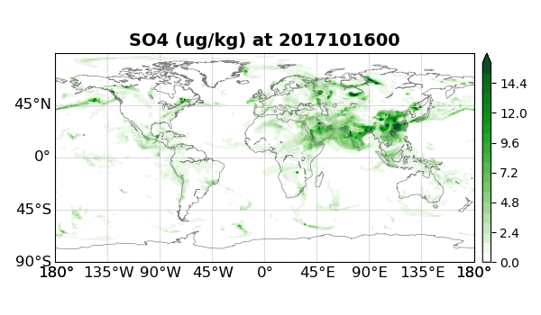
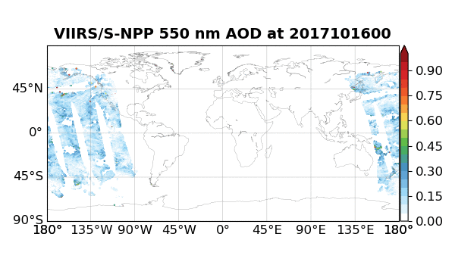
Background
Global Ensemble Forecast System - Aerosols (GEFS-Aerosols, Zhang et al., 2022) as one GEFS member went operational for global aerosol forecasting at NOAA since September 2020 that is based on NASA’s Goddard Chemistry Aerosol Radiance and Transport (GOCART) model (Chin et al., 2002) with 15 aerosol tracers.
2D Column-integrated aerosol optical depth (AOD) that represents total distinction of solar (or lunar) radiation by aerosols over an atmospheric column.
Near-real time (NRT) AOD assimilation for aerosol forecasting or aerosol reanalysis production.
Total Dust w/ 5 size bins
Total Sea salt w/ 5 size bins
Total OC and BC w/ 2 size bins
Sulfate
Correct
Simulate
ECMWF – 4DVar (Benedetti et al., 2009)
NASA – Physical space analysis (Randles et al., 2017)
NRL - EAKF (Rubin et al., 2016)
JMA – 2DVar (Yumimoto et al., 2017)
NOAA/GSL – 3D-EnVar (Huang et al., 2023; Wei et al., 2023)
NOAA S-NPP VIIRS 550 nm AOD retrievals

Slide 5
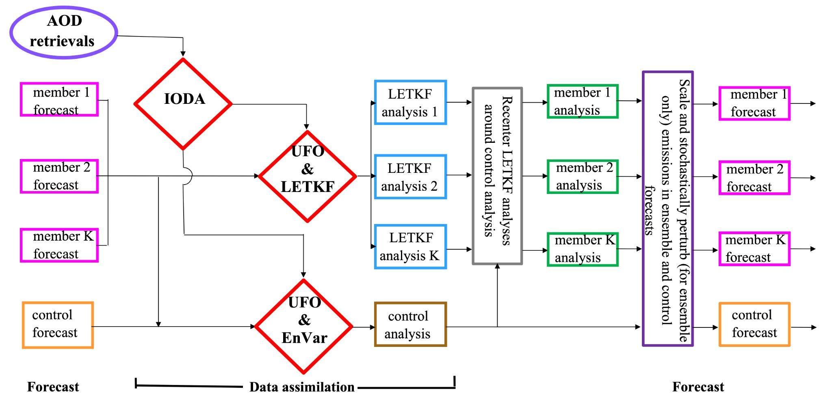
JEDI-based Ensemble-Variational Aerosol Data Assimilation System for GEFS-Aerosols
Aerosol emissions were scaled and stochastically perturbed in ensemble forecasts to account for aerosol emission uncertainty based on the SPPT scheme for meteorological fields in GEFS.
Huang et al., 2023, JAMES (https://doi.org/10.1029/2022MS003232)

Slide 6
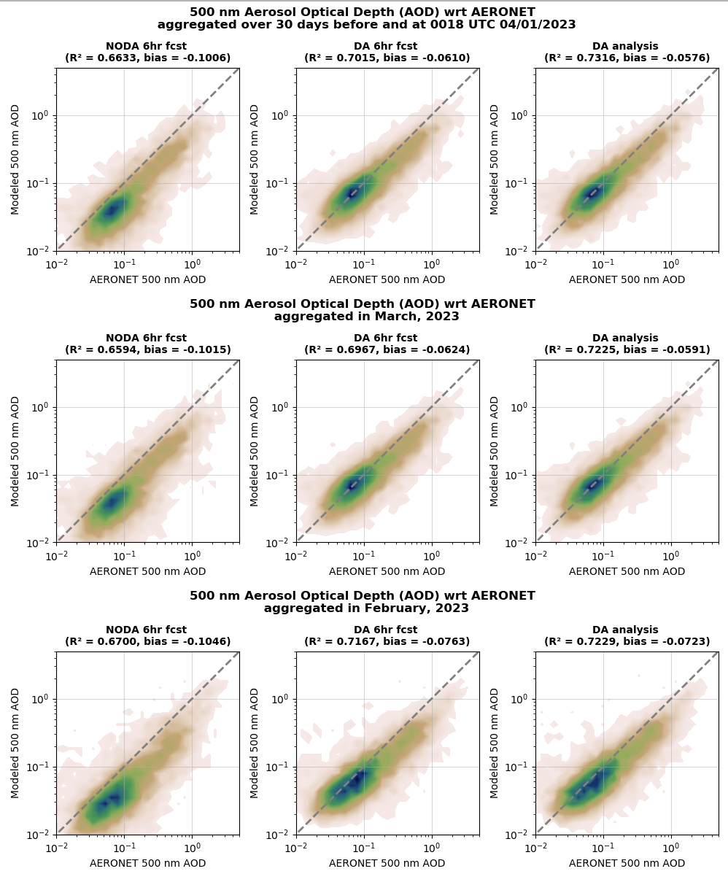
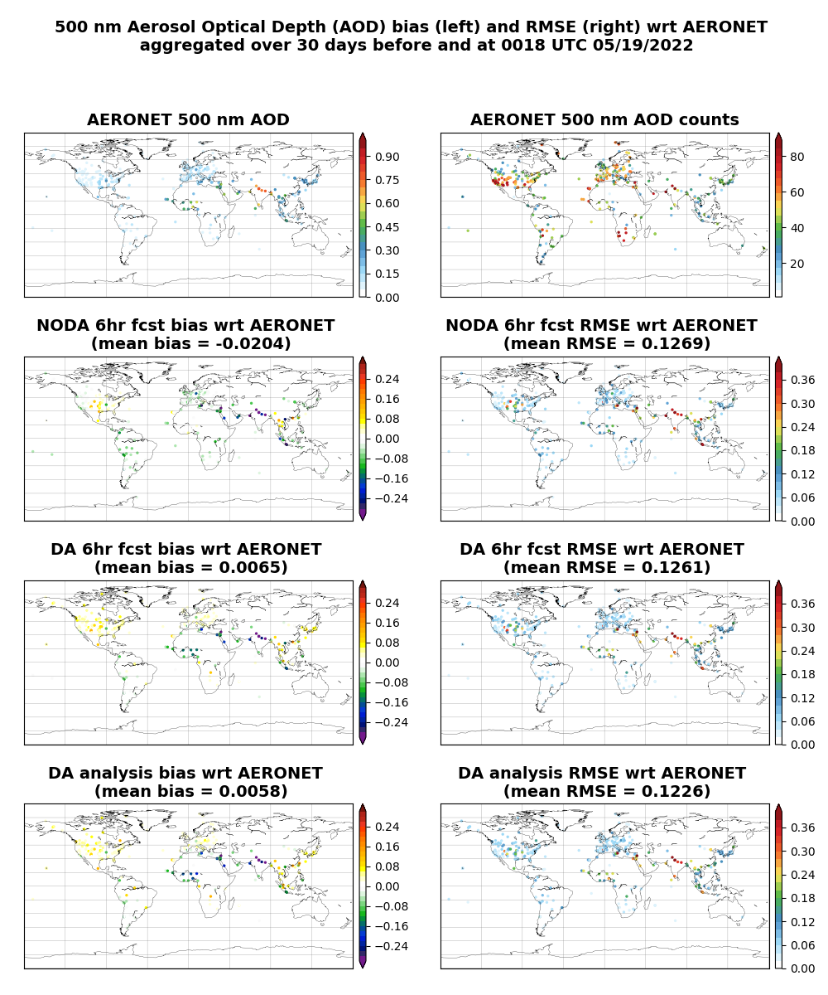
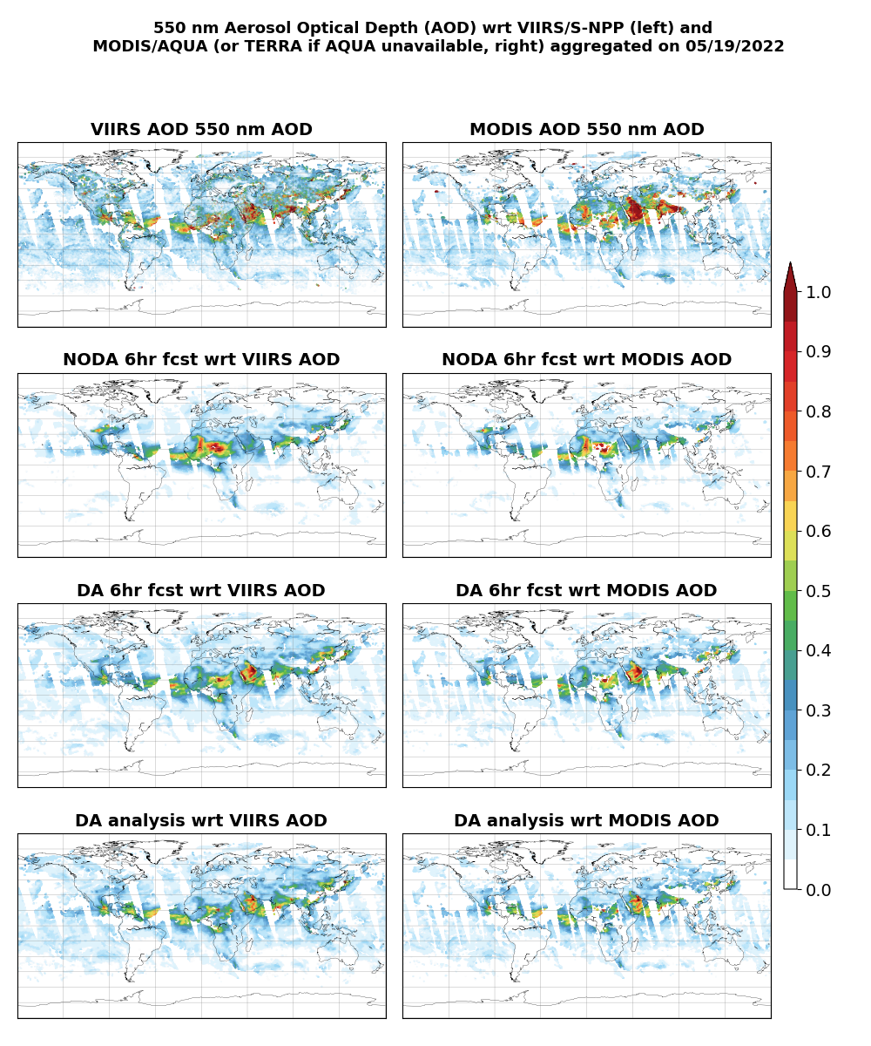
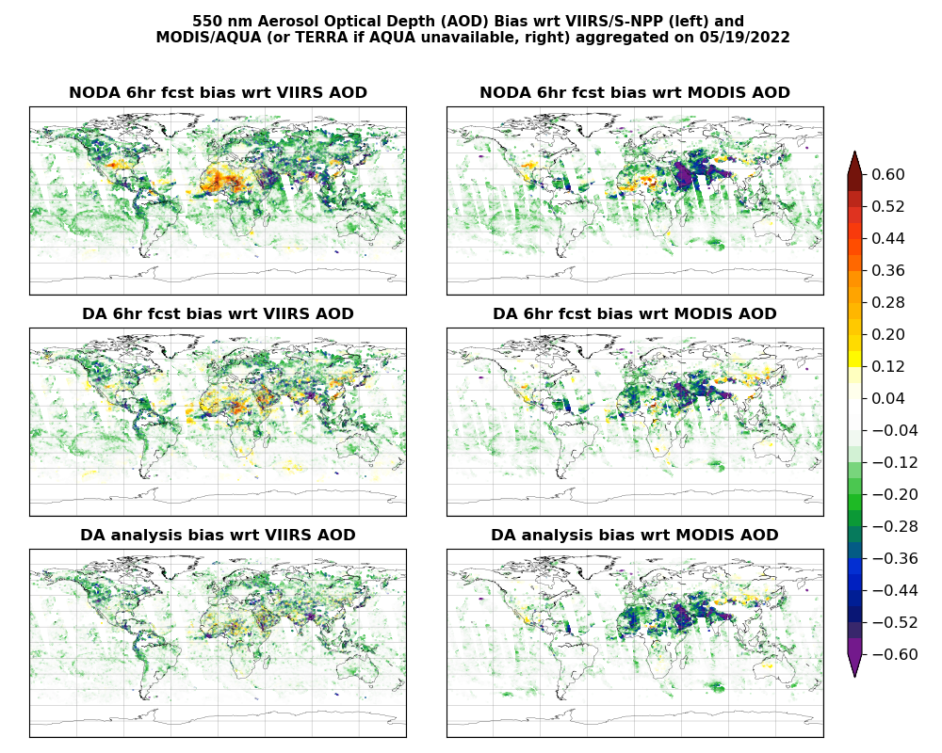
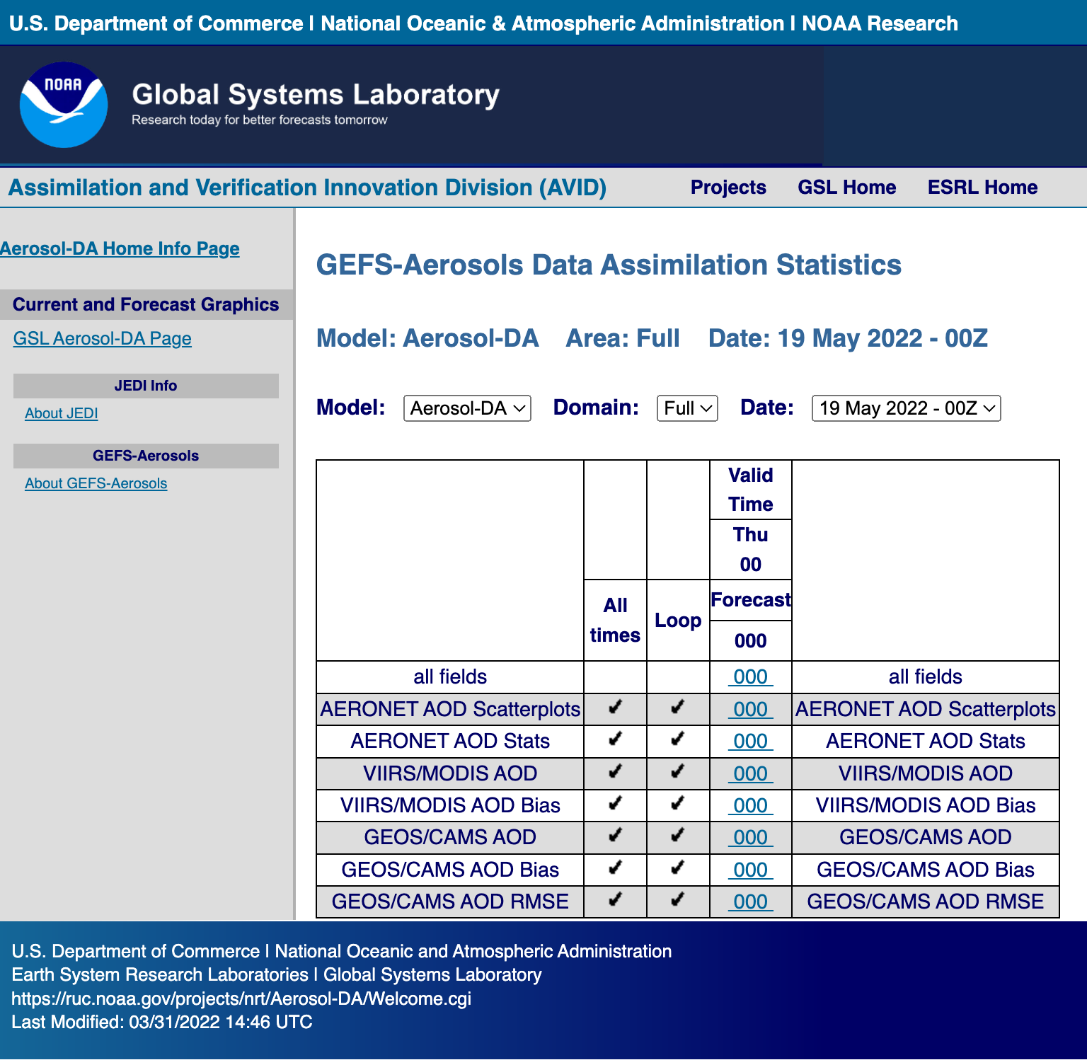
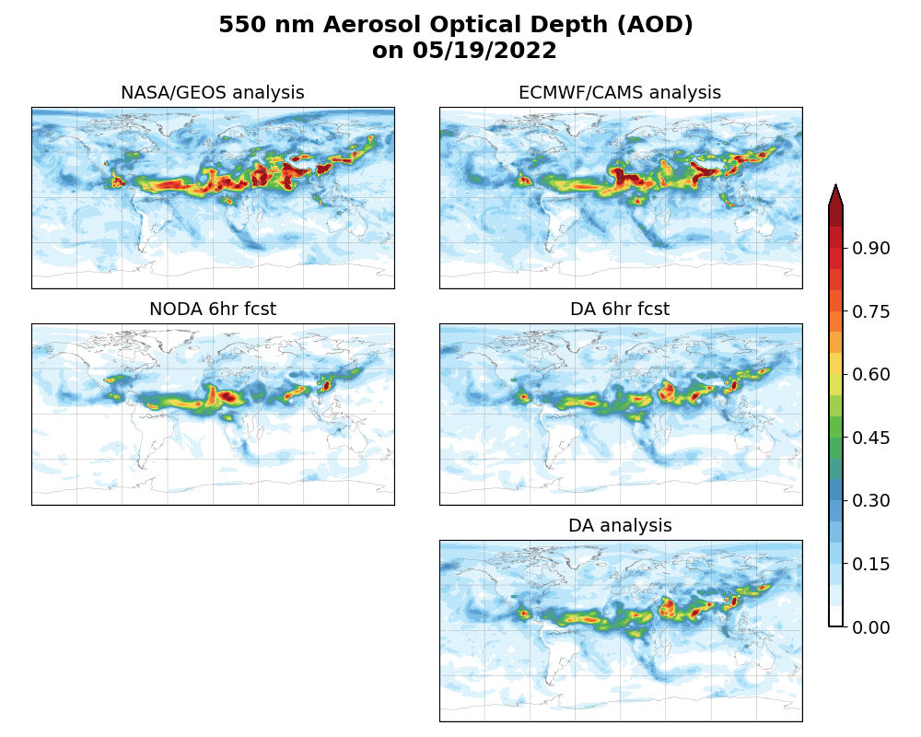
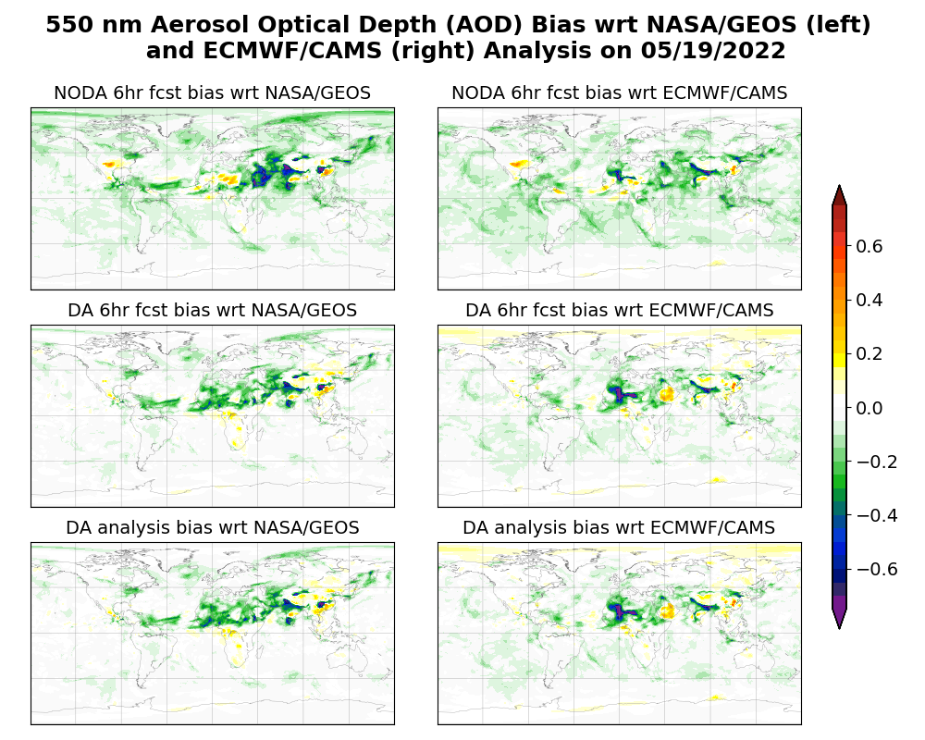
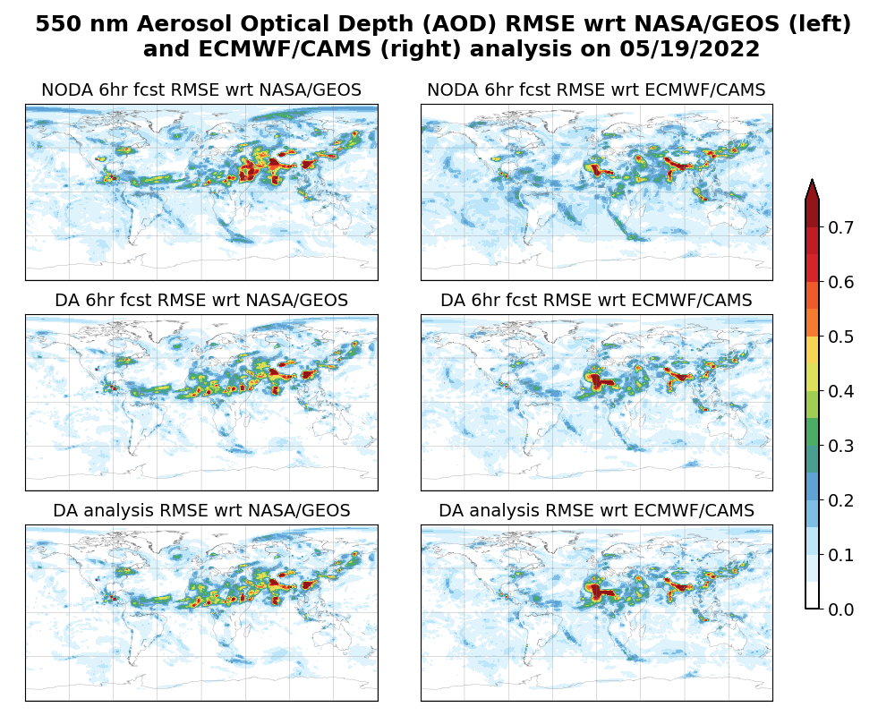
NRT VIIRS 550 nm AOD Assimilation at NOAA/OAR/GSL
--- Online NRT Diagnostic Display (10/01/2021- present)
FreeRun runs one-member aerosol forecast initialized every six hours.
AeroDA runs a six-hourly assimilation of NOAA/NESDIS VIIRS 550 nm AOD retrievals derived from Suomi-NPP (S-NPP) satellite and 20+1 forecasts at C96L64, and scales and stochastically perturbs aerosol emissions.
GSL’s intermediate CCPP-based GEFS-Aerosols model is used for aerosol forecasts (need to upgrade to recent model version). DA impact derived from the CCPP version will apply to the operational NUOPC-based GEFS-Aerosols.
AERONET 500 nm AOD
NOAA/VIIRS and NASA/MODIS 550 nm AOD
System description: https://ruc.noaa.gov/projects/nrt/
NRT diagnostics: https://ruc.noaa.gov/projects/nrt/Aerosol-DA/
NASA/GEOS and ECMWF/CAMS 550 nm AOD analysis

Slide 7
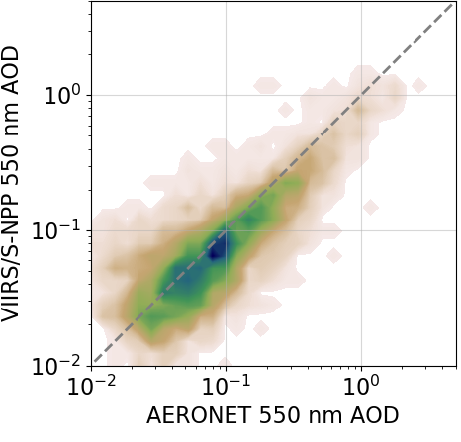
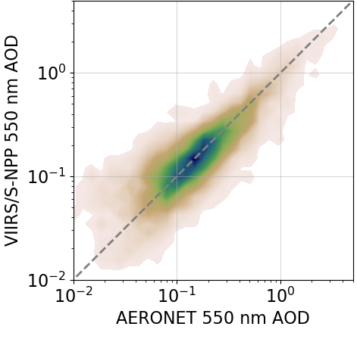
NRT VIIRS 550 nm AOD Assimilation at NOAA/OAR/GSL
--- Comparison with Ground-Truth NASA’s AERONET Level 1.5 AOD
NASA’s AERONET L1.5 500 nm AOD (https://aeronet.gsfc.nasa.gov/)
VIIRS/S-NPP vs
AERONET 550 nm AOD
FreeRun 6h fcst AeroDA 6h fcst AeroDA analysis
vs AERONET 500 nm AOD
Bias = -0.03
R² =0.76
Bias = -0.09
R² =0.39
Bias = -0.06
R² =0.60
Bias = -0.06
R² =0.66
December 2022
Bias = -0.01
R² =0.76
Bias = -0.12
R² =0.44
Bias = -0.04
R² =0.62
Bias = -0.04
R² =0.65
June 2023
NRT AERONET Level 1.5 AOD has a mean bias of +0.02 and one sigma uncertainty of up to 0.02 (Giles et al., 2019).

Slide 8
Extension of JEDI-based 3D-EnVar aerosol assimilation system for NOAA’s future operational UFS-Aerosols funded by
“Development of a Global Aerosol Reanalysis at NOAA in Support of Climate Monitoring and Prediction” funded by NOAA/OAR/WPO (2022-2024)
“Extending JEDI-based Global Aerosol Data Assimilation System to UFS-Aerosols” funded by NOAA/OAR/GSL Director’s Directed Research Funds (2022 –2023)
UFS R20 Atmospheric Composition Project (2022-2023)

Slide 9
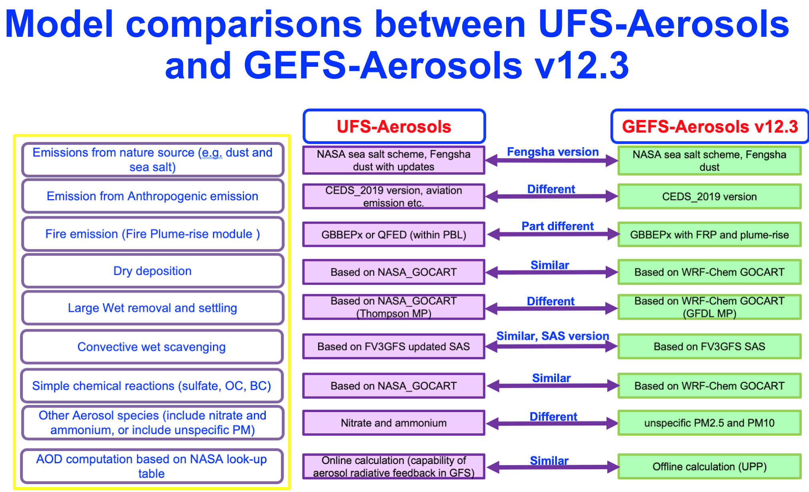
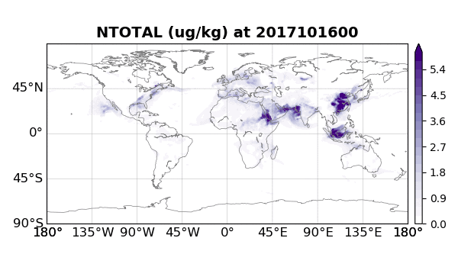
Extend JEDI-Based Aerosol Assimilation System to UFS-Aerosols
The Unified Forecast System – Aerosols (UFS-Aerosols) is under development at NOAA using an updated version of GOCART from NASA.​ It is planned to replace GEFS-Aerosols for operations in near future.
Extended AOD forward operator and its tangent linear and adjoint s in JEDI UFO to accommodate additional nitrate aerosol species in three size bins in UFS-Aerosols (merged to JEDI).
Adapted from Zhang, Li’s talk in AMS 2023, Denver, USA. “NOAA’s Global Aerosol Forecast Capabilities: GEFS-Aerosols and UFS-Aerosols”.
Total Nitrate w/ 3 size bins

Slide 10
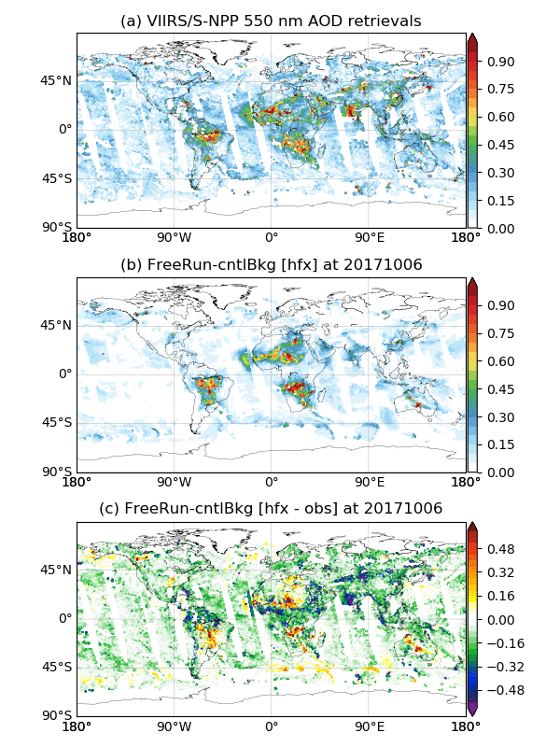
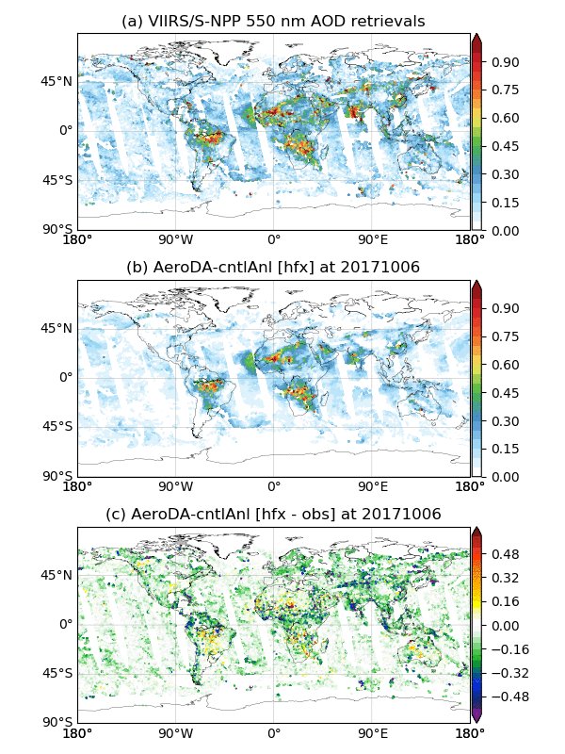
UFS-Aerosols Modeled 550 nm AOD .vs. VIIRS AOD Retrievals
-- October 06 – 27, 2017
FreeRun
AeroDA
FreeRun runs one-member aerosol forecast initialized every six hours.
AeroDA runs a six-hourly assimilation of NOAA/NESDIS VIIRS 550 nm AOD retrievals derived from Suomi-NPP (S-NPP) satellite and 20+1 forecasts at C192L127. (Aerosol emissions are not scaled or stochastically perturbed yet).
UFS-Aerosols is used for aerosol forecasts.
VIIRS
AOD
Modeled AOD
Model
minus
VIIRS

Slide 11
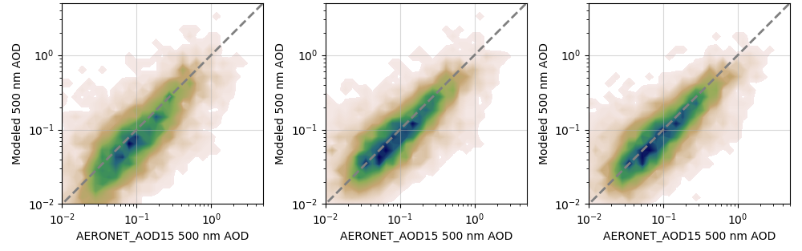
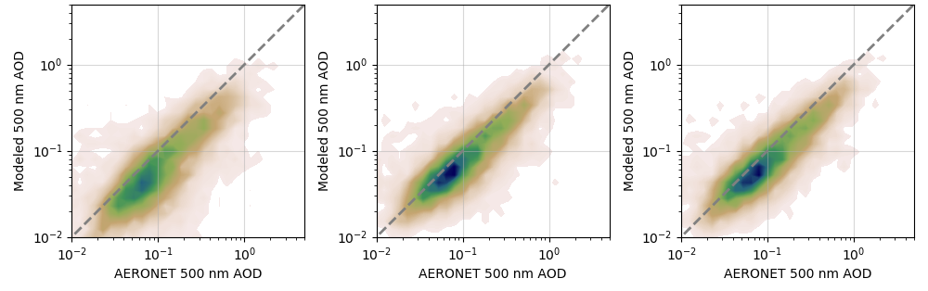
UFS-Aerosols and GEFS-Aerosols Modeled 500 nm AOD .vs. Ground Truth NASA AERONET L1.5 AOD
FreeRun 6h fcst AeroDA 6h fcst AeroDA analysis
vs AERONET 500 nm AOD
Bias = -0.04
R² =0.42
Bias = -0.03
R² =0.51
Bias = -0.03
R² =0.57
UFS-Aerosols
Emission not scaled or stochastically perturbed
20+1 members at C192L127
October 10 - 27, 2017
Bias = -0.07
R² =0.60
Bias = -0.05
R² =0.66
Bias = -0.05
R² =0.68
CCPP-based GEFS-Aerosols
(intermediate version)
Emission scaled and stochastically perturbed
20+1 members at C96L64
October 01 - 31, 2022

Slide 12
UFS-Aerosols AOD Analysis against MERRA2 and CAMSRA Reanalysis in Oct 2017
MERRA2
CAMSRA
Larger negative AOD bias over northern Africa in our analysis (lower panel) is related to that NOAA VIIRS 550 nm AOD retrievals is of lower magnitude in this region than NASA MODIS AOD retrievals operationally assimilated in NASA and ECMWF aerosol reanalyses.
AOD
reanalysis
FreeRun 6h fcst
bias
Oct. – Dec. 2021
(Huang et al. 2023)
AeroDA
analysis
bias

Slide 13
Ongoing collaborations to enhance
JEDI-based aerosol assimilation system

Slide 14
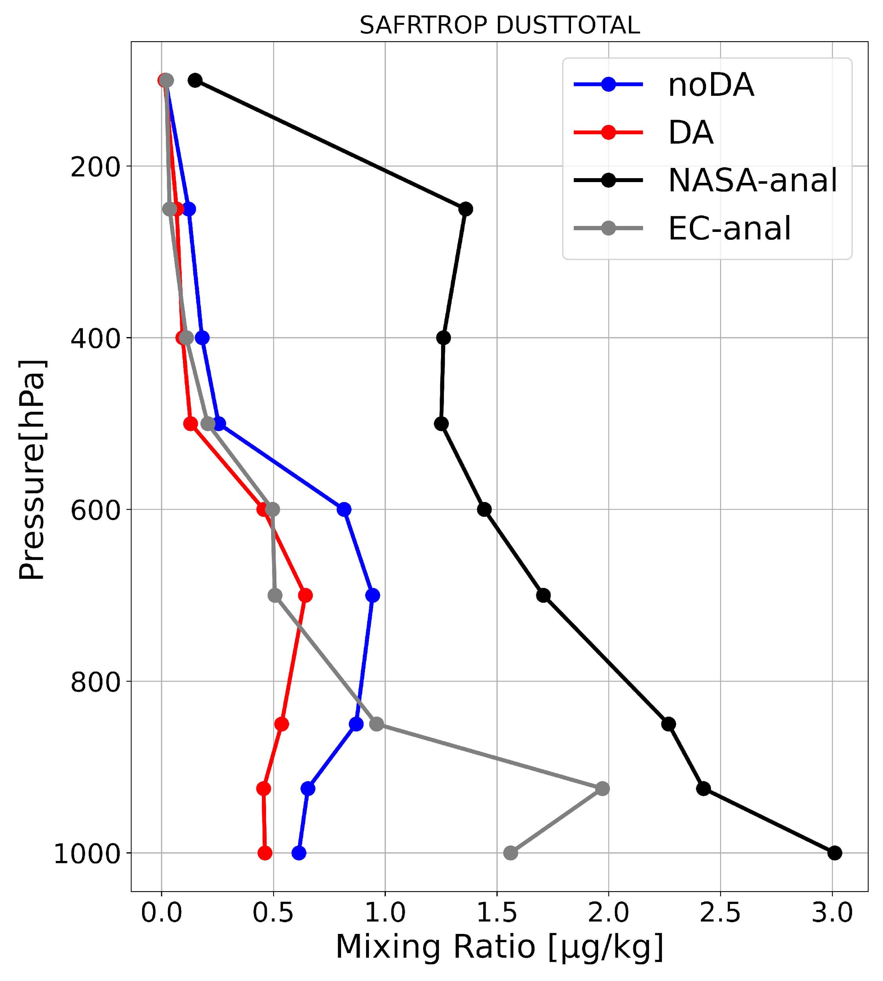
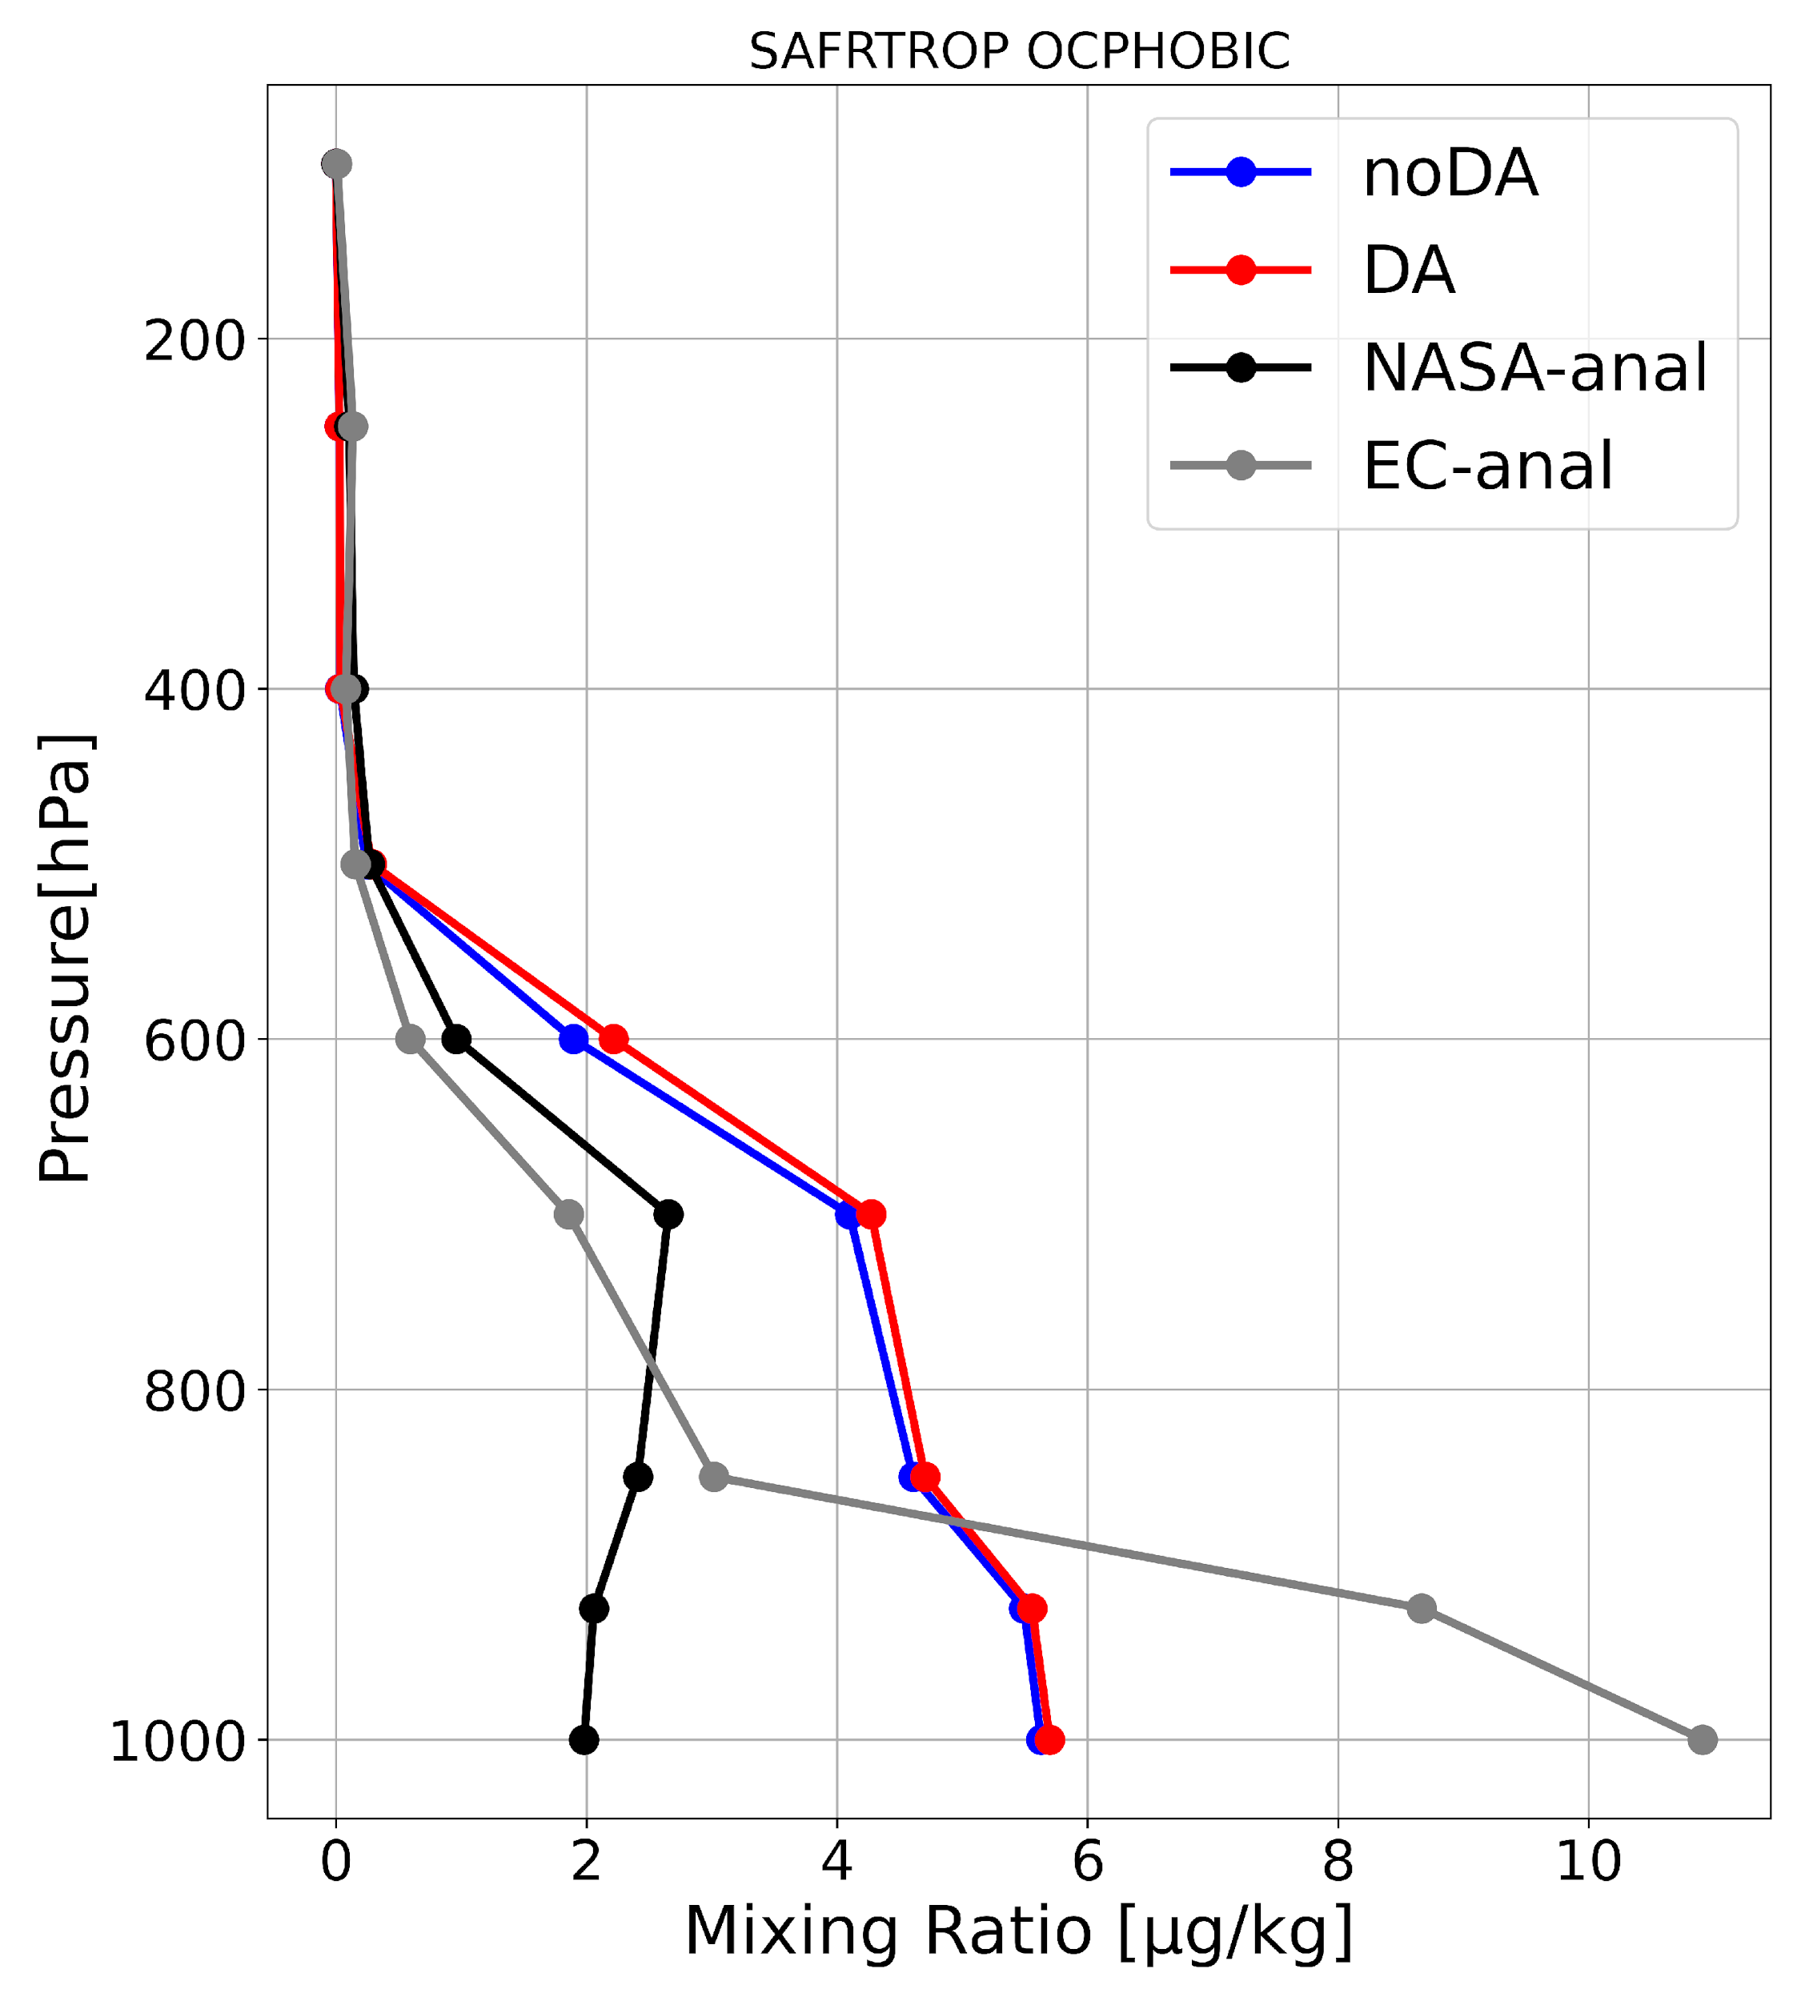
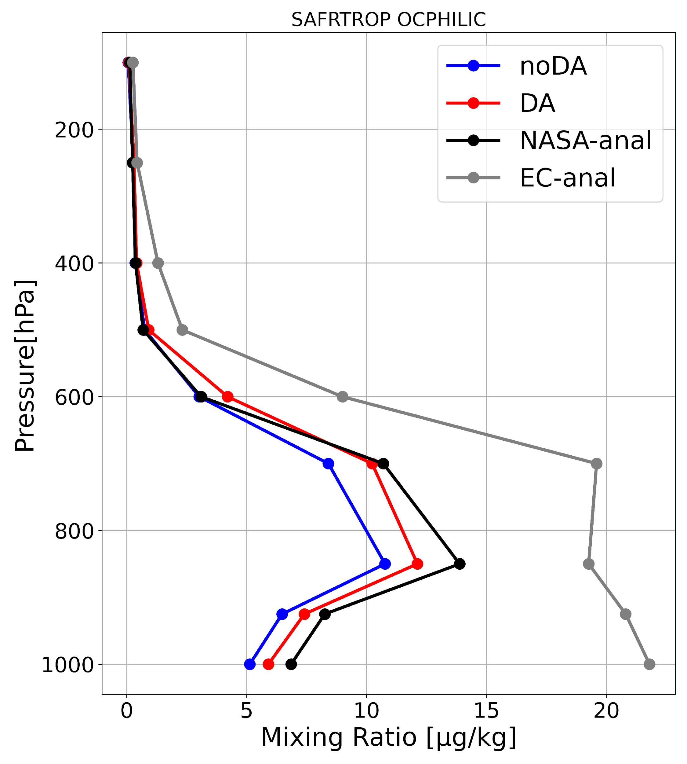
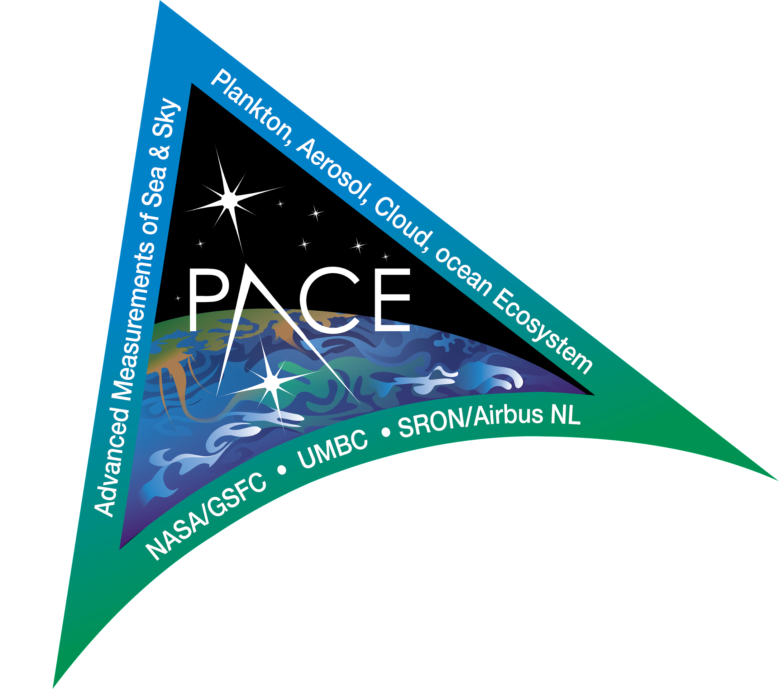
Assimilate Advanced Aerosol Retrievals from NASA PACE to Improve Aerosol Representation in UFS-Aerosols in collaboration with NASA, UMBC and SRON at Netherlands (funded by NOAA/CPO/ERB, AC4, and/or CVP program (2023-2026))
NASA’s Plankton, Aerosol, Cloud, ocean Ecosystem (PACE) mission with the primary Ocean Color Instrument (OCI) and two complementary multi-wavelength multi-angular polarimeters (MAPs) is scheduled for launch in Jan 2024. It presents an exceptional opportunity to retrieve more detailed aerosol characterization with unprecedented accuracy from space.
Assimilation of the integral AOD retrievals at 550 nm alone is incapable of properly constraining 3D aerosol species in the model.
Dust
550 nm AOD retrievals from PACE OCI that will replace MODIS to retire in 2023.
Multi-wavelength AOD retrievals including UV band
Fine-mode fraction of AOD
Single scattering albedo
and more ……
Reanalysis profiles from
GEFS-Aerosols, NASA MERRA2,
EC CAMSRA
in August 2016
Hydrophobic
OC
Hydrophilic
OC

Slide 15
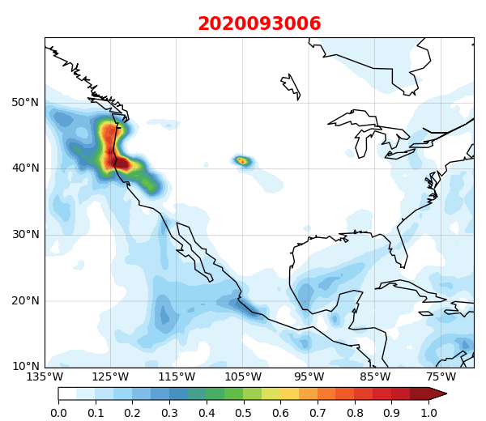
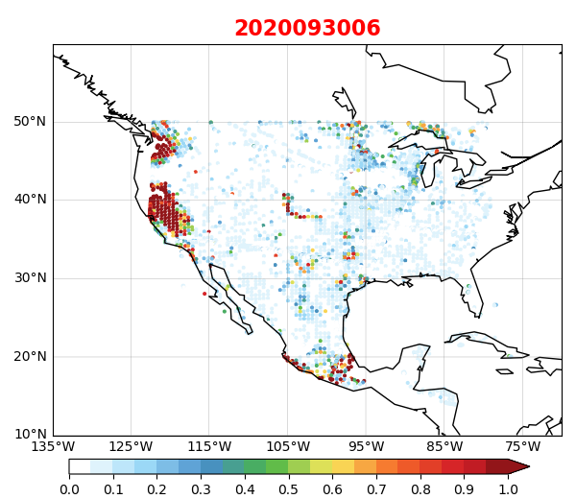
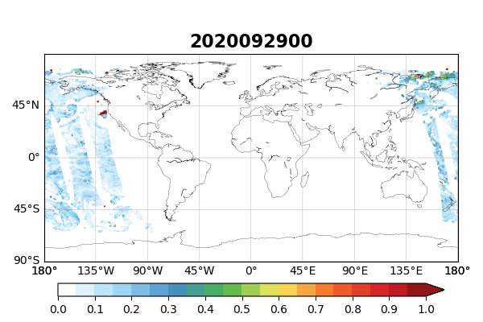
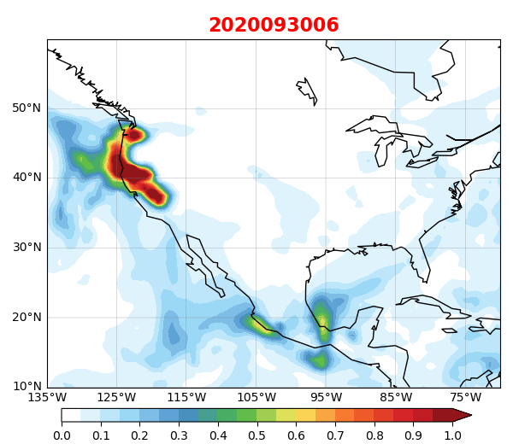
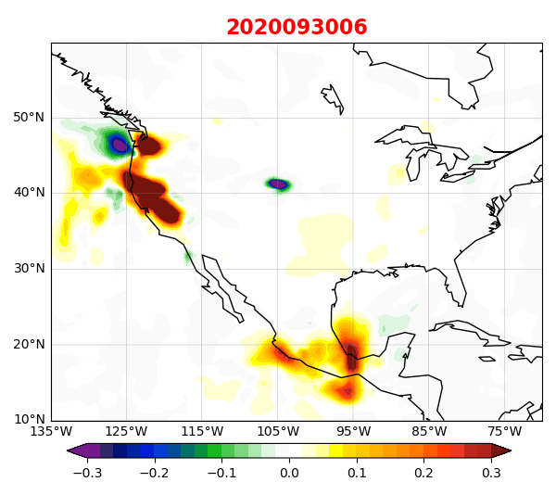
Complement Assimilating Nocturnal 550 nm AOD Retrievals in JEDI to Capture Aerosol Diurnal Variational Feature in collaboration with University of Iowa
VIIRS solar AOD complemented with lunar AOD derived from VIIRS moonlight observations (Zhou et al., 2021) over US at 06Z and 12Z

Slide 16
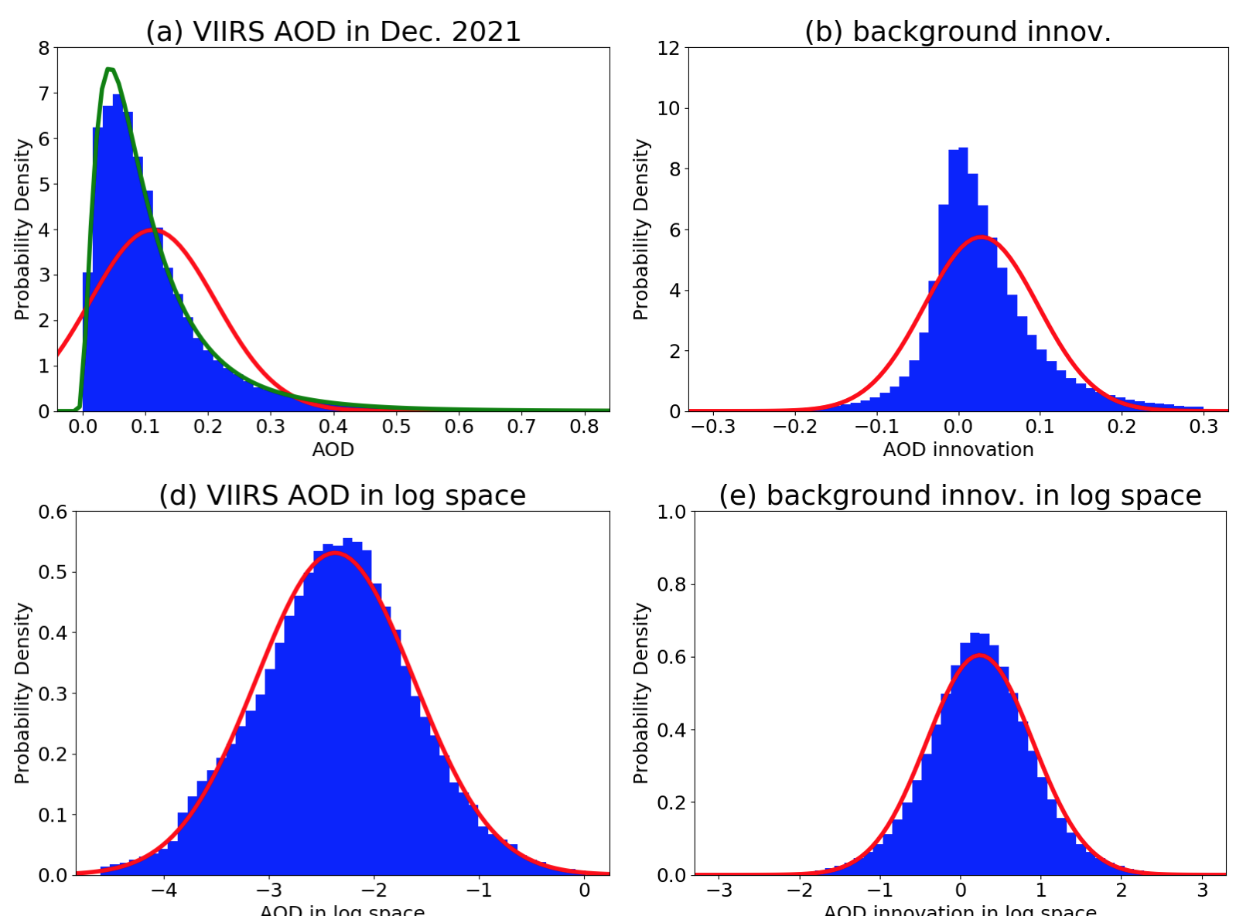
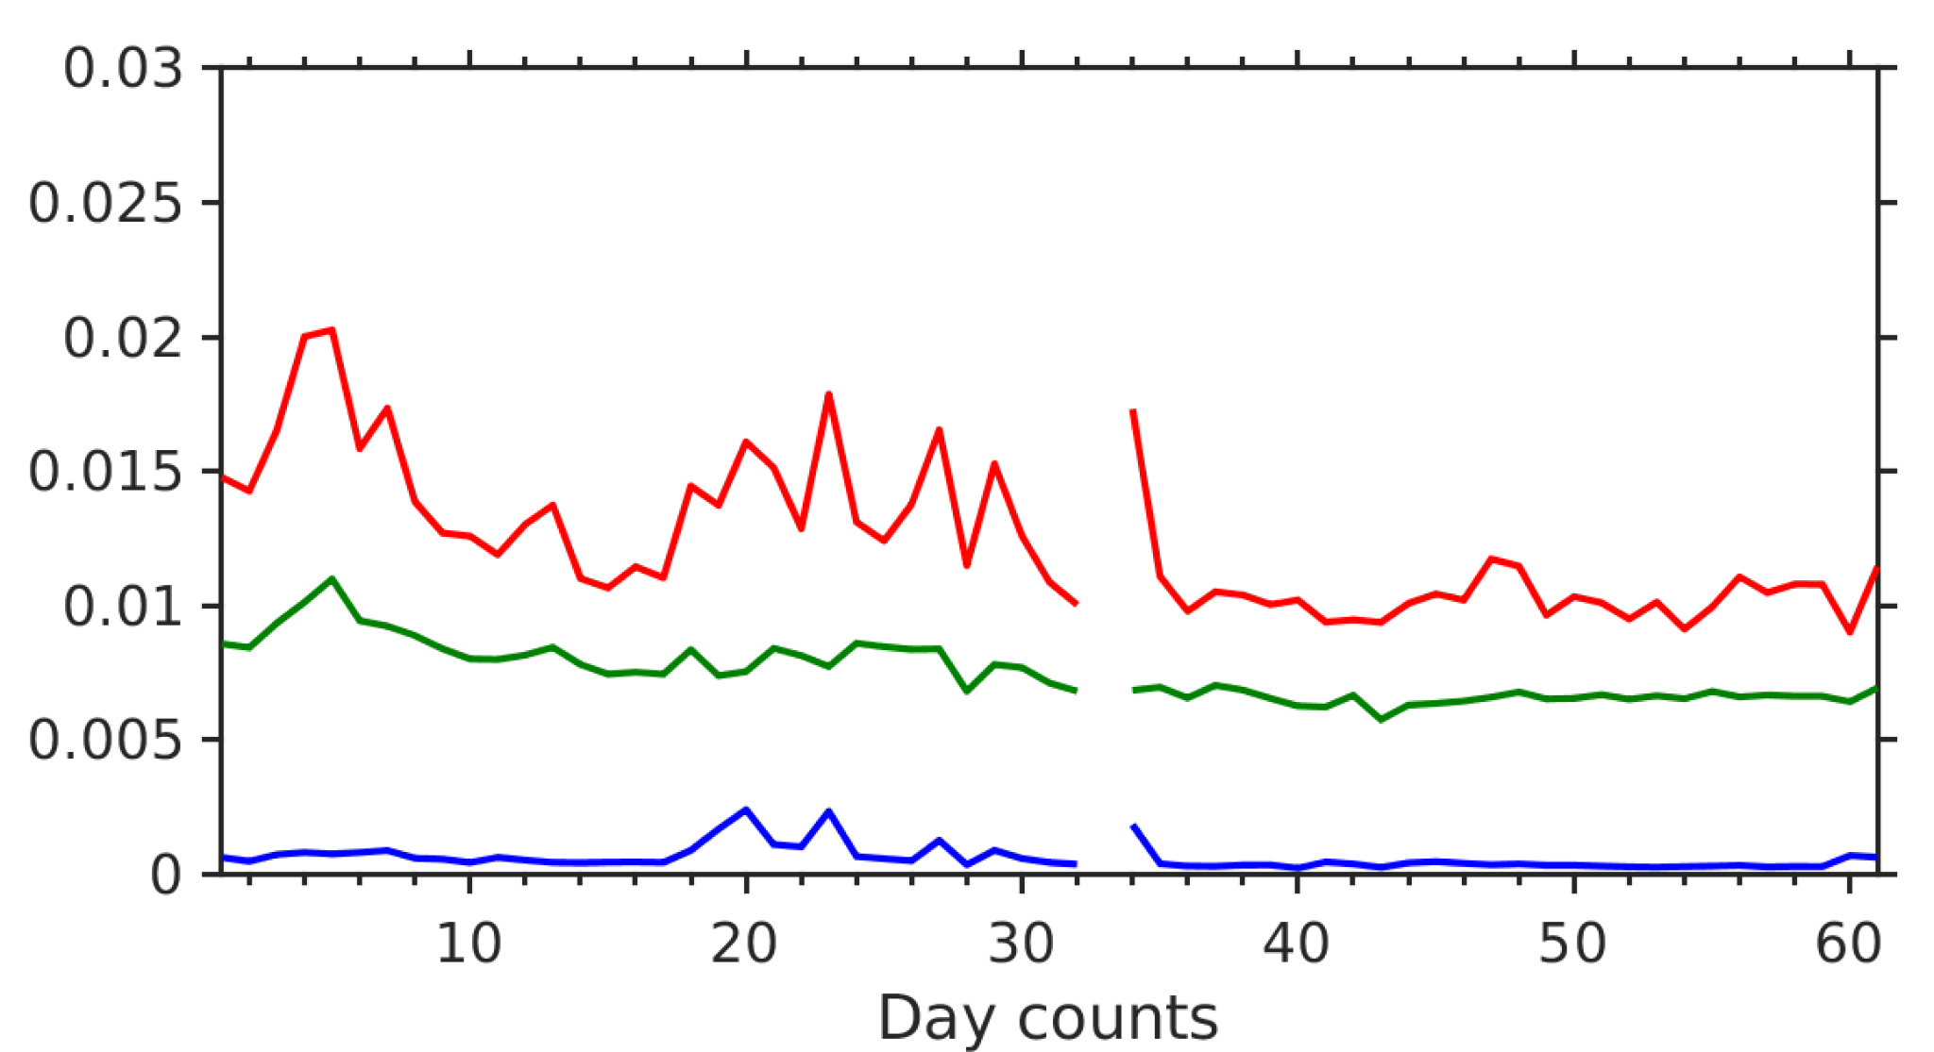
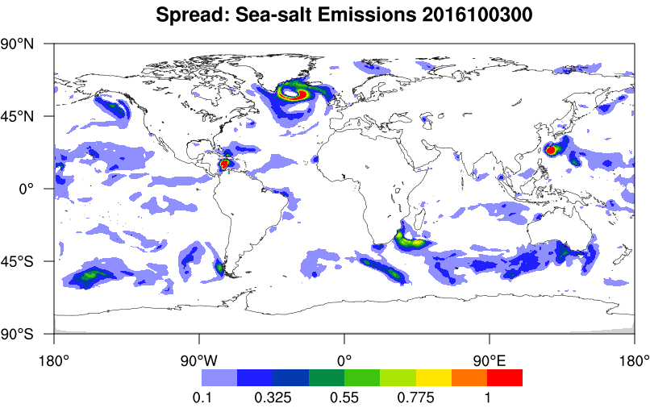
Address Inherent Deficiencies in the Current Aerosol Assimilation System
AOD
O-B
Account for Non-Gaussian distributions of observation (for retrievals typically 𝛿AOD = 𝛼 ∙ AOD + 𝛽) and model errors (requires transformation of variables);
Develop stochastic parameterization to improve ensemble spread;
Improve estimation of observation errors (requires diagnosis and further development of tools for thinning/super-obing);
Address systematic model biases and observation uncertainties
Physical
space
Log
space
AOD ensemble mean squared error
observation squared error
ensemble variance
NOAA VIIRS
NASA MODIS
Unit: 1E-9 kg m⁻² s⁻¹
Spread of sea salt emissions by perturbed stochastically
Aggregated 550 nm AOD on July 4, 2022

Slide 17
References
Zhang, L., Montuoro, R., McKeen, S. A., Baker, B., Bhattacharjee, P. S., Grell, G. A., ... & Li, F. (2021). Development and Evaluation of the Aerosol Forecast Member in NCEP’s Global Ensemble Forecast System (GEFS-Aerosols v1). Geoscientific Model Development Discussions, 1-54.
Chin, M., Ginoux, P., Kinne, S., Torres, O., Holben, B. N., Duncan, B. N., ... & Nakajima, T. (2002). Tropospheric aerosol optical thickness from the GOCART model and comparisons with satellite and Sun photometer measurements. Journal of the atmospheric sciences, 59(3), 461-483.
Benedetti, A., Morcrette, J. J., Boucher, O., Dethof, A., Engelen, R. J., Fisher, M., ... & Suttie, M. (2009). Aerosol analysis and forecast in the European centre for medium‐range weather forecasts integrated forecast system: 2. Data assimilation. Journal of Geophysical Research: Atmospheres, 114(D13).
Randles, C. A., Da Silva, A. M., Buchard, V., Colarco, P. R., Darmenov, A Govindaraju, R., ... & Flynn, C. J. (2017). The MERRA-2 aerosol reanalysis, 1980 onward. Part I: System description and data assimilation evaluation. Journal of climate, 30(17), 6823-6850.
Rubin, J. I., Reid, J. S., Hansen, J. A., Anderson, J. L., Collins, N., Hoar, T. J., ... & Zhang, J. (2016). Development of the Ensemble Navy Aerosol Analysis Prediction System (ENAAPS) and its application of the Data Assimilation Research Testbed (DART) in support of aerosol forecasting. Atmospheric Chemistry and Physics, 16(6), 3927-3951.
Yumimoto, K., Tanaka, T. Y., Oshima, N., & Maki, T. (2017). JRAero: the Japanese reanalysis for aerosol v1. 0. Geoscientific Model Development, 10(9), 3225-3253
Huang, B., M. Pagowski, S. Trahan, C. Martin, A. Tangborn, S. Kondragunta, D. Kleist, 2023: JEDI-Based Three-Dimensional Ensemble-Variational Data Assimilation System for Global Aerosol Forecasting at NCEP, in print in JAMES.
Giles, D. M., Sinyuk, A., Sorokin, M. G., Schafer, J. S., Smirnov, A., Slutsker, I., ... & Lyapustin, A. I. (2019). Advancements in the Aerosol Robotic Network (AERONET) Version 3 database–automated near-real-time quality control algorithm with improved cloud screening for Sun photometer aerosol optical depth (AOD) measurements. Atmospheric Measurement Techniques, 12(1), 169-209.
Saide, P. E., Carmichael, G. R., Liu, Z., Schwartz, C. S., Lin, H. C., Da Silva, A. M., & Hyer, E. (2013). Aerosol optical depth assimilation for a size-resolved sectional model: impacts of observationally constrained, multi-wavelength and fine mode retrievals on regional scale analyses and forecasts. Atmospheric Chemistry and Physics, 13(20), 10425-10444.
Bhattacharjee, P. S., Zhang, L., Baker, B., Pan, L., Montuoro, R., Grell, G. A., & McQueen, J. T. (2023). Evaluation of Aerosol Optical Depth Forecasts from NOAA’s Global Aerosol Forecast Model (GEFS-Aerosols). Weather and Forecasting, 38(2), 225-249.
Zhou, M., Wang, J., Chen, X., Xu, X., Colarco, P. R., Miller, S. D., ... & Holben, B. (2021). Nighttime smoke aerosol optical depth over US rural areas: First retrieval from VIIRS moonlight observations. Remote sensing of environment, 267, 112717.
Thank you!
Bo.Huang@noaa.gov

