Slide 1
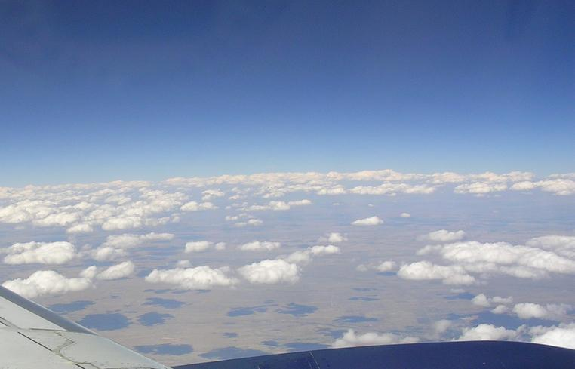
Science Spotlight On Hierarchical System Development
for Earth System Models
Mike Ek^{1,2}, Tracy Hertneky^{1,2}, Xia Sun^{2,3,4}, Ligia Bernardet^{2,3},
Tara Jensen^{1,2}, Lulin Xue^{1,2}, Jeff Beck^{2,3,5}, Jimy Dudhia^{1,2},
Grant Firl^{2,3,5}, Mike Kavulich^{1,2}, Weiwei Li^{1,2}, Louisa Nance^{1,2},
Kathryn Newman^{1,2}, Linlin Pan^{2,3,4}, Dustin Swales^{2,3}, Sam Trahan^{2,3,4},
Man Zhang^{2,3,4}, Christiane Jablonowski⁶, Cristiana Stan⁷, Lou Wicker⁸,
Stelios Flampouris^{9,10}, Yi-Cheng Teng^{9,10}, Tim Schneider¹
¹NCAR, ²DTC, ³NOAA GSL, ⁴CU CIRES, ⁵CSU CIRA, ⁶Univ. Michigan, ⁷George Mason Univ.,
⁸NOAA NSSL, ⁹Tomorrow.io, ¹⁰Earth Prediction Innovation Center
UFS workshop (Unifying Innovations in Forecasting Capabilities Workshop)
NCAR, Boulder, Colorado · 24-28 July 2023

Slide 2
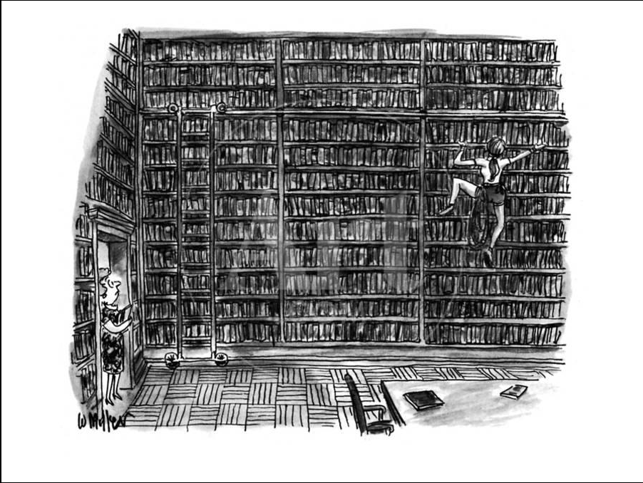
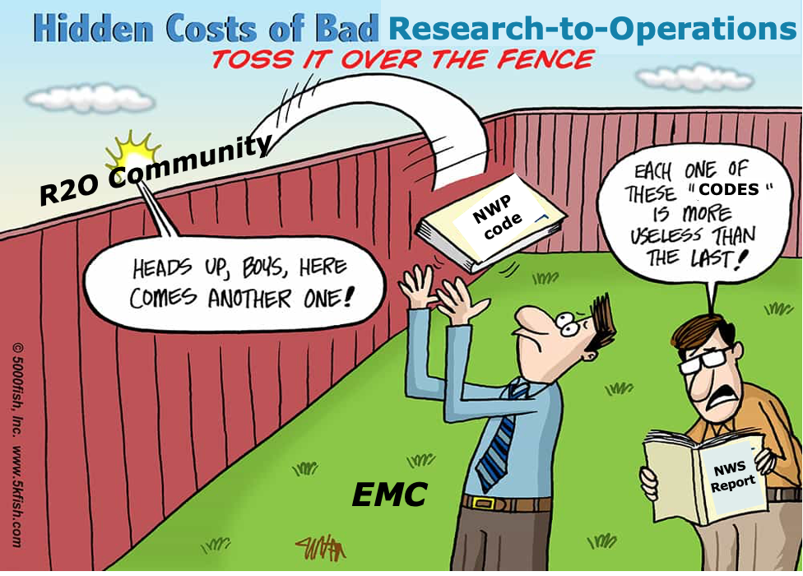
Previous (or Current?!) Paradigm
Earth System Model Development Process
Research
Earth System Research
Community
?
Here you go!
Operations
A lot of great research!
“Toss it over the fence” ?!
…that needs to be identified and transitioned somehow.
But how to improve this process?

Slide 3
Hierarchical System Development (HSD): What is it?
Hierarchy (from taxonomy): an arrangement or classification of things according to relative importance or inclusiveness.
Hierarchical System Development: a systematic “engineering” approach that tests small elements (e.g. physics schemes/subroutines) of an Earth System Model (ESM) first in isolation, then progressively connects those elements with increased coupling between ESM components, all the way up to a fully-coupled global model.
System in HSD is end-to-end in that it includes data ingest and quality control, data assimilation, modeling, post-processing, and verification.
Infrastructure: necessary to connect the HSD steps for an efficient and effective model development and improvement process. (CCPP)

Slide 4
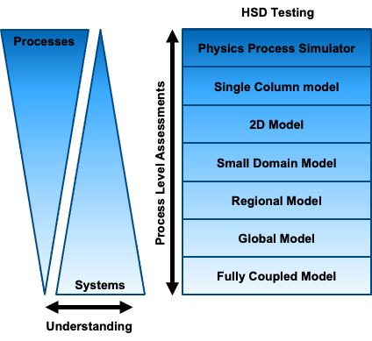
Hierarchical System Development: What is it?
Hierarchical System Development (HSD) is an efficient pathway for model development.
Enables model development community
with multiple entry points for research efforts
spanning simple to complex.
Many unique perspectives of HSD, defined
by Model complexity, Model configurations
(Jeevanjee et al. 2017), or Principles of large-
scale circulation (Maher et al. 2019).
Serves as an end-to-end system, i.e. data ingest
and quality control, data assimilation, modeling,
post-processing, and verification, with a
corresponding configurable workflow.
Infrastructure: necessary to connect the HSD steps (e.g. CCPP).
Verification: necessary to assess model performance (e.g. METplus).

Slide 5
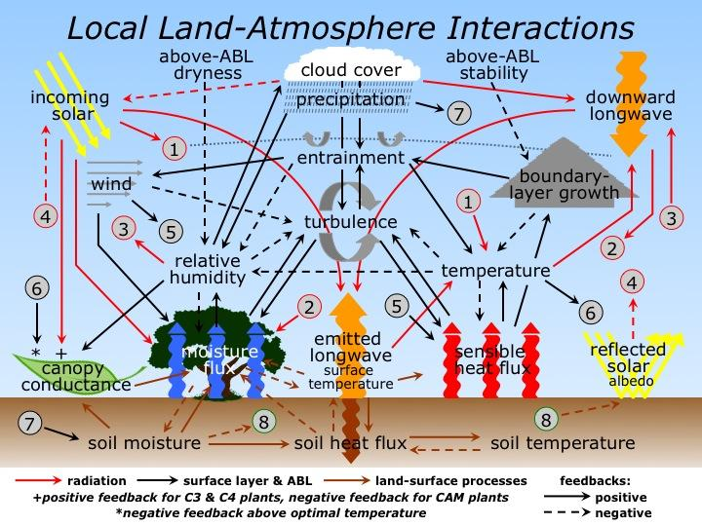
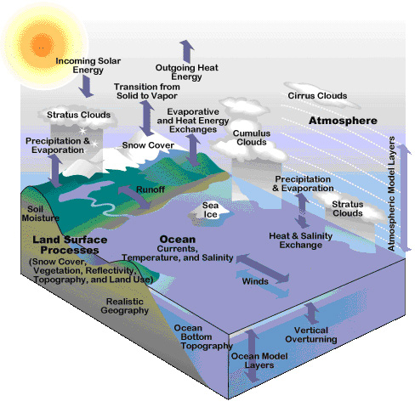
Hierarchical System Development: Why do we need it?
Many Earth System processes to model, from local to regional & global.
To understand model biases, we often need to start by simplifying the atmosphere/earth system down to a few key processes and interactions.
For efficient use of compute resources, need to identify/fix bugs early in the testing process… before making longer model runs.

Slide 6
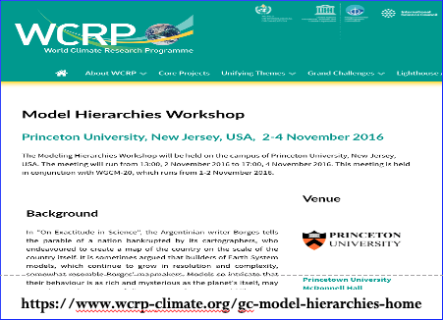
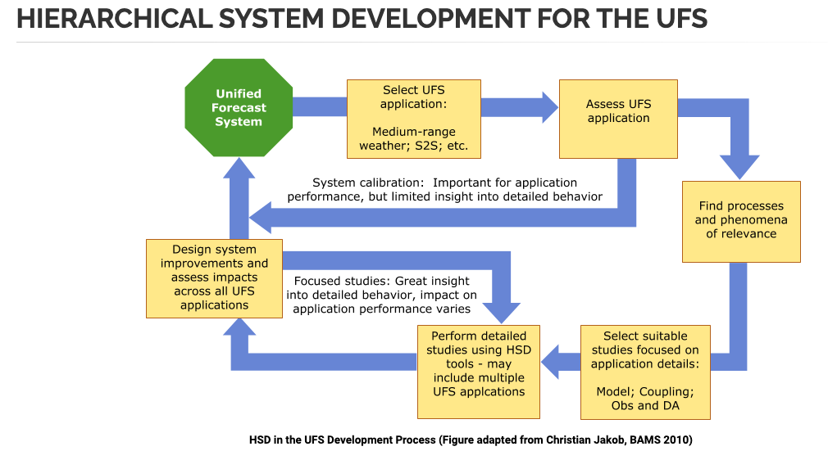
Hierarchical System Development: Brief Background
WCRP Climate workshop in 2016: Climate community uses hierarchical approach to understand model components and behavior. Follow-on Aug-Sep 2022: 2nd Model Hierarchies Workshop.
Tim Palmer (Univ. Oxford, UK MetOffice, ECMWF): “Hierarchical thinking should be second nature for all weather/climate scientists (of course).”
Julia Slingo’s (UK Met Office) 2017 review of WCRP: Increase focus on process- level understanding for model improvement, and connect weather and climate.
Christian Jakob (Monash U., Australia; AMS BAMS 2010):
”…community needs to improve diagnosis of processes
contributing to model errors, with more model developers needed! Not just model users!”
See the HSD-focused article that leverages Jakob (2010):
www.ufscommunity.org/articles/hierarchical-system-development-for-the-ufs
HSD R2O cycles

Slide 7
Hierarchical System Development: R2O cycles
This cycle: Lower down in R2O funnel / higher RLs
Need to
connect cycles
This cycle: Higher up in R2O funnel / lower RLs
Notes:
Discuss in more depth. Upper left cycle is working on a UFS App and calibrating (read: tuning), with limited insight on process behavior (e.g. at EMC, EPIC, etc–lower down in the R2O funnel). Lower left cycle is focus on the processes, but with limited insight on the entire App (e.g. more in the research community–higher up in the R2O funnel). The full cycle connects these two cycles. These 3 cycles are operating simultaneously and iteratively.

Slide 8
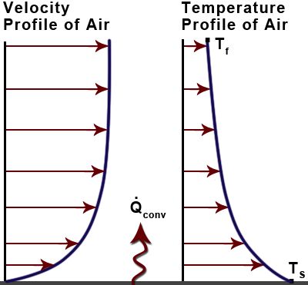
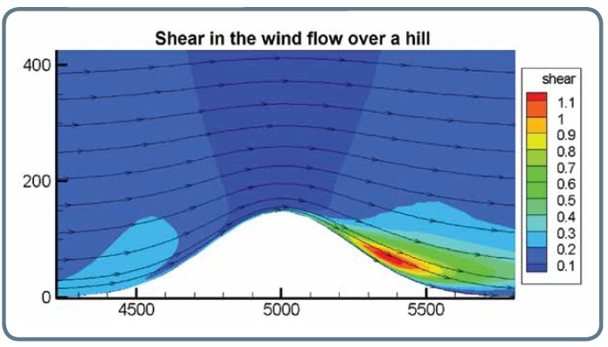
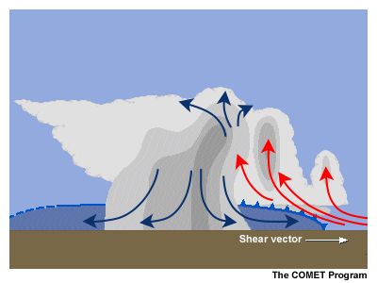
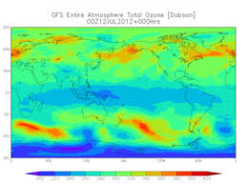
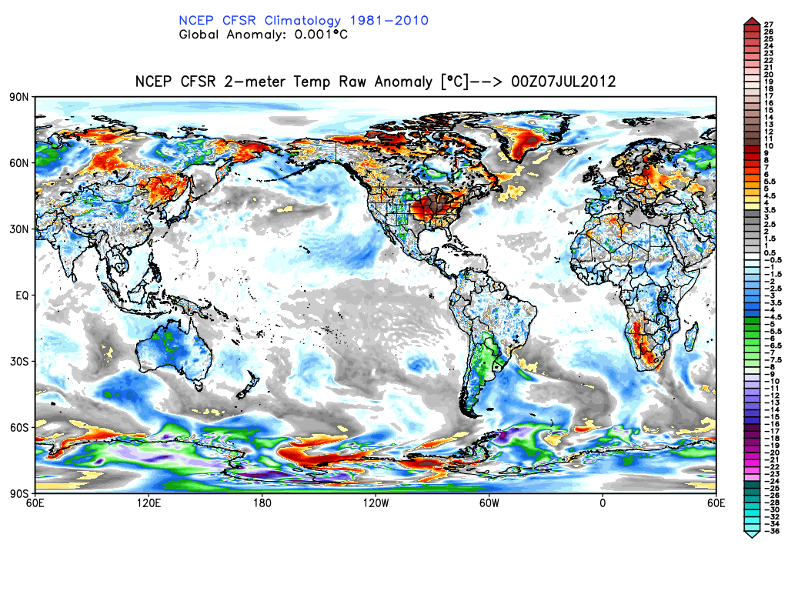
Hierarchical System Development (HSD): A simple-to-more-complex comprehensive approach to identify systematic biases and improve models
HSD Testing “Harness”
Processes
under construction
Physics Process Simulator
Single
Processes
Single Column Model
e.g. land-PBL
future capability
2-D Model
Higher Readiness levels Lower
Process-level assessments / metrics
Small-Domain Model
Regional Model
Complex
Systems
NWP metrics
Global Model
Systems
Fully-Coupled Model
Understanding
Simplest framework for intra-suite physics interaction.
Drive and validate models/components using observational, model output and idealized data sets with “cumulative benchmarks”
May involve cold starts or cycled runs.
Notes:
This is looking at HSD from the simple-to-complex modeling perspective.

Slide 9
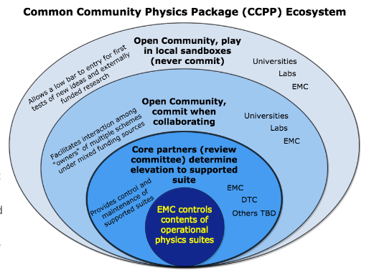
How to connect HSD steps to improve the model development process?
Infrastructure to connect the HSD steps: the Common Community Physics Package (CCPP) provides a method for testing atmospheric physics (and land).
CCPP consists of a library of physical parameterizations (which can be grouped as physics suites) and an infrastructure to connect physics with host models.
CCPP is designed to lower the bar for community involvement in physics testing and development through increased interoperability, improved documentation, and continuous support to developers and users.
The CCPP and CCPP Single Column Model (SCM) provide a software infrastructure that is an enabling tool that helps to more efficiently connect Hierarchical System Development steps.
CCPP has been integrated into the NOAA Unified Forecast System (UFS) for global and regional NWP, and is currently being integrated into NCAR & Naval Research Lab models, and leverages the NOAA-NCAR MOA on sharing modeling infrastructure, e.g. CCPP.
https://dtcenter.org/ccpp

Slide 10
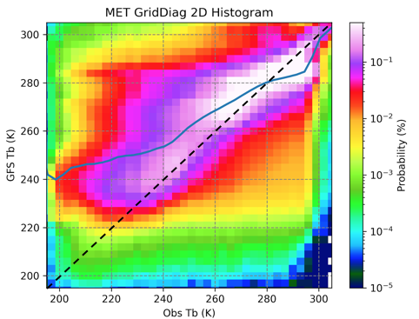
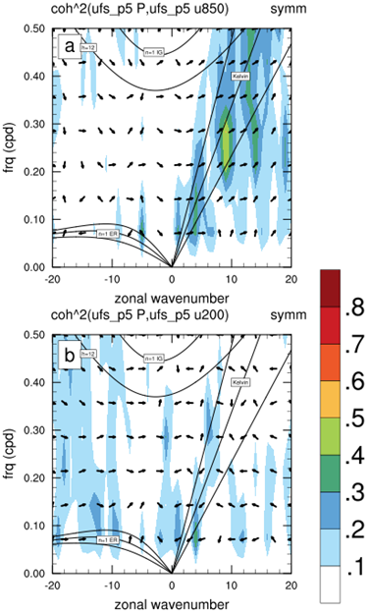
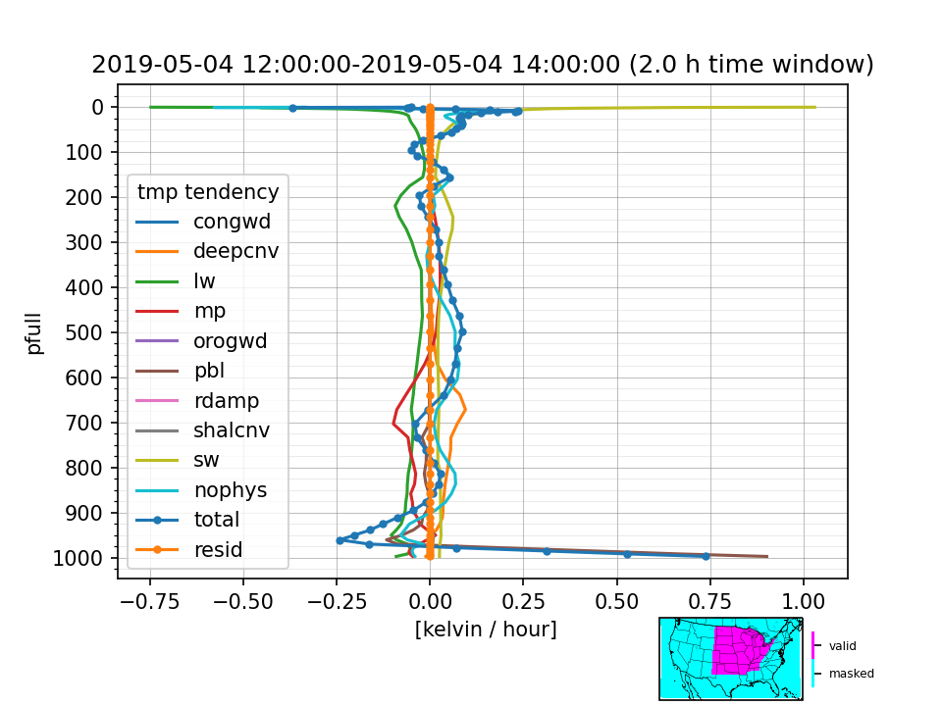
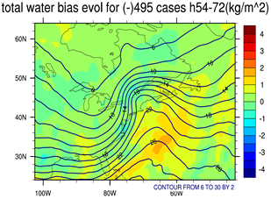
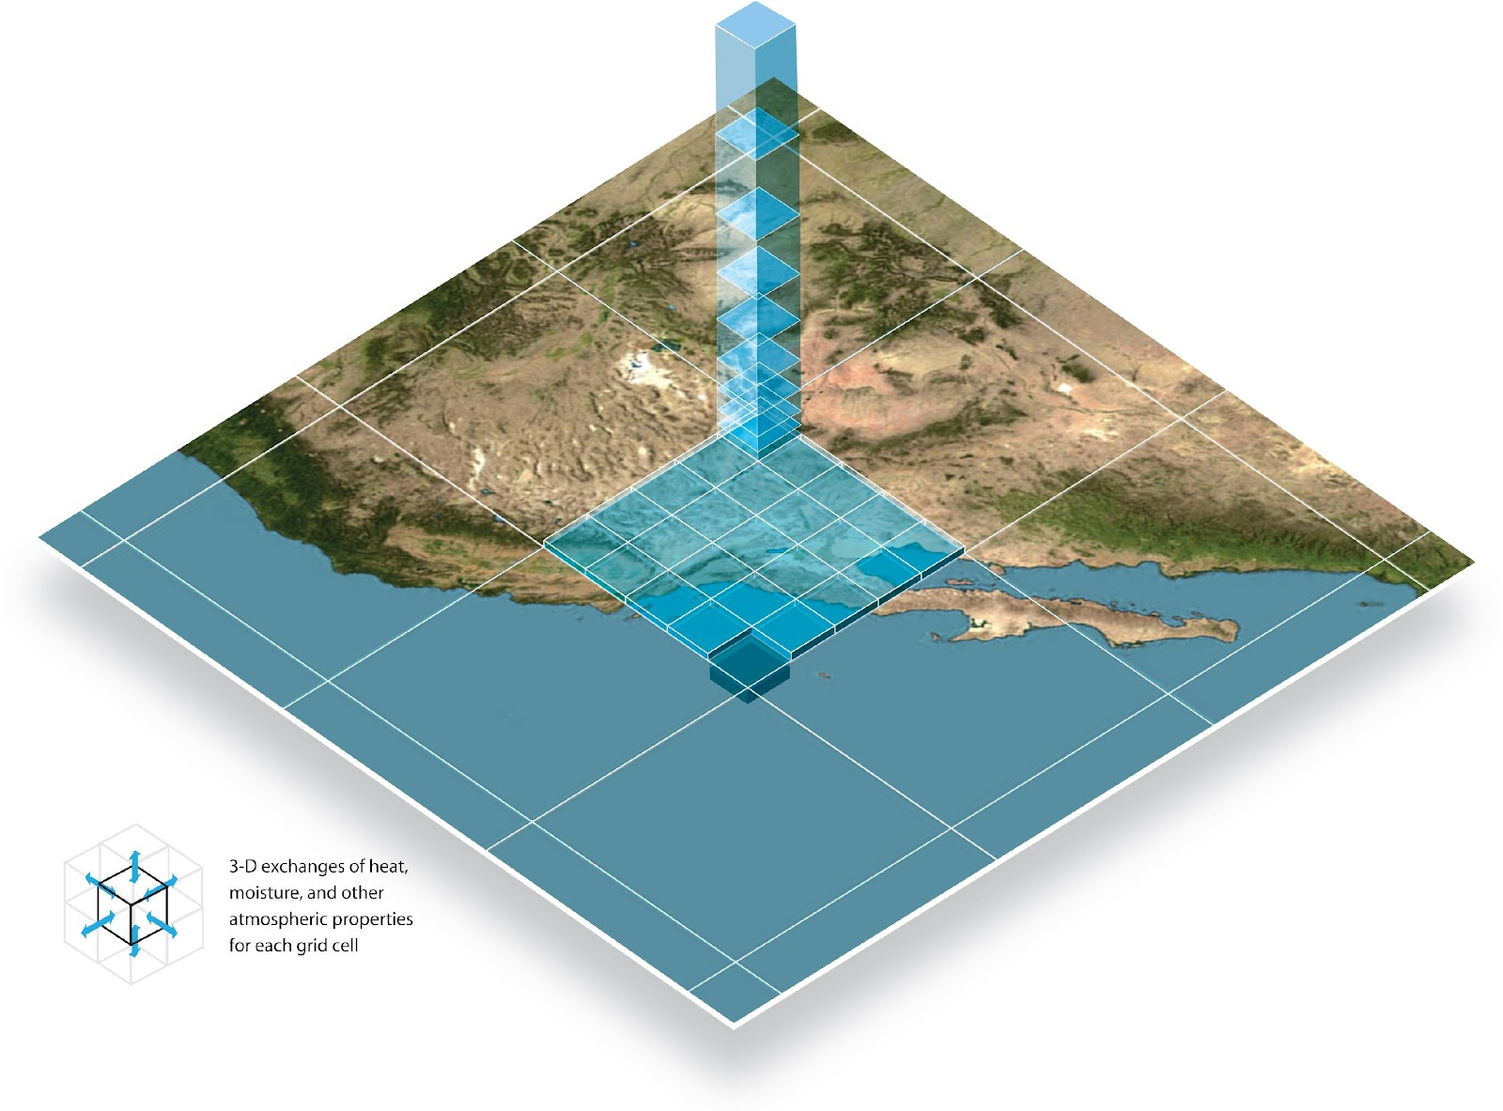
How to connect HSD steps to improve the model development process?
METplus verification software for NWP and other Earth system models for the HSD steps.
METplus includes metrics at the process level.
https://dtcenter.org/community-code/metplus
Multivariate Relationships.
S2S Diagnostics including planetary waves.
Errors and Tendencies within a columns, soundings, or profiles.
*New in METplus v5.0 to be released in Dec 2022
Systematic Biases.

Slide 11
How to connect HSD steps to improve the model development process?
Corresponding software development for the CCPP Suite Simulator via “on/off” switches in Single Column Model (CCPP SCM).
Within the physics step, the model-state (S) is updated after each physics scheme is called:
Radiation
Surface
To isolate the impacts of changes in individual physics schemes, we can replace the active physics schemes with data-driven physics tendencies.
Land-surface
Planetary Boundary Layer
For example, here all of the physics schemes, except the land surface model, have been “turned off” and data-driven physics tendencies have been “turned on”.
Gravity Wave Drag
Ozone Photochemistry
Upper-Atm H₂0
Deep Convection
Shallow Convection
Cloud Microphysics
Feature: Test physics coupling scheme-by-scheme
Advance model state w/ all active physics schemes.
Advance model state w/ only one active physics scheme.

Slide 12
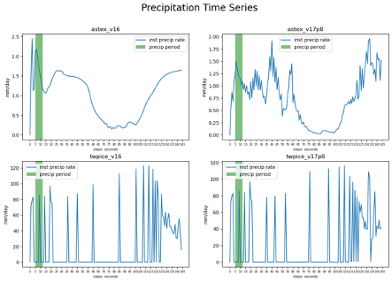
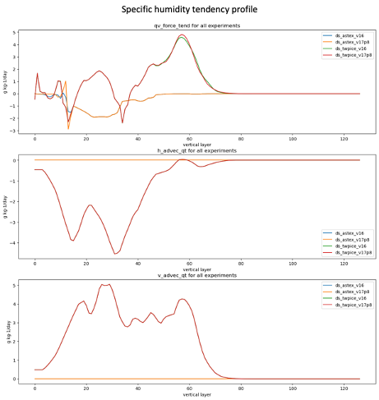
CLIM 670 Earth
System Modeling
Prof. C. Stan, GMU
Using the CCPP SCM as a Teaching Tool
Easy process of porting and compiling the code.
Attractive elements as teaching tool: (1) offers relatively large library of physical suites, (2) provides variety of pre-processed forcing data.
Allows students to design experiments to understand behavior of physical parameterizations in different environments, and explore limitations of the approach.
“My decision to select the CCPP SCM, developed by DTC, was influenced by my current work with the NOAA UFS which uses CCPP for majority of physics parameterizations in the atmospheric component, and further motivated by the detailed user and technical guide that accompanies the
public release of CCPP SCM code.”

Slide 13
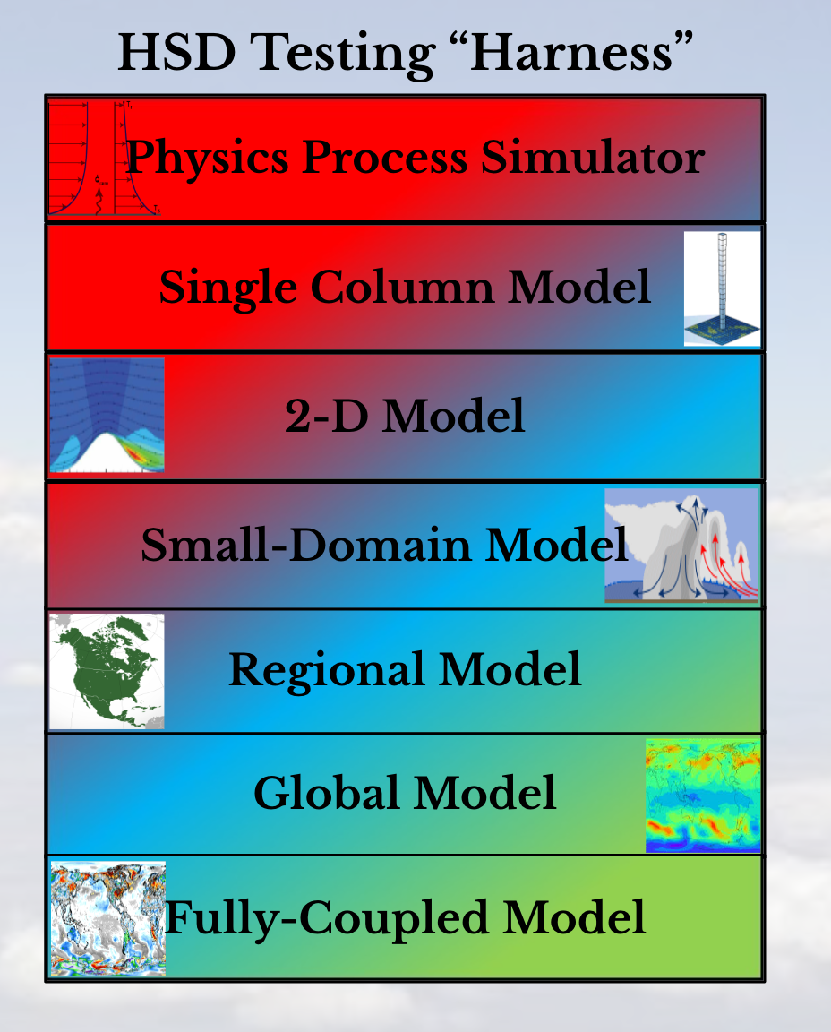
GEWEX “GABLS”
project
Hierarchical System Development: Example
Single Column Model: evaluation of interacting physics
Single column model study: Focus on land-atmosphere interaction. Finding: review/ refine land model surface flux calculations.
This project did not use CCPP SCM, but can be repeated with CCPP SCM.

Slide 14
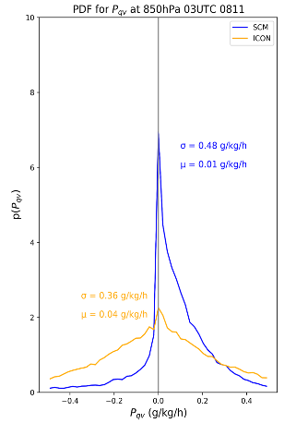
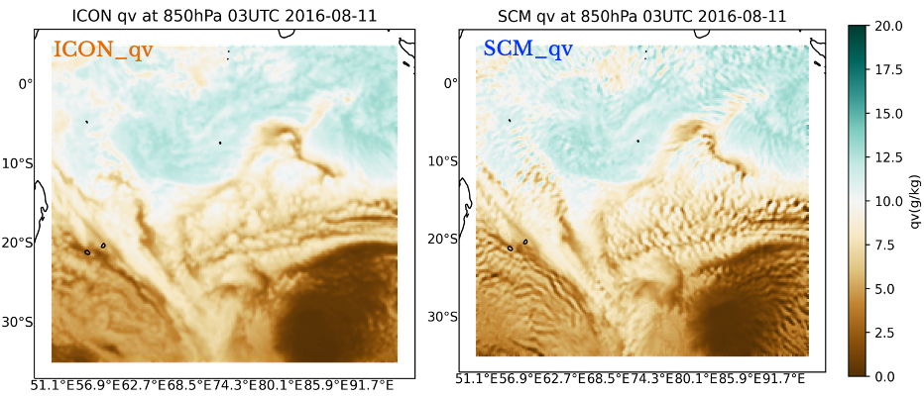
DTC WWRP project
Hierarchical System Development: Example
Model Uncertainty – Model Intercomparison Project (MU-MIP)
Hierarchical testing for improvement of stochastic and deterministic physical parameterizations.
Key Method: Compare state variables and tendencies in a convection-permitting high-resolution simulation against a lower-resolution parameterized-convection simulation.
SCM: Computationally cost-effective way to characterize model uncertainty to inform model development.
An array of CCPP SCM runs at 44,000 grids over Indian Ocean for 40-days (reinitialized every 3 hrs for 6 hr forecast), driven by ICON coarse-grained forcing.
CCPP SCM reproduces the spatial distributions of meteorological variables.
PDFs show SCM has larger probability for positive physics tendencies of qv than ICON, indicating missing or misrepresenting physical processes in low resolution SCM runs.

Slide 15
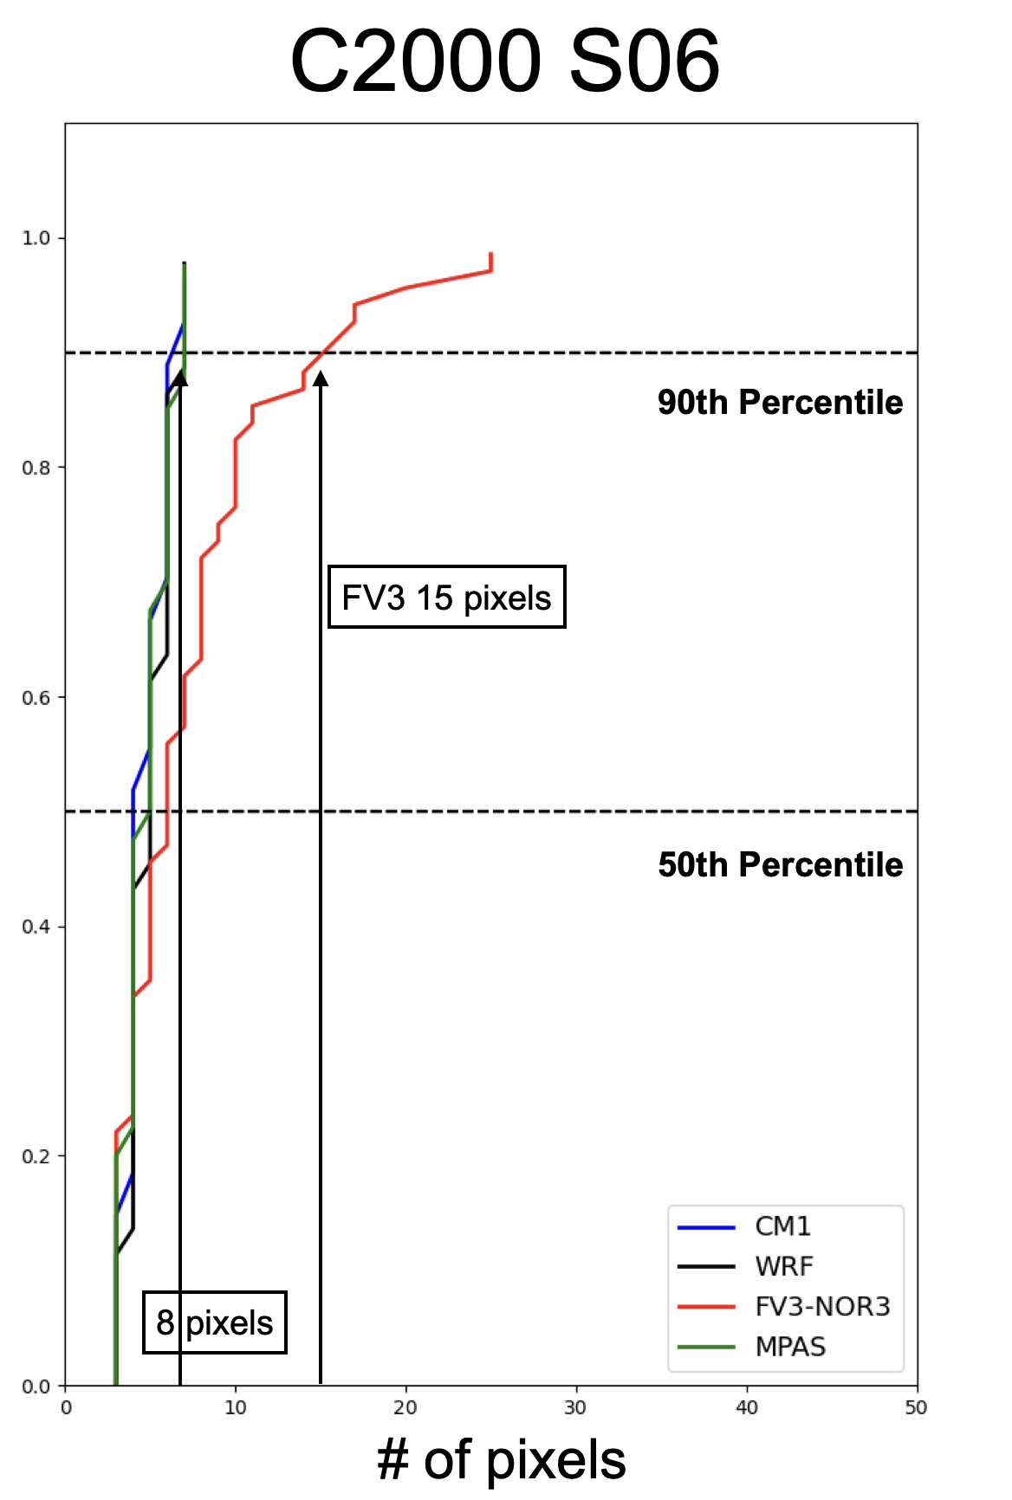
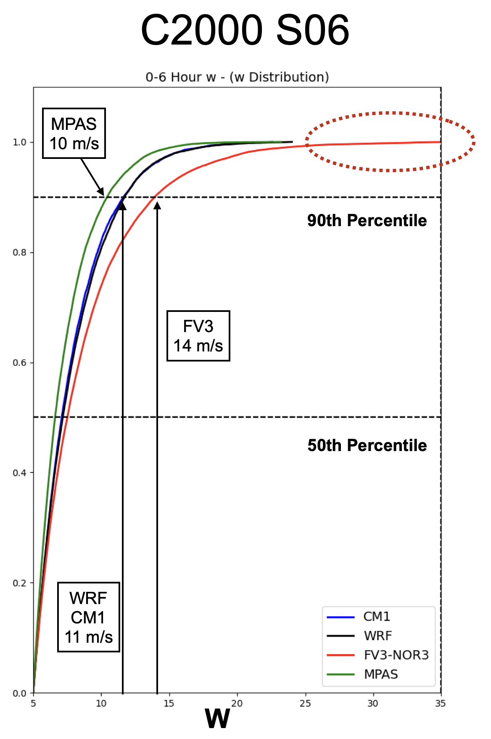
Hierarchical System Development: Example
Evaluation of Convective Storm Characteristics/Biases Across Model Cores
NOAA NSSL
research
Size (# of pixels) for storm objects
Squall Line simulation 0-2 hours
Squall Line W’s Cumulative
Frequency over 6hr simulations
Understanding the characteristics of convection from
full physics simulations is difficult.
Less complex framework to better understand system-
atic biases: 3D simulations using idealized conditions.
NGGPS and DCMIP2016:
Only looked at single supercell.
Most CONUS convection occurs in lines or clusters: per-
haps idealized squall line simulations more appropriate?
Squall lines generate a large number individual cells:
Better sample size?
Can specify CAPE (instability) and vertical wind profile: generating a wide variety of convective lines, intensities, precipitations, etc.
Controlled comparison of various systems for surface precipitation, vertical velocity, cloud top depth, etc.
NCAR is in the process of making all physics packages CCCP compliant.
MPAS
CM1
FV3
Hovmoller Diagrams for 3 Models
Strongly Shear Squall Line
0-6 hour 15 min Accum. Precip

Slide 16
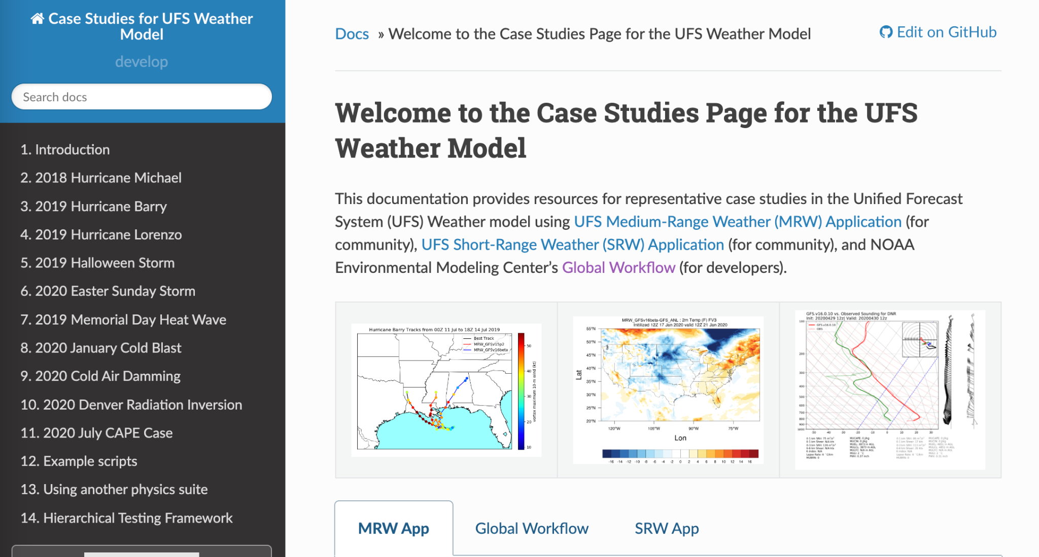
HSUP project
Hierarchical System Development: Example
UFS Case Studies
A platform to share UFS model representative case study configurations, datasets, results, and example visualization scripts.
ufs-case-studies have recently been integrated into SRW apps.
DTC and EPIC teams are collaborating to update repository & instructions.
UFS Case Studies: An entry point for UFS HSD
Read the Docs: https://ufs-case-studies.readthedocs.io/en/develop/index.html
GitHub: dtcenter/ufs-case-studies

Slide 17
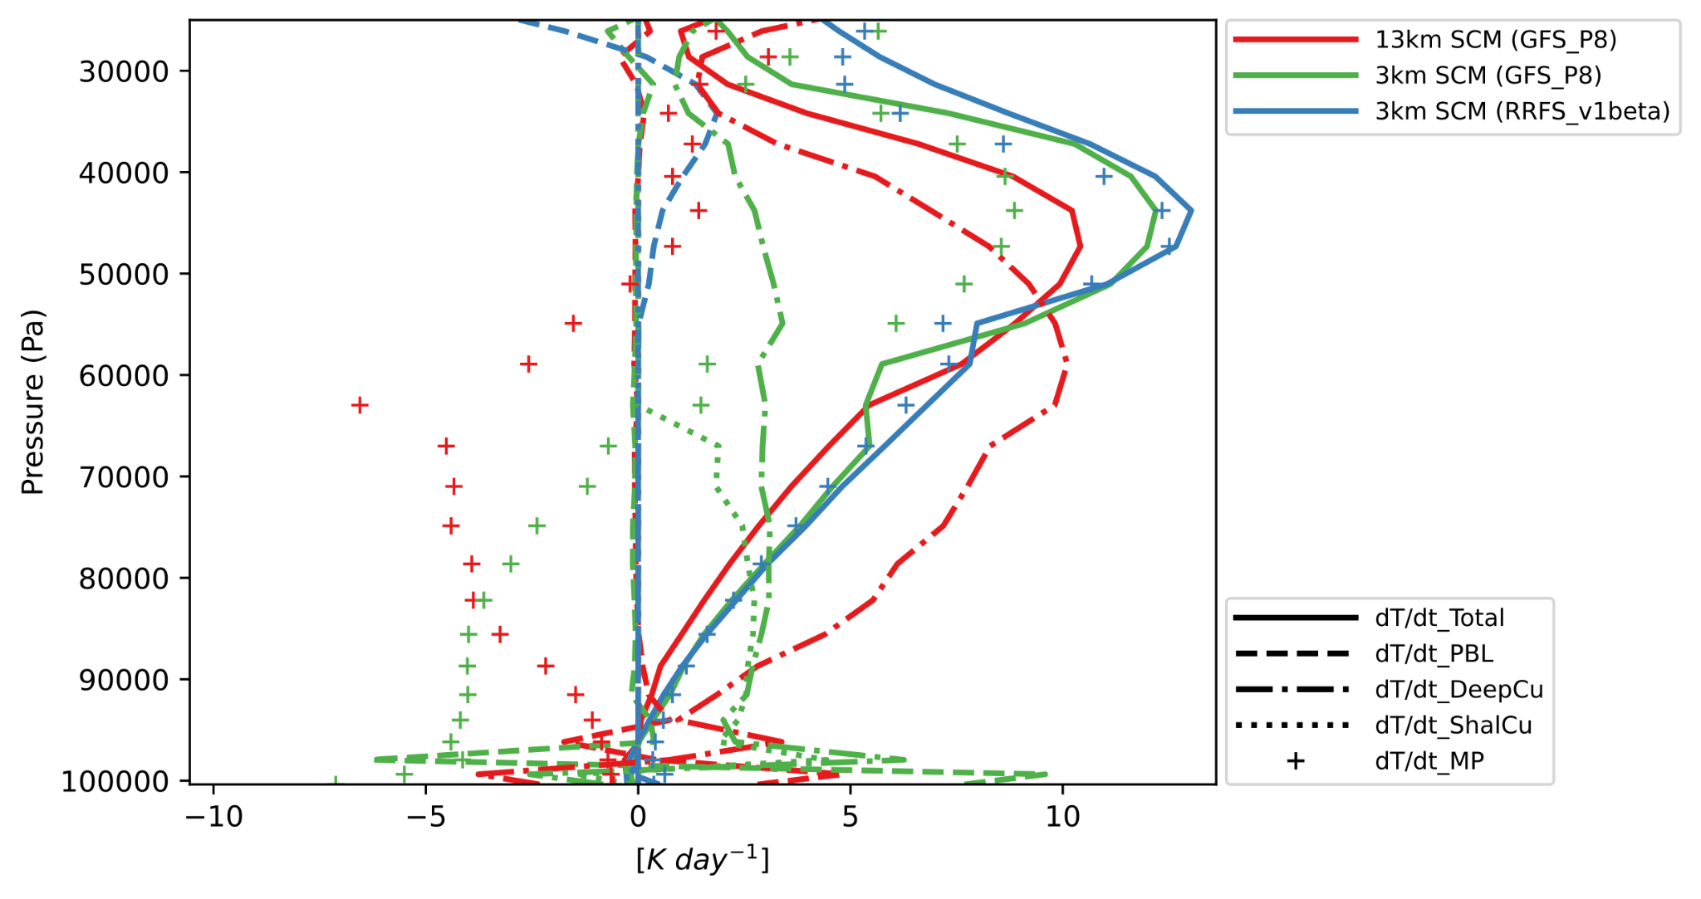
DTC UniPhy project
Hierarchical System Development: Example
Physics Testing and Evaluation towards Physics Unification
Total (solid) vs Parameterized (dashed) Precip Rate [mm/hour]
dT/dt by model physics
P8 (13km)
P8 (3km)
RRFS (3km)
SCM
SCM better than LAM wrt rainfall amount & variations.
Large-scale env critical for simulating MJO-induced rainfall.
Physics (3 km vs 13 km): higher res → more realistic.
deep_cu may be activated too frequently.
Tendency analysis: reality is somewhere b/t 13- & 3-km runs.
LAM
‹#›
‹#›
Results based on UFS SRW v2.0 and CCPP SCM v6.0
‹#›

Slide 18
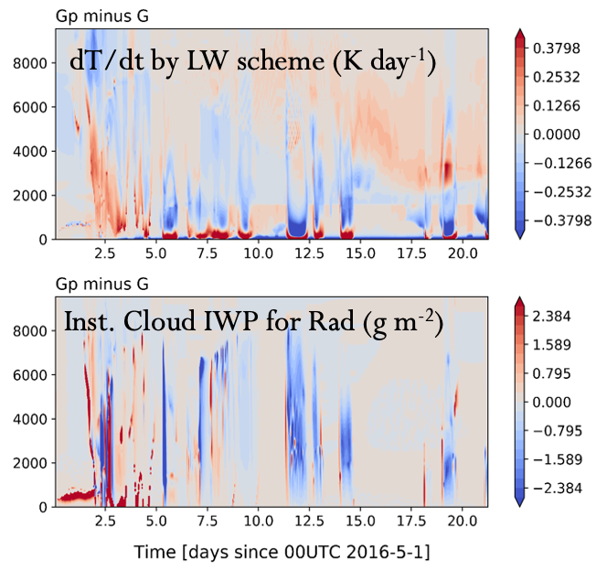
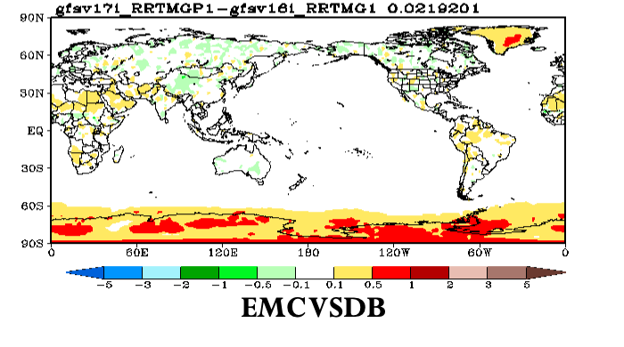
Hierarchical System Development: Example
Physics Testing and Evaluation for the UFS MRW and S2S
Applications
DTC UFS R2O project
SCM T&E of warmer Antarctic in RRTMGP for prototype-8 physics using ARM AWARE case - Informed possible cloud-radiation interaction issues in addition to land-atmosphere interactions; assisted decision making for exclusion of RRTMGP in public release of P8.
Excessive near-surface LW heating in GP but no corresponding cloud differences
‹#›

Slide 19
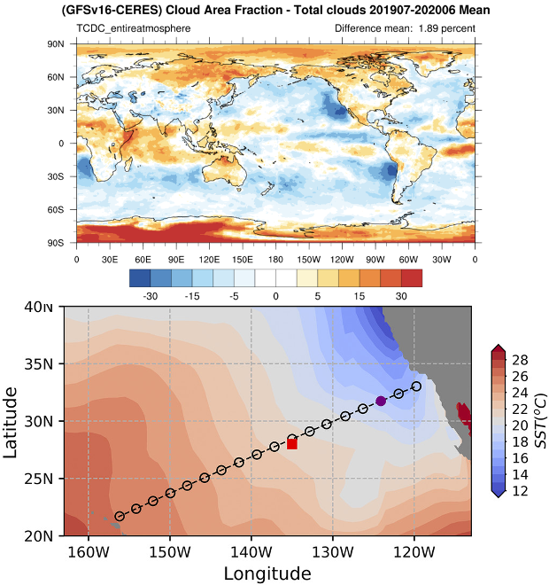
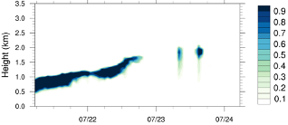
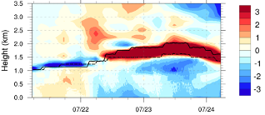
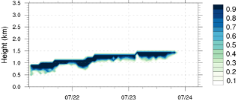
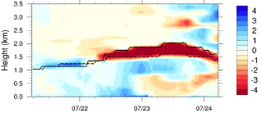
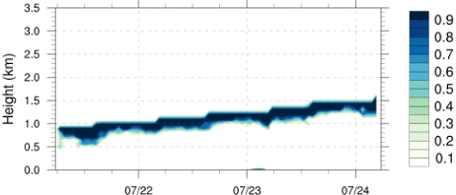
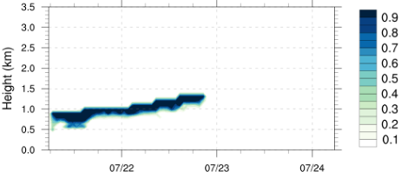
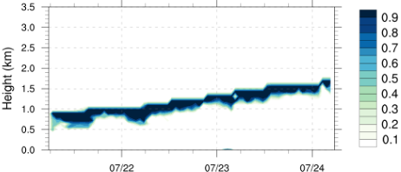
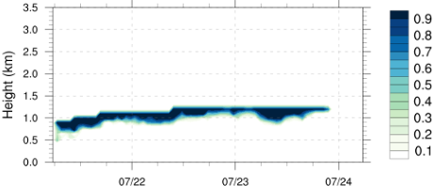
DTC UFS R2O project
Hierarchical System Development: Example
Physics Testing and Evaluation for the UFS MRW and S2S Applications
Cloud frac (obs)
Theta (SCM with GFS v16)
Cloud frac (SCM with GFS v16)
Qv (SCM with GFS v16)
No large-scale forcing
Advection of ThetaL only
Advection of Qt only
Large-scale vertical velocity only
Solid: Observations
Dashed: CCPP v5-SCM with GFS v16
Hertneky et al. (2022)
SCM T&E with ARM MAGIC case
Diagnose model issues with marine Sc-to-Cu transition (PBL, cumulus, cloud, radiation processes, etc): unlike in global forecast, Sc is not largely underestimated but thinner and grows more slowly in SCM; weaker entrainment & stronger capping inversion → colder, moister day 1 → a slower growth of PBL & cloud base days 2-3.
Roles of different components of large-scale forcing in leading to cloud misrepresentation: when only advecting θ, Sc breakup occurred at a similar time compared to obs, indicating that other forcings may negatively contribute to the cloud bias (e.g., too much moisture advection and inhibiting effects by large-scale vertical motions).
‹#›
‹#›

Slide 20
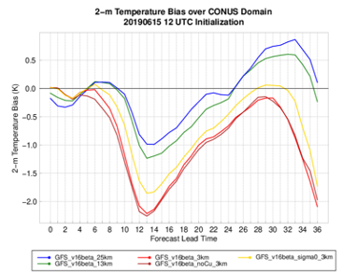
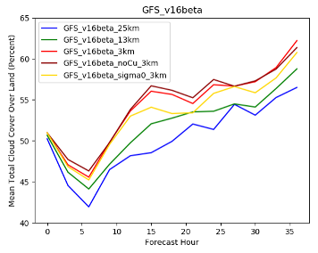
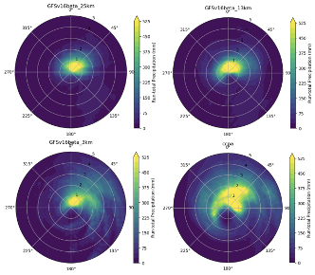
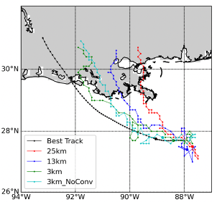
DTC Physics Across Scales
project
Hierarchical System Development: Example
Evaluation of CCPP physics suites across spatiotemporal scales
Determine how horizontal grid spacing impacts forecasts of various
phenomena in the UFS:
3-km (CAM), 13-km (Global Medium-Range Weather), 25-km (S2S) grid spacing.
GFS and RRFS physics suites tested.
CCPP SCM simulations.
Emphasis on hierarchical testing:
Utilize SCM, physics tendencies from CCPP, verification/diagnostics (METplus).
Finding: Neither physics suite produced scale-invariant results for forecasts of temperature, cloud cover, precipitation, or tropical cyclone track

Slide 21
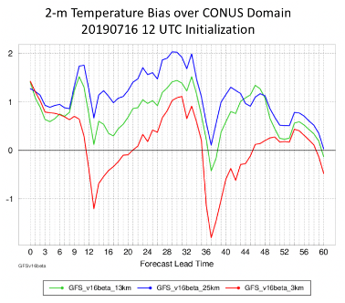
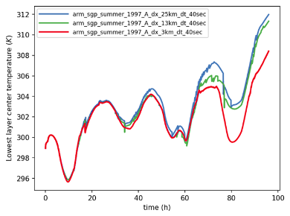
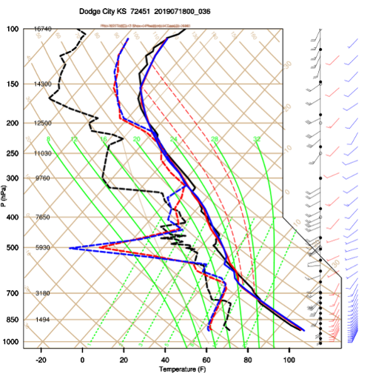
DTC Physics Across Scales
project
Hierarchical System Development: Example
Evaluation of CCPP physics suites across spatiotemporal scales (cont.)
Using the CCPP SCM to study model performance at different grid spacings
Using the CCPP SCM to “replay” a UFS column
UFS LAM
CCPP SCM
Sounding at Dodge City, KS for the full 3D UFS-LAM runs and the SCM forced with the UFS-LAM. Finding: general agreement between the UFS-LAM and the SCM - overmixed PBL occurring in both cases
--- 25 km --- 13 km --- 3 km
UFS-LAM heat wave case vs. CCPP SCM ARM SGP canned cases for 3 grid resolutions, using same physics. Finding: Cooler 2-m temperature trend for the finer grid resolutions comes out in the SCM simulation.
–OBS –UFS LAM –CCPP SCM

Slide 22
External project
Hierarchical System Development: Example
Aquaplanet (Global Ocean-Only) simulations of Tropical Cyclones
Aquaplanet study:
Idealized boundary condition model configurations.
Focus on formation and evolution of TCs in a simpler setting.
Finding: Bridge between GCM (course) resolution and convection-permitting (km-scale) resolution models.

Slide 23
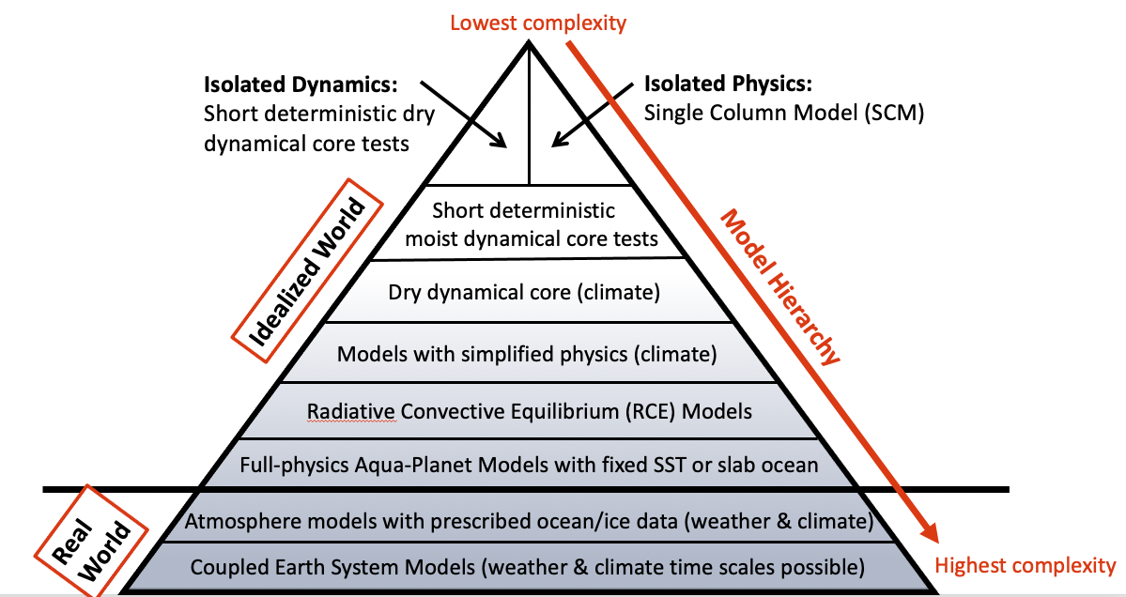
Example of an Existing Model Hierarchy: CESM’s “Simpler Models”
Purpose: HSD approach for the climate community: NCAR’s CESM ‘Simpler Models’ framework.
Many CESM ‘Simpler Models’ elements (see below) for the Global Model domain + SCM are similar to what we are trying to build for the UFS.
Hierarchy provides an improved understanding of the cause-and-effect relationships in models & serves as a teaching tool: desirable for the UFS
FV3 is an option in CESM.
Selected elements of this hierarchy are also available for FV3 at GFDL, NSSL and DTC, but not via official UFS distributions and workflows.
Adapted from a talk by Christiane Jablonowski (Univ. Michigan) at a EPIC-UFS workshop in 2022.

Slide 24
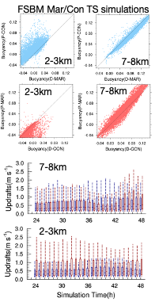
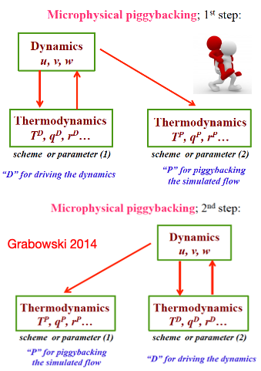
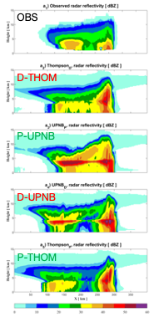
WPO project
Hierarchical System Development: Example
“Piggybacking”
Piggybacking is a framework that allows the dynamics and physics feedback loop to be disconnected. The physics can be run in a kinematic manner and provide signals purely induced by physics in a realistic flow.
Findings: The results show that testing physics in this framework reduces ensemble size and provides point-to-point comparisons of important processes.

Slide 25
HSD Community Survey and DTC-EPIC White Paper on HSD
Professor/
Faculty
Purpose: To gather insights & feedback from broader community to help shape future direction of HSD.
55 participants from a broad spectrum of disciplines and organizations.
Questions pertained to the necessity to develop HSD capabilities such as nesting/idealized/LES/CRM/etc.
Manager
Developers/
Combination
Researchers
Software
Engineer
Pie chart of survey respondents’ roles
Emerging themes:
Importance of HSD to span across all Earth system model components and not just land-atmosphere.
Need for highly configurable and well-documented testing workflows, such as for idealized cases.
“One-stop-shop” to test relevant case studies using different UFS capabilities, tools, and software, which are readily available and easy to install.
Capability to initialize a model with a large variety of datasets.
Effort and necessity rankings on the four HSD aspects proposed in the white paper for UFS HSD

Slide 26
Summary – Challenges & Opportunities
Earth System Models (ESMs) for weather and climate are becoming increasingly complex, with many processes and interactions. We need to get right answers for the right reasons!
Hierarchical System Development (HSD) is a systematic “engineering” approach that tests small elements (e.g. physics schemes/subroutines) of an ESM first in isolation, then progressively connects elements with increased coupling between ESM components (e.g. via SCMs, and small-domain and limited-area models), regional and global models, all the way to a fully-coupled global model.
HSD can help improve understanding of spatial and temporal dependencies in model physics, i.e. consistent solutions between models/applications at different resolutions. Also, HSD process is concurrent and iterative, i.e. more complex HSD steps can provide information to be used at simpler HSD steps, and vice versa.
The Common Community Physics Package (CCPP) provides an efficient infrastructure and set of physics that connects HSD steps, where CCPP is under active development by the community, with new parameterizations and framework capabilities being added.
METplus provides the necessary verification that includes metrics at the process level.
DTC and EPIC worked together to develop a HSD White Paper describing different aspects of the HSD approach for efficient and effective UFS model development and improvement
(recently completed and will be posted on the DTC, UFS-community and EPIC websites).

Slide 27
DTC Visitor Program
https://dtcenter.org/visitor-program
Propose a project to work on with us!
Two types of visitor projects:
Principal Investigator (PI) - Up to 2 months salary, travel and per diem - can be split into multiple visits.
Graduate Student - Up to 1 year of temporary living per diem and travel expenses for graduate student, plus support for advisor visits.
See Announcement of Opportunity on DTC website for more information on how to apply and guidance on topics of interest.
This is an important mechanism to support HSD- related work that will be of great benefit to the NWP and Earth system research and modeling community!

