Slide 1
Met Office Unified Model Development Best Practice
David Walters, Head: Research to Operations,
Weather Science, Met Office, United Kingdom.
Unifying Innovations in Forecasting Capabilities Workshop, Boulder, CO
27th July 2023

Slide 2
Overview
The Met Office Unified Model
Unified Model development process
Benefits and costs of unified modelling

Slide 3
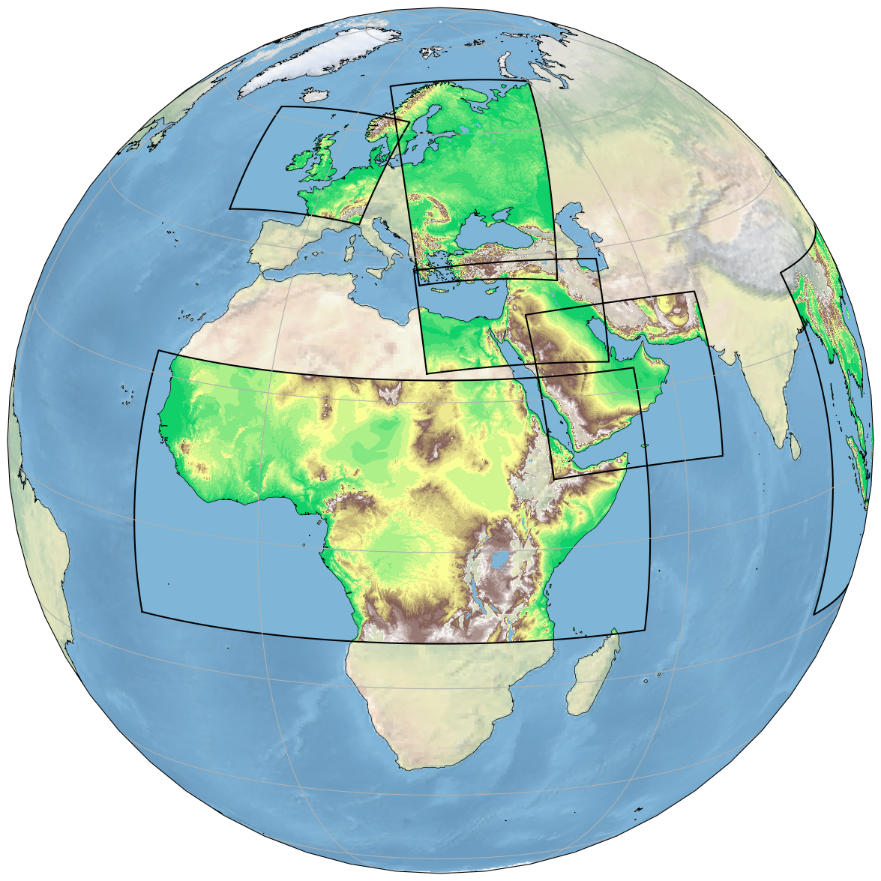
2023 Met Office NWP Suite
Global NWP:
10/20km deterministic/ensemble
Both coupled to ORCA025 (0.25°ocean
70 vertical levels (80km top)
Hybrid 4DVar/En-4DEnVar Data Assimilation (DA)
Forecasts to T+54 or T+192hr every 6 hours
)
UK NWP:
1.5/2.2km deterministic/ensemble
70 vertical levels (40km top)
Hourly 4DVar DA
Forecasts to T+12 - 120hr every hour
Hourly updating ensemble (up to T+120hr)
Other Models:
1km to 4.4km (without DA)
70 vertical levels (40km top)

Slide 4
The Met Office Unified Model™

Slide 5
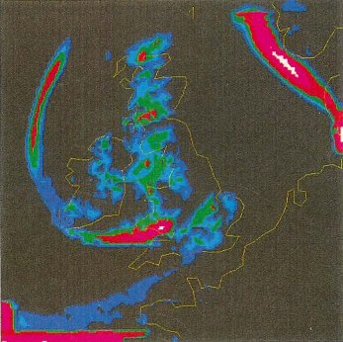
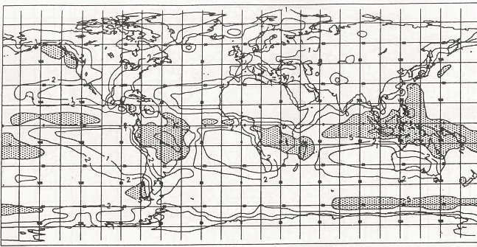
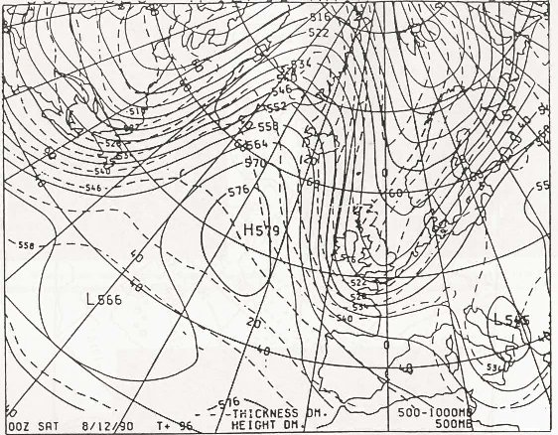
Unified forecast/climate model (Cullen, 1993)
Global coupled climate Global NWP Mesoscale NWP
Technical consolidation of code
1990: initial operational implementation
Benefit: Improvements to regional NWP performance from improved (climate) parametrisations
Compromise: Temporary step-back in some capabilities (e.g. regional model went from non-hydrostatic → hydrostatic)

Slide 6
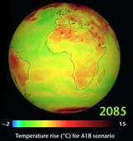
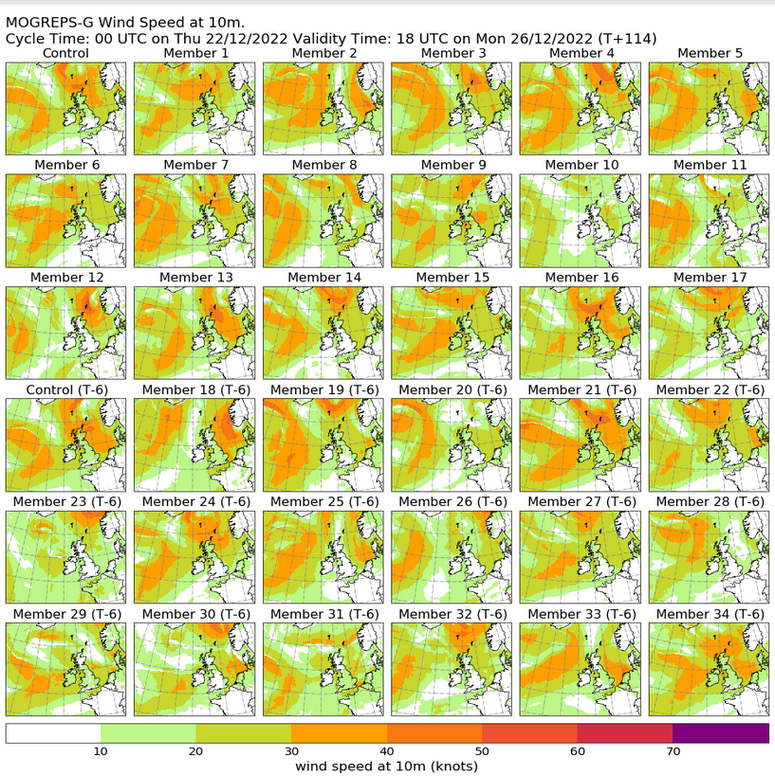
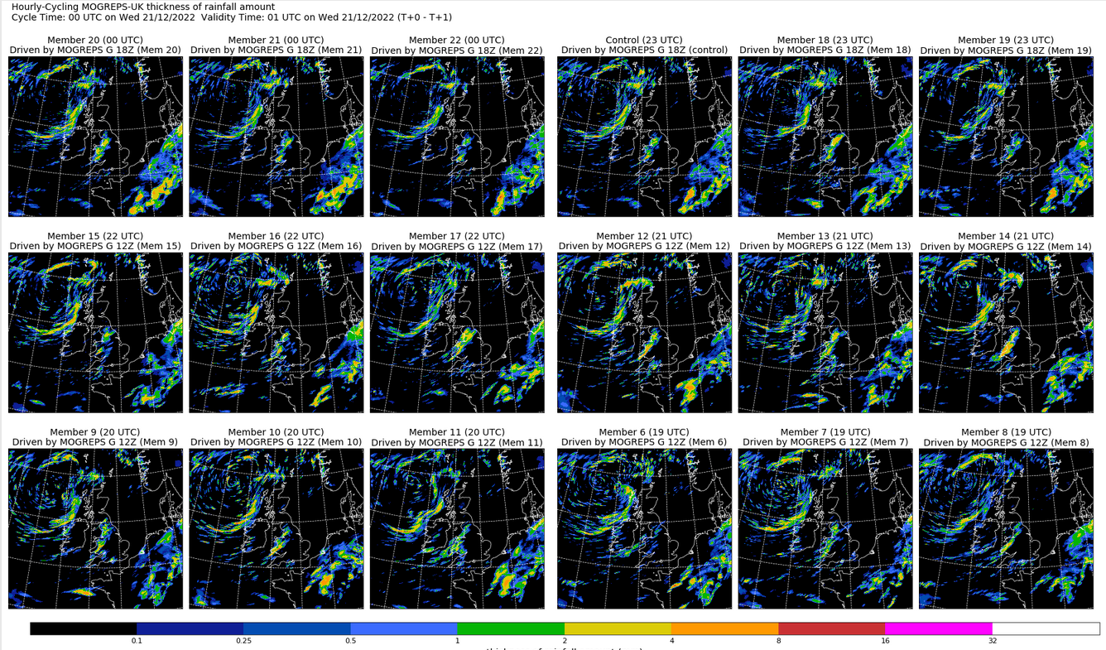
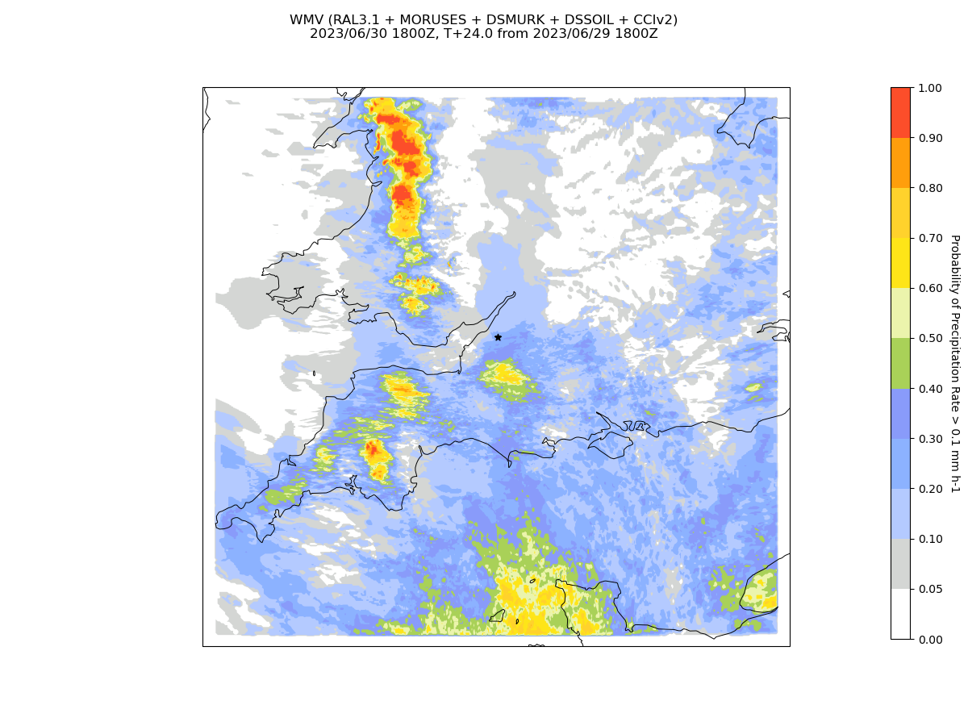
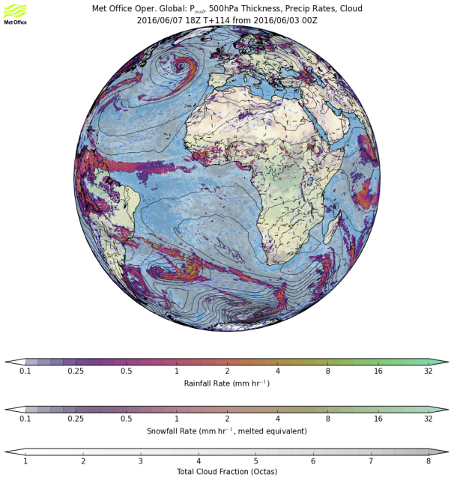
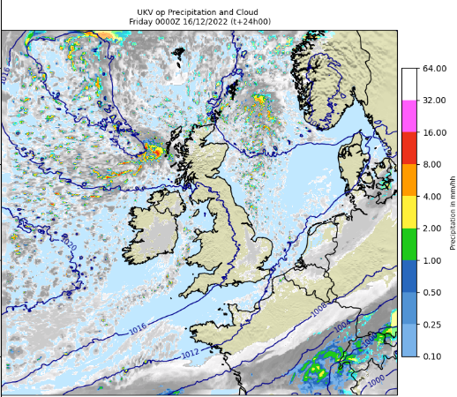
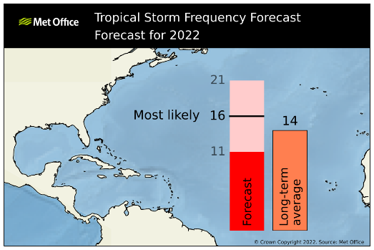
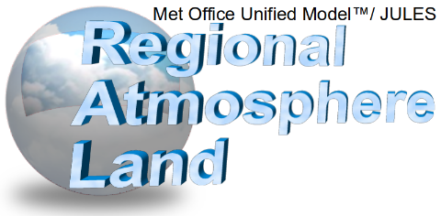
The Met Office Unified Model (Cullen, 1993) Brown et al. (2010), Walters et al. (2019), Bush et al. (2023)
Δx ≈ 130 → 60 km
Δx ≈ 20 km
Δx ≈ 10 km
Δx ≈ 2.2 km
Δx ≈ 1.5 km
Δx ≈ 300 m

Slide 7
Flexibility of the Unified Model
A factor of ~100 – 1000 between these …
Δx ≈ 135 → 10 km
Δx ≈ 300 → 100 m
… the same dynamics (and physics) has to continue to work

Slide 8
The Met Office Unified Model
Developing a seamless science configuration
Why attempt seamless model configs?
Good short-range and forecasts model climatology ensures physical fidelity
Allows testing in many applications/domains
Allows feedback (e.g. O2R) to inform all applications and not just those reported
Allows us to concentrate development on small number of parametrisations/options
But … additional constraints do add to the burden of model development process

Slide 9
The Unified Model Development Process

Slide 10
The Global Coupled (GC) development process
GC4 Global Coupled Science Configuration
GA8
GL9
GO6
GSI8.1
CICE
The Los Alamos Sea Ice Model

Slide 11
The GC development process
Continuous research cycle
All developments start here.
Testing based on a previous well-known GC configuration.
Includes multi-year projects and programmes.
Also includes Prioritised Evaluation Groups (PEGs).
Engagement with a wide range of partners … … but majority of physics development done within the Met Office.

Slide 12
The GC development process
Continuous research cycle
Std tests
All changes are:
Documented in ticketing system
Reviewed for impact and inclusion
Lodged into UM codebase
Roughly 1 – 2 year GC release cycle
“Freeze” GCx
Review & science
assurance
“Freeze” GCx+1
Plan next release:
Aims/scope
Resources
Constraints
Timescales
Identify changes:
Maturity
Priority
Current std tests:
20 yr AMIP simulation
Coupled/atmos-only NWP tests
Atmos-only NWP DA trials

Slide 13
The GC development process
Continuous research cycle
Std tests
Package testing
Roughly 1 – 2 year GC release cycle
Tuning
“Freeze” GCx
Review & science
assurance
“Chill” GCx+1
“Freeze” GCx+1
Plan next release:
Aims/scope
Resources
Constraints
Timescales
Identify changes:
Maturity
Priority
Current std tests:
20 yr AMIP simulation
Coupled/atmos-only NWP tests
Atmos-only NWP DA trials
Increase complexity of tests:
Higher resolution/coupled climate
Higher-res/more complex NWP
Tuning:
Individual phenomena e.g.dust, non-orog GWs
Emergent properties e.g. TOA radiation
Approach is to improve known problems and remain in obs. constraint

Slide 14
The GC development process
Continuous research cycle
Top model problems → PEGs
Std tests
Package testing
Roughly 1 – 2 year GC release cycle
“Release” GCx+1
Tuning
Widespread model assessment
Assessment
runs/tests
Assessment workshop Documentation
Assessment runs include:
~100yr Higher resolution/coupled climate simulations
High resolution Coupled Ensemble NWP
Seasonal hindcast runs

Slide 15
The GC development process
Continuous research cycle
Top model problems → PEGs
Std tests
Package testing
Roughly 1 – 2 year GC release cycle
“Release” GCx+1
Tuning
Widespread model assessment
Assessment
runs/tests
Assessment
runs/tests
Assessment workshop Documentation
System implementation projects
e.g. global NWP suite
e.g. Major climate release for CMIP

Slide 16
The GC development process
Continuous research cycle
Top model problems → PEGs
Std tests
Package testing
Roughly 1 – 2 year GC release cycle
“Release” GCx+1
Tuning
Widespread model assessment
Assessment
runs/tests
Assessment
runs/tests
Assessment workshop Documentation
System implementation projects
e.g. global NWP suite
e.g. Major climate release for CMIP
Continuous operational running
Operational
Implementation

Slide 17
Benefits and costs of Unified Model development

Slide 18
Benefits and costs of Unified Model development
Horizontal resolution:
UM (and parametrisations) developed to work across wide range of resolutions
GC developed and tested from Δx=135 – 10km, RAL from Δx=4.5 - 1km (and now < 1km)
Very few settings change with resolution (e.g. from a previous GA atmosphere setup):

Slide 19
Benefits and costs of Unified Model development
Horizontal resolution:
UM (and parametrisations) developed to work across wide range of resolutions
GC developed and tested from Δx=135 – 10km, RAL from Δx=4.5 - 1km (and now < 1km)
Very few settings change with resolution (e.g. from a previous GA atmosphere setup):
Benefit: increasing res. in lower-res systems is almost trivial
Benefit: can trust lower-res tests to teach you about higher-res systems → cheaper testing
Cost: more thought and care must be taken when initially developing and testing science
Cost: Unified Model is relatively expensive in computational terms

Slide 20
Benefits and costs of Unified Model development
Complexity/system/timescale/domain dependence:
UM (and parametrisations) developed and tested across systems/timescales/domains
A number of system dependent options (e.g. from a previous GA atmosphere setup):
% can use prognostic aerosol or traceable climatological aerosol
also can obviously run atmospheric model coupled/uncoupled

Slide 21
Benefits and costs of Unified Model development
Complexity/system/timescale/domain dependence:
UM (and parametrisations) developed and tested across systems/timescales/domains
A number of system dependent options (e.g. from a previous GA atmosphere setup):
Benefit: increased testing/stress improves the robustness of the model
Benefit: traceable hierarchies makes extending complexity simpler (e.g. aerosols for NWP)
Cost: code can become complex because of the number of different “use cases”
Requires higher level of governance and top-level control

Slide 22
Summary
Unified Model allows unified approach to model development
Unified science configurations used for Global and Regional modelling
Technical and scientific benefit
Up front cost in dev. and testing
Can make pragmatic implementation choices and maintain integrity
Once adopted, the benefits outweigh the costs

