Slide 1
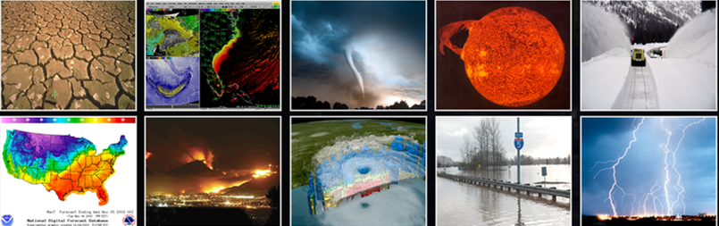
The Whole Atmosphere Model (WAM) Application of NOAA’s Unified Forecast System (UFS)
July 27, 2023
National Weather Service
Kevin Viner, Wen Chen, Fanglin Yang, Henry Juang, Brian Curtis
NOAA/NWS/NCEP/EMC
Svetlana Karol, Adam Kubaryk, Tim Fuller-Rowell, Tzu-Wei Fang
NOAA/SWPC
Valery Yudin
NASA GSFC

Slide 2
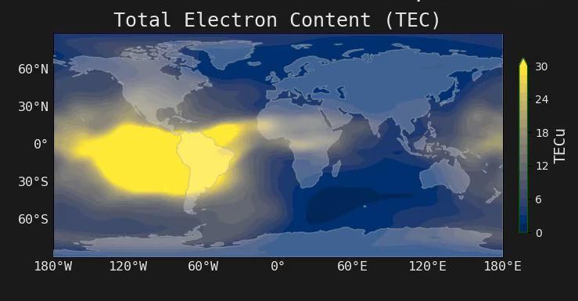
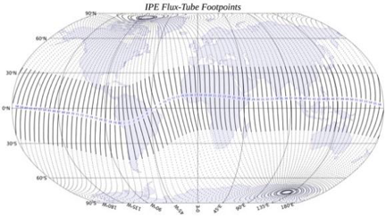
GSM WAM and IPE
Whole Atmosphere Model (WAM)
0-600 km, 0.25 scale height, 2°x 2° lat/long, T62, hydrostatic, 150 levels, 10-fold extension of Global Forecasting System (GFS) US weather model.
O3 chemistry and transport, cloud physics and hydrology
Radiative heating and cooling
Sea surface temperature field and surface exchange processes
Orographic and non orographic gravity waves parameterization
WAM Data Assimilation Scheme (WDAS)
Diffusive separation, ion drag, Joule heating, etc.
Ionosphere Plasmasphere Electrodynamics (IPE)
Time-dependent, global 3D model from 90 km to several Earth radii
IGRF coordinate system, accurately represents Earth’s magnetic field
Includes Field Line Interhemispheric Plasma (FLIP) model
ExB transport across magnetic field
Seamless perpendicular plasma transport pole-to-pole
Weimer/Heelis empirical ion convection model driven by solar wind data, TIROS auroral empirical model
Provides plasma densities (9 ion species), thermal electron and ion temperatures, and ionosphere and plasmasphere velocities
ESMF 3D-regridding WAM→IPE information
Solar and Geomagnetic Activities
(solar radiation, high-latitude E, aurora, joule heating)
Lower Atmospheric Perturbations
(thermospheric tides, planetary waves, gravity waves)

Slide 3
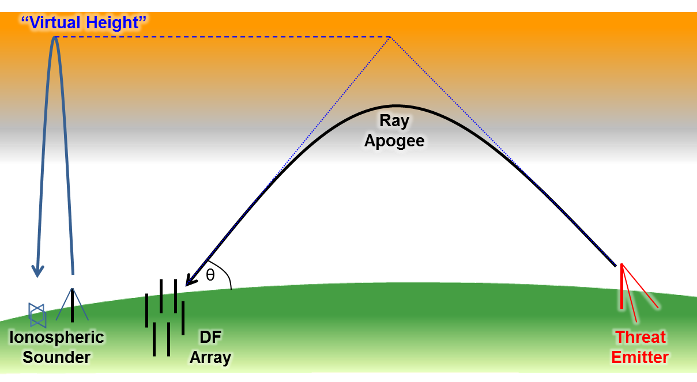
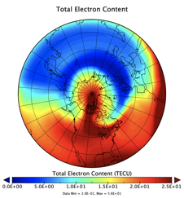
WAM-IPE Products/Concerns
For HF communication:
      Changes in the Minimum Usable Frequency (LUF) due to D-region absorption (D-RAP)
  Changes in the Maximum Usable Frequency (MUF) due to the peak plasma density (NmF2) and height of peak (hmF2)
  Undulations in bottom-side F-region
For positioning, navigation, timing, and other communication:
  Mesoscale structure and gradients in plasma density (diffract radio signals and cause amplitude or phase fluctuation in GNSS signals)
  Delay in navigation signal due to line of sight electron content (position error)
  Small-scale ionospheric irregularities causing scintillations/fluctuation or complete loss of signal

Slide 4
What are the goals of upgrading?
Non-hydrostatic effects
Deep Atmosphere effects
Much Higher resolution (25km)
Unification with other NOAA models under the UFS umbrella (FV3 dynamical core, Common Community Physics Package)

Slide 5
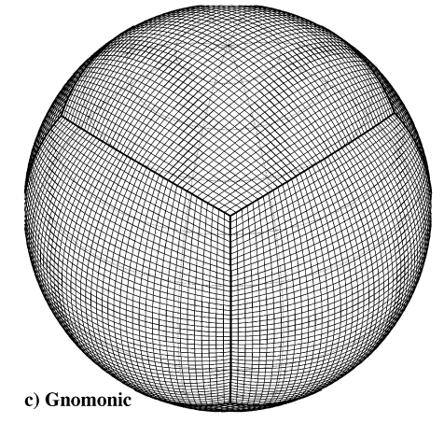
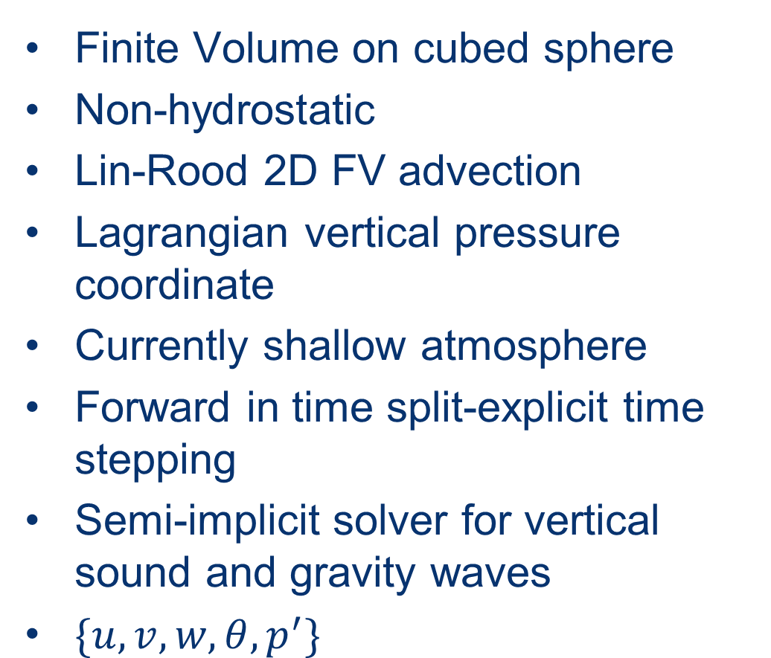
FV3
Finite Volume on cubed sphere
Non-hydrostatic
Lin-Rood 2D FV advection
Lagrangian vertical pressure coordinate
Currently shallow atmosphere
Forward in time split-explicit time stepping
Semi-implicit solver for vertical sound and gravity waves
$\{u,v,w,θ,p^{′}\}$

Slide 6
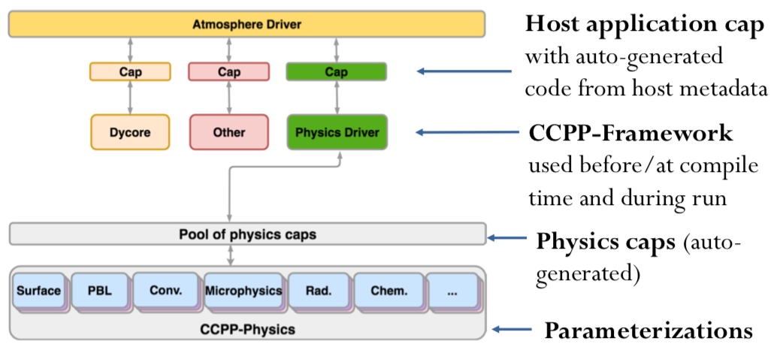
CCPP
Modular physics package
Link any number of physics schemes to any dynamics fitted with the package through xml

Slide 7
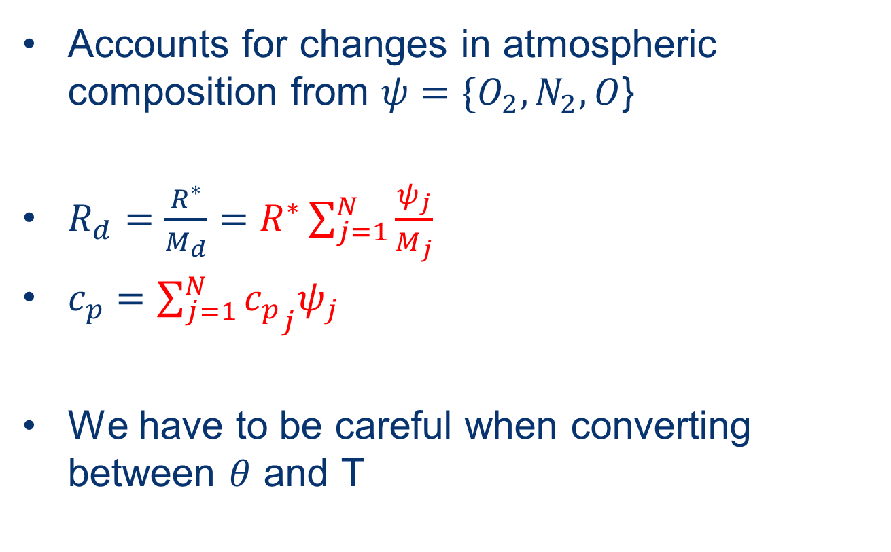
Multi-gas Functionality
Accounts for changes in atmospheric composition from ${ψ=\{O}_{2}, N_{2}, O$}
$R_{d}=\frac{R^{∗}}{M_{d}}=R^{∗}\sum_{j=1}^{N}{\frac{ψ_{j}}{M_{j}}}$
$c_{p}=\sum_{j=1}^{N}{{c_{p}}_{j}ψ_{j}}$
We have to be careful when converting between $θ$ and T

Slide 8
WAM-physics
The IDEA physics package from GSM-WAM is currently ported as a single scheme into CCPP
<group name="physics">
<subcycle loop="1">
<scheme>GFS_suite_interstitial_phys_reset</scheme>
<scheme>GFS_suite_stateout_reset</scheme>
<scheme>get_prs_fv3</scheme>
<scheme>GFS_suite_interstitial_1</scheme>
<scheme>wamphys</scheme>
<scheme>wamphys_post</scheme>
<scheme>GFS_surface_generic_pre</scheme>
<scheme>GFS_surface_composites_pre</scheme>
<scheme>dcyc2t3</scheme>
<scheme>GFS_surface_composites_inter</scheme>
<scheme>GFS_suite_interstitial_2</scheme>
</subcycle>

Slide 9
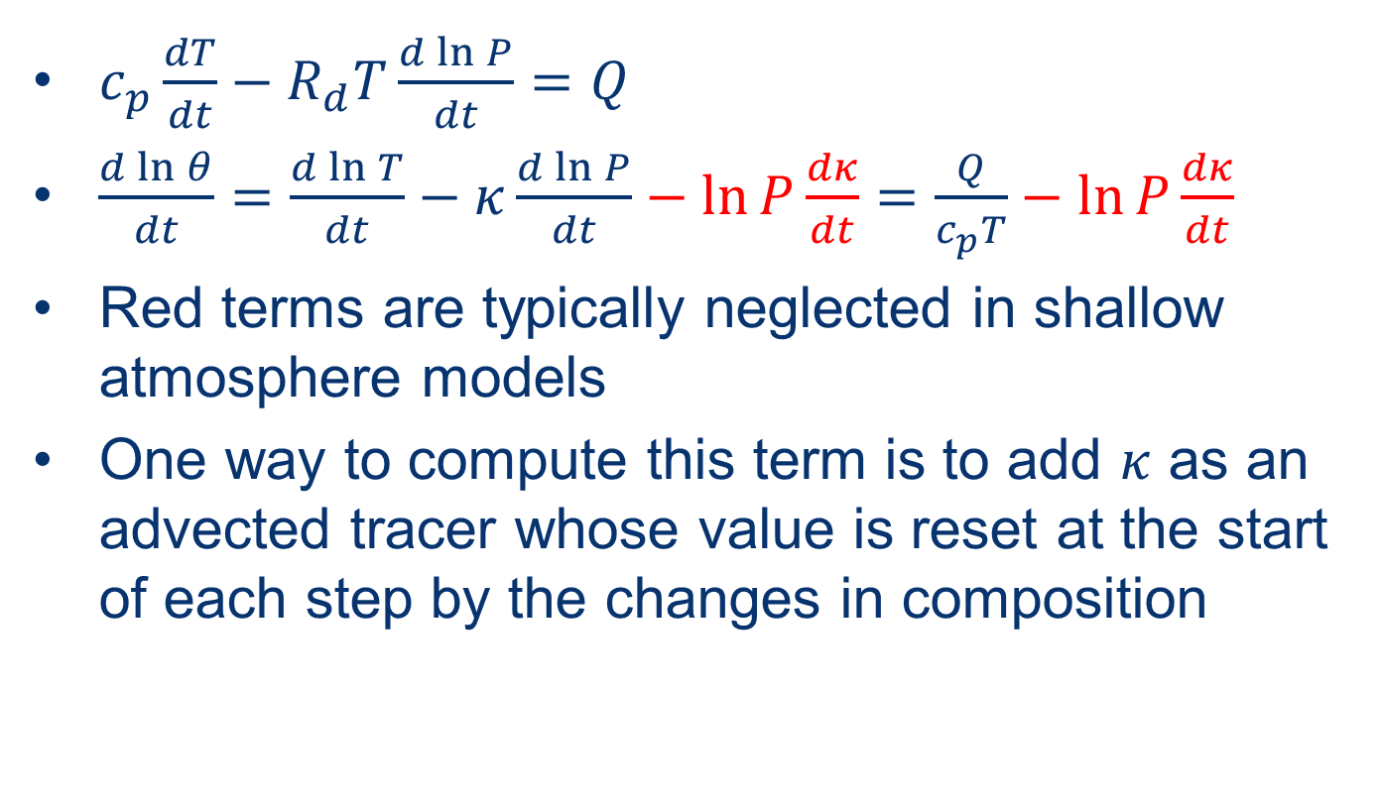
Kappa Correction
$c_{p}\frac{dT}{dt}−R_{d}T\frac{d\ln{P}}{dt}=Q$
$\frac{d\ln{θ}}{dt}=\frac{d\ln{T}}{dt}−κ\frac{d\ln{P}}{dt}−\ln{P}\frac{dκ}{dt}=\frac{Q}{c_{p}T}−\ln{P}\frac{dκ}{dt}$
Red terms are typically neglected in shallow atmosphere models
One way to compute this term is to add $κ$ as an advected tracer whose value is reset at the start of each step by the changes in composition

Slide 10
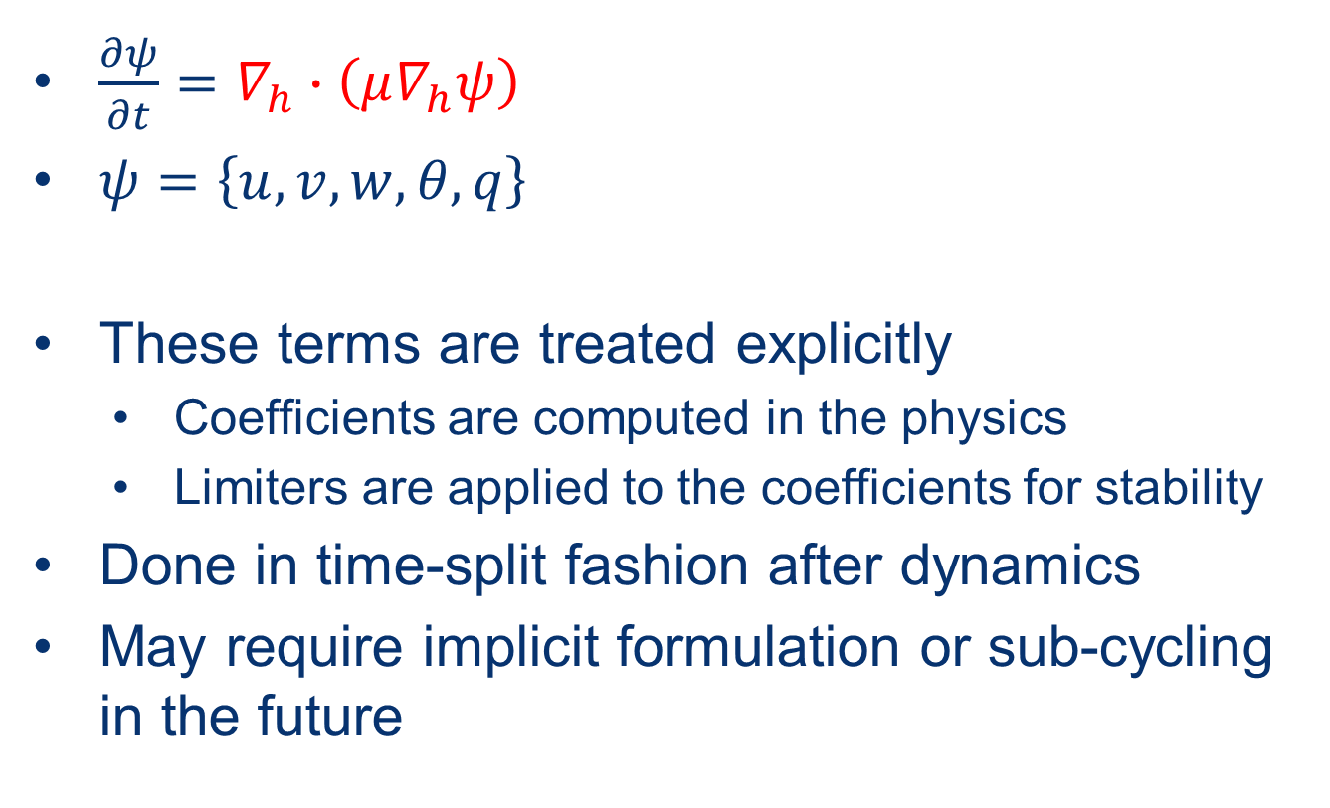
Horizontal Molecular Diffusion in FV3
$\frac{∂ψ}{∂t}=∇_{h}∙\left(μ∇_{h}ψ\right)$
$ψ=\left\{u, v, w, θ,q\right\}$
These terms are treated explicitly
  Coefficients are computed in the physics
  Limiters are applied to the coefficients for stability
Done in time-split fashion after dynamics
May require implicit formulation or sub-cycling in the future

Slide 11
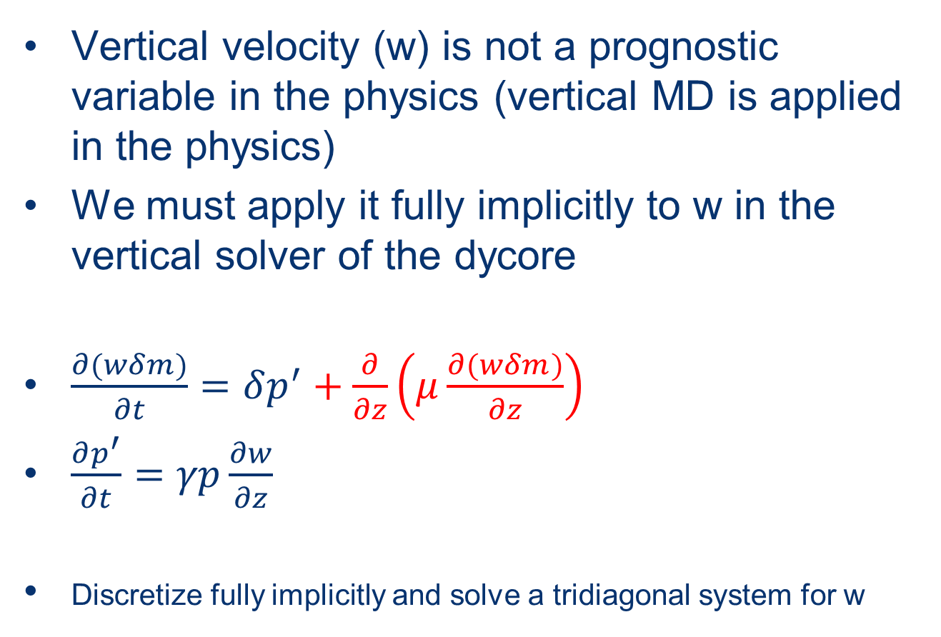
Vertical Molecular Viscosity on w in FV3
Vertical velocity (w) is not a prognostic variable in the physics (vertical MD is applied in the physics)
We must apply it fully implicitly to w in the vertical solver of the dycore
$\frac{∂(wδm)}{∂t}=δp^{′}+\frac{∂}{∂z}\left(μ\frac{∂(wδm)}{∂z}\right)$
$\frac{∂p^{′}}{∂t}=γp\frac{∂w}{∂z}$
Discretize fully implicitly and solve a tridiagonal system for w

Slide 12
Experiment Setup
C96 (~1 degree) grid spacing
150 levels up to ~500km
Start a single 5 day forecast from remapped GSM-WAM initial conditions
Examine global mean values for temperature and composition
Compare with GSM-WAM and NRL MSIS
*goal is to approximately match

Slide 13
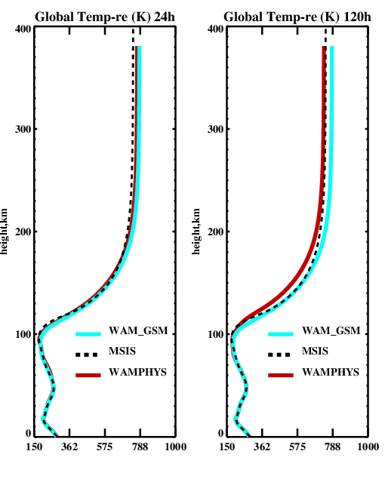
Results: Global Mean Temperature Profiles

Slide 14
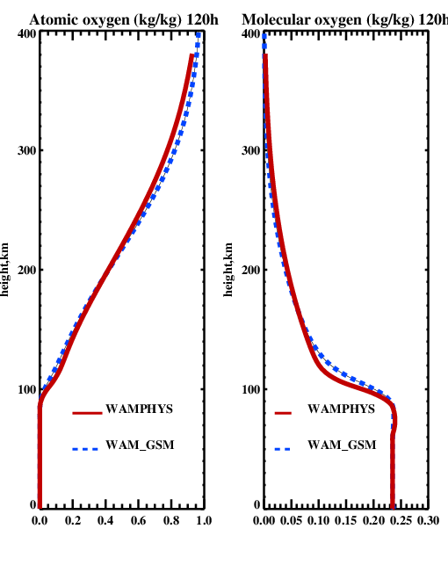
Results: Composition

Slide 15
Conclusions/Future Work
We’re able to approximately match the results of the neutral atmosphere GSM-WAM model with the new UFS-WAM application
Need to begin testing at higher resolution to examine non-hydrostatic effects
Deep atmosphere formulation (with full Coriolis and variable gravity)
Fully implicit horizontal molecular diffusion
Coupling to IPE through ESMF
Development of new DA through JEDI

