Slide 1
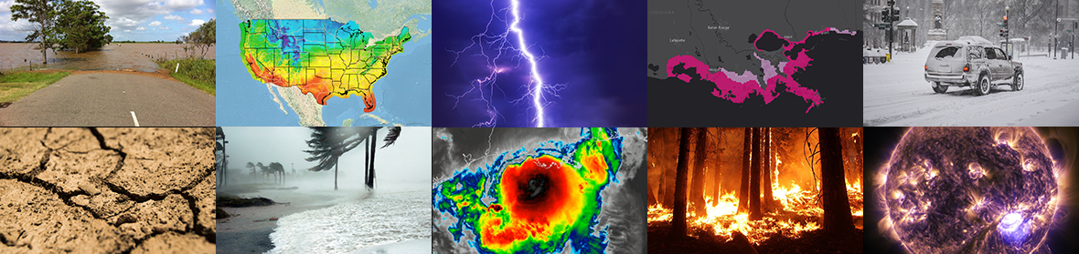
Improving Prediction of Wildfire Impacts on Air Quality with the UFS-AQM Online System
Jianping Huang (Lynker@NOAA/NWS/NCEP/EMC)
Ivanka Stajner, Fanglin Yang, Jeffrey McQueen, Raffaele Montuoro (NWS/NCEP/EMC)
Kai Wang, Ho-Chun Huang, Brian Curtis, Haixia Liu (EMC, Lynker), Chan-Hoo Jeon (EMC, SAIC)
Barry Baker (OAR ARL)
Youhua Tang, Patrick Campbell(ARL, GMU)
Daniel Tong (GMU)
Georg Grell (OAR GSL)
Hongli Wang, Ruifang Li (GSL, CIRES)
Unifying Innovations in Forecasting Capabilities Workshop
Gregory Frost, Rebecca Schwantes (CSL),
Siyuan Wang (CSL, CIRES)
James Wilczak (PSL)
Irina Djalalova, Dave Allured (PSL, CIRES)
Shobha Kondragunta (NESDIS STAR)
Chuanyu Xu, Zigang Wei (IMSG, NESDIS STAR)
Fangjun Li and Xiaoyang Zhang (SDSU)
Boulder, CO, July 27, 2023

Slide 2
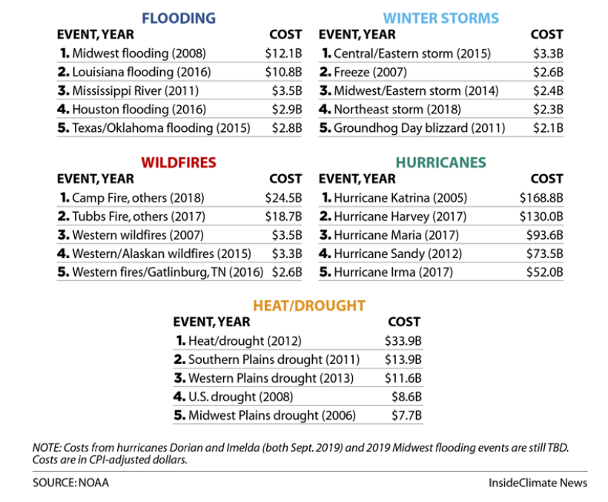
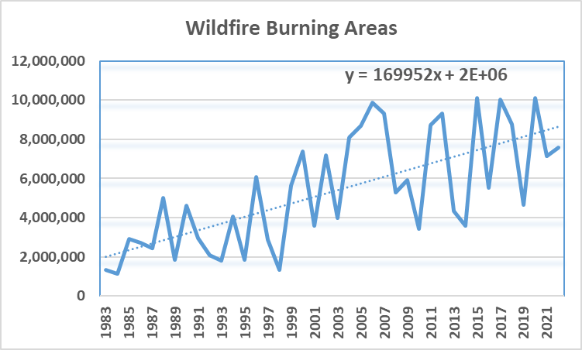
Societal Impacts of Wildfires and Trend of Burning Areas

Slide 3
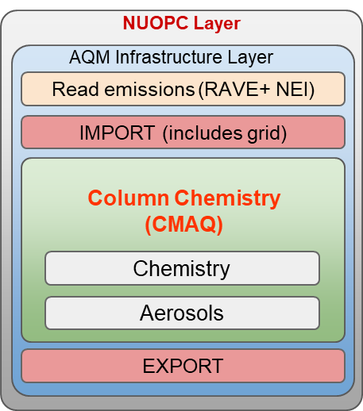


Online-CMAQ within the UFS framework
Atmos. Dycore (FV3)
Atmos. Physics (CCPP)
Writing Component
Notes:
FV3: Finite-Volume Cubed-Sphere dynamical core; CCPP: Common Community Physics Package
NUOPC: National Unified Operational Prediction Capability (NUOPC) layer; RAVE: Regional Advanced Baseline Imager (ABI) and Visible infrared Imaging Radiometer Suite (VIIRS) Emissions

Slide 4
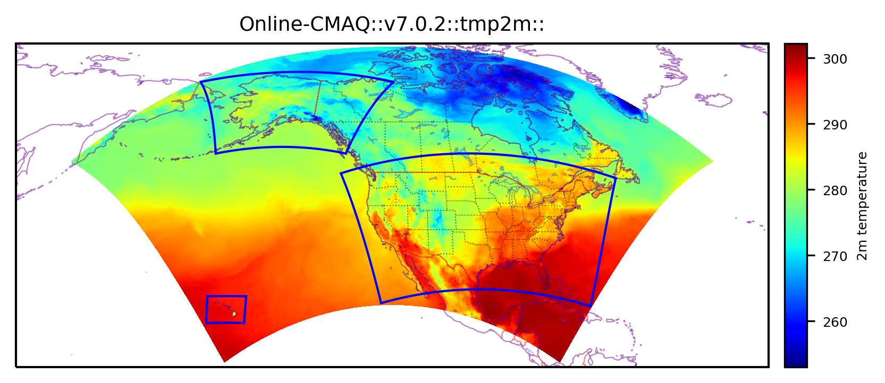
Online-CMAQ (UFS-AQM) in UFS: a single large North American domain (13 km)
The next candidate for operations at 13 km resolution
Near-real-time online-CMAQ has been running since July 8, 2022 over the North American large domain that covers all 3 current operational product domains: CONUS, AK and HI.
Updates are being integrated into this near-real-time run.
CCPP: GFSv16
Anthropogenic and biogenic emissions for the large domain (NEIC
2016v1 plus global)
Hourly RAVE wildfire emissions and Sofiev plume-rise algorithm
Updated LBC (AM4 + GEFS-Aerosols) and wet deposition
Fengsha dust module
Bias correction
Post-processing for 8h ozone maximum and daily average PM_{2.5}

Slide 5
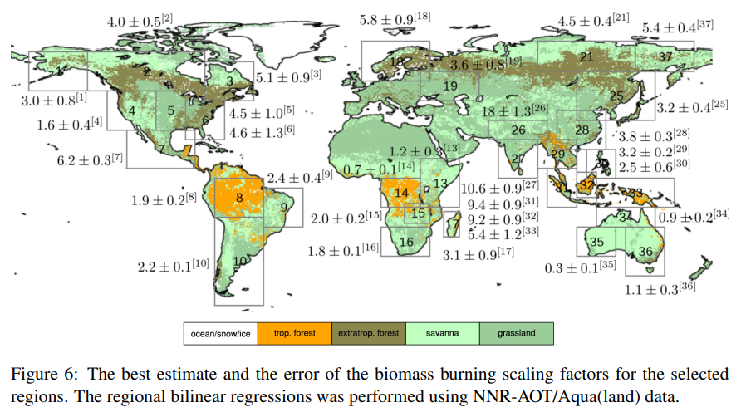
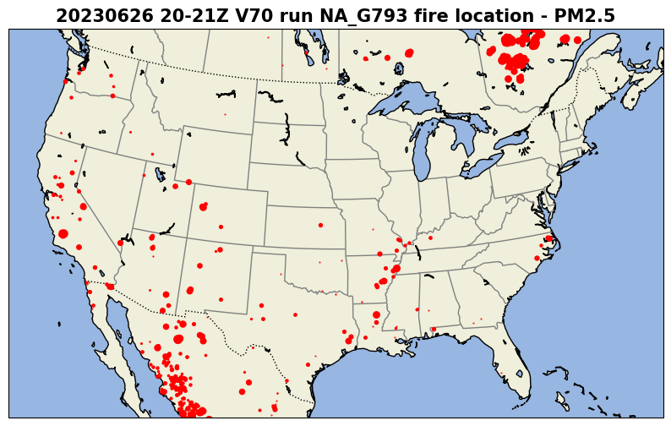
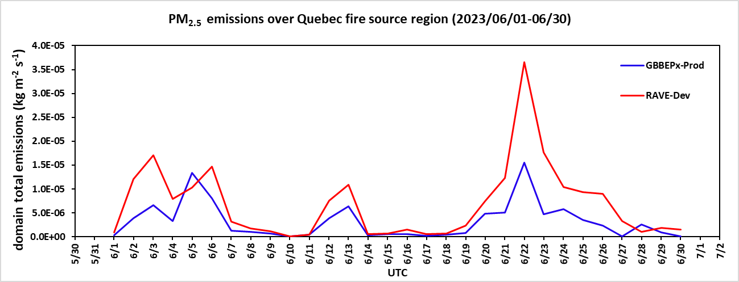
Satellite-detected firepoints and wildfire emissions
during Quebec fires in June 2023
UFS-AQM (Dev): Near-real-time Regional Advanced Baseline Imager (ABI) and Visible infrared Imaging Radiometer Suite (VIIRS) Emissions (RAVE) hourly data improved by applying scaling factors based on biome type.
Operational (Prod): The Blended Global Biomass Burning Emissions Product version 3 (GBBEPx V4)
Biome-dependent scaling factors:
Tropical forest: 4.5
Extratropical forest: 2.5
Savanna: 1.8
Grassland: 1.8

Slide 6
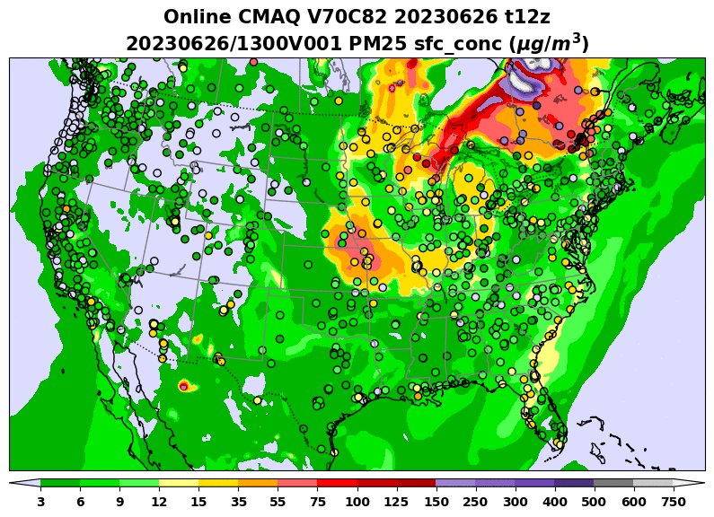
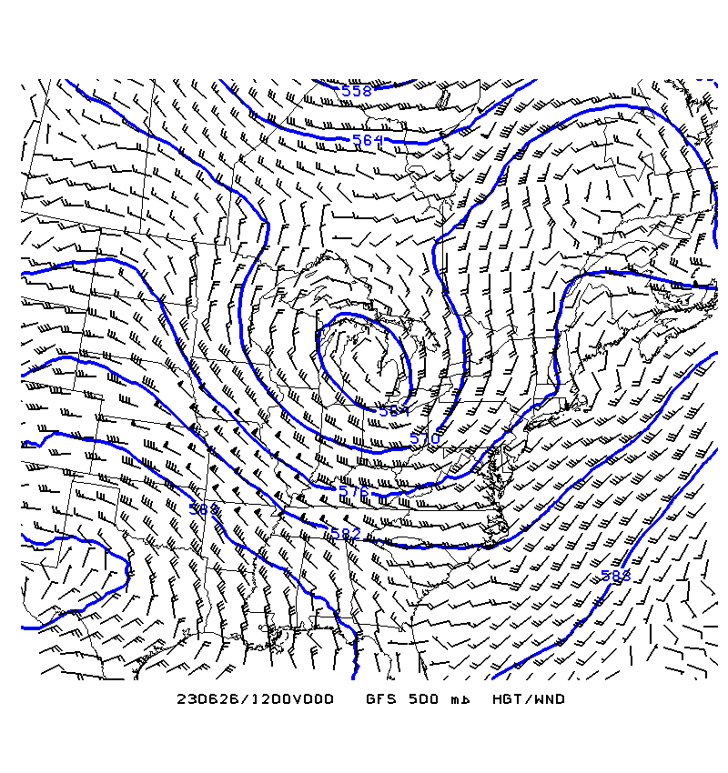
PM_{2.5} predictions during Quebec wildfires June 26, 2023
Geopotential Heights and Winds at 500 hPa
A storm system located northeast of the Great Lakes produced a counterclockwise wind, channeling the smoke produced by wildfires in Canada south into US, affecting air quality in the Midwest regions substantially.
Evolution of predicted PM_{2.5} is shown for 72-hour predictions initialized on June 26, 2023 together with independent AirNow observations of PM_{2.5} (in filled circles). High values of PM_{2.5} were attributed to wildfires.

Slide 7
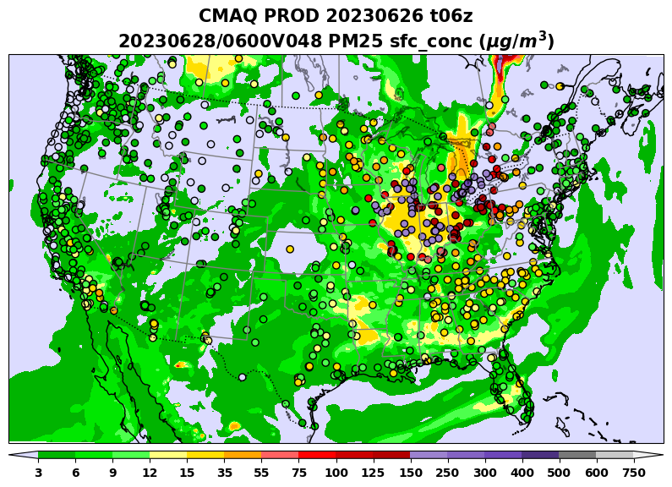
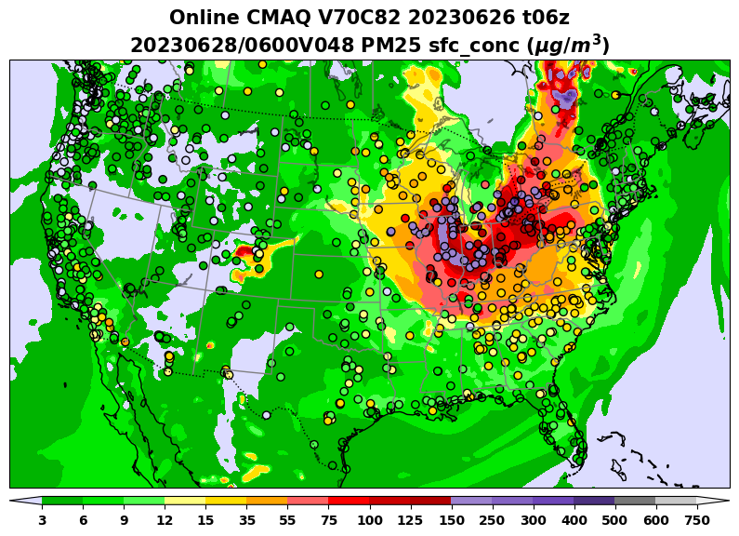
UFS-AQM-predicted PM_{2.5} (v7.0c82) versus operational forecast (Prod)
during Quebec wildfire events on June 26, 2023
The UFS-AQM system (v70c82) predicted higher PM_{2.5}, showing better agreement with AirNow observations as compared with operational forecast during Quebec wildfire intrusion.

Slide 8
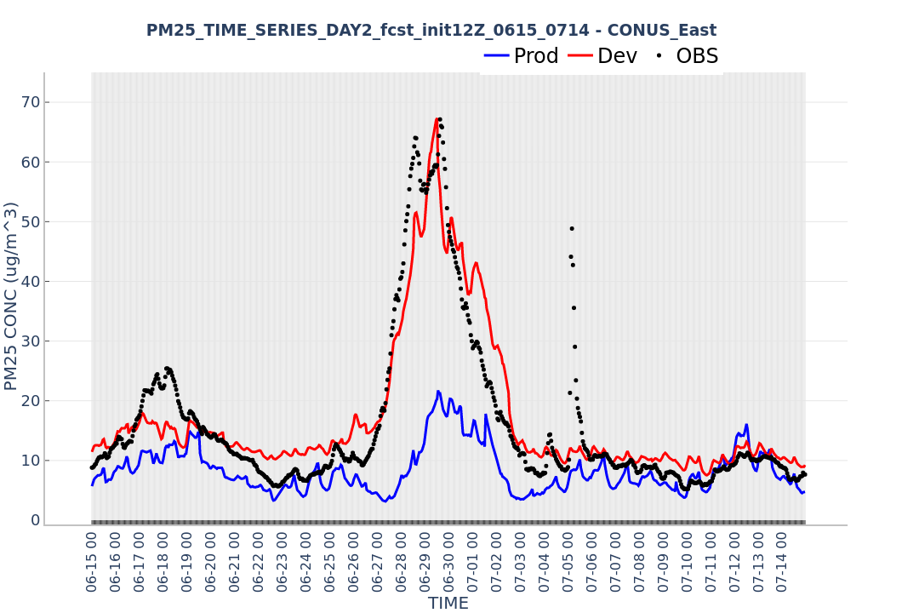
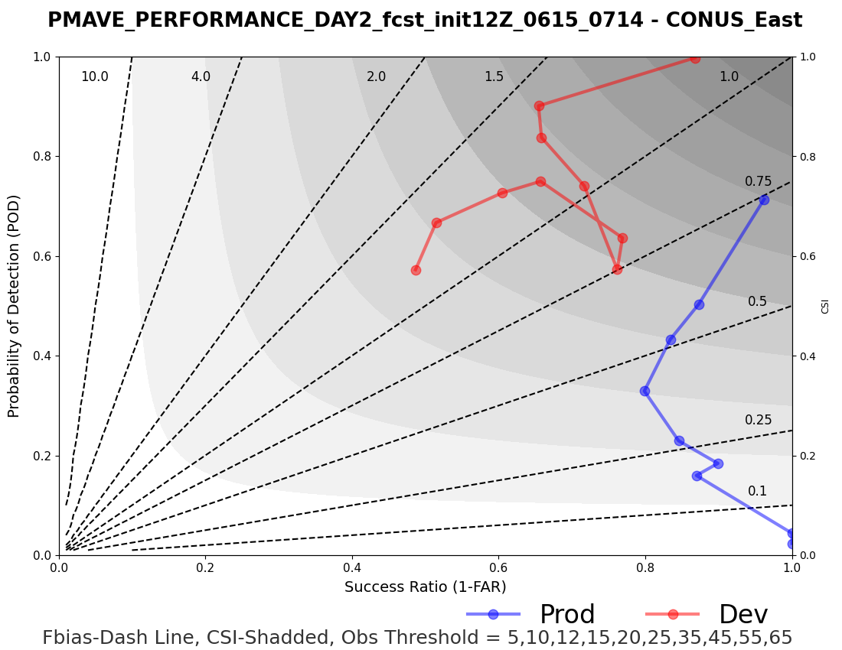
Evaluation of the UFS-AQM system-predicted hourly PM_{2.5}
The UFS-AQM system (Dev: v70c82) well captured PM_{2.5} peak values than the operational (Prod) system over East CONUS during Quebec fires in June and July, 2023.

Slide 9
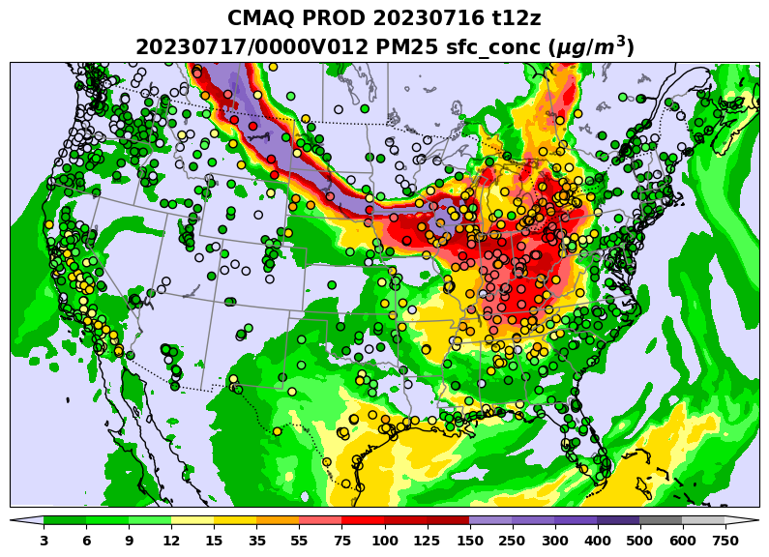
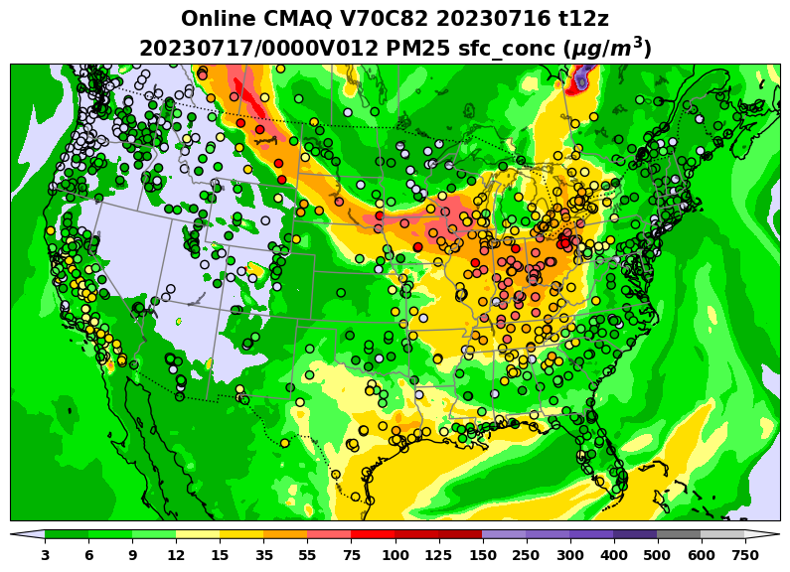
UFS-AQM-predicted PM_{2.5} (v7.0c82) versus operational forecast (Prod)
during the Alberta wildfire event on July 17, 2023
Another case shows that the UFS-AQM captured the smoke intrusion spatial pattern reasonably.
However, it still underpredicted over the areas near the northern border when compared to the operational predictions on July 17 at 00z UTC.

Slide 10
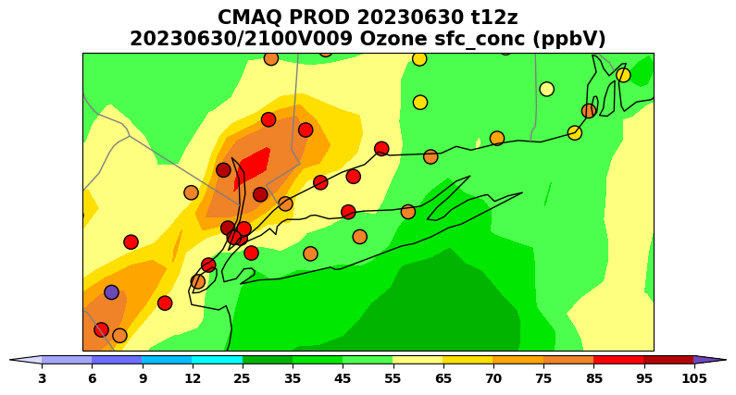
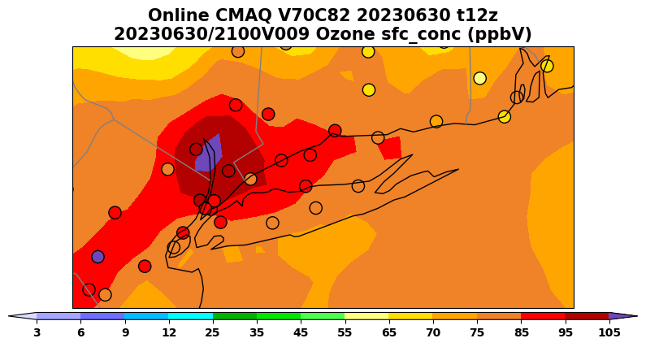
Evaluation of the UFS-AQM system: O₃ episodes
Several O₃ exceedance events were observed over the affected region during dissipation stage of Quebec fire events.
The UFS-AQM system (Dev: V70C82) predicts higher O₃ than the operational (Prod) system over east coastal region such as Long Island Sound on June 202

Slide 11
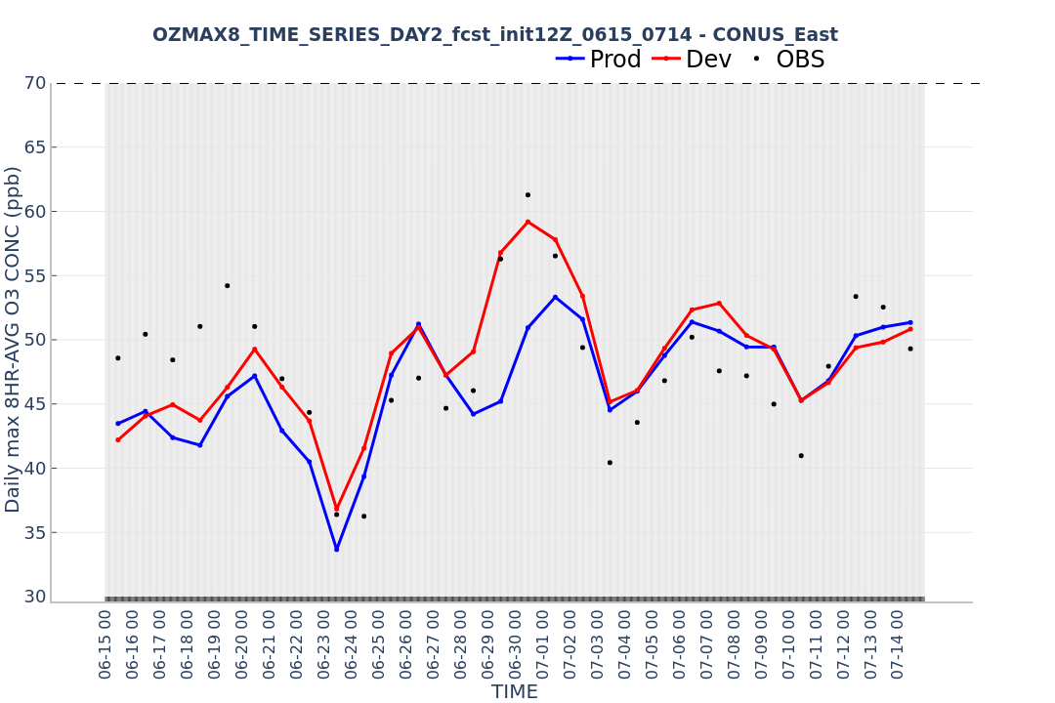
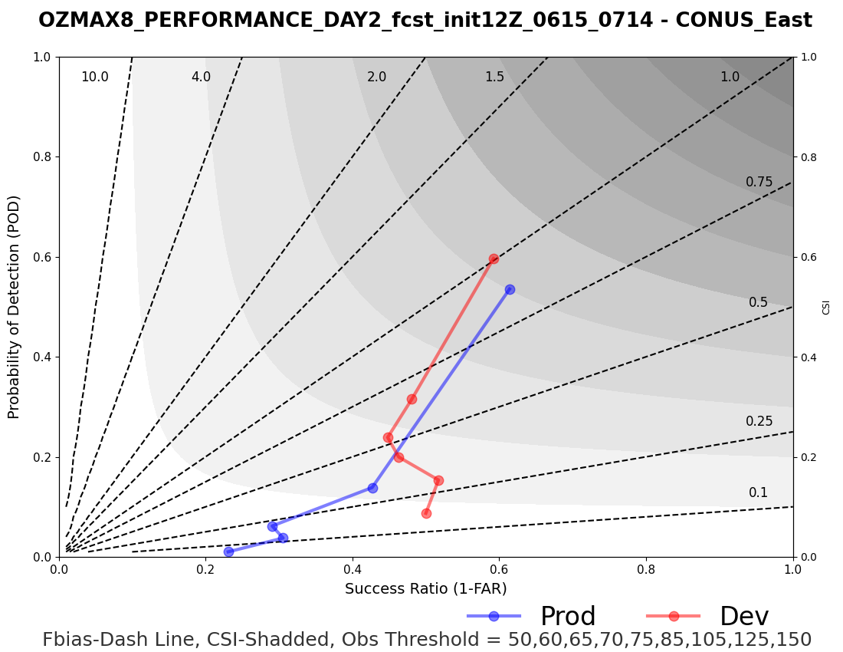
Evaluation of the UFS-AQM system: Daily 8-hr Max O₃
CONUS-East categorical performance of development system (v70c82) is improved over the operational (Prod): higher CSI and POD.

Slide 12
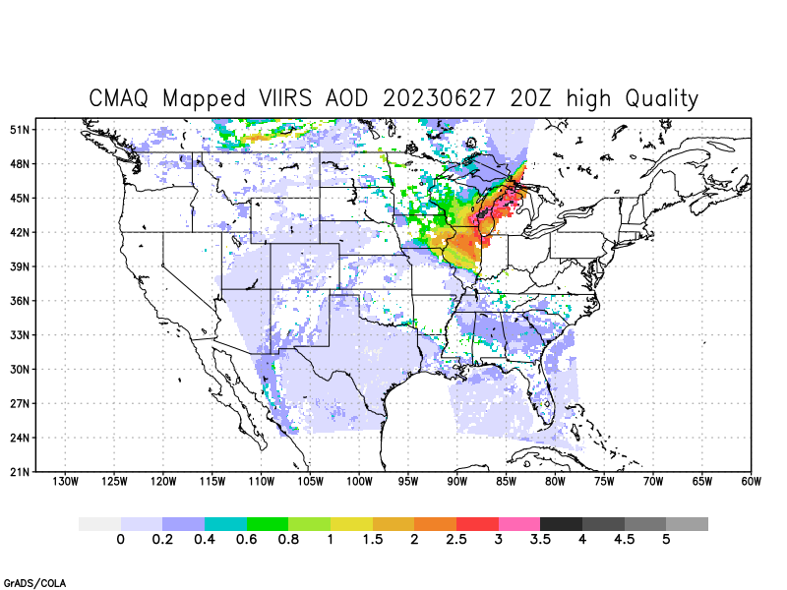
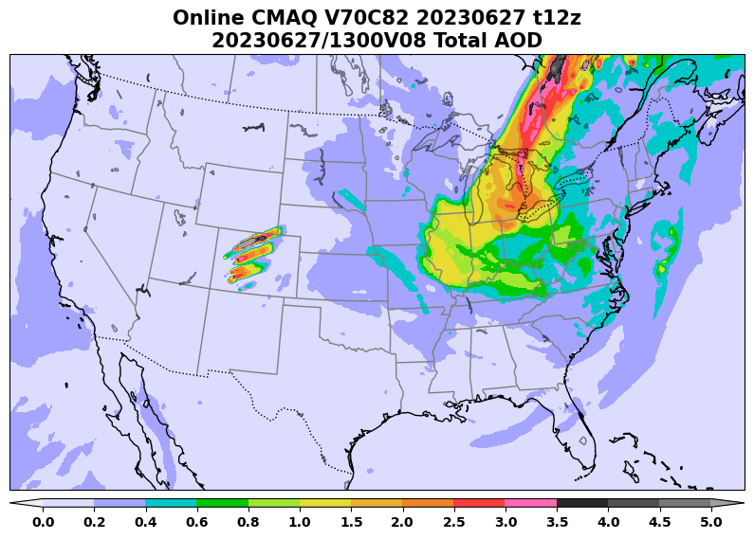
A comparison of predicted AOD with VIIRS retrieval
AQMv7 captured spatial pattern of AOD with value higher than 3.5 during Quebec fires.

Slide 13
Summary
NOAA has developed an Online-CMAQ system within the UFS framework to enhance representation of wildfire emissions and their impact on air quality predictions.
The UFS-AQM, also known as Online-CMAQ, is currently being evaluated as a potential replacement for the existing operational air quality forecast system.
The UFS-AQM, incorporating hourly RAVE data, significantly improved PM_{2.5} predictions compared to the operational system during the Quebec wildfires in June 2023.
Moreover, the UFS-AQM exhibited superior performance in capturing O₃ episodes when compared to the operational model.
Next steps
Will incorporate emissions of volatile organic compounds (VOCs) released by wildfires to enhance O₃ predictions near fire source and downstream regions.
Will test the system at a higher resolution to address prediction challenges over complex terrain and coastal regions.
Will update the CMAQ model along with anthropogenic emissions, refine wildfire emissions and plume rise algorithm, and utilize more advanced CCPP, data assimilation techniques as well as short-period training for bias correction to further improve wildfire predictions.

