Slide 1
spack-stack: A reproducible, many-platform software stack for operational weather applications
Alex Richert [1,2]
Collaborators: Dom Heinzeller [3], Cameron Book [4], Edward Hartnett [5,2], Stephen Herbener [3], Hang Lei [6,2], Mark A. Potts [1,7]
1) RedLine Performance Solutions
2) NOAA EMC
3) UCAR/JCSDA
4) Science and Technology Corporation
5) CIRES/CU Boulder
6) SAIC
7) EPIC

Slide 2
Overview
Motivation for spack-stack
Introduction to Spack
spack-stack and its benefits
spack-stack on HPC, cloud, and container platforms
Challenges and future efforts of spack-stack

Slide 3
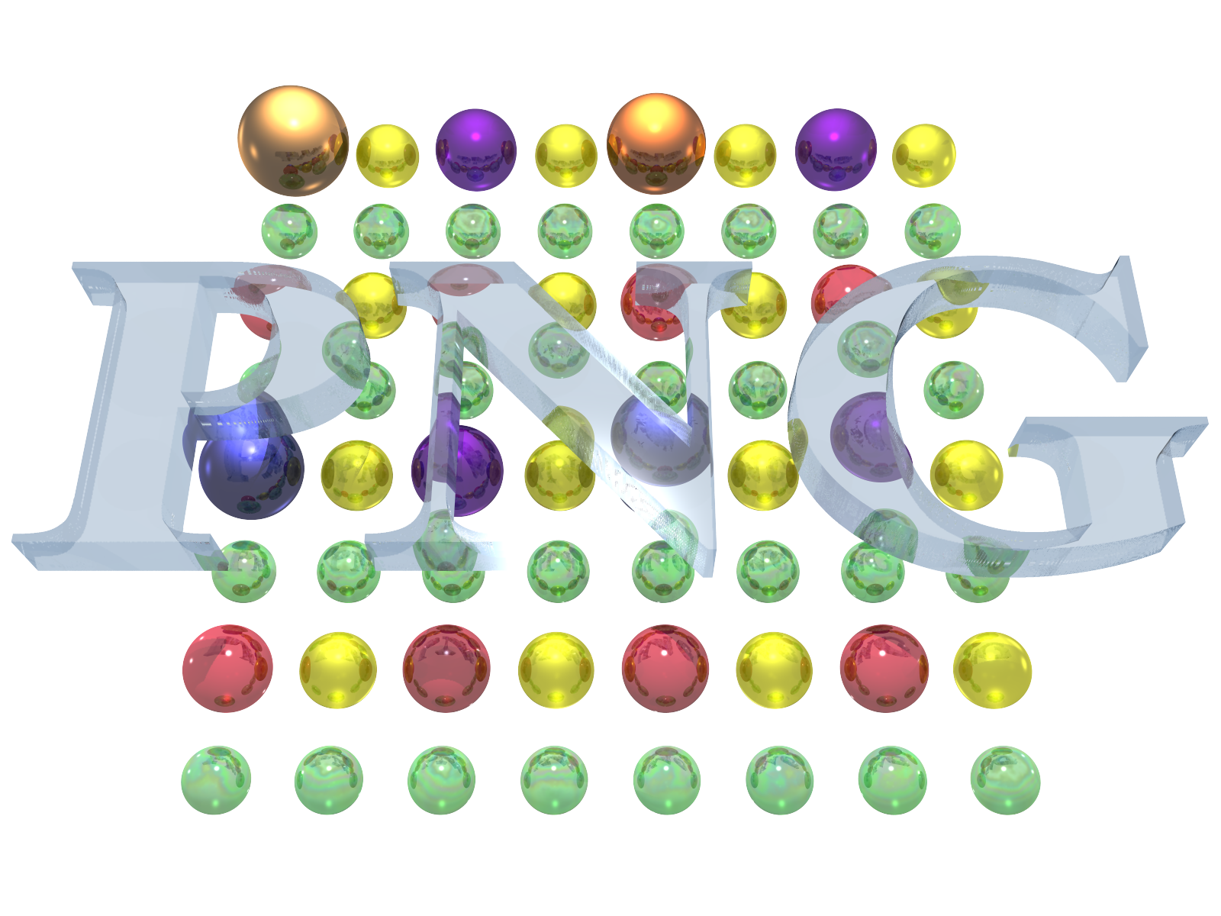
Motivation: spack-stack reflects the growing need for well organized software library installations
Large modern weather applications may have dozens of dependencies
These dependencies include libraries for file I/O, physics routines, etc.
Manual software management and "one-off" installations are expensive and risky

Slide 4
Spack is a package manager for scientific HPC workflows
Core developers at LLNL
Has recipes for ~7,000 packages, including most and soon all of those needed for UFS, JEDI
Handles dependencies, conflicts, compiler & build system logic, etc.
Spack is highly extensible and customizable

Slide 5
spack-stack is a set of Spack configurations and extensions
spack-stack is developed and maintained by NOAA EMC, JCSDA, and EPIC
It provides site-specific configurations and templates for our libraries
Built-in caching and parallel features reduce build times

Slide 6
spack-stack is installed as a unified environment on these HPC platforms:
Gaea, Hera, Jet (NOAA RDHPCS)
Acorn (NOAA WCOSS2 TDS)
Orion, Hercules (MSU)
Discover (NASA)
Narwhal, Nautilus (US Navy)
Casper, Cheyenne, Derecho (NCAR)
S4 (U Wisconsin)

Slide 7
spack-stack is installed as a unified environment on these cloud platforms:
...and is available through container images deployed by EPIC and JCSDA:
https://hub.docker.com/u/noaaepic/ (Docker)
https://hub.docker.com/u/jcsda/ (Docker)
https://cloud.sylabs.io/library/jcsda (Singularity)
spack-stack allows developers to move to the cloud faster and more consistently
NOAA ParallelWorks (AWS, Azure, GCP)
AWS ParallelCluster
AWS EC2 AMIs (Ubuntu, RedHat)

Slide 8
Challenges and future efforts
For code, documentation, and support, visit
github.com/JCSDA/spack-stack
Maintaining a unified environment requires ongoing engagement with application developers; versioned spack-stack releases ensure stability
NOAA EMC applications are currently moving over to spack-stack, and all future UFS application releases will use it
Regression testing and deployment of spack-stack across NOAA tier-1 platforms will be automated via Jenkins
In addition to JCSDA's container releases, EPIC will release spack-stack and spack-stack-based UFS app Docker images to support public users

