Slide 1
Application of ML/AI for Calibration of Parameters of the Multigrid Beta Filter (MGBF) and its Performance within the Three-Dimensional Real-Time Mesoscale Analysis (3D RTMA) Project
Miodrag Rancic, R. James Purser, Manuel De Pondeca, Edward Colon, Ting Lei
Lynker at NOAA/NWS/NCEP/EMC
Russ Treadon, NOAA/NWS/NCEP/EMC

Slide 2
Presentation outline
1. AI projects at EMC
2. Brief introduction into MGBF
3. Calibration procedure
4. Future extensions

Slide 3
2. AI projects at EMC (Environmental Modeling Center)
Emulation (6)
UFS short-term forecast surrogate for 3DRTMA
ML-based soil moisture
ML estimated land surface emissivity
Increase ensemble size
ML calibration of Multigrid Beta Filter
ML-based temperature-salinty balance
Post processing (3)
RRFS downscaling
Improve RTMA background
ML derived aviation parameters from RTMA
Observations (7)
AMV superobs
3DRTMA observation QC
Machine Learing observation QC
Aircraft observation QC
Observation anomaly detection
ML based radiance bias correction
Ml/AI Approach to Converting SMAP SSS to Bulk Salinity for Data Assimilation
Application of AI/ML methodology has become a very hot item in both academic and RT2O circles. NOAA’s EMC was for decades a pioneer in this discipline, thanks to efforts of Dr. Vladimir Krasnopolski. From recently we started a very ambitious plan of embracing AI technology in many ongoing projects. (However, only several of those from that list are presently already funded, or we were able to incorporate them in ongoing projects.)

Slide 4
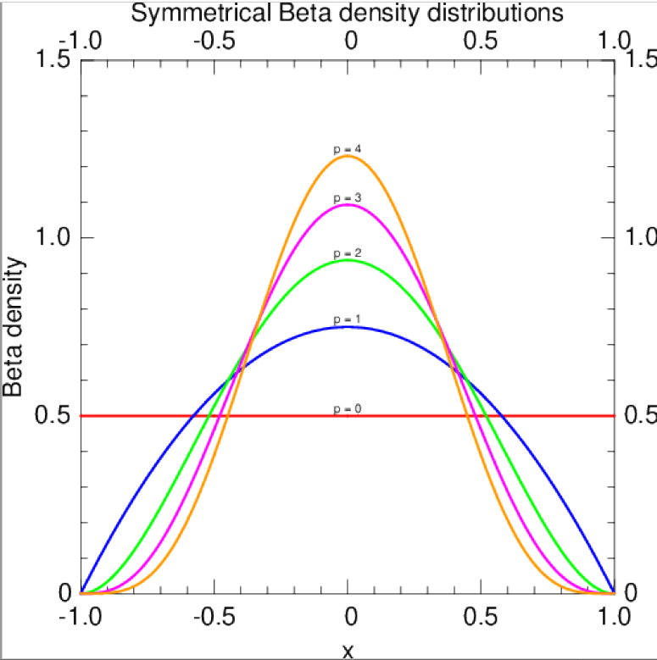
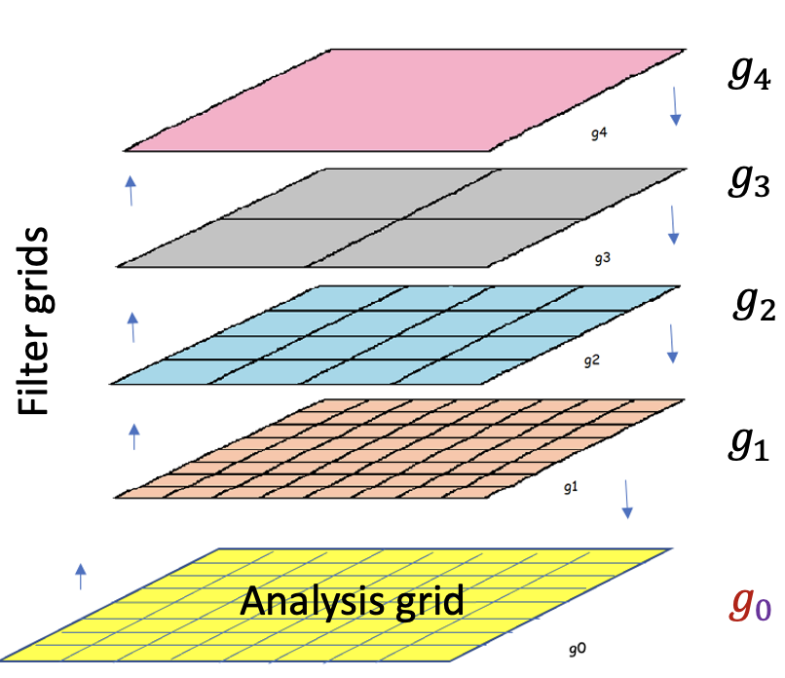
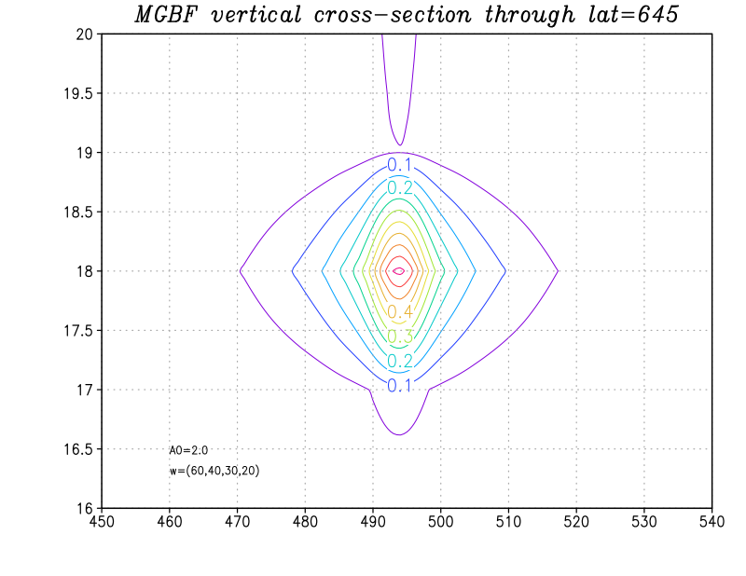
1. Brief introduction into MGBF technique
Parameters of the filter that control shape and size of the covariances are:
intensities of horizontal and vertical aspect tensors
$a_{0}^{h}$ and $a_{0}^{v}, and$
scale weights $\left(w_{1},w_{2},w_{3},w_{4}\right)$
in the case of 4 grid generations
The Multigrid Beta Filter (MGBF) is a new technique for modeling of background error covariance (B), which is replacing the recursive filter (RF) as a quasi-Gaussian approximation of covariances in data assimilation at EMC.
MGBF is based on the beta distribution with a finite support and is incorporated within a parallel multigrid structure to extend the spatial coverage. That all makes it more parallelizable, which results in much better scaling.
We plan to apply AI for calibration of parameters of MGBF

Slide 5
3. Calibration procedure
We consider for now just the homogenous and isotropic case, in which we assume variability of covariances only in vertical direction with equal horizontal directions
Within “calibration”, we are trying to define these 6 parameters of MGBF so that resulting covariance at each level has the shape and size equal to the background covariance, as suggested by the error statistics derived using the NMC method.
The NMC method is giving us for each of 3D variables, temperature ($T$), stream function $\left(ψ\right)$, velocity potential $(χ$) and moisture $\left(q\right),$the average values of a characteristic scale – e-folding distance – at each of of 65 model levels in both directions ($L_{x}$ and $L_{z})$

Slide 6
Similarly, error statistics gives us a horizontal e-folding distance ($L_{x}$) for each of 2D variables, surface pressure $\left(p_{s}\right),$sea surface, ice surface, and land surface temperatures $\left(T_{sea}, T_{ice}, T_{surf}\right).$
Technically, based on input of only 2 variables ($L_{x}$, $L_{z})$ , it would be very hard to conclude distribution of 6 parameters of MGBF ($a_{0}^{h},$ $a_{0}^{v},w_{1},w_{2},w_{3},w_{4}$).
Therefore, we need to make some assumptions.
In present version of GSI, the background covariance is represented as a weighted sum of Gaussians with scaled correlation lengths defined as
In version of GSI used in 3D RTMA,
in vertical direction:
$n=1, σ=0.125$,
and in horizontal:
$$n=3, σ=(0.046625, 0.09325, 0.1875)$$
Thus, the covariances are taken to be much shorter than given correlation lengths.
$$ψ\left(x\right)=\sum_{i=1}^{n}{α_{i}G\left(x,{σ_{i}L}_{x}\right)}$$

Slide 7
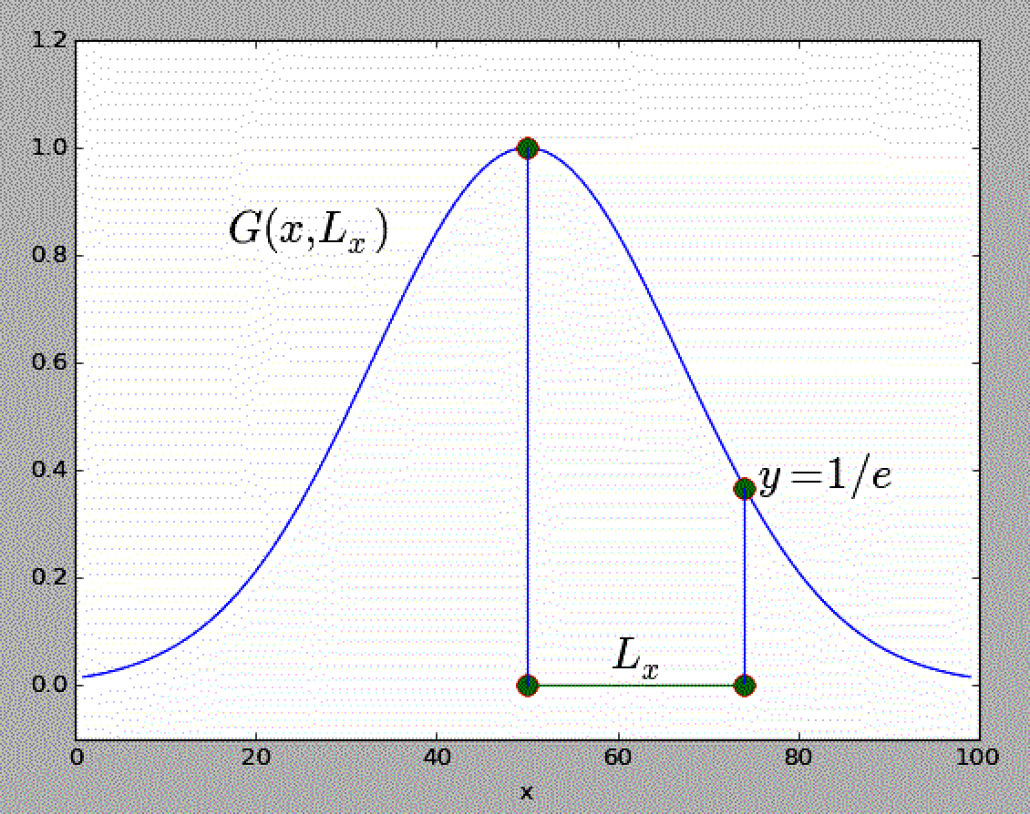
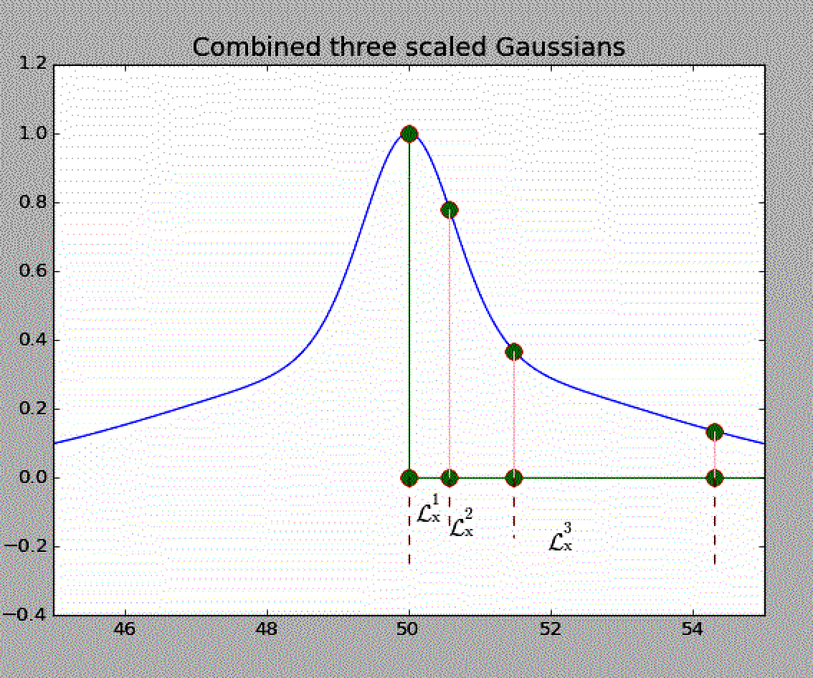

Slide 8
In horizontal, the derived profile (not a Gaussian any longer), can be described with not one, but three (or more) characteristic distances,$\left(ℒ_{x}^{1},ℒ_{x}^{2},ℒ_{x}^{3}\right)$, defined maybe as a half of e-folding distance, a e-folding distance and a double of it. The same procedure in the vertical direction give us three additional characteristic distances $\left(ℒ_{z}^{1},ℒ_{z}^{2},ℒ_{z}^{3}\right)$.
Thus, now we get 6 input variables to estimate 6 MGBF parameters:
$\left(ℒ_{x}^{1},ℒ_{x}^{2},ℒ_{x}^{3},ℒ_{z}^{1},ℒ_{z}^{2},ℒ_{z}^{3}\right)→$($a_{0}^{h},$ $a_{0}^{v},w_{1},w_{2},w_{3},w_{4}$)
It seems that we now have enough information, but the question is how to do that!

Slide 9
We have found a solution in running a large series of tests with the standalone version of MGBF code
At the same resolution and over the domain of same size at which GSI will be applied
Initialize each the run with a unit impulse at a certain level
Use slightly different inputs parameters ($a_{0}^{h},$ $a_{0}^{v},w_{1},w_{2},w_{3},w_{4}$) in each run
Measure the same characteristic lengths of resulting covariance in each run, that is e-folding distance from the maximum, one half and one quarter of it, both in horizontal and vertical directions:
($a_{0}^{h},$ $a_{0}^{v},w_{1},w_{2},w_{3},w_{4}$) $→$ $\left(λ_{x}^{1},λ_{x}^{2},λ_{x}^{3},{°λ}_{z}^{1},λ_{z}^{2},λ_{z}^{3}\right)$
In addition, it is important to measure the maximum value of the covariance $\left(ψ_{max}\right)$

Slide 10
The essence of the problem can be described with this diagram
$a_{x}$, $a_{z}, w_{1}, w_{2},w_{3},w_{4}$
MGBF
$λ_{x}^{1}$, $λ_{x}^{2}$, $λ_{x}^{3},$ $λ_{z}^{1}$, $λ_{z}^{2}$, $λ_{z}^{3}$
${\tilde{a}}_{x}$, ${\tilde{a}}_{z}, {\tilde{w}}_{1},$ ${\tilde{w}}_{2}, {\tilde{w}}_{3}$, ${\tilde{w}}_{4}$
MGBF
$ℒ_{x}^{1}$, $ℒ_{x}^{2}$, $ℒ_{x}^{3},$ $ℒ_{z}^{1}$, $ℒ_{z}^{2}$, $ℒ_{z}^{3}$

Slide 11
The problem could be solved by application of a deep neural net (NN) in which we reorder unput and output parameters
NN in a way emulates an inverse of MGBF by a nonlinear regression function.
We use half of data derived by running standalone version of MGBF for training (finding weighs and biases of NN) and half for testing
$$λ_{x}^{1}$$
$$a_{0}^{h}$$
$$λ_{x}^{2}$$
$$a_{0}^{v}$$
$$λ_{x}^{3}$$
$$w_{1}$$
$$λ_{z}^{1}$$
$$w_{2}$$
$$λ_{z}^{2}$$
$$w_{2}$$
$$λ_{z}^{3}$$
$$w_{2}$$

Slide 12
Once the NN is trained, we now use as an input correlation lengths derived from the error statistics and pick up on the output calibrated parameters of MGBF
In the final step, we rerun the standalone version of MGBF with derived parameters, find maximum values of covariances, and divide by it derived scale weights, which will ensure that in GSI we get normalized covariances
$$ℒ_{x}^{1}$$
$${\tilde{a}}_{0}^{h}$$
$$ℒ_{x}^{2}$$
$${\tilde{a}}_{0}^{v}$$
$$ℒ_{x}^{3}$$
$${\tilde{w}}_{1}$$
$$ℒ_{z}^{1}$$
$${\tilde{w}}_{2}$$
$$ℒ_{z}^{2}$$
$${\tilde{w}}_{3}$$
$$ℒ_{z}^{3}$$
$${\tilde{w}}_{4}$$

Slide 13
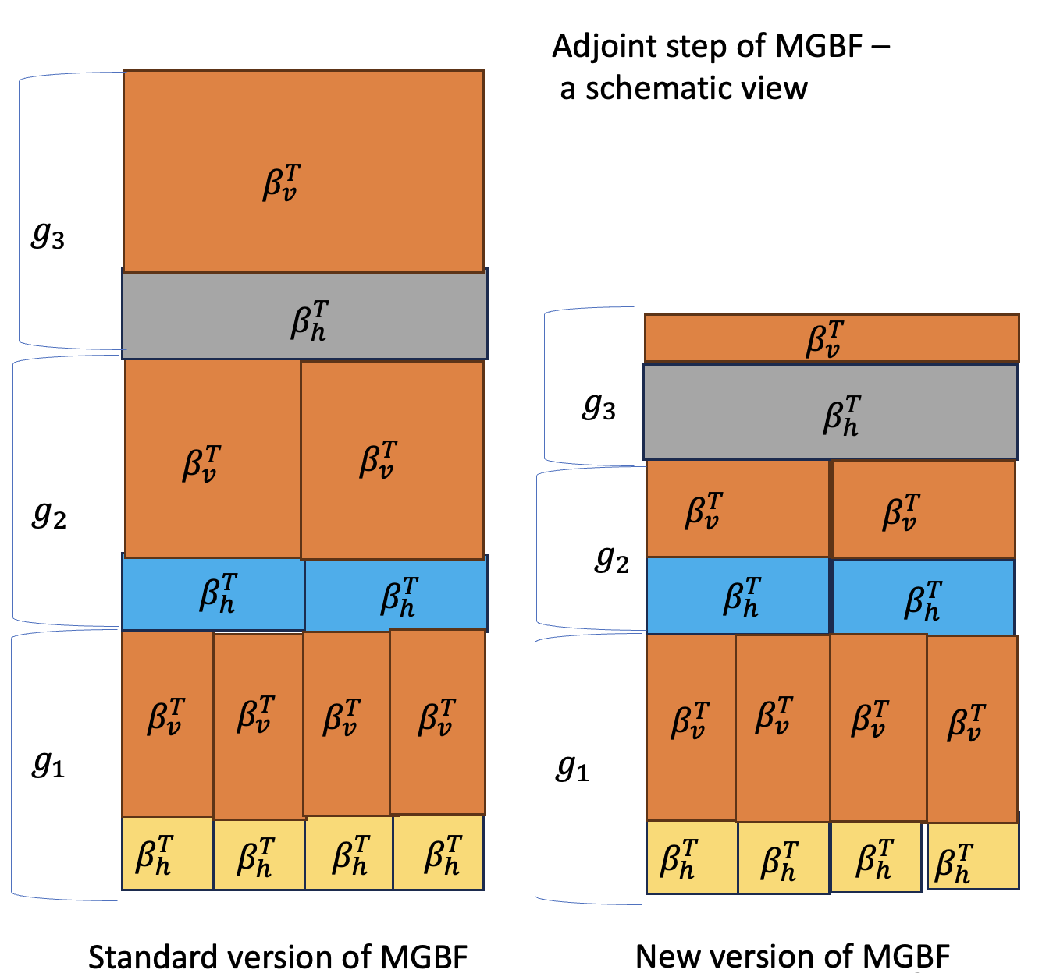
4. Future Extensions
In order to take full advantage of the described method, a new version of MGBF was developed to improve efficiency of filtering in vertical direction where we encountered very long covariances
This was done by reducing vertical resolution of higher grid generation, which in a way mimics horizontal application of multigrid
We are developing an upgrade of this version in which horizontal and vertical filter will be better separated, which will improve versatility of the described calibration procedure

Slide 14
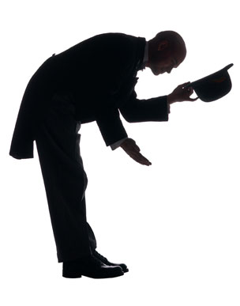
One limitation of the described method is assumption about the shape of the covariance that we made based on correlation length derived by the NMC method
We are looking into various ways how to get more useful information directly from error statistics of the background field without making such assumptions
Thank you for your attention!
Stay safe and healthy!

