Slide 1
Wildfire Integrated Modeling, Prediction, and Learning Environment (WIMPLE)
Presented by: Jared Goldman
Developed alongside: Avi Pfeffer, Sanja Cvijic, Nicolette McGeorge, Margarita Hiett
External Collaborators: NASA Jet Propulsion Laboratory, and
California Department of Forestry and Fire Protection

Slide 2
Wildfire Risk Modeling Domain
Problem: The threat of wildfire causes stress to homeowners, who are faced with potential loss of property and life as well as difficulty in obtaining insurance and increased insurance premiums
Solution: Personalized risk assessment and mitigation recommendation considering both regional- and property-level risk
Our Approach: WIMPLE provides homeowners with tools to map and model the wildfire risk on their property

Slide 3
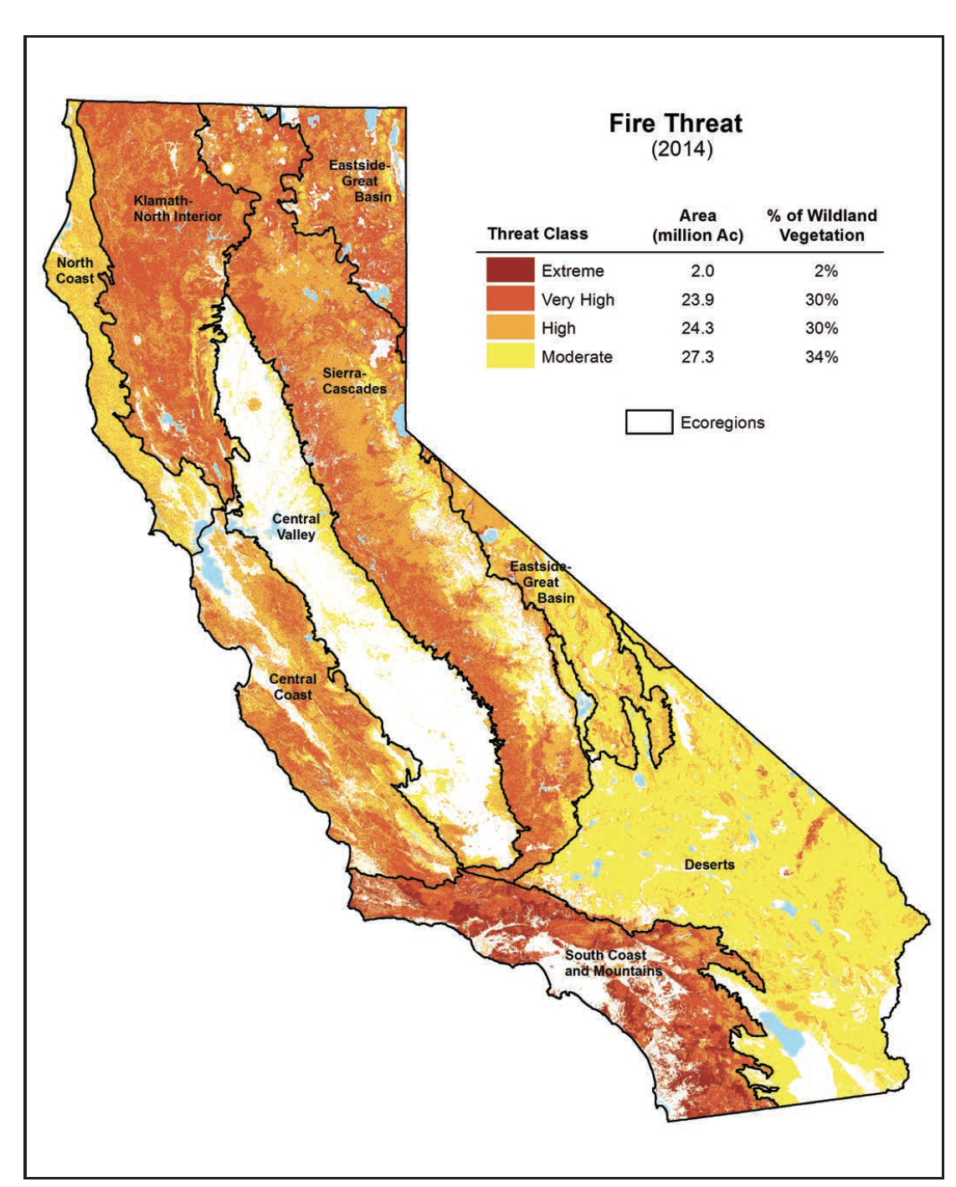
Current Approaches
National Wildfire Risk Assessment for Forest Service
Firewise USA
First Street Foundation
FireScore by Jupiter Intelligence
State-level Fire Resource Assessment Program (FRAP) maps
Verisk’s FIRELINE
Fire threat map from
2017 California FRAP Assessment

Slide 4
Our Approach
Informs homeowners about their wildfire risk through regional- and property-level risk assessment
Combines climate, fire incidence, and regional and local fire spread models in an understandable manner

Slide 5
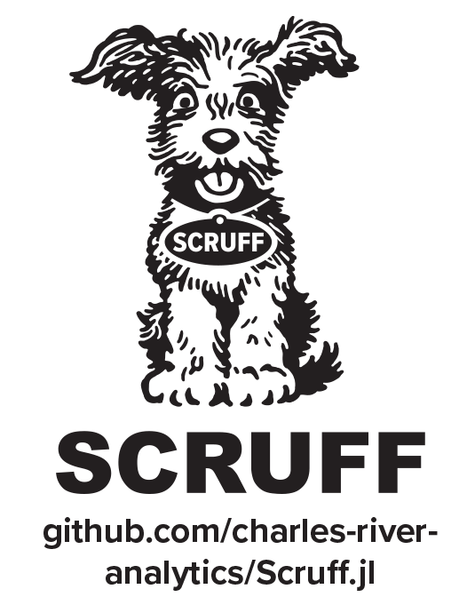
Technical Approach
Uses Hybrid AI (HAI) to build integrated, multiparadigm, multiscale wildfire models
Provides an explainable user interface that communicates risks and mitigations
Builds on Charles River Analytics' HAI framework: Scruff™

Slide 6
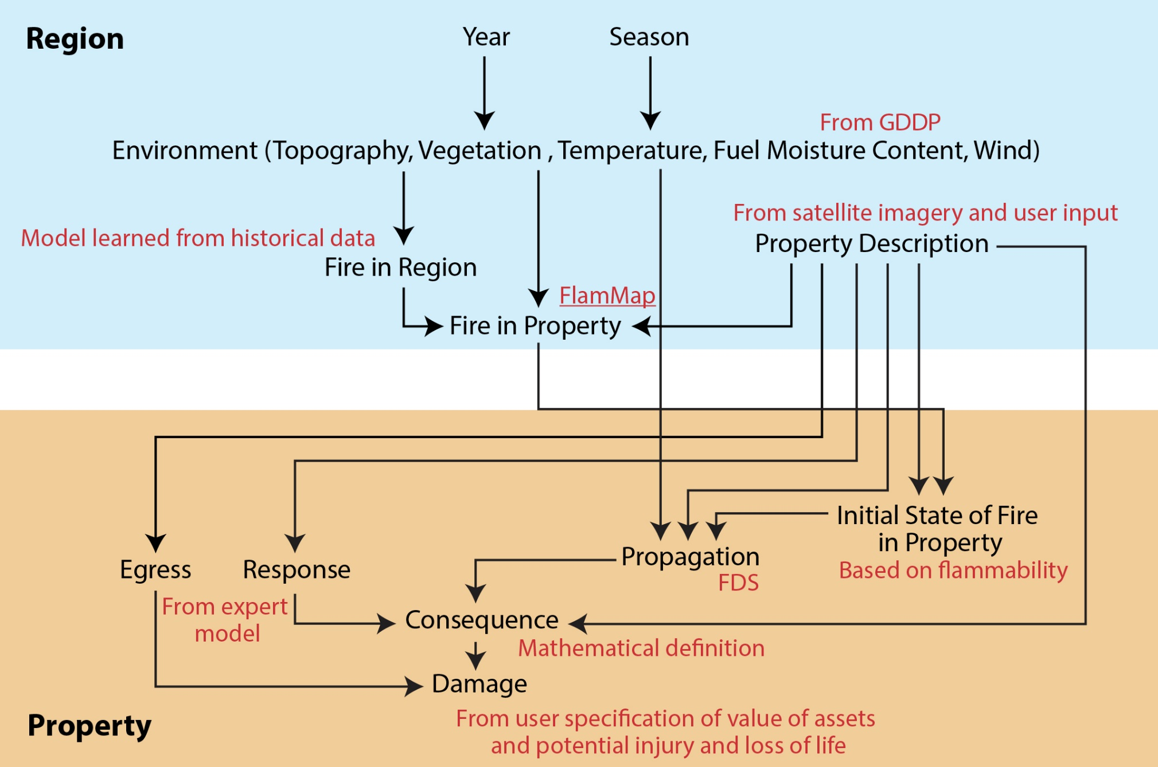
Integrated Model Design

Slide 7
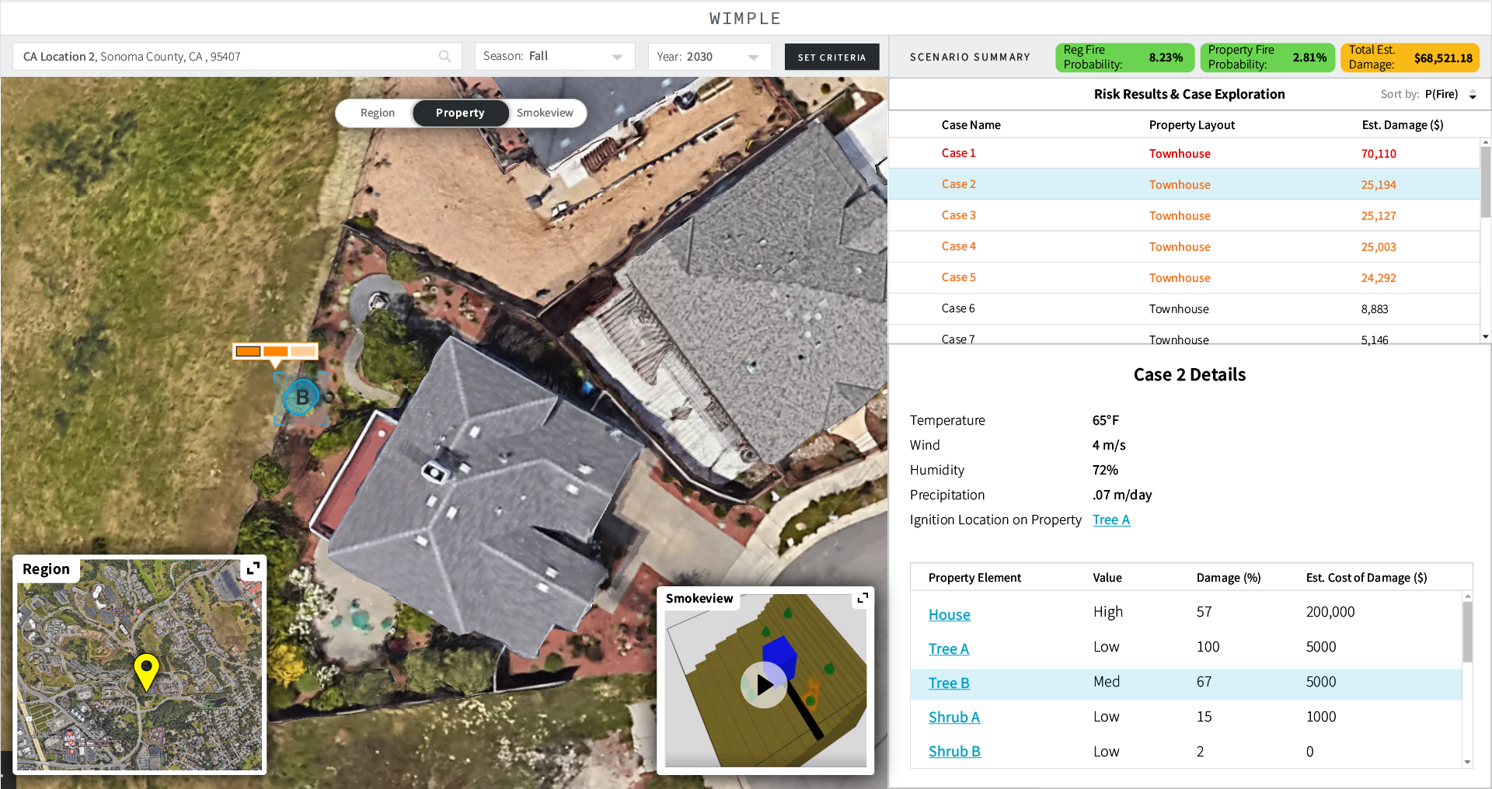
Technical Approach

Slide 8
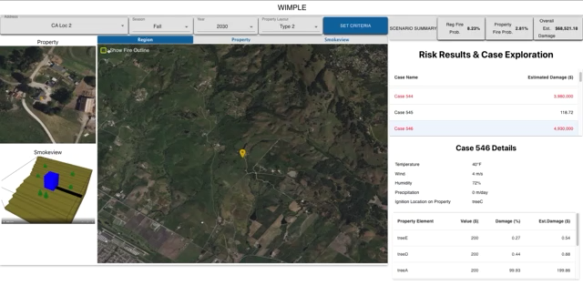
Demonstration Video

Slide 9
Future Work
Improve predictive Fuel Moisture Content Modeling
Design property layout builder for homeowners
Refine property-level model implementation
Coordinate with insurers to use this as a tool to reduce premiums

Slide 10

Questions and Discussion
Jared Goldman
Environmental and Humanitarian
AI Researcher
Charles River Analytics, Inc.
(617) 234-1548
jgoldman@cra.com

