Slide 1
Operationalizing a Weather Forecasting Systems at Tomorrow.io
Session:
UFS as a Decision Tool: A Private Industry Perspective
UCAR Center Green Campus
Thursday July 27, 2023
3:30pm Mountain

Slide 2
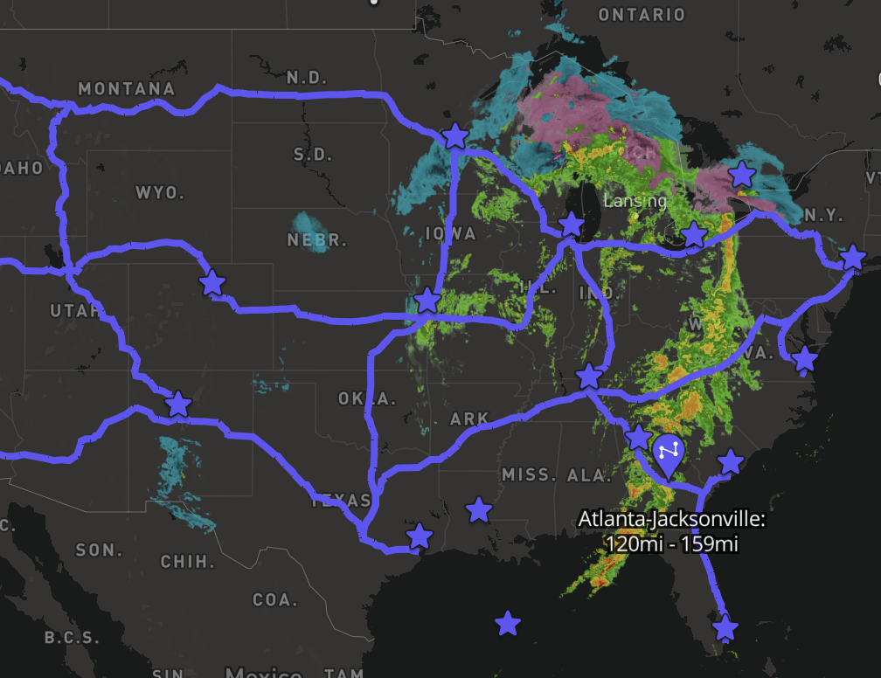
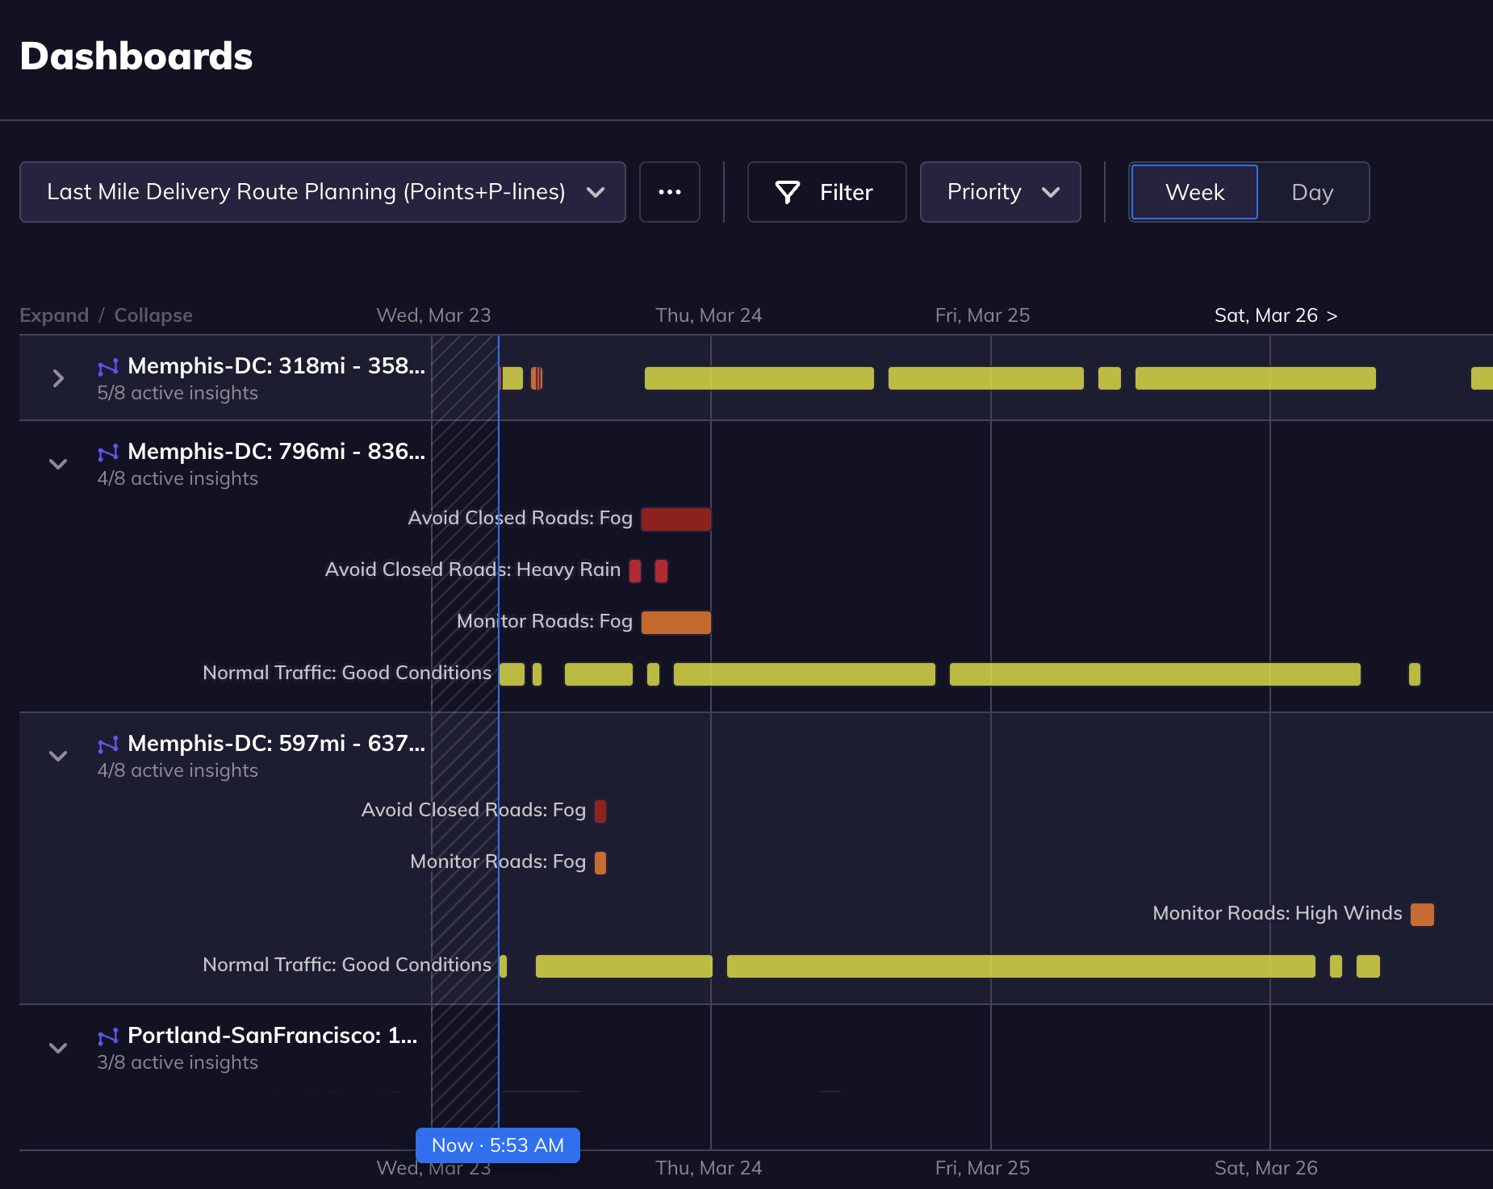
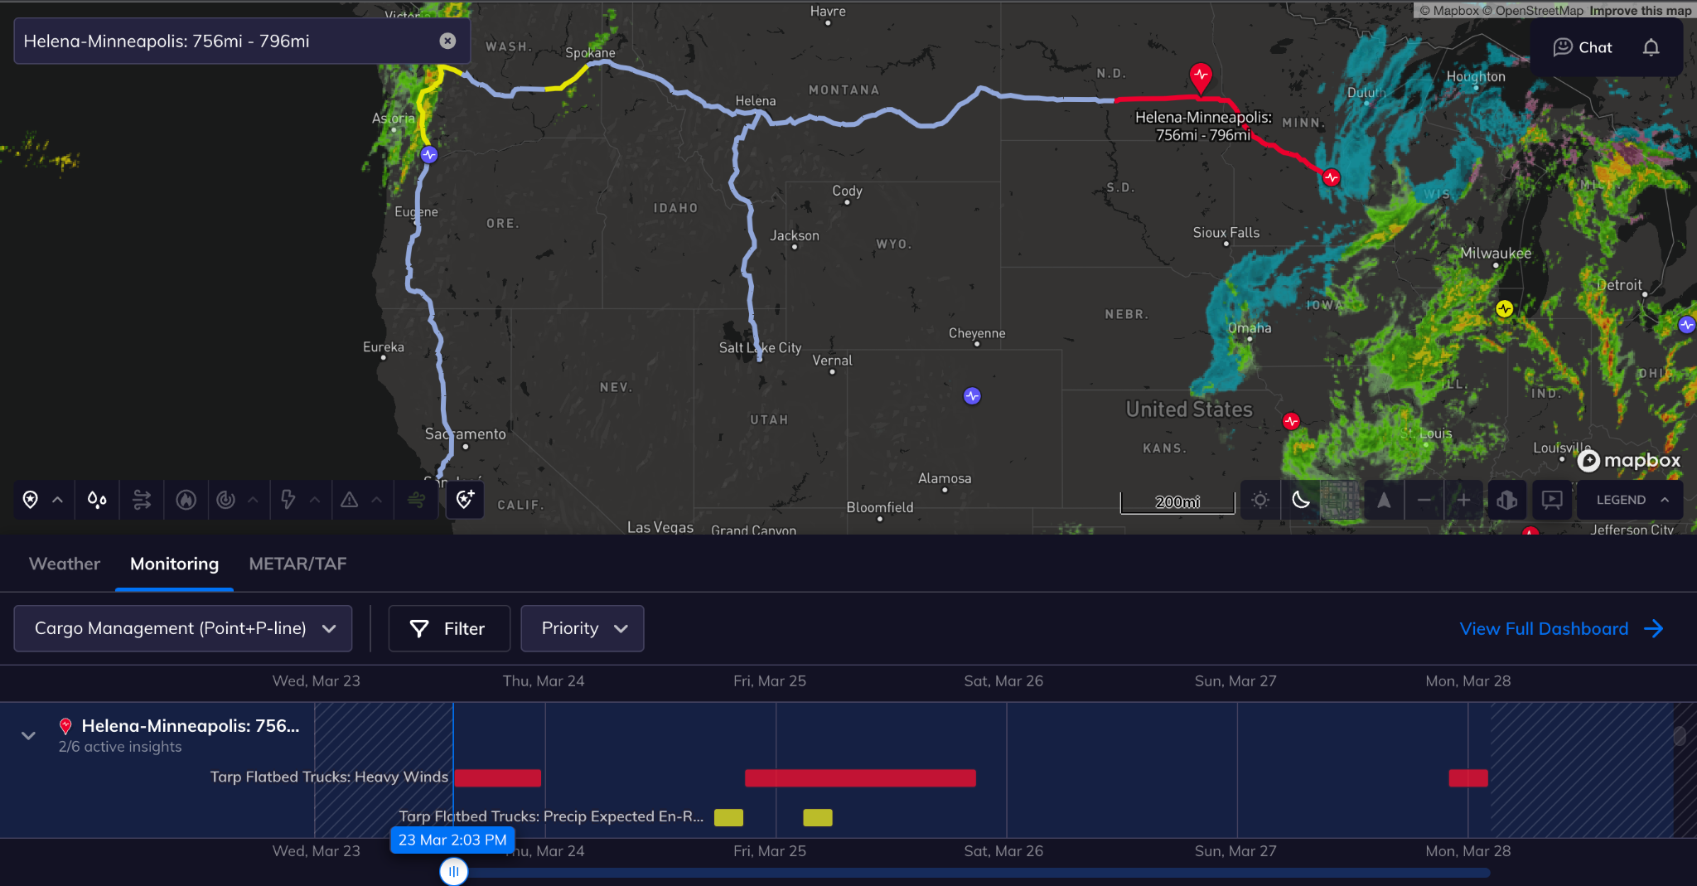
Tomorrow.io’s dashboard can be tailored to your specific needs
Upload fixed routes point location or use the routing endpoint for dynamic routes
Create insights and alerts based on specific weather parameters
Visualize and manage alerts along routes in real time

Slide 3
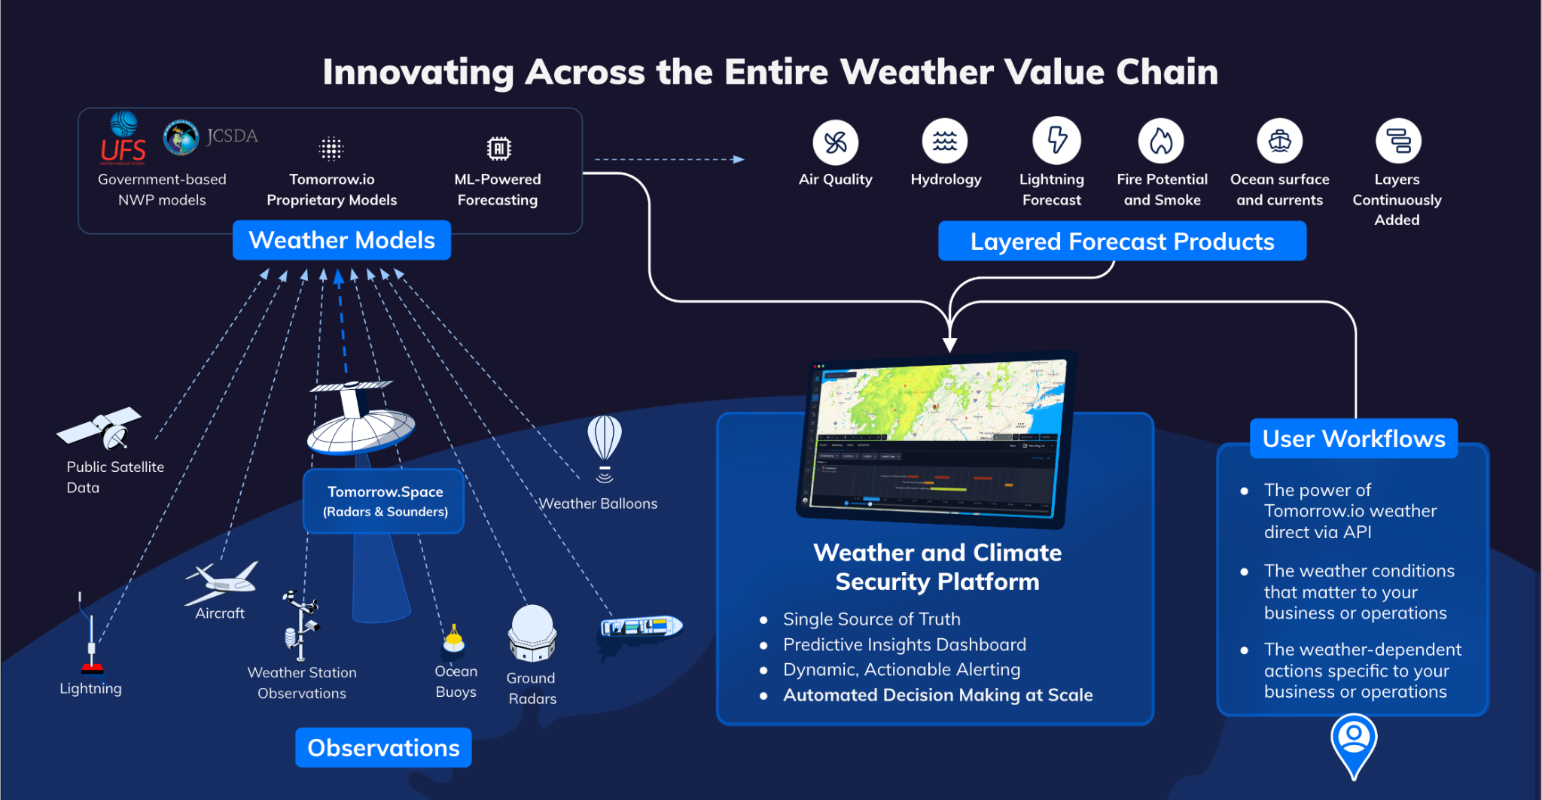

Slide 4
Leveraging multiple models to optimize accuracy across time scales
NowCast
ExtendCast
NWP (alone)
1F (ML + NWP)
Increasing forecast accuracy
0h 6h 5+ days
Forecast lead time

Slide 5
Integrated Modeling View From the Eyes of Our Customers
Tomorrow.io
Increasing forecast accuracy
Tomorrow.io’s weather forecast leverage the strengths of multiple complex modeling strategies to provide our customers with the most accurate forecast and associated forecast uncertainty
0h 6h 5+ days
Forecast lead time

Slide 6
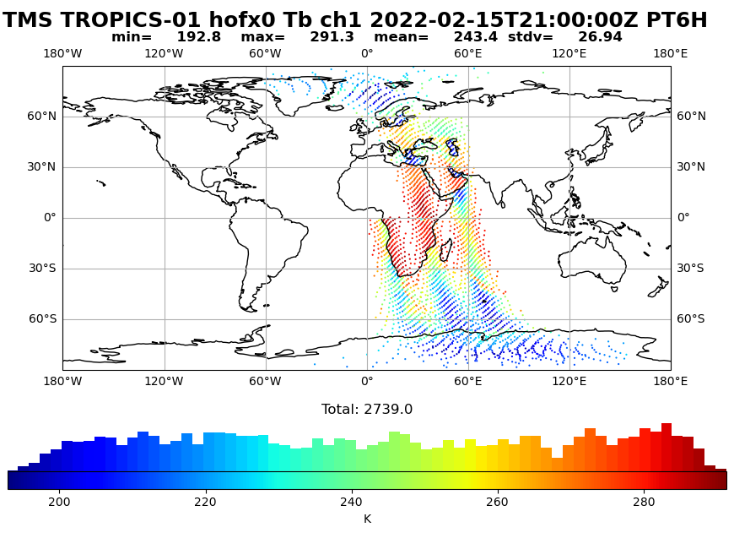
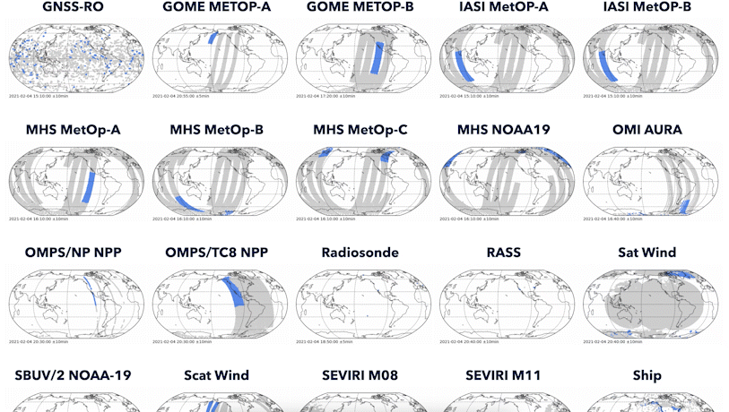
Partnerships and Plans
External Science/Development Support
NOAA CRADA
JCSDA
Internal Weather Team Development
Operational UFS/JEDI Cycling
Continue using nature runs to simulate observations
Work on building up our testbed system to assimilate the simulated observations
Radar operators + 3DVAR / 4DVAR / EnKF + Many observations = OSSE

Slide 7
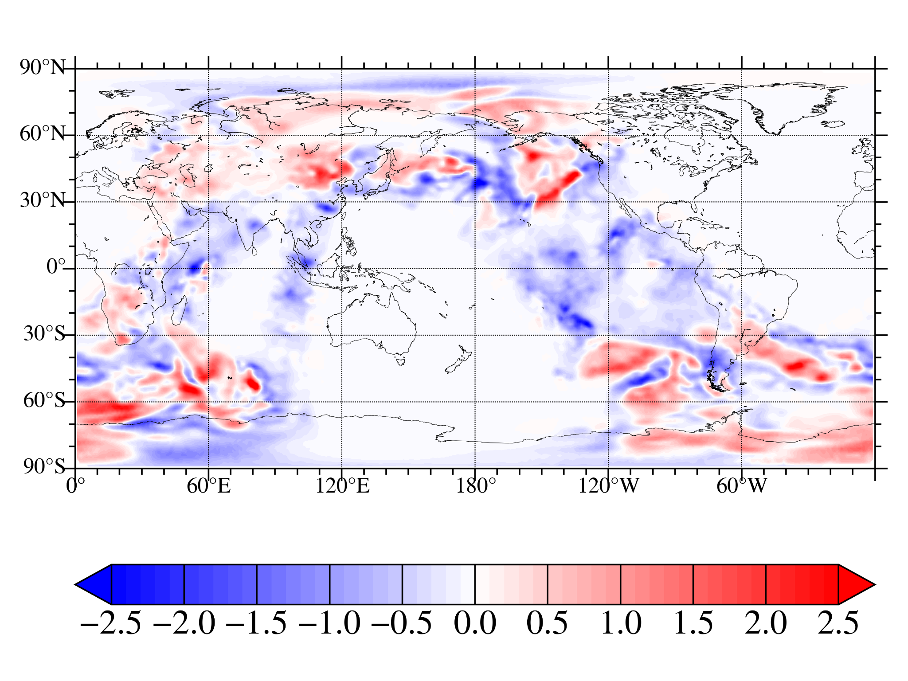
Building Our Global DA System
UFS/JEDI 3DVAR is working! Our simulated data has an impact on our model.
Figure shows model increment for temperature at 540 hPa, based on multiple TMS orbits ingested over a six hour window.
Next work: Adding more instruments.
Collect input obs + model results from previous cycle
Preprocess data Thinning, obs error estimation, QC
Data assimilation
Update model to reflect the new observations
Run a new forecast and repeat the cycle

Slide 8
Our Global DA System: One Cycle
Estimate of error in model “guess”
End user forecast products
Upstream data tanks
Collect many input obs + model “guess” for previous cycle
Preprocess data Thinning, obs error estimation, QC
Data assimilation
Run model to make predictions
Evaluate model outputs
Current work
Cross-org connections
Collect previous cycle of weather model

Slide 9
Helpful Government Support
Tutorials, academies, and workshops are a great way to introduce new users to the system
NOAA's transition to GitHub has made it much easier to understand their systems.
Shared computing resources (like the Orion supercomputer) make collaboration easier

Slide 10
HPC Considerations
The JCSDA/NOAA/NASA effort to unify the software stack needed to perform DA and run models is fantastically implemented
Users can be confident that codes are portable and decently tested
Containerization and cloud migration efforts also help users to use NOAA models
Many missed opportunities for optimizing code to reduce runtime and overall cost.
GMAO has novel work on automatic differentiation and GPU offload of models
Overall system needs considerable performance profiling.

Slide 11
Barriers to Development
Too much code is still hardcoded to NOAA systems
This is being addressed, but there is a ton of remaining technical debt
At present, there is no good method to work closely with JCSDA, even on a NOAA CRADA project
This blocks shared research and development
There is also no policy for community contributions to JCSDA
Contributions are somewhat discouraged, and this goes against the UFS/EPIC vision
Documentation practices need work
JCSDA example: rationale for changes and change logs are kept internal
This breaks downstream applications, and it makes it hard for EPIC to prepare for JEDI

Slide 12
How we would want to contribute:
We would like to work with CRTM, JEDI, and the wider community to develop the core science needed to use satellite radar in a global DA system
It would help if CRTM development were more open
We need a radar operator, and we need an open source CRTM coefficient generation package
We want to make instruments with the best possible impact
Shared experiments
We need a framework for open collaboration.

Slide 13
Thank you!

