Slide 1
Development of the Next Generation UFS Coastal Modeling Framework
Panagiotis Velissariou^{1,2}, Ufuk Turuncoglou⁴, Yunfang Sun^{1,3}, Saeed Moghimi¹, Ali Abdolali^{5,6}, Dan Rosen⁴ and Edward Myers¹
¹ NOAA National Ocean Service, Office of Coast Survey (NOAA/OCS)
² University Corporation for Atmospheric Research (UCAR)
³ Earth Resources Technology (ERT/SFI)
⁴ National Center for Atmospheric Research (NCAR)
⁵ U.S. Army Engineer Research and Development Center (ERDC/USACE)
⁶ Earth System Science Interdisciplinary Center (ESSIC/UMD)
Unifying Innovations in Forecasting Capabilities Workshop
Emerging Applications – Coastal & Marine
July 24-28, 2023. Boulder, CO & Online

Slide 2
It takes a village to raise a child …
NOS Storm Surge Modeling Team
Saeed Moghimi, Panagiotis Velissariou, Soroosh Mani, Yuji Funakoshi, Greg Seroka, Georgios Britzolakis, Zizang Yang, Bahram Khazaei, Yunfang Sun, Fariborz Daneshvar, Edward Myers
Academic partners (>20 PIs, Scientists, Postdocs and PhD students)
University of Notre Dame
Virginia Institute of Marine Science
Argonne National Laboratory
National Center for Atmospheric Research
Texas Advanced Computing Center
Columbia River Inter-Tribal Fish Commission
Louisiana State University
Sandia National Laboratories
University of Massachusetts – Dartmouth
University of North Carolina at Chapel Hill
Cooperative Institute for Great Lake Research
Oregon State University
NOAA and agency partners
National Ocean Service
The U.S. Integrated Ocean Observing System
Center for Operational Oceanographic Products and Services
National Geodetic Survey
National Weather Service
Office of Science and Technology Integration
Environment Modeling Center
National Hurricane Center
Office of Water Prediction
Oceanic and Atmospheric Research
Great Lakes Environmental Research Laboratory
Earth Prediction Innovation Center (EPIC)
U.S. Geological Survey
U.S. Environmental Protection Agency
National Science Foundation
International partners
Helmholtz-Zentrum Hereon, Germany
Laboratório Nacional de Engenharia Civil, Portugal
European Commission Joint Research Centre, Belgium
International Hydrographic Organization
United Nations
Industrial and cooperative partners
NCAR/UCAR
Spatial Front Inc
Axiom

Slide 3
Contents
CoastalApp (Coastal Application)
Introduction
Current Status
Workflow
Modeling and Data Components
CoastalApp-testsuite (Tests for CoastalApp)
Introduction
Usage
Test Cases
UFS-Coastal (Coastal Application)
Introduction
Current Status
Issues
Future Plans

Slide 4
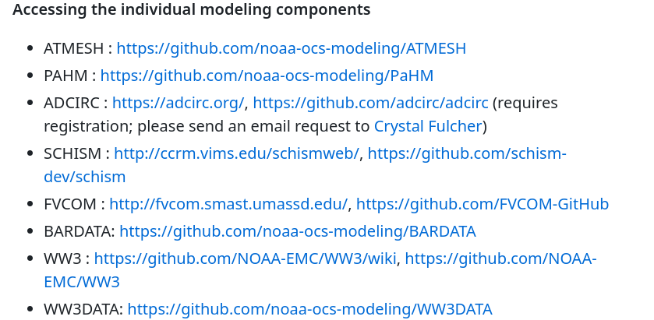
CoastalApp (Coastal Application)
https://github.com/noaa-ocs-modeling/CoastalApp

Slide 5
CoastalApp: System Workflow
https://github.com/noaa-ocs-modeling/CoastalApp
Preprocessing
Control/Configuration Files
Boundary & Initial Conditions
By Design a Flexible & Portable System
Wave Model
Status
Implemented
In development/testing or
future capability
Sea Ice
Baroclinic
Effects
Product
End User
Navigation support
Disaster mitigation
Water Quality
Sediment Transport
Numerical Weather Model(s)
Coastal Ocean Model(s)
PaHM
- NUOPC/ESMF Coupled Models
- 1-way/2-way Model Coupling
- Development in Collaboration Between
Federal and Non-Federal Partners
Inland Hydrology Model

Slide 6
CoastalApp: Modeling and Data Components
https://github.com/noaa-ocs-modeling/CoastalApp
The components highlighted in red are not implemented or fully functional
Atmosphere | Ocean | Wave
ATMESH¹ (implemented) | ADCIRC² (implemented) | WW3DATA¹ (implemented)
PaHM¹ (implemented) | SCHISM^{4,5} (implemented) | WW3³ (implemented)
Atm. Model (in development) | FVCOM⁶ (implemented)
 | BARDATA¹ (implemented)
 | CICE⁷ (in development)
NWM⁸ (in development)
1 NOAA/CSDL/CMMB
2 U. of Notre Dame
3 NOAA/NCEP/EMC
4 Virginia Institute of Marine Science
5 Helmholtz-Zentrum Hereon
6 University of Massachusetts – Dartmouth
7 Cooperative Institute for Great Lakes Research
8 NOAA/NWS National Water Center

Slide 7
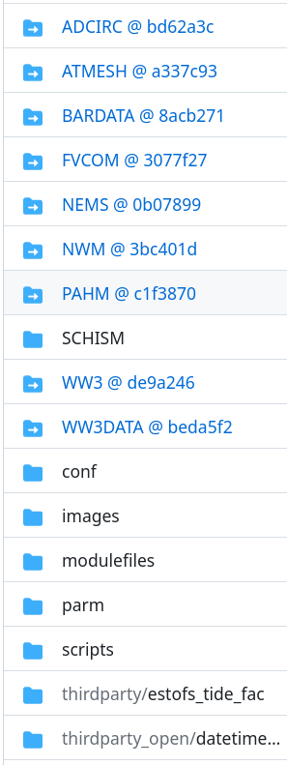
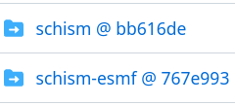
CoastalApp: Directory Tree
https://github.com/noaa-ocs-modeling/CoastalApp
git clone --recurse-submodules https://github.com/noaa-ocs-modeling/CoastalApp.git
Support Matrix
Compute Platforms: HPC clusters, personal desktops and cloud compute resources
Operating Systems: Unix/Linux, MacOSX
Build System: Bash, Module environment(s), Capabilities for building OS missing libraries

Slide 8
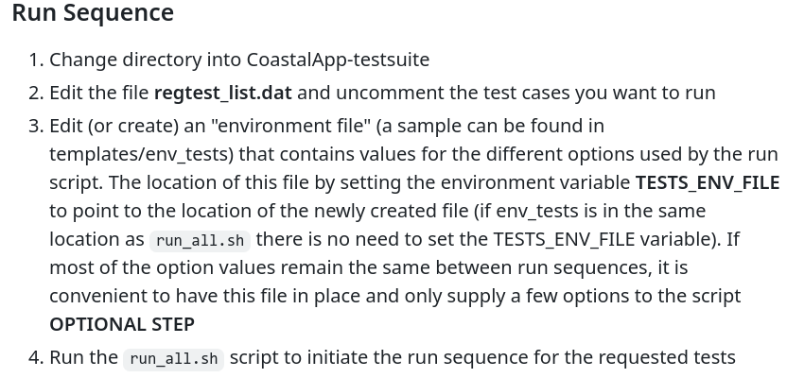
CoastalApp-testsuite (Tests for CoastalApp)
https://github.com/noaa-ocs-modeling/CoastalApp-testsuite
Regression tests for both CoastalApp and UFS-Coastal
Job Submission Managers
SLURM with user supplied options
PBS with user supplied options
mpirun/mpiexec with user supplied options

Slide 9
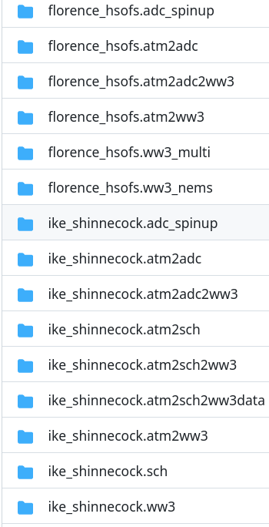
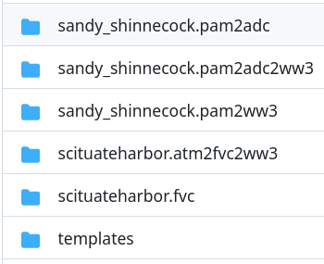
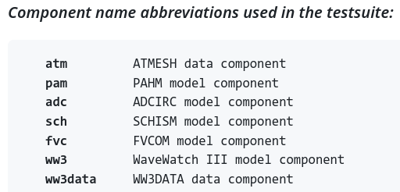
CoastalApp-testsuite: Directory Tree
https://github.com/noaa-ocs-modeling/CoastalApp-testsuite
git clone https://github.com/noaa-ocs-modeling/CoastalApp-testsuite.git
Multiple “testbed” platforms are supported:
NOAA RDHPCS (hera)
TACC (Frontera, Stampede)
Mississippi State University (Orion, Hercules)
Cloud (Parallel Works)

Slide 10
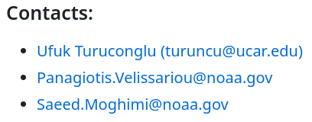
UFS-Coastal (Coastal Application)
https://github.com/oceanmodeling/ufs-coastal/tree/feature/coastal_app
Driver - UFS
MOM6
WW3
NOAHMP
FV3ATM
FV3
Dycore
HYCOM
At this point, only one-way configurations from CoastalApp-testsuite are ported to UFS-Coastal
The two-way configurations will be ported individually from CoastalApp-testsuite to UFS RT framework
The new application is using CDEPS as data component and replaces the ATMESH data component
CCPP
SCHSIM
CMEPS
Mediator
ADCIRC
FVCOM
GOCART
ROMS
CDEPS
Data Comp.
CICE
CMAQ
PAHM
additional components under ufs-coastal
ADCIRC and FVCOM model components are under development
ROMS and PAHM are future model component capabilities

Slide 11
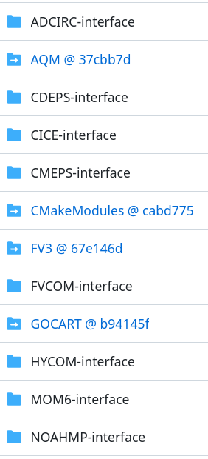
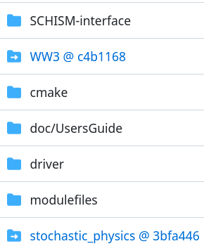
UFS-Coastal: Directory Tree
https://github.com/oceanmodeling/ufs-coastal/tree/feature/coastal_app
git clone https://github.com/oceanmodeling/ufs-coastal.git -b feature/coastal_app
Active Model Interfaces
ADCIRC
FVCOM
SCHISM
Active Regression Tests
ADCIRC (testing)
FVCOM (testing)
SCHISM (fully functional)

Slide 12
UFS-Coastal: Current Status
https://github.com/oceanmodeling/ufs-coastal/tree/feature/coastal_app
UFS-Coastal is now a fork of UFS Weather Model (branch: feature/coastal_app)
It is maintained under Ocean Modeling Collaboration GitHub organization to have better collaboration with community
Currently, following components are ported from CoastalApp to UFS-Coastal:
ADCIRC: unstructured mesh model to solve free surface circulation and transport
FVCOM: unstructured mesh finite volume ocean model
SCHISM: unstructured mesh model to solve baroclinic circulation across creek-lake-river-estuary-shelf-ocean scales
ATMESH custom data component is replaced with CDEPS

Slide 13
UFS-Coastal: Current Status (cont’d)
https://github.com/oceanmodeling/ufs-coastal/tree/feature/coastal_app
UFS Weather Model uses CMake to build components
To that end, all models are wrapped with CMake build interface under UFS-Coastal
SCHISM model NUOPC “cap” is slightly modified to work with CMEPS mediator. All the components under CoastalApp was coupled through the NUOPC connectors
Tests under CoastalApp-testsuite have been ported to RT system one-by-one.
# ADCIRC tests
COMPILE | 1 | intel | -DAPP=CSTLA -DADCIRC_CONFIG=PADCIRC -DCOUPLED=ON | | fv3 |
RUN | coastal_florence_hsofs_atm2adc | | baseline |
# FVCOM tests
COMPILE | 2 | intel | -DAPP=CSTLW | | fv3 |
# SCHISM tests
COMPILE | 3 | intel | -DAPP=CSTLS -DNO_PARMETIS=OFF -DOLDIO=ON | | fv3 |
RUN | coastal_ike_shinnecock_sch | | baseline |
RUN | coastal_ike_shinnecock_atm2sch | | baseline |
# WW3 tests
COMPILE | 4 | intel | -DAPP=CSTLW | | fv3 |
RUN | coastal_ike_shinnecock_atm2ww3 | | baseline |

Slide 14
UFS-Coastal: Issues
https://github.com/oceanmodeling/ufs-coastal/tree/feature/coastal_app
We are actively working on ADCIRC and FVCOM model components to make their NUOPC “caps” compatible with CMEPS mediator
CMEPS uses mesh as a representation of model grid/mesh
CMEPS assumes that all the import and export fields connected from the component on element location (the default of ESMF_FieldCreate() is node)
ESMF has no support for ghost elements at this point
We need to remove ghost elements from ADCIRC and FVCOM meshes and define import and export fields on element locations
Need to generalize forcing provided by the CDEPS (ATMESH data atmosphere mode)
All the test cases that are aimed to simulate Hurricane Florence or Ike need to be forced with same forcing. This will allow us to compare the results and find possible issues with the configurations

Slide 15
UFS-Coastal: Plans
https://github.com/oceanmodeling/ufs-coastal/tree/feature/coastal_app
Finalize work related to ADCIRC and FVCOM coupling interface and make them compatible with CMEPS
Update already ported regression tests and create baseline for them
These tests will run regularly against the development in UFS Weather Model and in case of syncing UFS-Coastal with authoritative repository
Add new tests for UFS-Coastal model components to cover the model components at least with single coupled test
Modernize UFS-Coastal build system by using ESMX generic driver
Implement isolated CI testing to each model components
This will benefit from nuopc-comp-testing composite GitHub action
Extend/improve nuopc-comp-testing composite GitHub action if it is required

Slide 16
Thank you for your attention!

Slide 17
Additional Slides

Slide 18
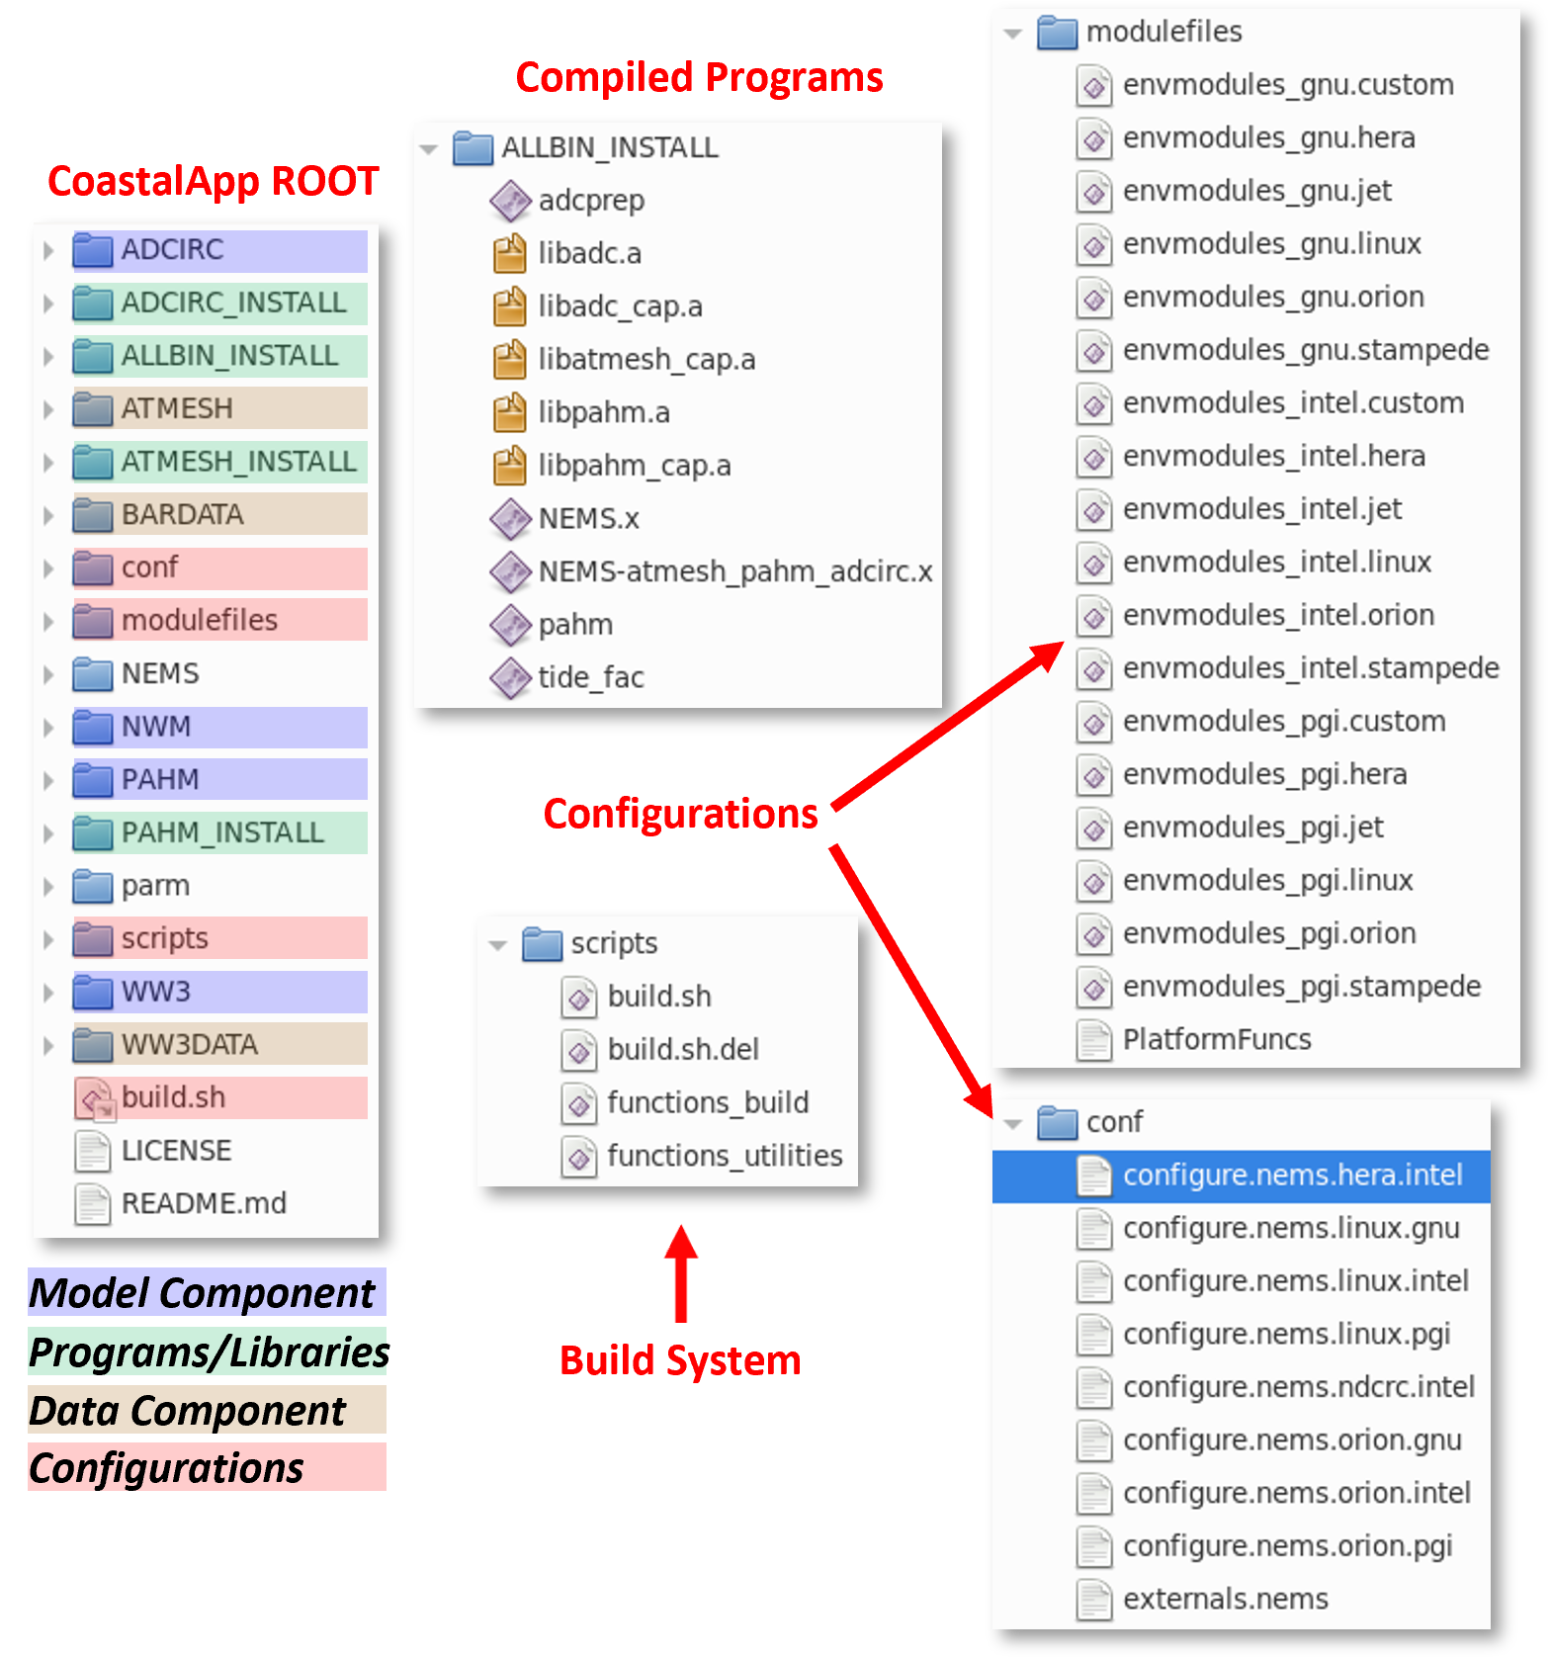
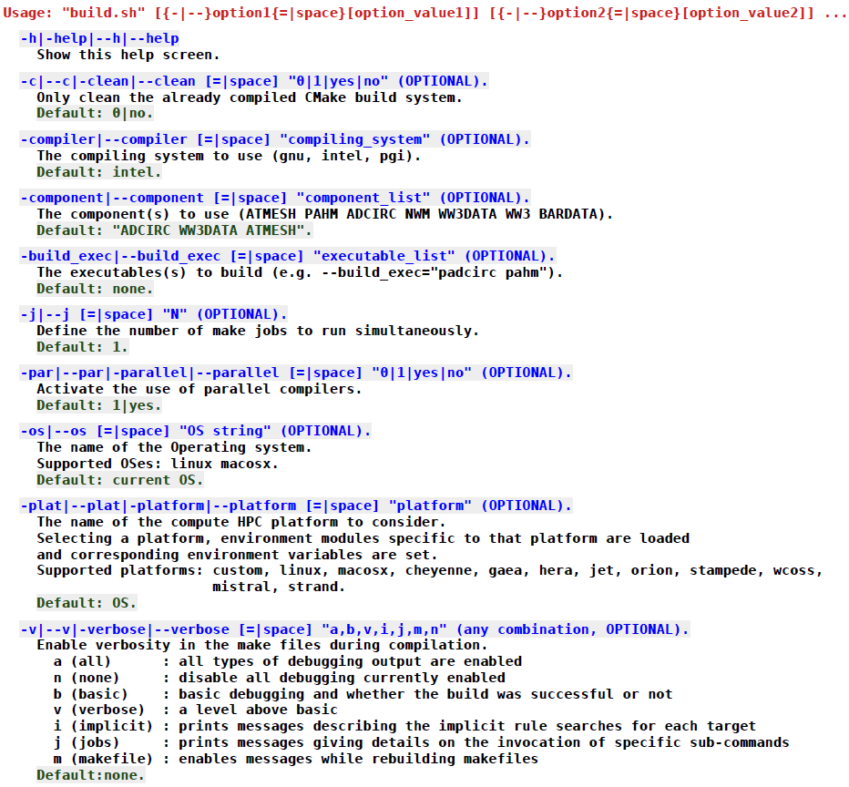
CoastalApp: System Layout and Usage

Slide 19
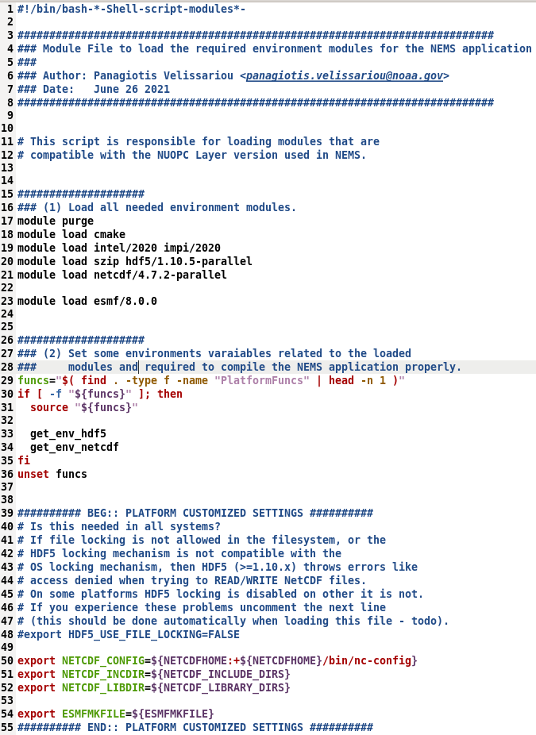
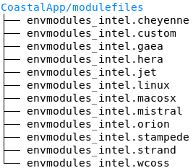
CoastalApp: ModuleFiles
Typical modulefile
Compiler one of [gnu, intel, pgi]
Load Modules
Set Environment
Finalize
(if needed)

Slide 20
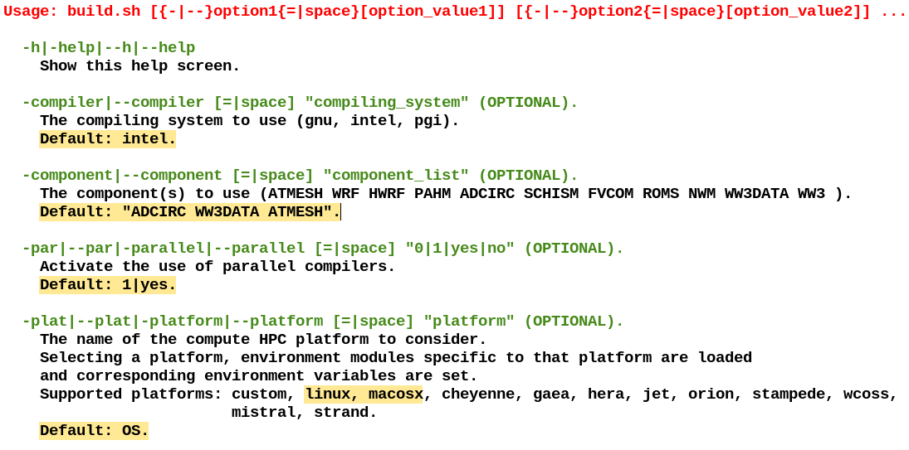
CoastalApp: Build Workflow

Slide 21
UFS-Coastal: Generic NUOPC Driver
https://github.com/oceanmodeling/ufs-coastal/tree/feature/coastal_app
Example: DATM+LND
As a part of the project, ESMF/NUOPC layer is extended to include Generic NUOPC Driver layer, which is called as Earth System Model eXecutable (ESMX)
Aims to accelerate development of new NUOPC-based systems
The ESMF 8.5.0 (targeted for end of July 2023) will have improved version of ESMX driver
It uses YAML based configuration files for build (ESMX_Builder) and run
The UFS-Coastal build system will be restructured to replace existing UFS NUOPC driver with new generic driver implementation
application:
disable_comps: ESMX_Data
link_paths: /home/runner/.spack-ci/view/lib
link_libraries: piof
components:
datm:
build_type: none
install_prefix: /test/app/cdeps/install
libraries: datm dshr streams cdeps_share
fort_module: cdeps_datm_comp.mod
noahmp:
build_type: none
install_prefix: /test/app/noahmp/install
fort_module: lnd_comp_nuopc.mod

Slide 22
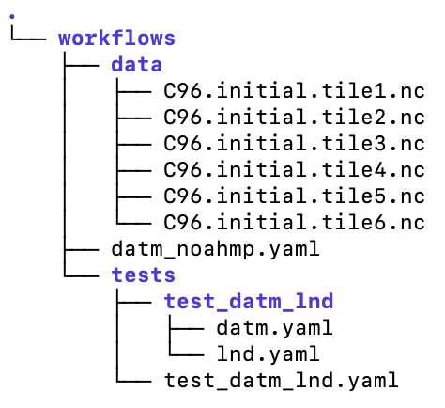
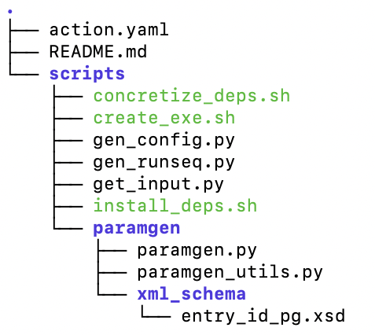
UFS-Coastal: Testing NUOPC Components
https://github.com/esmf-org/nuopc-comp-testing
New hierarchical testing capability for NUOPC components: nuopc-comp-testing
VM / Containerized Environment
GitHub Action
Install core development tools (apt-get install)
DATM+LND example
Install dependencies * (Spack)
NOAA-EMC/noahmp repository
Install CDEPS data components (i.e. DATM)
GitHub Action
Install model component that needs to be tested (i.e. Noah-MP)
nuopc-comp-testing repository
Create model executable
(generic driver NUOPC/ESMX)
Create run directory for test
Execute tested configuration
Get inputs (wget, ftp, Amazon S3 bucket) via Python *
Baseline Check (PASS/FAIL) *
Create namelist and configuration files (ParamGen)
* Steps that uses GitHub cache mechanisms

