Slide 1
Unifying Innovations in Forecasting Capabilities Workshop
A Unified Forecast System (UFS) Collaboration Powered by the Earth Prediction Innovation Center (EPIC)
JULY 27th, 2023
Center Green Auditorium, Boulder, CO
July 24-28, 2023

Slide 2
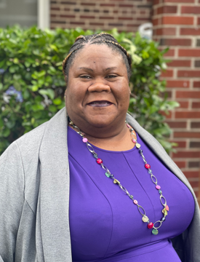
Today’s Moderator
Claudia Womble
Management and Program Analyst
Contracting Officer Representative III
Weather Program Office (WPO)

Slide 3
Thursday, July 27th
Two changes to today’s agenda:
9:45 AM - Kris Booker will be presenting for Keven Blackman
4:30 PM - Emerging Technologies: Cloud Computing session
** Ali Abdolali’s presentation - redacted **

Slide 4
Thursday, July 27th
9:00 – 9:15 – Welcome and Kickoff
9:15 – 9:45 – Unified Model Practices
9:45 – 11:00 – R2O and O2R Process with Q&A
11:00 – 11:30 – BREAK
11:30 – 12:0 0 – Keynote: Seeking Portability and Productivity for NWP Model Code
12:00 – 1:00 – LUNCH

Slide 5
Thursday, July 27th
1:00 – 2:00 – Panel Discussion on Open Computing and Shaping the Future of
Computing for Modeling
2:00 – 2:15 – BREAK
2:15 – 3:15 – Parallel Sessions on Emerging Applications
3:15 – 3:30 – BREAK
3:30 – 4:00 – UFS as a Decision Tool: A Private Industry Perspective
4:00 – 4:30 – Emerging Technologies: AI
4:30 – 5:00 – Emerging Technologies: Cloud Computing
5:00 – 6:30 – Poster Session

Slide 6
Live Streaming Announcement
We are livestreaming the event, so please be aware of hot mics and video recording.
If you would like to be further from the microphone, we suggest sitting in the back of the room.

Slide 7
Connect with us!
Connect with us on Twitter and Instagram with #UIFCW23
Twitter: @NOAAEPIC & @ufs_community
Instagram: @NOAAEPIC
Wi-Fi: UCAR Visitor

