Slide 1
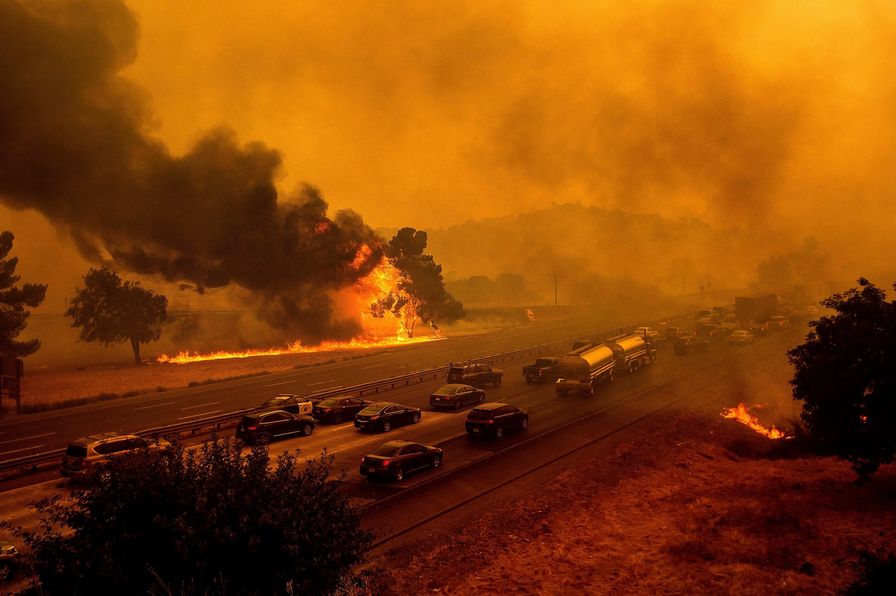
Simulating Radiative Effect of Smoke and Dust Aerosols Using NOAA's Next-Generation Storm-Scale Numerical Weather Prediction Model (preliminary results)
Ravan Ahmadov¹, Haiqin Li^{1,2}, Johana Remero-Alvarez^{1,2}, Eric James^{1,2}, Georg A. Grell¹, Jordan Schnell^{1,2}
¹NOAA/Global Systems Laboratory
²Cooperative Institute for Research in Environmental Sciences at the University of Colorado Boulder
UIFCW 2023

Slide 2
3.1 An introduction to the Rapid Refresh Forecast System - Smoke and Dust (RRFS-SD)
The host model: Rapid Refresh Forecast System (RRFS)
-- dynamics core: Finite Volume Cubed-Sphere (FV3)
-- physics: Common Community Physics Package (CCPP) FV3 HRRR physics suite (MYNN PBL, Thompson microphysics, RUC LSM)
Coupling smoke and dust modules into RRFS through CCPP
-- Plume rising: 1D cloud model is used to calculate injection heights and plume rise emission rates
-- Fire Emission: hourly Advanced Baseline Imager and Visible Infrared Imaging Radiometer Suite Emissions (RAVE)
-- Dust: FENGSHA dust scheme
-- Sea-salt: NASA GEOS-5 GOCART sea salt scheme
-- Fire Weather Index: Hourly Wildfire Potential diagnostic output
This is a simple aerosol model with 3 tracers of smoke, fine dust and coarsepm. Anthropogenic and biogenic emissions, gas or aerosol chemistry are NOT included.
In the global and regional scale NOAA United Forecast System (UFS) Weather Models, the MERRA2 climatology (2003-2013) is used as the background aerosols for the radiation process.
We add the smoke and dust from RRFS-SD on top of the MERRA2 climatology for radiation.
The same approach of aerosol indirect feedback in global modeling is also applied in RRFS-SD.
3.2 The method of direct and indirect feedback in RRFS-SD

Slide 3
3.3 Experimental design of aerosol direct/indirect feedback in RRFS-SD
 | CTL | fdb_dir | fdb_indir
Smoke/dust direct feedback to radiation | NO | YES | NO
Smoke/dust indirect feedback to cloud physics | NO | NO | YES
physics | FV3 HRRR physics suite | FV3 HRRR physics suite | FV3 HRRR physics suite
RRFS Initial/Boundary Conditions | Rapid Refresh (RAP) Analysis (2020090100~2020091523) | Rapid Refresh (RAP) Analysis (2020090100~2020091523) | Rapid Refresh (RAP) Analysis (2020090100~2020091523)
RRFS domain | Contiguous United States (CONUS) | Contiguous United States (CONUS) | Contiguous United States (CONUS)
Horizontal resolution | 3km | 3km | 3km
Vertical resolution | 64 layers | 64 layers | 64 layers
Integration length | 24h with hourly output | 24h with hourly output | 24h with hourly output
Smoke/dust start | Cold-start cycling (smoke & dust are cycled) | Cold-start cycling (smoke & dust are cycled) | Cold-start cycling (smoke & dust are cycled)

Slide 4
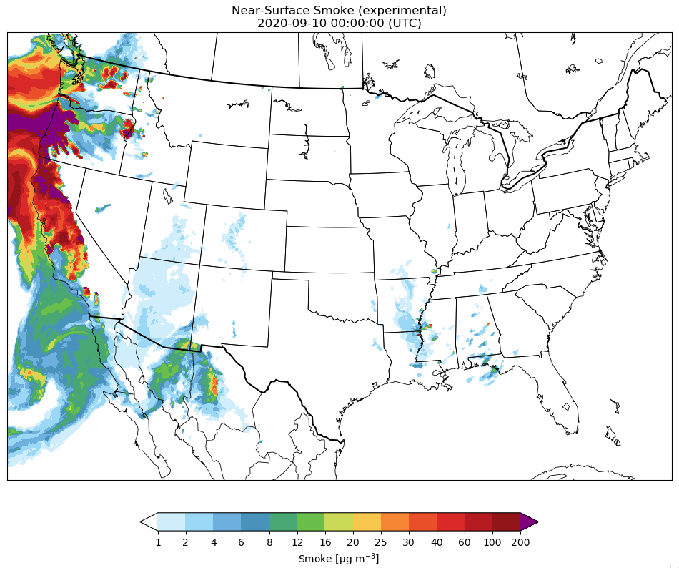
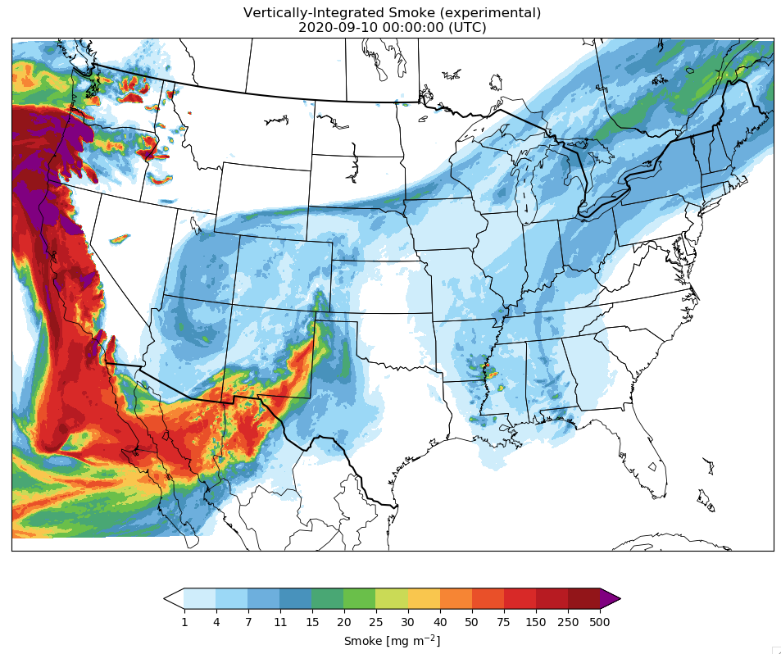
RRFS-Smoke simulation on the 3km resolution CONUS domain
September 10, 2020
Near-Surface Smoke (ug m⁻³)
Vertically-Integrated Smoke (mg m⁻²)

Slide 5
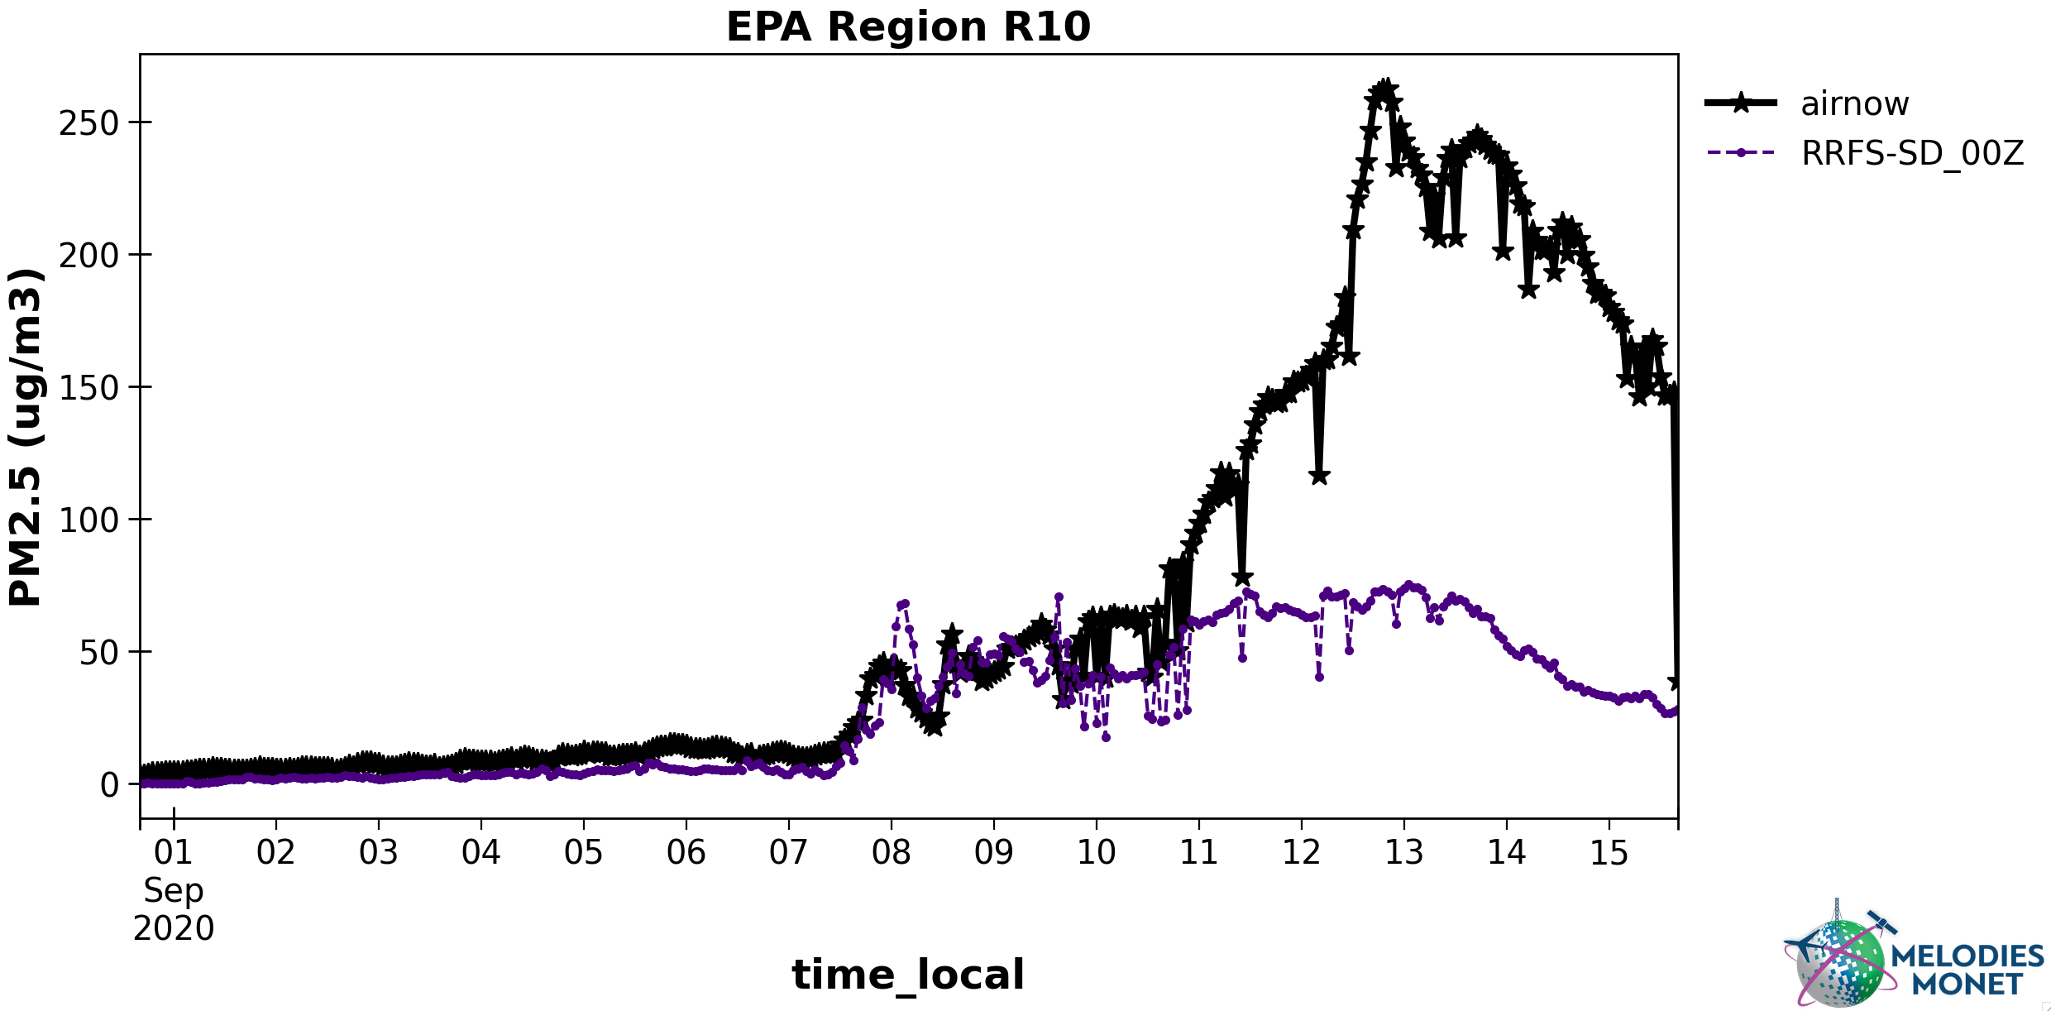
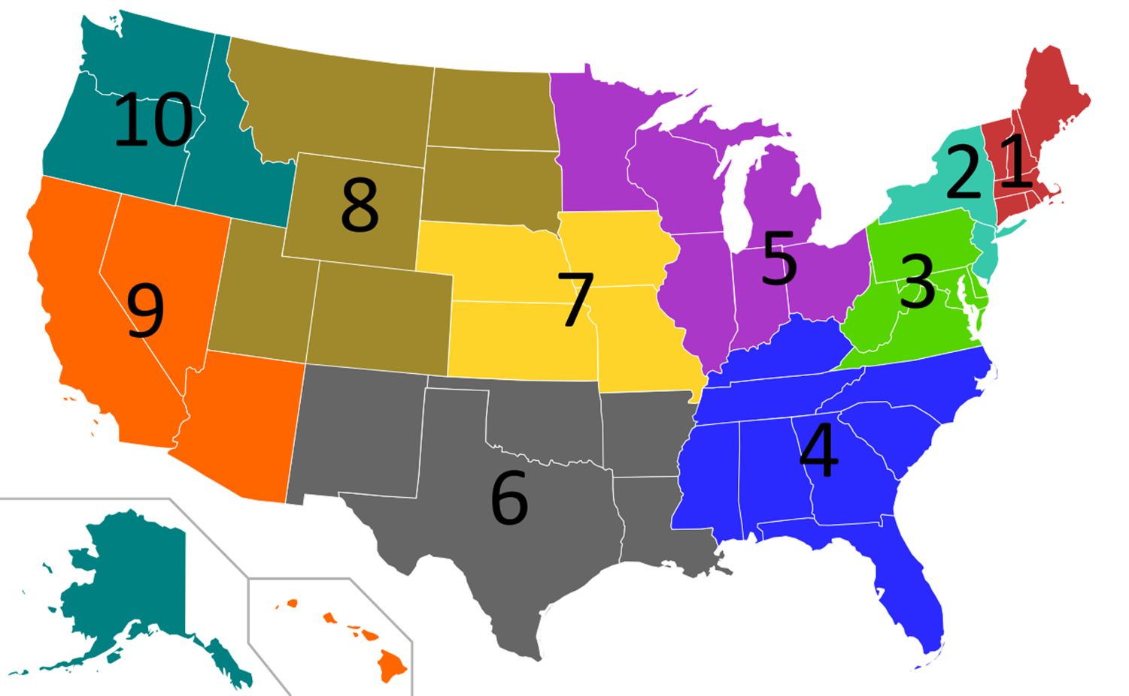
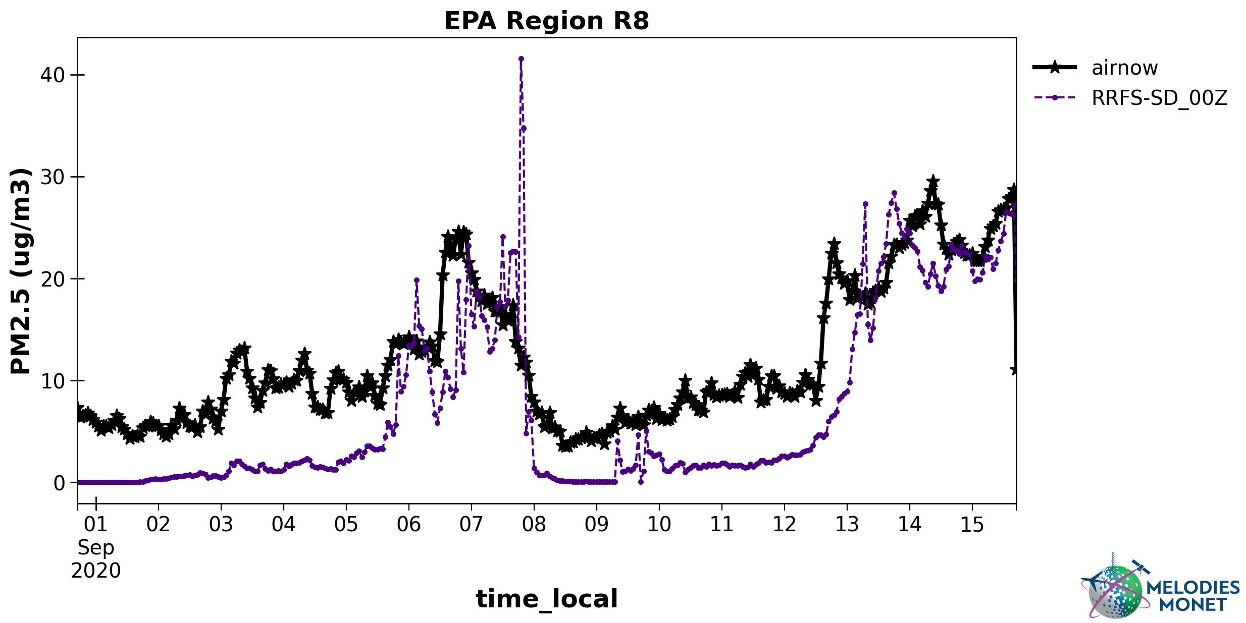
Evaluation of the RRFS-Smoke simulations using the AirNow PM2.5 observations for September, 2020
EPA Regions

Slide 6
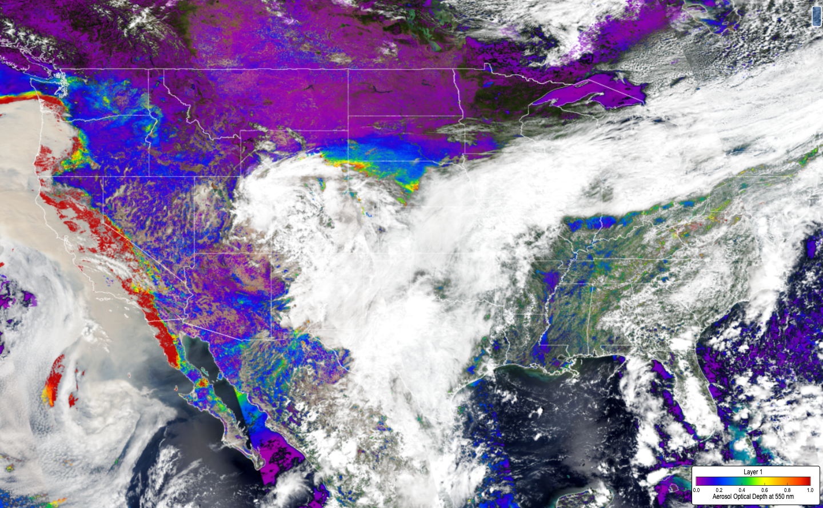
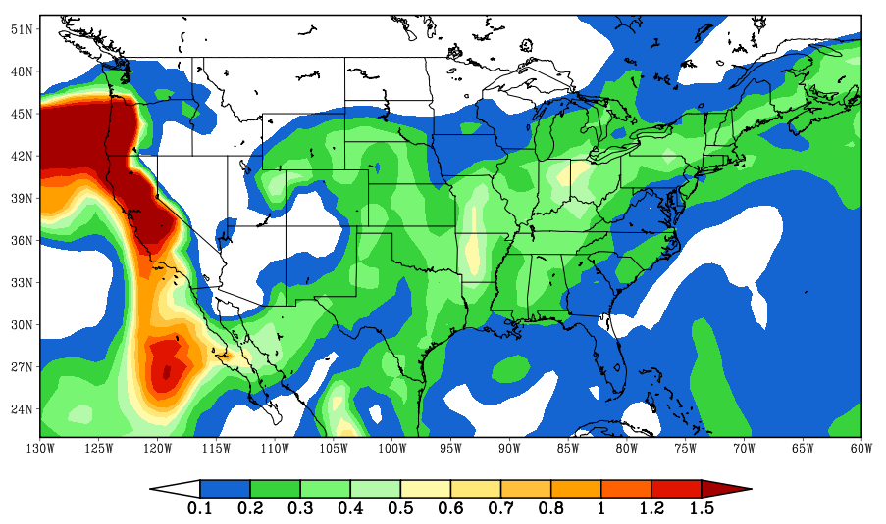
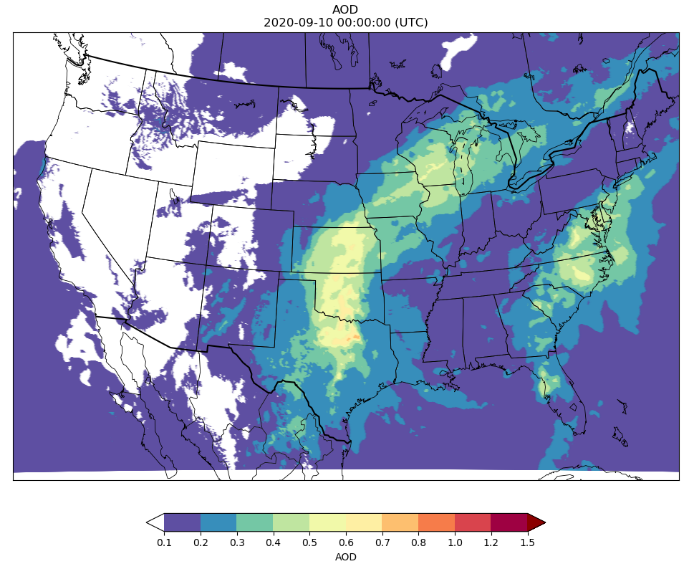
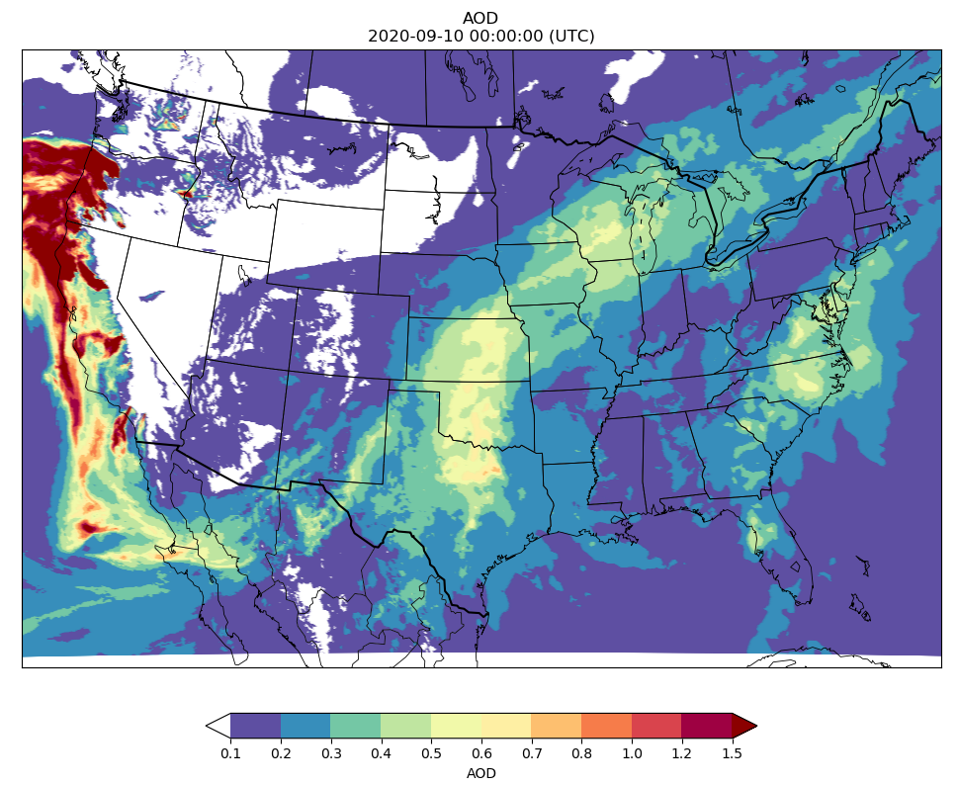
Aerosol Optical Depth (AOD) valid for September 10, 2020
NOAA-20
satellite
ECMWF
Aerosol analysis
Model AOD
Climatological
Aerosols only
Model AOD
smoke+climatological
aerosols

Slide 7
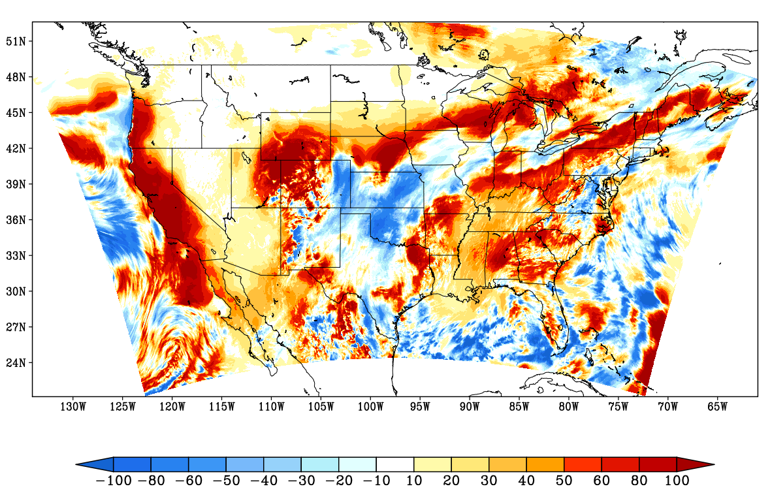
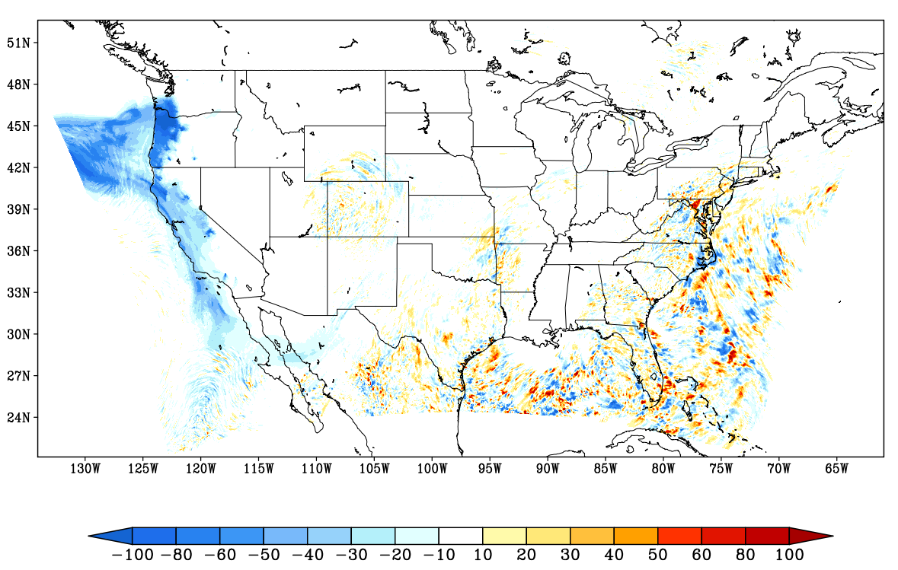
Surface downward shortwave radiation flux (W/m²)
20200910 daily mean
CTL .minus. CERES Observation
20200910 daily mean
fdb_dir .minus. CTL
(a)
(b)

Slide 8
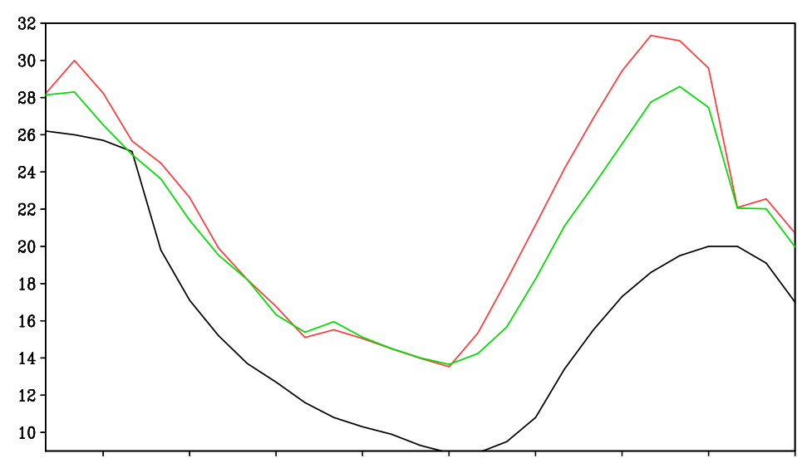
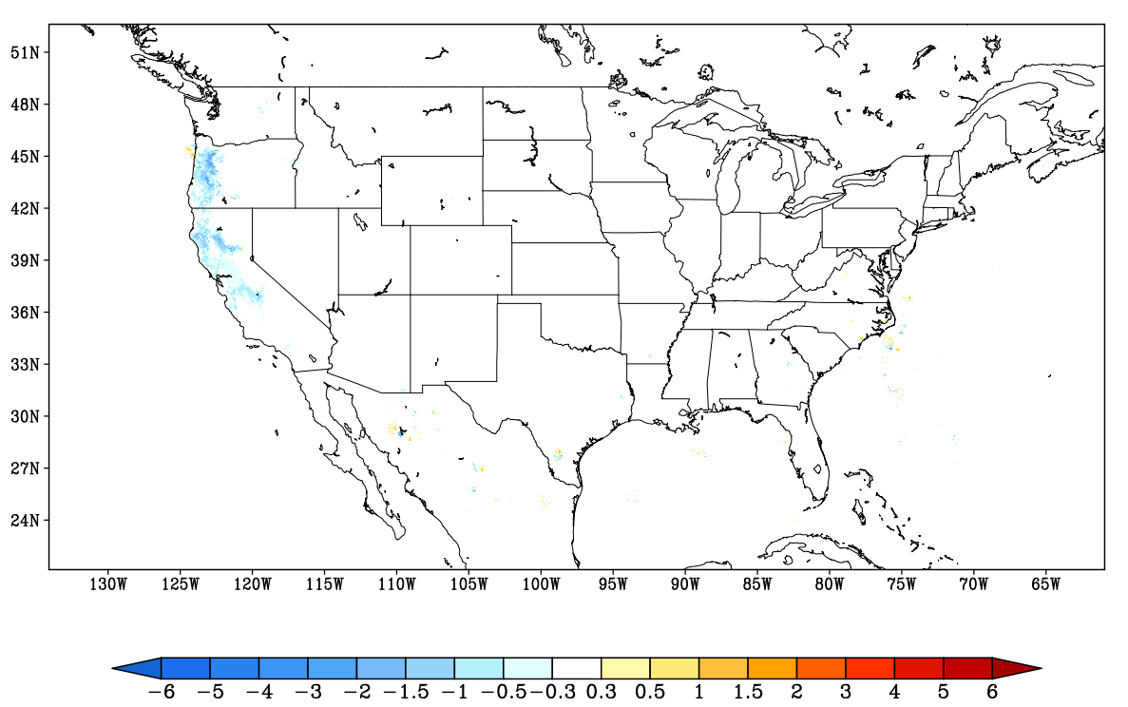
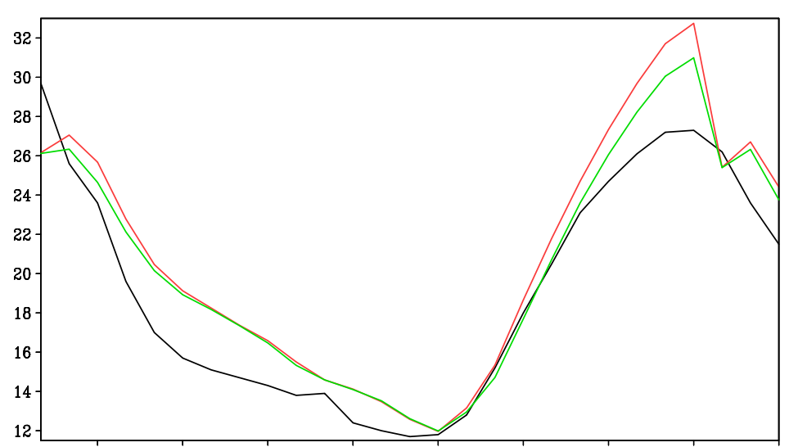
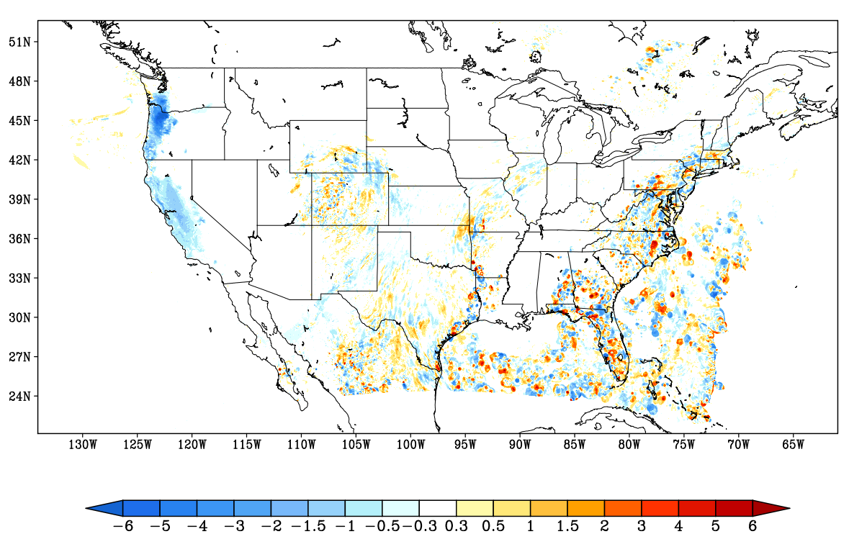
-- Observation
-- CTL
-- fdb_dir
20200910 03Z UTC
Corvallis, OR
18 21 00 03 06 09 12 15 18
Sept 10, 2020 local time
-- Observation
-- CTL
-- fdb_dir
20200910 21Z UTC
Merced, CA
18 21 00 03 06 09 12 15 18
Sept 10, 2020 local time

Slide 9
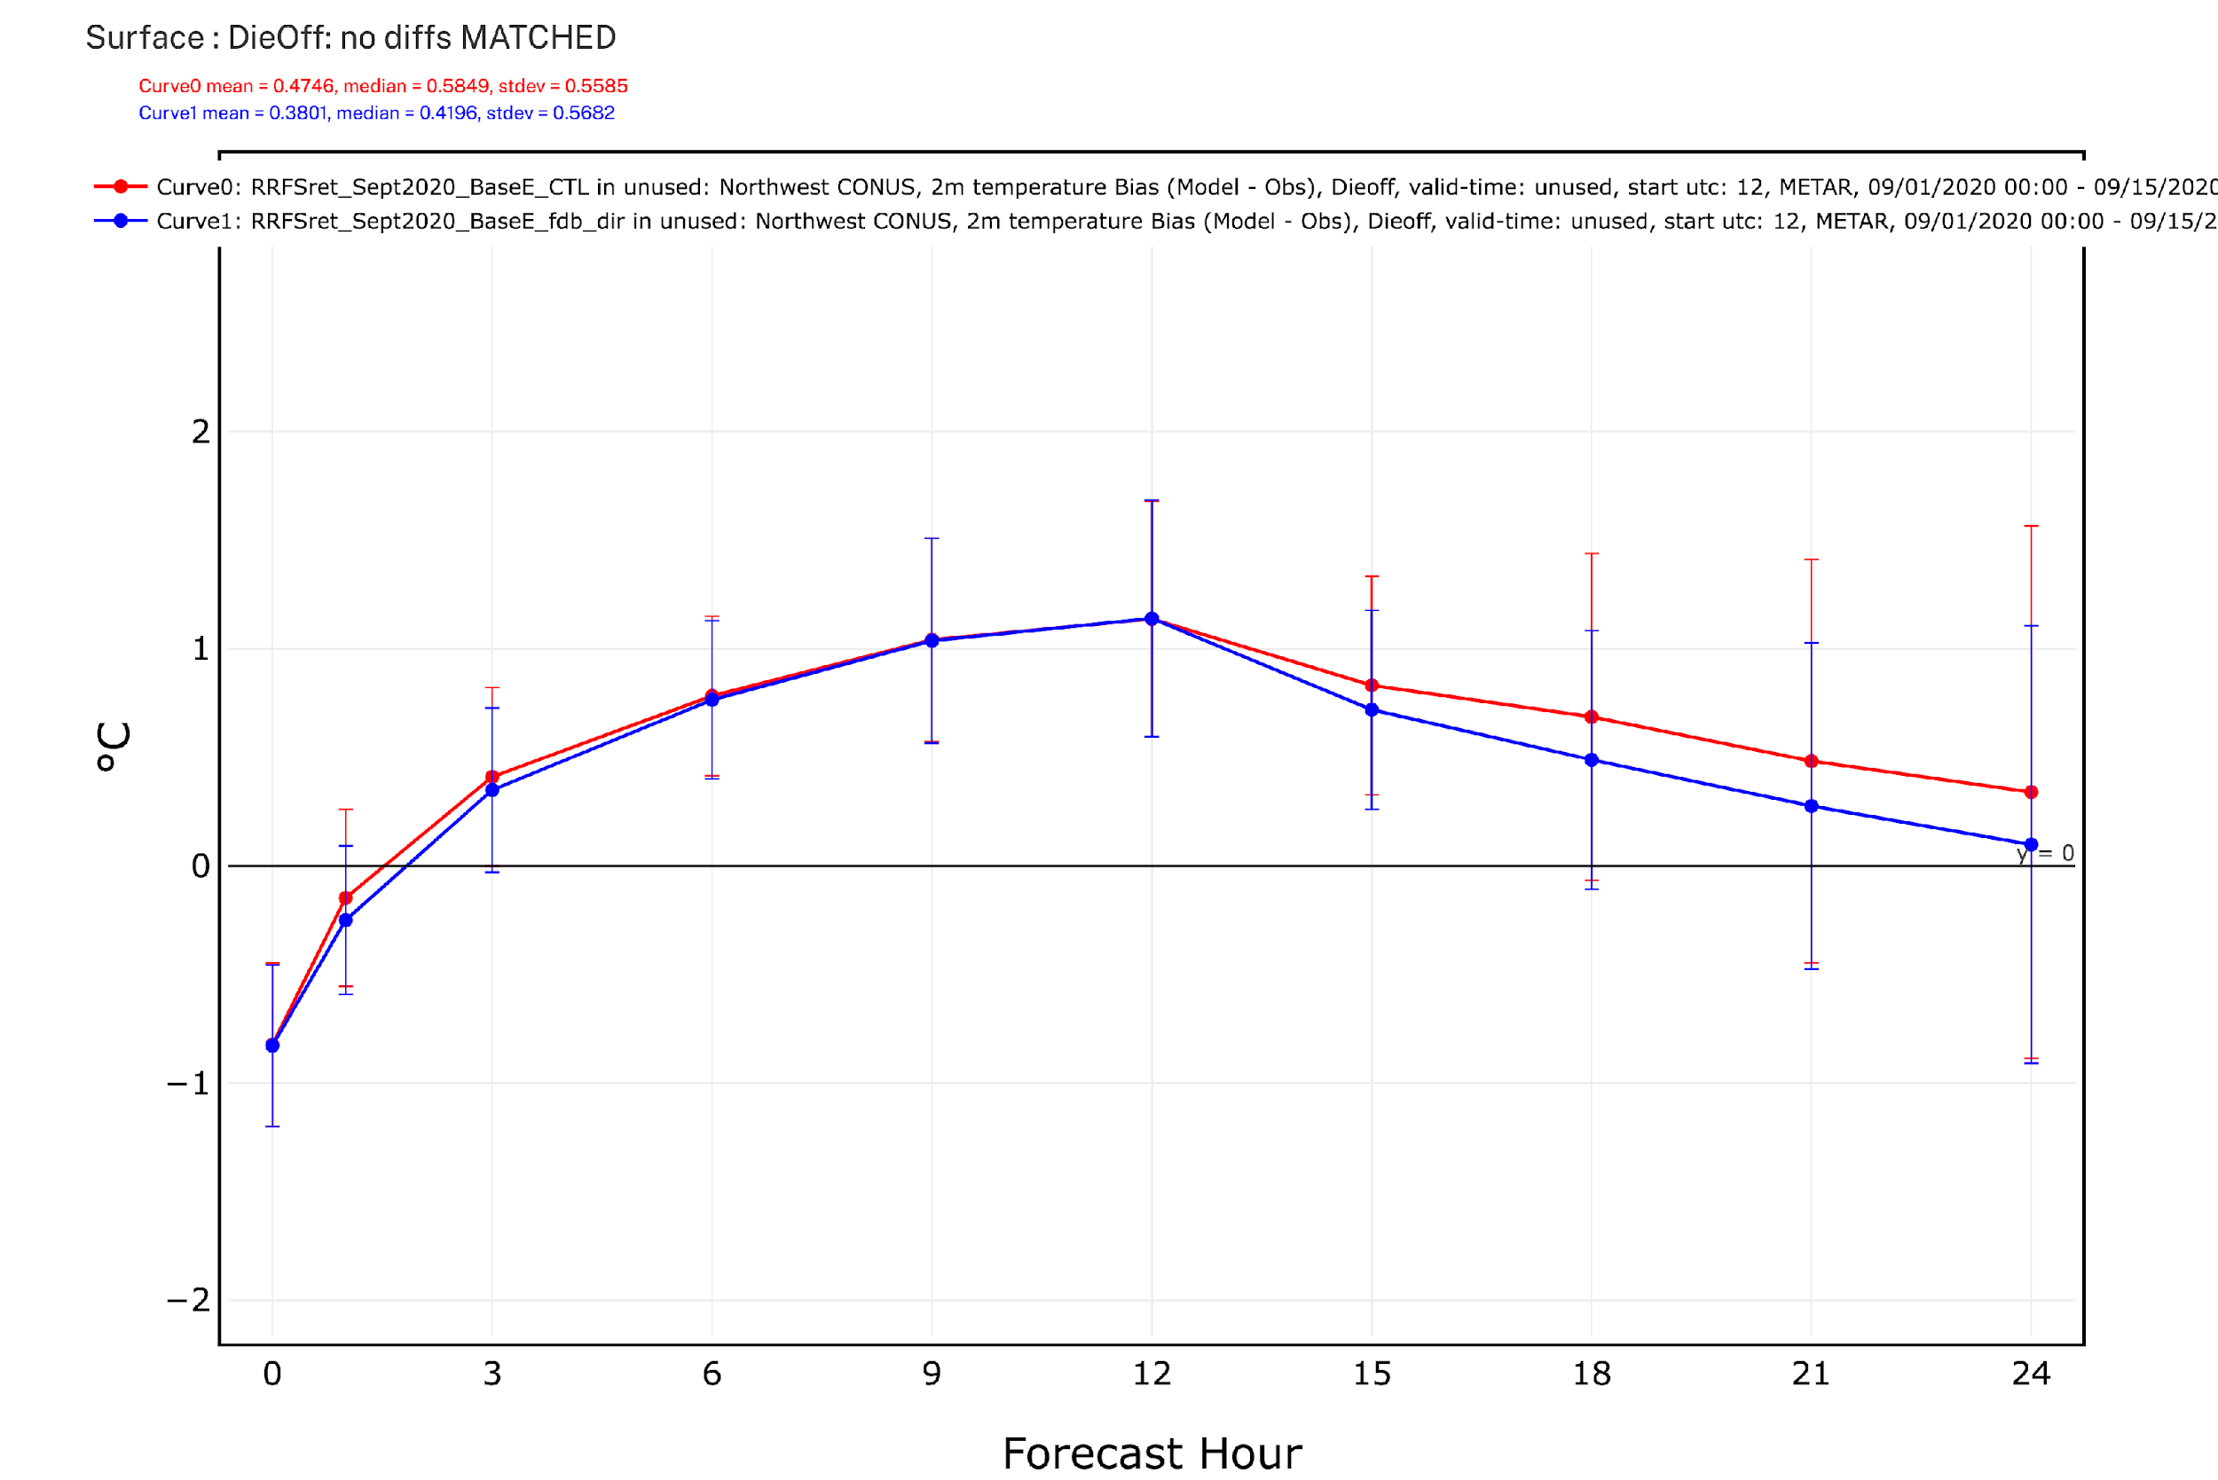
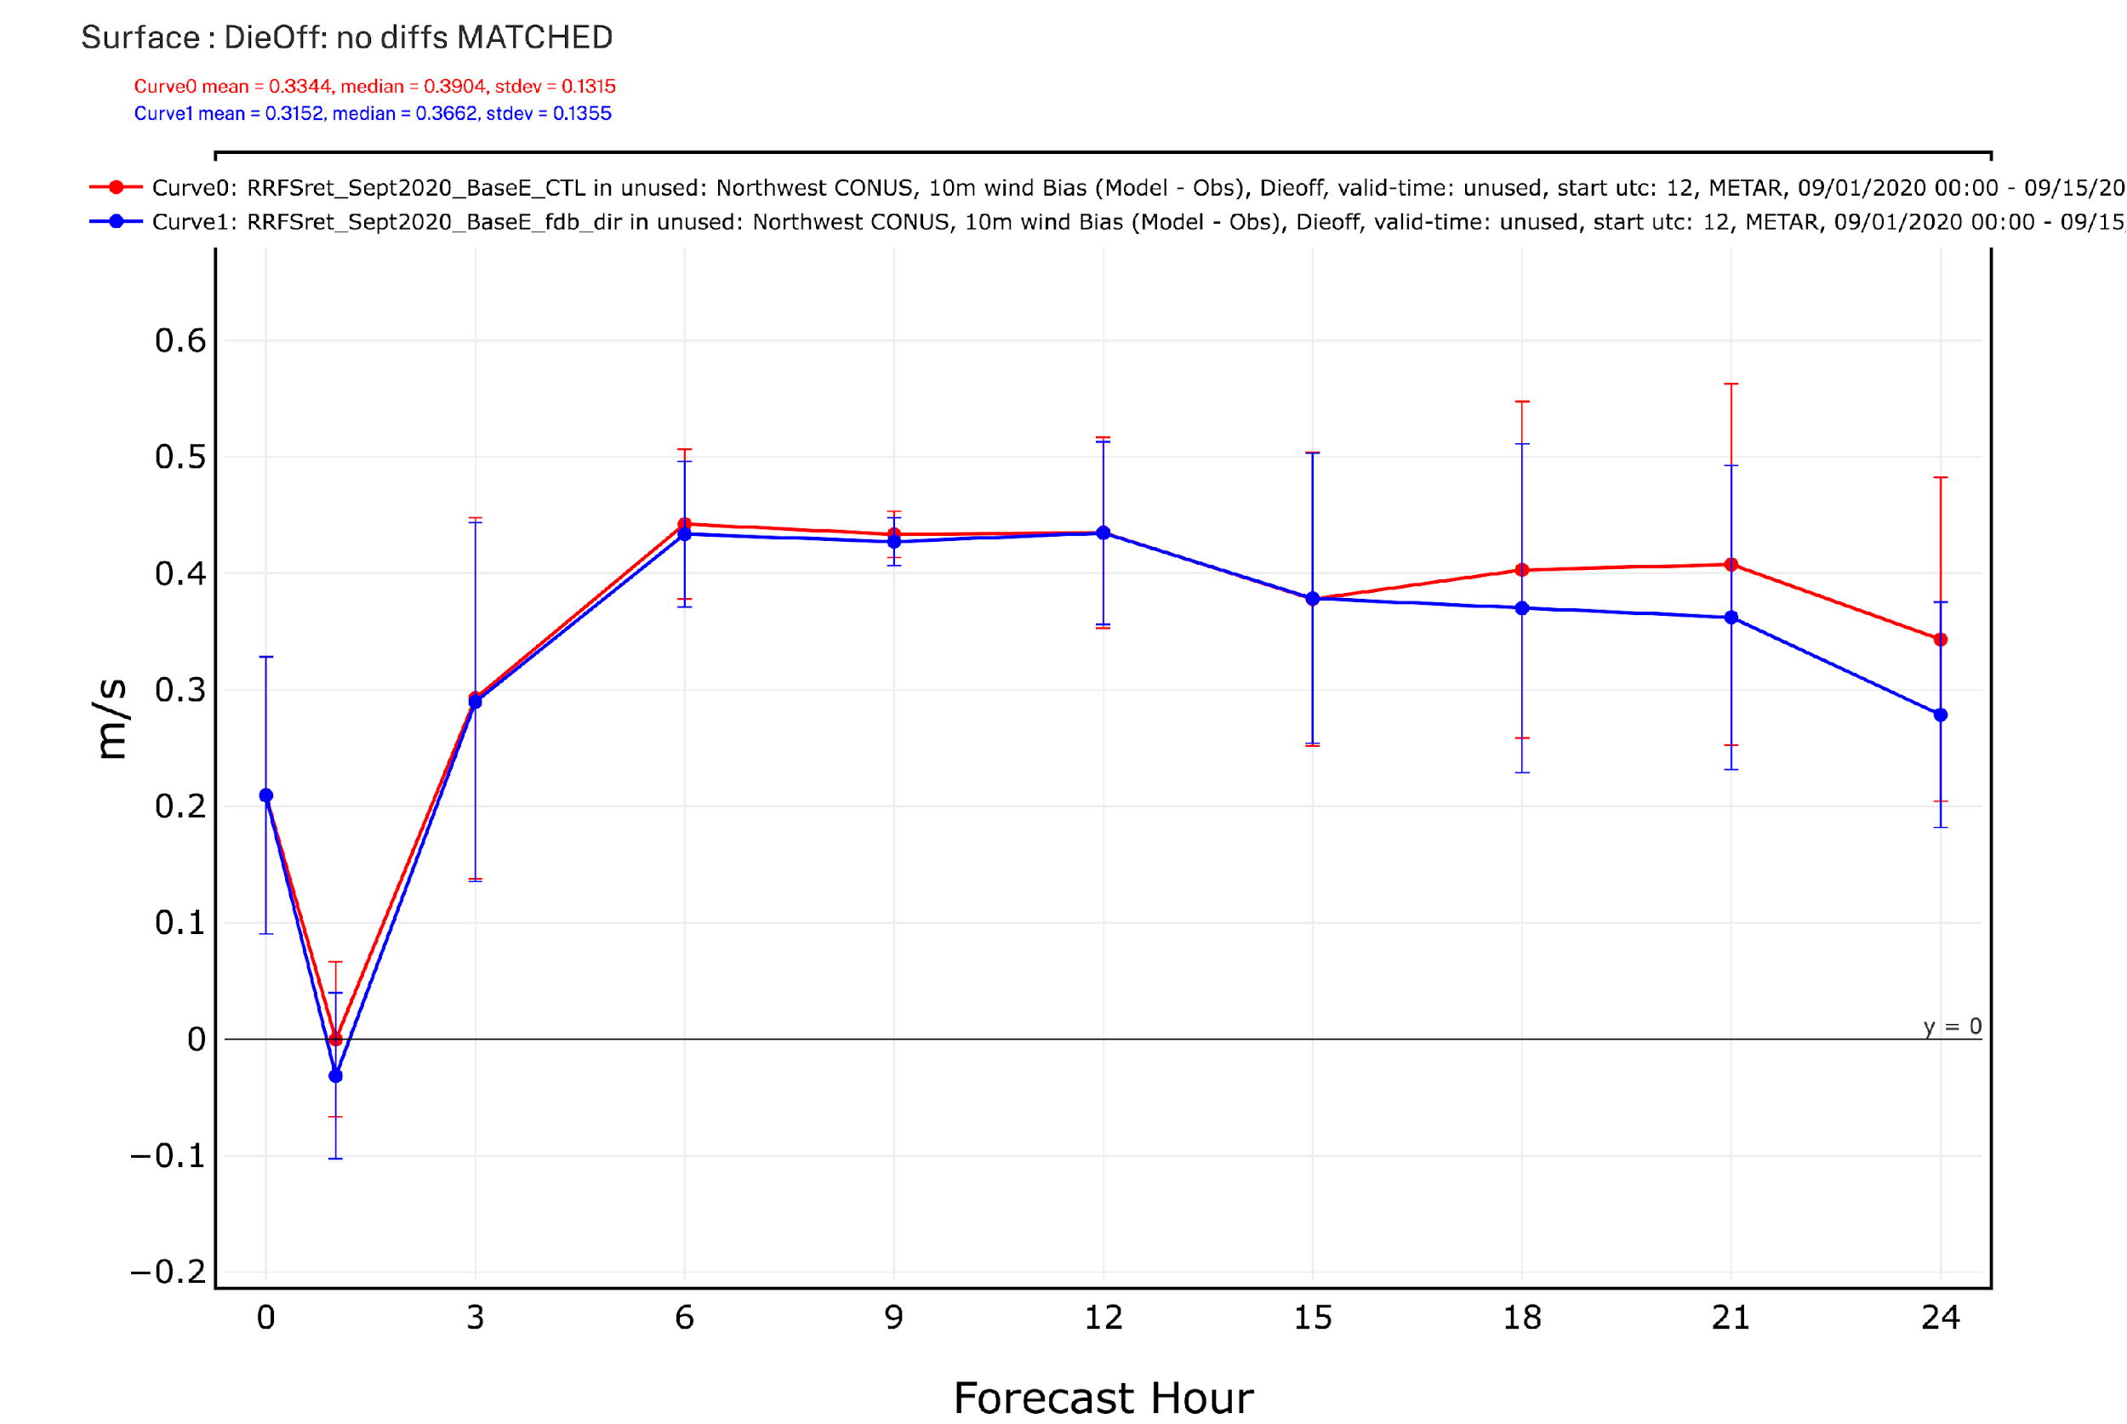
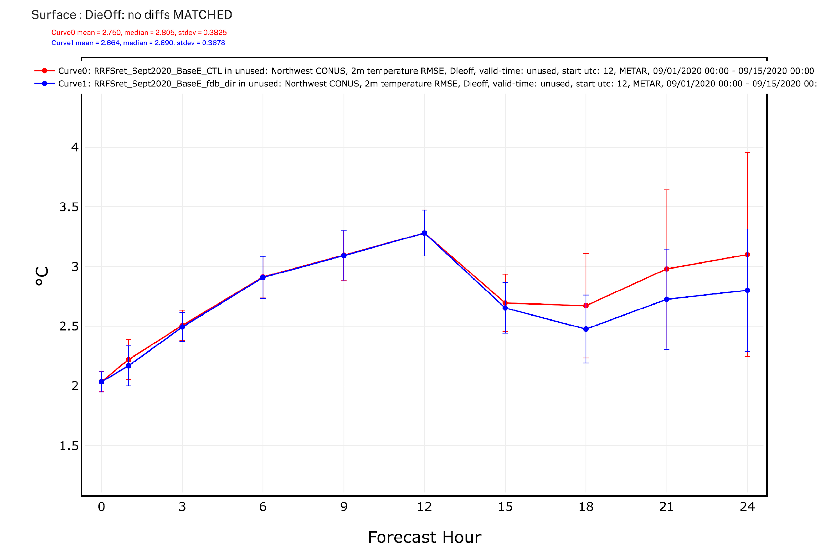
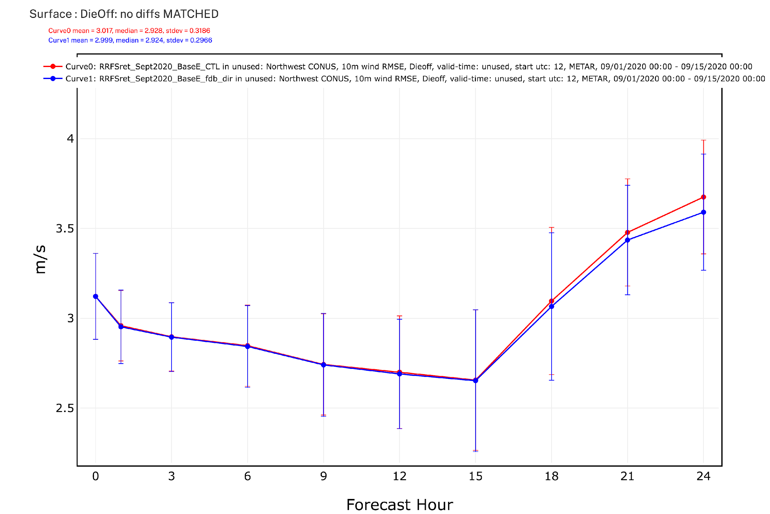
RRFS-Smoke verification over the northwestern CONUS region
(a) T2m bias
(c) 10m wind speed bias
(b) T2m RMSE
(d) 10m wind speed RMSE
-- CTL
-- fdb_dir

Slide 10
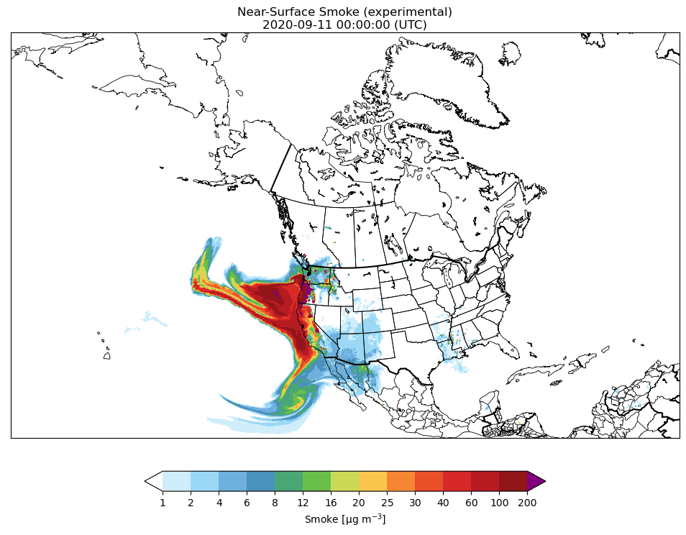
RRFS-Smoke simulation on the 3km res. NA domain

Slide 11
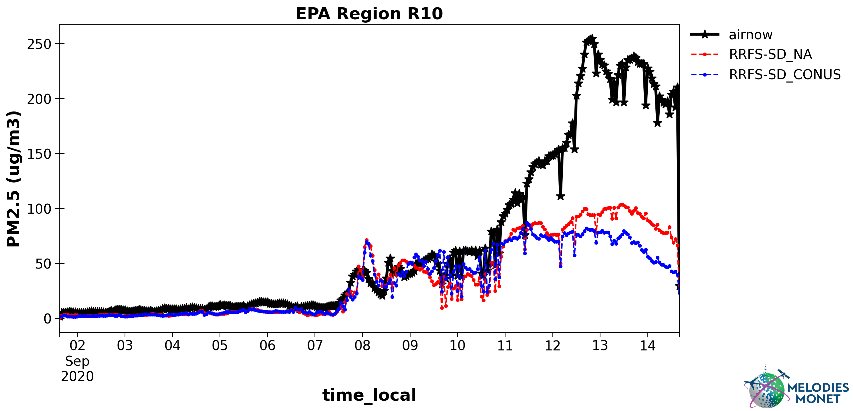
Verification of the RRFS-Smoke simulation on the 3km res. North American domain
Mean bias: -32.1, -37.5 (ug/m3)
r2: 0.31 0.27

Slide 12
Summary and future plans
RRFS-Smoke simulations are conducted for September, 2020 during the extreme fire season in the western US.
Smoke simulations are conducted on the 3km resolution domains covering the CONUS and NA regions, with and without radiative feedback of smoke.
Incorporating smoke direct feedback into RRFS helps to improve the weather forecast skill of the model noticeably.
Next step is to conduct RRFS-Smoke simulations on the NA3km domain with meteorological and aerosol data assimilation.

Slide 13
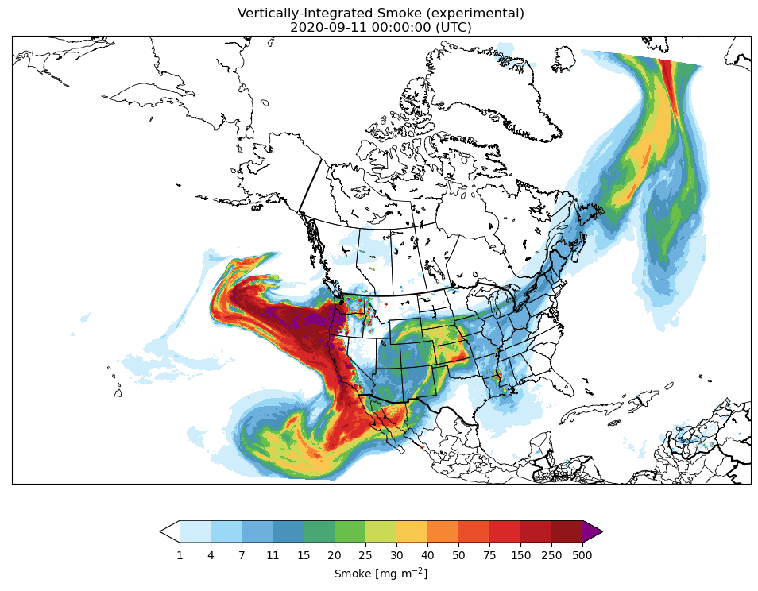

Slide 14
