Slide 1
Developing Guidelines for Defining, Measuring, and Fostering Innovations in Earth Prediction Systems at NOAA's Weather Program Office
Laura Dailey, Student Intern
William M. Lapenta Summer Internship Program
Jose-Henrique Alves, Maoyi Huang, Jessie Carman, Jordan Dale, Chandra Kondragunta, John Ten Hoeve
July 28th, 2023

Slide 2
About me
Senior at University of Delaware
Meteorology and Climate Science major
Interests in forecasting, severe weather, and weather communications
William M. Lapenta Intern 2023
Weather Program Office (WPO), NOAA Research (OAR)

Slide 3
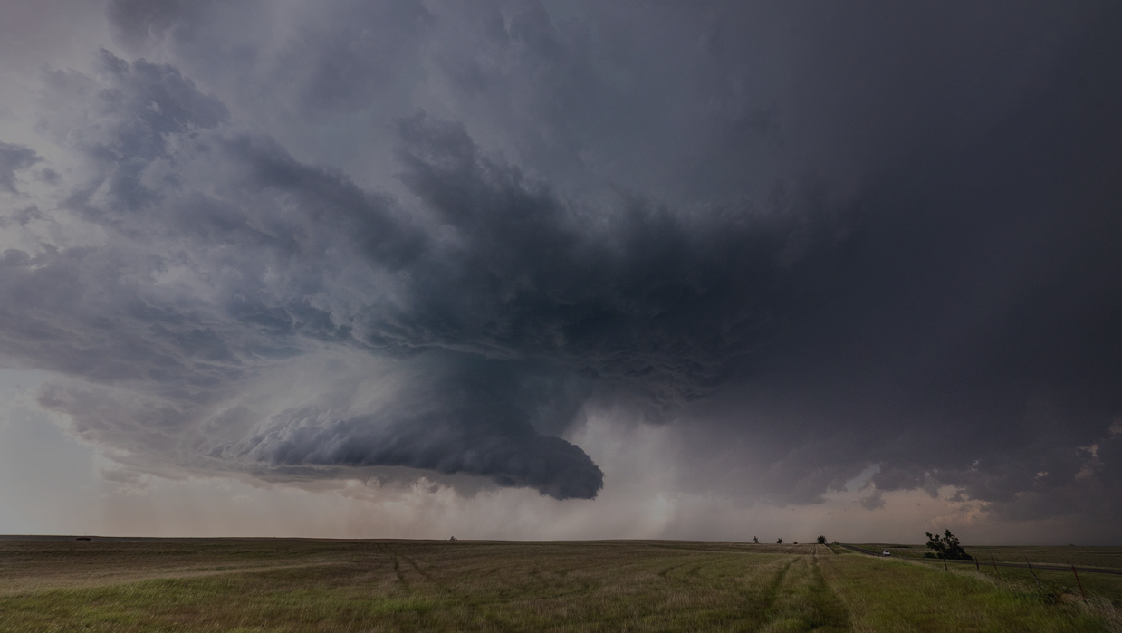
Innovation changes the standards of science
The UFS provides an innovative framework that inspires innovations.
What is innovation? How can we measure it? How can we foster it?
In a world where people are becoming more vulnerable to extreme weather, innovating forecasts are more important now than ever.
High risk, high reward ideas welcome!
Notes:
UFS is an innovation because it’s a community modelling system, meaning anyone can use the code, you don’t have to be in NOAA, which was never done before.

Slide 4
Objectives for my research
Develop guidelines for WPO to:
Understand the meaning of innovation
Measure innovation in funding opportunities and within WPO
Foster innovation
Intended outcomes:
Attract and fund innovative proposals in future NOFOs
Innovations Learning Agenda
Notes:
Understand how effective the competition was in fostering innovation, use the opportunity to use that as a starting point to develop these guidelines.

Slide 5
Methods
Conducted a structured interview process with 20 interviewees from WPO and throughout the weather enterprise.
Primary Customers (8)
Weather Program Office
Primary Stakeholders (3)
External Community (9)
NWS/ STI
CPO
UFS Steering Committee
Academic and Research (6)
Private (3)
Leadership (2)
Program Managers (6)

Slide 6
Defining Innovation
There are many different definitions of innovation. People can interpret it in different ways depending on their goals and apply innovation depending on their specific work.
There are two common types of innovation:
Incremental innovation
Radical innovation
WPO leads initiatives across the entire innovation spectrum
EPIC is a WPO program created to use open-development to accelerate the innovations-to-operations process.
WPO’s FY2023 Innovations for Community Modeling Competition pushed for more high-risk, high-reward ideas.
Where on the scale from incremental to radical does innovation belong?

Slide 7
What Does Innovation Mean?
Main Similarities:
Innovation is a new idea that provides value to an existing problem.
Innovation opportunities in all steps and readiness levels of the R2O2R process
WPO’s impact of innovations:
To improve earth prediction systems
To create better methods to inform the public about weather
To better understand the outputs of the forecasts
Innovation and risk go hand and hand
Main Differences:
In WPO, should innovative proposals be a brand new, disruptive change or a smaller, incremental change?
Program managers each view innovation in their work differently
Innovation value changes between different sectors in the Weather Enterprise
Notes:
Separate in bullet points. Should they be: brand new

Slide 8
Unique Perspectives in the Weather Enterprise
Government
Resists innovation
Why? Their mission requires employees to focus on other priorities and they don’t have enough resources to try something new.
Leads to a risk averse culture
Private Sector
Innovations are all the lifeblood of industry.
Teams are usually smaller and more agile
“When you're trying new things, you're gonna fail. If you're not failing, you're not learning. If you're not afraid, you’re not thinking big enough.” (Mark Brooks)
Academia
Research is always a
new idea and on the innovation spectrum
Professors train the next generation of scientists
Innovative research can spark more questions for researchers
Notes:
Font size same through the bubbles. These are the differences, later I will talk about how we can reconcile these differences to make them work better together.

Slide 9
Meaning of Innovation in NOAA’s Weather Program Office
An innovative research project is one that is:
A new concept, method, or strategy that provides value towards improving earth prediction systems.
Important for both the WPO’s priorities and its end users.
Not limited to one certain readiness level.
WPO recognizes the need for high-risk, high-reward. WPO is the place for trial and error. It can be incremental and taken in steps, but the end goal should be more than just an improvement.
Low risk
Expected Results, Almost Proven to Succeed
Medium risk
Some Uncertainty,
Proven Research, Decent Impact
High risk
Unpredictable, Transformative Change
Notes:
Although there are different perspectives in the weather enterprise, WPO provides a unique platform to reconcile the needs and interests of the 3 sectors.
This is what I learned from program managers/ leadership, covers low risk, understands the need for high risk. Shared ideas in WPO. The way WPO defines innovation, they in a good position to combine and bring the three sectors to work toegteher through funding and towards a common goal

Slide 10
Measuring Innovation
Ways to visualize metrics:
A control panel
A dashboard
An innovation balanced scorecard.
Categories of metrics:
Input metrics
Process metrics
Output metrics
Outcome metrics
Notes:
In WPO, metrics are needed to understand the benefit of funding innovative proposals. Separate metrics are needed to encourage innovation within the office and to track progress of the innovations.
Put into bullets

Slide 11
Designing Priority Metrics for WPO
Organizational metrics to encourage innovation:
Progress report metrics for awardees
Finance measurements
Diversity of awardees
Ideas generated
Ideas transitioned
Innovation metrics for NOFO’s, reviewing and selecting awards:
Mission value
Time to transition
User benefit
Cost Benefit
Risk metrics
Notes:
In WPO, metrics are needed to understand the benefit of funding innovative proposals. Separate metrics are needed to encourage innovation within the office and to track progress of the innovations.

Slide 12
Fostering Innovation in WPO and in NOAA
What are some things that WPO can implement or change to better foster innovation in NOFOs and within the community?
INCREASE INCLUSIVITY, DIVERSITY, AND COLLABORATION
Change review criteria, conquer groupthink, and collaborate more with people from different backgrounds.
CONQUER RISK AVERSION
Disregard the stereotype that every selection needs to be a ‘success’. Embrace failure. Learn from the outcome, whatever it may be.
ENCOURAGE INNOVATION
Tap into the creativity of employees and researchers alike and fix the mindset block for why people are not as innovative as they hope to be.
Notes:
Out of the responses I received, the suggestions and activities fell within these categories. Thats where it’s coming from. I included things I think could work based on what I heard.

Slide 13
FOSTERING INNOVATION IN WPO AND IN NOAA:
Inclusivity, Diversity, and Collaboration
Inclusivity in review criteria
Diversity in reviewers
Collaboration with decision-makers
Help applicants with paperwork process
Write proposals clearly and without constraints
Is the deadline fair for all?
Randomized selection that meet criteria to remove bias
Broad reviewer group
Avoid groupthink: private scoring and then collaborate for scores.
Overcome cognitive distance
Monthly leadership meetings
Does being remote diminish innovation?

Slide 14
FOSTERING INNOVATION IN WPO AND IN NOAA:
Conquering Risk Aversion
Cultural change: Expect employees to innovate and embrace failure as a necessary step
Innate fear of failure because we don’t want to disappoint those who fund our work.
There’s value in what you learn
Keeps people from trying that method or idea again
Teaches people what doesn’t work to discover what will.
Encourage risk and accept failure as opportunities for nurturing innovation
Develop a de-brief culture
Take a leap of faith and fund lower RLs. No matter what stage it’s at, it will always be a learning process.

Slide 15
FOSTERING INNOVATION IN WPO AND IN NOAA:
Ways to Encourage and Accelerate Innovation
Priorities:
Continue the efforts to create an open source and science environment.
Build a public-private-academic partnership
Things to Consider:
Common testbed?
Competitive funding vs. prizes?

Slide 16
FOSTERING INNOVATION IN WPO AND IN NOAA:
Ways to Encourage and Accelerate Innovation
Majority of respondents think they still have a long way to go to being innovative.
How to fix this mindset block:
Encourage employees to follow the 80/20 rule.
Interdisciplinary individuals & experts & many generations working together
Inspiration for an innovative mindset:
Think about why the default exists in the first place
The more you value achievement, the more you dread failure.
“You have to be comfortable with the uncomfortable” -Bill Lapenta

Slide 17
Discussion and Future Research
How to assist those who have never applied for WPO’s NOFOs?
How to select reviewers and incentivize people from different backgrounds to care about our NOFOs?
What is the best way to keep track of trends from the innovation metrics?
A survey assessment every year looking at all the variables?
How to get the public sector, private sector, and academia to work with each other and use the benefits that each industry has towards a common goal?
How to make people comfortable with failing and ensure them they will not be reprimanded?

Slide 18
CONCLUSION
Innovation is a new idea that provides value towards improving earth prediction systems, and can be anywhere from low-risk to high risk.
For WPO, it is important to have innovation metrics to fund innovative proposals and to measure how well WPO is doing at ‘being innovative’.
Takeaways from my research:
Important Innovation initiatives:
More Collaboration among leadership
Broader reviewer group to remove bias
Develop a de-brief culture
Build a public-private-academic partnership

Slide 19
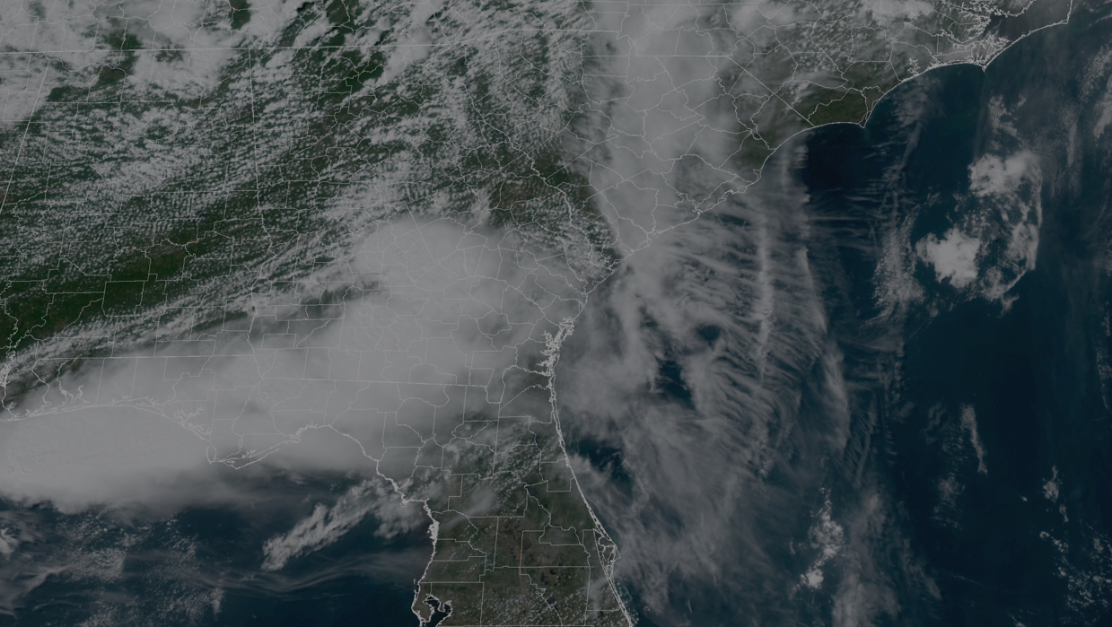
THANK YOU
Questions & Suggestions

Slide 20
Additional Slides

Slide 21
INNOVATION METRICS FOR WPO: NOFO’s, reviewing and selecting awards
Time to transition
Speed to meet milestones with measurable deliverables agreed upon by WPO and P.I.s
Will it be new and innovative by the time it gets into operations?
Do the users have enough time to be prepared for the innovation?
Cost Benefit
Is the potential of the innovation worth the cost?
Eventual profit from new ideas (either saves us money through the system processes or helping the economy by producing more accurate forecasts)
Mission Value
Contributes to WPO’s mission and is prioritized by both WPO and it’s stakeholders
The innovation plans to leave big impact on what we know about weather phenomena, forecasts, and communications
Risk metrics
What is the risk of this project? It should be proven to have potential but not already proven to succeed!
Highlight the reasons not to support the idea as well as the reasons to support it.
Where is it on the incremental vs radical scale?
User benefit
Is the change able to be a valuable improvement for different groups?
Is the change something that other people can learn and use?
Notes:
Ties into open innovation

Slide 22
INNOVATION METRICS FOR WPO: ORGANIZATIONAL
Number of ideas Generated
The more ideas generated (aka the more proposals submitted and the more room for innovative ideas thought of by employees), there’s a better chance that there will be innovations implemented that check all the boxes.
Number of Ideas Transitioned
Measuring the ideas transitioned shows how many innovations were developed and worked.
Highlight the ‘success stories’ as well as what we learned from the research that could not be implemented to operations.
Most of the time, a riskier idea does work by the time it gets to operations, and this can help overcome a risk averse culture.
Progress Report Metrics for PIs
What has the PI learned? Any trial and errors? What works? What doesn’t work? Did they meet the agreed deliverable at each milestone? What are their plans to re-evaluate the problem?
Finance measurements
How does WPO manages their budget on higher risk proposals?
Diversity of Awardees
Intellectual diversity leads to innovation when there’s a common language
Does the research proposal come from a person with unique expertise compared to other applicants?
Review criteria and reviewers can be biased against certain types of investigators who might bring value to WPO

