Slide 1
Investigating the Radiative Impact of Saharan Dust Aerosols on Medium Range Forecasts for African Easterly Waves in the Unified Forecast System
Christian Barreto-Schuler; Christopher Thorncroft; Sarah Lu; Dustin Grogan; Shih-Wei Wei

Slide 2
OUTLINE
1 BACKGROUND AND MOTIVATION
2 UFS EXPERIENCE and EXPERIMENTAL DESIGN
3 RESULTS
4 DISCUSSION AND FUTURE WORK
5 UFS FEEDBACK

Slide 3
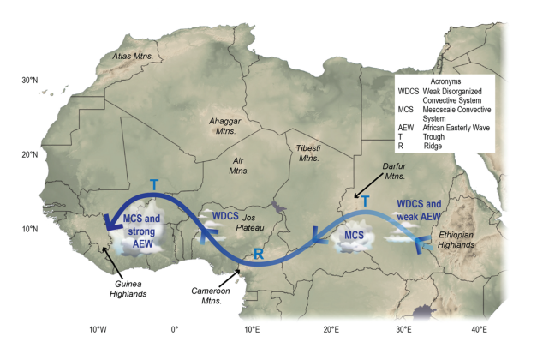
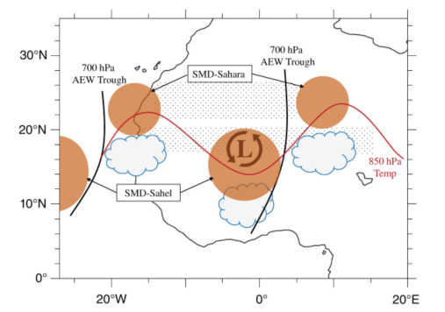
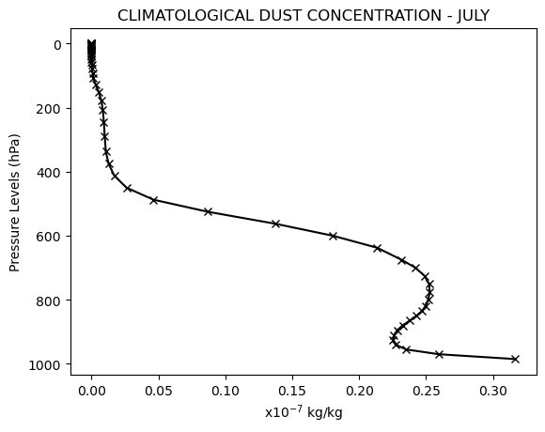
1. BACKGROUND AND MOTIVATION
African Easterly Waves (AEWs) are synoptic-scale disturbances that form over sub-Saharan Africa during the West African Monsoon season and are the primary precursor for Atlantic tropical cyclones (Russel et al, 2017).
Li and Sokolik (2018) point out that dust (a natural aerosol with average diameter between 0.1-100μm) is one of the most abundant aerosols on the Earth, which main source is the Sahara Desert (Bullard and Livingstone, 2009).
In addition, during the boreal summer, the dusty Saharan air layer is vertically extended from 850 to about 500 hPa, and more westward propagation of dust is enhanced. This behavior is mainly due to atmospheric features, such as low-level jets (LLJs), African easterly waves (AEWs), etc. (Grogan et al, 2017; Pu and Jin, 2021; Yu et al, 2021).
Semunegus et al. (2017)
Grogan and Thorncroft (2018)

Slide 4
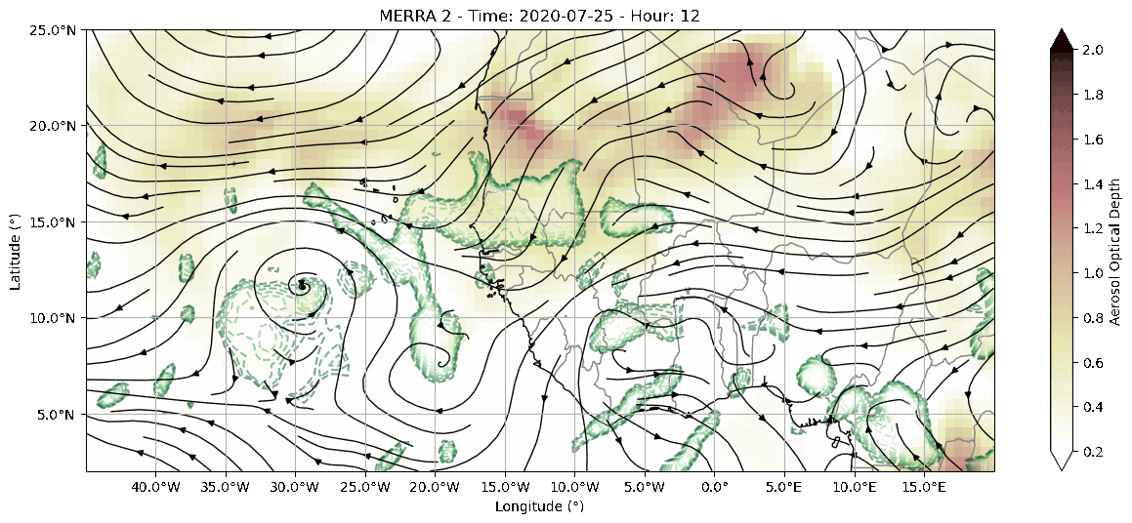
1. BACKGROUND AND MOTIVATION
African Easterly Waves (AEWs) are an essential part of the dynamics of northwestern Africa and plays an important role in the development of precipitation over Western Africa, the Tropical Atlantic region, and the Caribbean.
Our main goal is to evaluate how the increase of dust content in the atmosphere can affect the characteristic and properties of the AEWs.
Temporal evolution of Wind Circulation at 700 hPa (streams), precipitation greater than 1 mm/hr (green contours), and AOD 550nm (shaded) for the period of July 25th - 28th of 2020. Data: MERRA2.

Slide 5
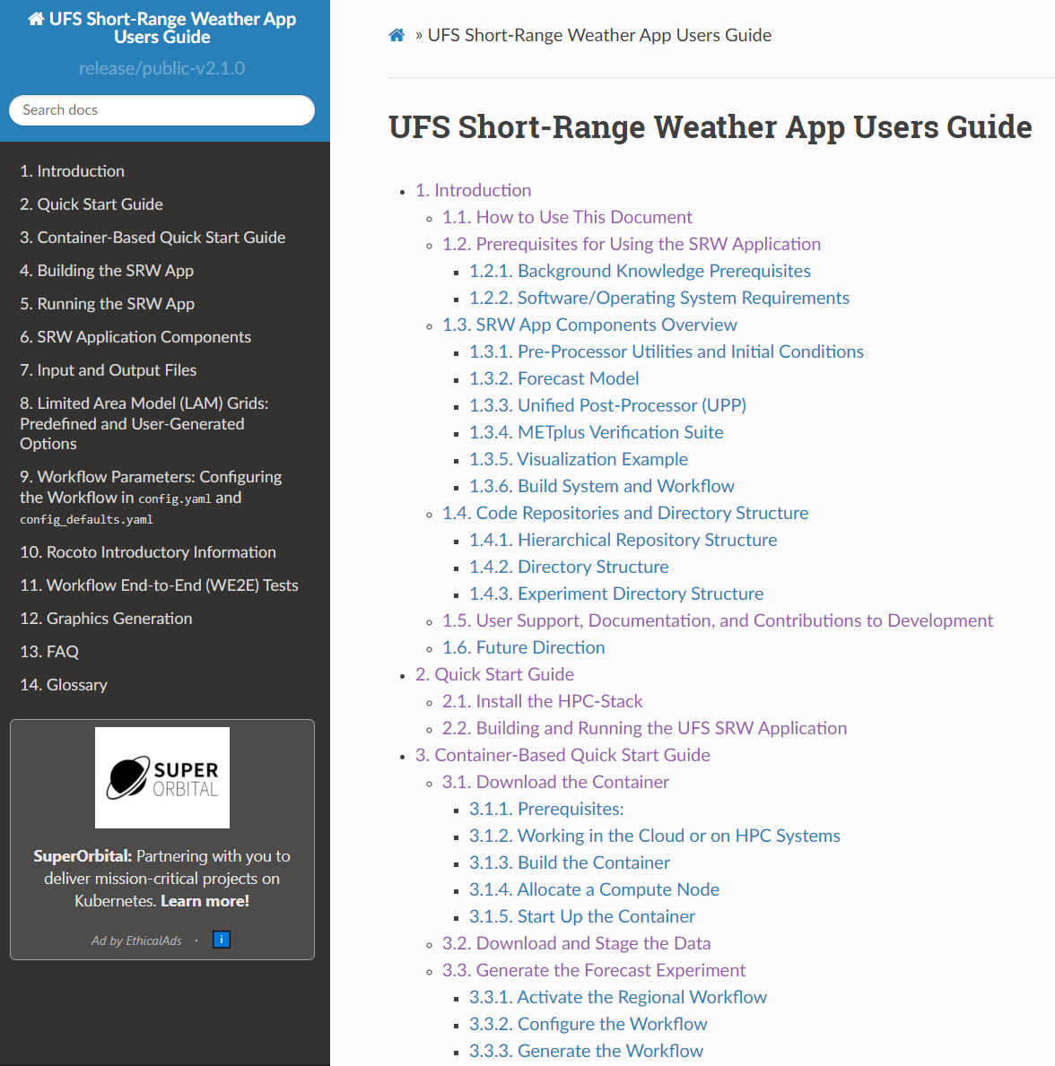
2. UFS EXPERIENCE and EXPERIMENTAL DESIGN

Slide 6
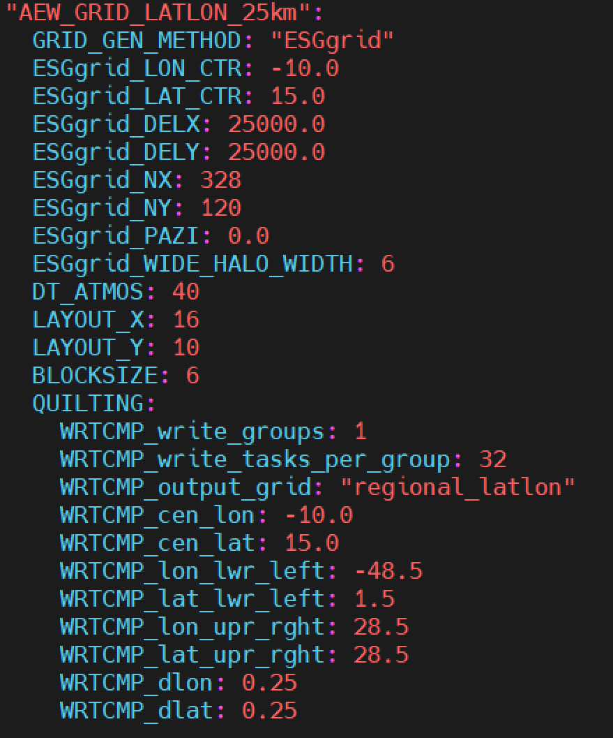
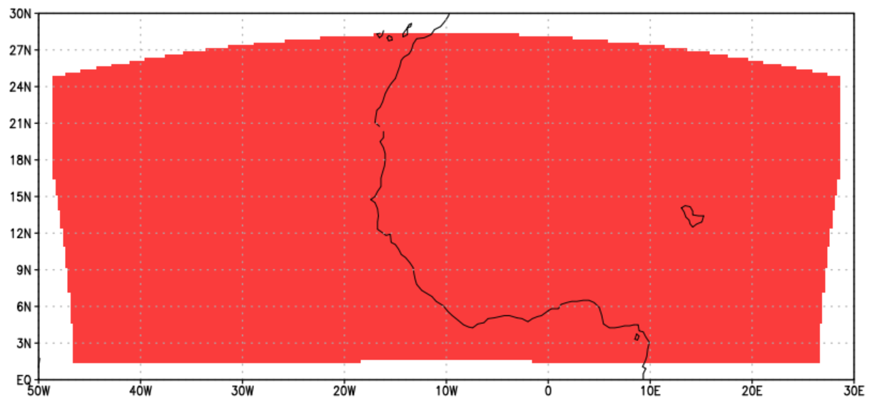
2. UFS EXPERIENCE and EXPERIMENTAL DESIGN
SETUP
Period:
2020-07-24T00:00 to 2020-07-30T00:00
Initialization data source:
GFS (0.5°x0.5°) / every 6 hrs
MERRA-2 CLIM. AEROSOL (0.625°x0.5°)
(iaer from 5111 to 1111)
Domain and grid spacing:
LatLon Projection scheme
Resolution of 25 km
328 x 120 points, centered at 10°W and 15°N
GRID_GEN_METHOD: ESGgrid

Slide 7
2. UFS EXPERIENCE and EXPERIMENTAL DESIGN
Physic Suite: GFS_v16
Two Simulations
 | GFS_v16
Radiation (SW/LW) | RRTMG
Microphysics (MP) | GFDL
Boundary Layer (PBL) | TKE-EDMF
Surface Layer (SL) | GFS
Gravity Wave Drag (GWD) | None
Land Surface Model (LSM) | Noah
Deep Convection (DCU) | Sa-SAS
Shallow Convection (SCU) | sa-MF
Lake Model (LM) | NSST
CONTROL (CTRL): UFS experiment with the original aerosols (dust) concentration from MERRA-2.
DUSTY_EXP (DU_EXP): UFS experiment with eight times the original Dust concentration (“simulating an extreme event”).

Slide 8
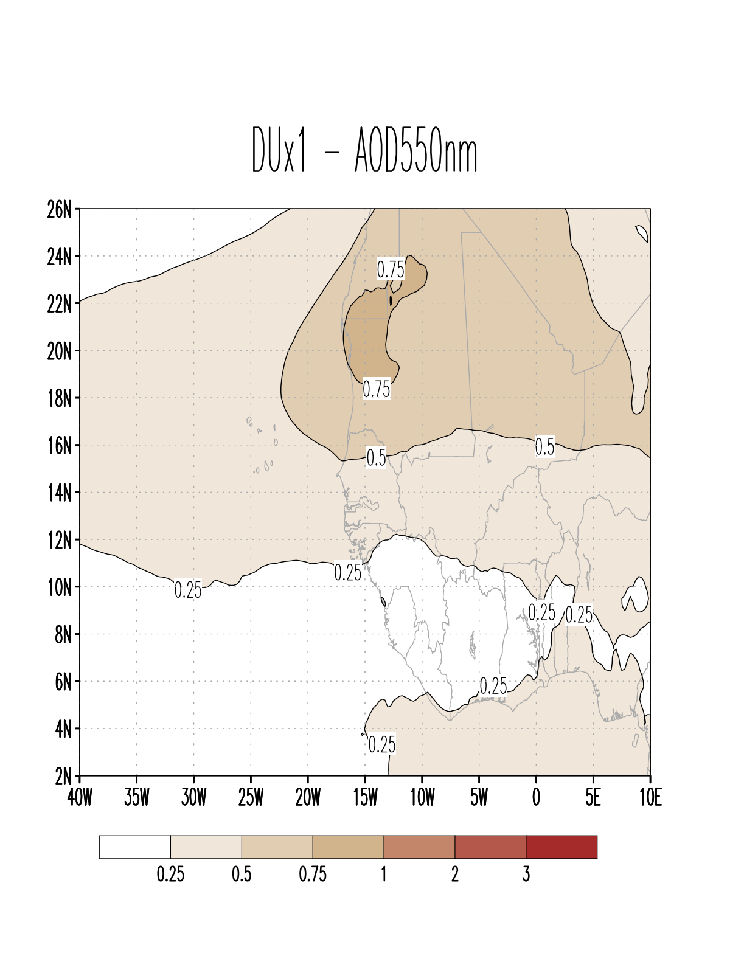
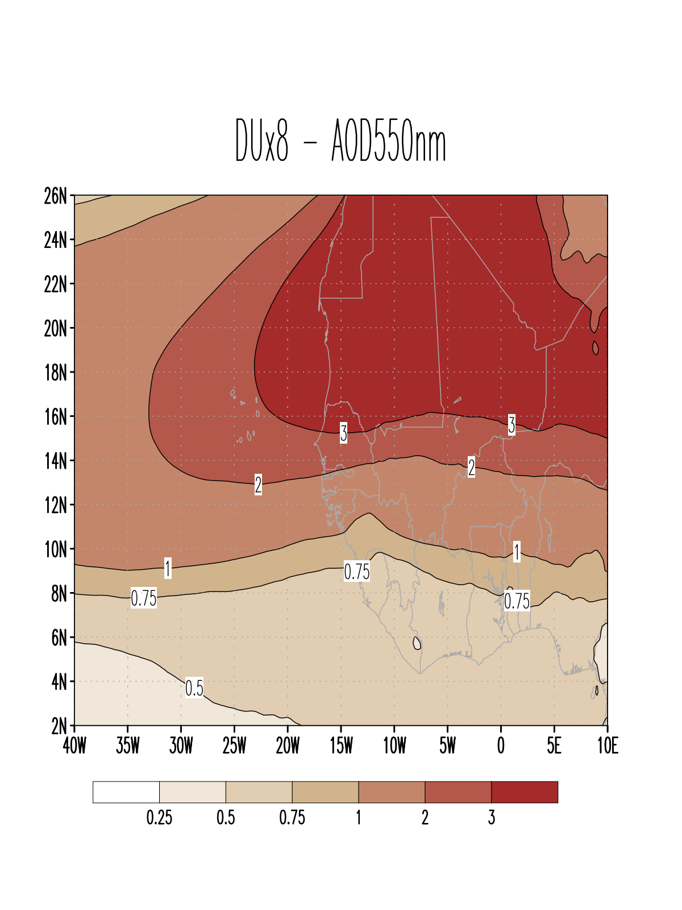
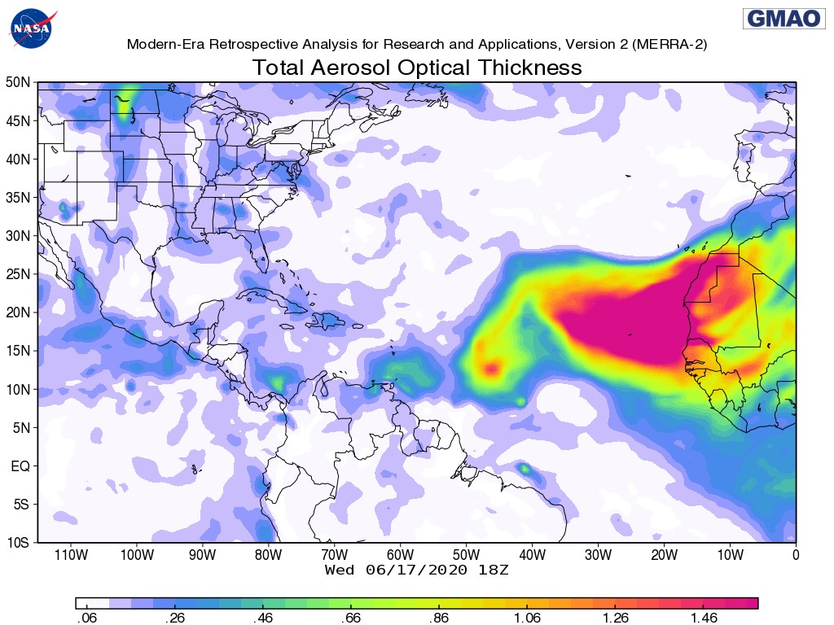
3. RESULTS: Aerosol Optical Depth (AOD) 550nm
CTRL
DU_EXP
REFERENCE
AOD for the CTRL simulation (Average over the period July 24th – 28th of 2020)
AOD for the DU_EXP simulation (Average over the period July 24th – 28th of 2020)

Slide 9
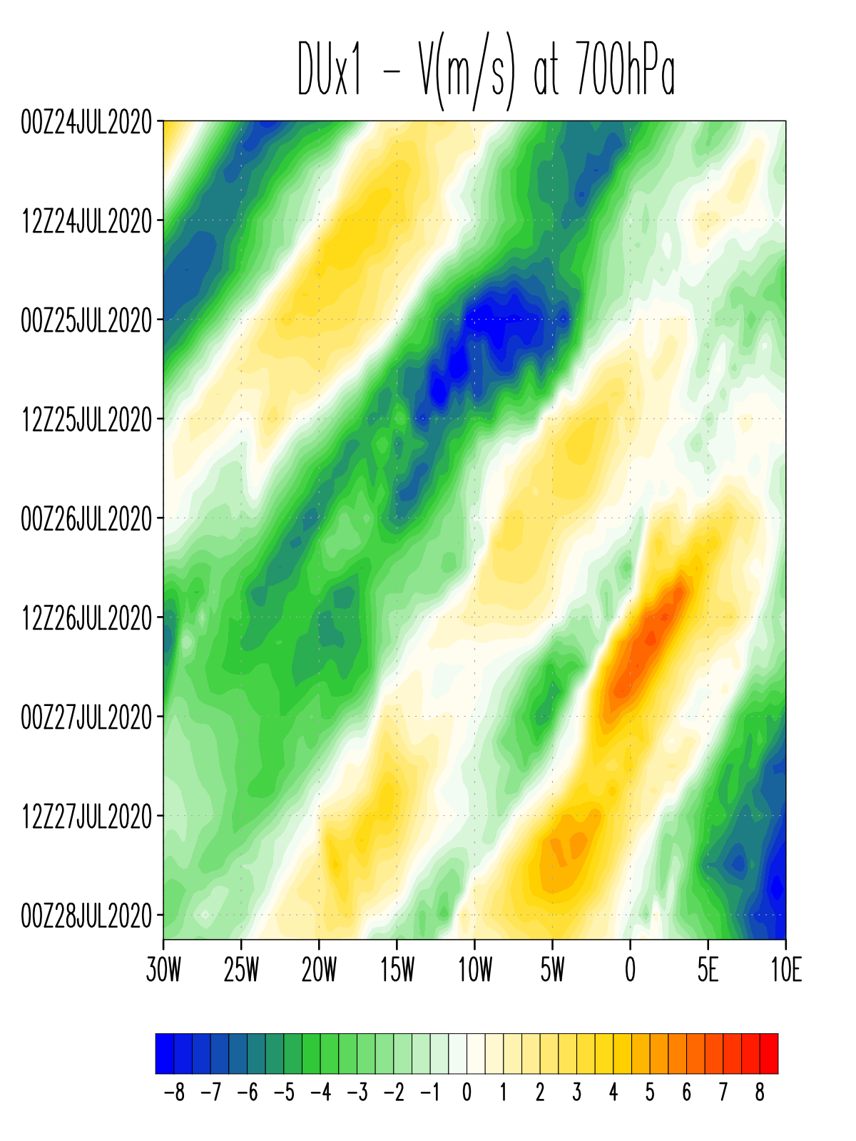
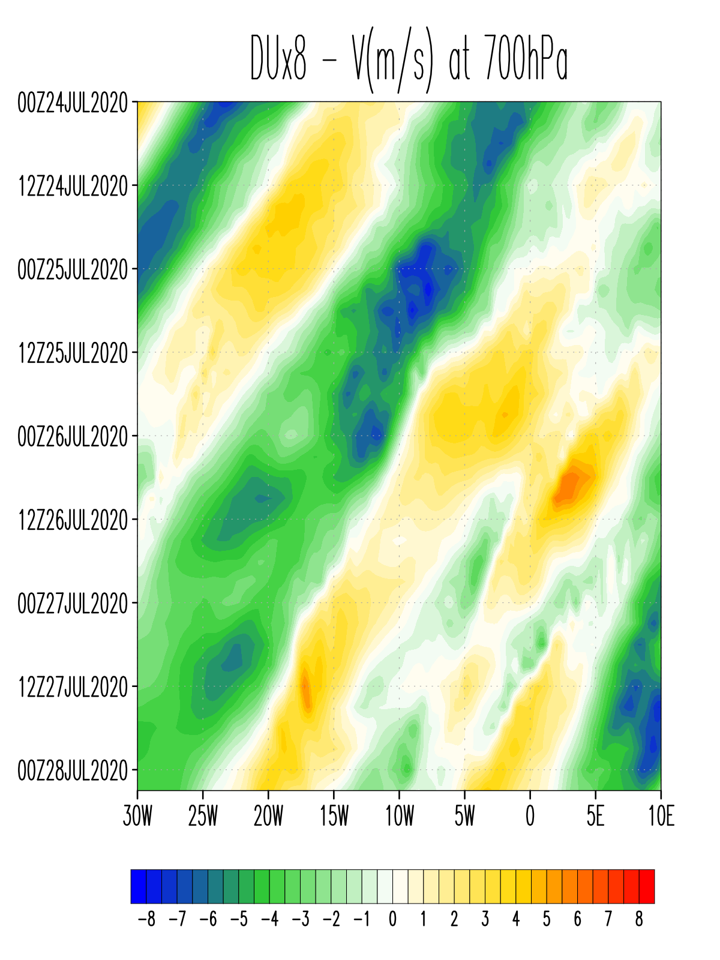
3. RESULTS: MERIDIONAL WIND AT 700hPa
CTRL
DU_EXP
Hovmoller Diagram
for meridional wind at
700 hPa for both experiments. Average from
10°N-20°N.

Slide 10
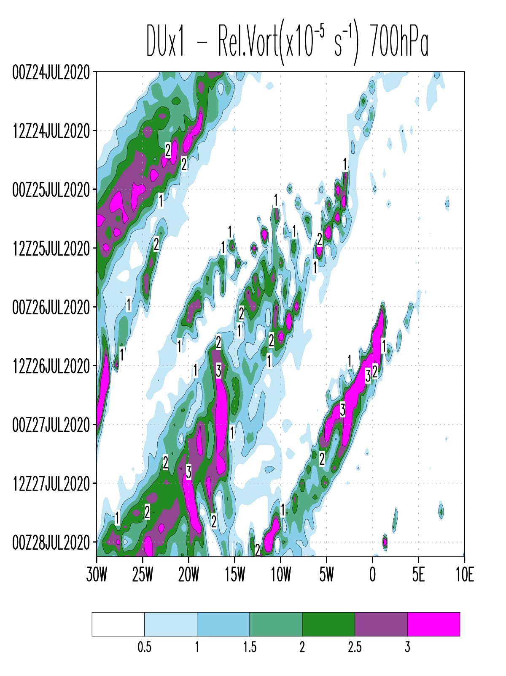
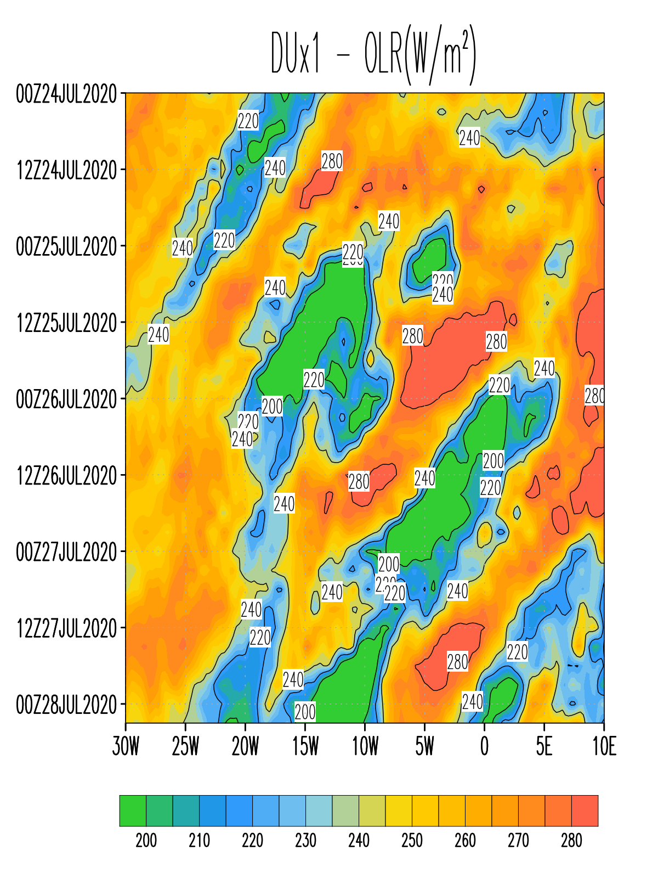
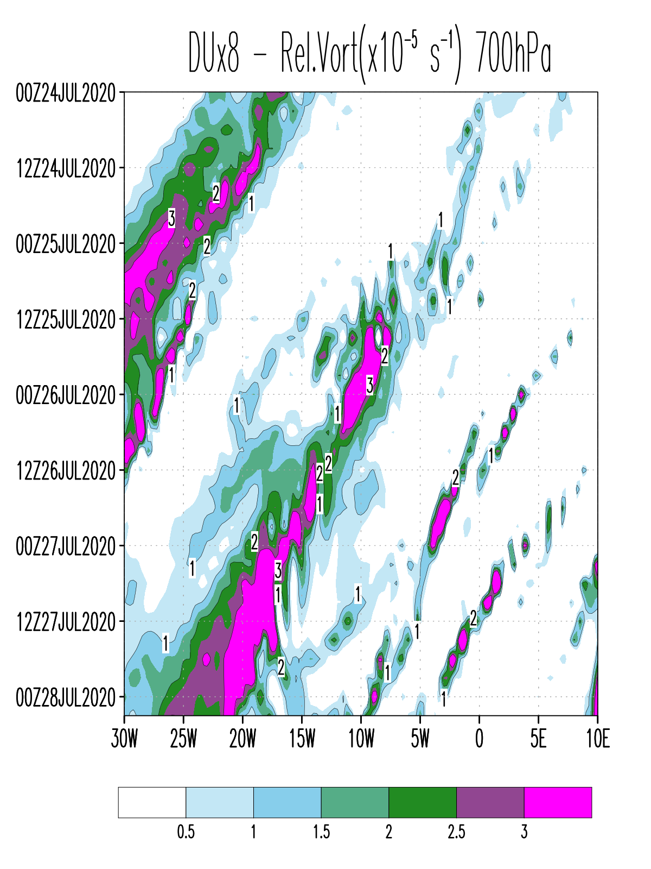
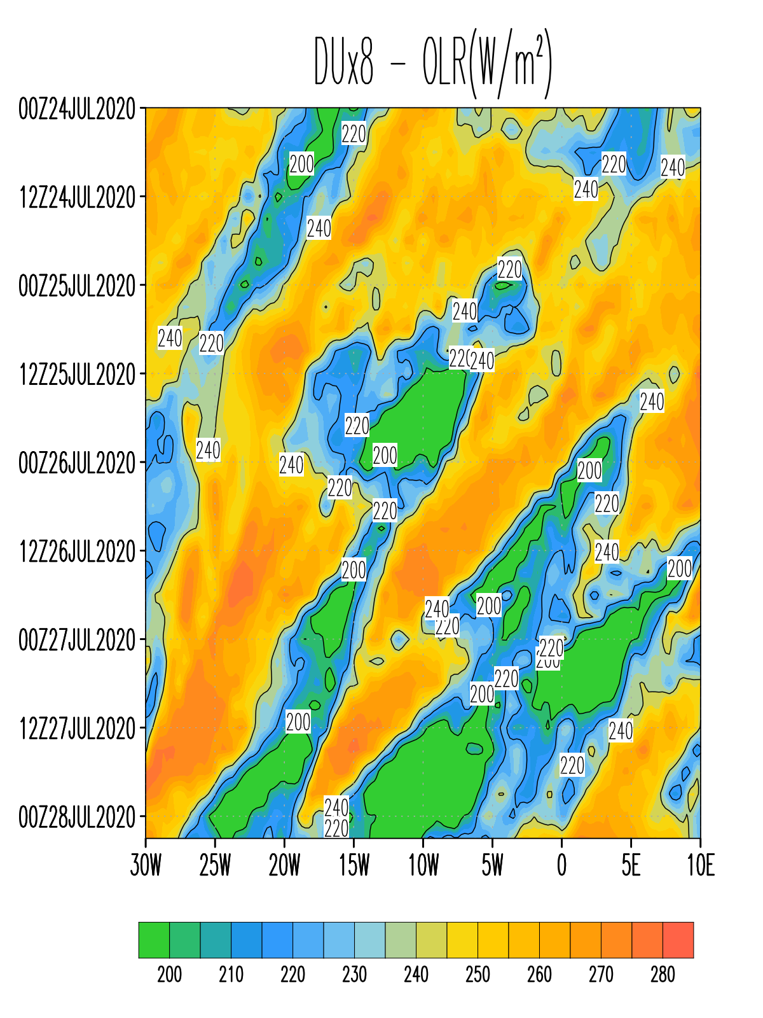
3. RESULTS: RELATIVE VORTICITY AT 700hPa and OLR
CTRL
DU_EXP
Hovmoller Diagram (10°N-20°N) of cyclonic vorticity at 700hPa and Outgoing Longwave Radiation (OLR) for the CTRL experiment
Hovmoller Diagram (10°N-20°N) of cyclonic vorticity at 700hPa and Outgoing Longwave Radiation (OLR) for the DU_EXP experiment

Slide 11
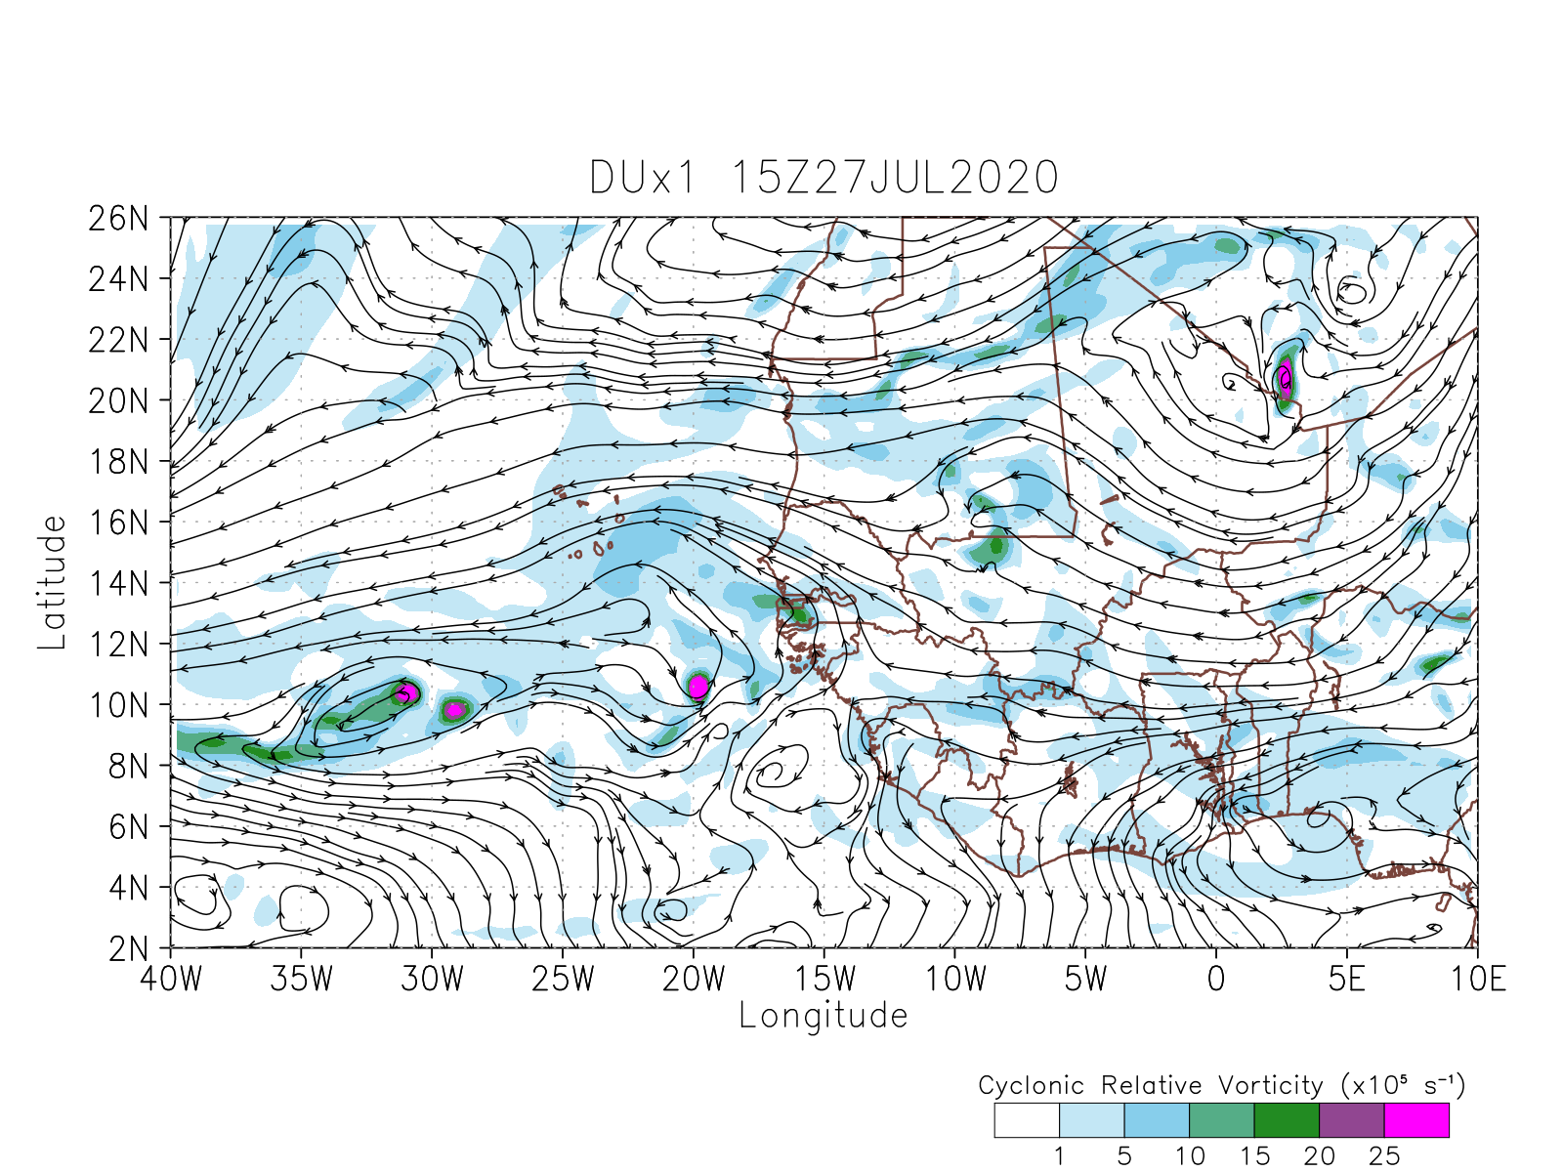
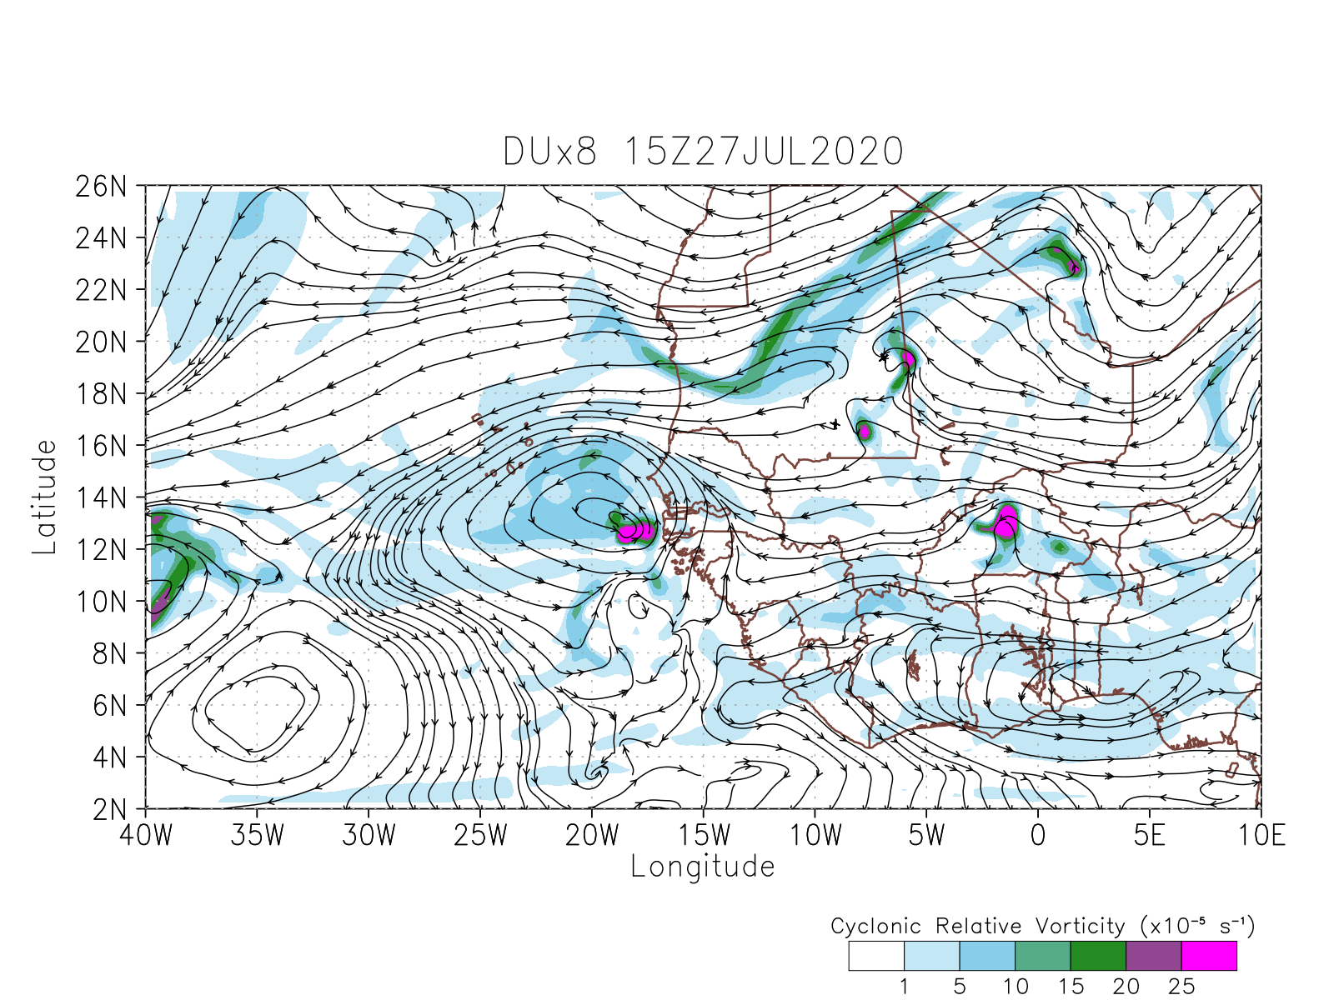
3. RESULTS: WIND CIRCULATION AND CYCLONIC VORTICITY AT 700hPa
CTRL
DU_EXP

Slide 12
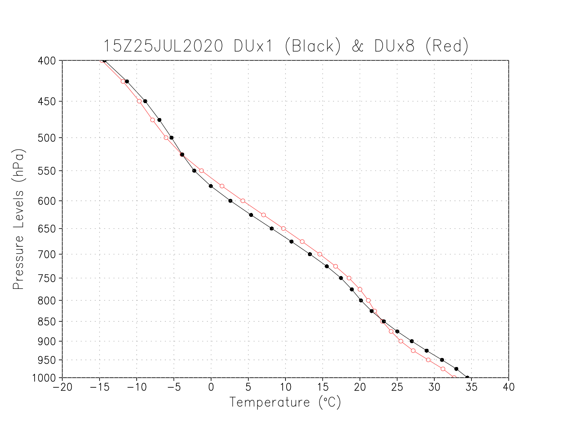
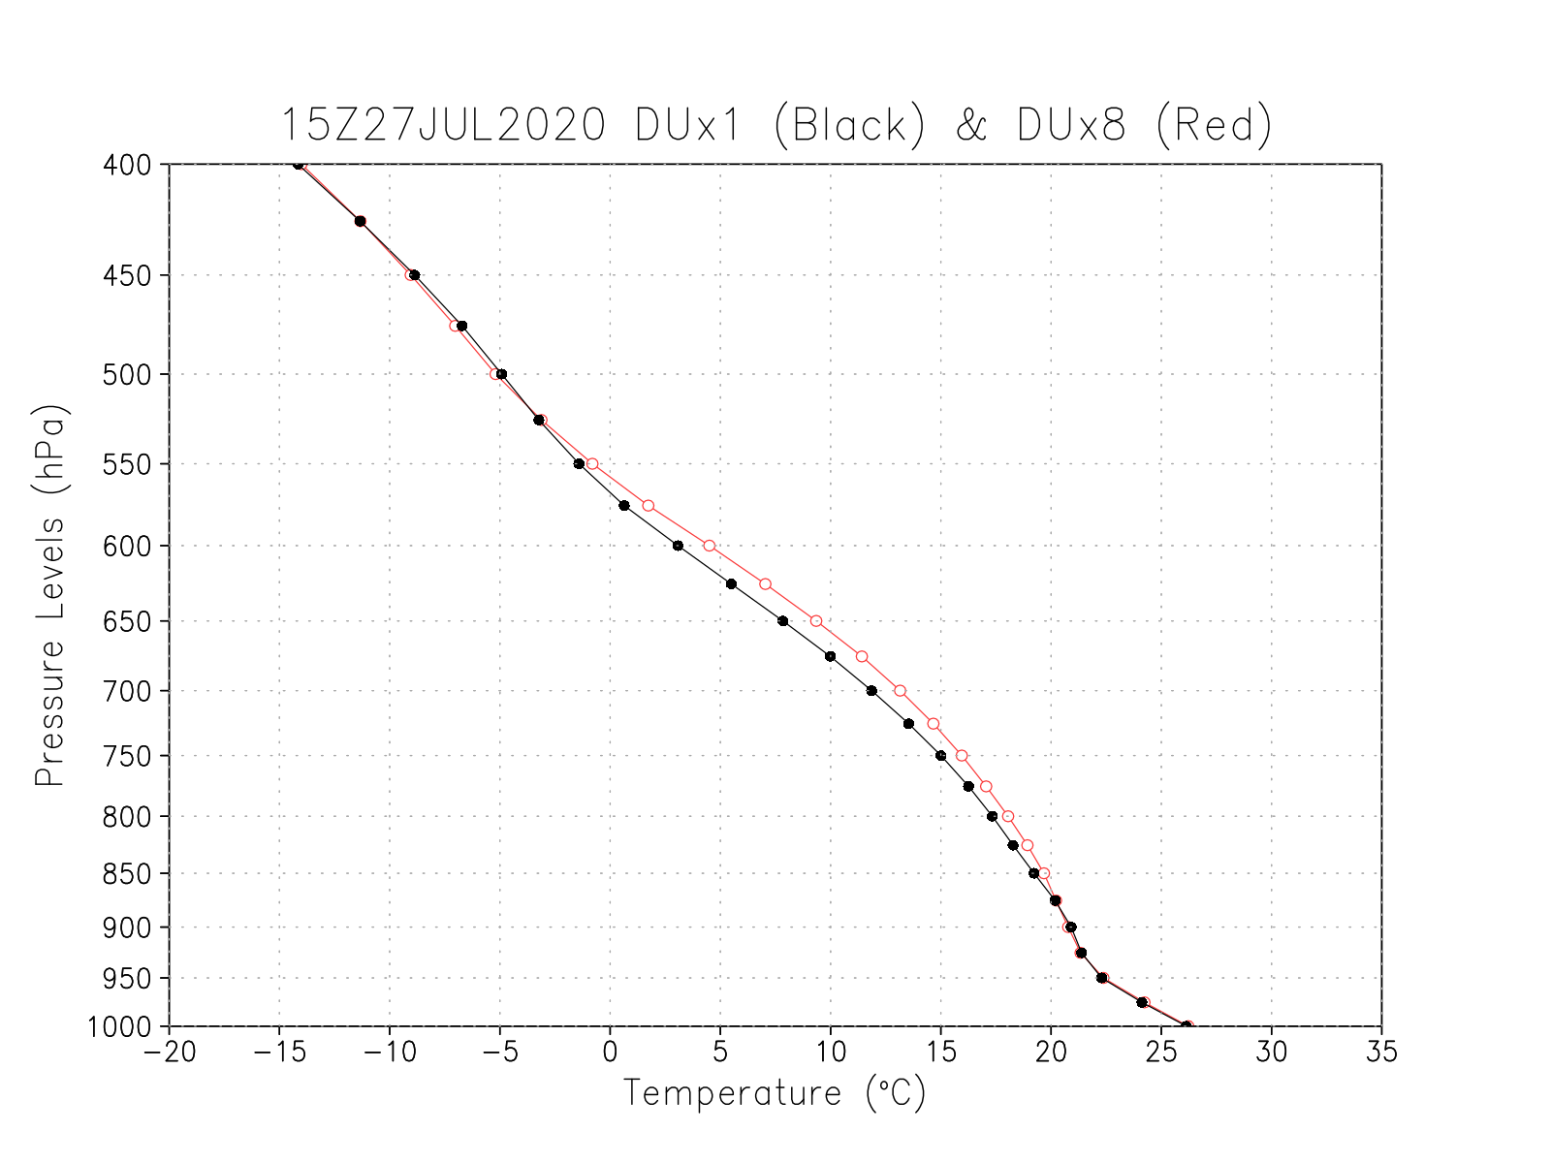
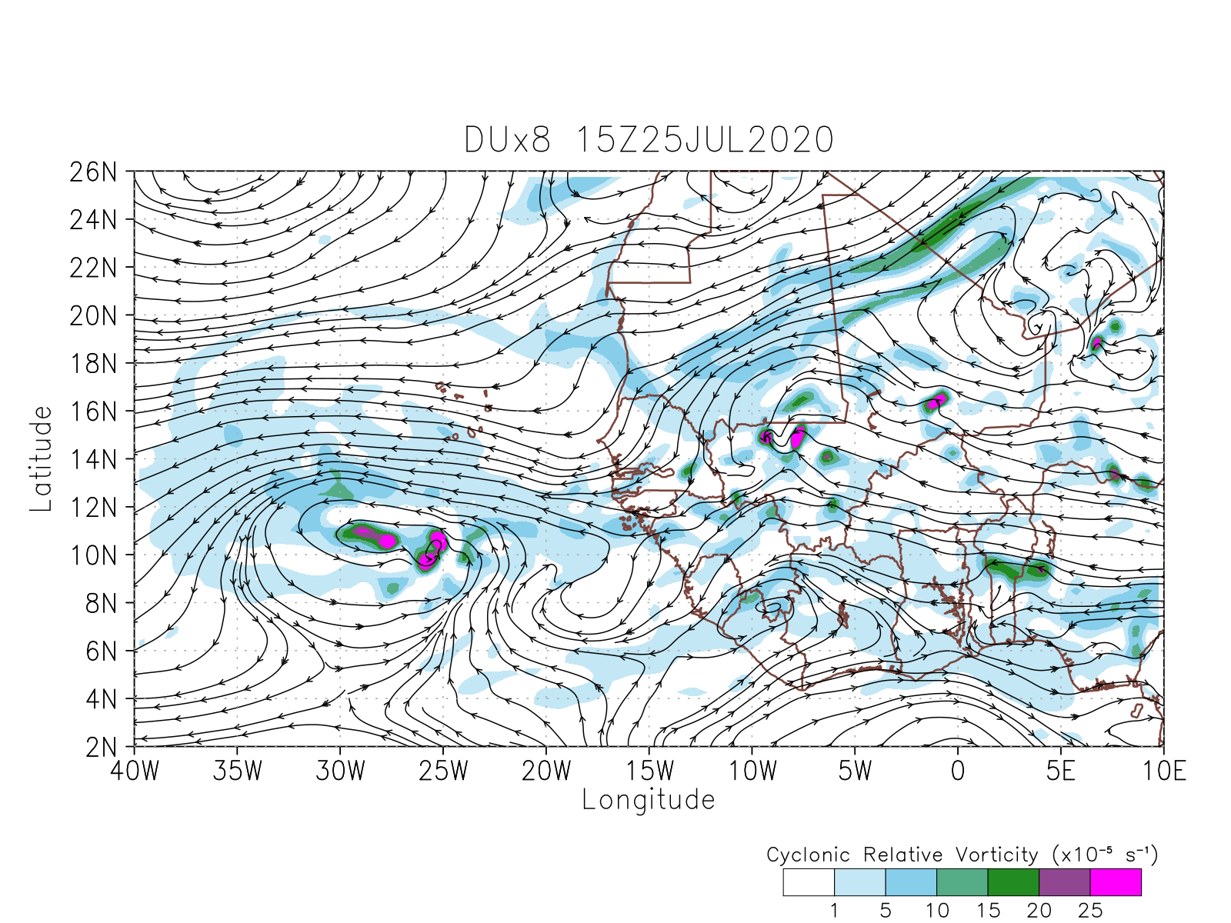
3. RESULTS: VERTICAL PROFILE OF TEMPERATURE
CTRL in Black and DU_EXP in Red
Average over 13°N-20°N and 15°W-0° for July 25th 15Z, 2020
Average over 11°N-18°N and 30°W-10°W for July 27th 15Z, 2020

Slide 13
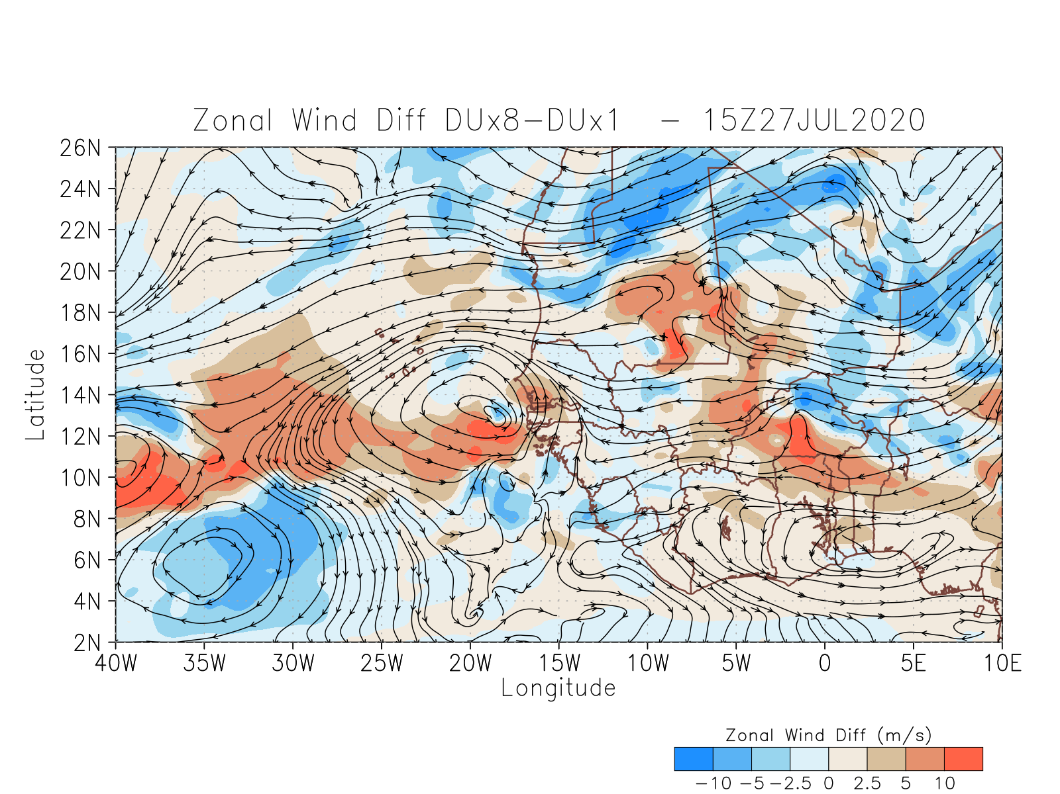
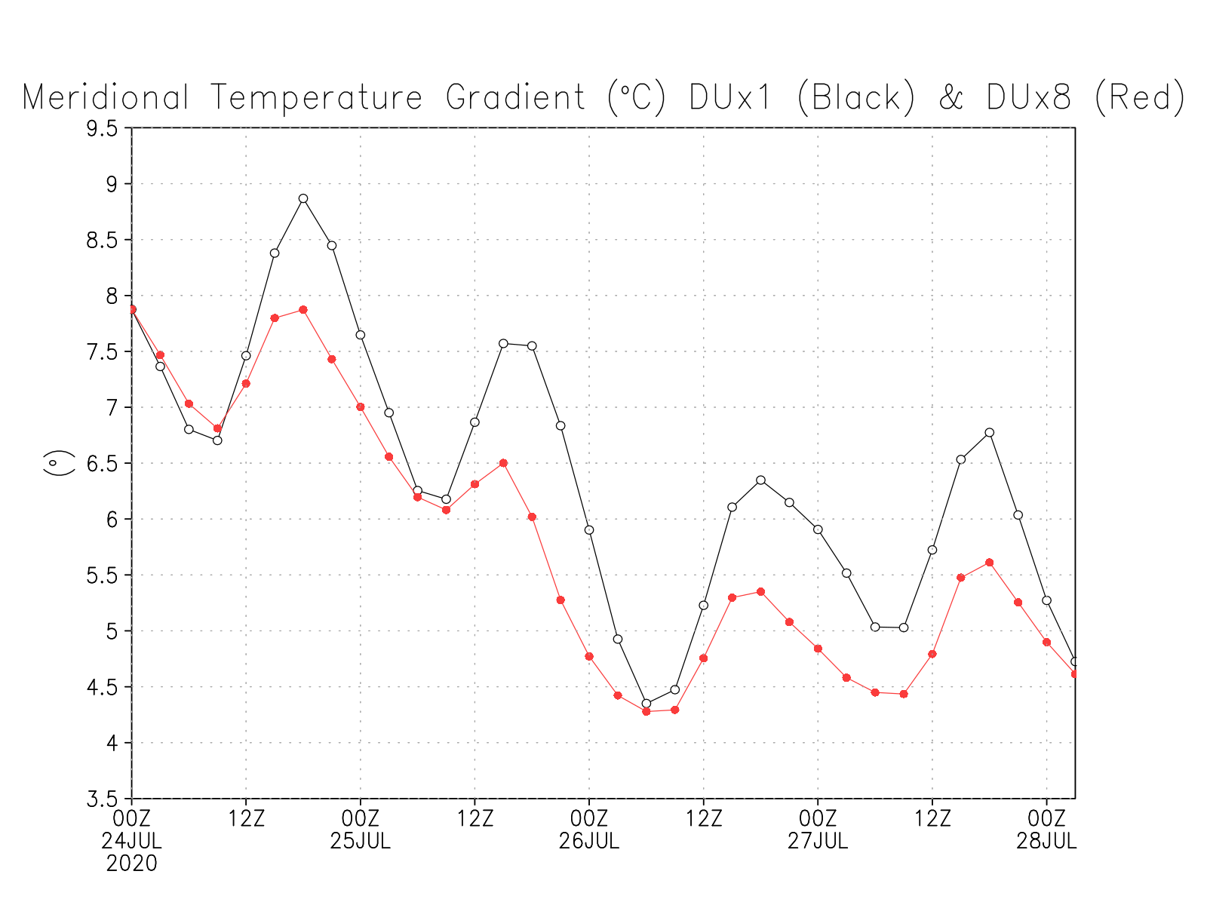
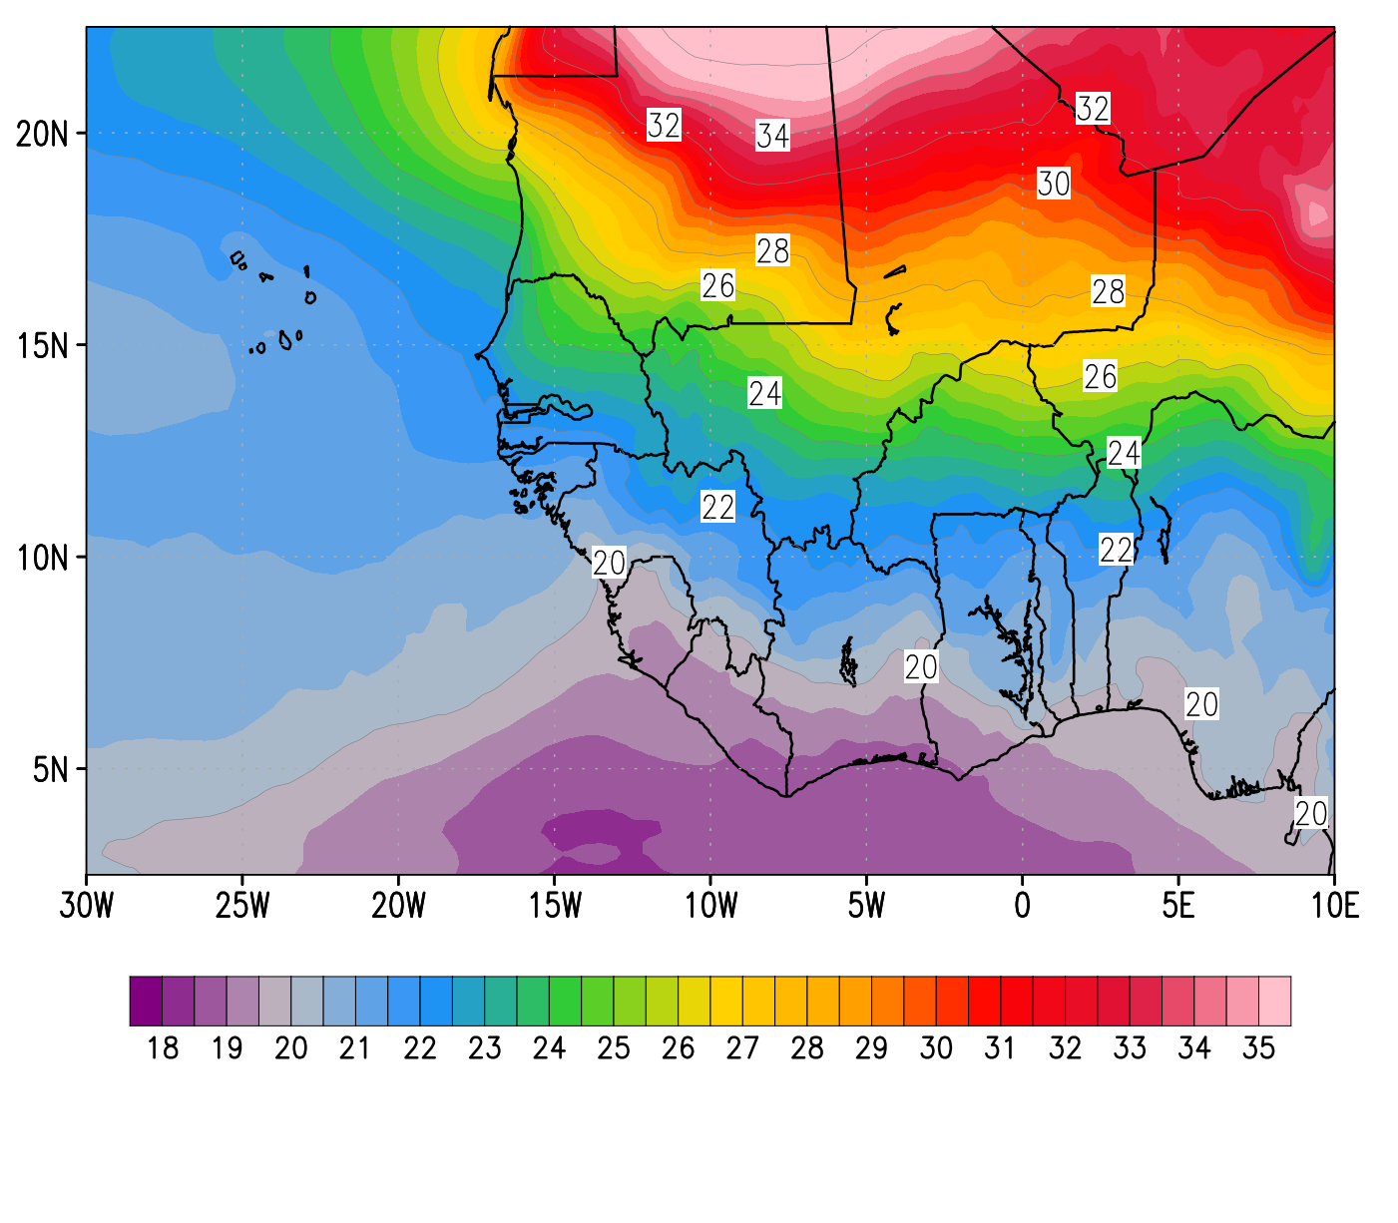
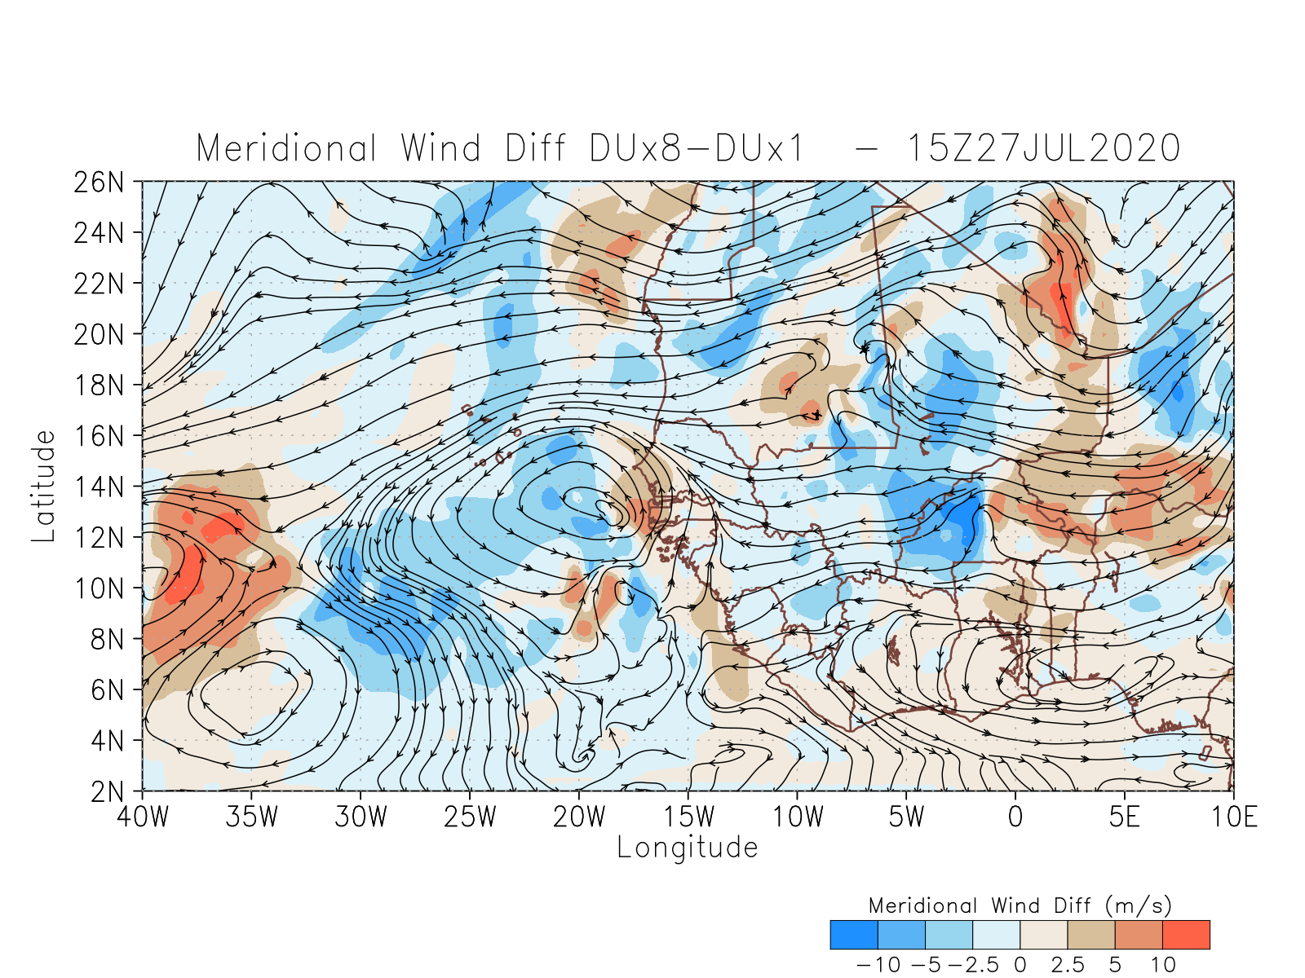
3. RESULTS: MERIDIONAL DIFFERENCE OF TEMPERATURE (1000-850hPa) and WIND DIFFERENCES
ZONAL WIND DIFF. AT 700hPa (DU_EXP - CTRL)
CTRL
TMPave(1000-850hPa)
CTRL in Black and DU_EXP in Red
MERIDIONAL WIND DIFF. AT 700hPa (DU_EXP - CTRL)
Spatial distribution of the Temperature (°C) in the lower troposphere (average from 1000-850hPa) over tropical northwestern African region.
Temporal evolution of the meridional temperature gradient (difference between the north and south section) for the CTRL and DU_EXP experiments.

Slide 14
4. PRELIMINARY RESULTS AND FUTURE WORK
Idealized UFS experiments were conducted. The dusty experiment exhibit the following features:
The wave structure looks “more defined” in the dusty experiment (DU_EXP), especially once the AEW is over the ocean.
More cyclonic vorticity along the AEW identified initially on July 24th. However, it is not necessary the case for the wave initialized on July 26th.
Generated less meridional temperature gradient in the lower troposphere, which led to less westward wind and a more meandering circulation.
Colder (warmer) temperatures are seen at the levels of 1000-850 hPa (850-550hPa). Once the wave is over the Atlantic ocean, there is no significant temperature differences in the lower troposphere.
More realistic UFS simulations will be conducted in the future.

Slide 15
5. UFS FEEDBACK
CODEFEST is a very effective way to spin-up. The EPIC team helped to solve technical issues via zoom virtual room.
The Users Guide provides detailed information covering many specific aspects. However, the Quick Start section can be further improved. Tutorials are needed for compiling/working in the cloud (AWS).
Some python and bash scripts could be improved or updated.
It would be helpful to provide the guidance on how to speed up the run in the Frequently Asked Questions (FAQ) section. For instance, by changing the LAYOUT_X and LAYOUT_Y numbers.

Slide 16
THANK YOU

