Slide 1

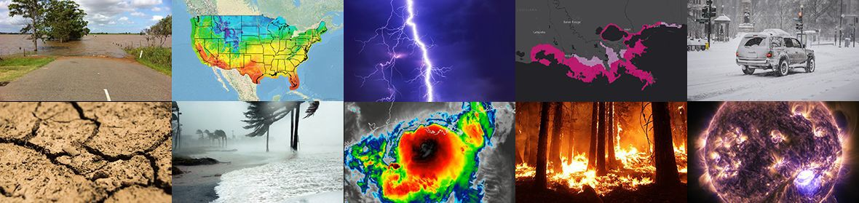
NOAA’s Seasonal Forecast System (SFS) Development Plan and SFS Application Team
Yan Xue¹, Kevin Garrett ¹, Jessie Carman ², Avichal Mehra ³, Philip Pegion⁴
¹ NOAA NWS Office of Science and Technology Integration
² NOAA OAR Weather Program Office
³ NOAA NWS Environmental Modeling Center
⁴ NOAA OAR Physical Science Laboratory
NATIONAL WEATHER SERVICE
UIFCW, Jul 24-28, 2023, Boulder, CO
Building a Weather-Ready Nation // ‹#›

Slide 2
FY23 Congressional Appropriations → Funding
“S2S Weather Prediction: The agreement provides $12,100,000 across NOAA line offices for its efforts to improve S2S Weather Prediction. This includes $5,000,000 in NWS Science and Technology Integration for the development of the Seasonal Forecast System and $7,100,000 for the S2S research program in the OAR U.S. Weather Research Program”
$5.0M
$7.1M
National Weather Service (NWS)
Oceanic & Atmospheric Research (OAR)
Development of Seasonal Forecast System (SFS)
Weather Program Office’s S2S Research Program

Slide 3
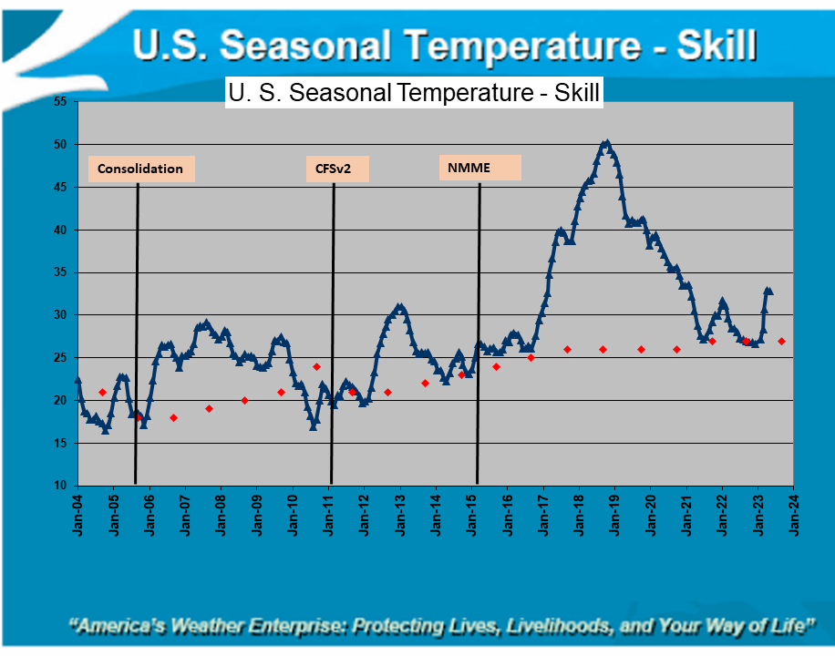
SFS Development Plan: 1. Introduction
Weather Act 2017 on Subseasonal and Seasonal (S2S) Prediction
  Subseasonal (2 weeks - 3 months)
  Seasonal (3 months - 2 years)
NOAA’s S2S Report to Congress (2020)
  Improving the skill of S2S forecasts
  Enhancing the value of S2S products for stakeholders
Progress and challenges in improving U.S. seasonal temperature skill
A recent degradation in forecast skill results from the inability of North American Multi-Model Ensemble (NMME) to accurately forecast cold anomalies (Becker et al. 2022).

Slide 4
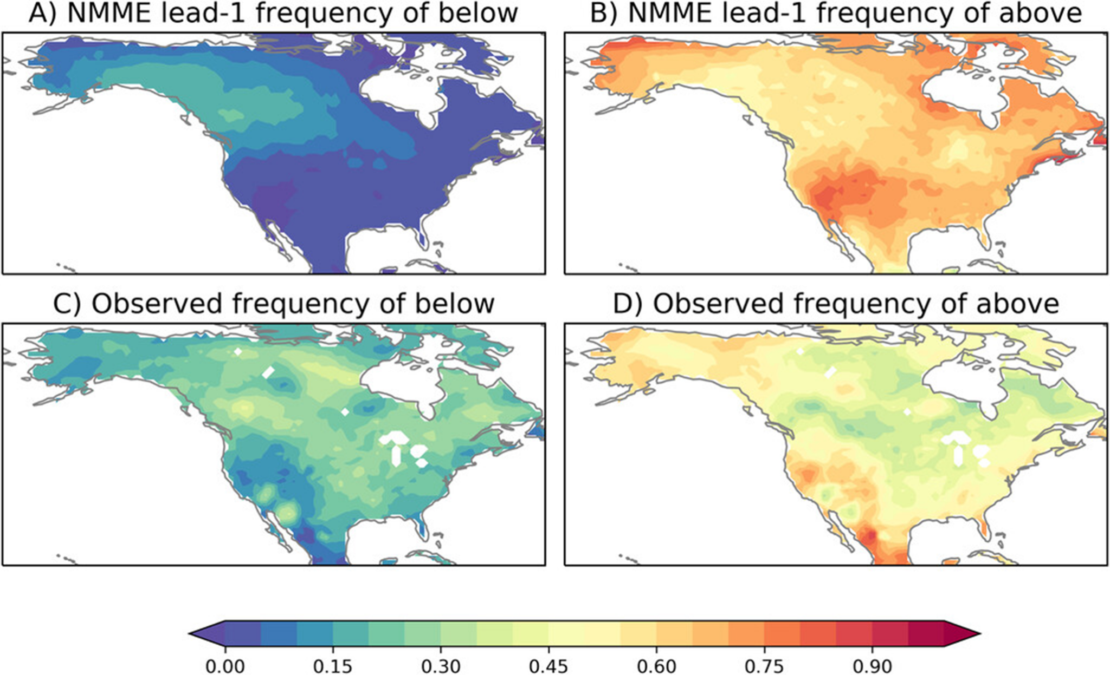
SFS Development Plan: 2. Goals and Objectives
Develop SFSv1 as a replacement of Climate Forecast System version 2 (CFSv2), a decade-old system
Address common errors in CFSv2 and NMME
  MJO propagation across Maritime Continent
  False ENSO alarms
  Positive SST trend errors in tropical Pacific
  Too frequent above-normal temperature forecast
  Too infrequent below-normal temperature forecast
Release the coupled SFS system to the public
Release reanalysis-reforecast data sets to the community
Becker et al. 2022

Slide 5
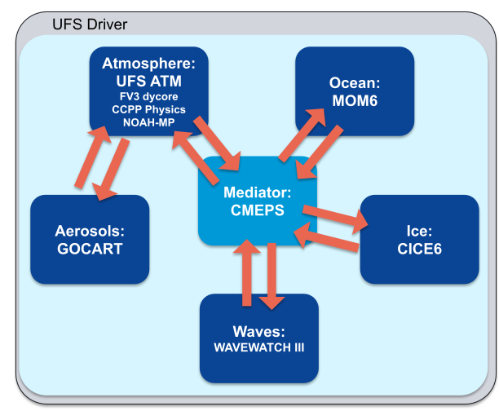
SFS Development Plan: 3. Transition to UFS Framework
Finite Volume Cubed Sphere (FV3) dynamical core
Common Community Physics Package (CCPP)
Noah-Multi Parameterization Land Surface Model (Noah-MP LSM)
Modular Ocean Model (MOM),
Los Alamos Sea ice model (CICE)
WAVEWATCH III wave model (WW3)
Goddard Chemistry Aerosol Radiation and Transport (GOCART)
Community Mediator for Earth Prediction System (CMEPS)
Joint Effort for Data Assimilation Integration (JEDI)
Enhanced Model Evaluation Tools (METplus)
MRW/S2S Applications:
GFSv17, GEFSv13, SFSv1

Slide 6
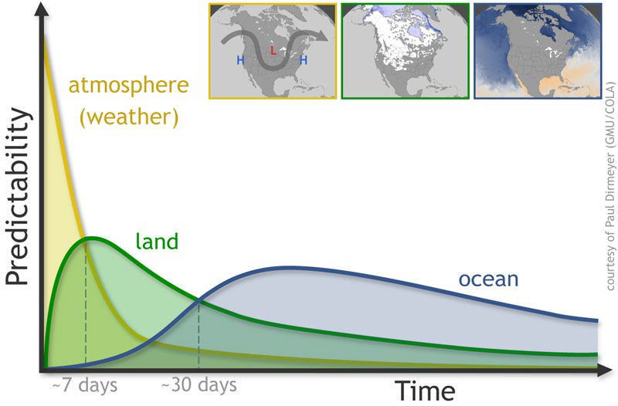
SFS Development Plan: 4. Research and Development Focus Areas
SFS Design, Testing and Analysis
Physics and Dynamics Improvements
Land Model Improvement
Ocean, Waves and Sea-Ice Model Improvements
Aerosol and Atmospheric Composition Improvements
Coupled Ensemble Strategies, Design and Development
Coupled Data Assimilation Developments and Observation
SFS Reanalysis & Reforecast*
SFS Infrastructure and Cloud Strategy*
Product Developments & Verification
* Key goals of project

Slide 7
SFS Development Goals
Coupled reanalysis should provide balanced initializations across interfaces between coupled model components that maximize source of long-term predictability, e.g. from ocean, sea ice and land
Coupled model should minimize systematic drift from initial conditions and minimize false alarms for extreme events, e.g. overconfident in El Nino forecast
Ensemble forecasts should provide best estimation of uncertainties
Improvements in physics/dynamics and model components should reduce systematic biases and improve forecast skill
SFS infrastructure should provide critical support to model coupling, testing, evaluation and eventual transition to operations
SFS developments should be incorporated into UFS repositories

Slide 8
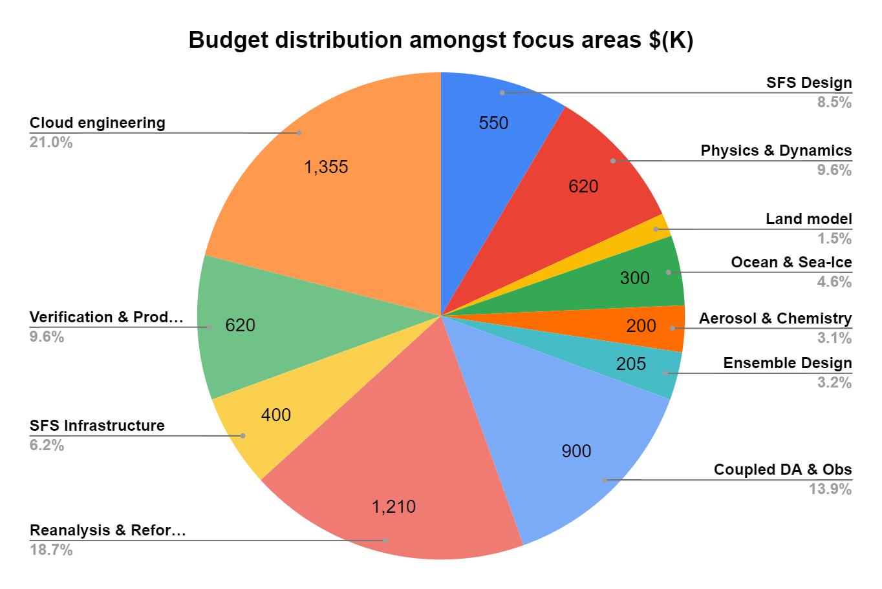








FY23 Budget for SFS Development:
$5.0M (NWS)
$1.46M (OAR)
PSL

Slide 9
SFS Application Team (Co-Leads: Avichal Mehra, Phil Pegion)
SFS Design, Testing and Analysis (Leads: Avichal Mehra, Shan Sun, Wanqiu Wang)
Physics and Dynamics Improvements (Leads: Fanglin Yang, Ligia Bernardet, Lisa Bengtsson)
Land Model Improvement (Leads: Mike Barlage, Clara Draper)
Ocean, Waves and Sea-Ice Model Improvements (Leads: Shan Sun, Wanqui Wang, Neil Barton)
Aerosol and Atmospheric Composition Improvements (Lead: Ivanka Stajner)
Coupled Ensemble Strategies, Design and Development (Leads: Philip Pegion, Yuejian Zhu, Neil Barton)
Coupled Data Assimilation Developments and Observation (Leads: Daryl Kleist, Sergey Frolov)
SFS Reanalysis & Reforecast (Leads: Sergey Frolov, Daryl Kleist, Phil Pegion, Yuejian Zhu)
SFS Infrastructure and Cloud Strategy (Leads: Arun Chawla, Rahul Mahajan, Jun Wang, Denise Worthen, Phil Pegion)
Product Developments & Verification (Leads: Wanqiu Wang, Jason Levit, Tara Jensen, Juliana Dias)

Slide 10
SFS Year 1 Plan (Oct 1, 23 - Sep 30, 24)
SFS design & testing and analysis
  Phase I reforecast configuration: 1-degree, GEFSv13 based, 3-month lead time, 30-years of Jan. and Jun. starts; Initialized with GEFSv13 replay to ERA5 atmosphere, ORAS5 ocean/sea ice; 10-ensemble members, stochastic physics
  Physics & dynamics upgrades focusing on improving ENSO, MJO, QBO, tropical convection
  Land upgrades focusing on improving vegetation, soil moisture, snow physics
  Ocean and sea ice upgrades focusing on improving sea ice, air-sea fluxes, reducing SST bias and long-term drift
  Aerosol upgrades focusing on impacts on meteorology

Slide 11
SFS Year 1 Plan (Oct 1, 23 - Sep 30, 24)
Coupled data assimilation & reanalysis
  Retrieve, reformat, and stage reprocessed datasets for 1980-present on Cloud
  Test weakly coupled data assimilation system through specific periods of interest
  Generate a scout run at 1-degree for 40-years
SFS infrastructure and cloud strategy
  Improve model component testing, energy conservation, develop global workflow supported on both RDHPCS and Cloud
Verification and product development
  Verification and diagnostics package, science evaluation to meet stakeholder needs

Slide 12
We welcome feedback and
seek collaboration!
Yan Xue: NWS/OSTI-Modeling, S2S Lead, Yan.Xue@noaa.gov
Kevin Garrett: NWS/OSTI-Modeling, Director, Kevin.Garrett@noaa.gov
Jessie Carman: OAR/WPO, S2S Program Manager, Jessie.Carman@noaa.gov
Avichal Mehra: NWS/NCEP/EMC, Co-Lead SFS AT, Avichal.Mehra@noaa.gov
Philip Pegion: OAR/PSL, Co-Lead SFS AT, Philip.Pegion@noaa.gov

Slide 13
Ten Research & Development Focus Areas
Physics & Dynamics
Coupled DA and Obs. Processing
Ensemble Development
Land
SFS Design, Testing and Analysis
Reanalysis & Reforecast
Ocean, Sea Ice and Waves
Verification & Product Development
Atmospheric Composition
SFS Infrastructure and Cloud Strategy

Slide 14
NWS Weather, Subseasonal, Seasonal Forecast Systems:
Transition to Global Coupled UFS-based Systems
Current Systems
GFS v16 (since March 2021)
Weather (0-14 days), deterministic, no coupling with ocean/ice. FV3
GEFS v12 (since September 2020) Subseasonal (0-35 days), ensemble, no coupling with ocean/ice. FV3
CFS v2 (since March 2011)
Seasonal (0-9 months), ensemble,
coupled with ocean/ice. Spectral Atm/MOM4 Ocean/SIS1 Sea ice
Future UFS Systems
GFS v17
(T2O Phase)
GEFS v13
(T2O Phase)
SFS v1
(Planning Phase)
UFS System Configuration

Slide 15
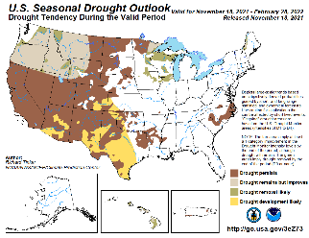
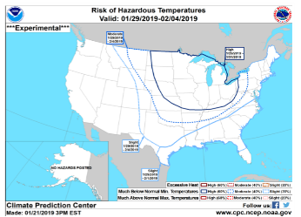
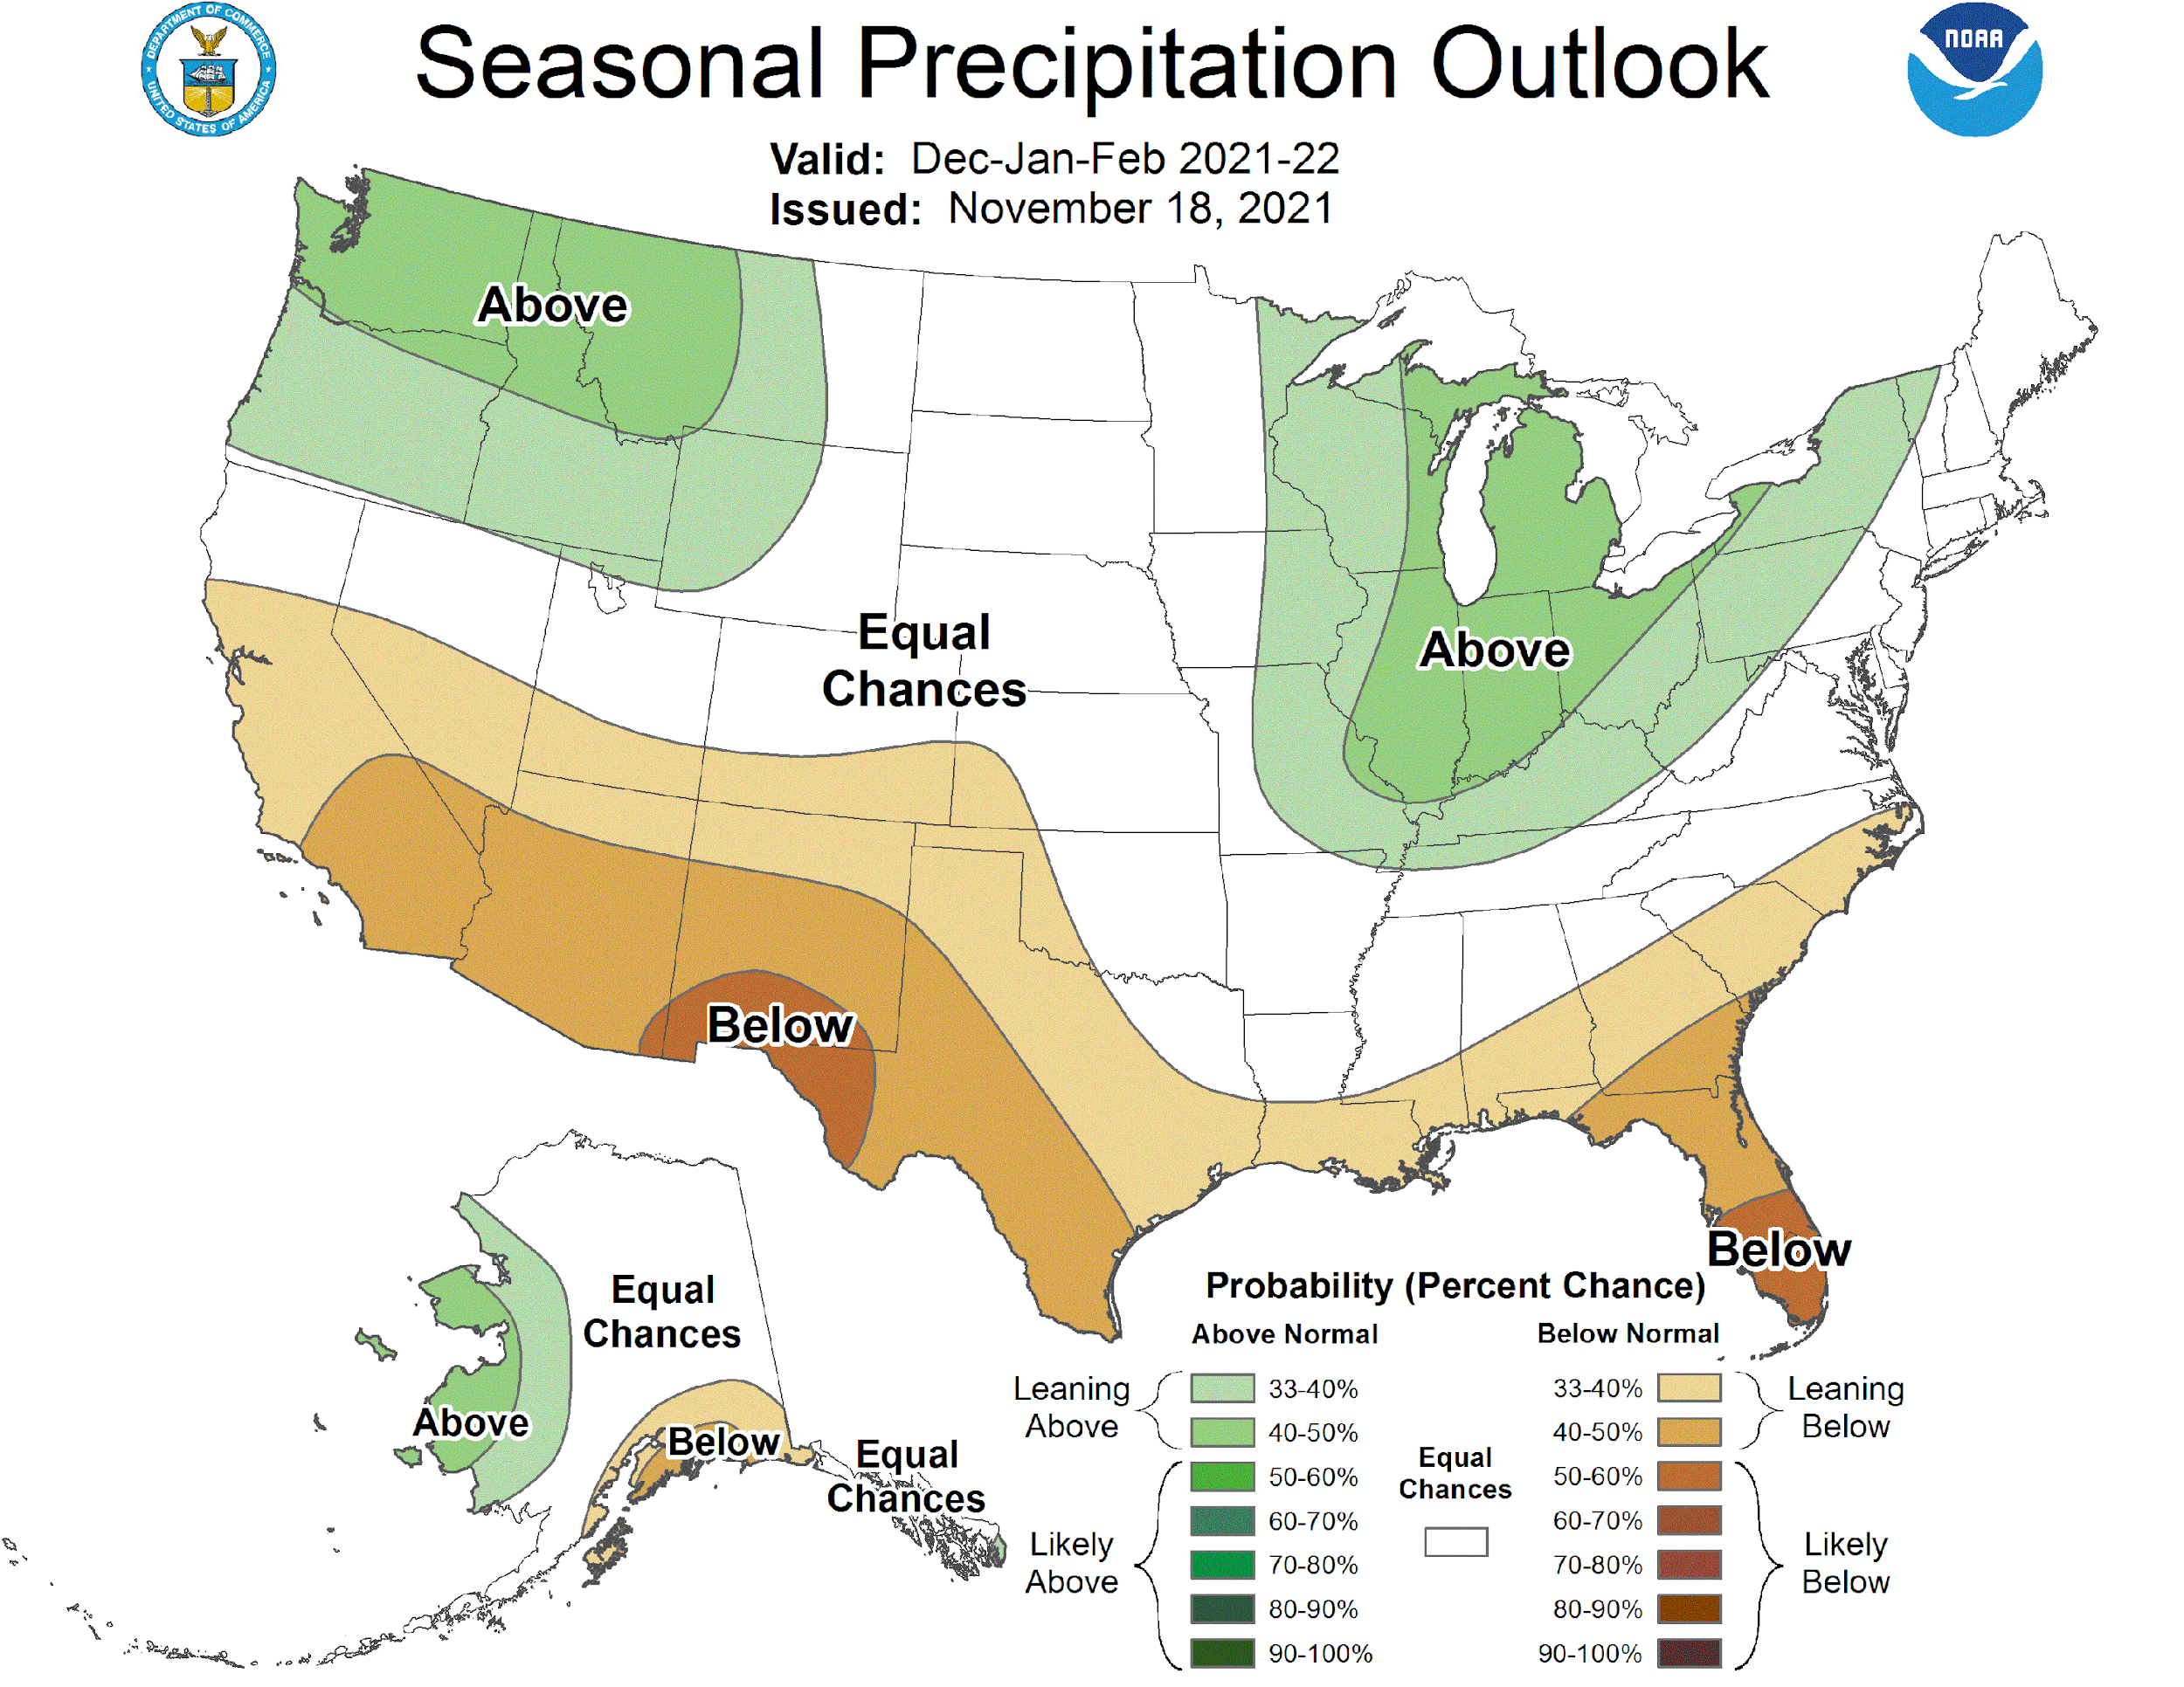
NWS Subseasonal-to-Seasonal Forecast
Temperature and Precipitation Outlooks (CONUS, AK, HI)
  Week 2, Week 3-4, Monthly, and Seasonal
Monthly and Seasonal Drought Outlooks (CONUS, AK, HI)
US Hazards Outlook
  Week 2 extremes of temperature, precipitation, and wind
Global Tropics Hazard Outlook
  Weeks 2-3 extremes of temperature and precipitation, and potential of tropical cyclones
Seasonal Hurricane Outlook
ENSO Prediction
Arctic Sea Ice Prediction
  Weeks 1-6, Monthly, and Seasonal

