Slide 1
Diagnosing Sea Ice in the Unified Forecast System (UFS)
Neil Barton¹, Robert Grumbine¹, Dmitry Dukhovskoy¹, Philip Pegion², Avichal Mehra¹
¹NOAA/ NWS/ NCEP/ EMC, ²NOAA / OAR / PSL
2023 UIFCW, July 28th, 2023

Slide 2
Acknowledgement to UFS Coupled Prototype Active Developers
Atmospheric Physics NCEP/EMC: Shrinivas Moorthi, Jongil Han, Michael Barlage, Helin Wei, Anning Cheng, Bing Fu, Wei Li, Ruiyu Sun, Rongqian Yang, Qingfu Liu, Weizhong Zheng, Sajal Kar, Alexei Belochitski, Yihua Wu, Eric Sinsky, Bo Yang, Hong Guang, Xu Li, Fanglin Yang ESRL/GSL: Dom Heinzeller, Shan Sun, Michael Toy, Ben Green, Tanya Smirnova, Joseph Olson ESRL/PSL: Philip Pegion, Lisa Bengtsson, Clara Draper, Jian-Wen Bao, Songyou Hong, Dustin Swales DTC: Weiwei Li, Ligia Bernardet Catholic University of America: Valery Yudin | Coupled Model Component Development NCEP/EMC: Jessica Meixner, Jiande Wang, Lydia Stefanova, Shrinivas Moorthi, Jun Wang, Denise Worthen, Robert Grumbine, Bing Fu, Ali Abdolali, Bin Li, Minsuk Ji, Matthew Masarik, Walter Kolczynski, George Gayno, Yuejian Zhu, Neil Barton, Arun Chawla, Avichal Mehra ESRL/GSL: Shan Sun, Ben Green ESRL/PSL: Phillip Pegion, Lisa Bengtsson GFDL: Brandon Reichl, Alistair Adcroft, Robert Halberg, Stephen Griffies, Rusty Benson, Marshall Ward, Matthew Harrison NCAR: Rocky Dunlap, Mariana Vertenstein, Alper Altuntas, Gustavo Marques, Gokhan Danabasoglu, Keith Lindsay NRL/ESMF: Gerhard Theurich GMU: Cristiana Stan, Ben Cash, Jim Kinter, Lawrence Marx FSU: Eric Chassignet, Alan Wallcraft, Alexandra Bozec NASA: Akella Santha Univ. Alaska: Katherine Hedstrom U. Mich.: Christiane Jablonowski Univ. Victoria: Andrew Shao
Atmospheric Composition NCEP/EMC: Raffaele Montuoro, Li Pan, Partha Bhattacharjee, Walter Kolczynski, Jeff McQueen, Ivanka Stajner ARL: Barry Baker, Patrick Campbell, Rick Saylor ESRL/GSL: Li (Kate) Zhang, Shan Sun, Georg Grell CSL: Siyuan Wang, Jian He, Stuart McKeen, Gregory Frost NESDIS/STAR: Xiaoyang Zhang, Ethan Hughes, Shobha Kondragunta | Coupled Model Evaluation NCEP/EMC: Lydia Stefanova, Jiande Wang, Partha Bhattacharjee, Sulagna Ray, Wei Li, Michael Barlage, Weizhong Zheng, Robert Grumbine, Huug van den Dool, Avichal Mehra CPC: Wanqiu Wang, Yanyun Liu, Jieshun Zhu ESRL/PSL: Zachary Lawrence, Amy Solomon, Maria Gehne, Chris Cox GMU: Cristiana Stan, V. Krishnamurthy, Eunkyo Seo

Slide 3
Sea Ice Modeling in UFS
UFS Driver
CICE6
Department of Energy Based Model
Los Alamos National Laboratory (LANL)
CICE consortium
DOE, NSF, US Naval Research Lab, NASA, NOAA, DMI, Environment Canada, iPAN
¼ degree tripolar grid (same as ocean)
5 thickness categories
Mushy thermodynamics
B-grid
JEDI-SOCA (Sea-Ice Ocean and Coupled Analysis) for initialization (sea ice concentration, sea ice thickness, snow thickness)
Atmosphere:
UFS ATM
FV3 dycore
CCPP Physics
NOAH-MP
Ocean:
MOM6
Aerosols:
GOCART
Mediator:
CMEPS
Waves:
WAVEWATCH III
Ice:
CICE6

Slide 4
CICE Coupling
UFS Driver
Atmosphere
Ocean
Sea Ice
Waves
SSTs
Latent Heat, Sensible Heat, LW (net and down), SW (dir and diff) Rain Rate, Snow Rate, T, Q, U, V, P, Height
SSTs, Slope, SSS, SSU, SSV, Freezing/Melting Potential
U 10m, V 10m
LW up, T_{skin}, Latent Heat, Sensible Heat, Momentum, Snow Volume, Ice Fraction, Ice Volume, Albedo
Ice Fraction
Basal heat flux, basal freshwater flux, basal salinity flux, basal stress, basal SW
Rain Rate, Snow Rate, T, Q, U, V, P, Height
SSU, SSV
Surface Roughness
Stokes Drift
Mediator

Slide 5
Sea Ice Results from Prototype 8
Forecast Setup:
Every 1st and 15th day from April 2011 to March 2018
35 Day Forecasts
Prototype Testing Runs
Initial Conditions:
CICE: CPC analysis (CSIS) (Liu et al. 2019)
MOM6: CPC 3DVAR
FV3: GEFS Reanalysis
Observations:
Sea Ice Concentrations/ Extent
NASA A-Team Sea Ice Thickness

Slide 6
Northern Hemisphere Comparison

Slide 7
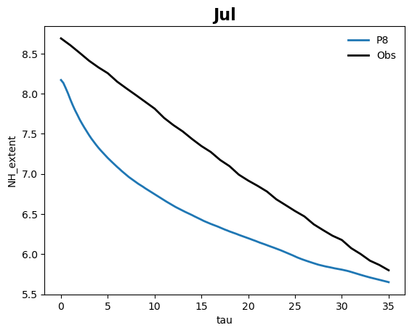
NH Sea Ice Extent
Sea Ice Extent
Area with > 15% sea ice

Slide 8
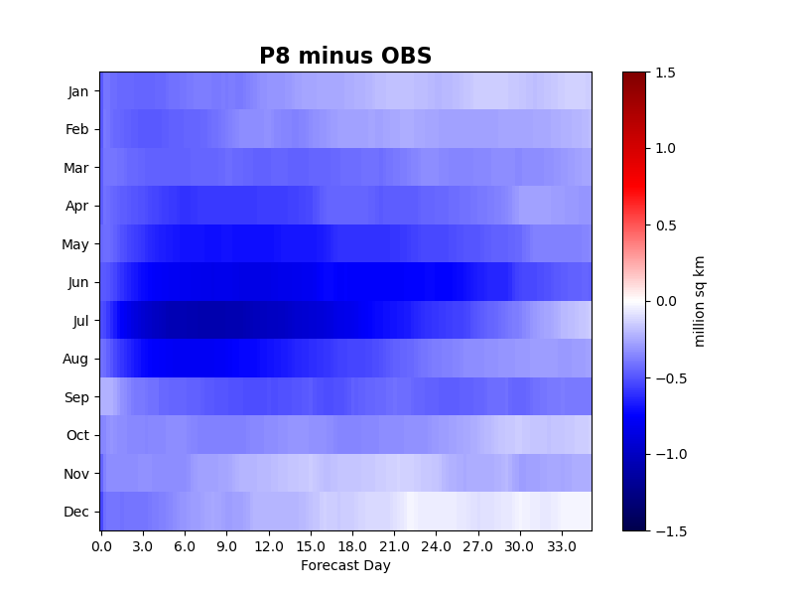
NH Sea Ice Extent
Negative bias in Sea Ice extent
Negative bias in initial conditions
Greater negative biases during summer melt months
More rapid melt

Slide 10
Southern Hemisphere Comparison

Slide 11
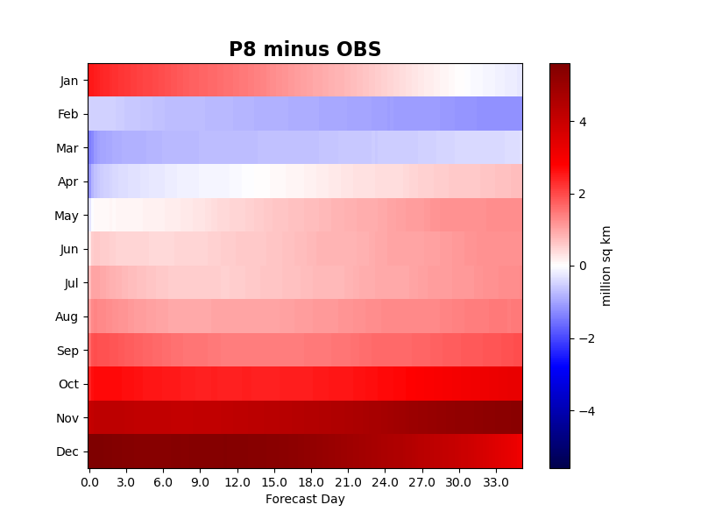
SH Sea Ice Extent
SH sea ice extent biases are larger than NH biases.
P8 SH sea ice extent is mostly greater than observations except during seasons melt period.
Larger differences in initial sea ice compared to observations when comparing to NH

Slide 13
Sensitivity to Physics
P8 is result of constant development of the UFS
Each prototype had multiple changes that results in difficulties when isolating the cause of change
Limited HPC resources to test individual changes
However, GSL re-ran P8 with the old GFDL physics for analysis
Hypothesis: Thompson microphysics can represent the clouds in the Arctic more accurately, in particular with respect to low-level mixed-phases clouds, which leads to a better representation of surface radiation, and then sea ice.
Thompson Microphysics | GFDL Microphysics
P8 | previous prototypes of UFS (ops since 2019)
double microphysics (mixing ratio and droplet size) | single moment microphysics (mixing ratio)
*Runs completed by NOAA/ OAR/ GSL Ben Green and Shan Sun*

Slide 14
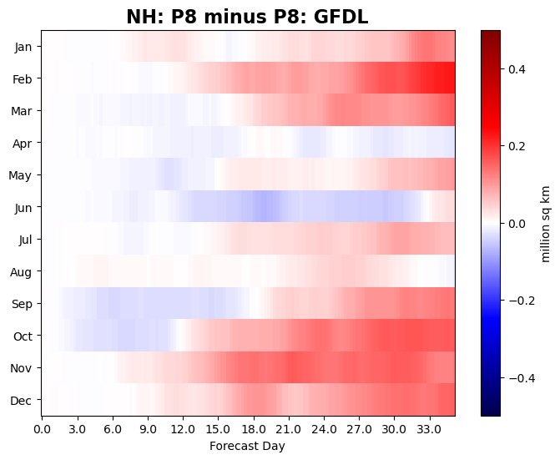
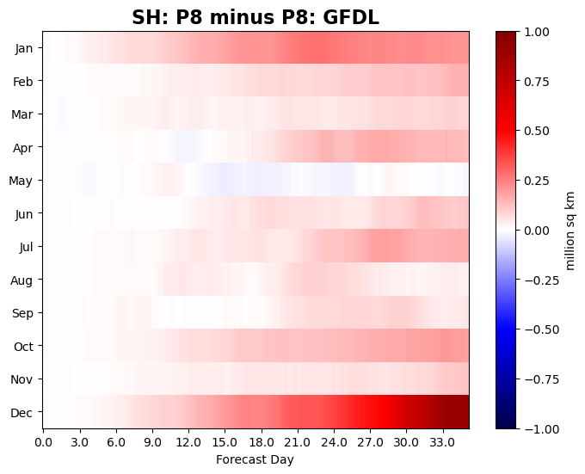
Sea Ice Extent: Sensitivity to Physics
Overall, there are not large differences between NH sea extent with the changes in microphysics
However, Thompson microphysics systematically produces more sea ice in the NH winter months

Slide 15
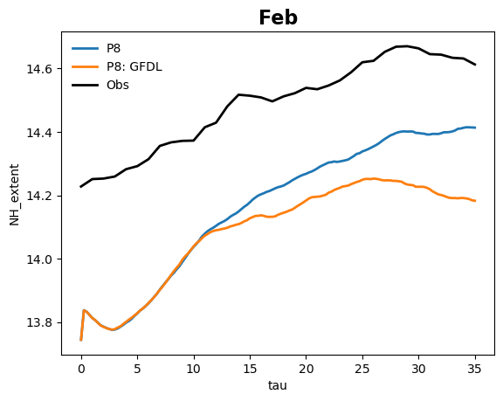
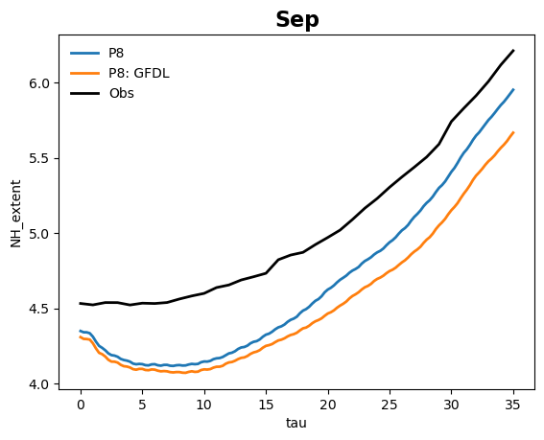
NH Sea Ice Extent

Slide 16
NH September: Sensitivity to Physics
Thompson (P8) minus GFDL
Low Cloud
Higher low cloud cover cloud occurs in Thompson microphysics compared to the GFDL microphysics.
Differences in clouds start early in the forecast
Week 1
Week 3
Week 3

Slide 17
NH February: Sensitivity to Physics
Low Cloud
Thompson (P8) minus GFDL
Week 1
Higher low cloud cover cloud occurs in Thompson microphysics compared to the GFDL microphysics.
Week 3
Week 3

Slide 18
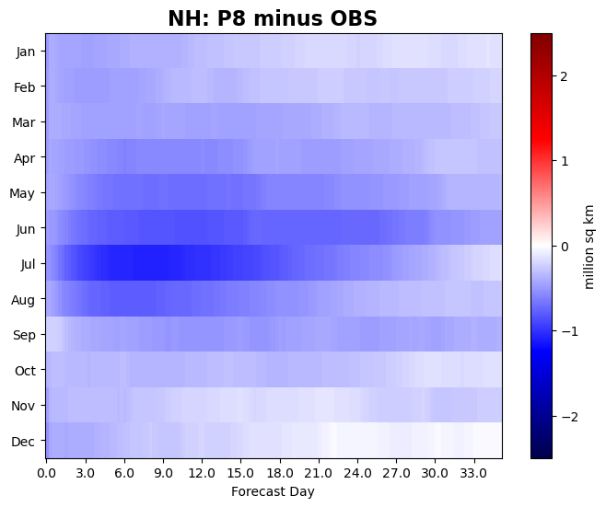
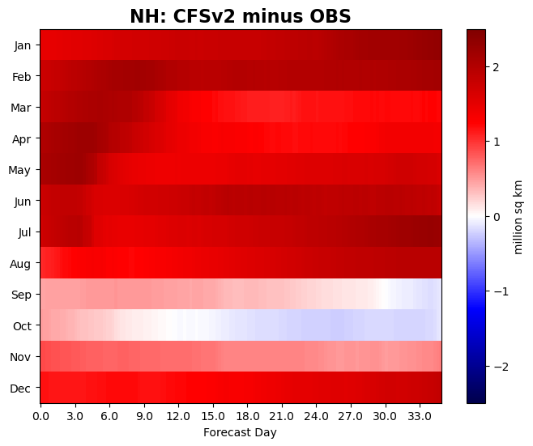
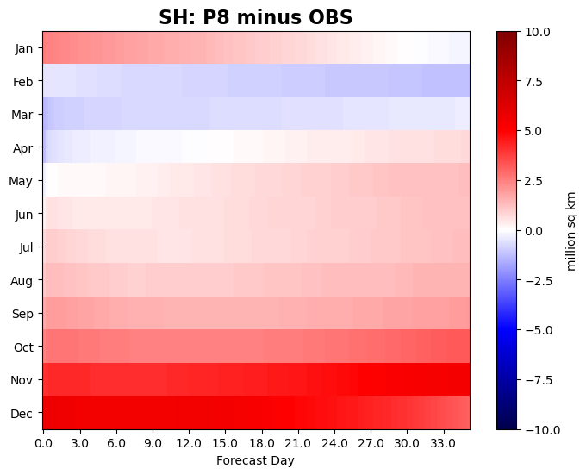
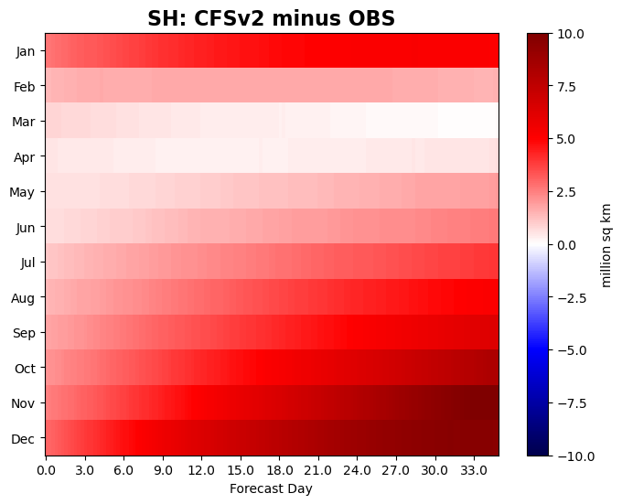
Comparison to CFSv2
Raw, uncorrected model results
P8 sea ice extent biases are much smaller than CFSv2 biases in Northern and Southern Hemisphere
Recalibration needed for biases corrections for S2S UFS runs

Slide 19
Conclusions
Initial look at large scale sea ice in the global UFS runs
Sea ice extent in NH is reasonable
Larger biases occur in the SH compared to the NH.
The initial sea ice in SH summer season should be examined is greater detail
The switch to Thompson microphysics slightly alters the sea ice extent predictions
In particular, NH winter sea ice is greater with Thompson microphysics and results in closer agreement to observations
Corresponding with higher low-cloud fractions. However, more analysis of cloud properties is needed
Shorter Term Updates:
Ensembles
Initialization in weakly coupled DA system
Longer Term Updates/testing:
C-Grid
Meltponds, aerosols

Slide 20
Thank You!
neil.barton@noaa.gov

Slide 21
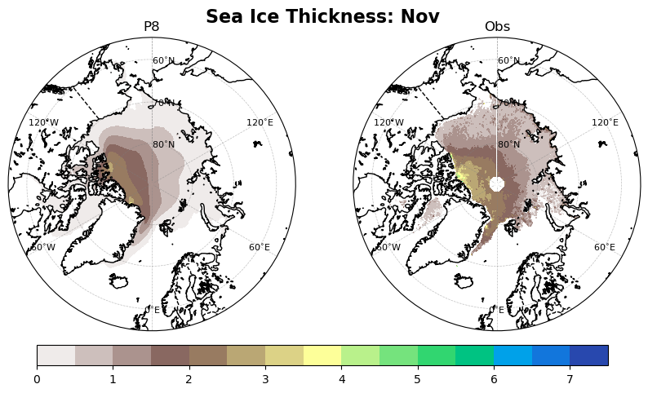
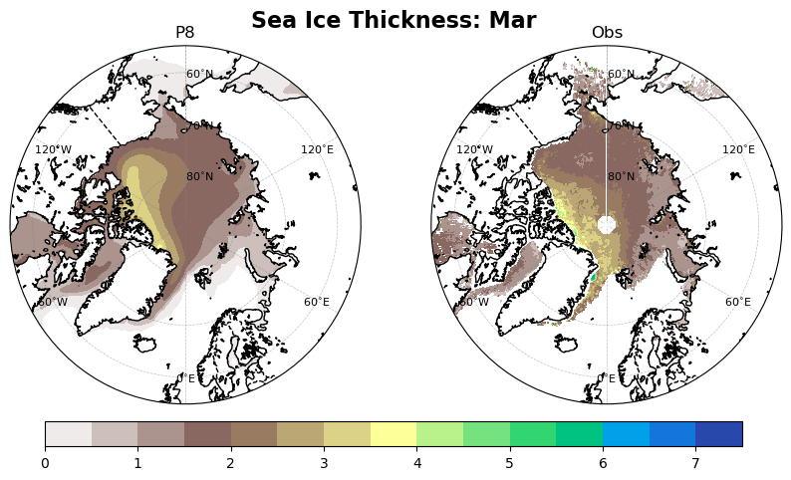
Sea Ice Thickness Comparison
Week 1 average of Sea ice thickness
Initialized from CPC analysis
Biases similar to initialization Collow et al. (2019)
Overall decent agreement for no assimilation of thickness
Higher sea ice thickness values north of Canada in the model compared to observations

