Slide 1
Impact of stochastic physics in coupled simulations of the UFS and CESM
Philip Pegion - NOAA-Physical Sciences Laboratory
Judith Berner - NCAR
Maria Gehne, Xiao-Wei Quan, Zac Lawrence - NOAA/PSL and CIRES

Slide 2
Introduction
The weather program office funded a project to study the Benefits of Stochastic Parameterization on the Sub-Seasonal to Seasonal Timescale in Hindcasts with CESM and UFS
The goal of the project is to compare the impacts stochastic physics has in two different modeling systems in initialized predictions and long climate simulations.
Ran both models through the CVDP plotting package (https://www.cesm.ucar.edu/projects/cvdp)
Higher frequency UFS diagnostics were processed with MDTF-Diagnostics package (https://www.gfdl.noaa.gov/mdtf-diagnostics/) and the Tropical Diagnostics python package (https://github.com/NOAA-PSL/tropical_diagnostics)

Slide 3
Model setup
UFS
coupled prototype 8 tag but without waves.
1-degree horizontal resolution
50 year simulations
Historical forcing forcing for first 21 years (2000-2020) then fixed at 2020 values.
Stochastic suite: SPPT (Stochastically Perturbed Physics Tendency)
SKEB (Stochastic Kinetic Energy Backscatter)
CESM2
Coupled Global Climate model, CMIP6 control tag
1 degree horizontal resolution
100 years, constant preindustrial forcing
Stochastic suite: SPPT

Slide 4
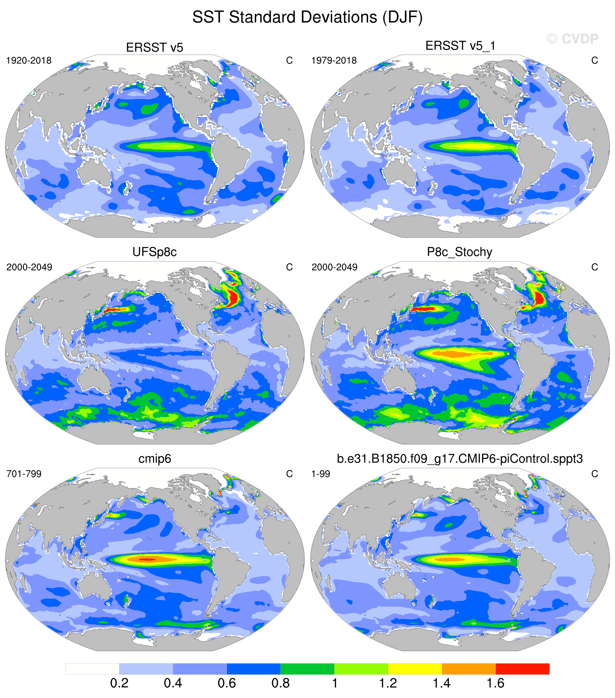
Interannual Results: SST variability
Observations
(historical)
Observations
(satellite era)
The UFS with deterministic physics lacks tropical variability. With stochastic physics the UFS has too much tropical variability.
CESM has the opposite problem. ENSO is too strong with deterministic physics, and is a little weaker with stochastic physics.
UFS-P8
UFS-P8-stoch
CESM2
CESM2-stoch

Slide 5
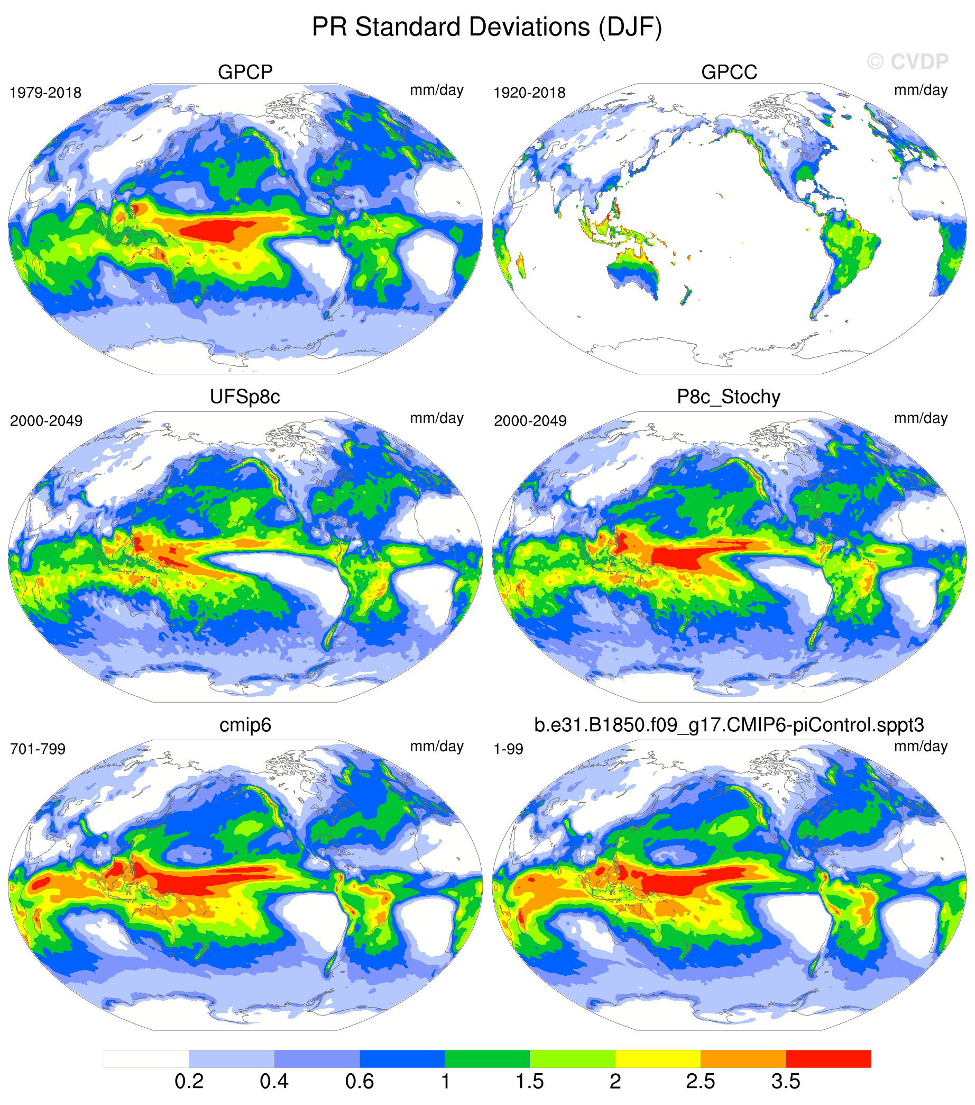
Interannual Results: Precipitation Variability
Observations
(historical)
Observations
(satellite era)
Stochastic physics has little impact to CESM2 on the inter-annual timescale, but a substantial impact in the UFS over the Tropical Pacific.
UFS-P8
UFS-P8-stoch
CESM2
CESM2-stoch

Slide 6
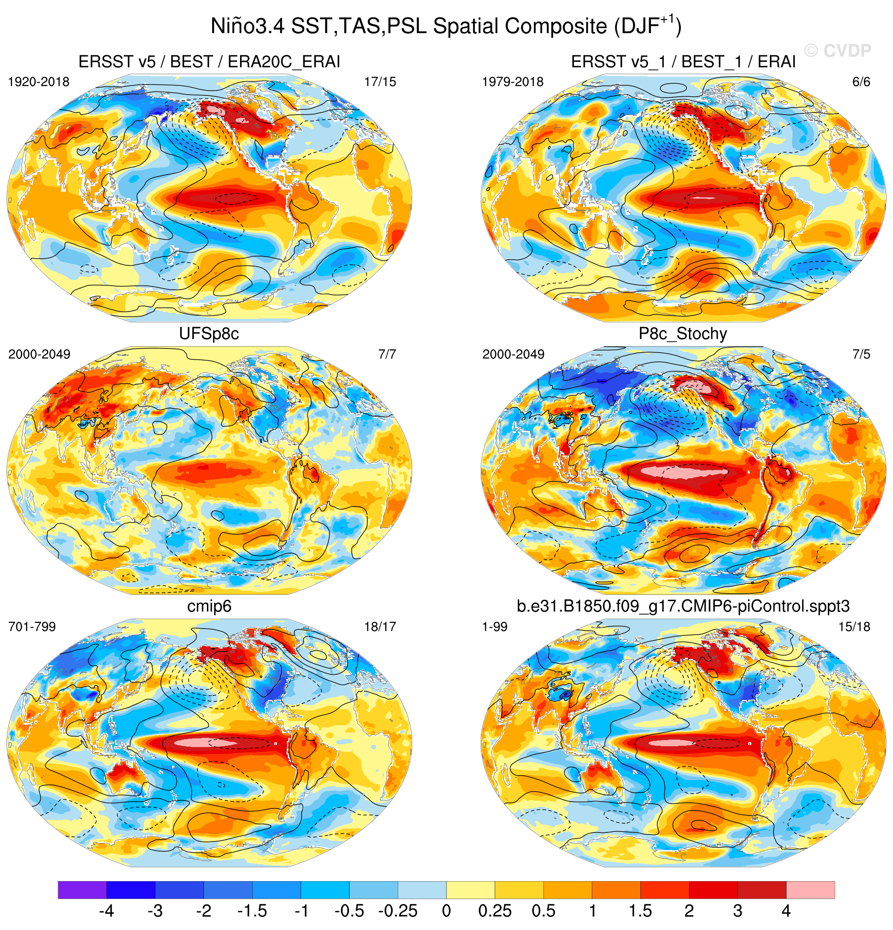
Interannual Results: ENSO and teleconnections
Observations
(historical)
Observations
(satellite era)
Stochastic physics improves ENSO teleconnections in the UFS. Both models have the strongest SST anomalies too far west, which is a common coupled model issue.
UFS-P8
UFS-P8-stoch
CESM2
CESM2-stoch

Slide 7
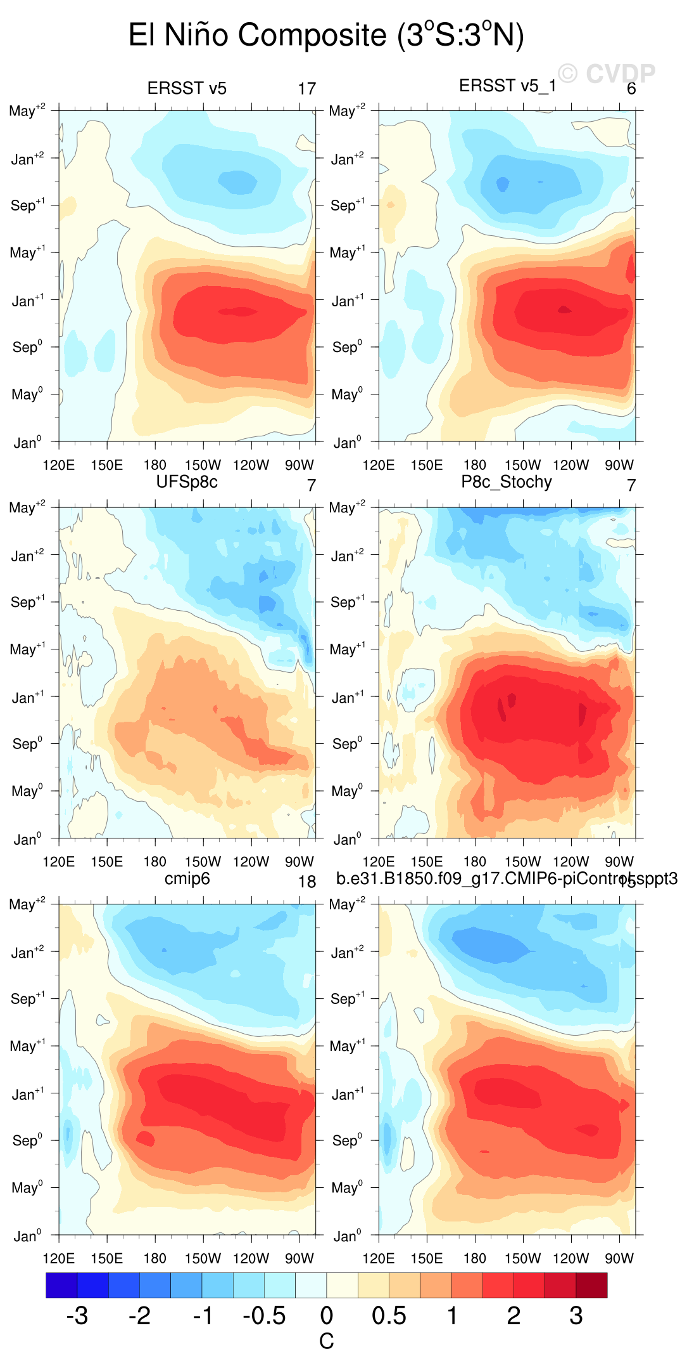
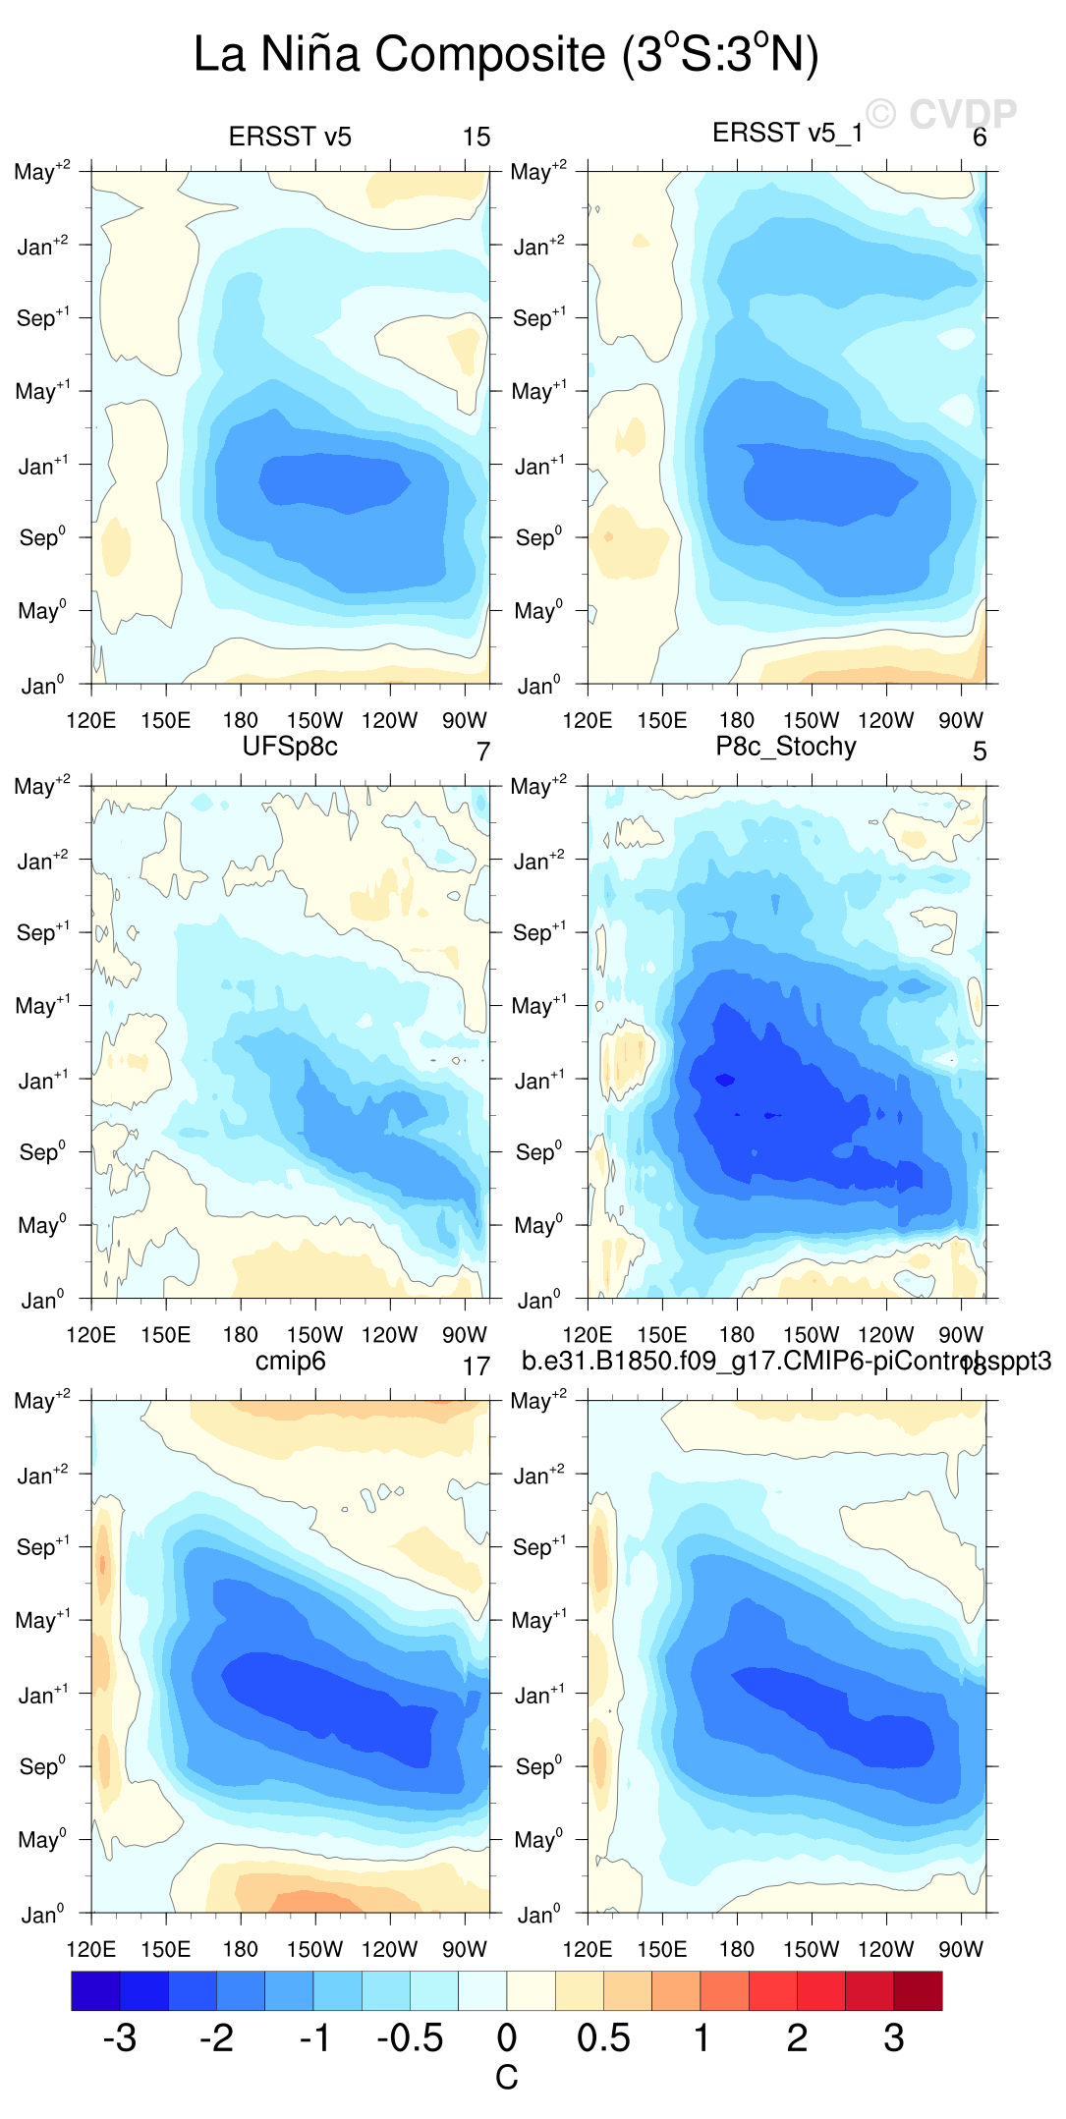
Composite ENSO Evolution
Observations
(historical)
Observations
(satellite era)
Observations
(historical)
Observations
(satellite era)
UFS-P8
UFS-P8-stoch
UFS-P8
UFS-P8-stoch
CESM2
CESM2-stoch
CESM2
CESM2-stoch
UFS with stochastic physics exhibits too early of an ENSO onset, but shows a good decay phase, including the likelihood of a multi-year La Niña.

Slide 8
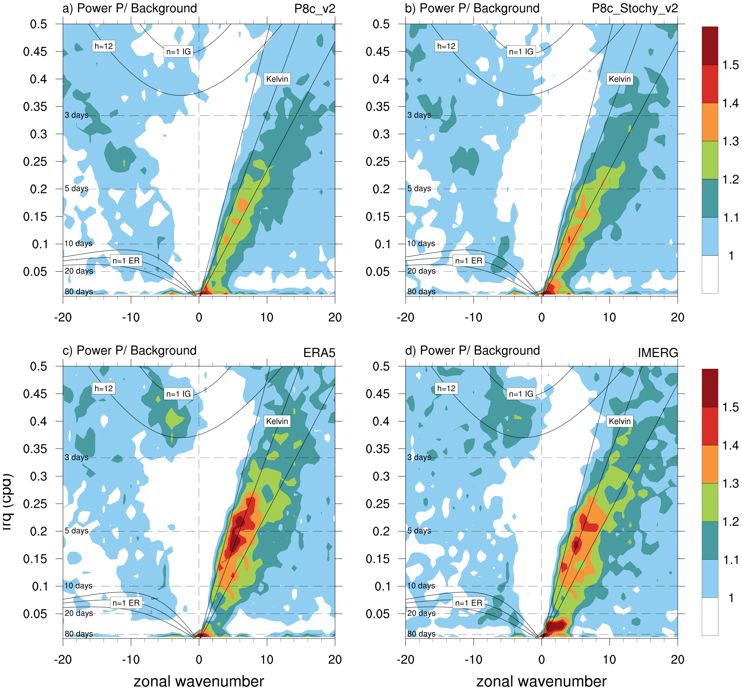
Subseasonal Results: Precipitation wavenumber-frequency
UFS-P8
UFS-P8-stoch
Stochastic Physics enhances the MJO and Kelvin wave activity although it is weaker than observations
ERA5
IMERG

Slide 9
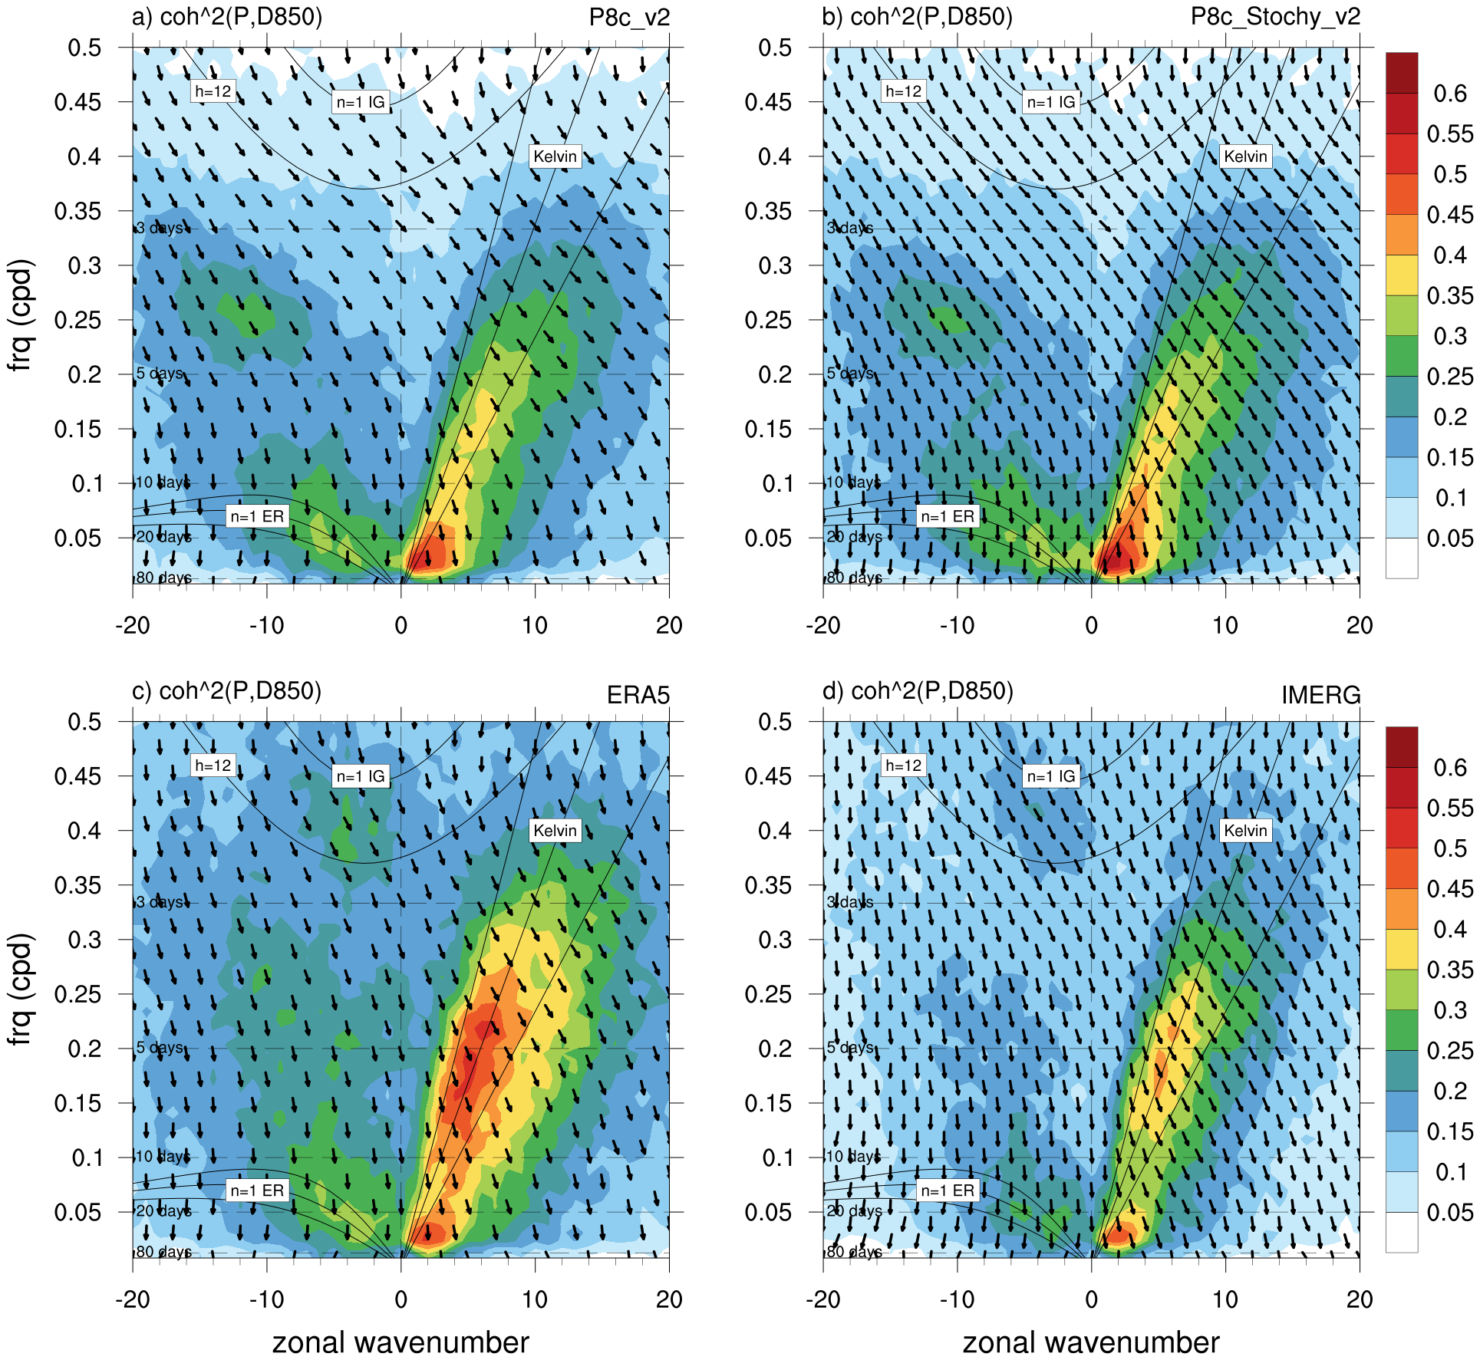
Subseasonal Results: Coherence of Precipitation-Divergence at 850 hPa
UFS-P8
UFS-P8-stoch
The coherence between low-level divergence and precipitation is well represented in the UFS. With the low-level convergence leading the precipitation by 1/8th of a cycle for eastward propagating waves.
ERA5
IMERG

Slide 10
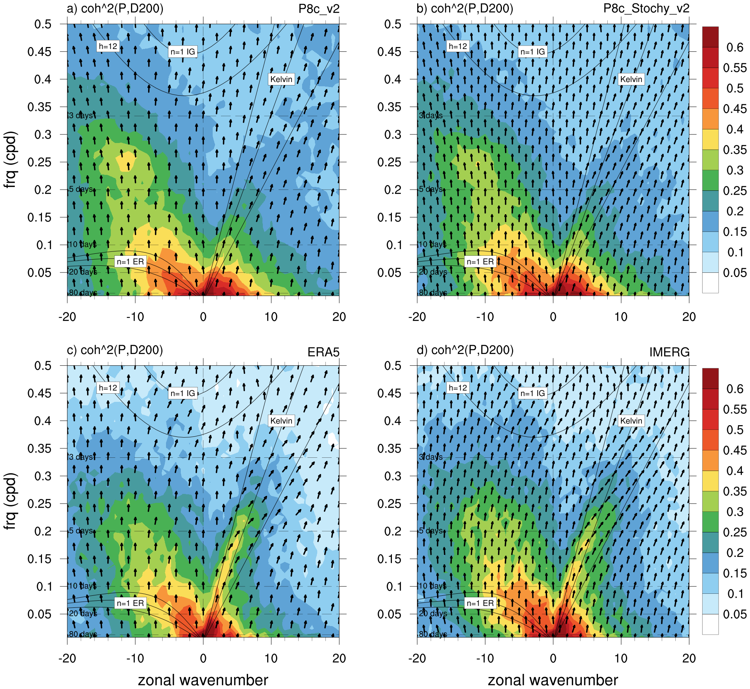
Subseasonal Results: Coherence of Precipitation-Divergence at 200 hPa
UFS-P8
UFS-P8-stoch
But the upper-level divergence in response to the precipitation is weak in the kelvin wave band.
ERA5
IMERG

Slide 11
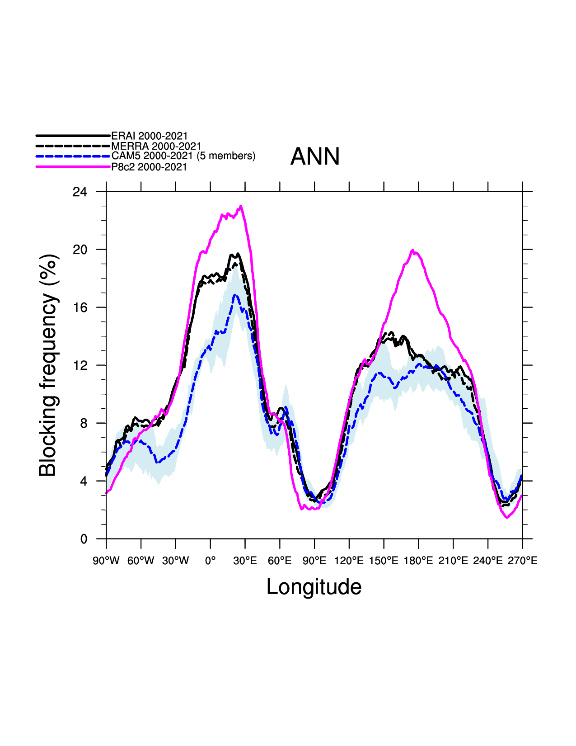
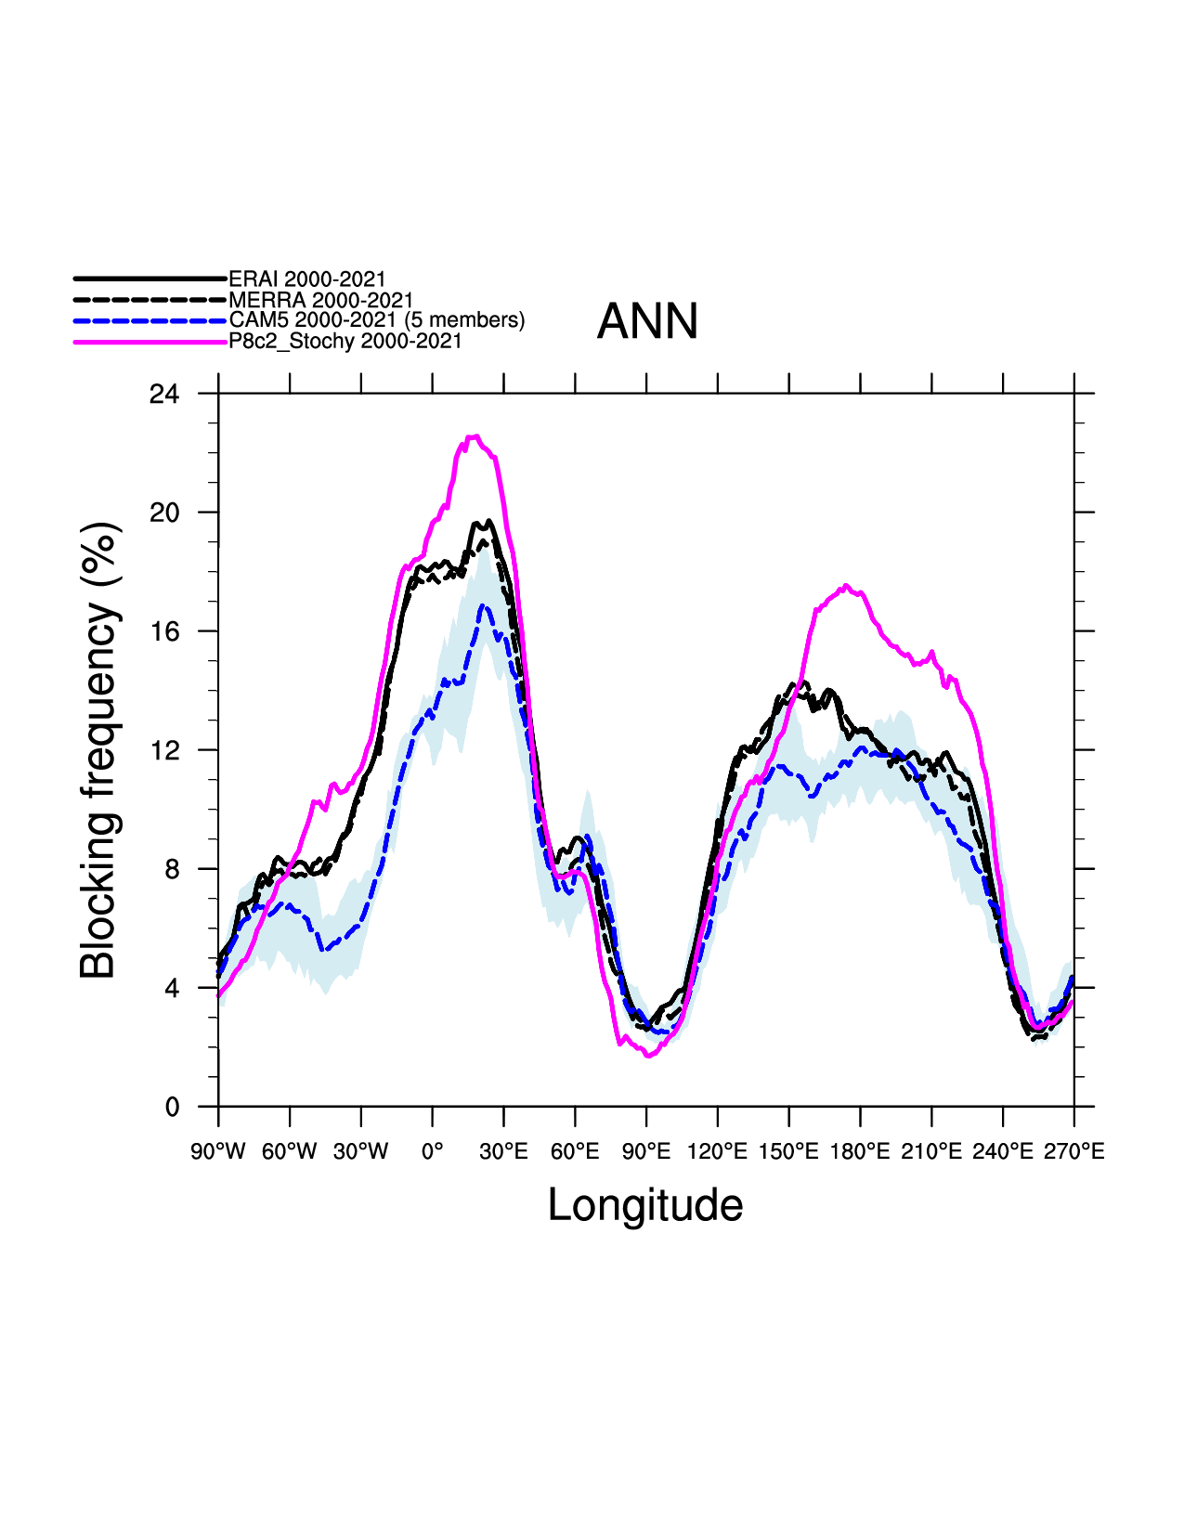
Subseasonal Results: N.H. Blocking frequency
UFS-P8
UFS-P8-stoch
UFS with deterministic physics had too much blocking over both the Atlantic and Pacific Sectors. Stochastic physics slightly improves the frequency over the Pacific.

Slide 12
Summary
We have run a pair of 50-year UFS climate simulations that are directly compared to the NCAR’s coupled climate model.
In both models, stochastic physics improves the ENSO variability
The primary 1-deg UFS lacks interannual variability in the tropics
The UFS with stochastic physics exhibits a lot of good features that will enable it to be useful tool in the development of Seasonal Forecast System.

