Slide 1
Debrief: Findings, Recommendations, Next Steps
Neil Jacobs, Hendrik Tolman, Kevin Garrett, Chris Domanti, Maoyi Huang

Slide 2
Take-aways
What we do saves life and properties.
Similar to the legacy of moon landing a few decades ago, a legacy is inspiring this generation to advance science and technology.
Our legacy: To understand and take actions to make our own planet sustainable for generations to come.
UFS needs diverse Superheroes. Diversity and innovation are intertwined and essential to one another.
UFS have evolved to a community modeling system that can enable not only operational weather modeling but also process level modeling/analyses.
Government, academia, and private sector should co-design its future.
Emerging technologies/applications can help accelerate innovation
As a community, we have the responsibility to help people see and realize their dreams.
Made progress but more can be done
EPIC’s mission is to be the web to connect all the parts.

Slide 3
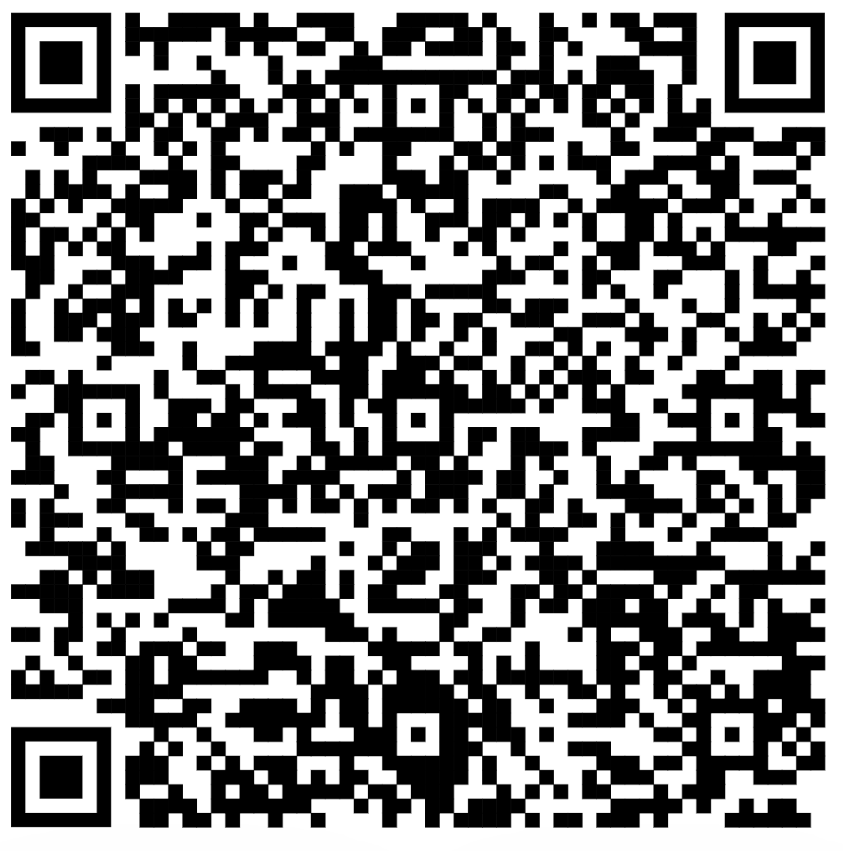
UIFCW Event Survey

