Slide 1
Representation Matters: Insights, Strategies, and Perspectives from the Inaugural UFS/EPIC Student Ambassador
Alekya Srinivasan, First Student Ambassador for the Unified Forecast System
Mentors: Jennifer Vogt, Krishna Kumar, Maoyi Huang, Neil Jacobs
Acknowledgements: Aaron Jones, Laura DeHaan, Gina Eosco, Hendrik Tolman, Keven Blackman, and Kristopher Booker

Slide 2
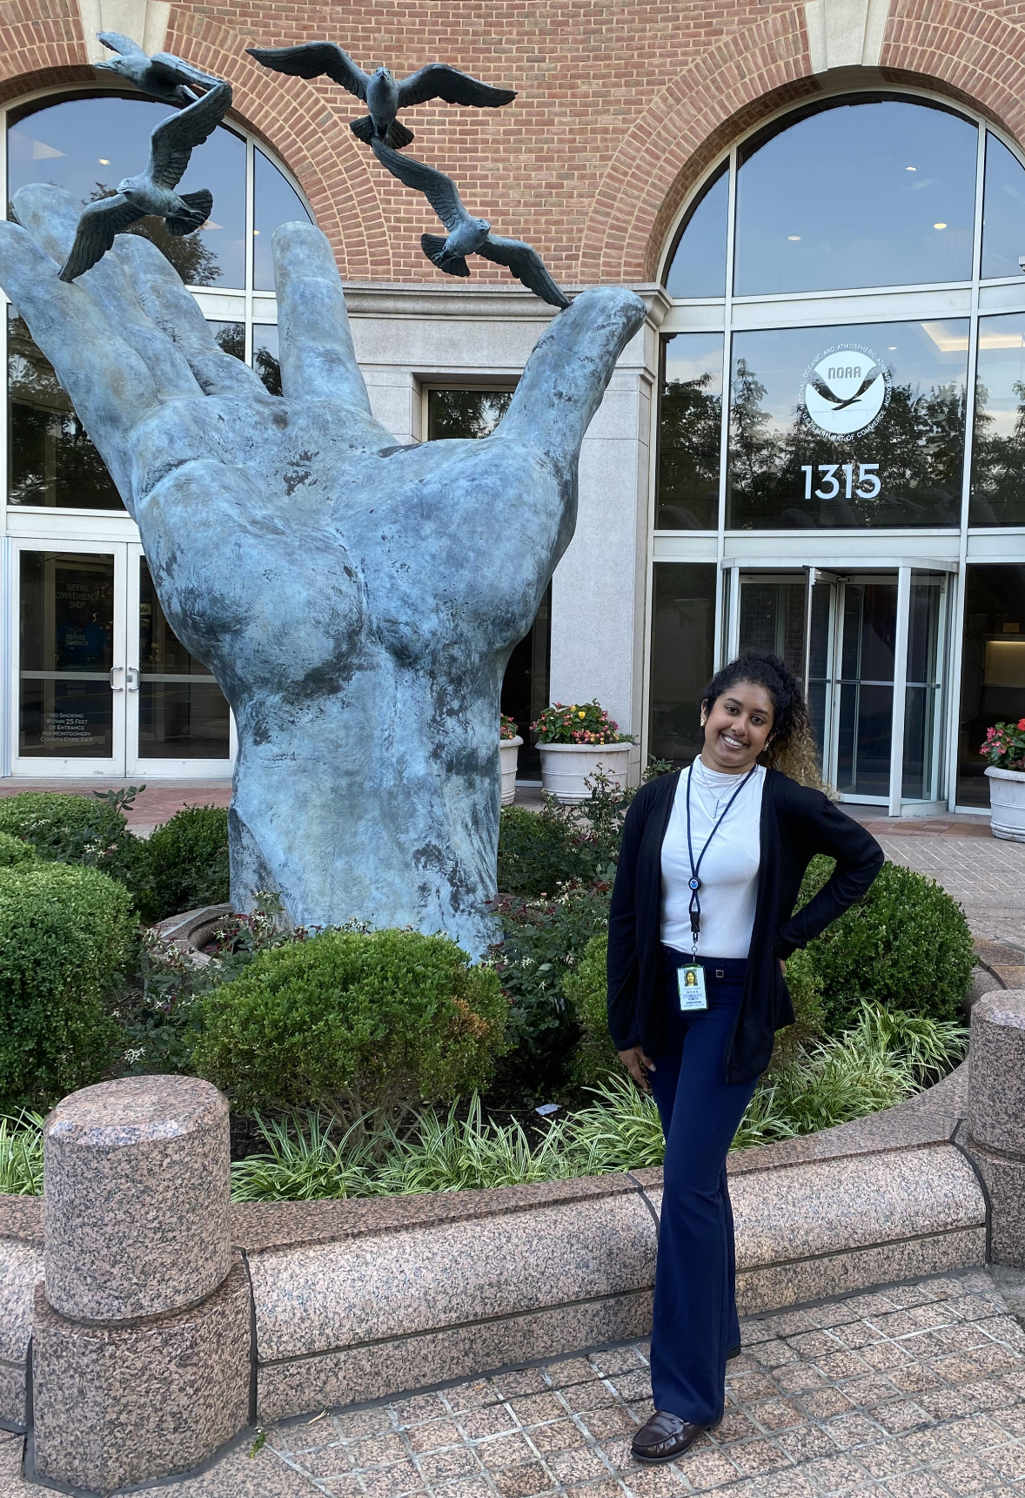
Speaker Background Information
2023 William M. Lapenta Intern
First Student Ambassador for the Unified Forecast System (UFS)
Undergraduate student at Penn State University
Pursuing a B.S. in Meteorology & Atmospheric Science
Very excited to share summer research and findings with UIFCW 2023!
Continuing Bill Lapenta’s legacy

Slide 3
What is the Role of the UFS/EPIC Student Ambassador?
Advocating for community engagement & technological advancements for academia
Determining/evaluating usability of UFS tutorials in academic environments
Utilizing outreach and technology to support/promote community collaboration across the Weather Enterprise
Providing an undergraduate student perspective on UFS accessibility and stakeholder engagement

Slide 4
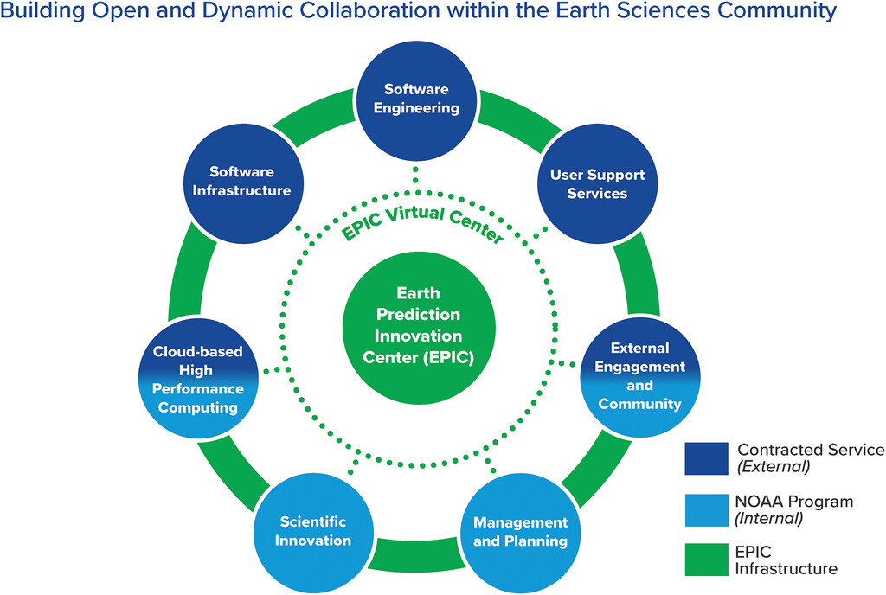
Earth Prediction Innovation Center (EPIC) - Building Blocks
Focus Points:
Successfully providing user support
Community outreach
Supporting innovative research
Adaptable software and technological resources
Maintaining a diverse user database
Fig. 3. Bulletin of the American Meteorological Society 103, 10; 10.1175/BAMS-D-21-0061.1

Slide 5
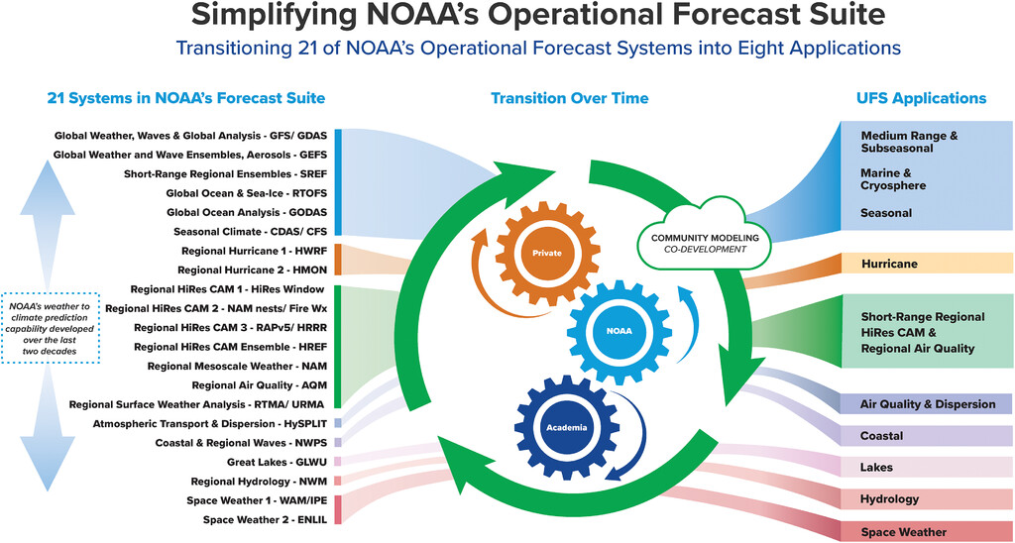
The Unified Forecast System
Community-based Earth modeling system
Encourages collaboration to accelerate R2O journey
Public and private code repositories located in GitHub

Slide 6
Designing Innovative Solutions
Successfully providing user support
Community outreach
Short Range Weather and Land DA technical report
Supporting innovative research
UFS Student Engagement Plan
Adaptable software and technological resources
Maintaining a diverse user database

Slide 7
Community Engagement

Slide 8
Creation of a UFS Student Engagement Plan in Phases
Referencing information from UIFCW 2022 Report
Personal recommendations for providing research support to enhance stakeholder engagement
Undergraduate student perspective on programming and NWP
Brief overview of meteorological accreditation standards (GS-1340, AMS, NWA, WMO)
Phase 1
Perform outreach to renowned Atmospheric Science/Computer Science university programs to gauge professors’ perspectives on UFS
Phase 2
Continuing to reference research performed in UIFCW 2022 Report
Training recommendations
Inquiring student outlook when entering a community workshop like UIFCW
Importance of collaboration and user support
Perform outreach geared towards students attending UIFCW 2023
Analyzing academic perspectives and interest levels regarding UFS
Phase 3

Slide 9
Community Outreach
How the UFS Benefits Academia
Creating list of universities & student attendees
Designing email drafts
Sending emails to universities & student attendees
Creation of questions in Google Form format
Receiving innovative feedback

Slide 10
UFS University Outreach Project and Results
General Questions Asked
University Feedback
How has your institution already implemented programming/NWP into curriculums?
What, if any, are some of your software requirements? Are there any obstacles that you have encountered/are encountering?
How can we help? What, if any, support do you have for the software you are currently using?
Would you be interested in participating in a “UFS Roadshow” (in-person demonstrations) and/or receiving online live tutorials?
Interest in live UFS demonstrations - opens a doorway to greater stakeholder engagement
Mentions of both undergraduate and graduate programs having programming courses available
Only some universities have NWP courses, some are optional electives
Python - commonly used programming language
Closing the gap between academic research and innovative technology/software
One of the main issues EPIC and the UFS community face in the eyes of academia

Slide 11
UIFCW Student Outreach Project and Results
(In Progress)
General Questions Asked
UIFCW 2023 Student Attendee Feedback
What, if any, is your experience with the UFS?
Are you familiar with the UFS? If so, would you want the UFS to be incorporated into your academic studies?
Are there any programs or resources that you wish your university offered?
What do you hope to accomplish from representing academia at the UIFCW 2023?
Little experience with NWP
No users of UFS, one mention of WRF
Interest in UFS becoming integrated into general university-level curriculums
UFS training courses, NWP and coding classes, introductory courses are requested
Students are attending UIFCW 2023 to present research, network, and familiarize themselves with modeling frameworks
Representation of academia:
Uplifting student voices
Gaining forecasting and modeling knowledge to share with peers
Learning about current research
Discuss progression of academic research

Slide 12
Student Ambassador Insights
Students want to be heard
Providing students with hands-on UFS learning experience
Reaching younger generations
Social media platforms
Engaging and motivating speakers visiting universities
Allowing students to hear other student experiences
UFS success stories
Funding and grant information
Increases confidence when students are provided reassurance from others
Create separate training series for undergraduate and graduate students

Slide 13
Anticipated Outcome of UFS Student Engagement Plan
Main Goal: getting more students interested and involved with UFS
Greater stakeholder engagement including students and professors
Increase in R2O and O2R achievements in academia
Broadening of diverse UFS and NWP user database

Slide 14
Technological Component

Slide 15
Creation of Short Range Weather and Land DA Technical Report
Tutorials evaluated:
Running Short Range Weather (SRW) packer and infrastructure code installation in the Cloud environment (pre-recorded)
Virtual SRW/packer/AWS sandbox general tutorial
CodeFest Land DA virtual training

Slide 16
Student Perspective-Based Technical Evaluation
Discussing personal background experiences with programming
Analyzing teaching methods used
Recommendations for a seamless integration into academia
Suggestions for improving intended deliverables
Identifying gaps that need to be addressed
Prioritizing student user support and satisfaction

Slide 17
Inclusive environment for all platforms in tutorials (Mac, PC, etc.)
Tutorials for puTTy configuration
EC2 Instance Connect
Other SSH clients
Distribution of pre-tutorial materials
Creation of AWS account
General terms to know before tutorial
Explanation of documentation commands
Recommendations for Future Deliverables
Pre-recorded and in-person tutorials: more impactful than virtual
Tutorials that are fast-paced and have quick delivery are not ideal for academic integration
Inclusion of all relevant and required information
Mentioning “i” for inserting text in a file

Slide 18
SRW Reconfiguration to Jupyter Notebooks
** Access through Amazon Web Services (AWS) EC2 Instance Connect **
Rewriting SRW code in Jupyter Notebooks
Publishing code on public GitHub repository
Increased student engagement
Running Jupyter Notebooks through EC2 Server
Why Jupyter Notebooks?
Appealing to younger programmers
Organized notebook format
Documentation command definitions implemented into code
Can be downloaded and accessed on a browser

Slide 19
Anticipated Outcome of SRW and Land DA Technical Report
Main Goal: ensuring usability of tutorials in an academic setting
More academic research represented and accelerated in Research to Operations (R2O) journey
Greater efficiency and impact of UFS tutorials
More user support leads to greater stakeholder engagement
Increased incorporation of UFS and Numerical Weather Prediction (NWP) into general academic curriculums
Connects to enhancing a diverse community of users through Weather Enterprise

Slide 20
What I have Learned/Challenges I Faced
Trial and error while using AWS during SRW infrastructure tutorials
Initial use of incorrect instance connection methods
Incorrect EC2 instance settings - many issues with running code
Running Jupyter Notebooks on EC2 server - needed to expand size of instance, change security group settings, and accessing Jupyter online
University Outreach might not have provided me with enough data to support original project vision
Created a second method of outreach - UIFCW Student Outreach
These results will be included in UFS Student Ambassador Final Report
Discussing plans of approach with numerous mentors - learning about EPIC, how UFS is the future, and how to represent UFS as First Student Ambassador
Bringing academia to spotlight of community and technological advancements
Continuing a legacy of community modeling and innovative collaboration
Creating amazing connections with mentors and leaders throughout NOAA

Slide 21
Future Initiatives for Continuing Research Post-Internship
Completion of SRW reconfiguration into Jupyter Notebooks
Community can successfully access this code on public GitHub UFS repository
Construction of an UFS/NWP academic lesson plan
Continuing to uphold a welcoming environment for academia and young programmers
Improving methods of outreach and continuing to reach out to both Minority Serving Institutions (MSI) and Historically Black Colleges and Universities (HBCU)
Attending more CodeFest’s and Hackathon’s for further analysis and understanding of tutorials
Include analysis of UIFCW Student Outreach results in final report

Slide 22
References
Alves, J., Tolman, H., Roland, A., Abdolali, A., Ardhuin, F., Mann, G., Chawla, A., Smith, J. (2023). NOAA’s Great Lakes Wave Prediction System: A Successful Framework for Accelerating the Transition of Innovations to Operations. Bull. Amer. Meteor. Soc., 104, E837-E850. https://doi.org/10.1175/BAMS-D-22-0094.1.
Jacobs, N. (2021). Open Innovation and the Case for Community Model Development. Bull. Amer. Meteor. Soc., 102, E2002-E2011. https://doi.org/10.1175/BAMS-D-21-0030.1.
Stagnari, A., Dubots, L., Vogt, Jennifer., Huang, M. (2022). Working with Stakeholders: Engaging Sectors to Influence the Future of EPIC and UFS. Unifying Innovations in Forecasting Capabilities Workshop Report.
Uccellini, L., Spinrad, R., Koch, D., McLean, C., Lapenta, W. (2022). EPIC as a Catalyst for NOAA’s Future Earth Prediction System. Bull. Amer. Meteor. Soc., 103, E2246-E2264. https://doi.org/10.1175/BAMS-D-21-0061.1.

