Slide 1
Unifying Innovations in Forecasting Capabilities Workshop
A Unified Forecast System (UFS) Collaboration Powered by the Earth Prediction Innovation Center (EPIC)
JULY 28th, 2023
Center Green Auditorium, Boulder, CO
July 24-28, 2023

Slide 2
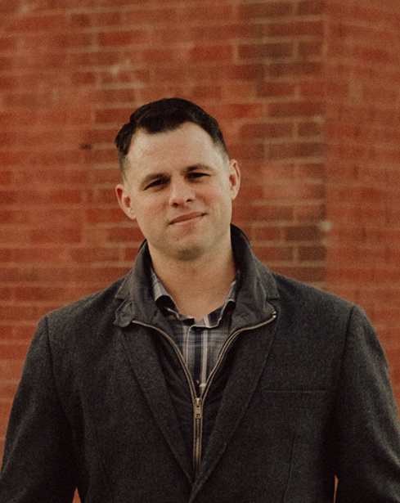
Today’s Moderator
Aaron Jones
Product Owner of the EPIC Community Engagement Team, Raytheon
Retired Air Force Weather

Slide 3
Friday, July 28th
9:00 – 9:15 – Welcome and Kickoff
9:15 – 10:30 – Updated & Challenges on UFS Applications
10:30 – 11:00 – BREAK / LIVE DEMO OF SRW IN THE CLOUD
11:00 – 12:00 – Making UFS Cool
12:00 – 12:30 – Debrief: Findings, Recommendations, and Closing Statements
12:30 – ADJOURN

Slide 4
Live Streaming Announcement
We are livestreaming the event, so please be aware of hot mics and video recording.
If you would like to be further from the microphone, we suggest sitting in the back of the room.

Slide 5
Connect with us!
Connect with us on Twitter and Instagram with #UIFCW23
Twitter: @NOAAEPIC & @ufs_community
Instagram: @NOAAEPIC
Wi-Fi: UCAR Visitor

