Slide 2
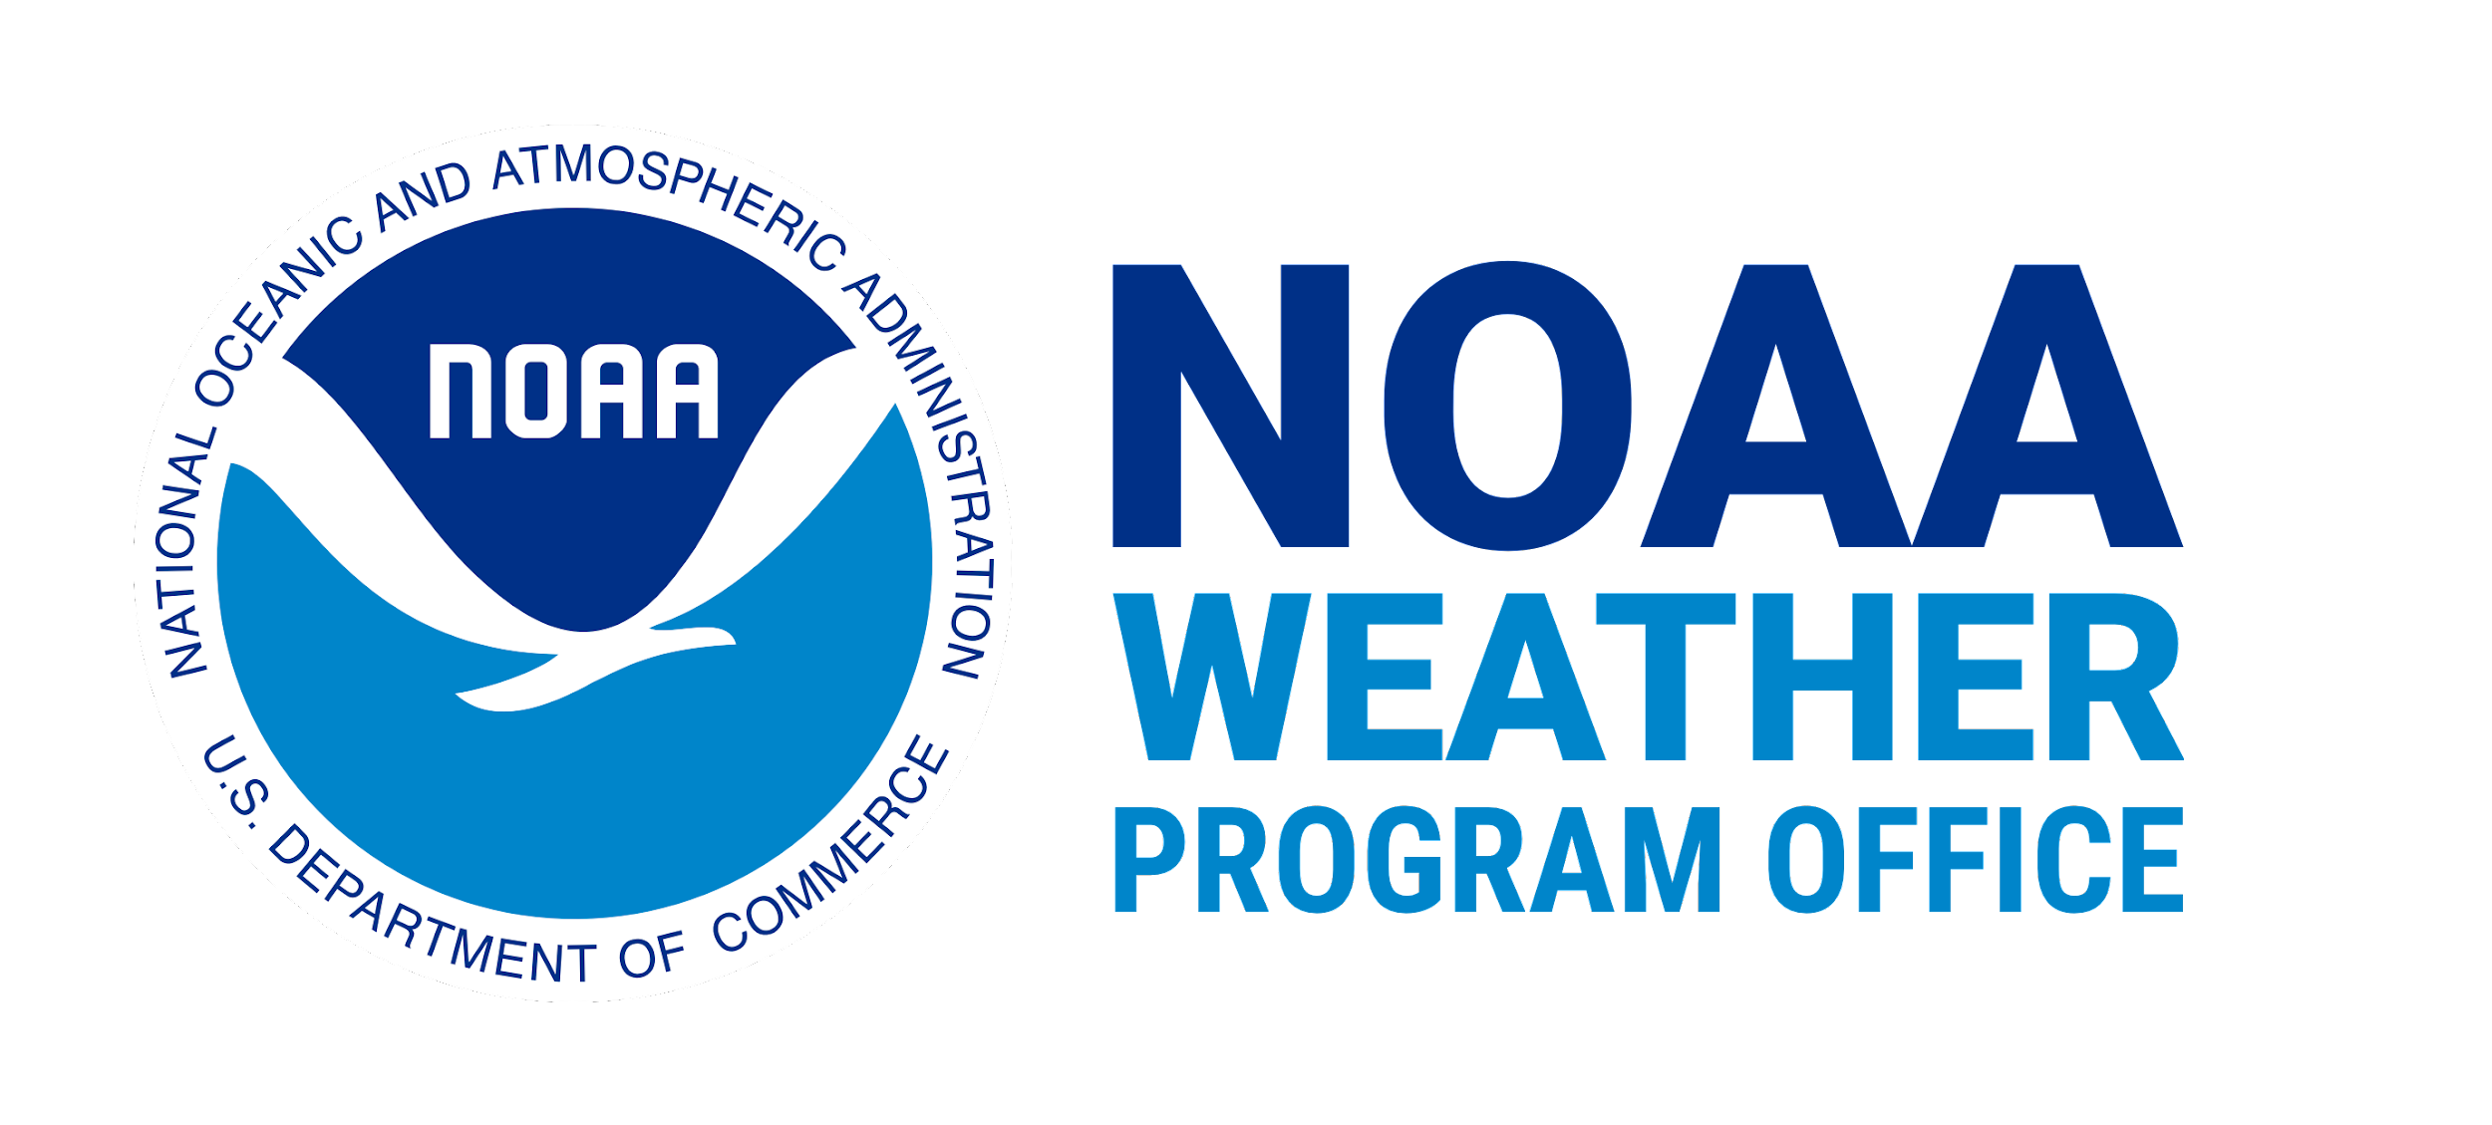
NOAA – UCAR Partnership
Mentors
Cindy Bruyère
Hanne Mauriello
Kate Rodd
Julie Cross
Dawn Mullally
Whitney Robinson
Leah Dubots
Maoyi Huang
Dorothy Koch
John Ten Hoeve
Krishna Kumar
Jennifer Vogt
Tamara Battle
Jose-Henrique Alves
Cristiana Stan, George Mason University
Daryl Kleist, NOAA
Barry Baker, NOAA
Mike Barlage, NOAA

Slide 3
NOAA – UCAR Partnership
WINGS will enable Fellows to gain insights and real-world experience in their field of study
Support the Fellows’ integration into the workforce, and offer a unique opportunity to contribute to forecast model development
This inaugural award year’s focus is on NOAA’s Earth Prediction Innovation Center (EPIC) Program – specifically around community research and modeling system advances and improvements in the Unified Forecast System (UFS)
Focus topics this year included:
Data Assimilation
Atmospheric Physics
Systems Architecture (coupling, workflow, continuous integration and development)
Machine Learning/Artificial Intelligence
Software Engineering to advance numerical weather prediction

Slide 4
The Fellow Experience
This Fellowship is designed for Ph.D. candidates who have completed their required coursework and are in the beginning stages of writing a dissertation
Fellows will continue to work with their academic advisor
An additional mentor is recommended by WPO and CPAESS
The Fellowship is a two-year appointment allowing the Fellows to complete their Ph.D.

Slide 5
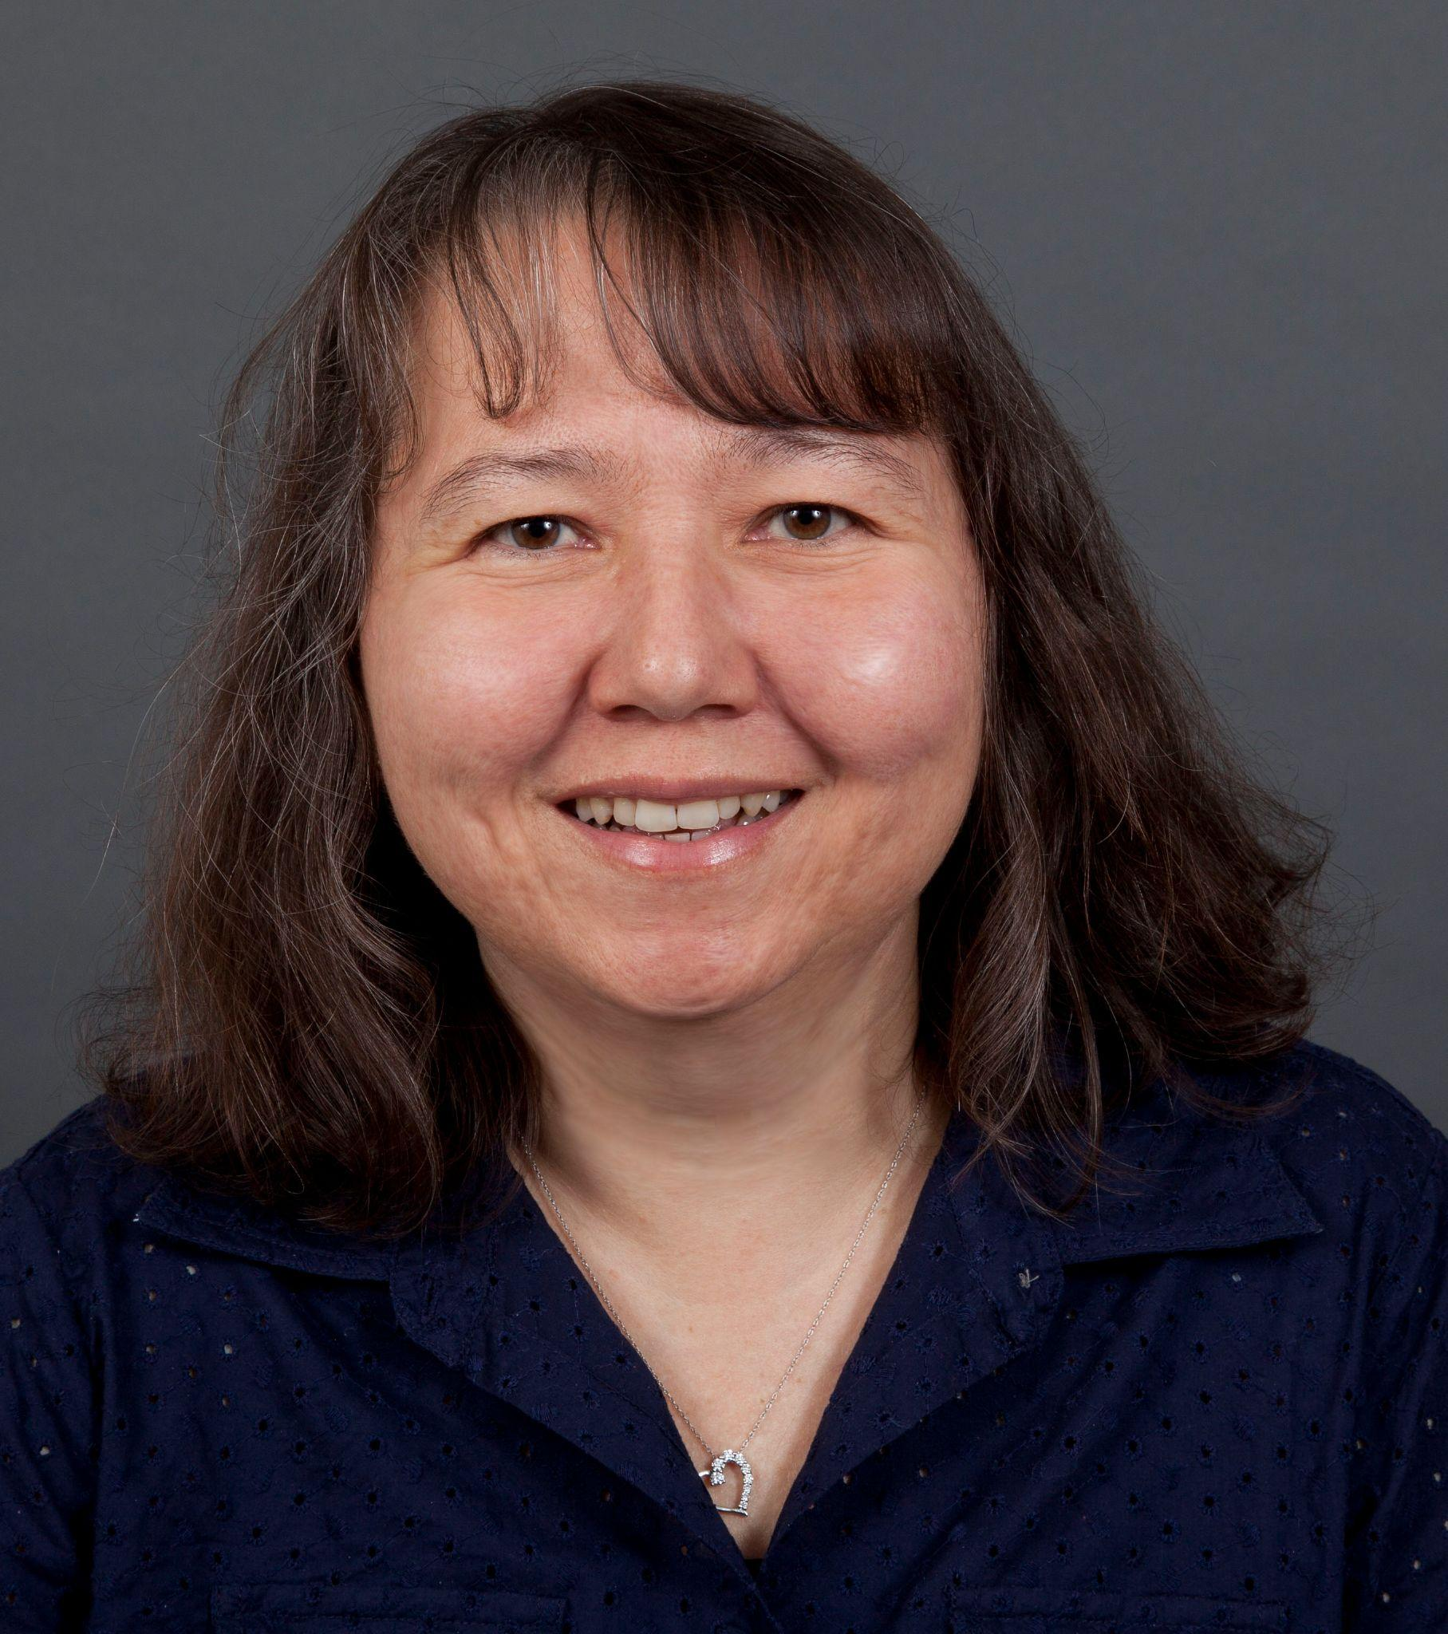
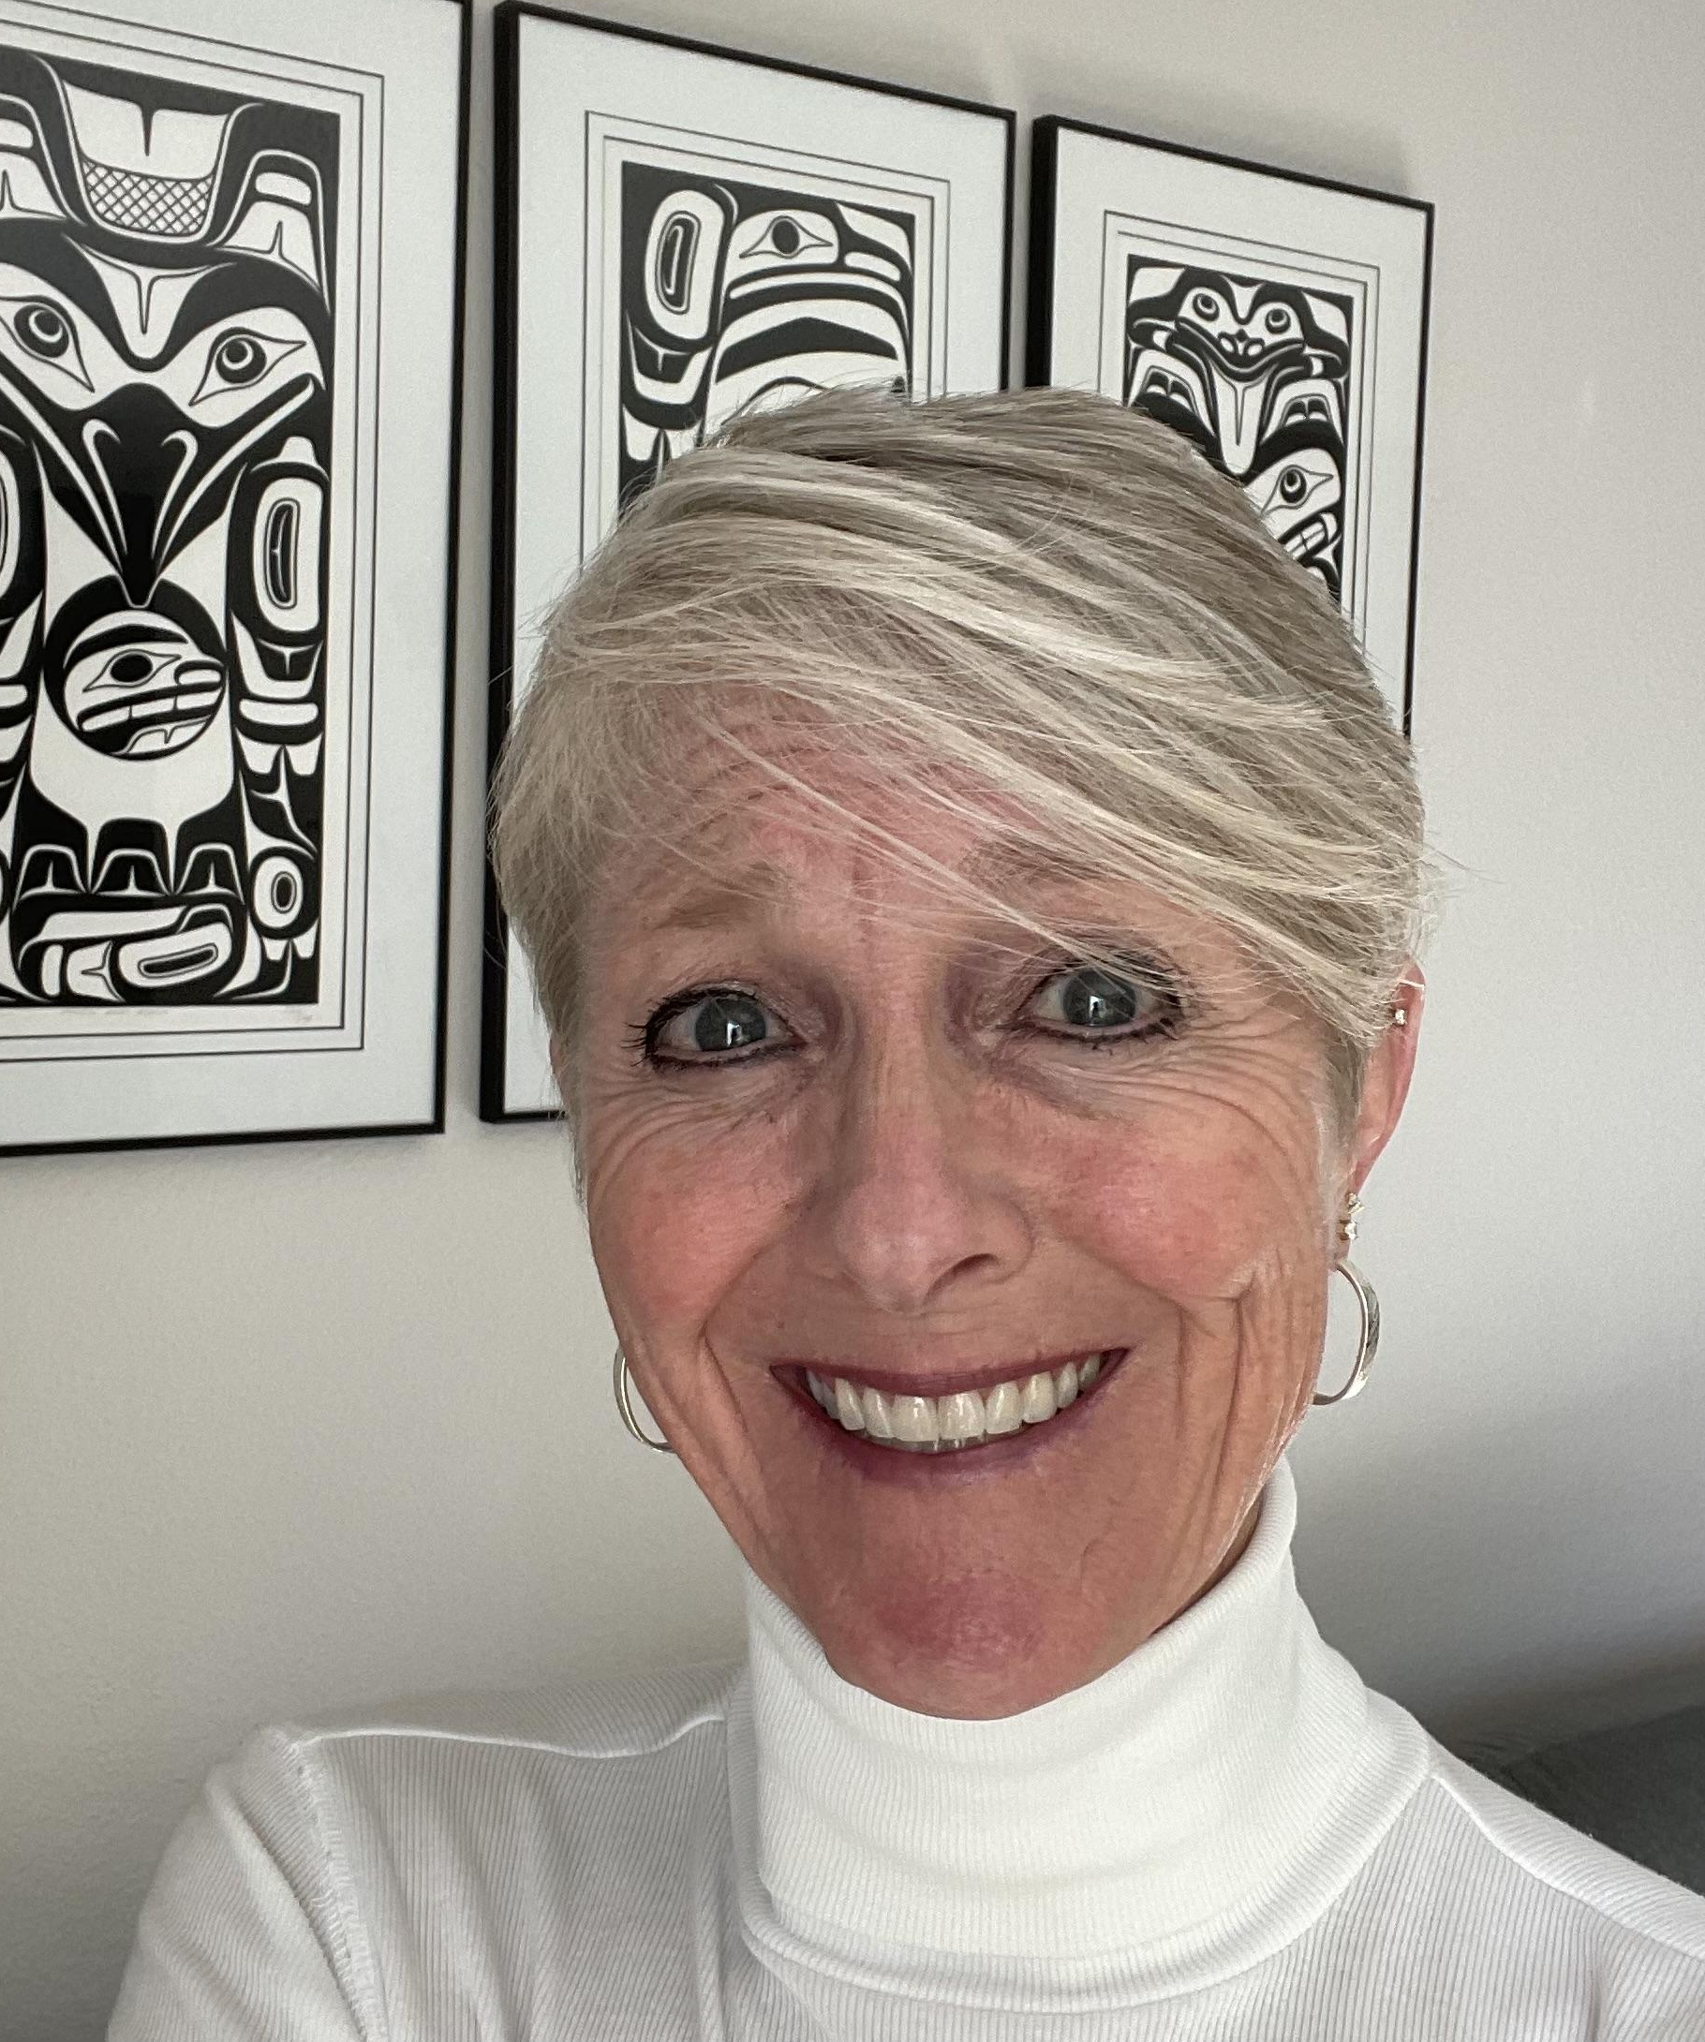
Further Information
CINDY BRUYÈRE
Deputy Director of UCAR SPS & CPAESS
bruyerec@ucar.edu - cpaess.ucar.edu
KATE RODD
CPAESS Program Coordinator
krodd@ucar.edu - cpaess.ucar.edu

Slide 6
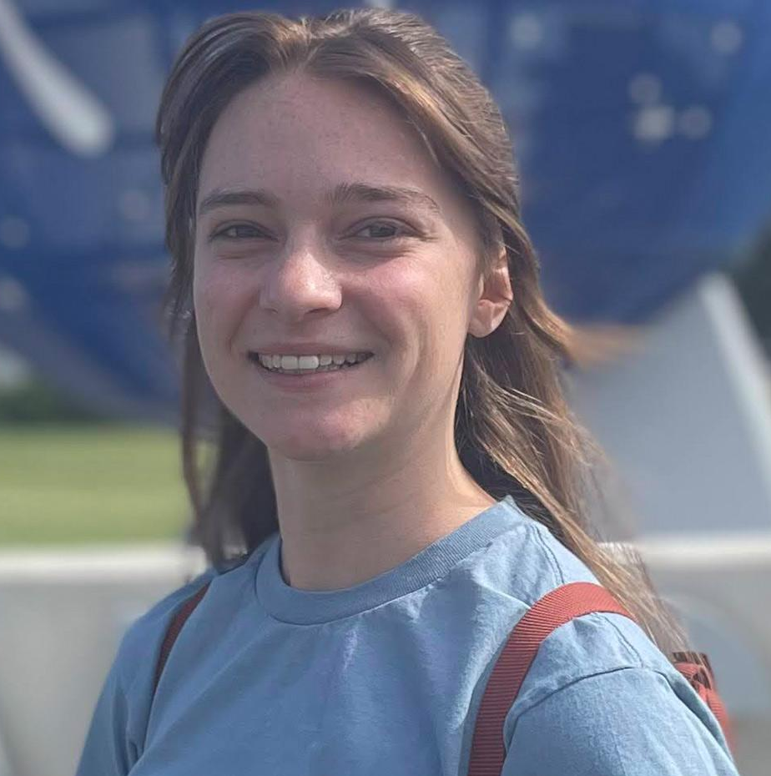
This Year’s Fellows: Emily Faber
Impacts of Surface Winds on Dust Emissions: Comparison of Measurements and Models to Improve Model Parameterization and Further Understanding of Sub-Grid Processes
University of Maryland Baltimore County (UMBC)
Advisor: Dr. Adriana Rocha-Lima

Slide 7
This Year’s Fellows: Shreyas Dhavale
The Origin and Evolution of the Monsoon Onset Vortex and its Sub-Seasonal Impacts: Integrating Theory and Predictability Studies using the UFS
North Carolina State University
Advisor: Dr. Anantha Aiyyer

Slide 8
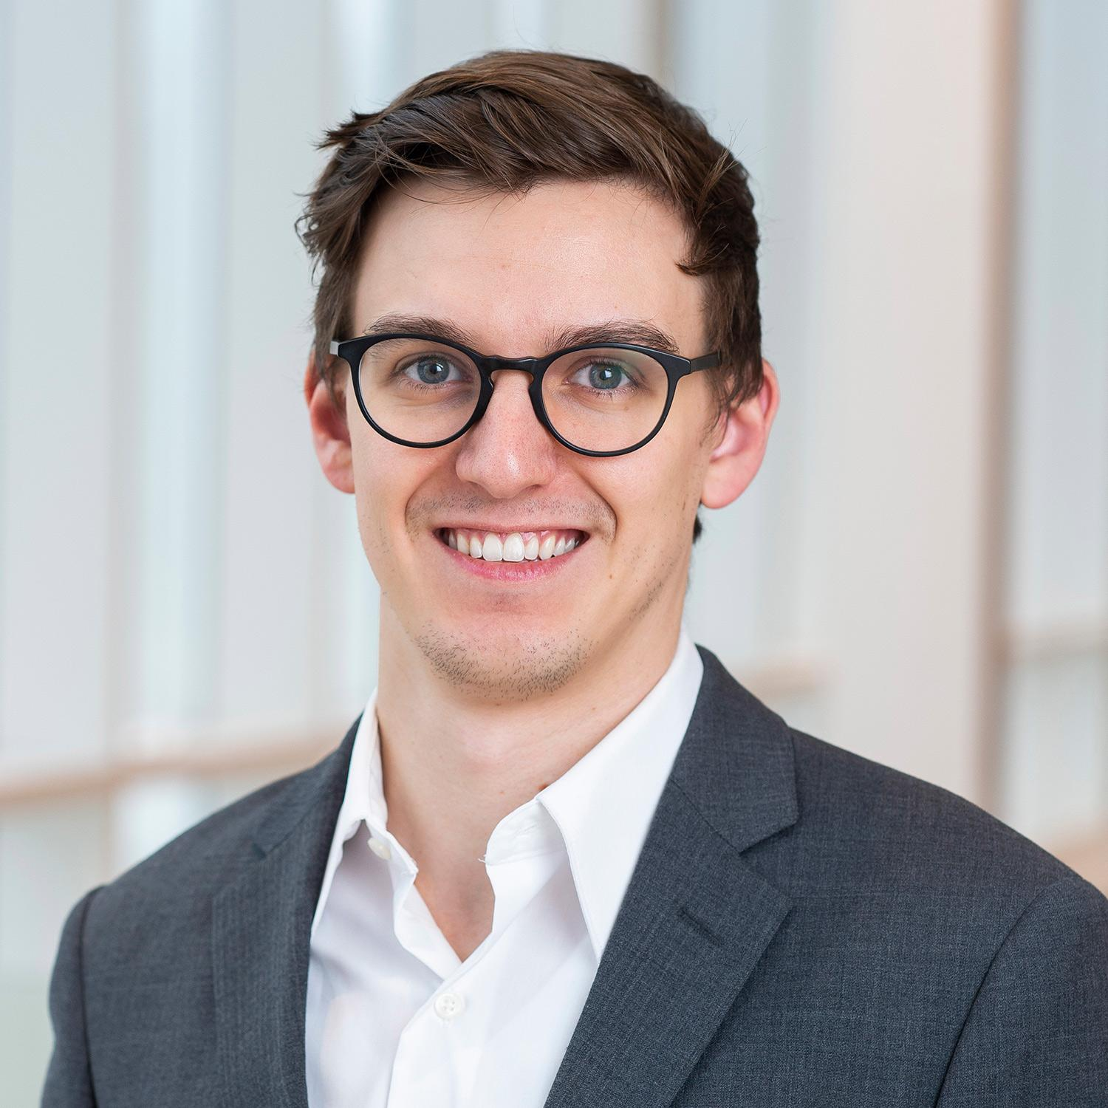
This Year’s Fellows: Joseph Knisely
Exploring New Satellite Bias Correction Methodologies for Numerical Weather Prediction within Theoretical and Operational Frameworks
University of Maryland's Department of Atmospheric and Oceanic Science (AOSC)
Advisor: Dr. Jon Poterjoy

