Slide 1
INCLUSION IN COMMUNITY MODELING
Importance and Need for Diversity & Inclusion
Panelists: Neil Jacobs, Sen Chiao, Bill Parker, Shakila Merchant, DaNa Carlis, and Mike Farrar
Chairs: Maoyi Huang and Kevin Garrett

Slide 2
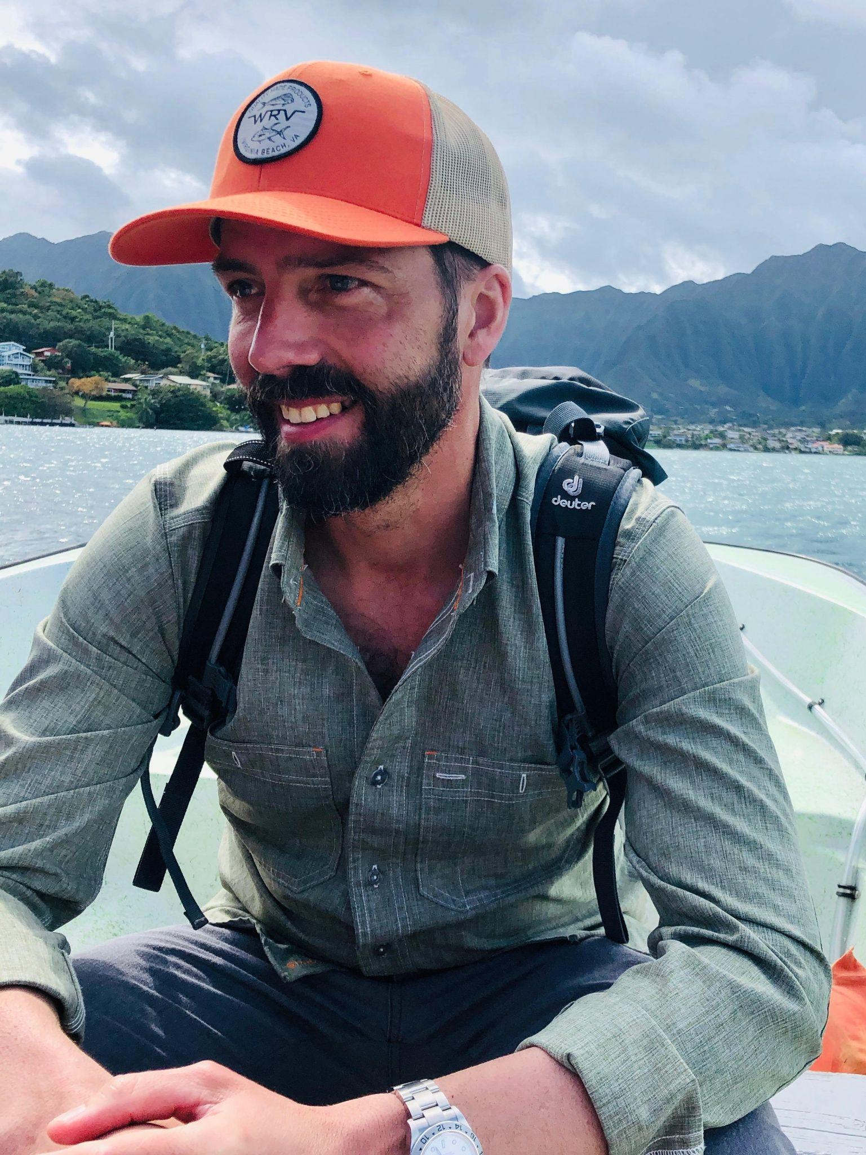
Opening Remarks
Neil Jacobs, Ph.D.
UFS Chief Science Advisor

Slide 3
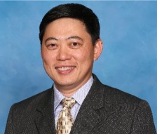
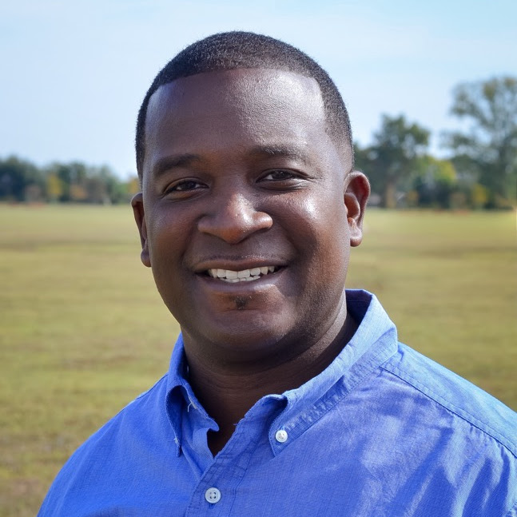
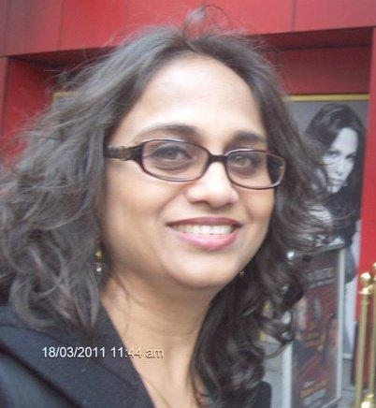
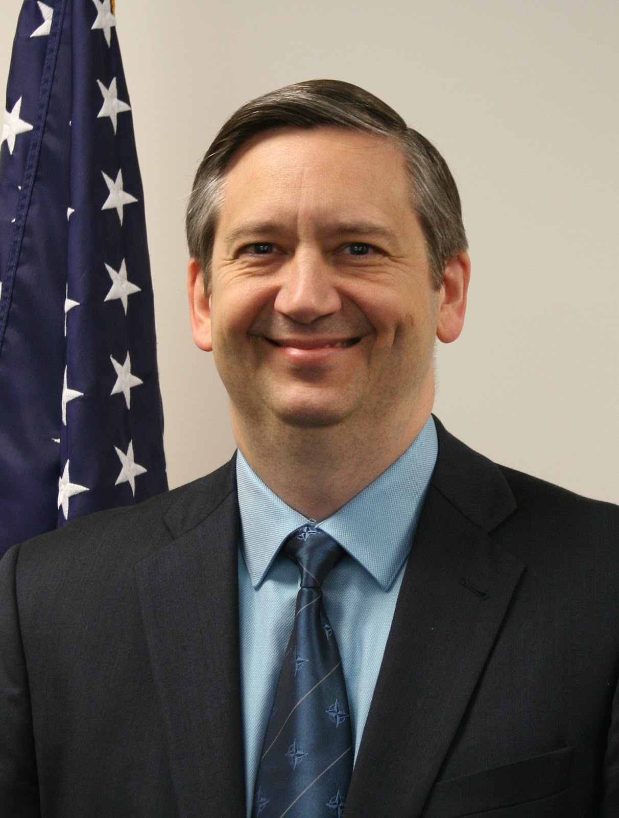
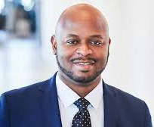
Panelists
Sen Chiao
Director, NOAA Cooperative Science Center in Atmospheric Sciences and Meteorology
William "Bill" Parker
Meteorologist-in-charge
Weather Forecast Office
Jackson, MS
Shakila Merchant
NOAA Center for Earth System Sciences and Remote Sensing Technologies
DaNa Carlis, Director
National Severe Storms Laboratory
Michael Farrar, Director
National Centers for Environmental Prediction

Slide 4
NOAA Cooperative Science Center in Atmospheric Sciences and Meteorology (NCAS-M)

Slide 5
NCAS-M commitment and participation

Slide 6
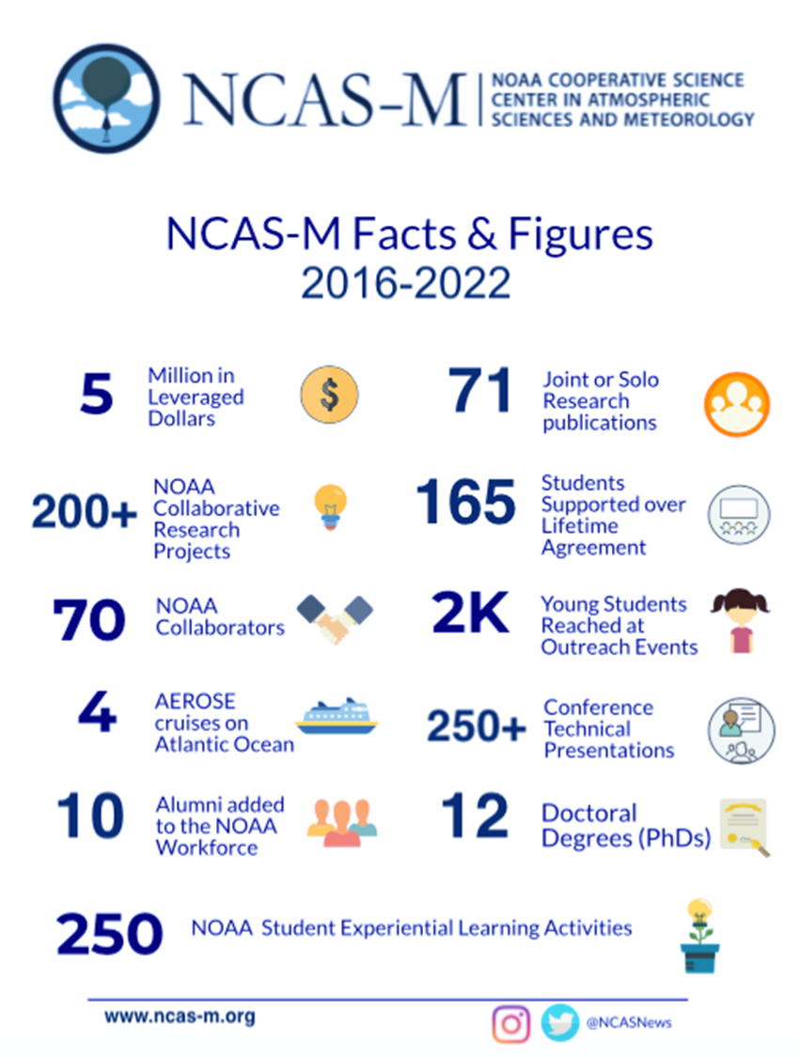
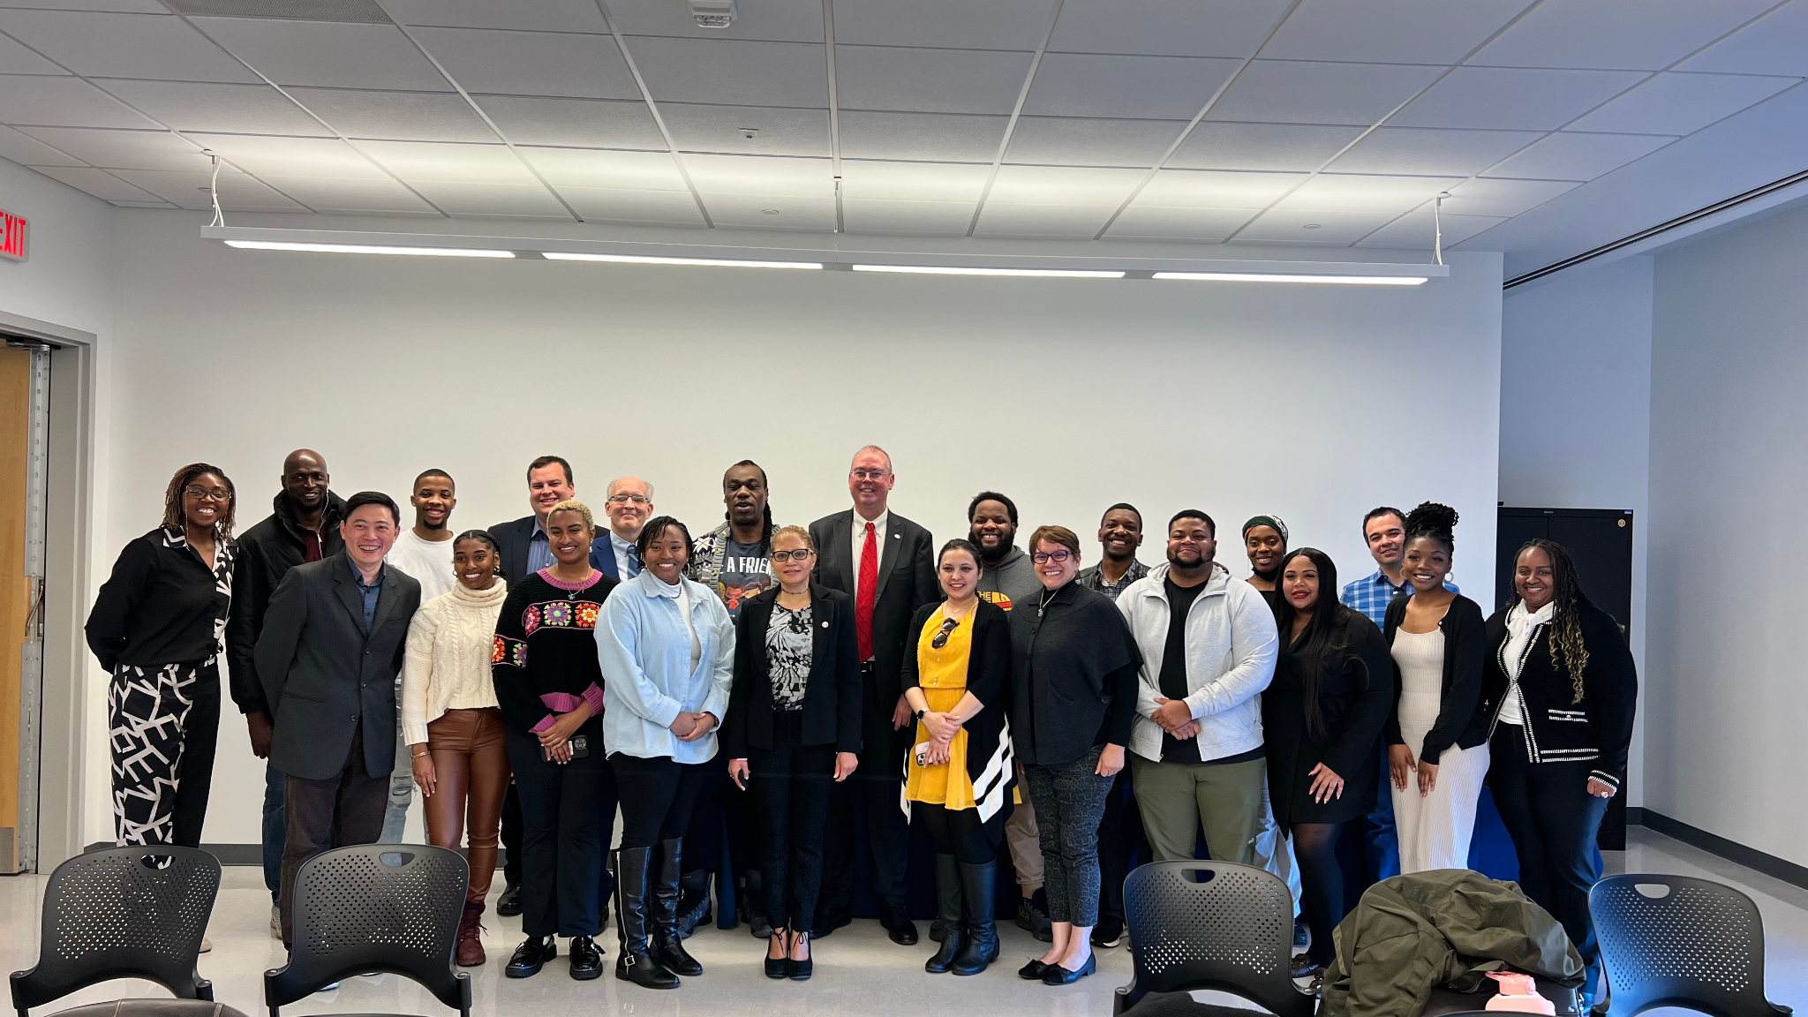
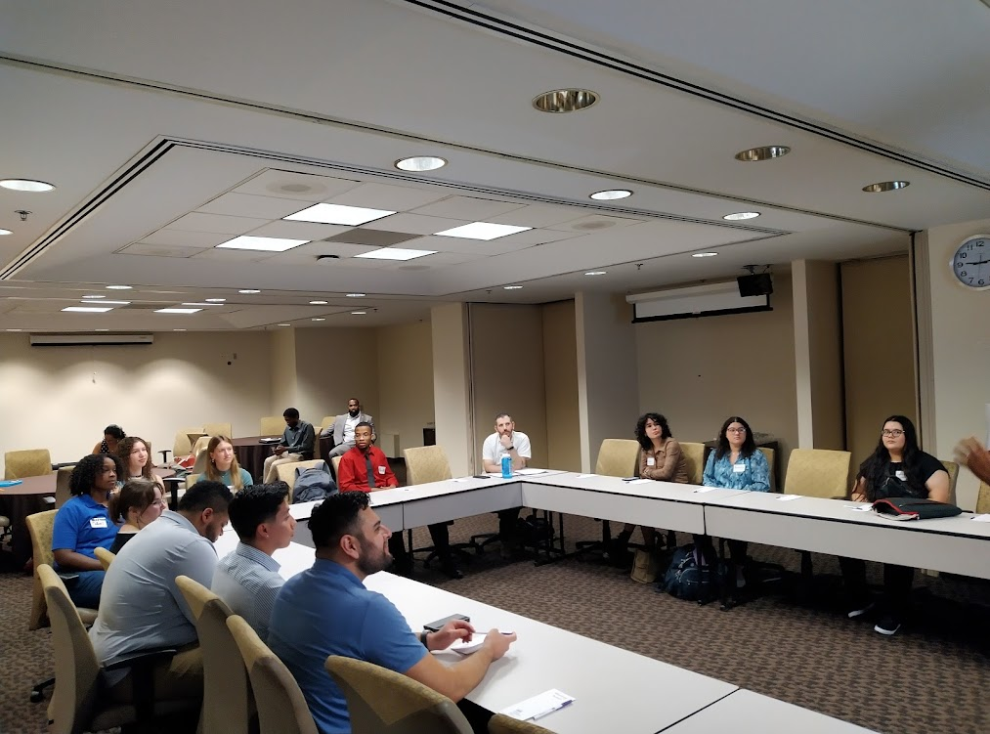
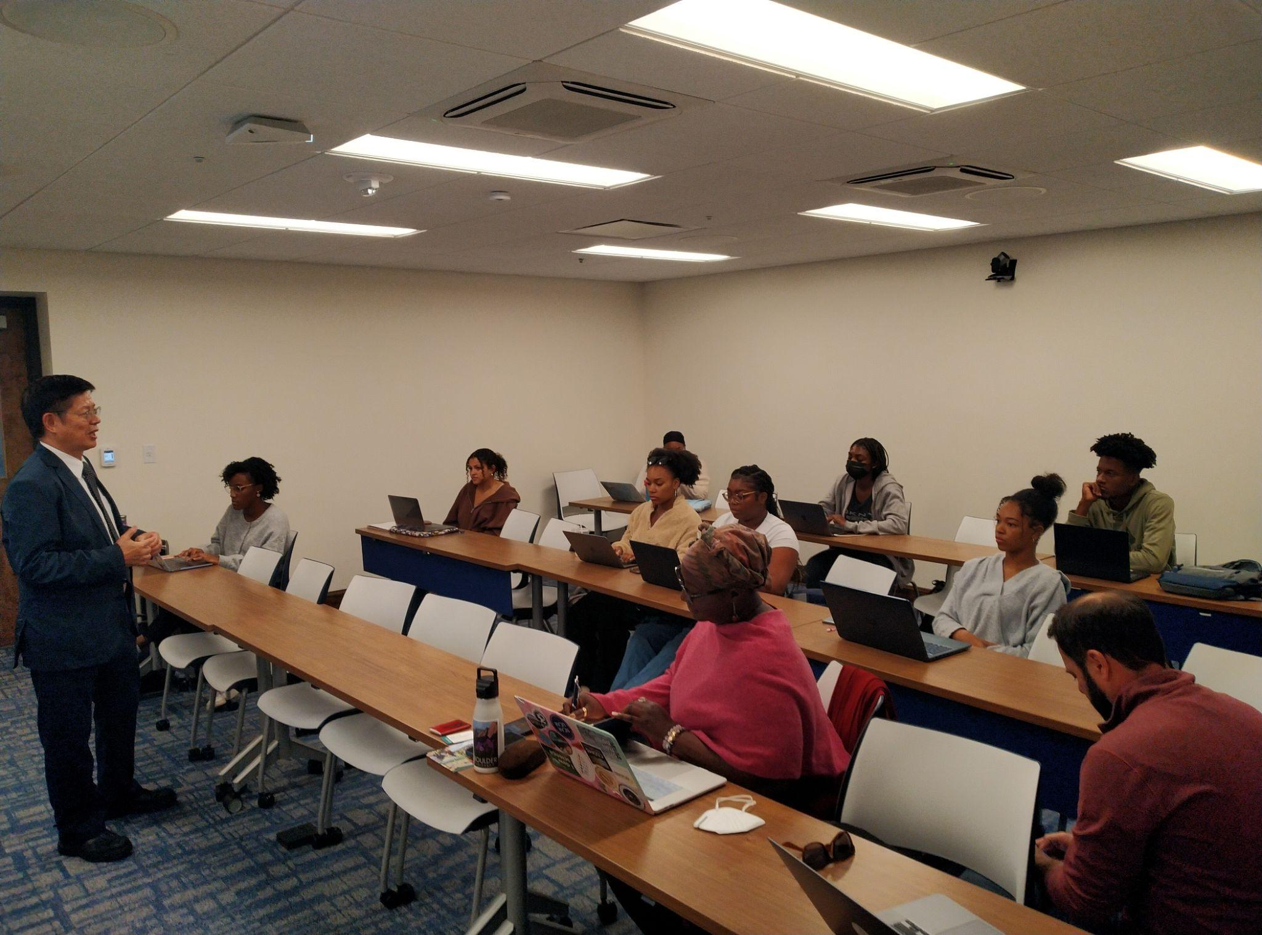
Outcome of NOAA Funding

Slide 7
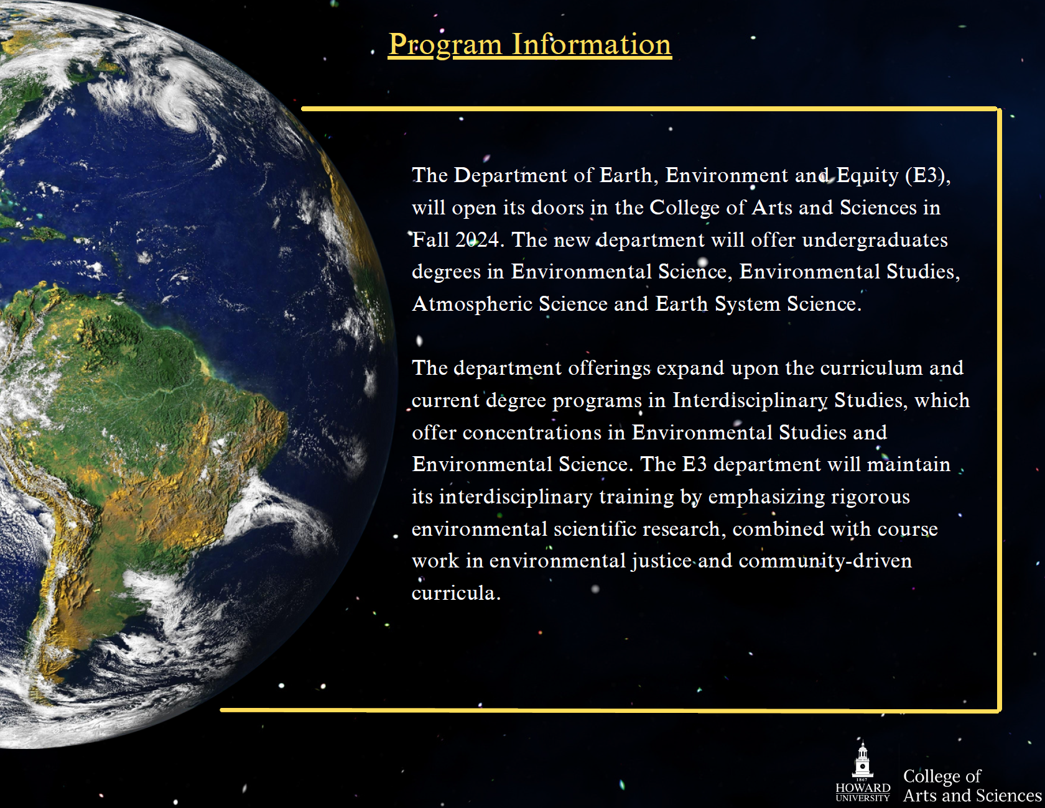
The Department of Earth, Environment, and Equity (E3)

Slide 8
NOAA Center for Earth System Sciences and Remote Sensing Technologies II (CESSRST) Program
NOAA CESSRST program was funded by NOAA/EPP Grant #NA16SEC4810008
NOAA CESSRST II program is funded by NOAA/EPP Grant #NA22SEC4810016

Slide 9
Four NOAA Cooperative Science Centers
There are four centers with 24 university members
NOAA Center for Atmospheric Science and Meteorology (NCAS‐M) – Howard University, DC
NOAA Center for Coastal and Marine Ecosystems (CCME) –Florida A&M University, FL
NOAA Living Marine Resources Cooperative Science Center –University of Maryland, Eastern Shore, MD
NOAA Center for Earth System Sciences and Remote Sensing Technologies (CESSRST)The City College of CUNY, NY

Slide 10
Training a diverse workforce in NOAA Mission Enterprise
Coastal Resilience
Costal Ocean water quality
Coastal erosion in Arctic
Coral Reefs
Harmful Algal Blooms
Center Type Competencies
Remote Sensing, Data Science,
Environmental Modeling
Social Science
Professional Competencies
Experiential Training
Cutting-edge mentored research projects
Early NOAA Engagement
NOAA Experiential Research & Training
Opportunities
Stake-holder Engagement
Atmospheric Hazards
Weather Hazards/Storms/Heatwaves
Atmospheric Composition/Air Quality
Satellite applications to weather and air quality
Weather and Air Quality Modeling
Integrated Social Science
Communications/perceptions of risk and decision-making, vulnerability to natural hazards, Climate Change Impacts and resiliency, Environmental Justice
Water Prediction and Ecosystem Services
Floods & Droughts- Risk Assessment and Ecosystem Outcomes
Assessment and Application of National Water Model
Monitoring Land-Atmosphere-Ocean Exchange/Fluxes
Microwave and Visible Hyperspectral environmental observations from UAS platform

Slide 11
NOAA EPP/MSI Education and Training Model is Unique
A Holistic Training
Prepares Fellows for
Research, Academics, Professional
Future Workforce, and/or Further Studies

Slide 14
Data Products
POST GRADUATION
20 Years of investment
Data Products
Air Temperature for Cities
356
18
Heat Index for Cities
142
STUDENTS EMPLOYED BY NOAA CONTRACTORS
CESSRST Lidar Network
STUDENTS EMPLOYED IN PRIVATE INDUSTRY
Chl NN algorithm
STUDENTS EMPLOYED IN ACADEMIA JOBS
112
Urban Thermodynamic Profiles
11
VIIRS Chl algorithm
STUDENTS EMPLOYED BY NOAA FEDERAL
4
STUDENTS EMPLOYED BY OTHER FEDERAL, STATE, LOCAL OR TRIBAL GOVT.
Regional PM2.5 Product
Urban Wind Pattern
STUDENTS WORKING AS ENTREPRENEURS
Compilation of PBL heights

Slide 15
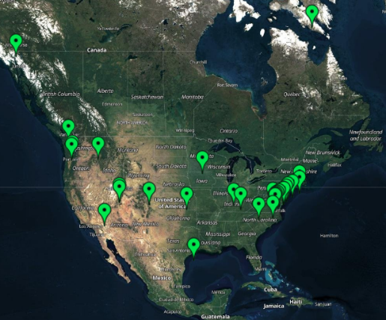
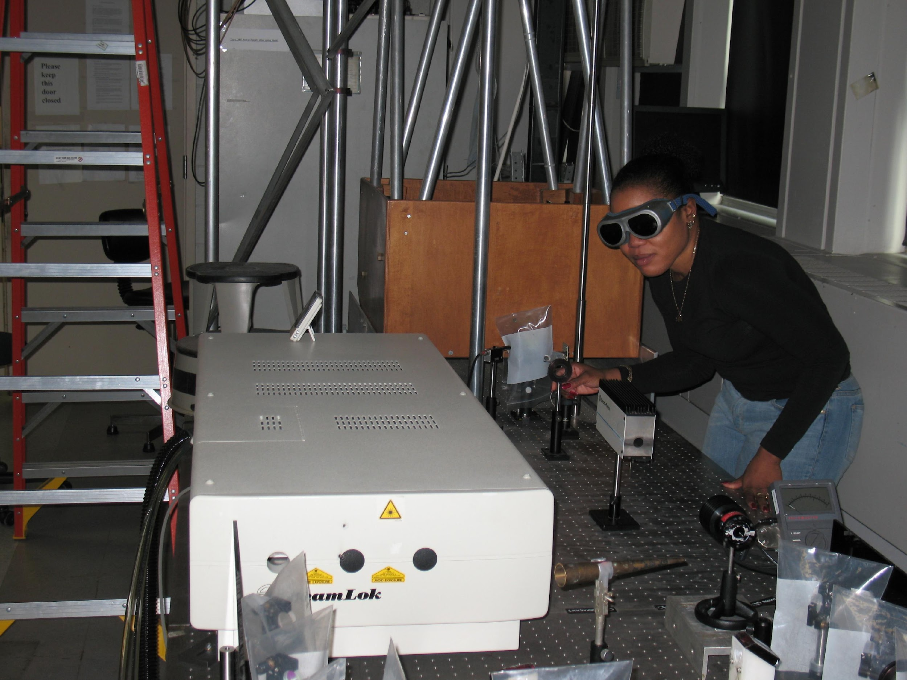
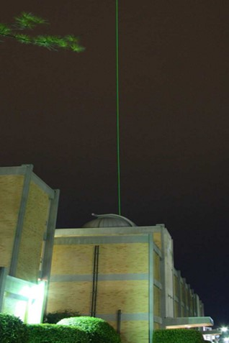
National Capacity and Research Infrastructure || NOAA CESSRST
Lidar Network at CESSRST Institutional Sites (CCNY, UMBC, Hampton U)
Prescribed Fires in VA and WV
CCNY LIDAR Lab
https://alg.umbc.edu/ucn || https://ucn-portal.org
Hampton U
Aerosol Lidars (CLN)
Unified Ceilometer Network (UCN)
Tropospheric Ozone Lidar Network (TOLNET)
40 Federal Local and State environmental agencies
Two NOAA Cooperative Science Centers
One NOAA Cooperative Institute
9 Minority Serving Institutions

Slide 16
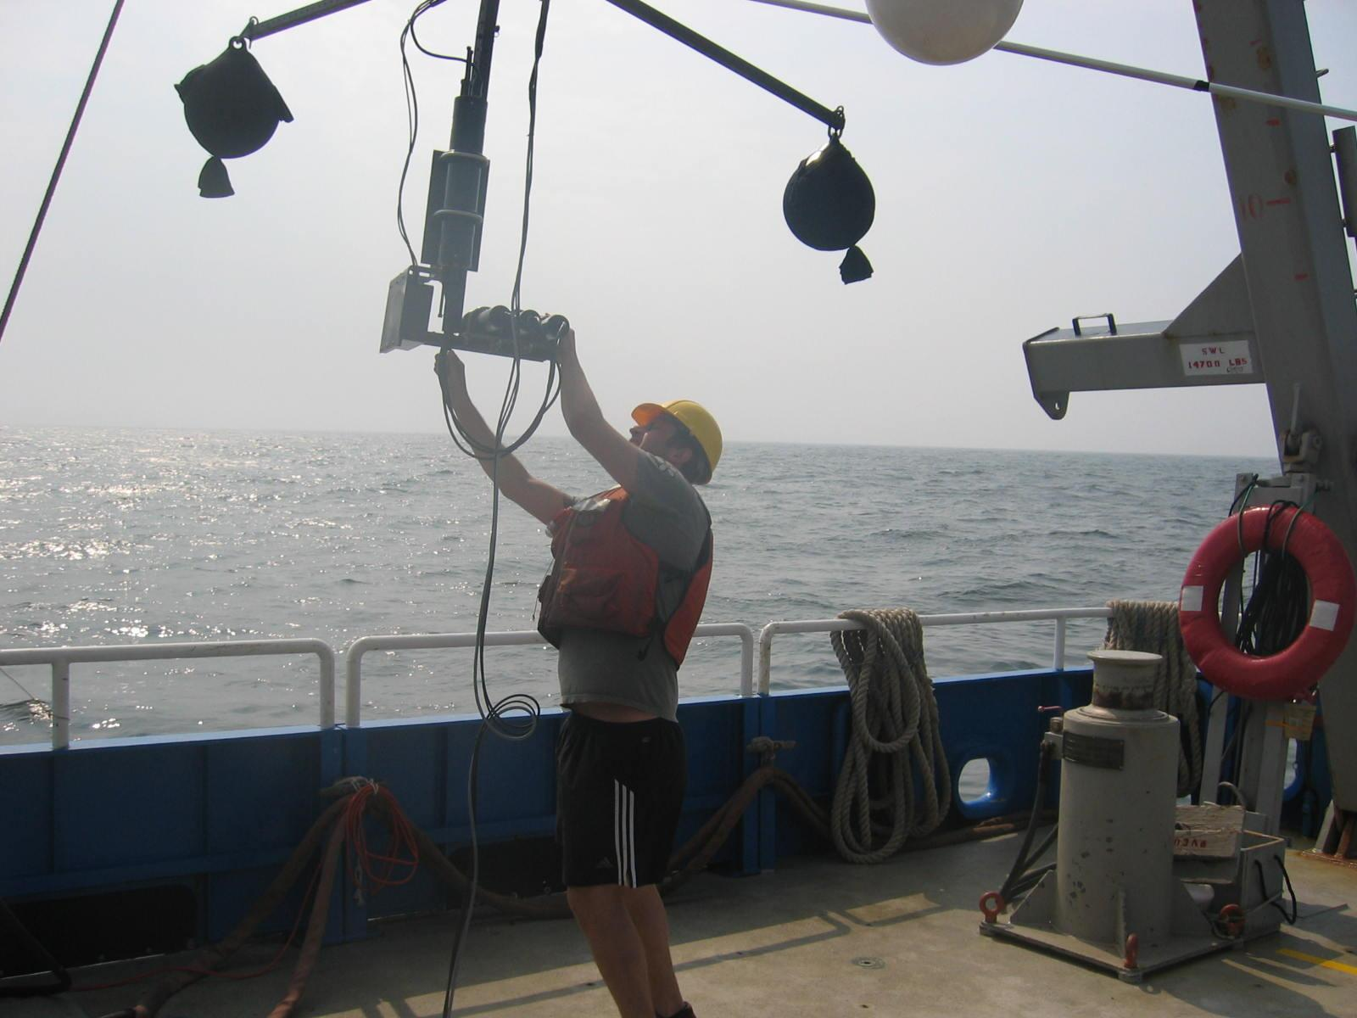
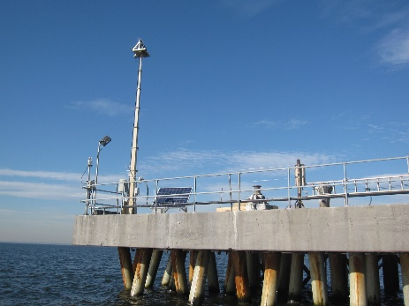
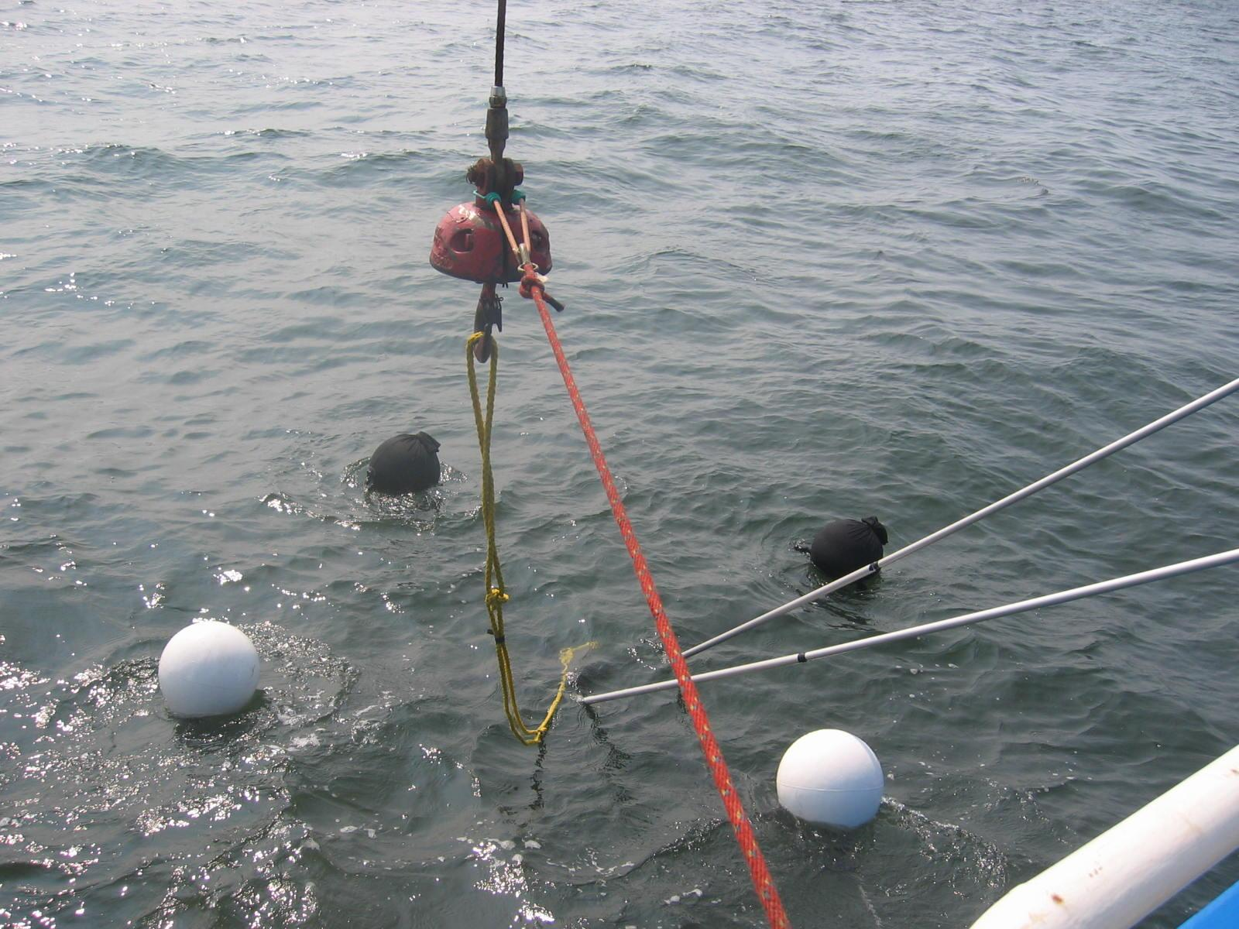
Long Island Sound Coastal Observatory (LISCO), NY
https://alg.umbc.edu/ceilometer-testbed/
Coastal Ocean Water Quality/Ocean Color Satellite Calibration and Validation and Field Sites
https://www.star.nesdis.noaa.gov/socd/mecb/color/CalVal_n20.php
Algal Bloom Experimental Products NOAA NCCOS Chlorophyll-a https://coastwatch.noaa.gov/cw_html/NCCOS.html

Slide 17
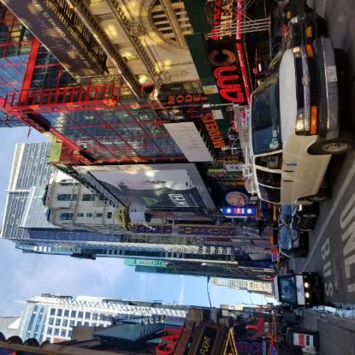
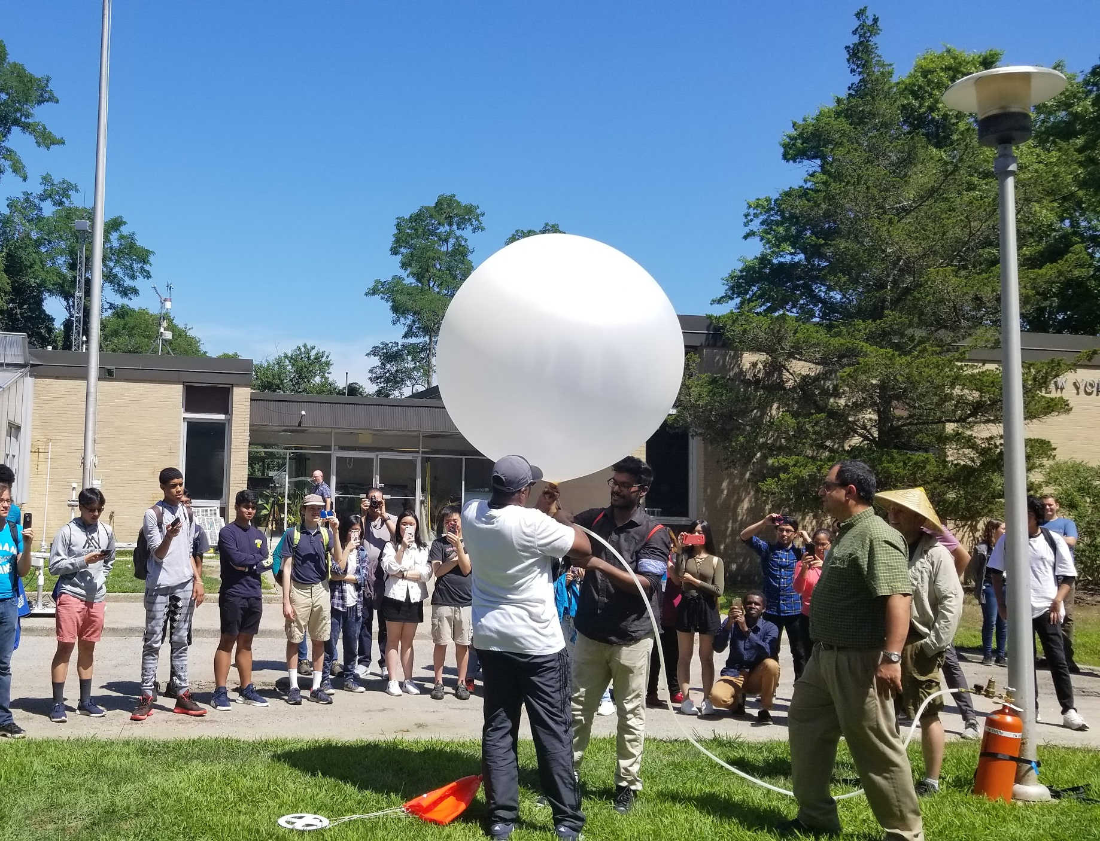
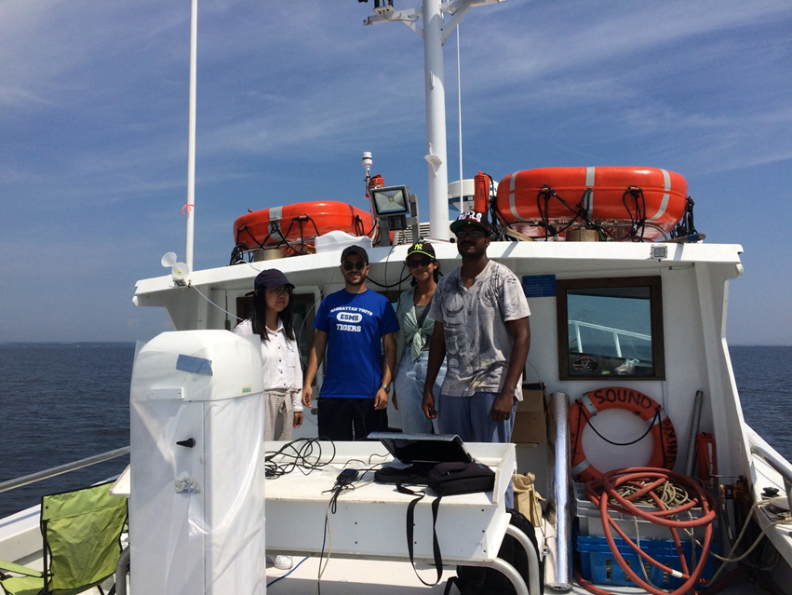
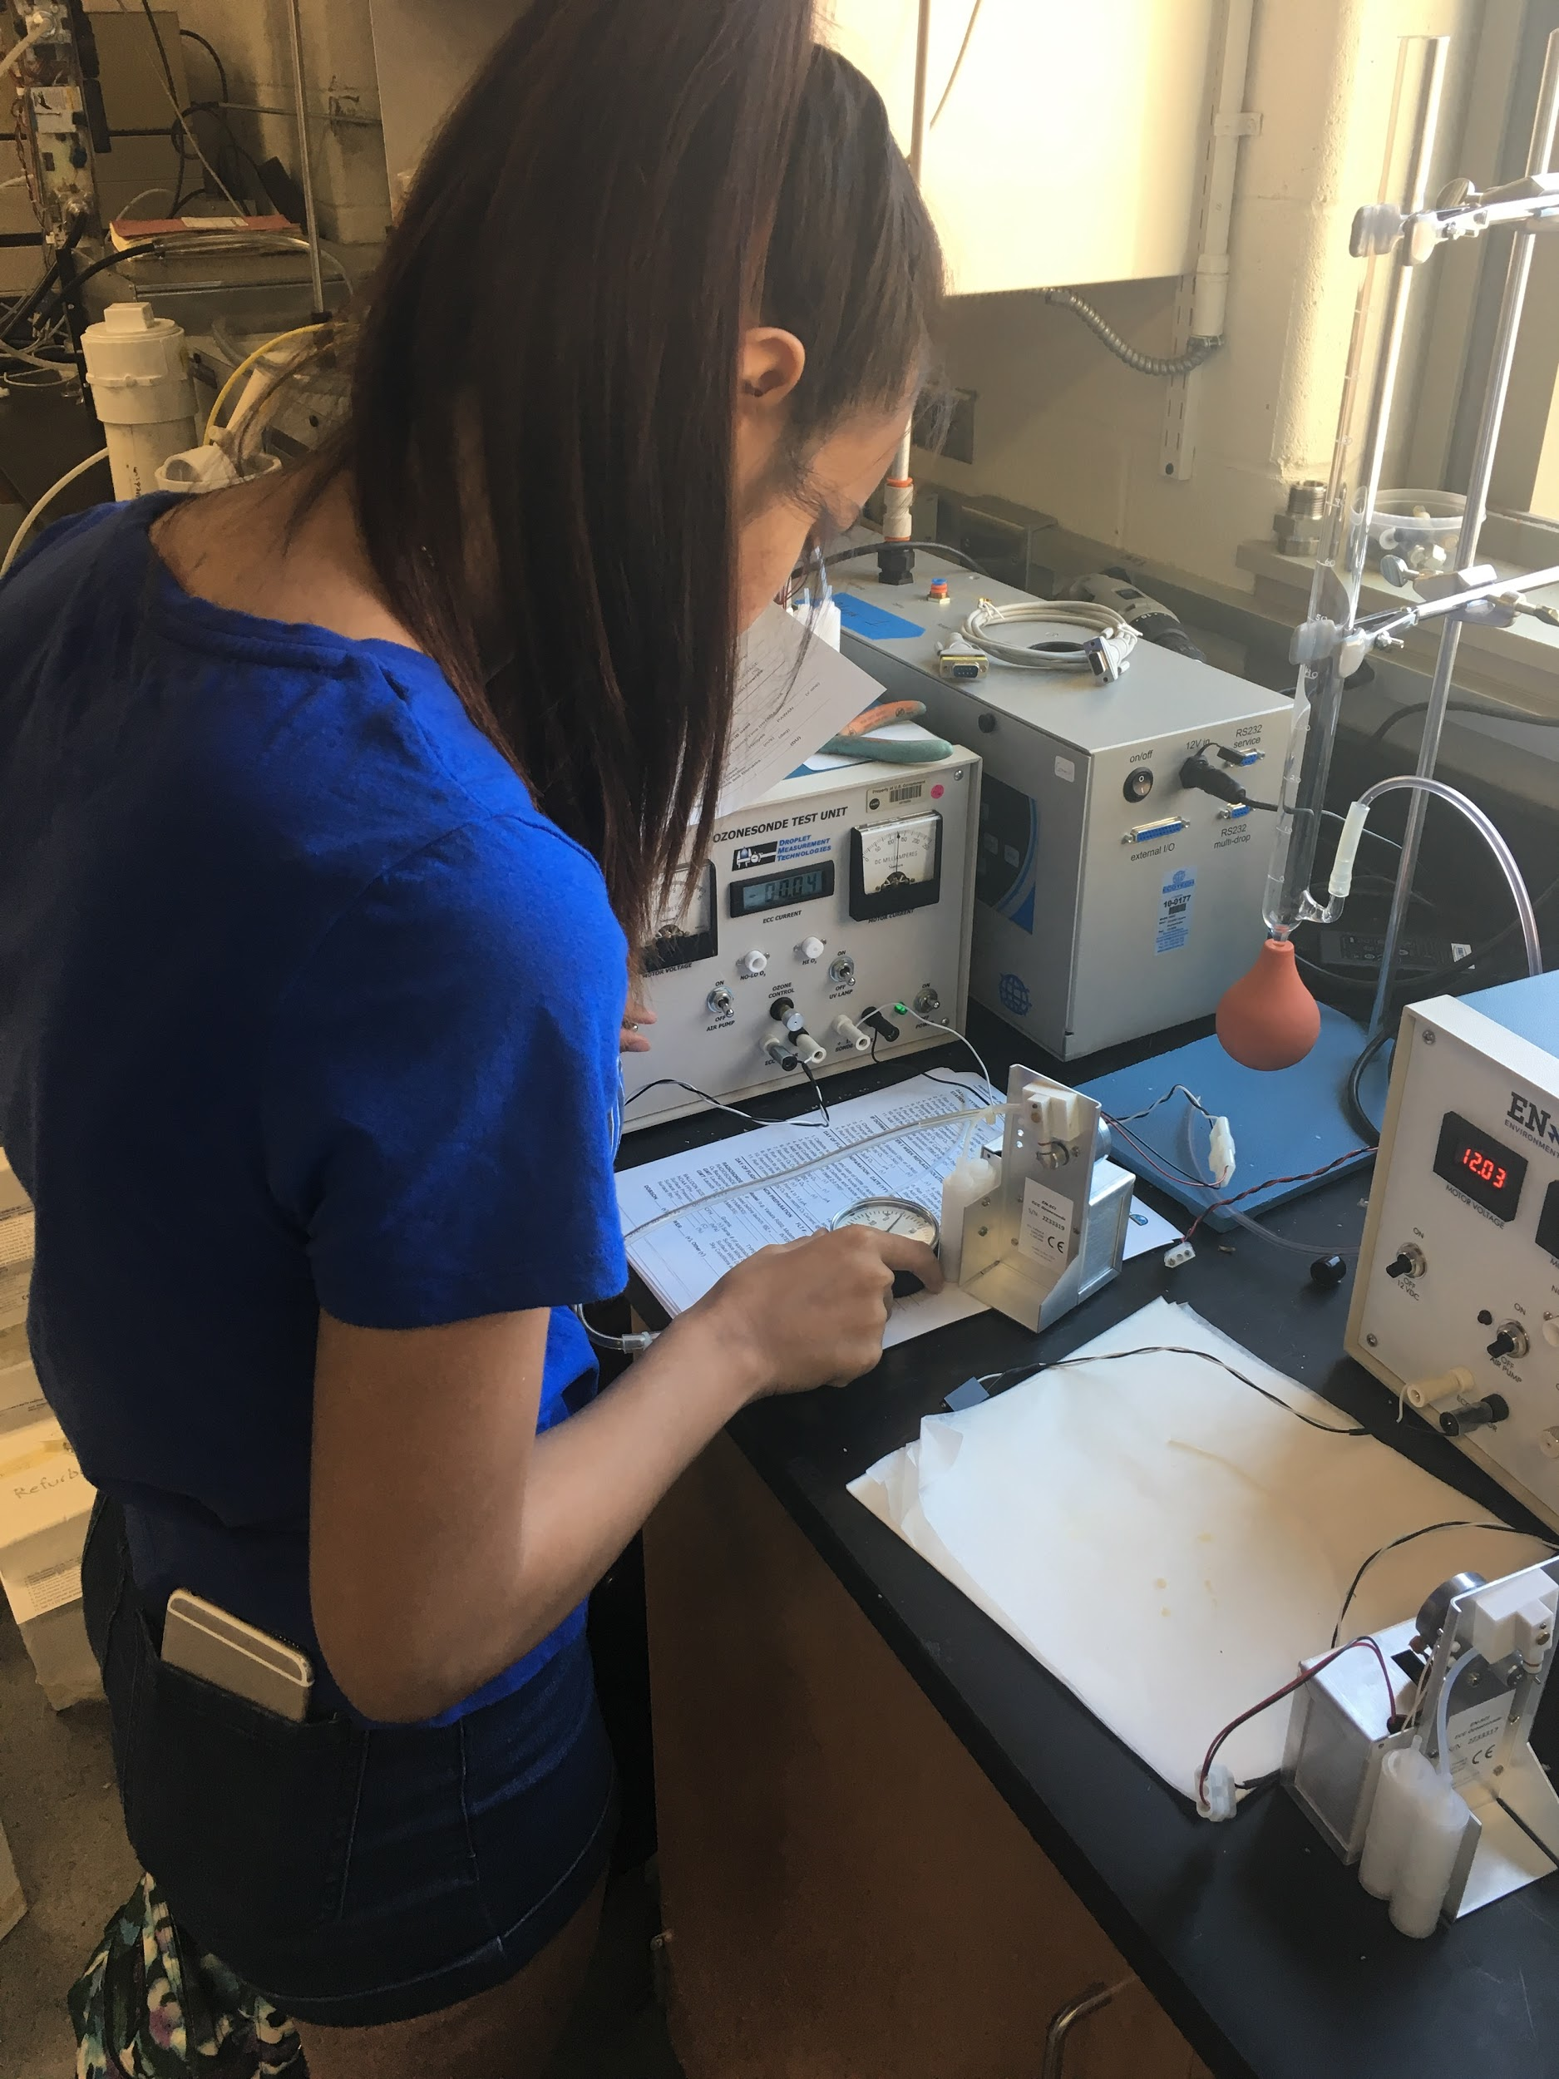
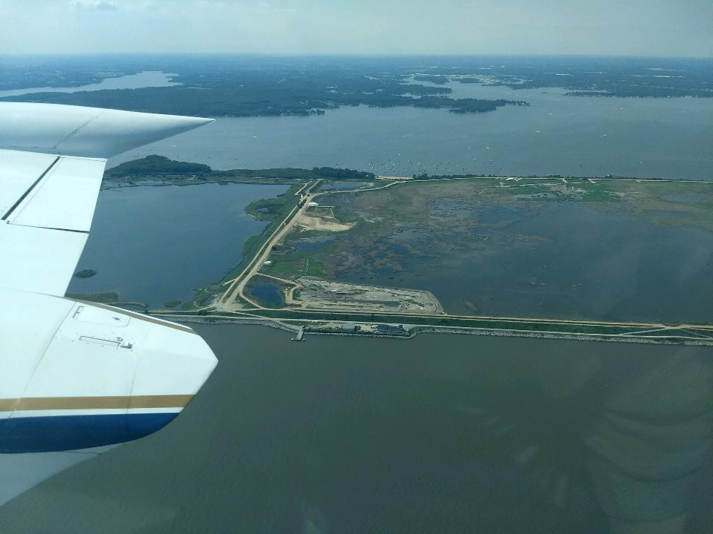
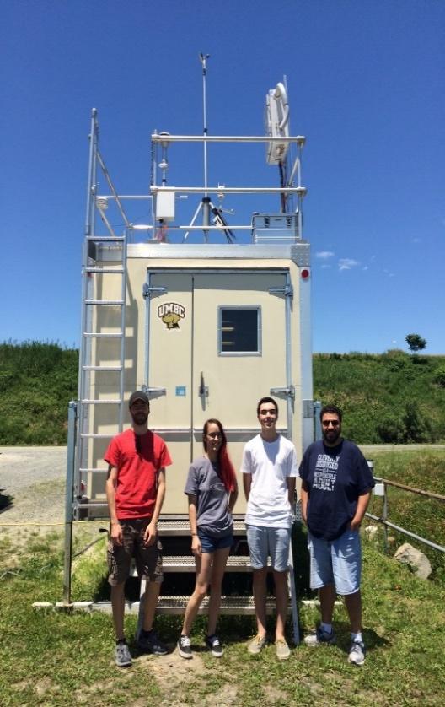
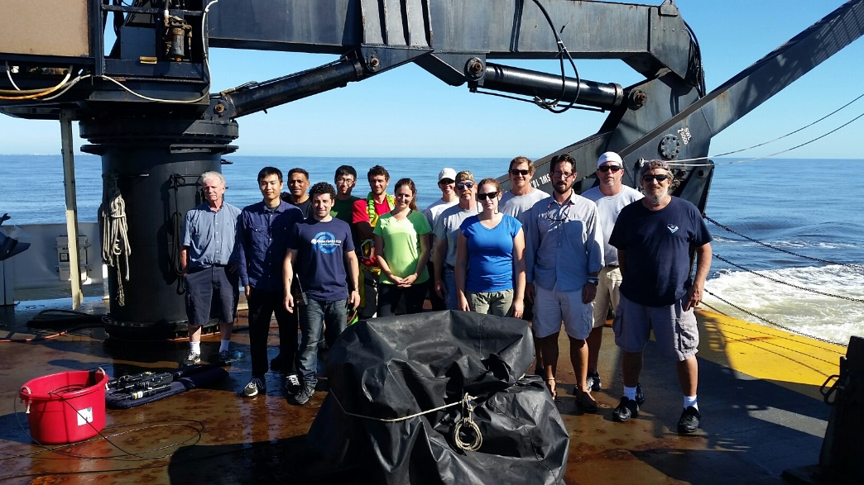
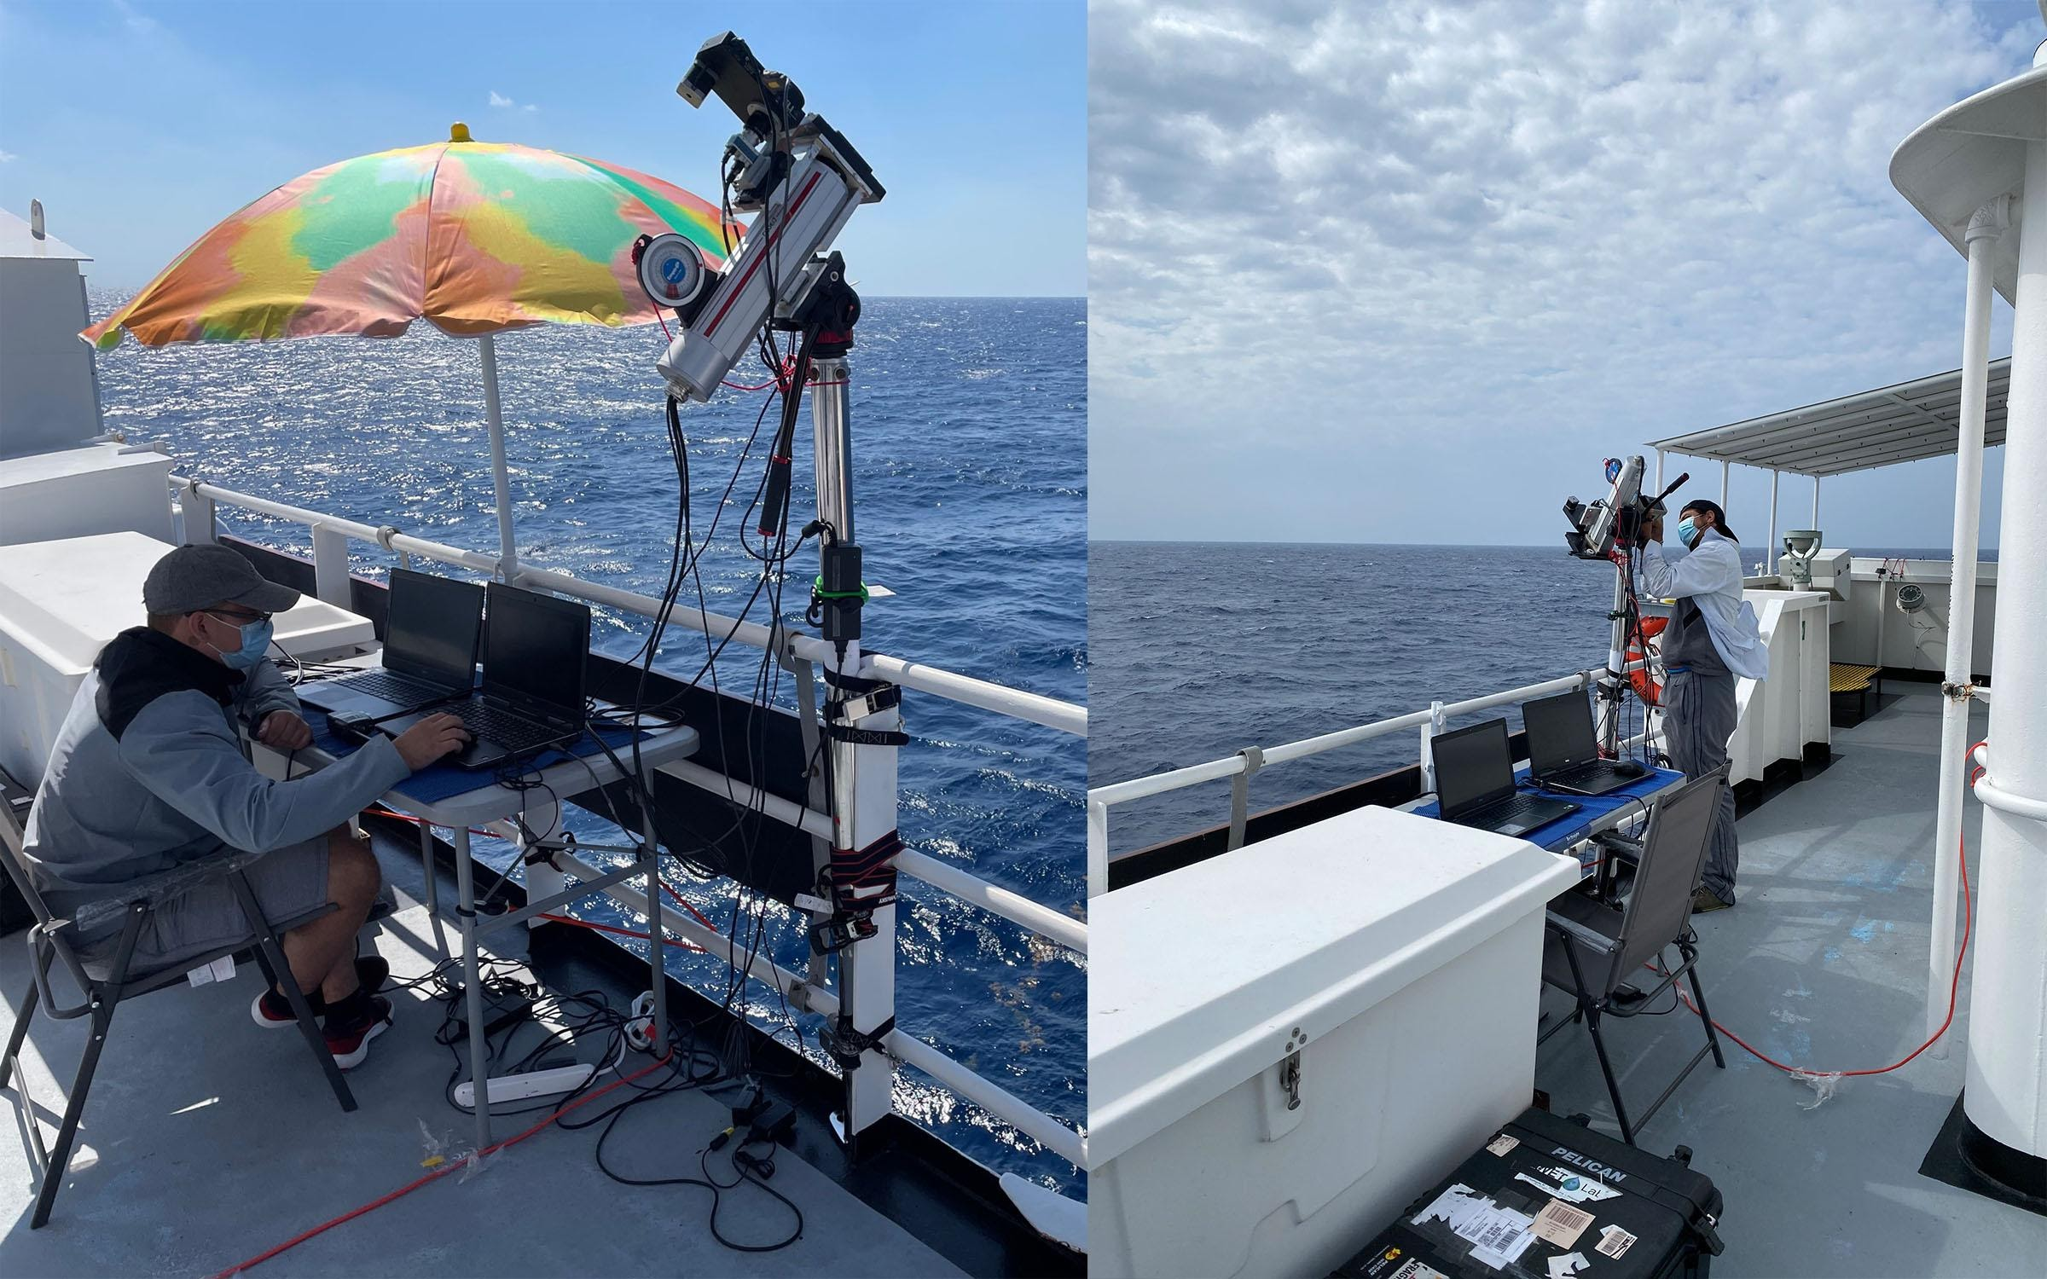
NOAA Collaborative Field Campaigns and Cruises
Multi-agency Long Island Sound Tropospheric Ozone Study (LISTOS 2018)
Follow-on NOAA OAR/ESRL/CSL campaigns AEROMMA Atmospheric Emissions and Reactions Observed from Megacities to Marine Areas in Summer 2023
Multi- agency Ozone Water Land Environmental Transition Study (OWLETS 1 and 2 - 2017/2018
NOAA OAR participation Washington Post “Air quality study over Chesapeake Bay seeks to understand pollution
NOAA and Multiagency Ocean Water Color and Water Quality Cruises
CESSRST groups participated in multiple cruises (many on NOAA ships) for the validation of satellite sensors: VIIRS on SNPP and NOAA-20 satellites and European Space Agency (ESA) OLCI sensors on Sentinel 3A and 3B satellites.

Slide 18
Building future Weather Ambassadors and Community of Scientists & Engineers
Notes:
2018

Slide 19
What does it mean to be Weather Ready
Notes:
2017

Slide 20
Networking with NOAA NWS Forecasters – understanding Weather and Observations

Slide 21
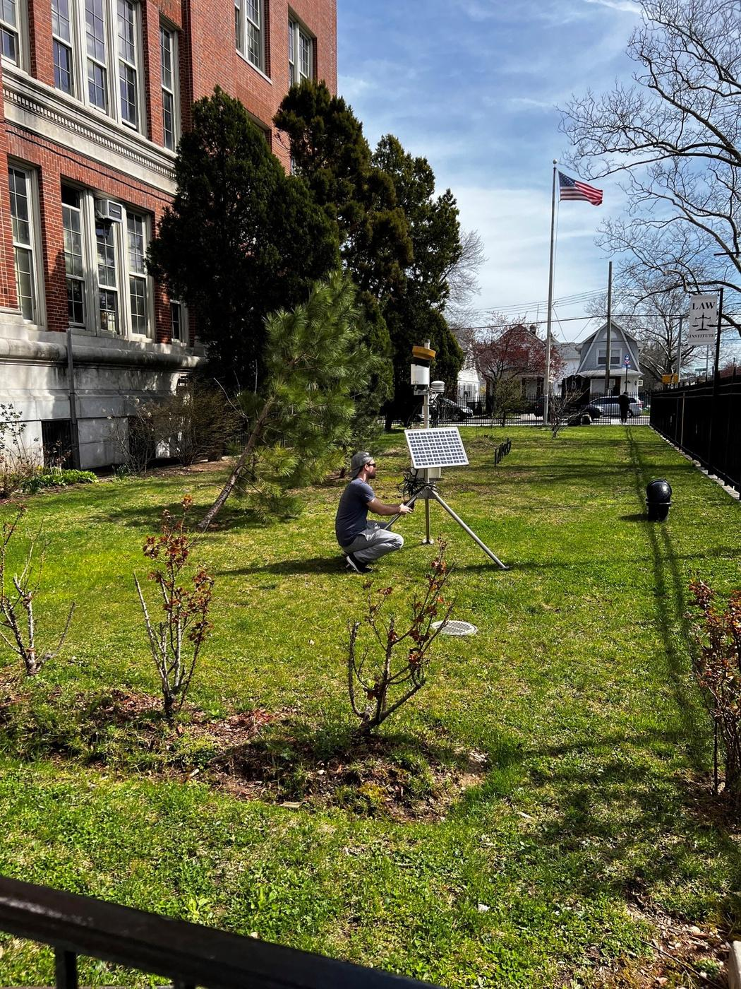
Sensing one Borough at a time - New York Urban Hydro-meteorological Testbed (uHMT) Project
The New York Urban Hydro-meteorological Testbed
(NY-uHMT) project uses autonomous weather stations to collect comprehensive, real-time data on meteorological and hydrological conditions in New York City regions.

Slide 22
Mapping the Location of Autonomous Weather Stations
EH+M
SWH : Susan E. Wagner High School
EH+M : Eagle Harlem Academy & Mott High School
SWH

Slide 23
ENGAGING THE ENGINEERING COMMUNITY IN COMMUNITY MODELING
Establishing Partnerships
Hosting Community Dialogues
Offering Technical Assistance
Providing Education and Training

Slide 24
Potential Academia Partnerships with UFS Community
Build upon existing NOAA EPP/MSI CSC Education and Training Models
Recruitment & Outreach
Private – Academia-Federal Synergy
Summer Bridge and Pathways
NERTO and other NOAA internships
Building capacity (or lack of?) within MSIs/HBCUs
R1 Institutions, challenges and opportunities for (all – faculty, staff, students)

Slide 25
Major Academic Programs Developed in Last 20 Years Through NOAA Partnership at CUNY
2019
2010
M.S in Data Science and Engineering
ABET Accredited
2006
2012
2023….in progress
B.S/B.E in Earth System Sciences and Environmental Engineering
M.E in Earth System Sciences and Environmental Engineering
PhD in Earth System Sciences and Environmental Engineering
20 years
Of NOAA Investments
3 Academic Programs
(Supported in the formulation of two Academic & one Certification Programs at CUNY and Hampton U.)
25 NOAA Mission related STEM courses

Slide 26
Discussion Topics
What government-university programs/projects have worked to engage students vs. which ones have not…and why?
What is the best role for the private sector in building a diverse cadre of scientists and engineers? What can we do better in government and academia to partner with the private sector?
What are the barriers for underrepresented groups to contribute to UFS development?
How can we improve UFS public releases, tutorials, training, user support, and community outreach to make UFS more accessible to all?

