Slide 1
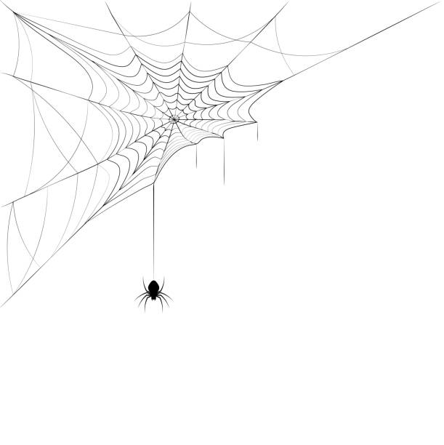
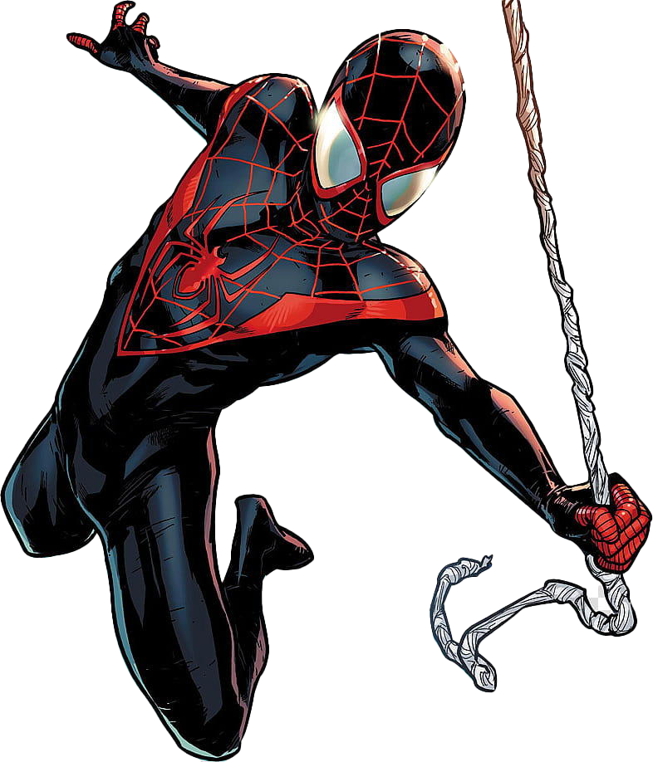
Partnerships: Expanding Our Community
Thoughts, ideas and strategies to create partnerships and expand our approach to engagement
Tamara L. Battle
Policy and Partnerships Lead
NOAA Weather Program Office

Slide 2
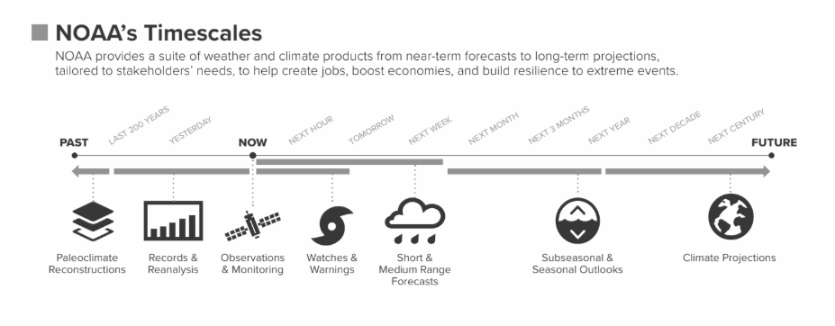
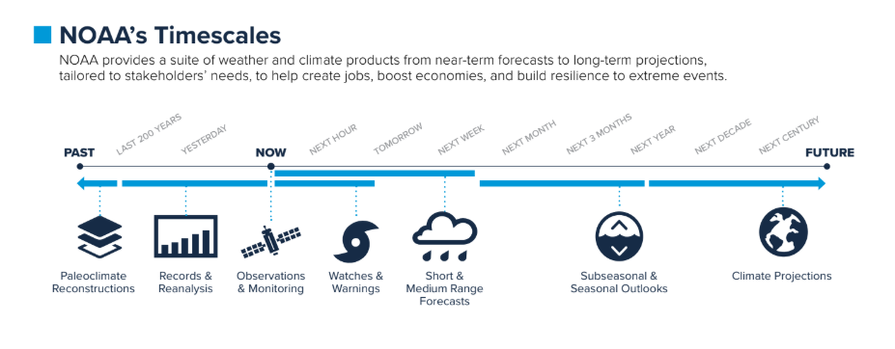
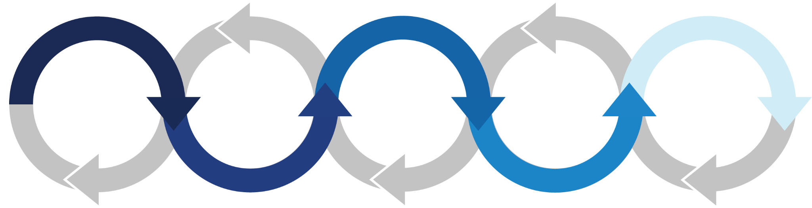
NOAA WEATHER RESEARCH
Observations
Modeling
Forecast Applications
Forecast Products
Forecast Communication
Weather research spans the forecast value chain.
Notes:
Balancing Investments
NOAA strives to support research across timescales and spanning the entire weather value chain from hourly to seasonal forecasts, with an aim to balance innovative high-risk research that pays off years into the future with the immediate needs of NOAA operations.

Slide 3
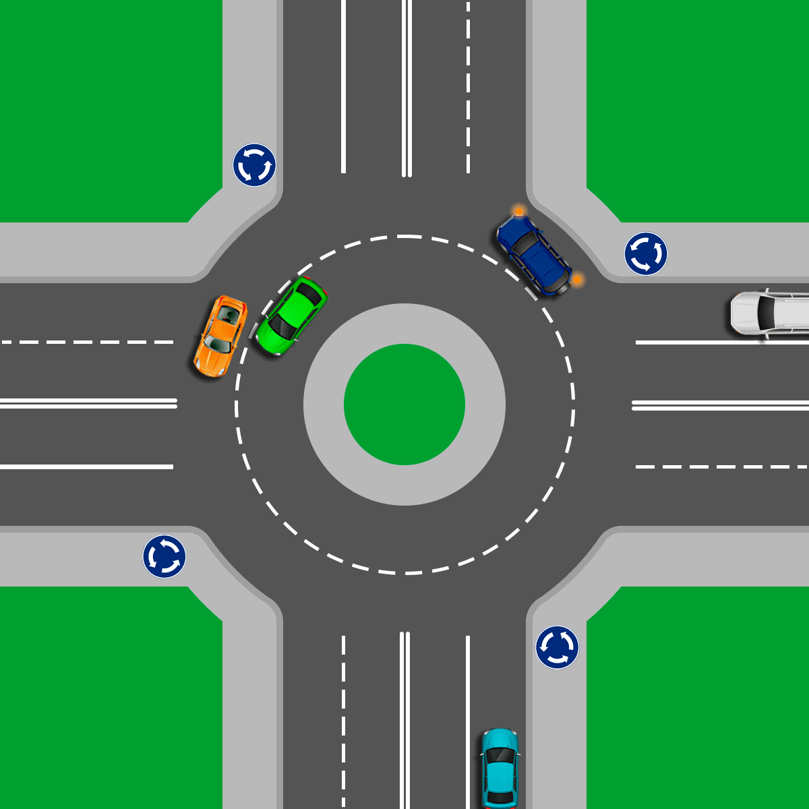
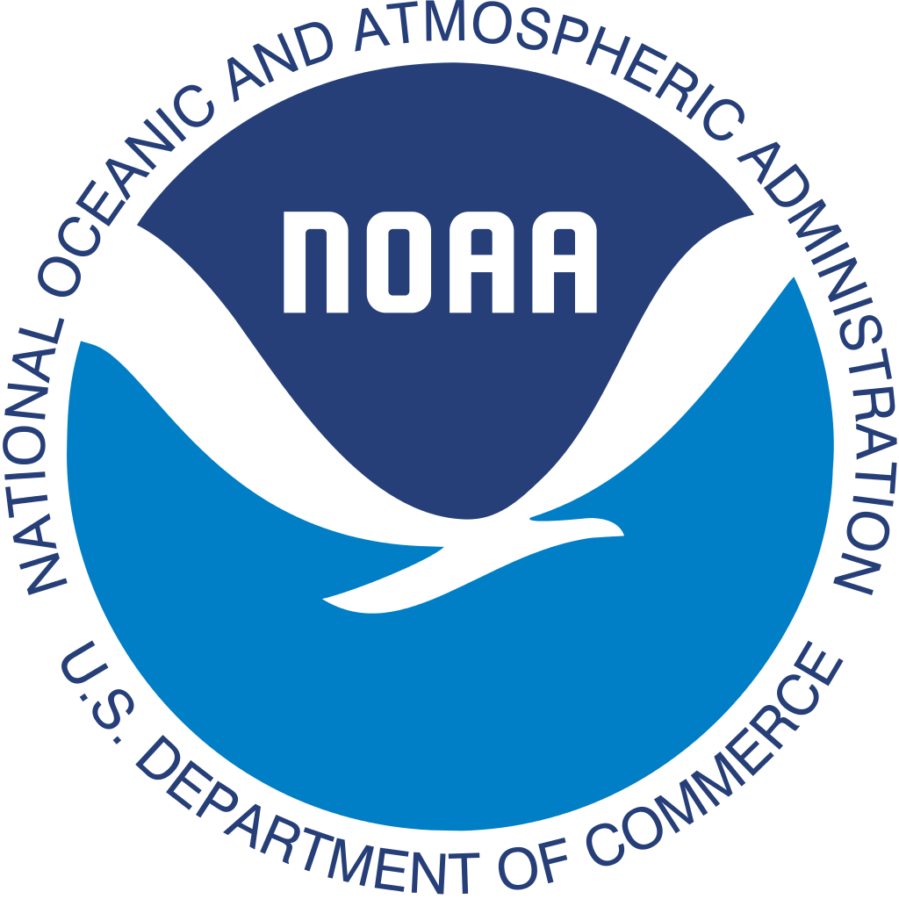
COORDINATING CONNECTIONS
Industry, Academia, & Other Agencies
Strategic Partnerships are the bedrock underpinning weather research at NOAA.
NOAA facilitates R&D through partnerships with the Weather Enterprise, and shepherds that research through the R2O transition process including earth system modeling development.
The Unified Forecast System (UFS) is a community-based coupled Earth modeling system, designed to support the Weather Enterprise to enable the most accurate and reliable operational numerical forecast model in the world.
NOAA Research
National Weather Service
Weather R&D

Slide 4

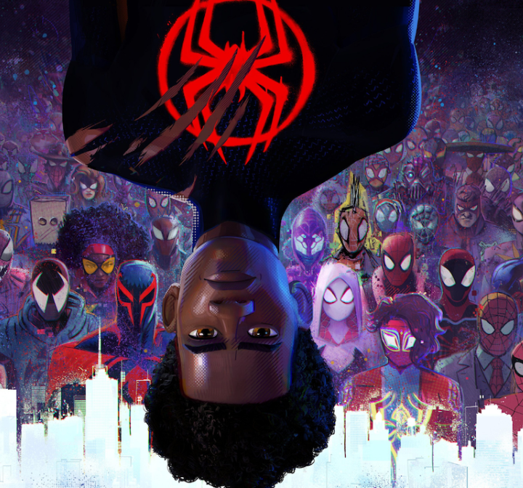
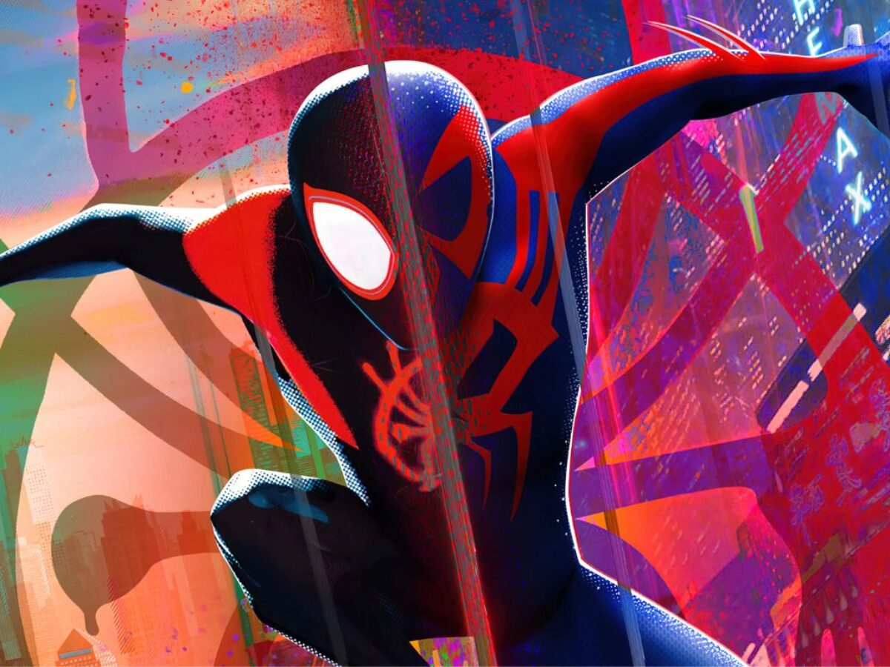

SETTING THE TABLE
Now Generation Workforce
Insights into Inclusion
Innovative Trailblazers
Champions for Change
Expanding the search for diverse individuals
Learning and addressing barriers across the Weather Enterprise
Stimulating creative thinking and nurturing innovative ideas
Embracing new approaches to old challenges
“Strength lies in differences, not similarities” - Stephen R. Covey
Notes:
Foster relationships and identify gaps across the Weather Enterprise
Forge better connections with researchers, scientists, forecasters and other partners to fully understand user needs
Embrace diversity, equity, inclusion and accessibility through communication activities.

Slide 5


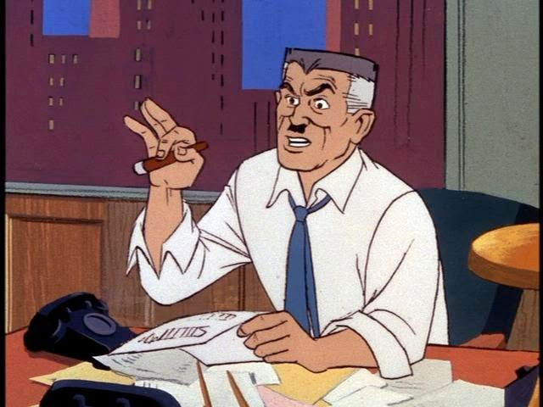
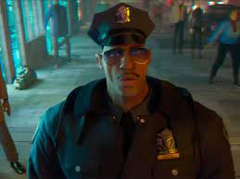
THE NEED FOR PARTNERSHIPS… INCLUSION
Peter Parker
Miles Morales
Unified Forecast System
Notes:
Representation in films, television and games refers to how groups of people and communities are portrayed, and whether they are included at all. There are a number of groups who are under-represented or are given only a narrow range of roles.
Spiderman = UFS…. a superhero that may save the day, but some can’t figure out if he’s the hero or the villain
James Jameson - newspaper editor
Jefferson Davis - police officer

Slide 6
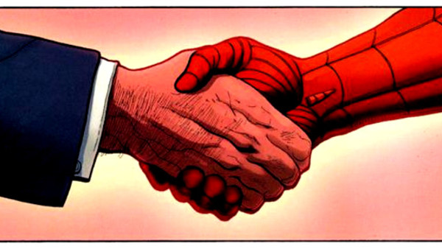
NOAA CIs vs. CSCs
Cooperative Institutes (since 1967)
A NOAA-supported, non-Federal, academic, and/or non-profit institution, that has an established, outstanding research program in one or more areas relevant to NOAA's mission:
Established degree programs in NOAA-related sciences;
Engages in research directly related to NOAA’s long-term mission needs that require substantial involvement of one or more research units within the research institution(s), as well as one or more NOAA programs.
Provides significant coordination of resources among all non-government partners and promotes the involvement of students and postdoctoral scientists in NOAA-funded research.
Cooperative Science Centers (since 2001)
A consortium of academic institutions led by an MSI (minority serving institution), that have demonstrated education and research performance in NOAA-mission sciences:
Trains students in core NOAA mission fields (atmospheric sciences and meteorology; earth system sciences and remote sensing technology; coastal and marine ecosystems; and living marine resources)
Supports increasing number of post-secondary grads with STEM degrees; creating new opportunities for underrepresented populations to be introduced to career paths within NOAA.
Transitions
Notes:
14 CIs vs. 4 CSCs comprised of 28 institutions -
NOAA Center for Atmospheric Sciences and Meteorology (NCAS-M II) - Howard University
Center for Coastal and Marine Ecosystems (CCME II) - Florida A&M University
Center for Earth System Sciences and Remote Sensing Technologies (CESSRST II) - City College of NY
Living Marine Resources CSC (LMRCSC II) - UMD Eastern Shore
OF THE DOCTORAL DEGREES AWARDED IN THE U.S. FROM 2003-2019, COOPERATIVE SCIENCE CENTER INSTITUTIONS AWARDED:
54% earned by African Americans in atmospheric sciences.
35% earned by AAs in marine science
30% earned by AAs in environmental sciences
21% earned by hispanics in atmos sciences
39% earned by hispanics in marine science
19% earned by hispanics in environmental science

Slide 7
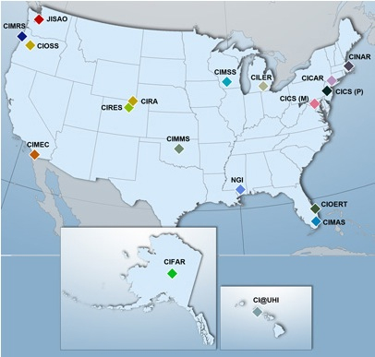
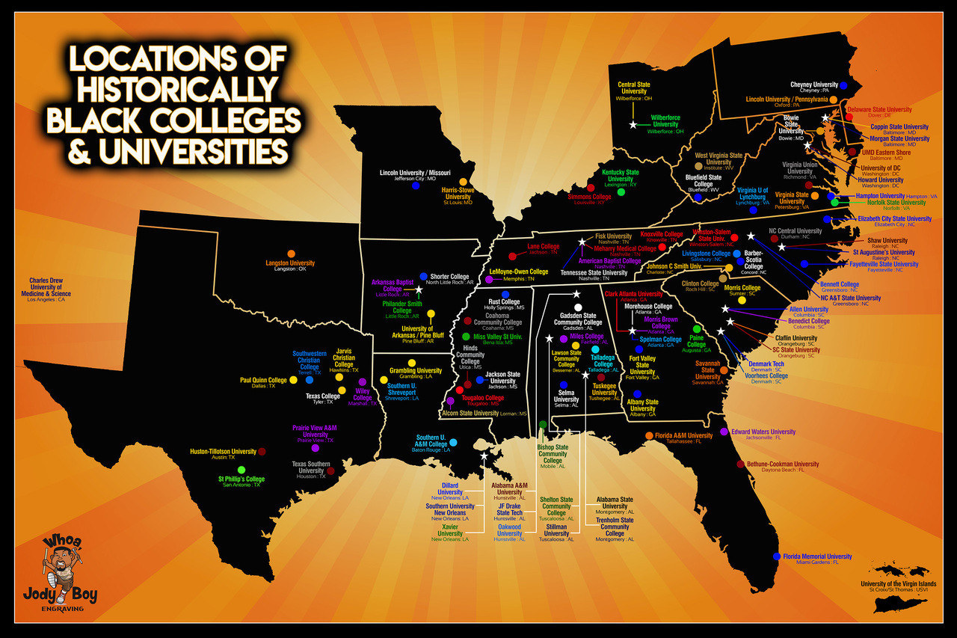
LEVERAGING NOAA CIs and CSCs
Most CIs are co-located with NOAA labs or centers, which allows for optimal collaborative opportunities.
Several CSC lead or partner institutions are also located within close proximity to NOAA facilities and CIs, creating an avenue for increased collaboration and support.
Strategy: Establish various CSCs, HBCUs, HSIs and MSIs as
“UFS Modeling Centers of Excellence”
Notes:
Out of 107 HBCUs, 35% (37 institutions) have STEM programs
Cloud computing resources, and getting in on the ground floor of efforts like UFS
Many MSIs don’t have the infrastructure (such as high performance computing) or access to resources, and are often out of the loop - no one engages them directly other than a few faculty members at random annual meetings
Also the “human” infrastructure - many MSI faculty are teaching, writing proposals, and often expected or required to be involved in DEI efforts at institutions which can be a time- and resource-drain
HBCUs and MSIs are not engaged at the ground level, so there needs to be a more systematic approach to engaging them
One strategy is to host UFS workshops at HBCUs, HSIs, TCUs and other MSIs - foster discussions on sharing resources and applications - for example, in Mississippi, researchers wanting to use forecasts and hindcasts but difficulty accessing HPC (such as ORION at MSU). How do we leverage these resources to welcome more institutions at the ground level?

Slide 8
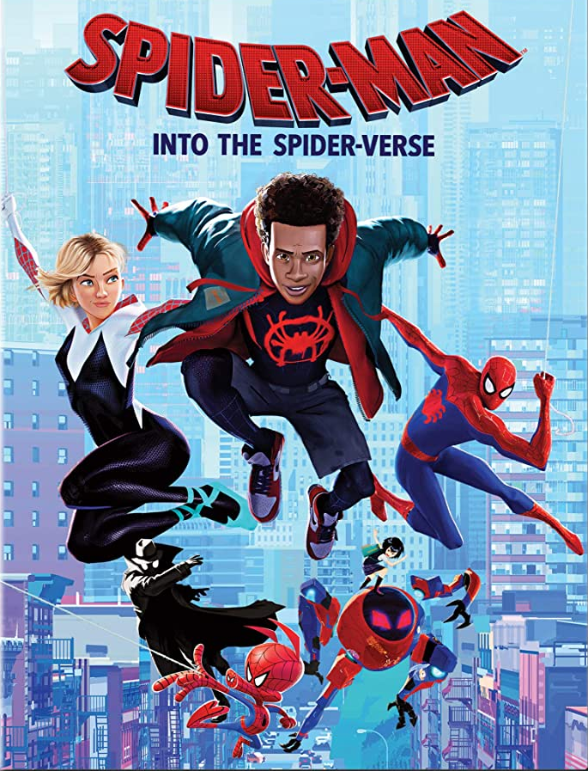
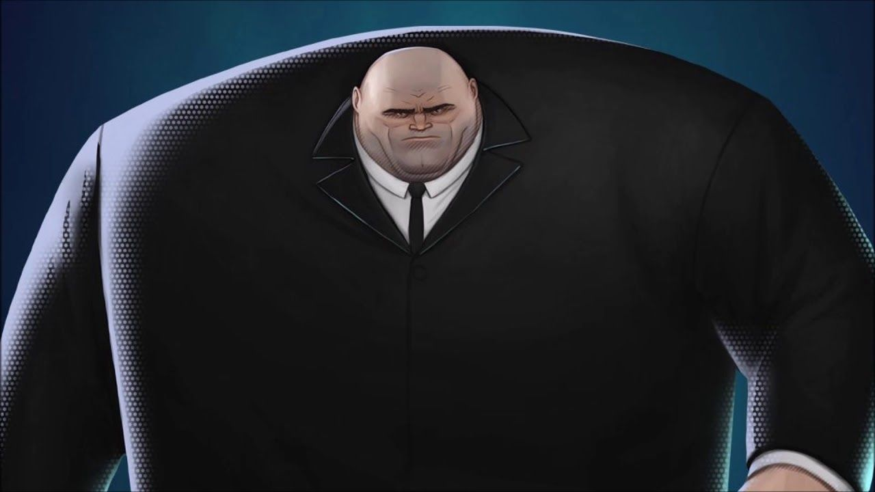
STRATEGIES FOR PARTNERSHIPS… COLLABORATION
Earth Systems
Community Modeling

Slide 9


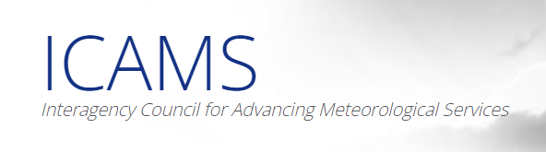



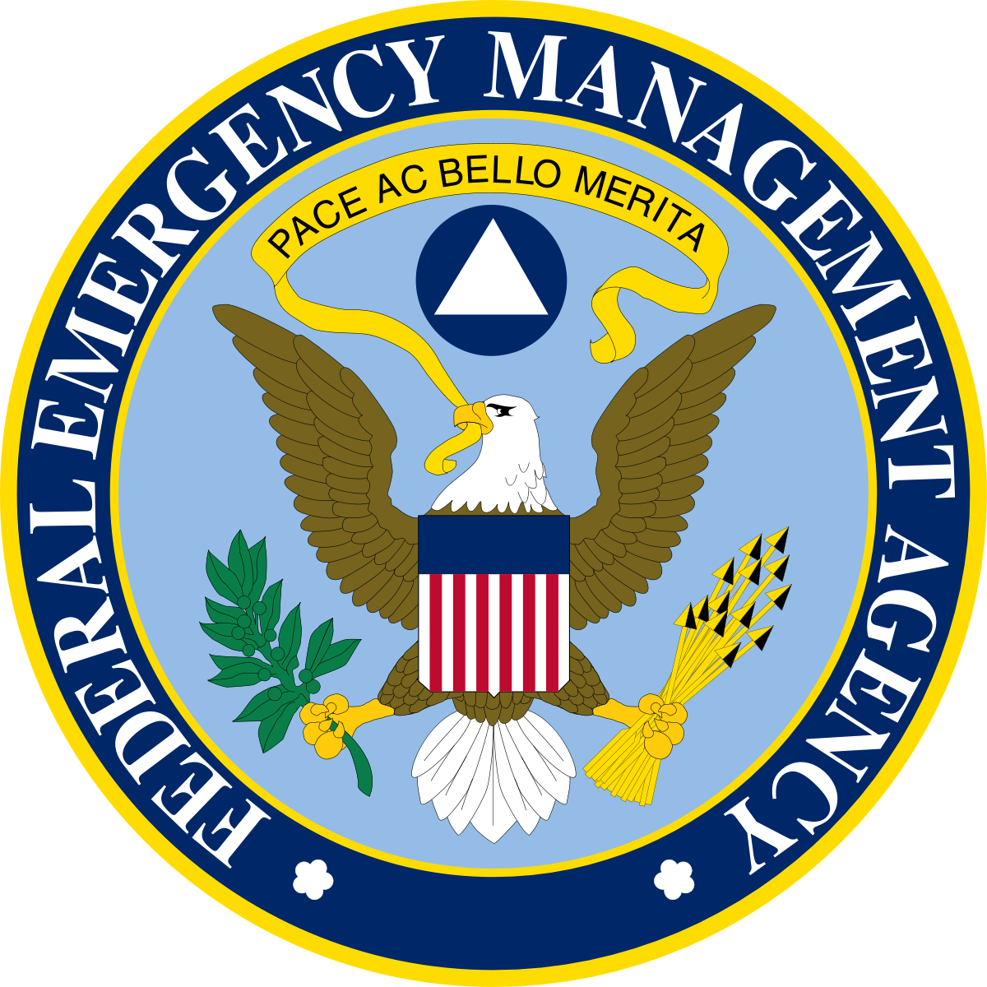



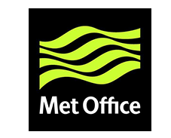
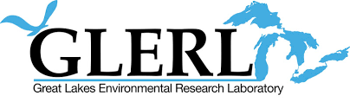



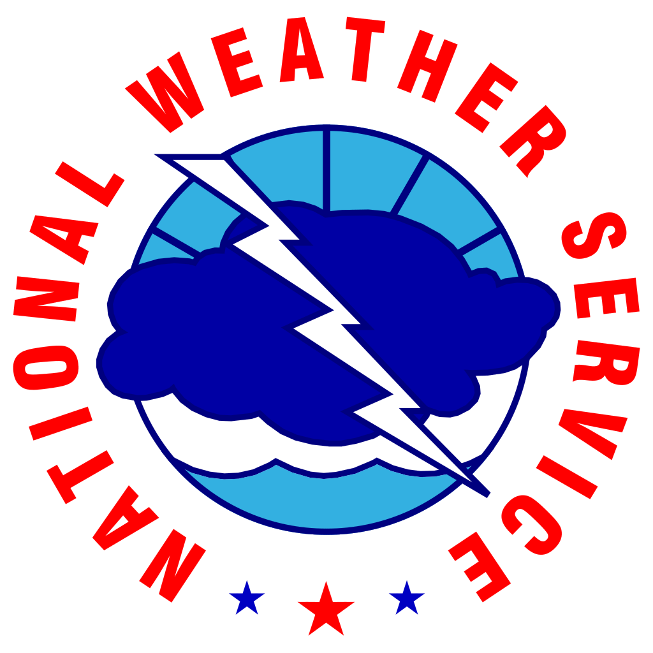
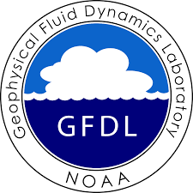
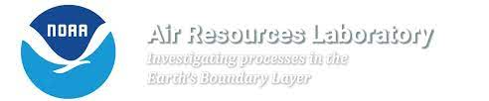

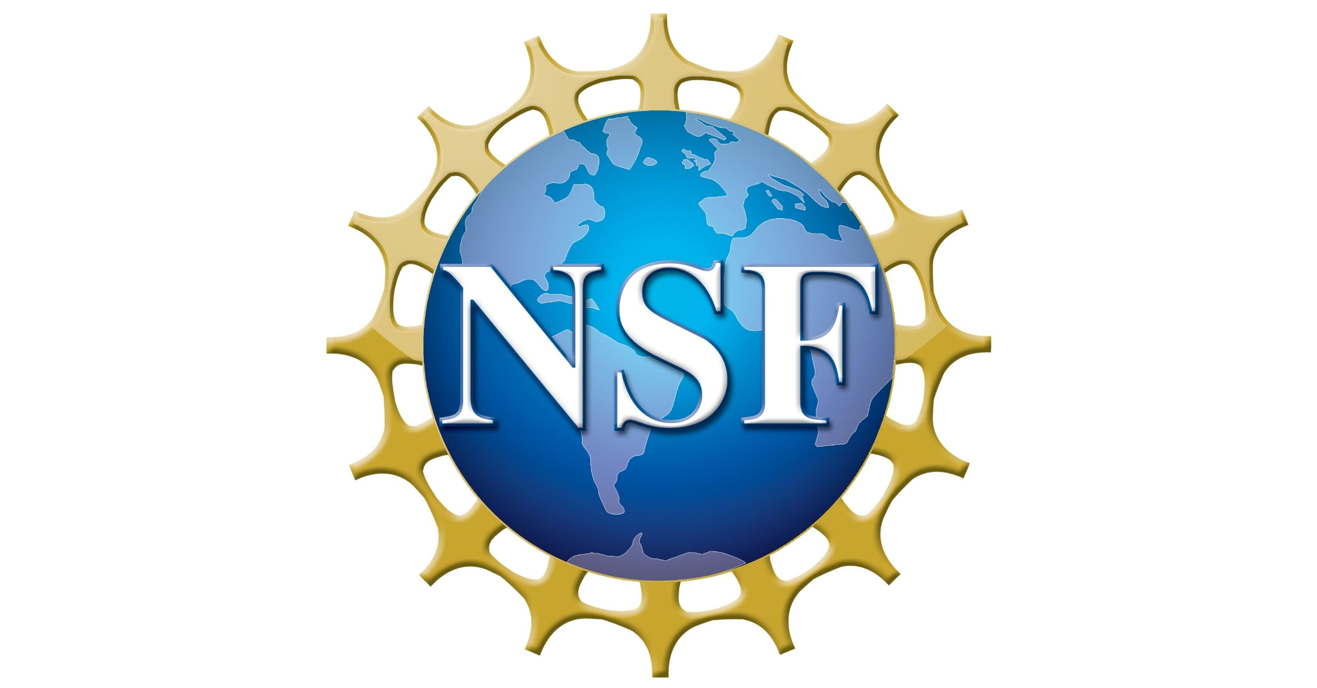
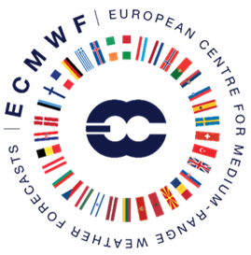


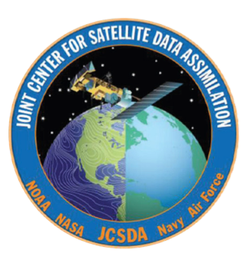
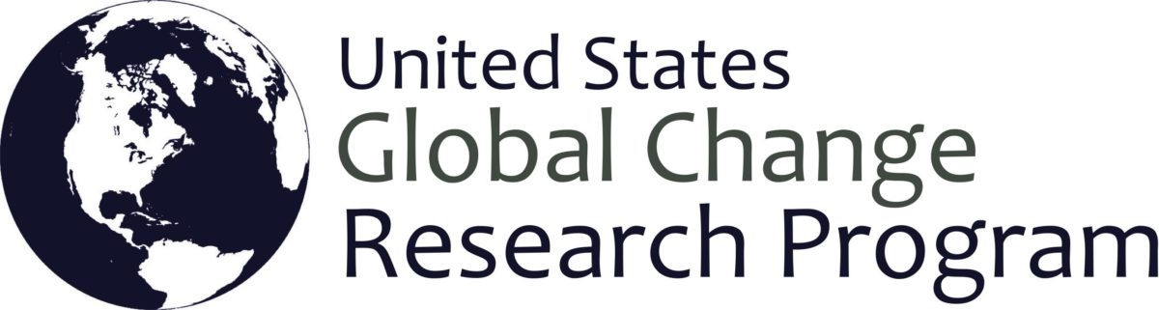



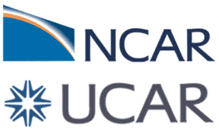
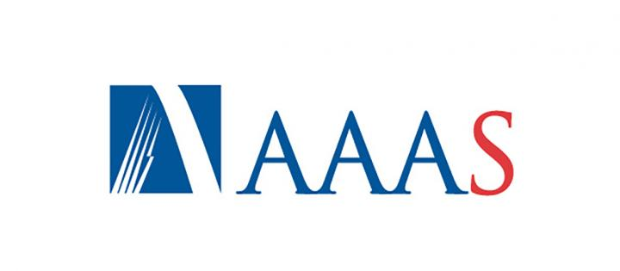

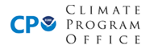
PARTNERS: A SNAPSHOT
2
Notes:
ICAMS = Interagency Council for Advancing Meteorological Services

Slide 10

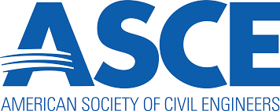







FINDING THE NEXT GENERATION WORKFORCE
What we need:
Data Assimilation
Atmospheric Physics
Systems Architecture (coupling, workflow, continuous integration and development)
Machine Learning/Artificial Intelligence
Software Engineering
Atmospheric Dynamics
Verification and Validation (post-processing)
Air Chemistry
Where we’ve been searching:
Strategy: Expand the search grid and criteria:

Slide 11
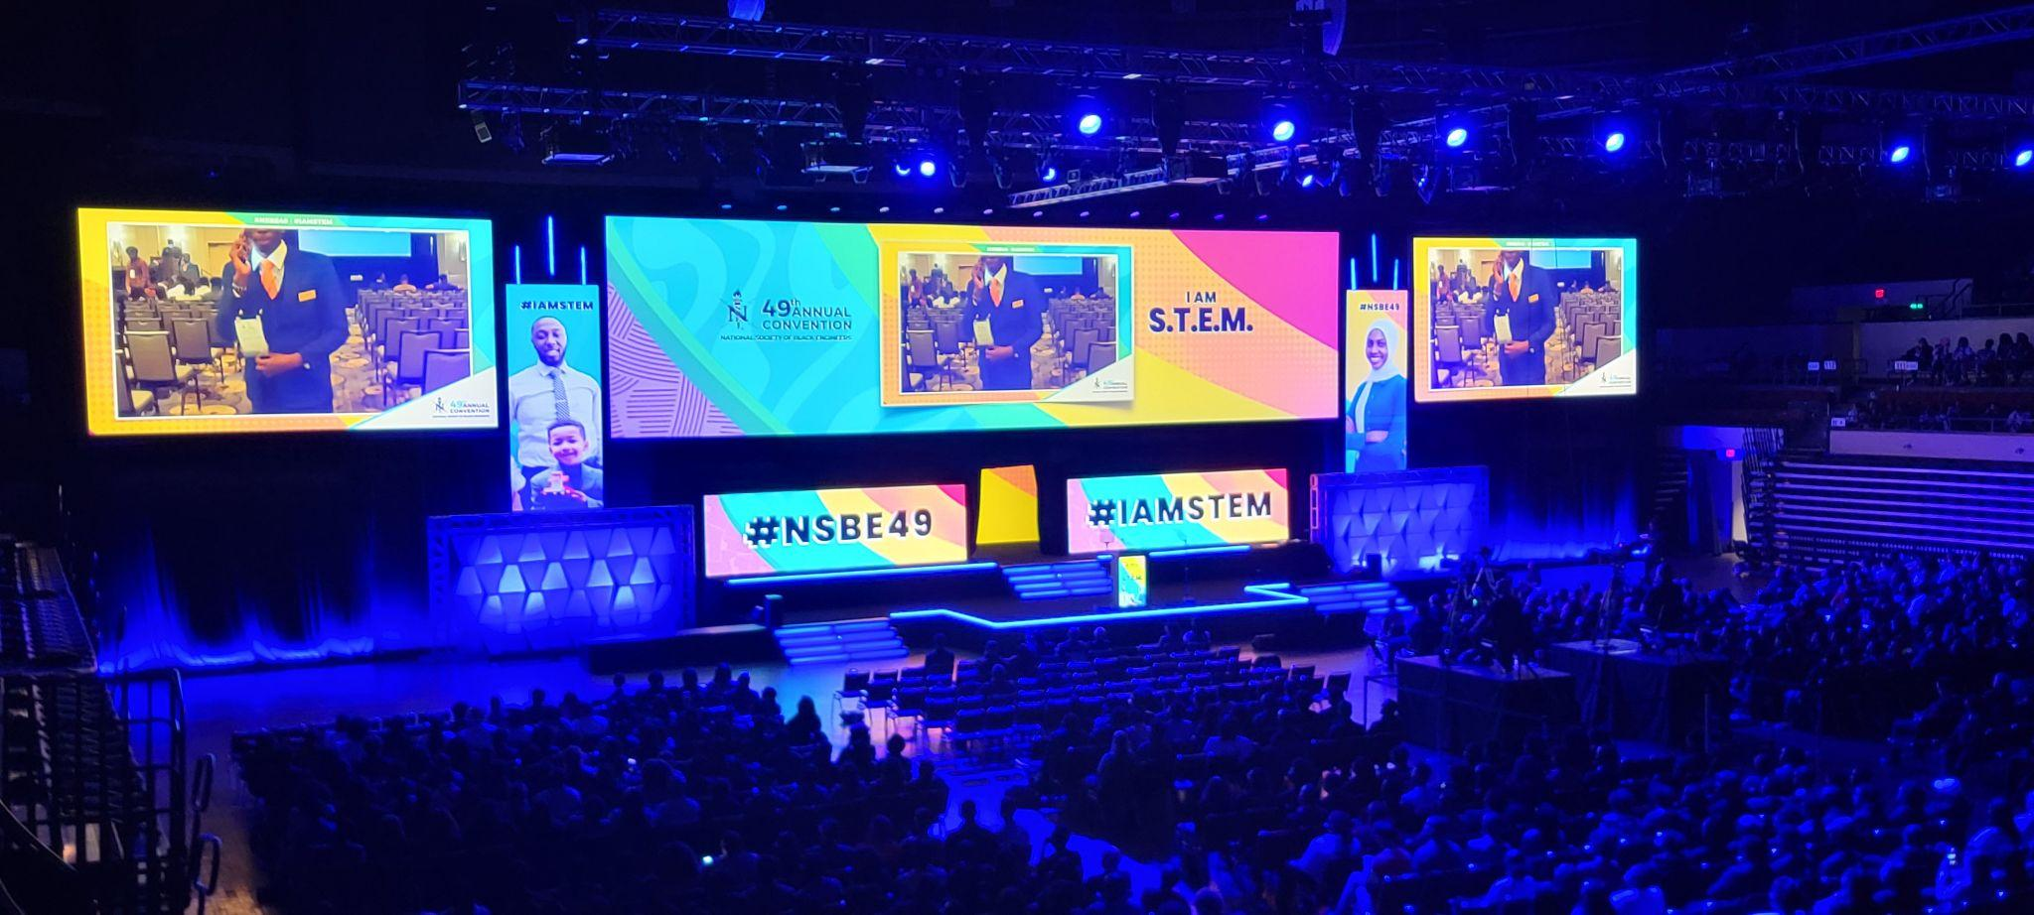
FINDING THE NEXT GENERATION WORKFORCE
Society for Advancement of Chicanos/Hispanics and Native Americans in Science (SACNAS)
National Society for Black Engineers (NSBE)
National Association of Black Geoscientists (NABG)
National Society of Black Physicists (NSBP)
American Society of Civil Engineers
American Institute of Chemical Engineers (AIChE)
Women of Color (WoC) in STEM
Association for Computing Machinery (ACM)
Institute of Electrical and Electronics Engineers (IEEE)
#NSBE49 (March 2023) registered over 13,000 attendees!
Opening Session, NSBE 49th Annual Convention, Kansas, City, MO (March 22, 2023)

Slide 12
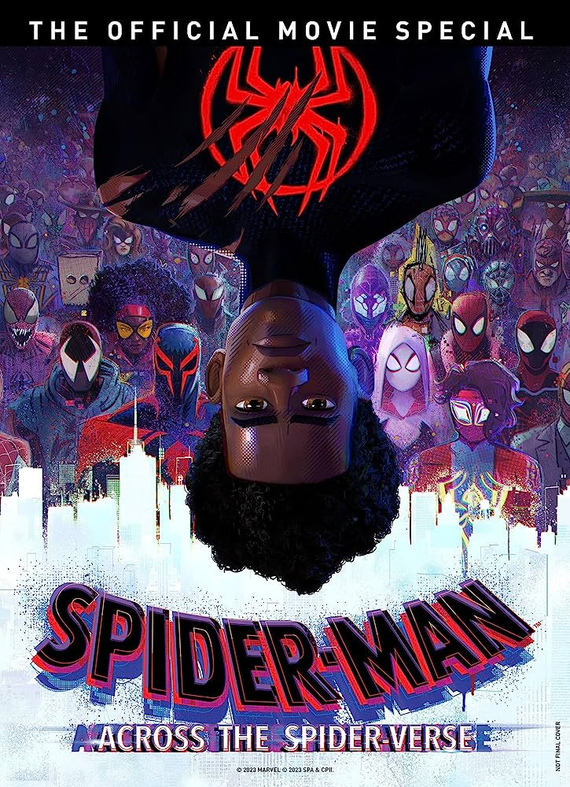
EXPANDING THE COMMUNITY… INNOVATION
Strategy: Level the playing field:
Use social media and virtual connections, to meet the community where they are
Reach out directly to HBCUs, HSIs, TCUs, and other MSIs, for ground-level engagement
Integrate and mentor new talent in the workforce, earlier in the process
Expand opportunities to court non-atmospheric science majors

Slide 13
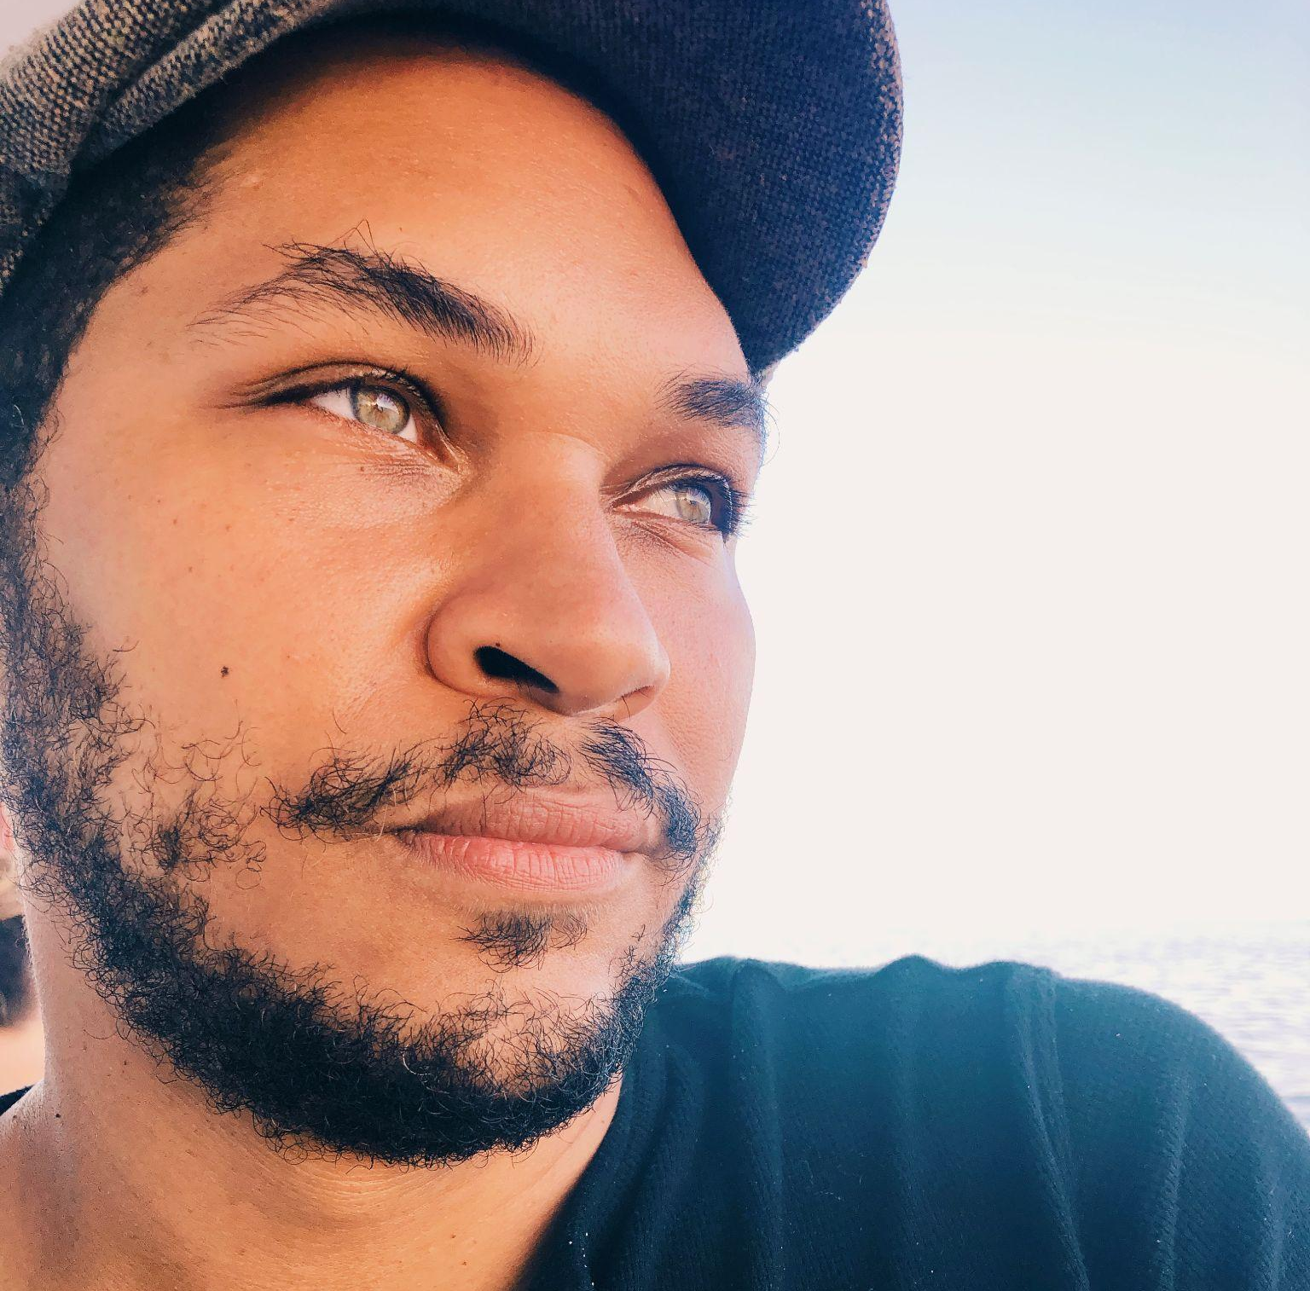
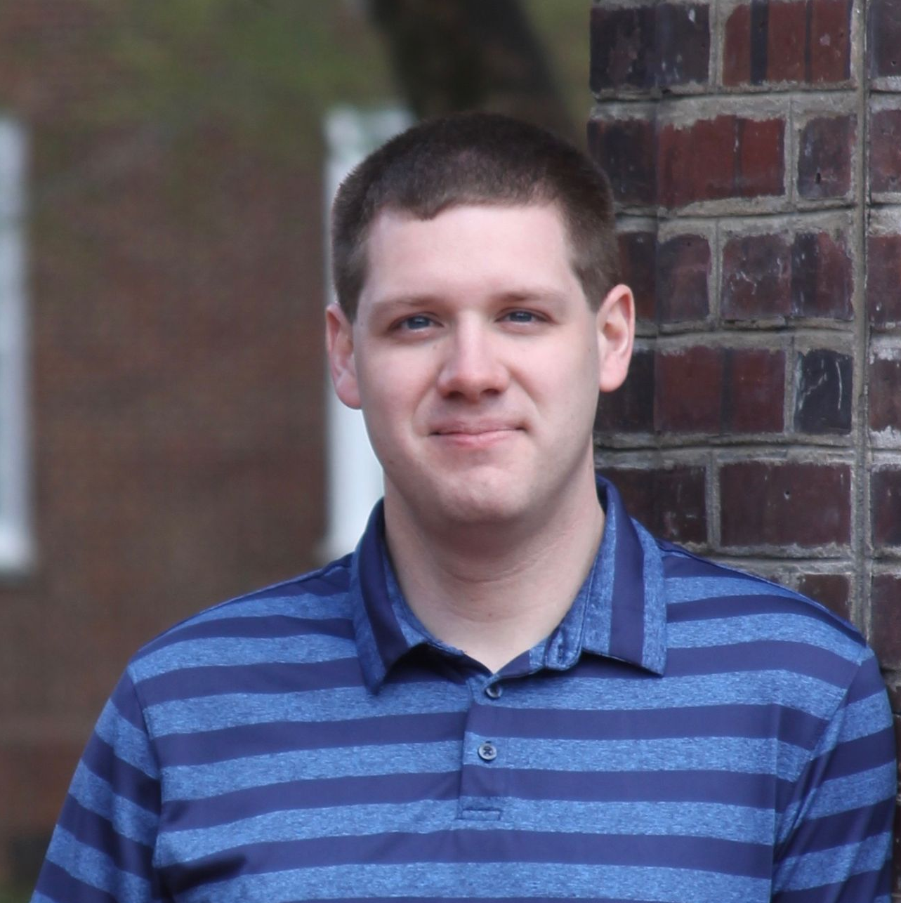
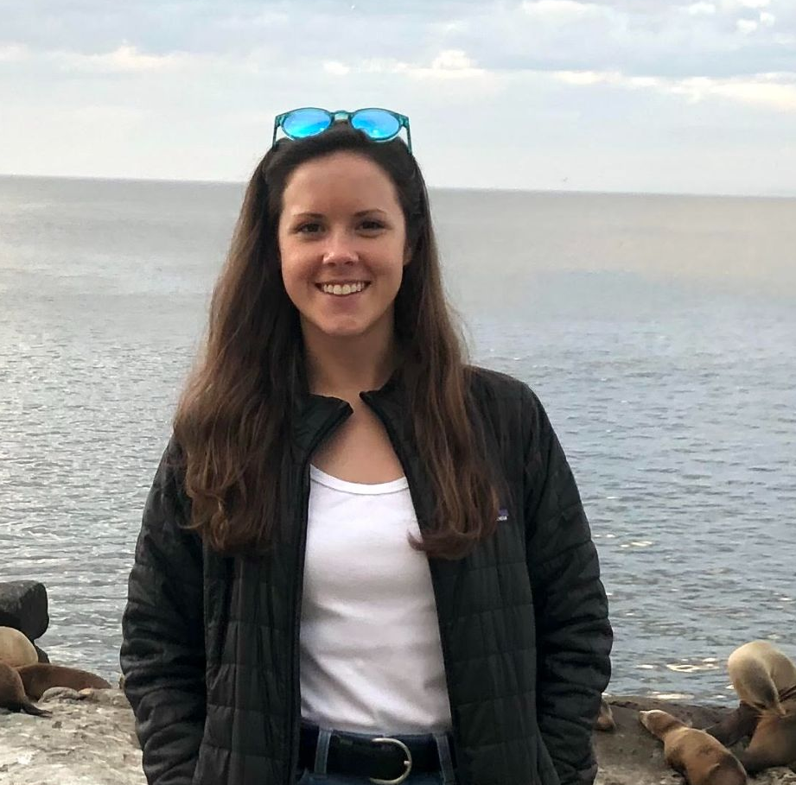
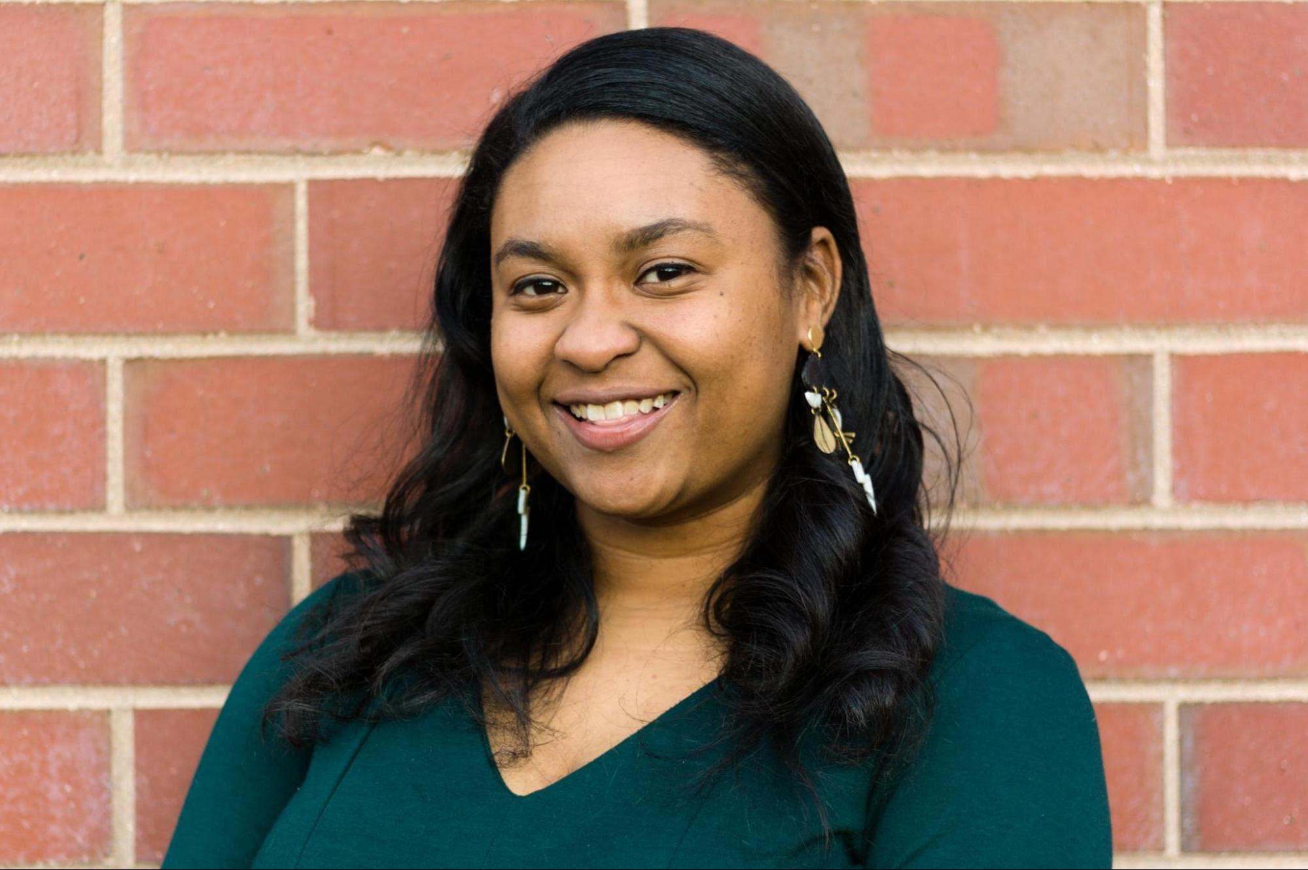
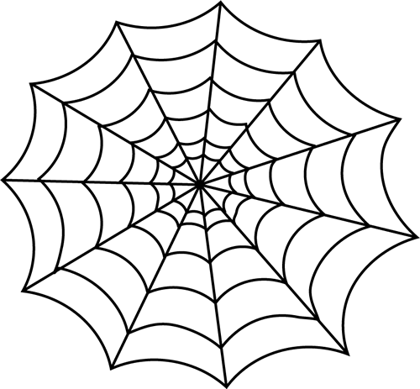
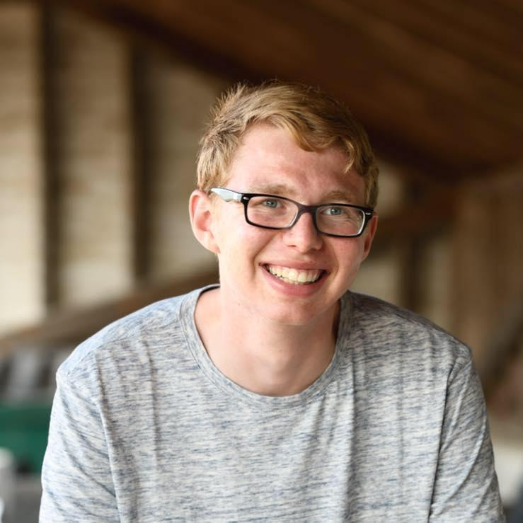

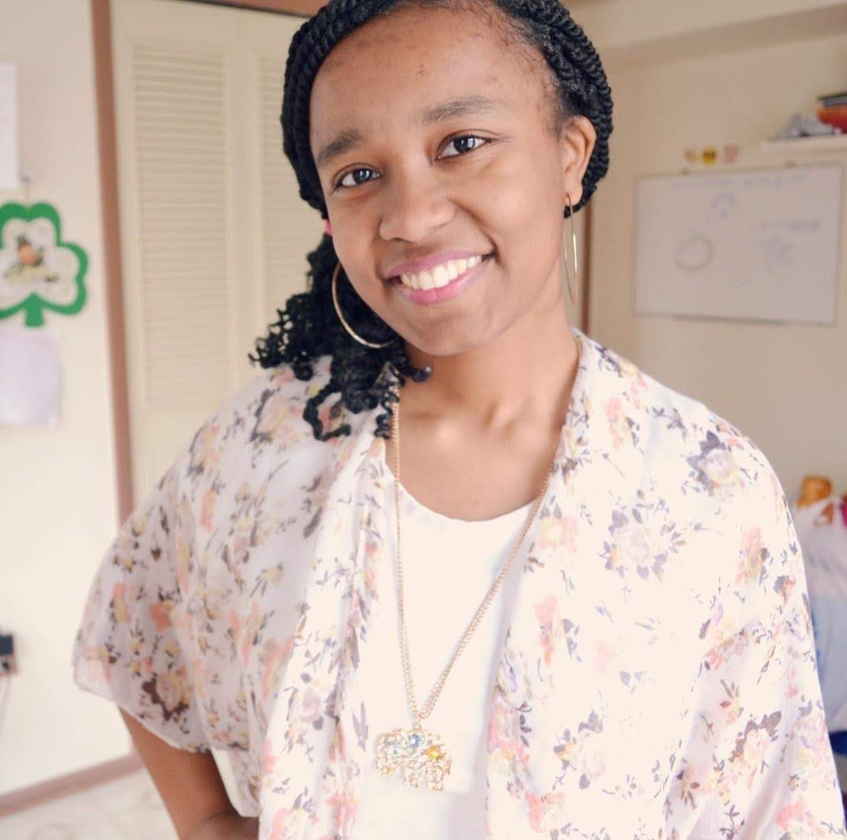
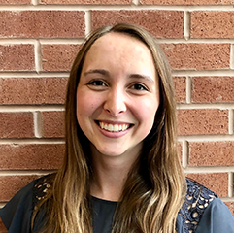
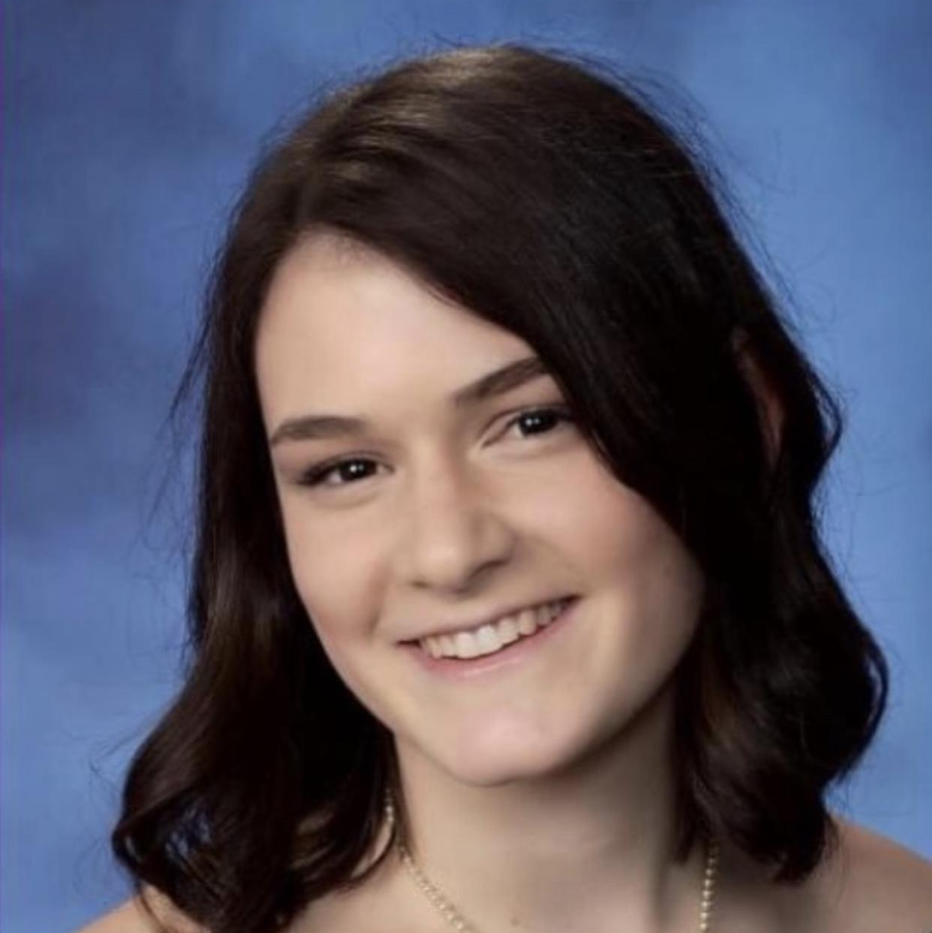
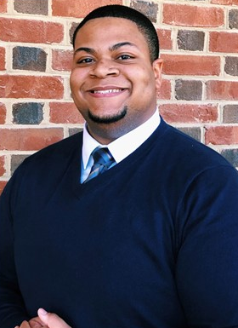
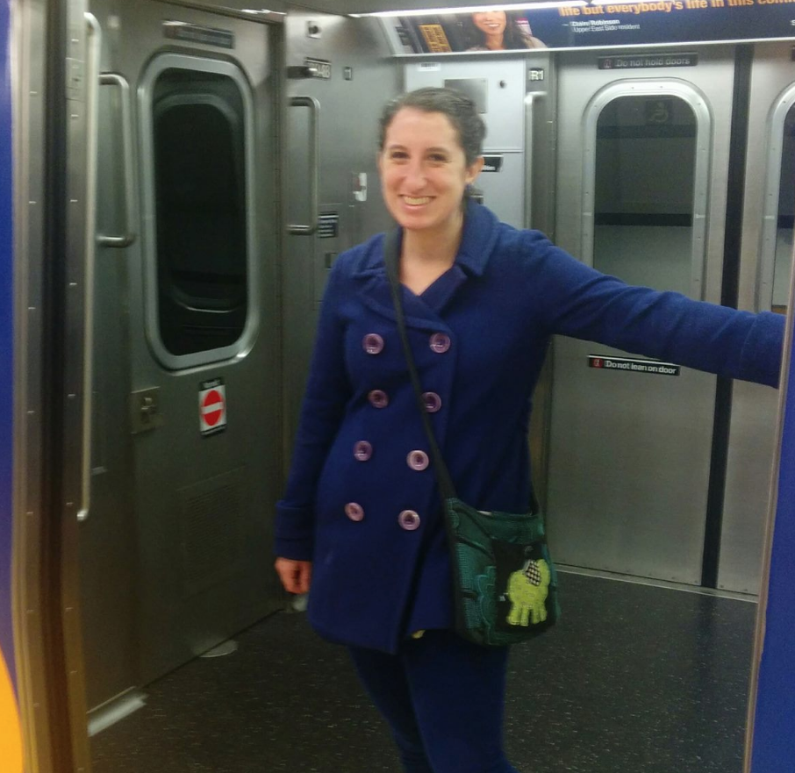
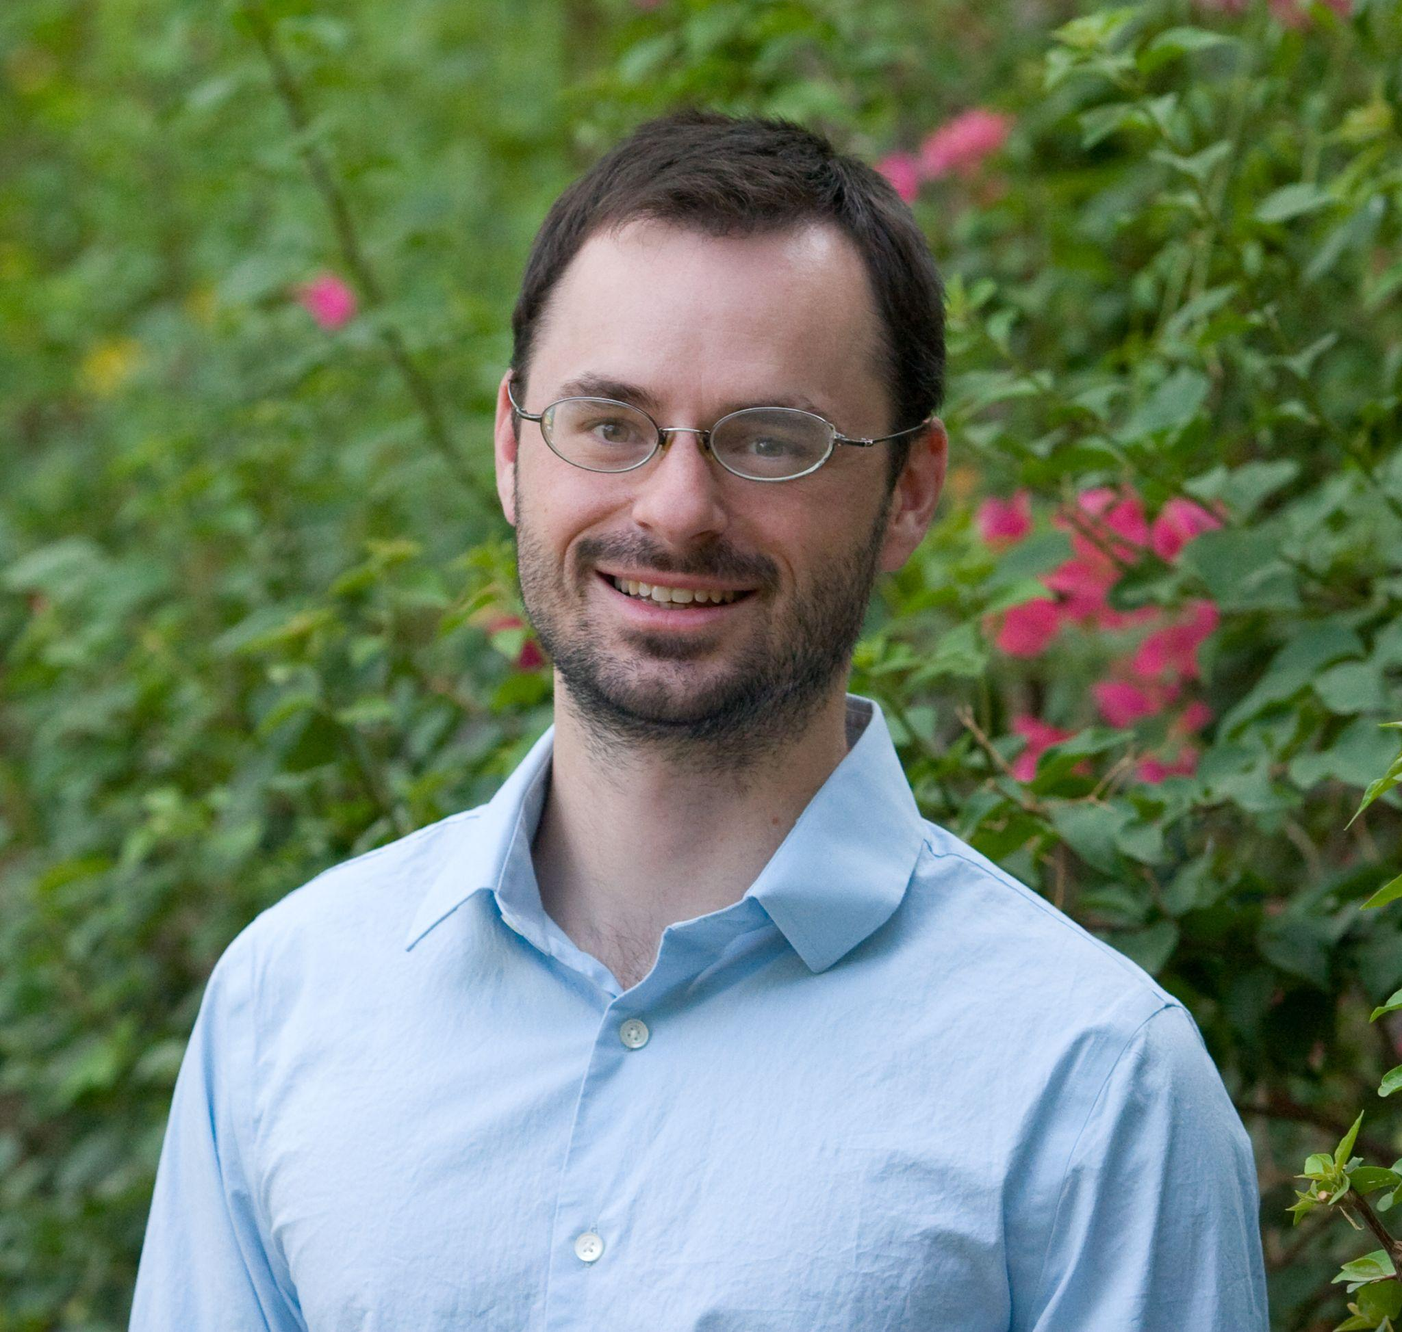
FORMER WPO INTERNS
Knauss
Lapenta
Pathways
AAAS
Notes:
WPO has hosted individuals with backgrounds in sociology, geography, communications, environmental policy, disaster sciences, advertising, and transportation science.

Slide 14
STUDENT & ROTATION OPPORTUNITIES
Opportunity | Career level | Duration | Former Students
Lapenta Scholars | Undergraduate and Graduate | Summer | Jackie Sepulveda Donald Long Stephen Wegmann Mike Michaud Ashley Stagnari Sam Ephraim
Knauss Fellowship | Graduate | 1 year | Renee Richardson (WPO contractor) Alison Agather (WPO contractor) Christine Bassett (WPO contractor) Melissa Pratt-Zossoungbo (WPO fed)
Pathways Internship Program Recent Graduate Program Presidential Management Fellowship Program | High School, Undergraduate, Graduate, Post-Graduate | Varies | Leah Dubots (Pathways - OAR CFO) Ayesha Wilkinson (Pathways) Alexus Moore (Pathways) John Ten Hoeve (PMF)
Hollings / Educational Partnership Program | Undergraduate | Summer-9 weeks
AAAS Fellowship | Early Career | 12-24 months | Steve Elliott Alice Grossman
LANTERN and LCDP Internal to NOAA | Various | 3-6 months

Slide 15
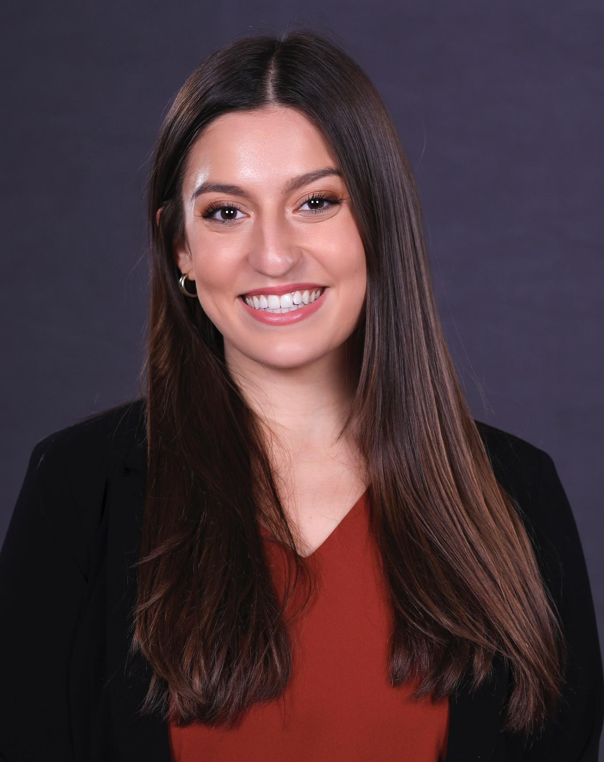
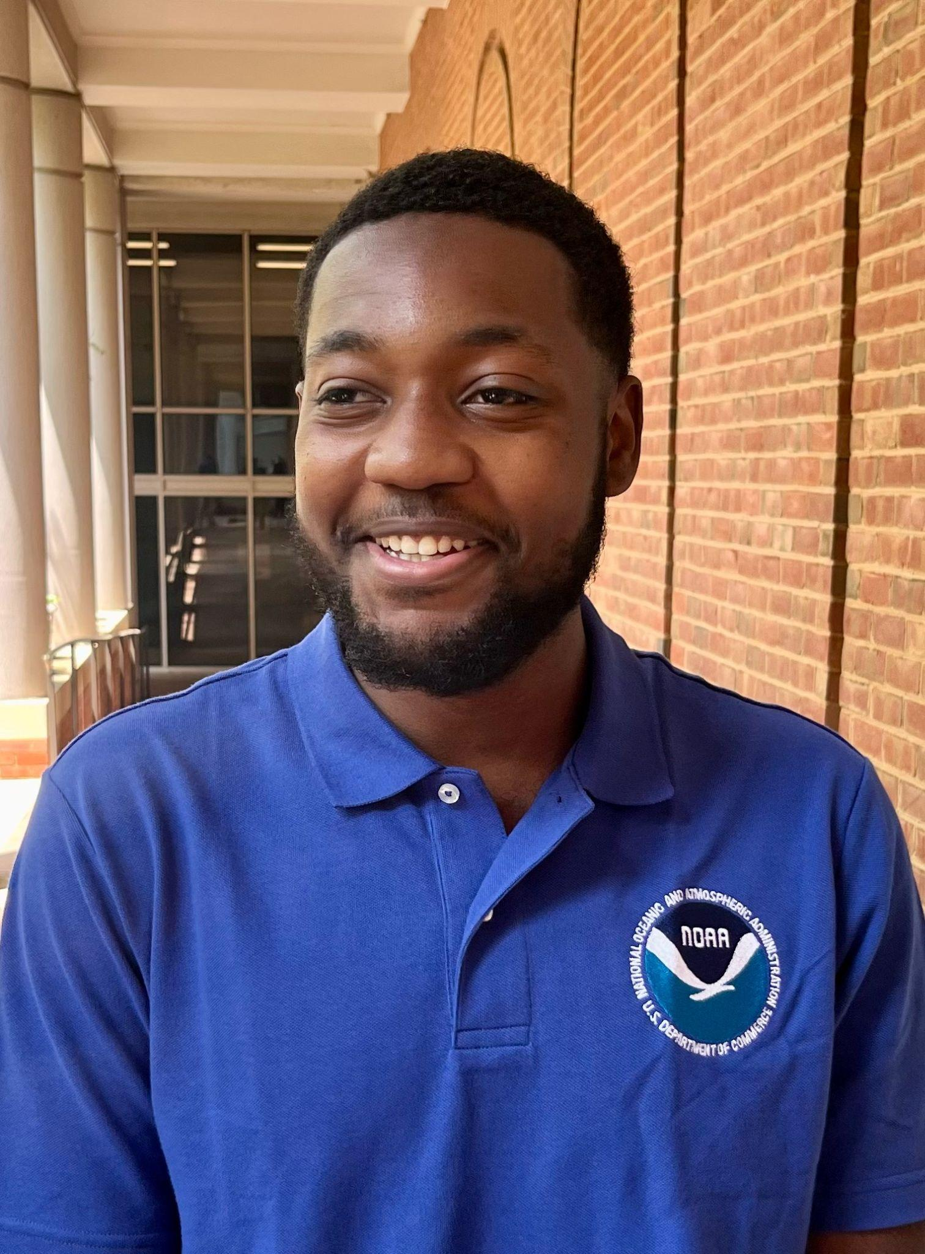
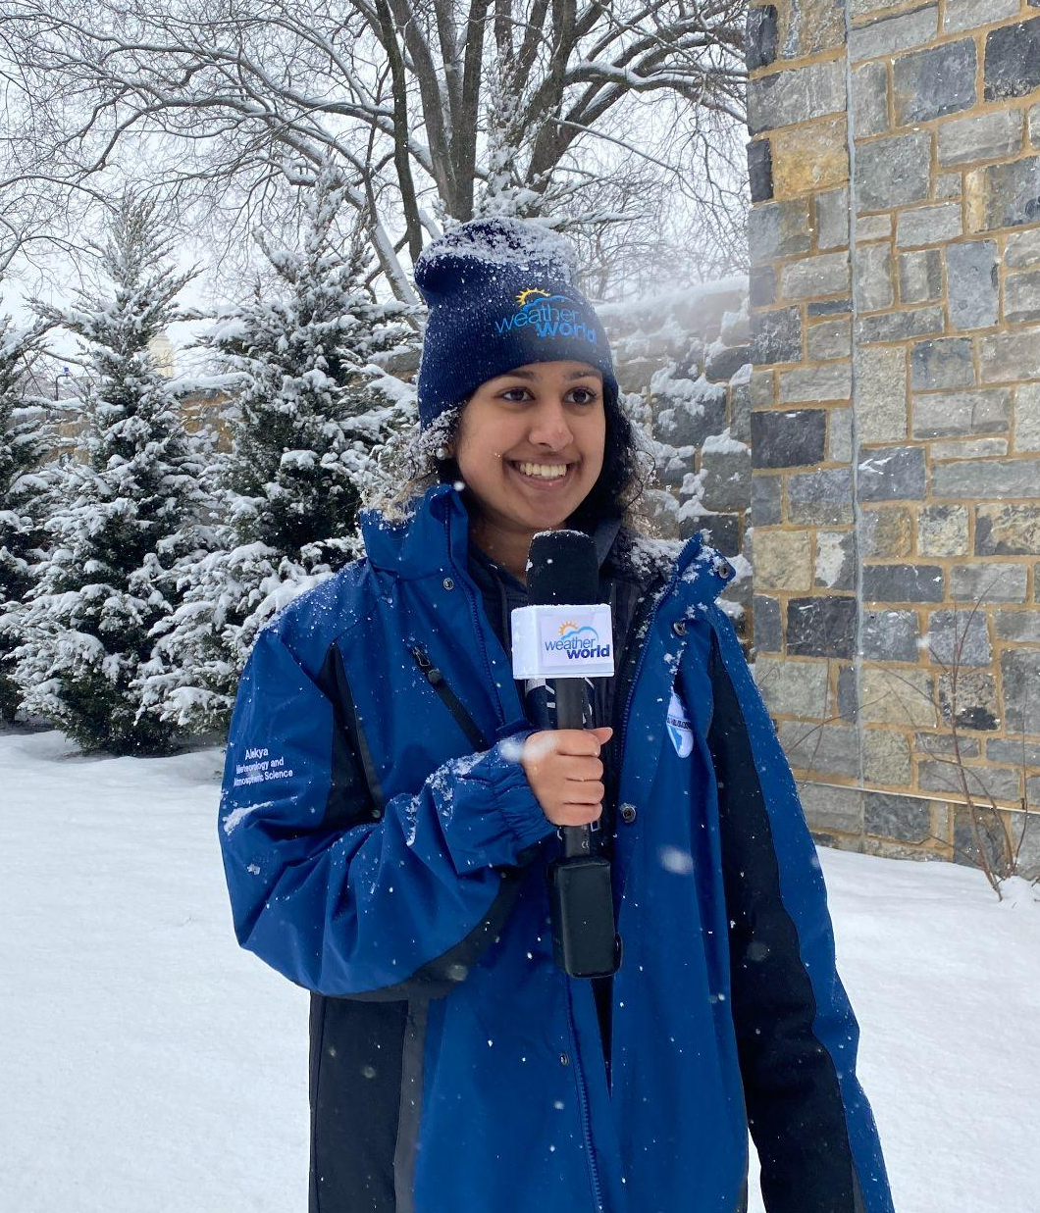
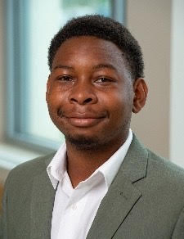
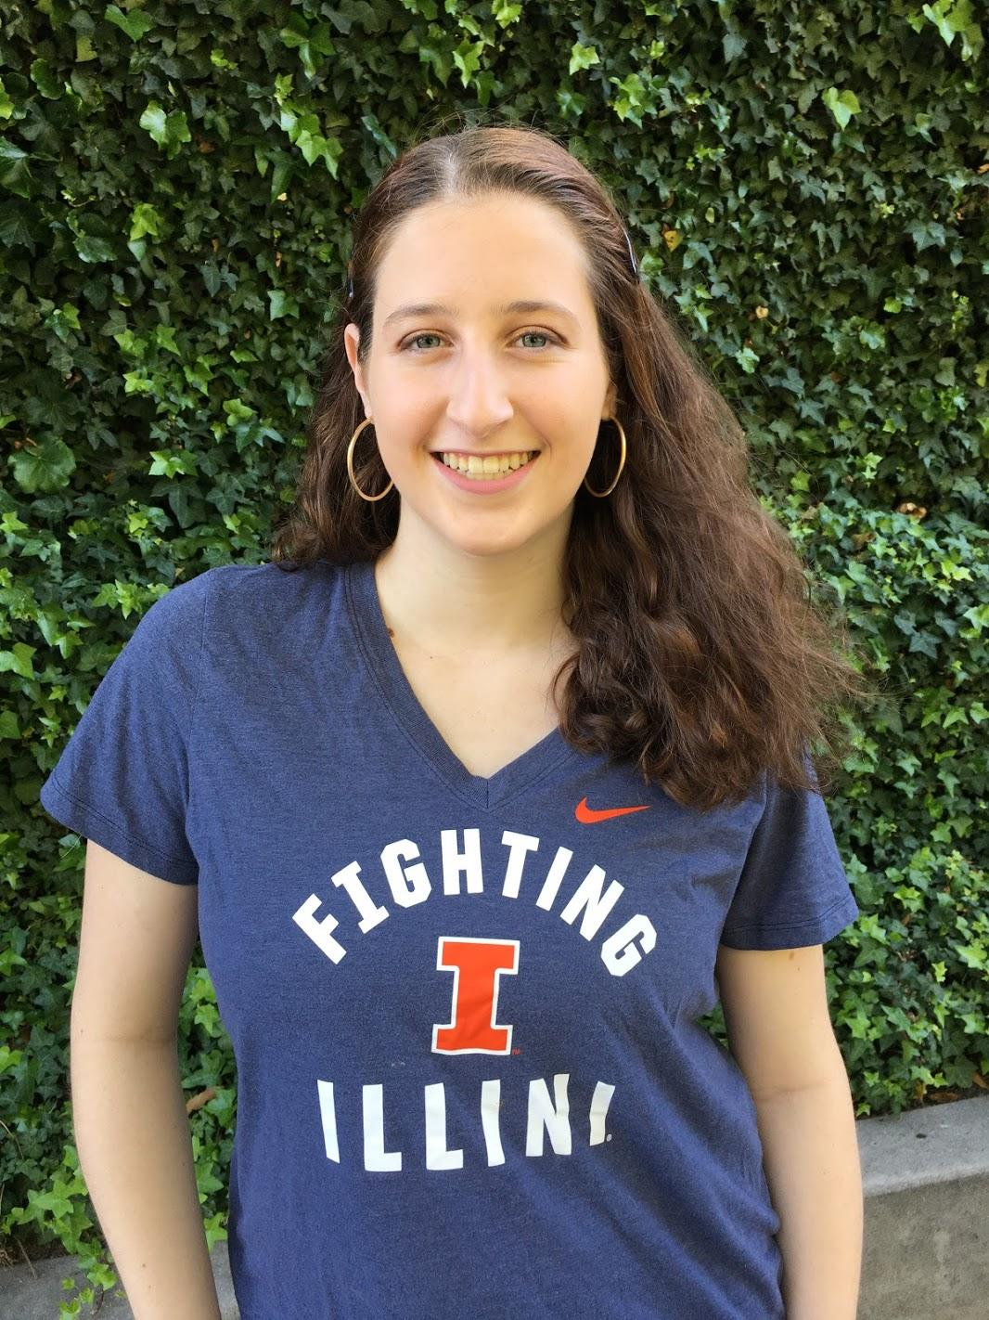

CURRENT WPO INTERNS
Laura Dailey
Lapenta Intern
Innovations
Cameron Bennett
EPP/MSI Intern
WPO and AOML
Alekya Srinivasan
Lapenta Intern
EPIC Program
Anthony David Jr.
Lapenta Intern
Social & Behavioral Science Program
Emily Glenn
Lapenta Intern
ACES/Policy
Notes:
Majors in meteorology, atmospheric sciences, environmental science and sustainability, climate sciences
Interests in policy, social sciences, risk communications

Slide 16
EXPANDING THE WEB
Broaden Earth System Community Modeling under UFS and EPIC
Establish new collaborations with non-traditional partners
Reinforce integration of social science into UFS applications
Provide equitable resources and access for partners and new collaborators
Leverage future opportunities, while promoting innovative high/risk high/reward approaches
Create, develop, and sustain mechanisms to develop the next generation workforce
Expand DEIJA efforts for UFS and its partners
Inquiry
Insight
Inclusion
Information
Innovation
Notes:
Inquiry - be curious, not judgemental - ask some tough and (sometimes) uncomfortable questions
Insight - be mindful that the playing field needs leveling, and consider seeing gaps, barriers and obstacles from multiple vantage points
Inclusion - be welcoming to other perspectives, it’s going to take a village to solve many of these problems, and there’s more than enough room at the table
Information - be willing to share resources, data and information - the old ways of competing against one another need to be retired
Innovation - be open to thinking more radically and outside of the box, and embrace new multidisciplinary approaches to old problems

Slide 17






THANK YOU
wpo.noaa.gov
@NOAA_WPO
CREDITS: This presentation template was created by Slidesgo, including icons by Flaticon, and infographics & images by Freepik.
Department of Commerce // National Oceanic and Atmospheric Administration

