Slide 1
Using UFS as a teaching and research tool
Sarah Lu, University at Albany, SUNY & Joint Center for Satellite Data Assimilation

Slide 2
Outline
Background
Community based development
Why UFS?

Slide 3
Background
My experiences in running Global Forecast System

Slide 4
My experiences in running Global Forecast System
I was tasked to implement Noah land surface model and GOCART aerosol model into NOAA Global Forecast System (GFS) 15-20 years ago
What was my approach?

Slide 5
My experiences in running Global Forecast System
Talked to colleagues who know the code
Took my notes

Slide 6
My experiences in running Global Forecast System
Code management?
Workflow?
Documentation?
Re-produce my colleague’s experiments?
How about spin-up?

Slide 7
My experiences in running Global Forecast System
Code management? Version control was introduced years later
Workflow? Complicated scripts and layered configuration
Documentation? Not available or out of date
Re-produce my colleague’s experiments? Maybe, trial and error
How about spin-up? Extensive efforts

Slide 8
Community based development
Code Management
Workflow
Platform
Documentation
Experiments
Spin-up
From the perspectives of a university faculty

Slide 9
UFS: Shift to community-based development
UFS is a comprehensive, community-developed Earth modeling system, designed as both a research tool and as the basis for NOAA’s operational forecasts.
A unified system with shared science components and software infrastructure

Slide 10
Code management
A community repository with clear development processes

Slide 11
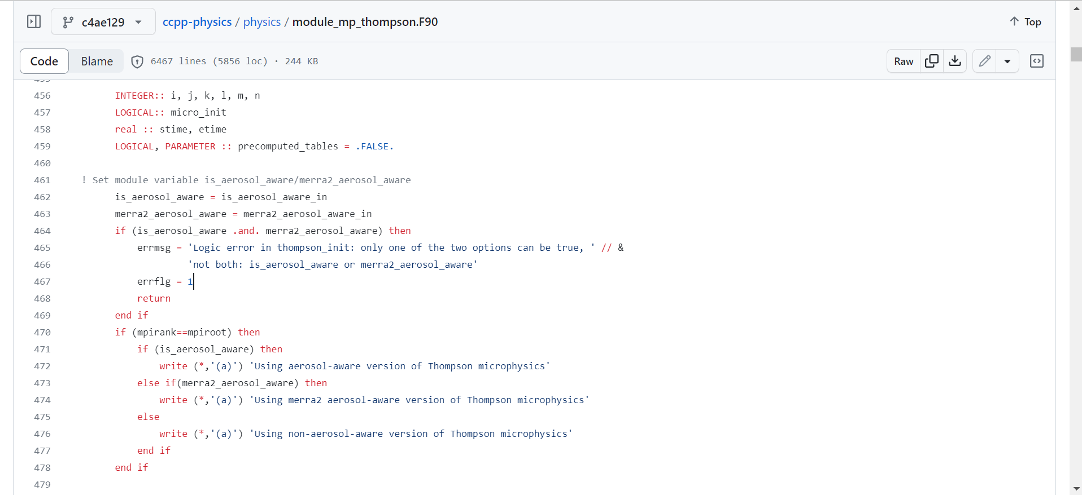
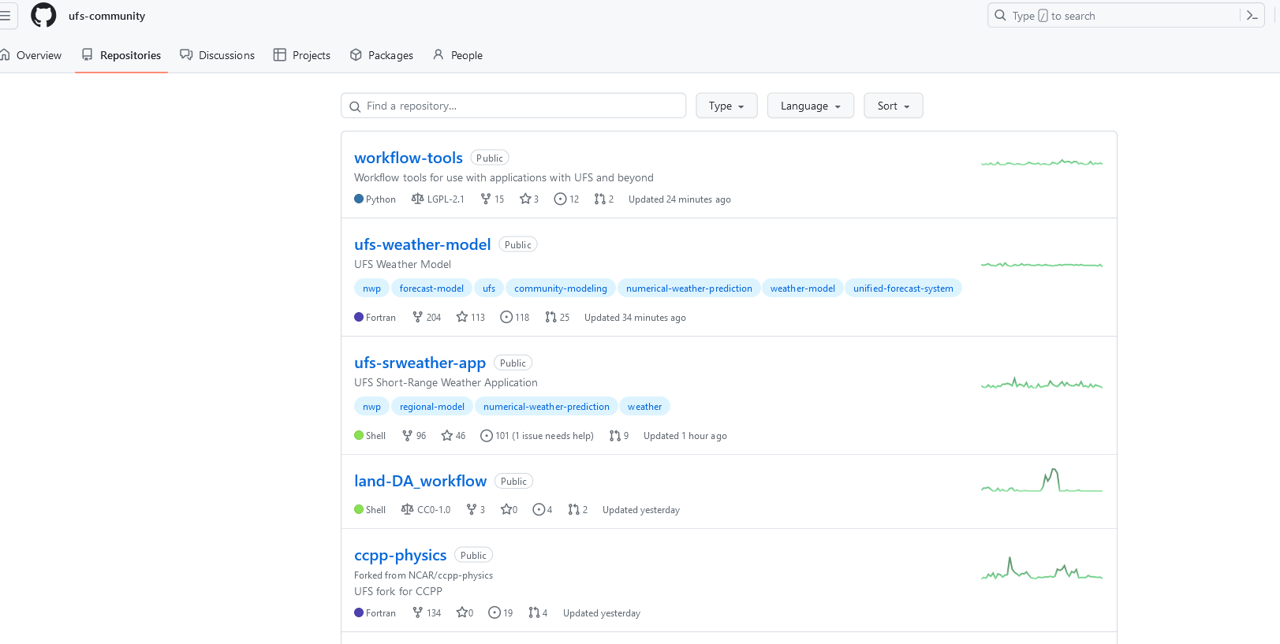
Code management
A community repository with clear development processes

Slide 12
Workflow
Unified Workflow tools for use with various UFS applications
Enable the community to build and run the UFS experiments without the guessing games

Slide 13
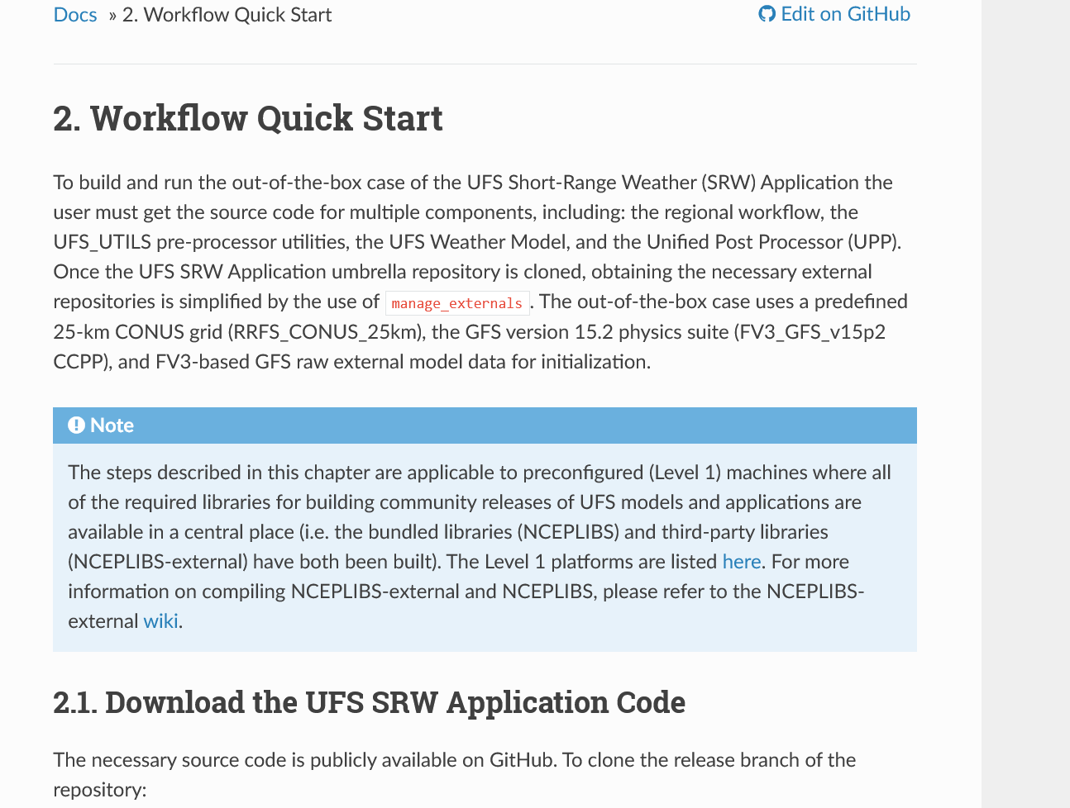
Workflow
Unified Workflow tools for use with various UFS applications
Enable the community to build and run the UFS experiments without the guessing games

Slide 14
Platform
Working on supported platforms is no issue.
Cloud computing? Cost could be an issue for the university.
Unsupported platform (e.g., university cluster) is challenging.

Slide 15
Documentation
On-line science-based documentation
Documentation is informative but it is difficult to find key information

Slide 16
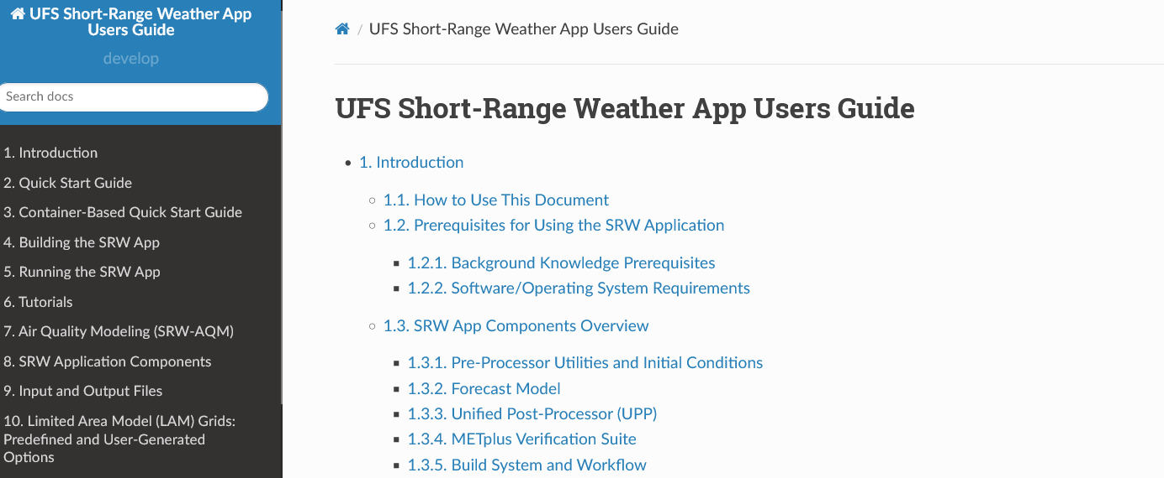
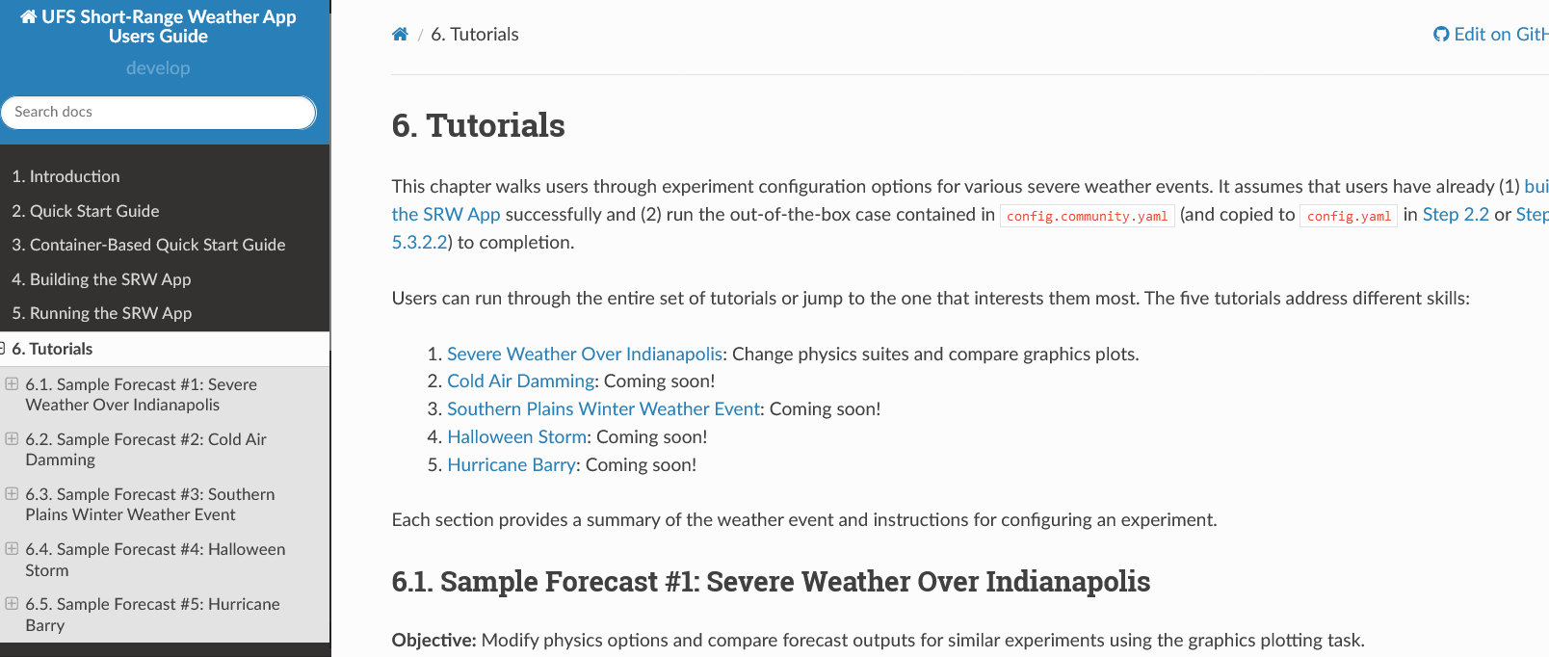
Documentation
On-line science-based documentation
Documentation is informative but it is difficult to find key information.

Slide 17
Experiments
Use cases enable the community to run the out-of-the-box case
Container and cloud computation could be a plus

Slide 18
Spin-Up
Graduate student test
Showcase Dr. Grogan’s UFS study
Code fest
See Christian Barreto’s presentation (the Friday session, Making the UFS Cool)
Online resources and user support by EPIC

Slide 19
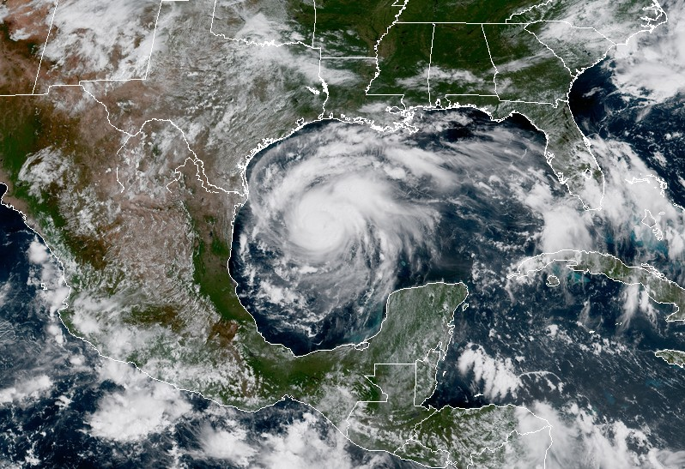
Examination of Aerosol Impacts on the Landfall of Hurricane Harvey (2017) using the Unified Forecast System (UFS) Model
Dustin Grogan, Cheng-Hsuan (Sarah) Lu, and Shih-Wei Wei (UAlbany)
Anning Cheng, Jeff McQueen, Partha Bhattacharjee and Hsin-Mu Lin (NCEP/EMC)
First Annual UFS Users Workshop
July 28th, 2020

Slide 20
Purpose of Study
To examine how the aerosol-cloud feedback affects the forecasting of Hurricane Harvey (2017) as it made landfall using the UFS model.

Slide 21
UFS physics suite
Radiation: RRTMG
Aerosol attenuation determined from OPAC climotology (Hess et al. 1998).
Option to include aerosols from GOCART (Colarco et al. 2010).
Microphysics: MG3 (Gettelman and Morrison 2015; Gettelman et al. 2015)
CCN nucleation from Abdul-Razzak and Ghan (2002) and IN activation from Cooper (1985).
Option to include aerosol CCN nuclation (Fountoukis and Nenes, 2005) & IN activation (Brahona and Nenes, 2009)
Aerosols: MERRA-2 renalysis (Buchard et al. 2017; Randles et al. 2017); 2003-2014 monthly averaged.

Slide 22
Experimental Setup
Two Experiments at C384L65 resolution
CTL− CCN/IN activation temperature dependent
AER− CCN/IN activation from climatological MERRA-2 aerosols
RRTMG− aerosol attenuation determined by MERRA-2
ICs from GFS-ANL (spectral-based)
10 day forecasts initialized at 8-22-2017 00Z

Slide 23
Harvey Track and Intensity: Aug 22nd − Sep 2nd, 2017

Slide 24
Summary
Including the aerosol-cloud feedback from MERRA-2 climatological aerosols affects the forecasting of the landfall of Harvey (2017).
Intensified the storm during and after landfall (both excluded RI event).
Produced an northeastward track over land (more consistent with obs).
Stronger convective branch on the east side of the storm (comparable with obs).

Slide 25
UFS Experience
Oct 2019: Conducted the graduate student test for 1st UFS release.
Feb 2020: Conducted the graduate student test for the weather-only UFS release.
April 2020: Updated with ’GFSv16beta’ physics suite.
Updated to include aerosol-radiation-cloud feedback determined from GOCART (pull request 34)
May 2020: Conducted UFS sensitivity experiments with different configurations of the aerosol-cloud feedback.
July 2020: Presented preliminary results at UFS workshop.
Lessons learned:
Graduate student test is an effective way for spin-up
GitHub enables code up-to-date
Collaborative interaction is critical

Slide 26
Why UFS?
Why using UFS as a teaching and research tool?

Slide 27
Why UFS?
My simple answer is: WHY NOT?
Why using UFS as a teaching and research tool?

Slide 28
Why using UFS as a teaching and research tool?
Online resources and user support to spin up graduate students and postdoc
Use cases as the template to get started
A consistent code base to develop, test, and run

Slide 29
Why using UFS as a teaching and research tool?
Enable the research community to contribute to the operational outcomes
Enable the university to access open source prediction model suite
Enable the young scientists to engage in the development for different areas

Slide 30
Thank You. Comments and Suggestion? Sarah Lu (clu4@albany.edu; clu@ucar.edu)

