Slide 1
EPIC Infrastructure update
Collaborative effort between - Community Collaborators slide attached
Special Acknowledgments: Dr. Mark Potts Dr. Stylianos Flampouris, Dr. Jong Kim, Kris Booker

Slide 2
Agenda
Partners/EPIC Progress
We hear you, We want to hear more
Community Infrastructure
Repeatable to SRW, RRFS, LandDA, HAFS, and future applications
CI/CD
Complete for SRW
Repeatable for LandDA, HAFS, and future applications
Tutorials and training
Closing
Need for Testing
Closing

Slide 3
Partners

Slide 4
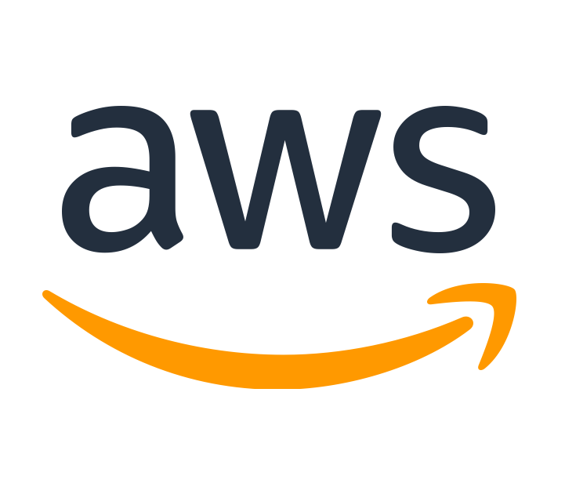
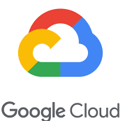
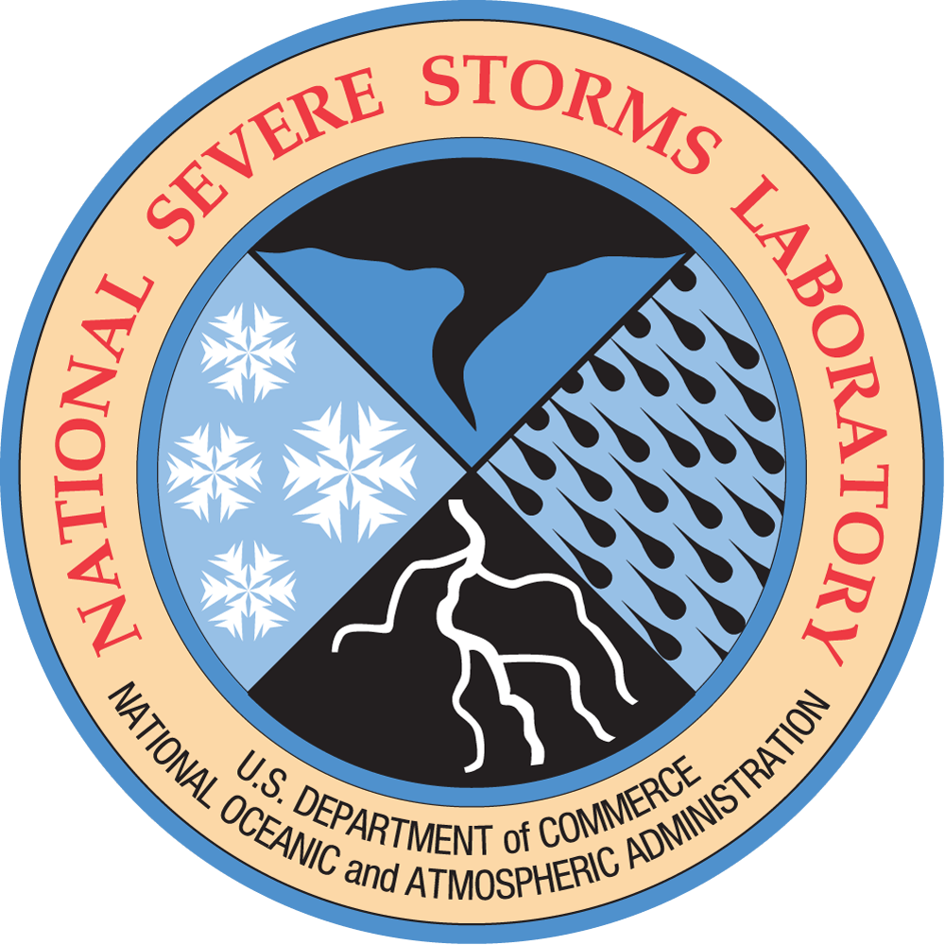
Community Collaborators/Partners
Acknowledgement
NOAA OAR: WPO, GSL, PSL, NSSL, CSL, AOML, GFDL
NOAA Open Data Dissemination (NODD) Program
NWS: EMC, OSTI
DTC
UCAR: CGD, JCSDA
Academia: George Mason University, Oklahoma University, University of Michigan
CSPs: AWS, Azure, and Google Cloud
Cooperative Institutes: CIRES, CIMSS

Slide 5
EPIC Progress

Slide 6
We hear you, we want to hear more!
We need fewer users and more contributors.
How do I replicate EPIC event infrastructure?
How can we track contributors versus users across applications?
How can we utilize repeatable processes (CI/CD) to test applications have passed all gates?
Peer reviews need to be faster.
More tutorials:
Contributing to UFS GitHub
GitHub Discussion and how to get user support
Azure AZ-HOP
Don’t wait for a survey/meeting email: support.epic@noaa.gov

Slide 7
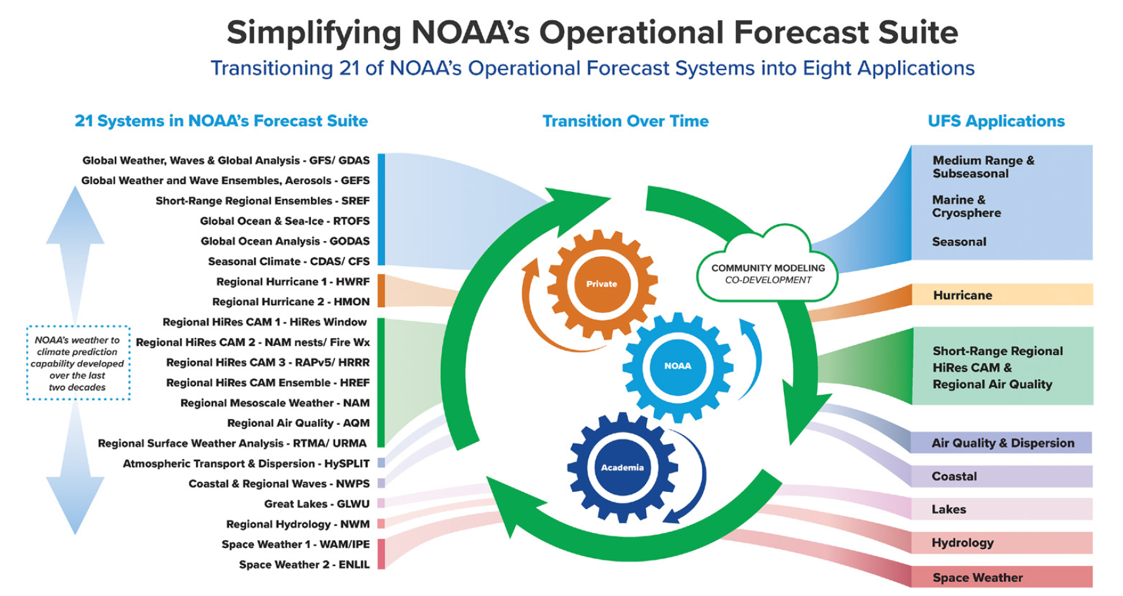
Uccellini et al. (BAMS, 2022)

Slide 8
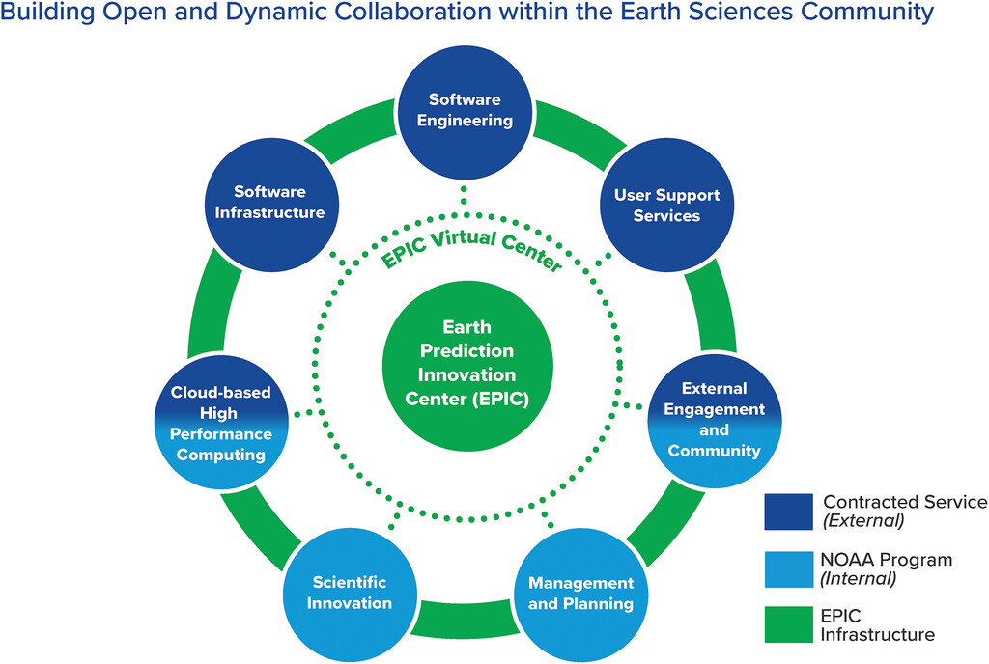
EPIC Architectural Plans
Continued Plans:
CI/CD across more applications
Transparent Gates
Fail or Succeed Quickly
Enhanced testing frameworks
Advanced User Support
Configuration Management
Cloud configuration scripts
Community Tools
Unified Workflow
Community Events

Slide 9
Community Infrastructure

Slide 10
EPIC Cloud Architecture
AWS RTX Sandbox | An AWS account that sits outside of the NOAA firewall to allow for non-CAC users.
AWS ACIO Sandbox | An AWS account that sits outside of the NOAA firewall to allow for non-CAC users. Login.gov access.
Azure RTX and ACIO Sandbox | An Azure account that sits outside of the NOAA firewall to allow for non-CAC users.
GCP ACIO Sandbox | A GCP account that sits outside of the NOAA firewall to allow for non-CAC users.
AWS ACIO Dev | An AWS account that sits inside the NOAA firewall containing our application code that is in active development under ACIO.
AWS ACIO Prod | An AWS account that sits inside the NOAA firewall containing our application code that is live in the production account under ACIO.
Parallel Works | A third-party HPC provider inside of the NOAA firewall that provides us virtual machines to test UFS applications on all 3 cloud service providers.

Slide 11
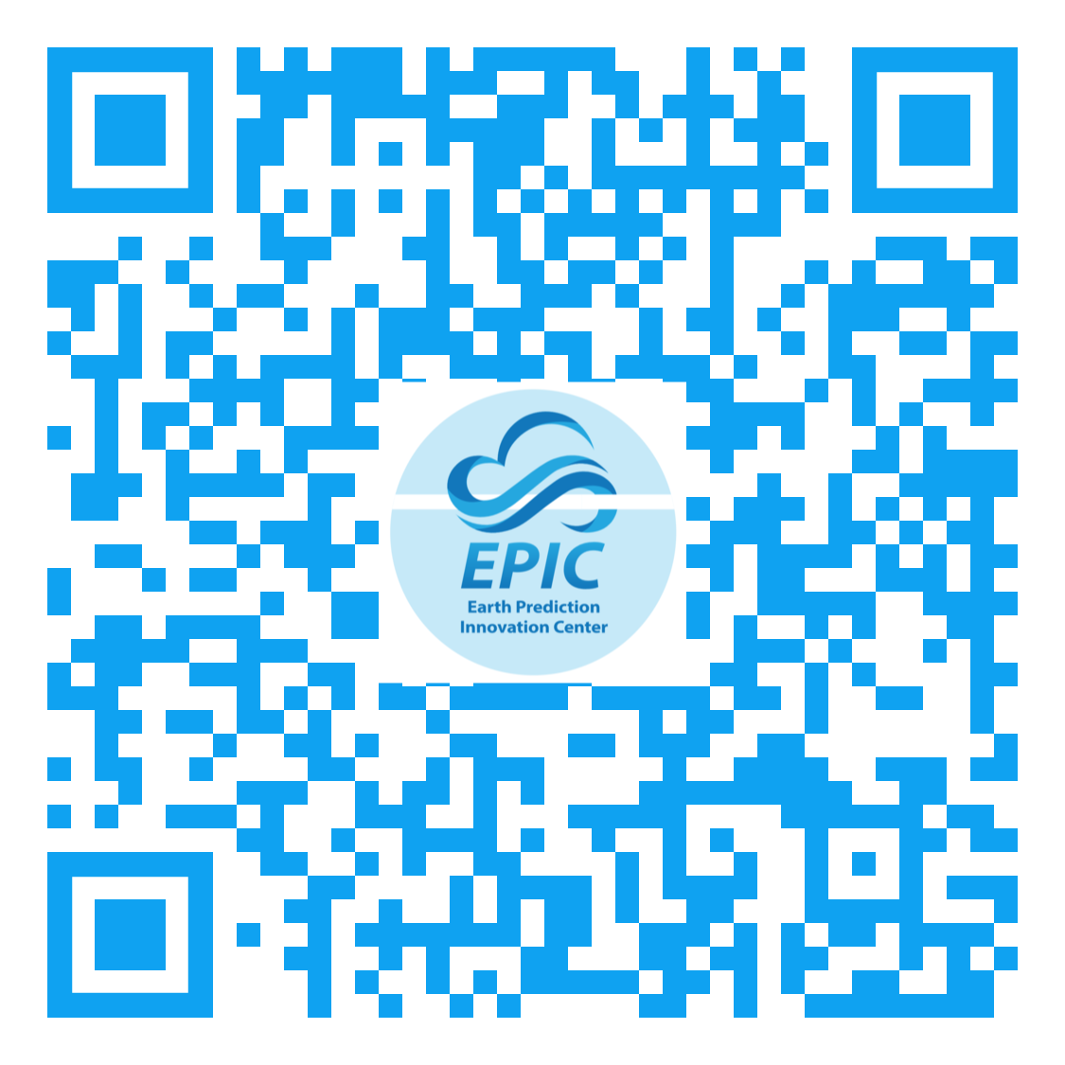
New Tutorial - Infrastructure as Code
Common Infrastructure using Packer - able to deploy on any CSP
https://github.com/NOAA-EPIC/packer-srwcluster
12 lines of code to build out and run SRW
Tutorials - Earth Prediction Innovation Center (noaa.gov)
Video 2: Creating a Head Node in AWS
Can be any of the CSP’s
Video 3: Running any application
Starting with SRW v2.1
Next: LandDA

Slide 12
CI/CD Pipeline

Slide 13
Pipeline Gates
Checkout Source Code | Pull source code from GitHub and stage the data for analysis before deploying the code.
Unit Testing | Run available unit tests for projects and ensure that the tests run as expected. Collect code coverage metrics for the available baselines.
Lint (Flake 8) | Perform static code analysis that enforces style consistencies across programming languages.
Dependency Check | Scan third-party libraries and modules for current vulnerabilities.
Build the Cloud Stack | Terraform/Cloudformation scripts will create a repeatable process for deploying applications.
Lint Cloud Stack | Examine the cloud stack template and return various suggestions.
Nag Cloud Stack | Pinpoint security vulnerabilities in cloud stack templates.
Scan Secrets | Scan for any improper use of security passwords or credentials.
Static Code Analysis | Scan code in all programming languages using SonarQube to determine current vulnerabilities, maintenance issues, and defects. Note: SonarQube also has the ability to utilize architectural metrics such as cyclomatic complexity and maintainability metrics. Cyclomatic complexity as the example infers is a value that tells the ability that a new engineer will be able to come in and maintain the baseline. If the number is high, then you have an application that is tough to upkeep, so tracking this number over time will make sure that your application is easy to maintain, which in turn reduces technical debt costs.
Package/Pull Artifacts/Deploy | This gate sequence will package up the artifacts and the application and deploy the application as needed after completing all quality gate checks.
Run Regression Tests | Run a list of regression tests to test the overall end-to-end functionality.
Average Build time
Average time per gate
Average build time per platform
Code Coverage
Forecast Skill

Slide 14
CI/CD Pipeline
Master Pipeline:
No-Integration Pipeline:

Slide 15
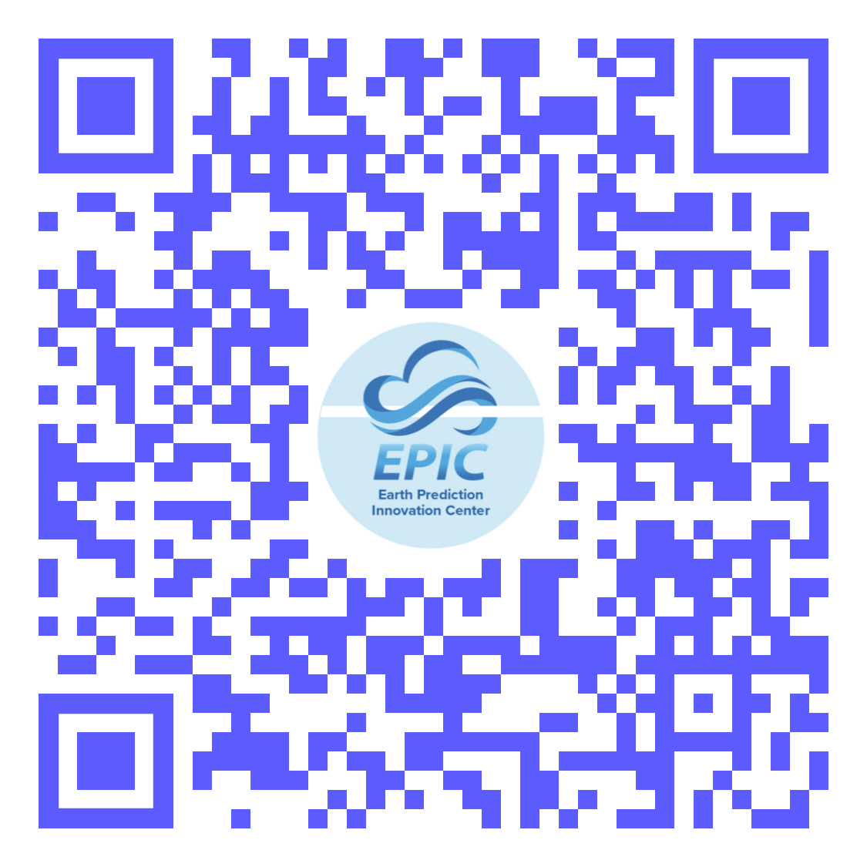
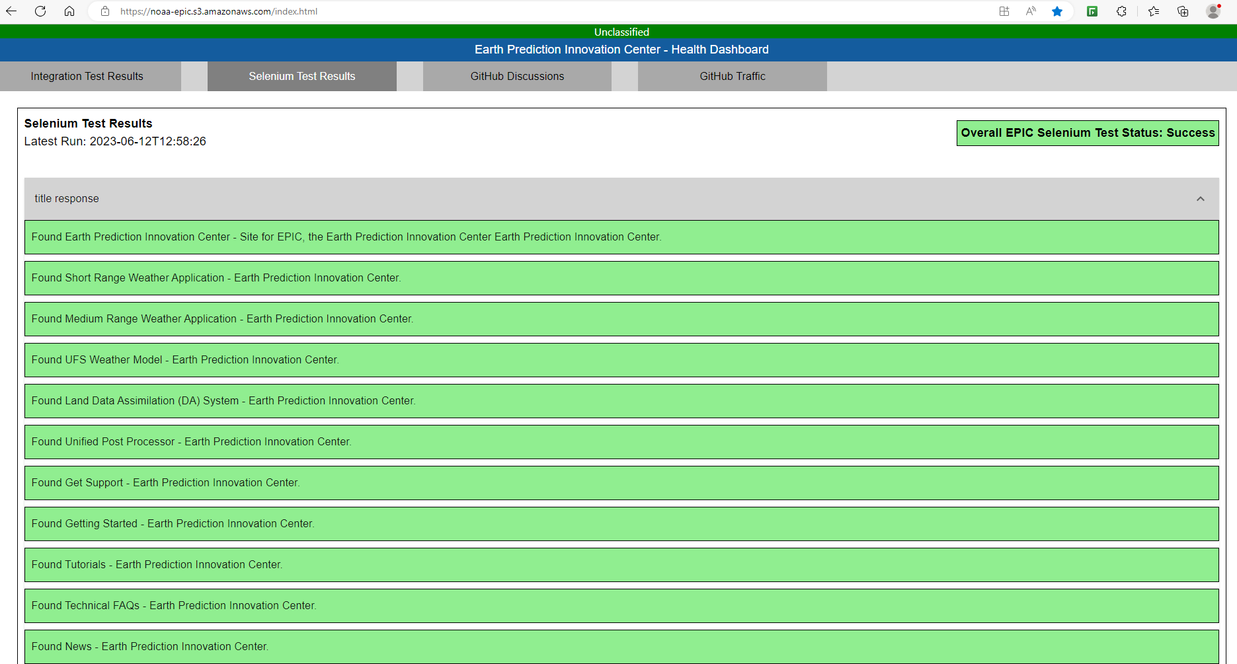
EPIC Dashboard - Selenium

Slide 16
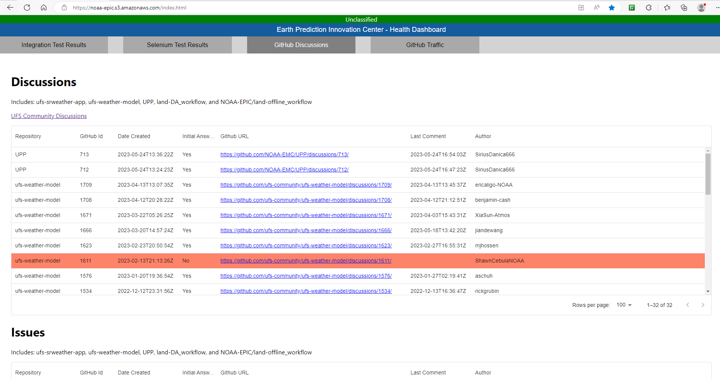
EPIC Dashboard - GitHub

Slide 17
EPIC Dashboard - GitHub Traffic

Slide 18
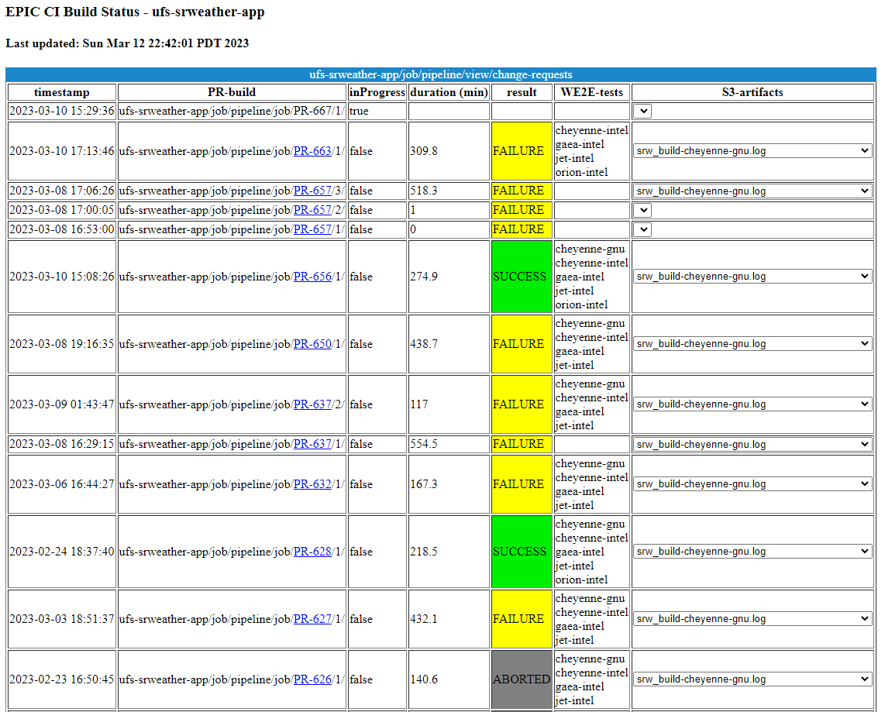
EPIC Dashboard - Pipeline

Slide 19
Implemented Process
UFS-SRW Application - Example
Infrastructure – Update the CICD pipeline of the SRW to include the driver for forecast verification
Scientific Hypothesis – Evaluate the impact on severe winter weather with the relevant UFS case to validate the hypothesis, i.e., Indianapolis case
Objective Verification – Calculate skill score index based on weighted average of a combination of metrics (RMSE), variables (wind speed, dew point temperature, temperature, and pressure at the lowest level in the atmosphere), and lead time
Output – Every source code update has a performance indicator; i.e., aiming for higher than 1.0.
Next Steps
Expansion of the infrastructure to all the UFS repositories, already in the Land DA
Well-established problems with focused research and development
Significant increase to HPC resources dedicated to the testing, i.e., currently the SRW testing is not triggered due to the lack of resources
Support for incremental change in development mindset, there are already great examples

Slide 20
Tutorials and Training

Slide 21
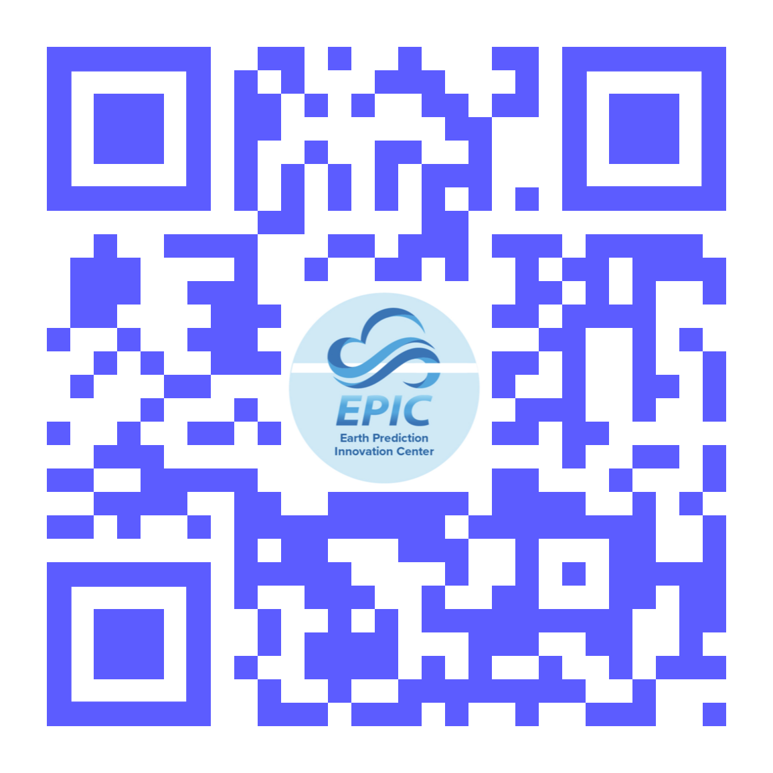
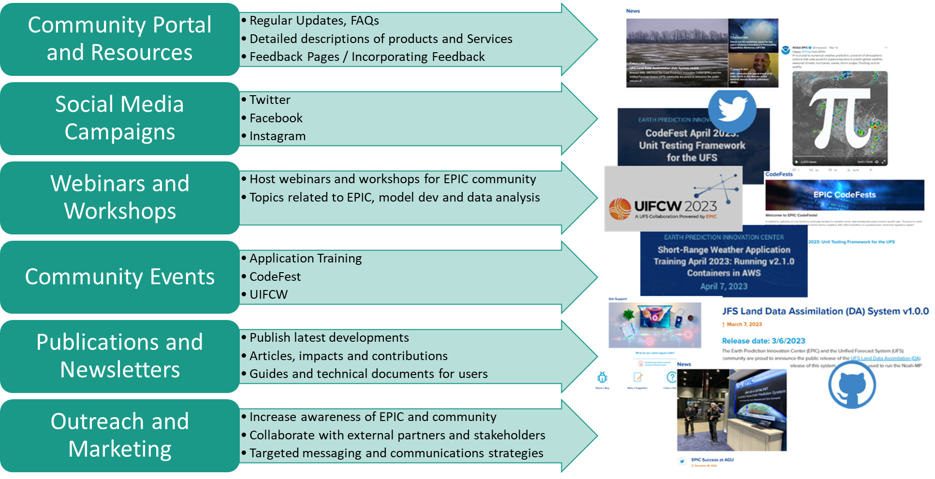
Community Engagement Activities

Slide 22
Upcoming Events, Projects & Promotions
Quarterly CodeFests & Application Trainings
Short-Range Weather CodeFest 2023: Unit Testing Framework for UFS - April 3-7, 2023
Short-Range Weather Application Training 2023: Running V2.1 Containers in AWS - April 7, 2023
EPIC CodeFest June 2023: Unit Testing Framework for the UFS - June 19-23, 2023
EPIC Application Training June 2023: Land Data Assimilation (DA) System - June 23, 2023
Plan/Host UIFCW, Summer 2023
Quarterly Video Tutorials
UPP webpage on ECP (support transitioned from DTC to EPIC)
Explore combining EPIC-UFS Communications Strategy
Conferences (AGU & AMS)
Launch an EPIC-UFS Newsletter
Develop an enhanced metrics dashboard for the ECP
Identify potential areas for improvement and engagement, discover new ways to incentivize external participation

Slide 23
Need for testing and governance

Slide 24
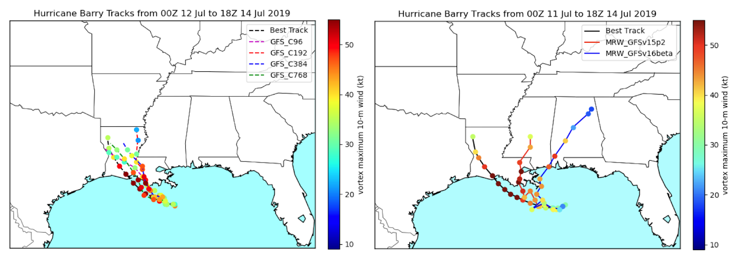
Testing Framework
Objective: To quantify the impact of any code update, in terms of forecast accuracy and computational performance.
Homogenize testing infrastructure
Optimized testing (Reduction of cost)
Simplification of Code Management
User-friendly
Multi-level testing
Increasing Complexity
Different Resolution
Different Physics Parameterizations

Slide 25
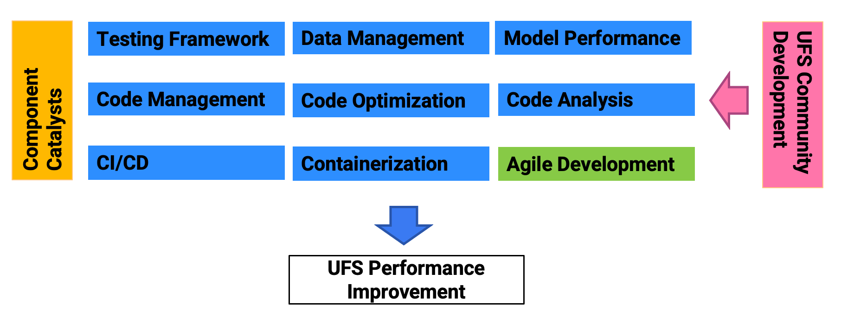
Infrastructure as an Innovation’s Catalyst
Work in Progress by EPIC contract with the UFS Community
Creation of a prosperous environment for rapid innovation!

Slide 26
Closing
We value continuous feedback
Our Advanced User Support Team is prepared to assist as needed with your technical questions.
Await your transparent tools
Community Dashboard
Infrastructure as code
CI/CD Pipeline results are public for all applications
More tutorials:
Contributing to UFS GitHub
GitHub Discussion and how to get user support
Azure AZ-HOP
Don’t wait for a survey/meeting email: support.epic@noaa.gov

