Slide 1
Overview: State of the Science of UFS
Jim Kinter ikinter@gmu.edu
Vijay Tallapragada vijay.tallapragada@noaa.gov
Jeffrey Whitaker jeffrey.s.whitaker@noaa.gov
Co-Leads, UFS-R2O Project
With many thanks for inputs from UFS-R2O Team Leads

Slide 2
Outline
UFS as a community forecast system for research and operations
UFS-R2O Project: Community of UFS Developers
Three Years of Science Infusion
Where do we stand compared to other systems?
What is still needed to realize the vision?

Slide 3
Inspiration
From UCAR Modeling Advisory Committee (2018 report):
NOAA must be “all-in” in developing and deploying a unified community model, with a unified collaborative strategy
NOAA Modeling & Data Assimilation needs to be integrated and collectively managed
NGGPS selection of FV3 dynamical atmospheric core
Establishment of Unified Forecast System (UFS)
From EPIC Vision and Mission:
Accelerate scientific research and modeling contributions through continuous and sustained community engagement to produce the most accurate and reliable operational modeling system in the world.
Status quo ante: Unmanageable/costly-to-maintain “quilt” of forecast applications

Slide 4
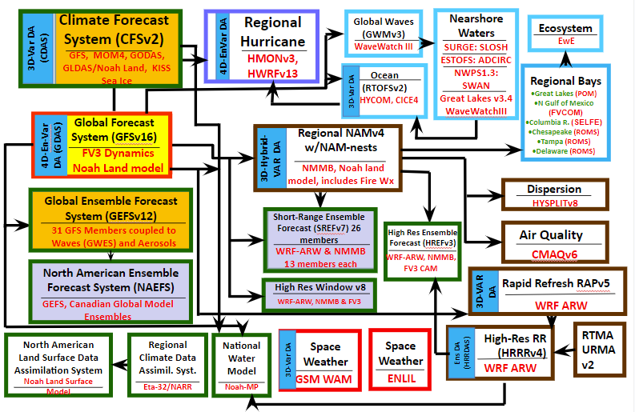
Current State of NCEP Production Suite
NCEP operates more than 38 distinct modeling systems to meet the stakeholder requirements
Quilt of Models developed to meet the service needs over a long period of time
Simplification of NCEP Production Suite is critical to reduce redundancy and improve efficiency

Slide 5
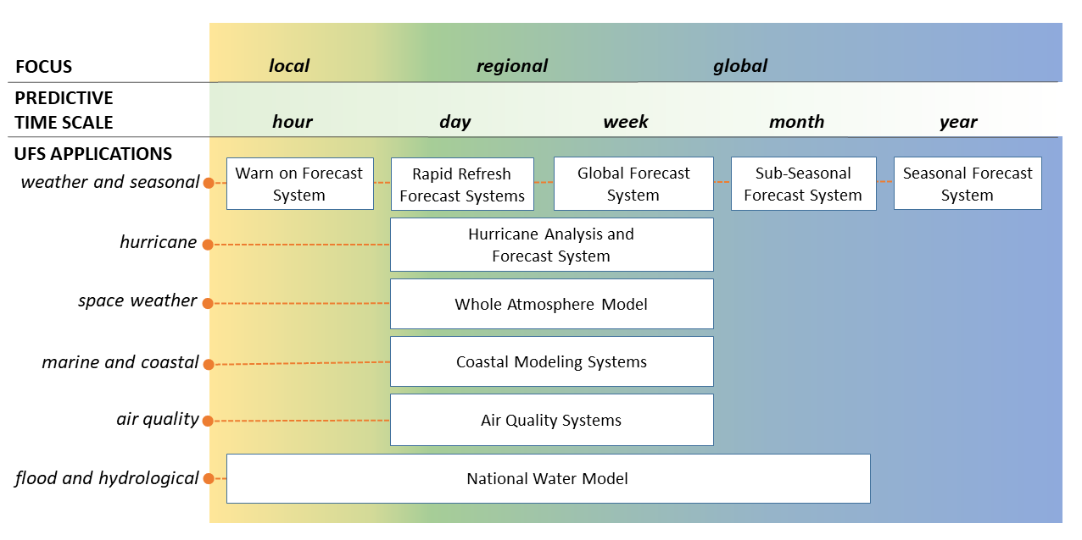
The Goal: Transition to UFS Applications and
Simplify NCEP Production Suite

Slide 6
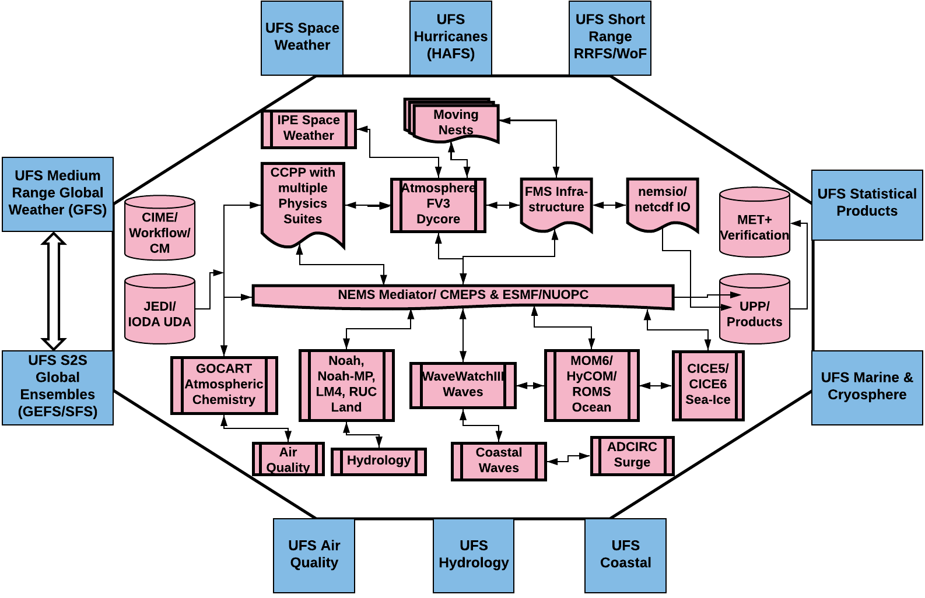
Unified Forecast System (UFS) as a Community-based Coupled Earth System Model for Research and Operations
Components of UFS are configured to develop distinct operational applications while supporting the dependencies between the applications and products

Slide 7
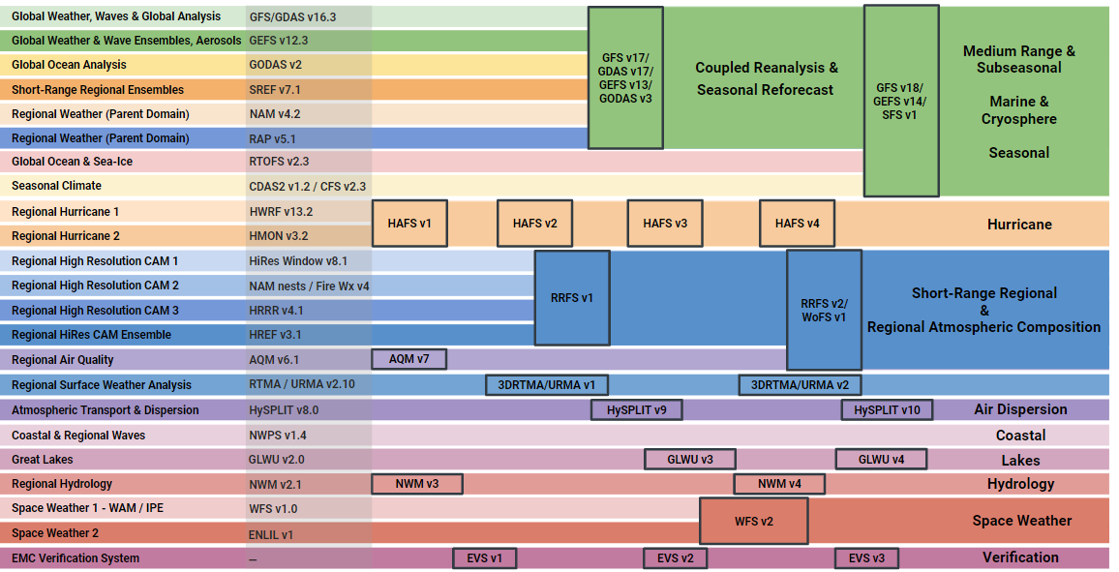
16 separate applications
7 UFS-based applications
EMC Migration Plan to UFS-based Modeling Suites
Notes:
HWRF and HMON will be decommissioned on or about November 30, 2023.

Slide 8
The UFS-R2O Project
EPIC
Other lower readiness-level projects
UFS-R2O Project
UFS
Basic
Research
Launched in 2020, the UFS-R2O project is a broad collaboration within the UFS community intended to accelerate innovations into NOAA operational modeling for weather and climate prediction. It focuses on the transfer of innovations into operations based on priorities drawn from both forecasters and scientific developments.
Other high readiness-level projects
Transition to Operations (EMC)
Operations
Operational forecast systems

Slide 9
Scientific Priorities
Motivated by forecast priorities collected from stakeholders/testbeds
Reduce coupled model biases
Improve representation of key modes of variability (e.g. MJO)
Optimally combine Earth system observations and model forecasts using an advanced data assimilation system to initialize coupled ensembles (land-ocean-sea ice-atmosphere-aerosols).
Develop a convection-allowing ensemble forecast capability for short-range prediction of severe weather and hurricanes
Improve initialization at all scales (convective to global), through improved use of observations and advances in data assimilation algorithms.
Improve quantification of model uncertainty in ensembles, especially near model component interfaces.

Slide 10
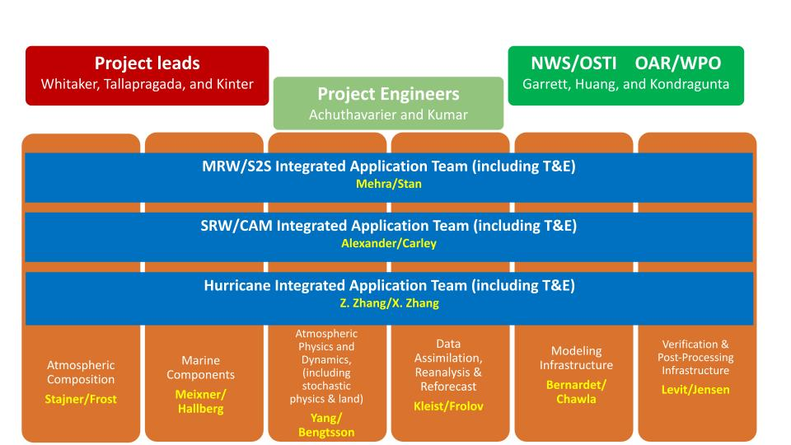
Project Structure

Slide 11
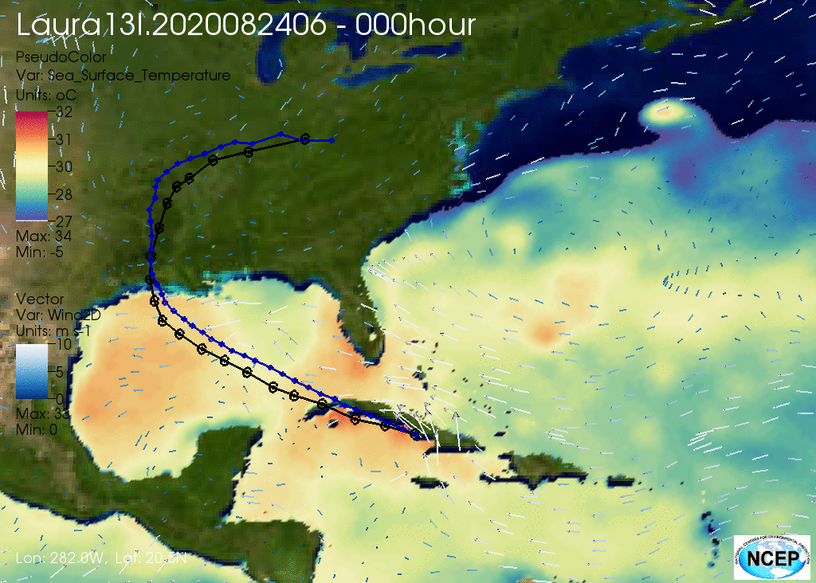
Hurricane Application Team
Hurricane Analysis and Forecast System (HAFS): to create more accurate high-resolution forecast guidance for tropical cyclones across the globe.
Coupled ATM/OCN with cloud resolving nests and coupled domains
Improved physics schemes for tropical cyclones
Advanced inner-core and satellite data assimilation
HAFSv1 implemented into operations on 27 June 2023

Slide 12
Hurricane AT Achievements
Developed a coupled forecast system based on FV3-LAM (ATM) and HYCOM (OCN) with moving nests
Finalized two configurations (HAFS-A and HAFS-B) for implementation to replace operational HWRF and HMON in FY23
Both configurations have demonstrated significant improvement in track forecasts, and comparable performance for intensity forecasts relative to HWRF and HMON, based on ~2,500 cycles in 3 years of retrospective forecasts

Slide 13
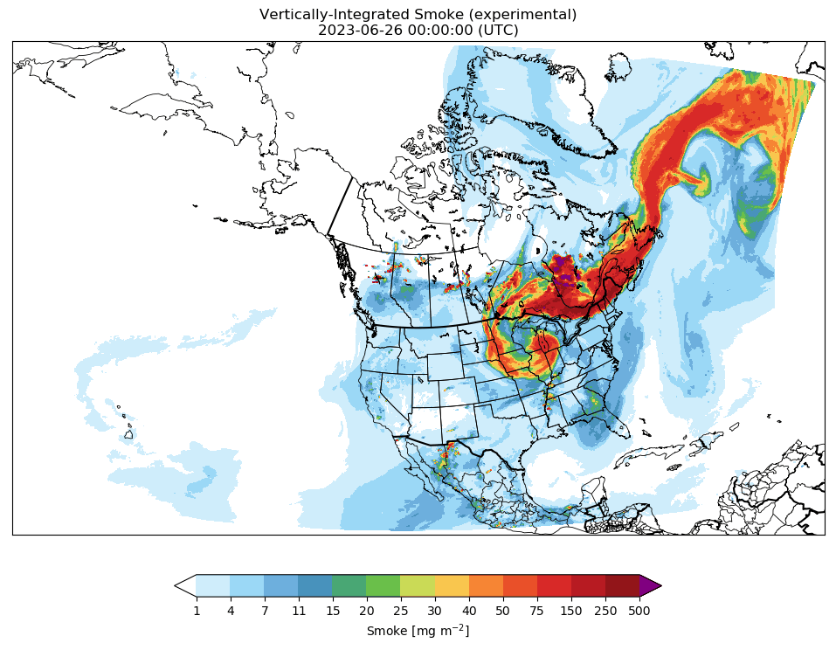
Short-Range Weather / Convective-Allowing Models AT
Develop a Rapid-Refresh Forecast System (RRFS) based on UFS to replace existing hi-res modelling suite, and a 3-Dimensional Real Time Mesoscale Analysis (3DRTMA) system to support National Digital Forecast Database operations.
3 km vertically integrated smoke forecast from 26 June 2023 depicting impact from Canadian wildfires

Slide 14
SRW/CAM AT Achievements
Brought together regional NWP development teams across NOAA and academia
Regional convective-allowing, hourly-updating, ensemble system developed based on FV3-LAM with 18-hour, 9 member forecasts (out to 60-h every 6-h)
Hybrid ensemble-variational assimilation (30 members).
Stochastic and multi-physics ensemble
15-minute 2.5-to 1.25 km analysis system to support NDFD operations using 1-h RRFS forecast as background
First versions of RRFS and 3DRTMA to be implemented operationally in FY25
Successful real-time demonstration of a cycling ensemble-DA based RRFS in 2022/2023 NOAA testbed experiments

Slide 15
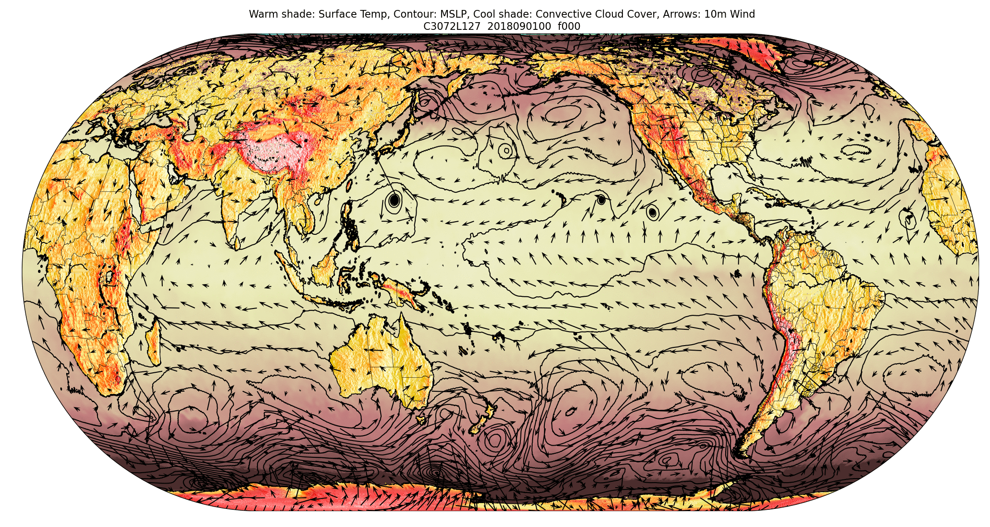
Medium-Range Weather / Subseasonal to Seasonal AT
UFS Earth System Model Components:
FV3 (Atmosphere)
MOM6 (Ocean)
CICE6 (Sea Ice)
WW3 (Waves)
NOAH-MP (Land)
GOCART (Aerosols)
A Six-Way Global Coupled Unified Forecast System (UFS)
A fully coupled UFS serves as a foundation for future operational global forecast systems at NOAA/NWS/NCEP ranging from weather to subseasonal to seasonal scales. Coupled DA for atmosphere, ocean, sea-ice, aerosol and land components.

Slide 16
MRW/S2S AT Achievements
Pre-operational testing for implementation in GEFSv13 and GFSv17 in FY26
Next-gen DA system based on JEDI
Initially for ocean/land/aerosols, ATM in next upgrade
‘Weakly coupled’ GDAS for GFSv17
New ATM physics package with many community innovations
Ensemble system with stochastic physics in ATM, land and ocean
Reanalyses and reforecasts for GEFSv13
Interactive aerosols based on GOCART
Prototype data available in AWS

Slide 17
Data Assimilation, Reanalysis and Reforecast Cross-Cutting Development Team
Accelerating non-atmospheric, JEDI-based assimilation capabilities
Initial OI-like snow assimilation
Coupled ocean/sea-ice
Initial capabilities for composition assimilation (in-kind)
Produced 40-year, prototype marine reanalysis based on JEDI-SOCA
Initial demonstration of weakly coupled assimilation prototype
GSI-atmosphere, JEDI-marine
Continued improving use of observations in operational GFS/GDAS
All-sky microwave to include precipitating fields of view, MP-specific scattering
Significant preparatory work for future coupled reanalysis

Slide 18
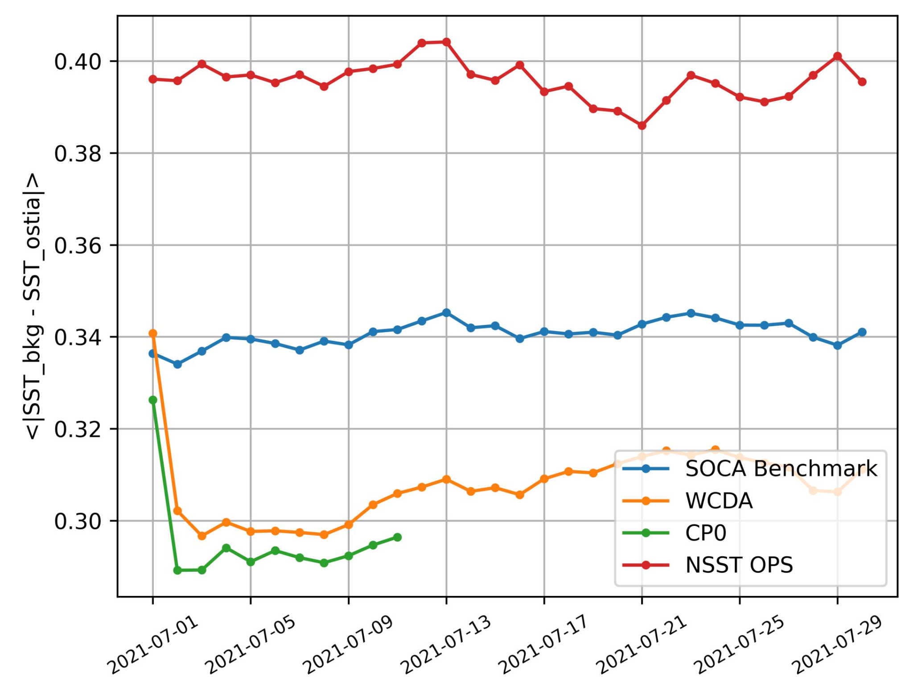
Weakly Coupled Data Assimilation preliminary results: SST
AVHRR NOAA-18, channel 3 <|Obs-Bkg|> from SI/CRTM h(x)
comparison against OSTIA
GFS
Better estimate of the foundation temperature leads to better simulation of radiances sensitive to SST.
GFS
Data Atmos + SOCA
More obs passed the GSI QC
Smaller O-B almost everywhere
GSI+JEDI/SOCA 3DVAR
WCDA (GSI+JEDI/SOCA)
GSI+JEDI/SOCA Hybrid EnVAR
cp0: Status as of 07-11-2023.
Ocean & sea ice hybrid EnVAR with 30 offline members
[K]

Slide 19
Modeling Infrastructure Development Team:
Common Community Physics Package (CCPP)
Designed, developed, and implemented the Common Community Physics Package (CCPP) for the UFS and community models
Operational transition of the CCPP to the newest UFS Hurricane Analysis and Prediction System (HAFS)
See the DTC lead story about this point at: https://dtcenter.org/news/lead-story
CCPP version 6 public release (June 2022)
Released standalone (with Single Column Model, SCM) and as part of UFS SRW App
23 supported schemes in 6 supported suites
Online tutorial and documentation updates (SciDoc, TechDoc, and User’s Guide)
Support provided via GitHub discussions
See Heinzeller et al., 2023, GMD

Slide 20
CCPP Advantages
Updated physics packages in a centralized authoritative code repository (CCPP-Physics) shared among research and operational communities.
Runtime configuration of physics suites and physics packages through the CCPP Framework.
Agile test beds and workflows enabled by the CCPP.
Hierarchical system development capability enabled by the CCPP.
Testing and evaluation capability enabled by the CCPP Single Column Model (SCM).

Slide 21
Modeling Infrastructure Development Team: ESMF
ESMX, Earth System Model eXecutable layer: simplifies standing up and maintaining NUOPC-based systems and promotes hierarchical model component testing
Spack-based build of ESMF in UFS, (https://spack.io/) provides more portability and flexibility
Multi-tile Arrays and Fields (e.g., six-tile cubed sphere grid) in Read and Write operations: simplifies grid manipulations
ESMF-managed UFS threading, allowing different threading levels for different components
Exchange grid implemented as an option for flux calculations in UFS via CMEPS / CCPP
Efficient writing of fields with moving nests
Various enhancements to performance, profiling and regridding

Slide 22
Atmospheric Physics & Dynamics Development Team
Unified processes across scales
Upgraded or improved practically every aspect of atmospheric physics
First implementation of a scale-aware convective parameterization
Upgraded two-moment microphysics scheme
Enhanced gravity wave physics
Improved PBL and convection schemes
Adopted advanced land model (NOAH-MP)
Incorporated convective gray-zone considerations
Enhanced tropical variability prediction
Attained world-class skill in shallow cumulus cloud prediction in RRFS

Slide 23
Atmospheric Composition Development Team
UFS-Aerosol: prognostic aerosol component of the UFS 6-way S2S coupled system
Strong foundation for NOAA's next-generation subseasonal and seasonal forecast systems
Fully NUOPC-compliant aerosol application, based on NASA's GOCART aerosol model
Incorporates improved aerosol process descriptions (e.g., fire emissions, dust sources, wet scavenging, and aerosol precipitation flux)
Includes aerosol direct/semi-direct radiative feedback and satellite aerosol optical depth DA
Developed a biomass burning emission climatology for longer forecast times
EMC aims to incorporate UFS-Aerosol in GEFSv13, and its performance is being tested in EP4
Collaboration partners: NWS, OAR, NESDIS, and others

Slide 24
UFSR2O Project Phase 2 - Planning and Priorities
Phase 2: July 2023 - June 2026
Support multiple upcoming transitions
HAFSv2 and beyond
RRFSv1 & 3D-RTMAv1
GFSv17 and beyond
GEFSv13 and beyond
Prioritize activities supporting transition of externally funded projects (Disaster supplementals, JTTI, NOFOs)
Ensure transition of capabilities that address forecasters feedback on model performance
Integrate UFSR2O with new Seasonal Forecast Application Team

Slide 25
UFSR2O Project Phase 2 - Planning and Priorities
MRW/S2S Application Team
Produce a fully coupled extended reanalysis and reforecast set
SRW/CAM Application Team
Address long-standing convective storm structure issues and related biases in RRFS
Address RRFS ensemble tendency to be under-dispersive
Transition to JEDI DA
HAFS Application Team
Develop multiple nest capability
Transition to JEDI DA
Transition from HyCOM to MOM for ocean component
Ensembles: stochastic physics, enhanced probabilistic products, consider 7-day extension
Integrate new science and infrastructure from the Development Teams

Slide 26
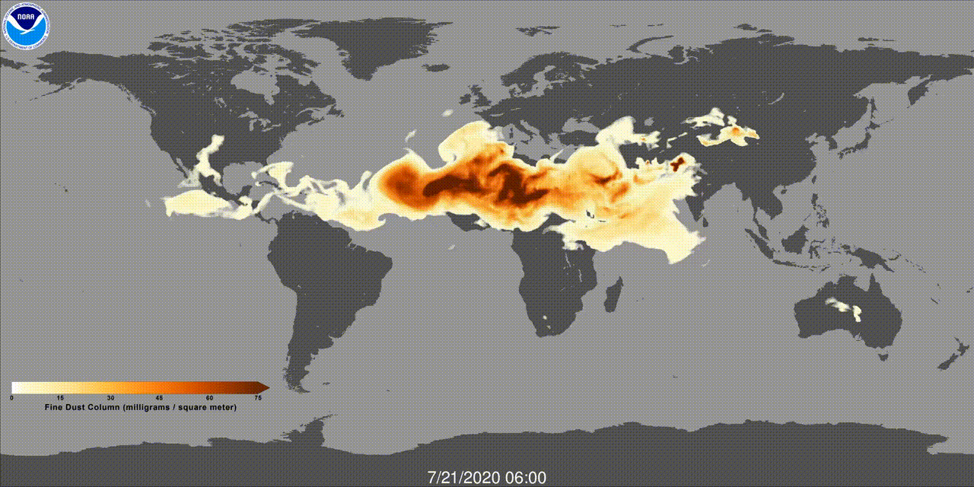
UFSR2O Project Phase II - Planning and Priorities
Physics and Dynamics Dev Team
Enhance atmospheric physics for HAFS
Address challenges with gray-zone convection, 3D turbulence, scale-adaptive physics, non-stationary gravity wave drag
Improve physics-dynamics coupling
Adopt NOAH-MP across all UFS applications; hydrology
Tuning, tuning, tuning!
Atmospheric Composition Dev Team
Evaluate performance of aerosol predictions and impacts on meteorological predictions in ensemble prototypes
Improve aerosol DA approaches
Extend UFS-Aerosol to seasonal scales
Implement UFS-Aerosol cloud microphysics
Incorporate simplified gas phase chemistry

Slide 27
UFSR2O Project Phase II - Planning and Priorities
DA, Reanalysis and Reforecast Dev Team
Full JEDI-based capabilities for unified DA across UFS-based applications
Coupled assimilation across UFS-based applications
Embrace and integrate new technologies, e.g., AI/ML, continuous assimilation, new/novel observations
Modeling Infrastructure Dev Team - CCPP
Implement/include/organize new CCPP contributions in coordination with community partners
Single precision, GPU acceleration, improve interoperability
Hierarchical development: data component model and “replay” mode in Single Column Model
Modeling Infrastructure Dev Team - ESMF
Support hierarchical model development and testing
Implement spherical vector regridding
Support developers and users of the UFS

Slide 28
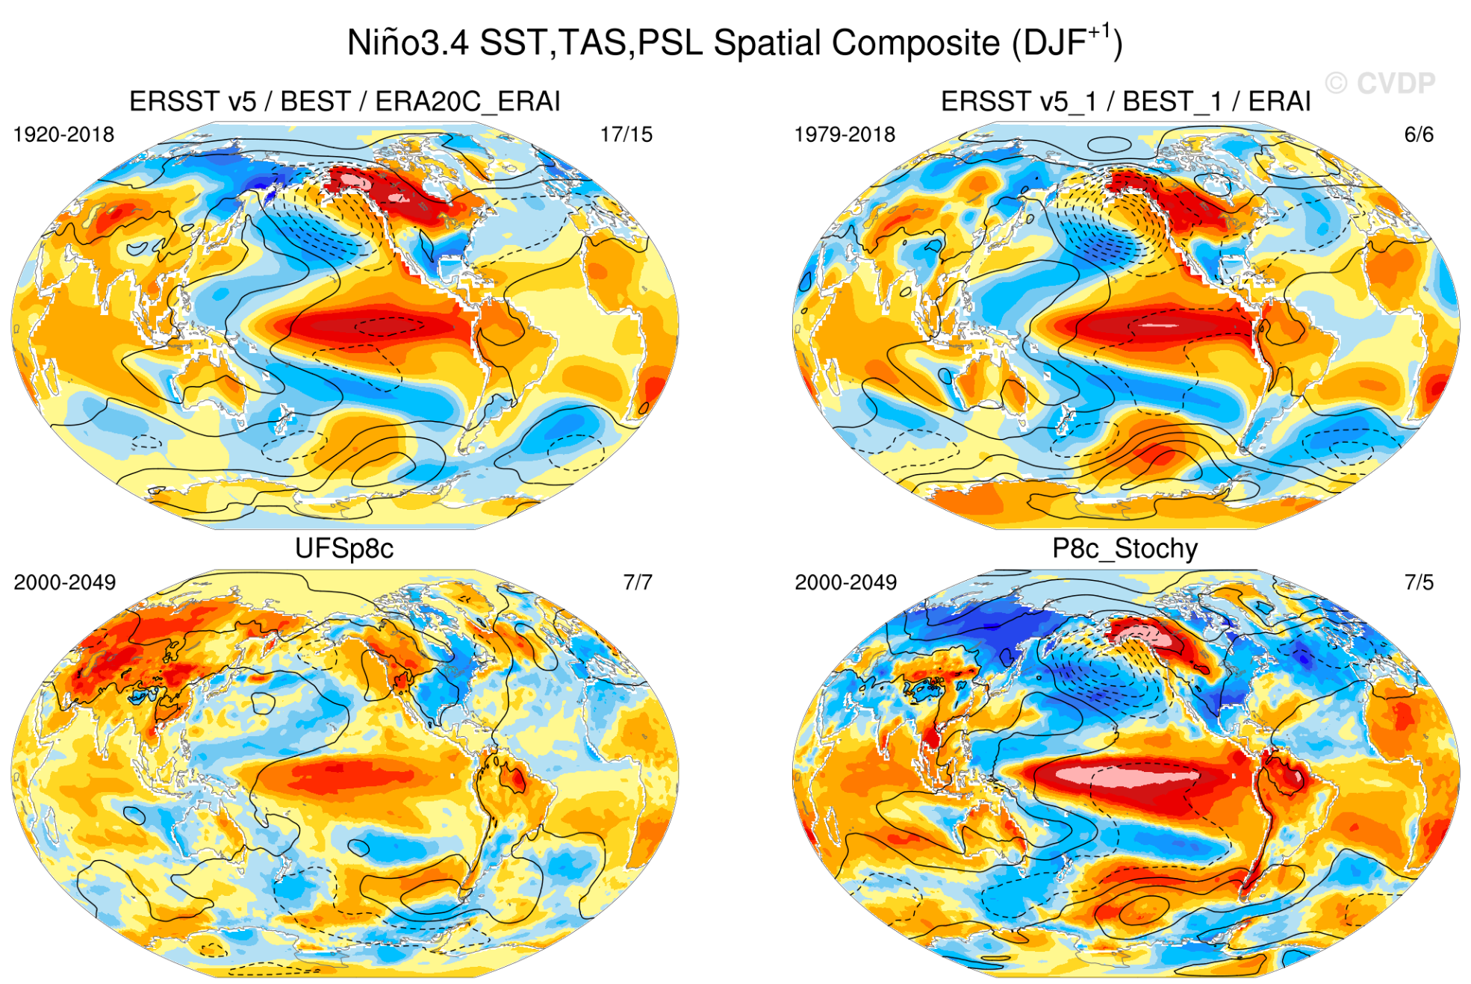
Preparing for Seasonal Forecast AT:
UFS simulates ENSO better with stochastic physics
UFS P8 run at 1 deg w/ & w/out stochastic forcing for 50 years, the first 20 having observed CO₂ for 2000-2020, and the last 30 years with CO₂ fixed at 2020 levels.
The stochastic physics includes both SPPT and SKEB active, using the EP3 values.
ENSO teleconnections match observations better with stochastic physics (although ENSO SST signal too strong).

Slide 29
Current State of the UFS:
Where do we stand compared to other systems?
UFS is unique in the world right now
Capabilities to do operationally relevant prediction science
NB: There is a long way to go to realize the vision
UFS has end-end forecast capabilities (data assimilation) that are lacking in other open development modeling systems that are used in the research community, e.g. CESM and WRF
Capabilities lag behind other operational systems (e.g., ECMWF Integrated Forecast System and MetOffice Unified Model), but none of these have the open development model we seek.

Slide 30
What Is Still Needed to Realize the Vision?
Computing resources (See Priorities in Weather Research)
Operational transitions for all applications and JEDI DA
Advance UFS as Earth system model to include new applications like seasonal, coastal, space weather, hydrology (See Priorities in Weather Research)
Reimagine the Production Suite to enable more agile and flexible process for T2O
Portable systems and workflow, with supporting datasets with capability to reproduce operational applications (EPIC).
Entrain wider development community working on non-NOAA systems (NSF, cloud etc.)
Community-driven, well-defined rules of engagement (stages and gates) in R2O funnel
Well defined governance and accountability

Slide 31
Questions?

Slide 32
Supplementary Slides

Slide 33
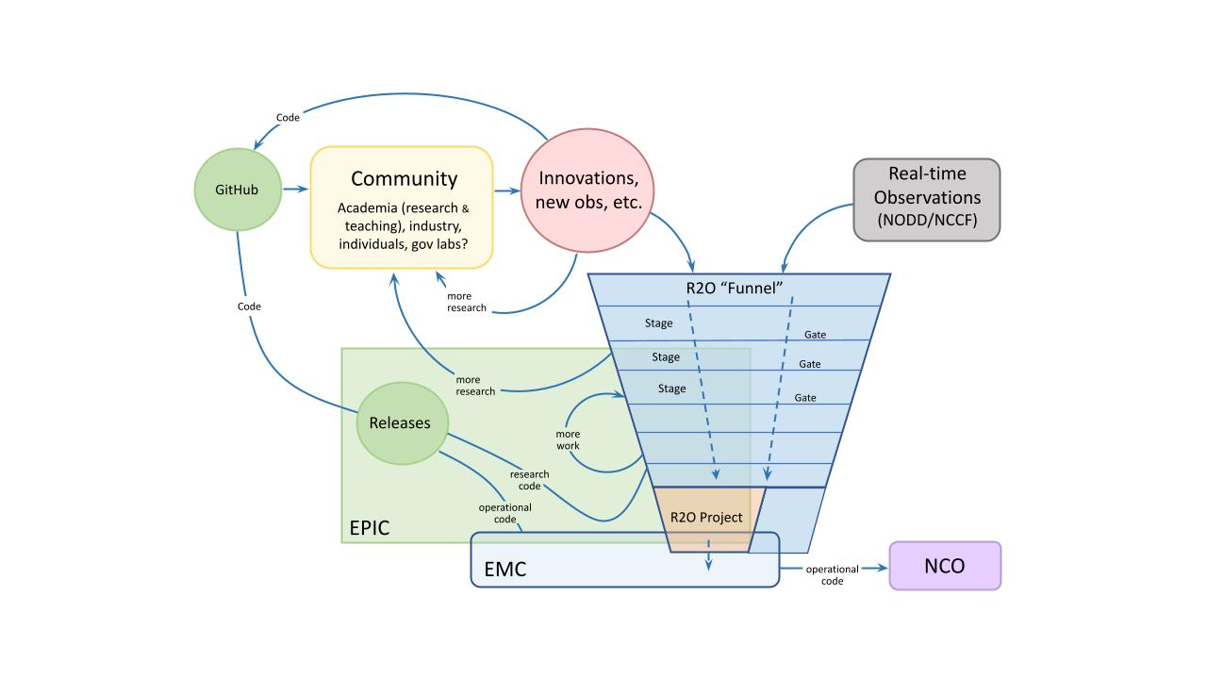
The UFS Community
NOAA Programs that Support UFS
NWS/OSTI Modeling Programs: NGGPS, Weeks 3&4, HFIP
OAR/WPO Programs: EPIC, JTTI, S2S, Atmospheric Composition
Disaster Supplementals FY18, FY19, FY22 and Bipartisan Infrastructure Legislation FY22
UFS Research-to-Operations (UFS R2O) Project
Three year project (FY20-23) with 5-year vision
Developing the next-generation global and regional forecast systems and transition to NOAA operations in FY23 and beyond
Jointly supported by NOAA NWS and OAR
Community team (NOAA, NCAR, JCSDA, Academia)
Website: https://vlab.noaa.gov/web/ufs-r2o

Slide 34
UFS Progress and Priorities: MRW/S2S Application
Most important advancements:
A six-way fully coupled global system (a first for UFS).
Prototype data has been made available on AWS
Multiple publications in peer-reviewed journals
Most important Priorities:
Finalize configurations for GFS v17 and GEFS v13 based on the new coupled system.
Need a fully coupled extended reanalysis (and reforecast) based on this coupled system for operational and research use.
Need to configure and test the coupled model performance for seasonal or longer time scales.

Slide 35
UFS Progress and Priorities: CAM/SRW Application
Most important advancement:
Brought together regional NWP development teams across NOAA and Academia.
Most important priorities:
Addressing long standing convective storm structure and related biases in RRFS.
Ensemble: Spread / error relationships for RRFS still trend toward underdispersion even with multiphysics.
Transition to JEDI DA.

Slide 36
UFS Progress and Priorities: Hurricane Application
Most important advancements:
Completed UFS-HAFS operational implementation on June 27, 2023
An atmosphere-ocean-wave coupled TC forecast system,
Configured two HAFS operational systems
Quasi-realtime forecasts
Three-year retrospectives (~2500 cycles total)
More than 20 peer-reviewed publications and 50 talks
Most important Priorities:
Development of multiple nests;
DA: transition to JEDI; Physics enhancements: PBL, Noah-MP, CP & Microphysics
Ocean: Transition from HyCOM to MOM6;
Ensembles: Stochastic physics, enhanced products, 7-day extension

Slide 37
UFS Progress and Priorities: Physics Development Team
Most important advancements:
Unification of processes across scales
Transition of an advanced two moment microphysics scheme
Introduction of advanced gravity wave physics i
Improved PBL and convection schemes
Transition of a new advanced land model (NOAH-MP)
Transition of convective gray-zone considerations
Overall improvement in tropical variability
World-class skill achieved in the prediction of shallow cumulus clouds in RRFS.
First planned transition of a scale-aware convective parameterization

Slide 38
UFS Progress and Priorities: Physics Development Team
Most important Priorities:
Challenges with gray-zone convection, three dimensional and scale-adaptive physics; Aerosol-cloud-radiation interaction.
Development, coordination and testing across scales of the new C3 convection scheme.
Development, coordination and testing across scales of the new prognostic cloud scheme.
Improvement of the parameterization of non-stationary gravity wave drag.
Development of 3D turbulence for the turbulence gray-zone.
Improvement in physics-dynamics coupling.
Moving to a more advanced land surface model, NOAH-MP, across all UFS applications.
Introduction of land hydrology for earth system modeling.
Importantly - a tedious but rarely recognized task - tuning, tuning, tuning, to optimize performance, integrate schemes, and reduce systematic biases!!

Slide 39
Data Assimilation Priorities in Phase II
Full JEDI-based capabilities for unified DA across UFS-based applications
Coupled assimilation across UFS-based applications
Production of weakly coupled reanalysis
Embracement and integration of new technologies and innovation
AI/ML
Toward more continuous assimilation
Integration of new observations, including from novel sources

Slide 40
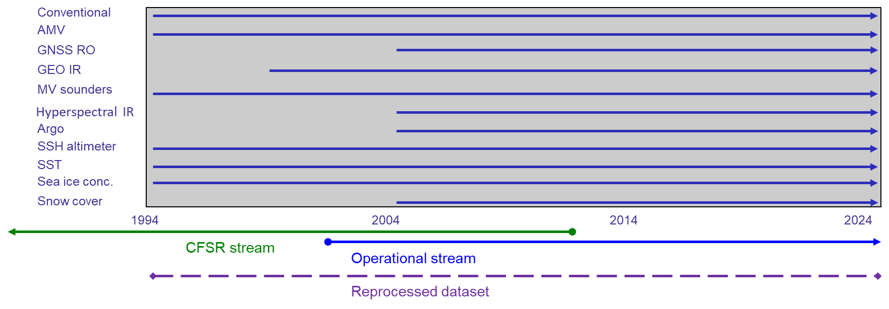
Status of the weakly coupled reanalysis
Joint NOAA-NASA project to upload reanalysis ready observations to AWS S3.
Data for 1994-2020 uploaded. Will enable backwards extension to 1979 in the next fiscal year.
Next 12 month will conduct scout runs with fully coupled UFS to test fidelity of the observational archive.
NOAA-NASA joint observational archive for reanalysis

Slide 41
The most important atmospheric composition advancements over the past 3 years of the UFS R2O project
With 3 years of support from the UFS R2O Program, a team of NOAA and partner scientists developed UFS-Aerosol, the prognostic aerosol component of the UFS 6-way S2S coupled system.
UFS-Aerosol is a fully NUOPC-compliant aerosol application within the UFS weather model repository based on the latest version of NASA’s GOCART aerosol model.
While based on elements of NOAA’s current global aerosol forecast model (GEFSv12-Aerosol), UFS-Aerosol incorporates many advances, including:
Improved descriptions of aerosol processes, like fire emissions, dust sources, convective wet scavenging of aerosols, and large-scale aerosol precipitation flux;
Aerosol direct/semi-direct radiative feedback; and
Satellite aerosol optical depth data assimilation.
The UFS-Aerosol team also developed a biomass burning emission climatology for use at longer forecast times.
UFS-Aerosol has been targeted by EMC for incorporation in GEFSv13. Testing and evaluation of UFS-Aerosol performance in EP4 mini-ensembles is currently underway.
The UFS-Aerosol team extends a robust long-term collaboration between 3 Line Offices (NWS, OAR, and NESDIS) and their partners to develop atmospheric composition in NOAA forecasts.
UFS-Aerosol provides a solid foundation for NOAA’s next-generation operational sub-seasonal and seasonal forecast systems that allows more sophisticated treatments to be incorporated in future.

Slide 42
How the current atmospheric composition capabilities of the UFS compare to similar systems at other operational centers
UFS-Aerosol produces realistic aerosol spatial distributions and temporal variability, and its skill at aerosol prediction is comparable to forecasts made by other centers.
No other operational center currently incorporates prognostic aerosol-radiation feedback in their S2S forecasts.
UFS-Aerosol radiative feedback has a relatively neutral impact on meteorological skill.
P8 Weeks 1-4 UFS-Aerosol vs. AERONET Total AOD
Analysis by Jian He, Zach Moon, and Barry Baker

Slide 43
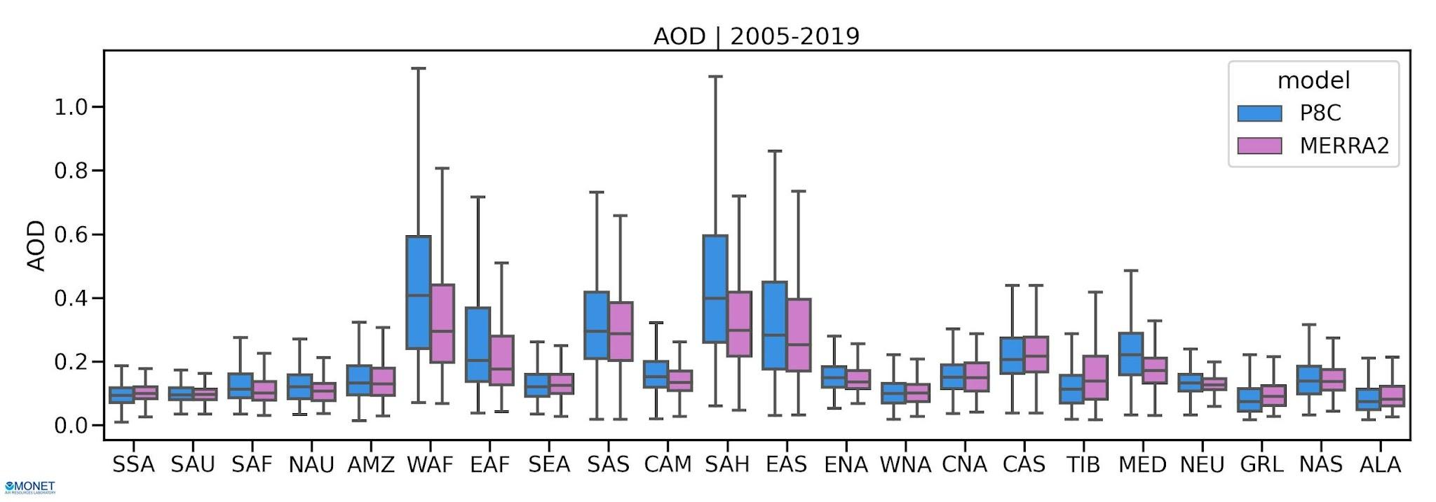
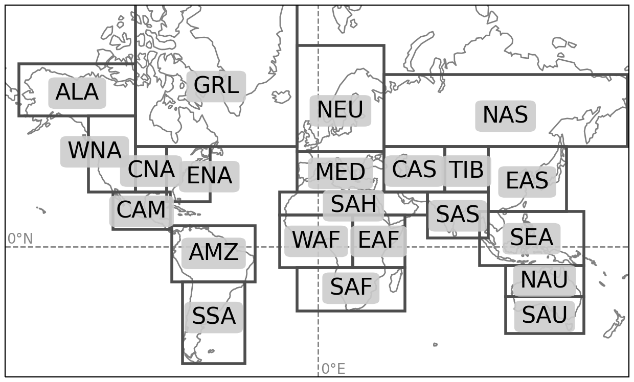
How the current atmospheric composition capabilities of the UFS compare to similar systems at other operational centers
UFS-Aerosol produces realistic aerosol spatial distributions and temporal variability, and its skill at aerosol prediction is comparable to forecasts made by other centers.
No other operational center currently incorporates prognostic aerosol-radiation feedback in their S2S forecasts.
UFS-Aerosol radiative feedback has a relatively neutral impact on meteorological skill.
P8 Weeks 1-4 UFS-Aerosols Total AOD vs MERRA-2 Total AOD
Analysis by Colin Harkins, Jian He, Zach Moon, and Barry Baker

Slide 44
How the current atmospheric composition capabilities of the UFS compare to similar systems at other operational centers
UFS-Aerosol produces realistic aerosol spatial distributions and temporal variability, and its skill at aerosol prediction is comparable to forecasts made by other centers.
No other operational center currently incorporates prognostic aerosol-radiation feedback in their S2S forecasts.
UFS-Aerosol radiative feedback has a relatively neutral impact on meteorological skill.
P8 Weeks 3&4 July simulations max 2-m T bias vs CPC observations
Climatological aerosols
Prognostic aerosols
Prog - Clim Difference
Boxes = Prognostic aerosols improve or degrade skill compared to climatology
Analysis by Lydia Stefanova

Slide 45
The most important atmospheric composition priorities for the coming years that we need to address in order to fully realize the vision
Near term: Complete transition-to-operations into GEFSv13, with the goal of incorporating UFS-Aerosol with radiation feedback into all ensemble members for the full S2S forecast period
Complete testing in EP4A and in any future mini-ensemble experiments
For each such experiment, evaluate performance of aerosol predictions and evaluate impacts on GEFS meteorological predictions
Longer term: UFS Aerosol and Atmospheric Composition advancements proposed for GEFSv14 and SFSv2
Include predictive approaches for biomass burning emissions
Investigate stochastic perturbations to aerosols
Improve aerosol DA approaches
Extend UFS-Aerosol to seasonal scales
Implement UFS-Aerosol cloud microphysics
Make 30-year UFS-Aerosol reforecast and create a UFS aerosol climatology
Incorporate simplified gas phase chemistry in UFS global S2S and seasonal forecasts

