Slide 1
EPIC Support for the UFS

Slide 2
Ways we support the modeling community
Support releases and the R2O2R pipeline
Library management
Port models to new systems
End user support and training
Establish development best practices
Regression testing
Configuration management guidelines
Documentation updates
Model development
Workflow development
GSI to JEDI transition
Community outreach
Workflow unification

Slide 3
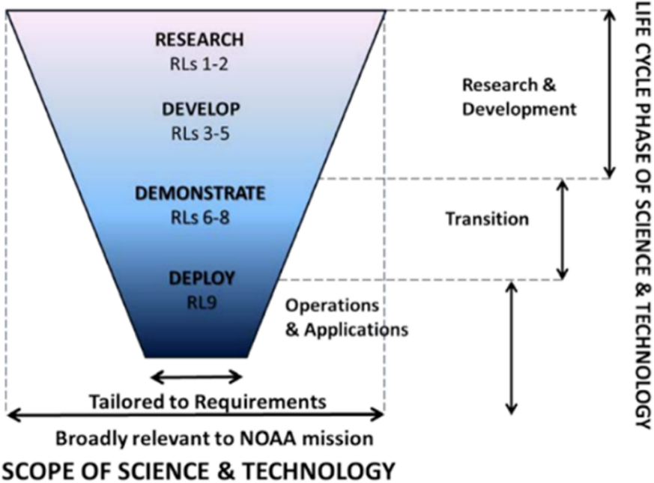
Weather Model Releases
Bring research to operations and operations to research (R2O2R)
Allow researchers and operations to coordinate their work
Transitioning operational applications into the Unified Forecast Model

Slide 4
Motivation for Releases
Transparency about code
Facilitate research
Enable contributions back to operations
Provide operational-ready models for private companies as well as system requirements
For academia, provide additional scientific documentation for research
Developers also benefit from releases
Documentation updates
Enhanced portability
Updated/improved testing
Hardening of code

Slide 5
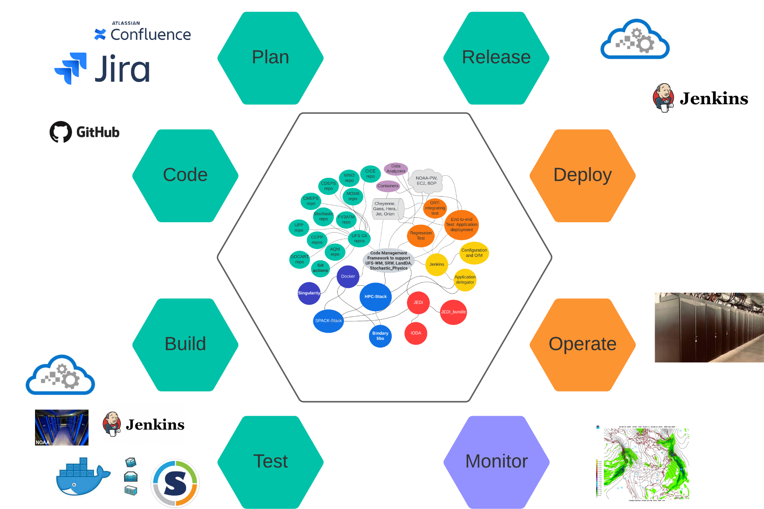
CCT Release Vision
Manage repositories using continuous integration and delivery (CI/CD)
Minimize work required to testing, documentation, and training
Perform releases incrementally to capture
New libraries, workflows, etc
Significant scientific, testing, or programmatic milestones
Operational implementations
Coinciding with large scale experiments

Slide 6
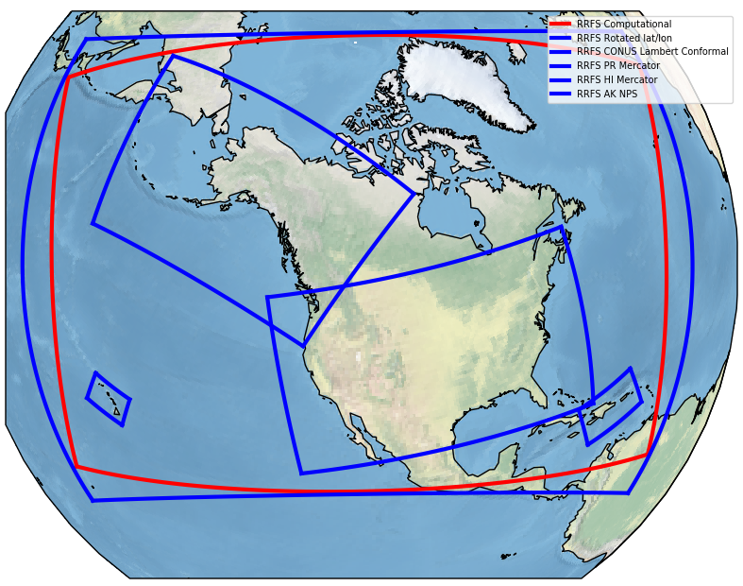
Upcoming RRFS and SRW Releases
HRRR
HREF
RRFS
SRW
NAM
RAP
Next Gen Ops
Q4 2023
Research Branches
Current Ops

Slide 7
Upcoming SRW Release
EPIC’s Roles
Coordinate the incorporation of the RRFS capabilities into the UFS Short Range Weather (SRW) App
Configuration management, testing, community engagement, documentation
Incorporate as many RRFS features as possible
Deploy a set of common libraries (via spack-stack) across platforms for all subcomponents
UFS, GSI, Unified Post Processor (UPP), UFS Utilities
Upgrade spack/spack-stack capabilities to handle new libraries/evironments
Migrate each of these components to the spack-stack unified environment
‘Fix’ the GSI so it will run with newer compilers and migrate it to spack-stack
Provide demos, training, documentation updates, and end user support

Slide 8
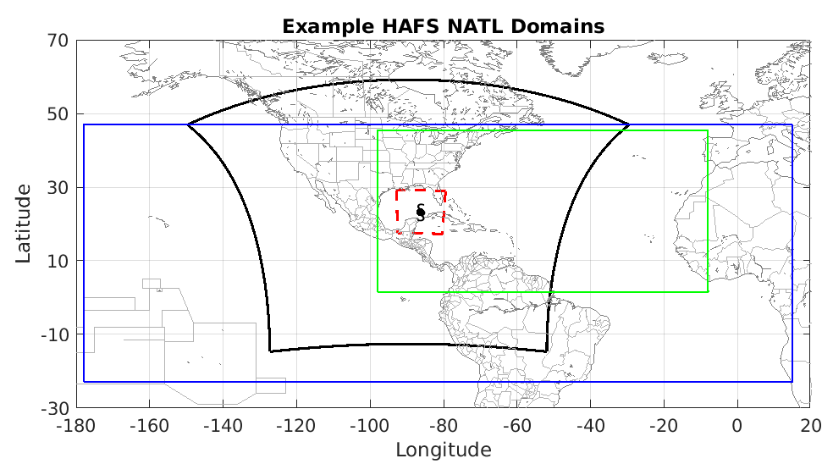
Upcoming HAFS Community Release
HWRF
HAFS-A
HAFS-B
HAFS
HMON
Version 1.0 Operational
2022
Research Repository
Current Ops

Slide 9
Upcoming HAFS Community Release
EPIC’s Roles
Take over user support forums
Regression testing with development
Create a new branch for community development and research
Keep the research branch synchronized with new operational features
Maintain/update scientific documentation, training, and demos
Host developers’ meetings

Slide 10
Upcoming RRFS-Smoke Release
HRRR-Smoke
RRFS-Smoke
SRW
Experimental Release
Research Repository
Current Ops

Slide 11
Upcoming RRFS-Smoke Community Release
EPIC’s Roles
Develop a workflow for the RRFS-Smoke application
Merge the workflow into the UFS SRW
Port to a minimum of Gaea and the cloud platforms
Enhance SRW initial and boundary condition generation to include Smoke parameters
Enable regression testing against the FIREX-AQ field campaign
Create a new branch and/or repository for community development and research
Update scientific documentation, training, and demos

Slide 12
Releases in a Nutshell
Releases enable the community’s ability to use and develop various weather applications
EPIC supports the release pipeline in many ways, including
Documentation
Demonstrations
Workflow development
Testing
Maintain the R2O2R pipeline
We appreciate your feedback!
Take a survey to share your thoughts on releases

Slide 13
Library Management
Weather applications use many scientific libraries
Some developed by NOAA, many by external parties
NOAA-EMC and JCSDA developed separate library deployment systems
HPC-stack and spack-stack, respectively
EPIC manages installs of both on multiple systems and provides testing
Helping lead effort to transition to the to the newer, more rigorous spack-stack system

Slide 14
User Support
Provide demos and trainings
Building/running UFS models
Making use of development tools
Using the cloud to run and develop code
Natalie Perlin, AGU 2022
David Huber, UIFCW

Slide 15
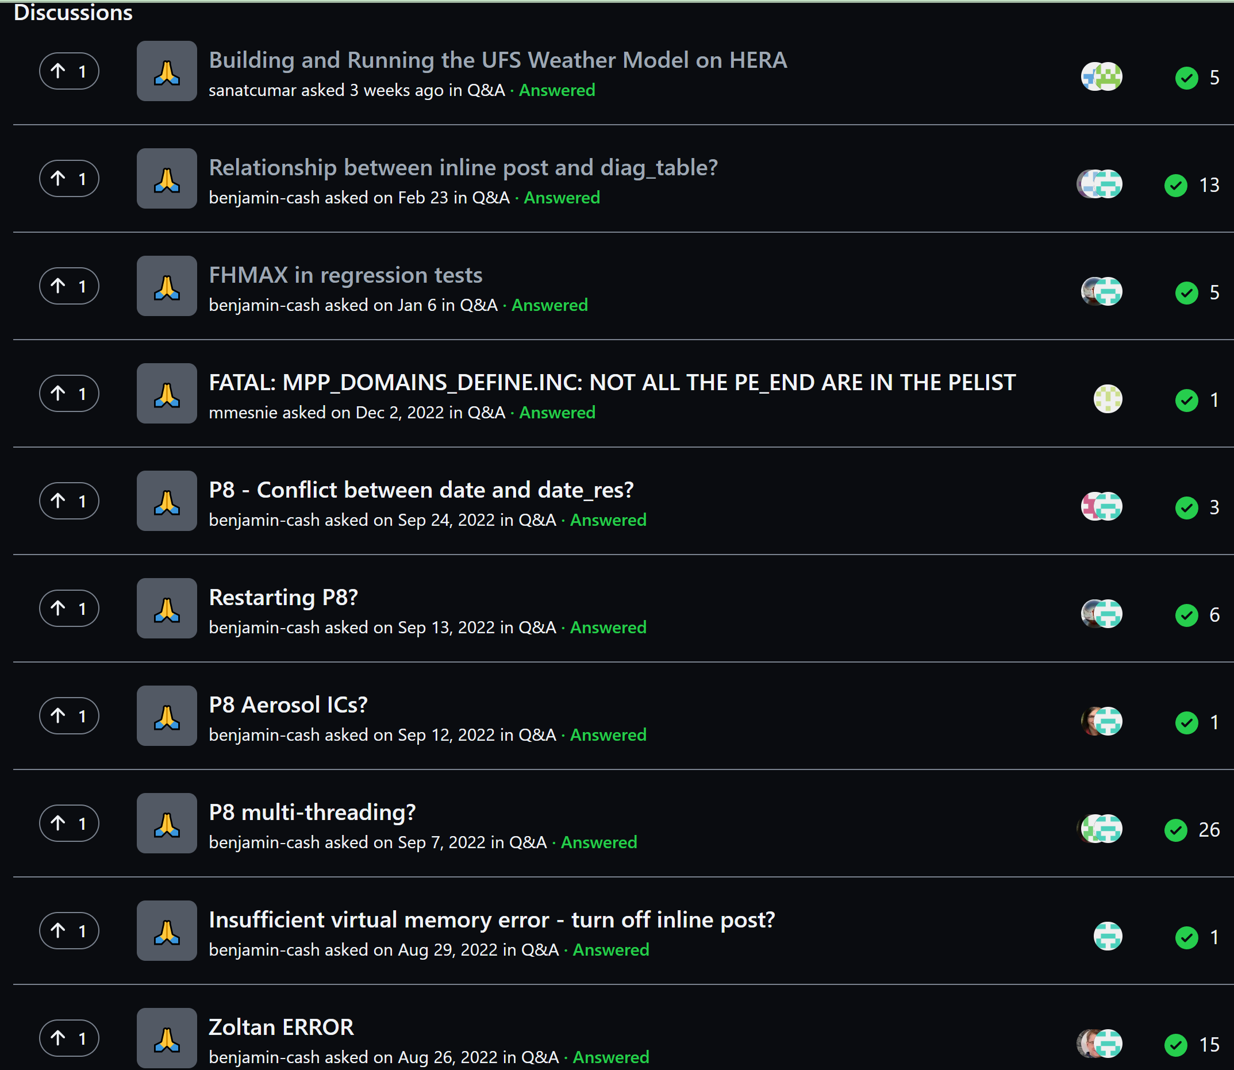
User Support
Provide demos and trainings
Answer user questions on UFS forums and issues
How to acquire data
Building and running applications
Questions about the model, components, etc
FAQ

Slide 16
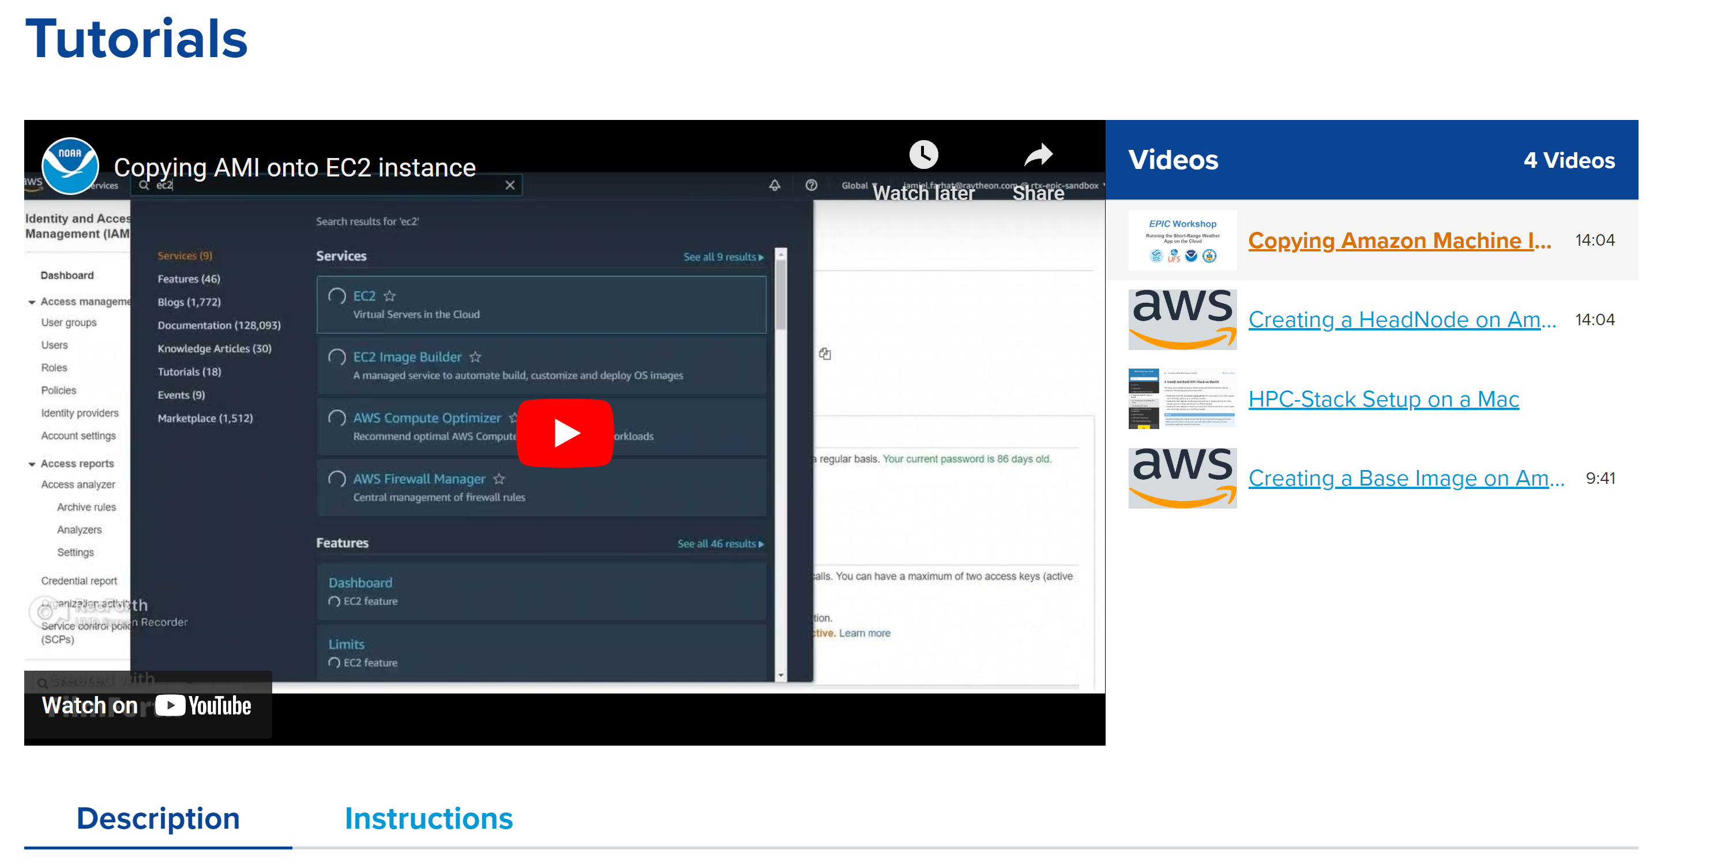
User Support
Provide demos and trainings
Answer user questions on UFS forums and issues
Video tutorials (epic.noaa.gov/tutorials)
Released quarterly
Useful topics for new and existing users/developers

Slide 17
Documentation
Every update modifies features
Guides, walkthroughs, requirements are living documents
Building, running
Contributing
Reviewing
User feedback also leads to documentation updates
EPIC tech writers collaborate with developers to keep these documents alive and well!

Slide 18
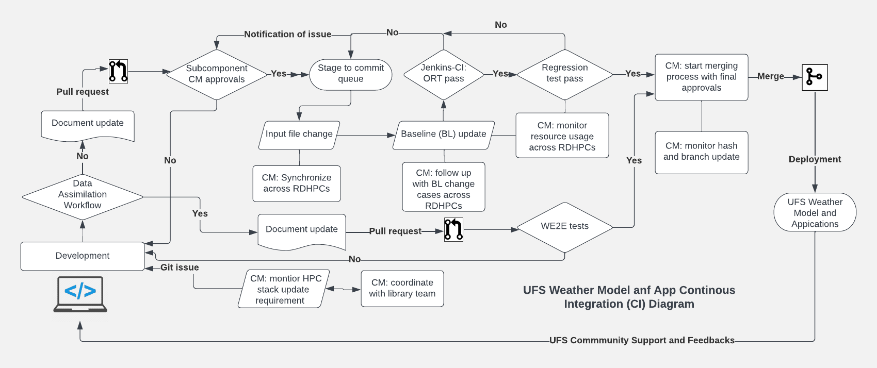
UFS Code Change Integration Process
Configuration Management

Slide 19
UFS Code Change Integration Process
Configuration Management
Ensure code integration and porting to supported
Platforms of UFS WM and Apps consistent with
subcomponents
Review and track the PRs daily, identify issues and
Conflicts, work with developers
Ensure the testing framework reflects the latest
development and code changes
Improve the testing framework to efficiently run
baseline regression and workflow End-to-End (WE2E) tests
Standardize DevOps implementation and optimize code
Management strategy
Build and test pipelines and data management tools
Develop/maintain Docker images and AMIs

Slide 20
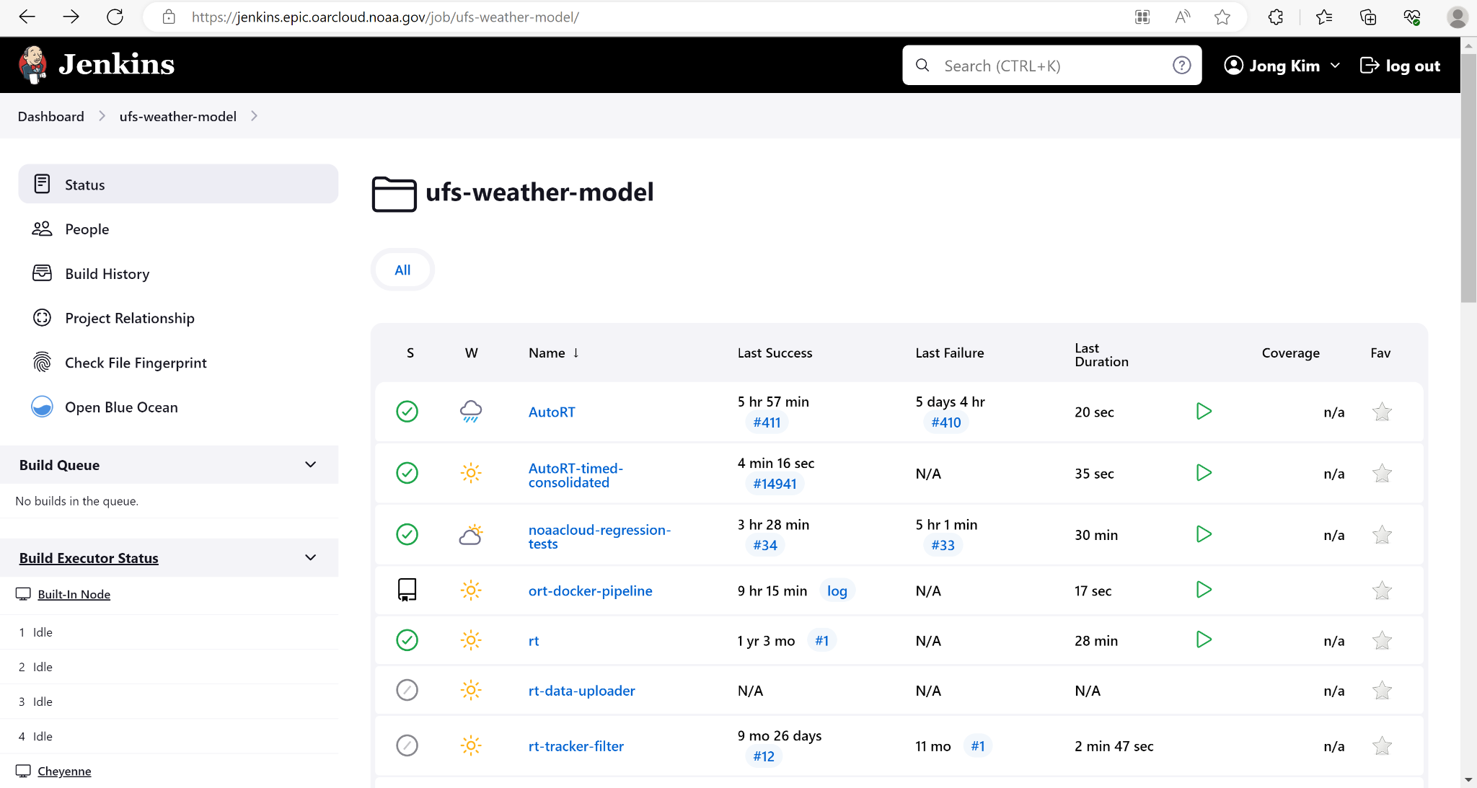
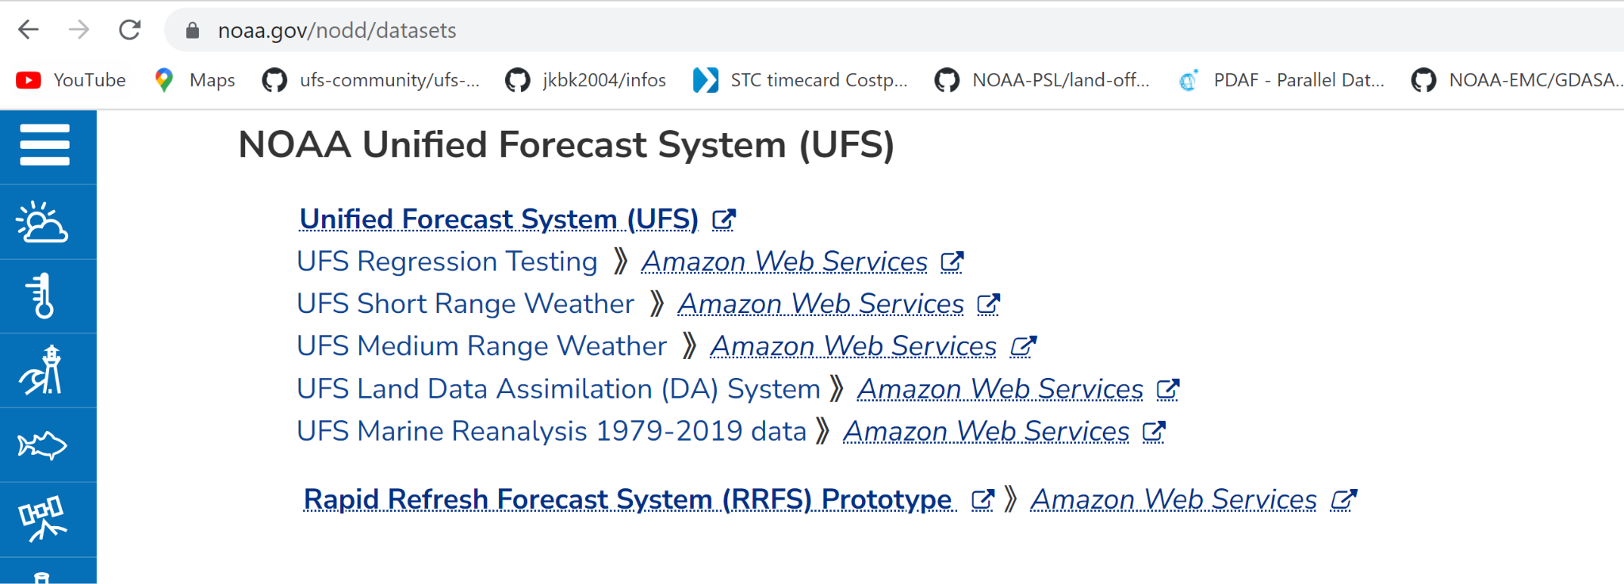
Jenkins Pipelines to support UFS-WM, SRW, and Land DA
EARTH PREDICTION INNOVATION CENTER (EPIC)
Configuration Management
Regression and workflow end-to-end tests across NOAA RDHPCS and Cloud Platforms
Implemented through Docker and Singularity container approaches
Cloud data service through NOAA Open Data Dissemination (NODD) to support UFS baseline tests and case studies

Slide 21
Community Outreach
Social Media
Twitter (@noaaepic)
Facebook (facebook.com/NOAAEPIC)
Instagram (@noaaepic)
Conferences
UIFCW
AGU
AMS
Website
epic.noaa.gov
epic.noaa.gov/contact-epic
Please take the Release Survey!

