Slide 1
UIFCW 2023: Opening Remarks
Dr. Dorothy Koch
NOAA OAR Weather Program Office Director
NOAA Modeling Team Chair
July 24, 2023

Slide 2
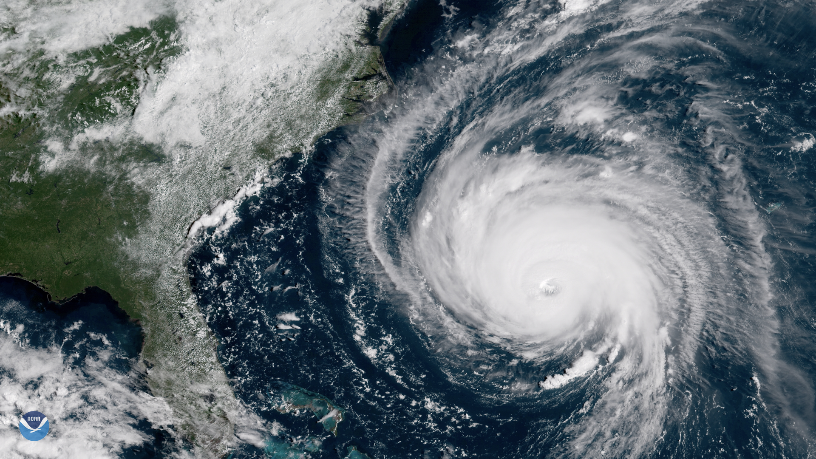
Highlights
UFS implementations
HAFS v1 in operations!
FY23 Weather Program Office (WPO) Innovation Funding Opportunity ($7M)
Award announcement coming later this summer
More than 90% of projects directly involve the UFS!
EPIC: UFS public releases
UFS Land Data Assimilation System v1.0 and v1.1
UFS Short-Range Weather (SRW) App v2.0 and v2.1
Upcoming: SRW3.0 (fall), UFS Hurricane App (TBD)
EPIC: Community Engagement
WPO Innovation for Next Generation Scientists Dissertation (WINGS) Fellowship
The 2nd Unified Innovation in Forecasting Capabilities Workshop
Quarterly UFS App Training and CodeFests
NOAA-Microsoft CRADA
Alekya Srinivasan
First (EPIC) UFS Student Ambassador
5
Notes:
SRW in the fall
Hurricane - unclear

Slide 3
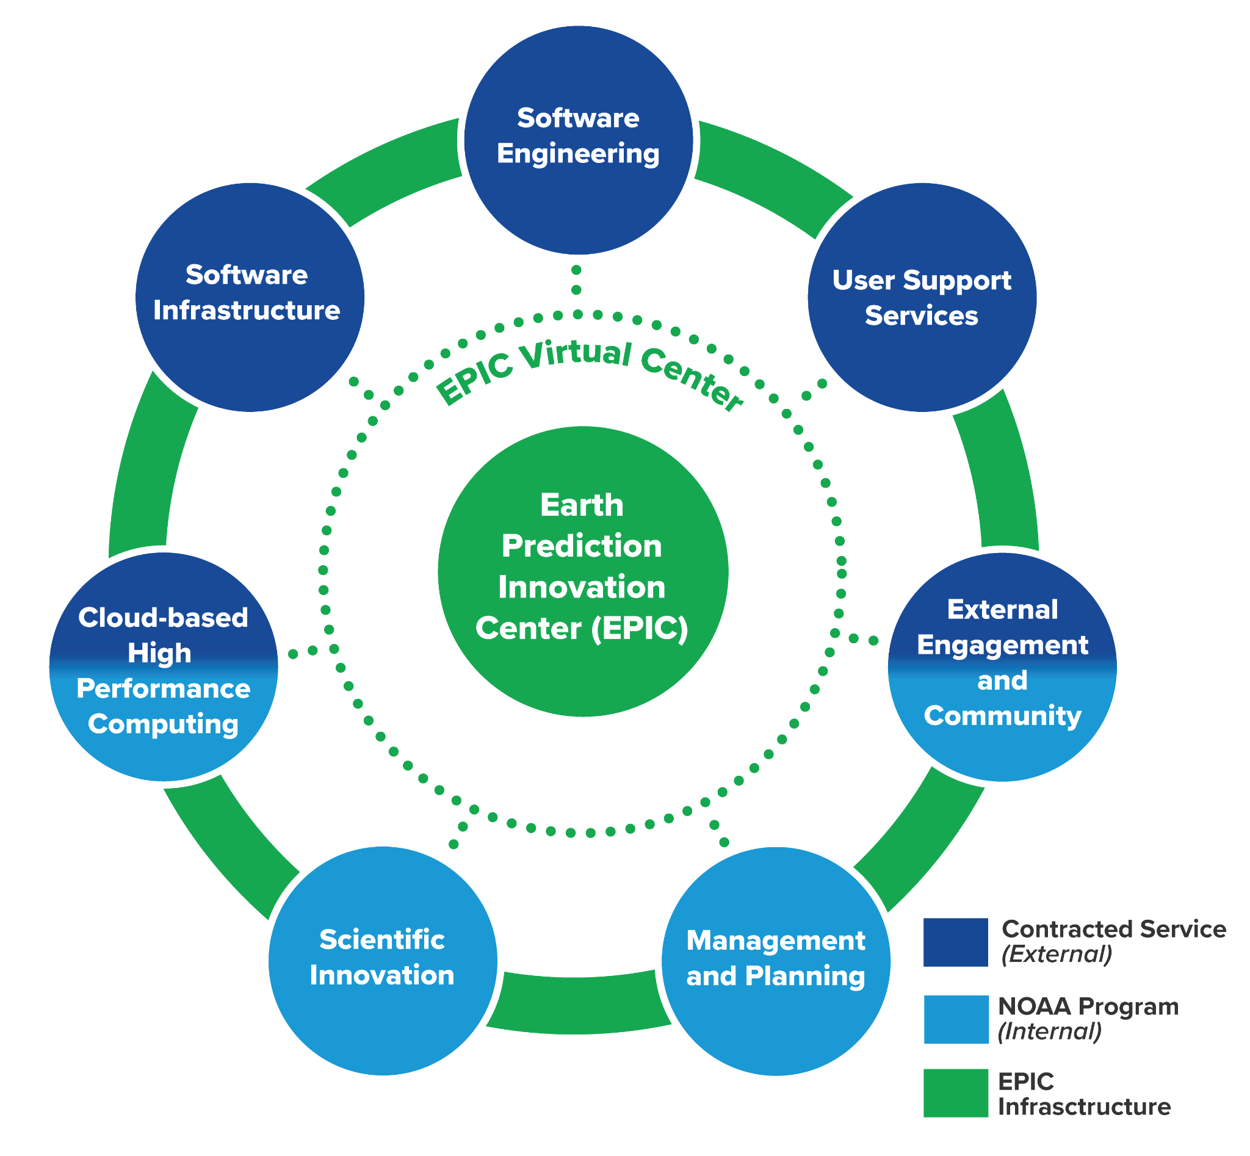
Program Highlights
EPIC UFS Infrastructure Development (EPIC.NOAA.gov)
Continuous Integration Continuous Delivery (CI/CD) on Tier-1 platforms and three CSPs for the UFS Weather Model and the UFS SRW App
Hierarchical Testing Framework (HTF) for efficient model development
Open-source Cloud Infrastructure as Code: create and run UFS Apps
Unified software stack for UFS and JEDI (Spack-stack, collaboration between EMC JCSDA and EPIC)
New UFS Modeling activities: Supplemental Projects (DRSA)
Hurricanes: HAFS v2 (HFIP team, e.g. Gopol)
Precipitation improvement: UFS and GFDL models (Huang)
Scientific validation
Integration Tests
Component Tests
Unit Tests
5
Notes:
Highlights in Year 2

Slide 4
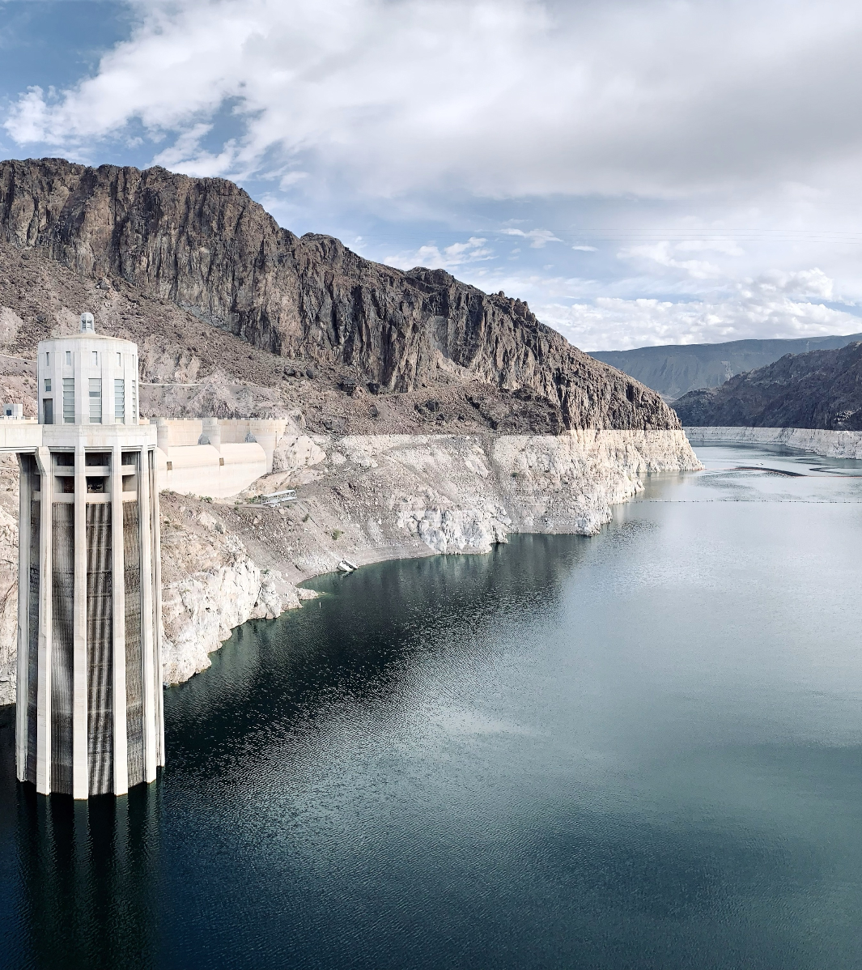
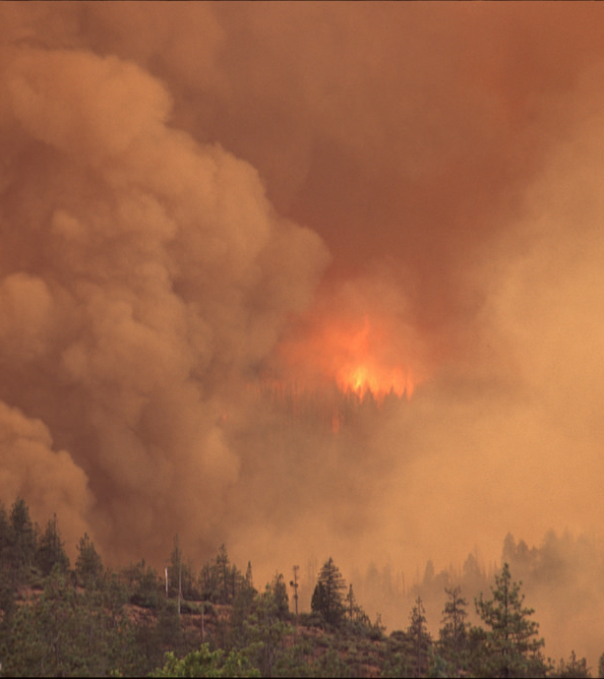
NOAA (new) UFS Modeling Initiatives
S2S (Carman (remote); Garrett; Xue)
FY23 appropriation (NWS/OAR) to develop the UFS SFS and establish the NOAA S2S Program. Includes SFS-based Climate Testbed (CPC/EMC/PSL); includes a focus on (western) precipitation S2S forecasting
Workshops to develop the S2S Program: 1. NOAA-focus (9/23); 2. Community (winter 2023-24)
AMS 2024 S2S sessions: Part 1: Stakeholder needs and priorities; Part 2: Predictions and predictability; Part 3: S2S Model developments and innovations
Atmospheric River (AR) Forecast system (Alexander, Tallapragada, Webb, Huang)
Water in the West appropriation (FY23) is developing a UFS-AR model with high-resolution over the Pacific/Western-CONUS embedded in global model. Test, with other models, against winter 2022-23 events. (Alexander, Tallapragada)
Fireweather program (FY23 appropriation; BIL, DRSA Supplemental)
Includes modeling (RRFS fireweather, smoke modeling), research, testbed
OAR Laboratory (GSL, PSL, ARL) and WPO grants program (Research/modeling and testbed)
5

Slide 5
NOAA Modeling Team (NMT)
Team under NOAA’s Earth System Integration Board (ESIB) coordinating modeling across NOAA (NWS, OAR, NESDIS, NOS, NMFS). Koch and Gross are current chairs.
NOAA modeling spans NWP, climate, coastal, operational ocean, fishery, genomics
NMT activities include:
Modeling Strategy Working Group is developing two 10-year Strategies
NOAA Modeling Strategy (Tolman)
NOAA Data Assimilation Strategy (Garrett)
Enabling Observations into Models Working Group: Improve use of data in models, anticipate needs for future products and observations to improve forecast model predictions
Operational Ocean Forecasting Working Group: Coordinate ocean/coastal modeling and infrastructure across NOAA
Possible future new groups include:
UFS coordination and oversight (for NOAA investments)
Advanced HPC
5

Slide 6
Community topics
What support and UFS engagement is most important to the community?
It will be helpful to know where to focus our support.
Developer (and how deep?)
Data assimilation (will JEDI work for your needs?)
Post-processing and product development
Test/evaluate (against what?)
User (for research)
How open does the code need to be for the community purposes?
(2024 AMS Town Hall submitted on this topic)
Operational code, initialized in real-time?, Well-vetted “released” code, Developing code?
NCAR
NOAA/UFS and NSF/NCAR are discussing stronger partnership on community modeling. Focus is on infrastructure (workflow, coupling, post-processing) and workshops are ongoing.
NASA
GEOS and UFS have many commonalities. NASA and NOAA have a collaborative project to share data needed for S2S model initialization (Frolov)
5

Slide 7
Challenges - To work on this week!
UFS governance
Navigating the government/non-government roles and responsibilities in the UFS
Code governance (Jacobs, Tolman, Huang)
Need for enforcement of CI/CD development practices
Designation and maintenance of official repository that will be provided/released to the community
Commitment of NOAA Labs and EMC to contribute to the official repository in order to avoid divergence of research/release and operational versions of UFS
EPIC (with the CCT’s) will be drafting a UFS Code Governance Plan, to be approved by UFS Leadership, NOAA Leadership
Data Assimilation (Whitaker, Kleist, Alexander, Huang)
Getting JEDI into UFS community releases, will take months-years. Should we continue to release codes without data assimilation?
Testbeds
Role of NOAA testbeds for testing and evaluation of the UFS
5

Slide 8
THANK YOU
wpo.noaa.gov
@NOAA_WPO
Department of Commerce // National Oceanic and Atmospheric Administration
Notes:
THANK YOU!

Slide 9
EPIC Contract Highlights
A Continuous Integration Continuous Delivery (CI/CD) for the UFS Weather Model and the UFS SRW App, ensures efficient and reliable development and deployment processes.
EPIC’s CI/CD pipeline allows the community to simultaneously test the UFS on all Tier-1 systems and three major CSP's, reducing the risk of deployment issues and improving software quality.
The roll out of a fully-functional EPIC Community Portal (ECP) supports externalizing innovation, allowing community members to access technical content, fostering collaboration, knowledge sharing, and ideation without barriers.
Daily content updates enhance accessibility, ensuring regular updates of technical content, fostering engagement and timely information sharing.
EPIC is developing with the community a Hierarchical Testing Framework (HTF) outcome that engages everyone by adding tests at all levels,
EPIC’s testing framework enhances the development process speed and efficiency while minimizing resource consumption.
The availability of community Infrastructure as Code allows to easily create and run UFS Apps.
IaC anables community members to effortlessly develop and run applications on any Cloud Service Provider (CSP), promoting flexibility and scalability.
EPIC and the community are successfully collaborating to increase pull-request (PR) cadence, enabling application teams to release updates more frequently,
Reduces technical overhead and implementation constraints, ultimately improving development velocity.
5

