Slide 1
Integrating Social and Physical Sciences at the National Weather Service to Understand the Ready in Weather-Ready Nation
Leticia Williams, Ph.D. & Valerie Were, Ph.D.
Social, Behavioral, and Economic Sciences (SBES) Program
Office of Science & Technology Integration (OSTI)
National Weather Service (NWS)
July 26, 2023

Slide 2
Overview
Introduction to Social Science
Program Direction & Goals
Current & Future Projects
Next Steps for Integration

Slide 3

What is Social Science?

Slide 4
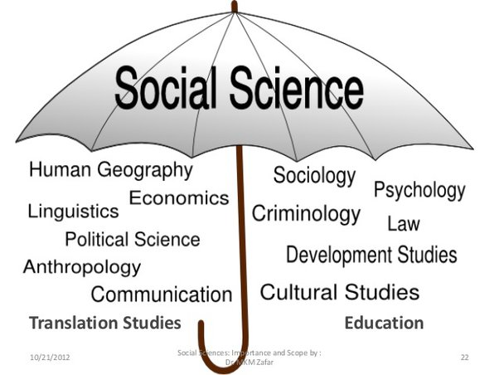
Social Science Defined
What is social science?

Slide 5
Social Science Value
Studies people, societies, and the relationships among them
Helps us make better decisions to improve our quality of life
Includes multiple disciplines (e.g. anthropology, economics, human geography, linguistics, communication sciences, political science)
Employs quantitative and qualitative methods
Credit: Slidesgo and Freepik

Slide 6
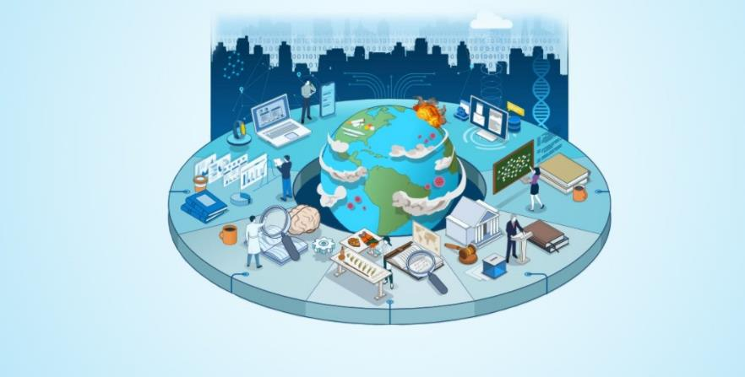
Social Science Methods

Slide 7

NWS OSTI SBES Program Direction
Vision Statement:
Turning weather, water, and climate information into social action
Mission Statement:
Making the National Weather Service better through social science

Slide 8
NWS OSTI SBES Program Goals
Goals:
Advance the Science: Conduct innovative research on the links among humans, weather, water, and climate.
Build SBES Capacity: Grow the utility of SBES to the NWS.
Collaborate Internally: Improve processes and promote better application of SBES.
Engage Externally: Leverage expertise and establish best practices to advance service equity.
Core Values: R⁶
Rigor
Relevance
Respect
Relationships
Revolutionary
Responsive

Slide 9




Research Priorities
Ensuring Equitable Services
to all Communities
Understand Place
Communicate Risk
Evaluate Products
Assess Impact
Examining the convergence of society, space, and weather | Refining tools and messages to communicate risk and uncertainty | Improving products and services for all partners, including the public | Developing measures and studying the outcomes of weather

Slide 10

Questions

Slide 11

How to integrate social science into the weather enterprise?

Slide 12


Current Projects
Understanding the Human Response to Water Hazard Products (BIL Prov.3) | ֎ | ֎ | ֎ | ֎
Understanding the Human Response to Fire Weather Products (BIL Prov.5) | ֎ | ֎ | ֎ | ֎
Supporting the Improvement of Tsunami Warning Messages |  | ֎ | ֎
Opportunities for WCMs to Support Service Equity and Use of Weather and Hydrologic Data Products | ֎ |  | ֎
Collaborative Science, Technology, and Applied Research (CSTAR) Program 2022 Projects | ֎
Supporting the Improvement of Winter Weather Products |  | ֎ | ֎
Space Weather Advisory Group User Needs Support |  |  | ֎
Notes:
Add Cstar Projects

Slide 13
Current Projects
Supporting the Improvement of Severe Weather Products |  | ֎ | ֎
Statistically Exploring the Relationship between Social Vulnerability and Tornado Warning Reception, Comprehension, and Response | ֎ |  |  | ֎
Using Colormaps to Communicate Risk |  | ֎ | ֎
Supporting the Evolution of the Weather Dashboard |  |  |  | ֎
Analysis for Probabilistic and Risk Reduction Decision Support for Fire Weather Services |  | ֎ | ֎
Literature Review of Prior NWS Funded Research Projects |  | ֎ | ֎
Testing the Waters: Using Social Science Methods to Incorporate Stakeholder Needs to Co-Develop WPC precipitation Products and Services |  |  | ֎
Societal Data Insights Initiative |  |  |  | ֎
Notes:
Back- STI Funded
Blue- other funded

Slide 14
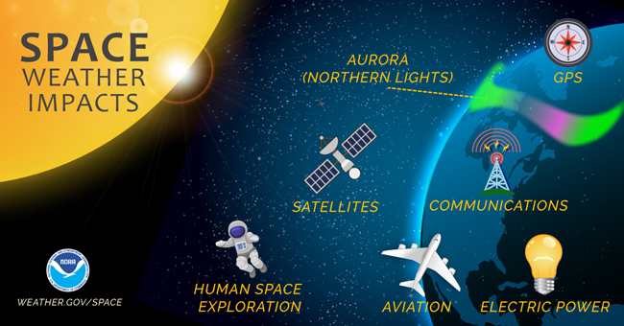
Space Weather Advisory Group User Needs Survey

Slide 15
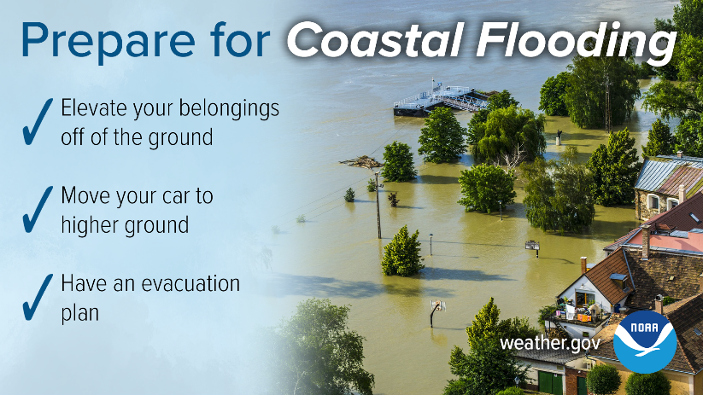
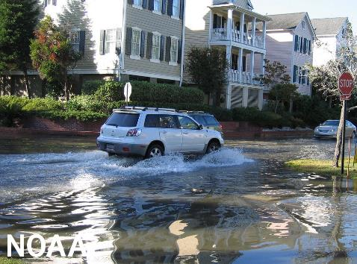
Understanding the Human Response to Water Hazard Products

Slide 16
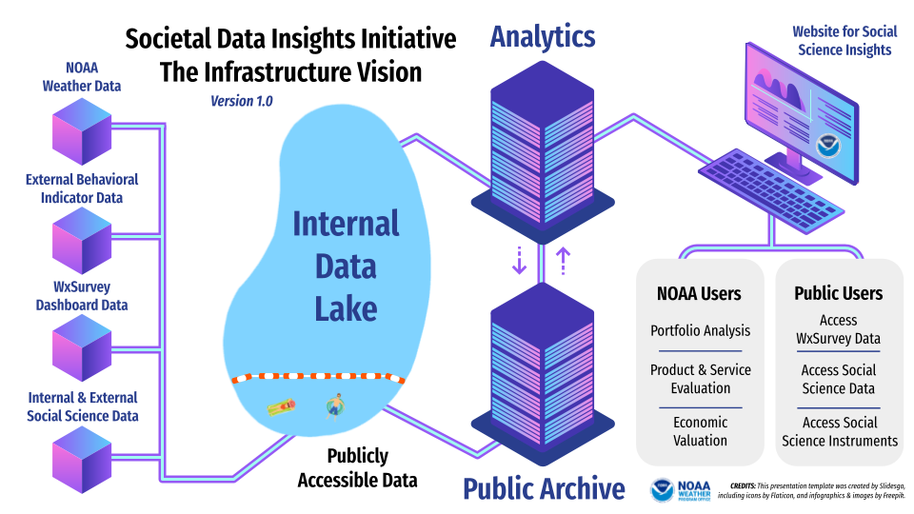
Societal Data Insights Initiative

Slide 17
Potential Future Projects
Conduct Social Network Analysis of Selected Communities and Hazards | ֎ |  |  | ֎
Conduct Case Studies of Specific Weather Hazards and Communities | ֎ | ֎ | ֎ | ֎
Conduct an assessment of existing NWS databases including the Storm Events, Damage Assessment Tool, NOESS, etc. | ֎ | ֎ | ֎ | ֎
Depict Risk and Severity Across Weather Hazards Consistently |  | ֎ | ֎
Develop Culturally Diverse Products and Services in Multiple Languages | ֎ | ֎ | ֎
Improve Forecast Literacy Among the Public | ֎ | ֎ | ֎ | ֎
Quantify and Understand the impacts of weather and NWS investments on communities | ֎ |  |  | ֎

Slide 18
Potential Future Projects
Understand the impacts of NWS Products and Services to Mitigate the Impacts of Weather | ֎ | ֎ | ֎ | ֎
Support Local WFOs and CSCs in Conducting SBES Research | ֎ | ֎ | ֎ | ֎
Develop a systematic processes for gathering SBES requirements, designing research, and transitioning research into operations |  | ֎ | ֎
Craft Achievable Metrics to Fulfill the NWS Mission | ֎ | ֎ | ֎ | ֎
Review the Product Development Process to Better Integrate SBES |  | ֎ | ֎
Design an Evaluation Framework to Align Assessments and Case Studies to Identify Best Practices and Challenges | ֎ | ֎ | ֎ | ֎
Integrate/Develop a SBES Testbed for the NWS |  |  | ֎
Notes:
Orange- External Projects
Purple- Internal Projects

Slide 19
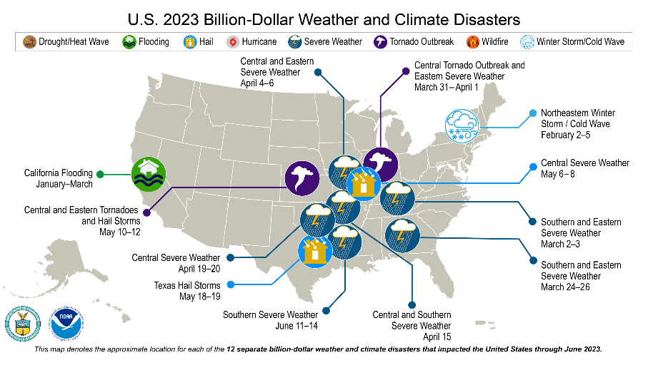
Assessment of Existing NWS databases including the Storm Events, Damage Assessment Tool, NOESS, etc.

Slide 20
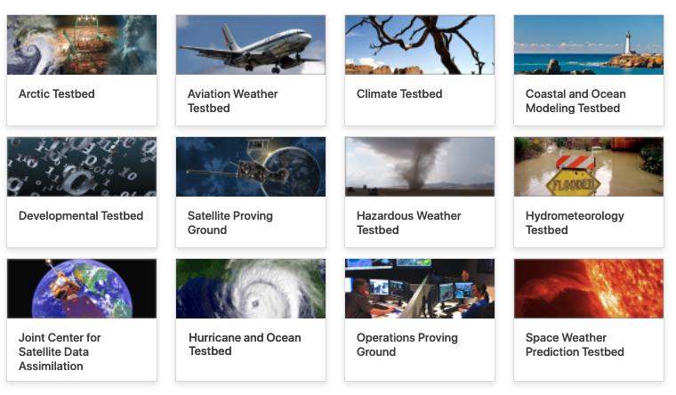
SBES Testbed for the NWS (or integrate into others)

Slide 21
Thank You!
Leticia Williams, Ph.D.
leticia.williams@noaa.gov
Valerie Were, Ph.D.
valerie.l.were@noaa.gov

Slide 22
Questions

