Slide 1
NWS:The Last Critical Mile Agenda
Unifying Innovations in Forecasting Capabilities Workshop
July 24, 2023
Dr. Stephan Smith,
Director, NWS Office of Science and Technology Integration

Slide 2
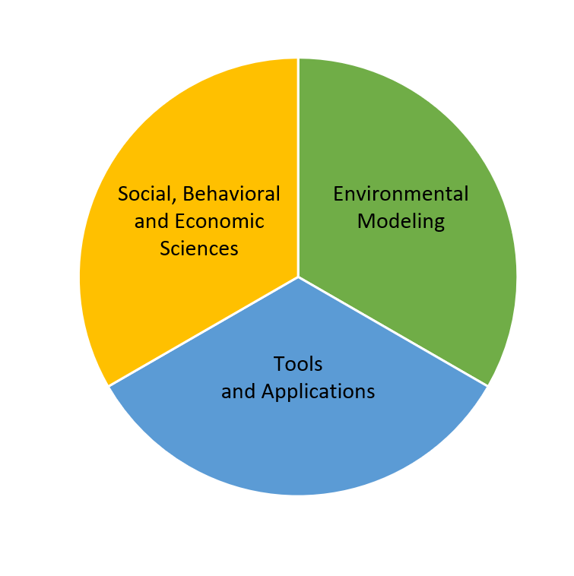
NWS Mission: Provide weather, water, and climate data, forecasts, warnings and Impact-based Decision Support Services (IDSS) for the protection of life and property and enhancement of the national economy.

Slide 3
The Last Critical Mile of Our Mission
NWS must transform the manner in which we provide our forecasts, warnings and IDSS by focusing on operational service delivery infrastructure and the Last Critical Mile of our mission to address the following: (a) adopting a robust, reliable, and Community-centric paradigm for dissemination of life-saving information, (b) exploiting cloud technology solutions to enable our workforce to become mobile, nimble, and flexible inside emergency operations centers in communities we serve, and (c) investing in the last critical mile and providing equitable services that account for the changing demographics of society and the unique vulnerabilities of each community we serve.

Slide 4
The Last Critical Mile of Our Mission (cont.)
The need for onsite service delivery and decision support is driven by NWS partners in the field, who rely on our ability to provide critical, life-saving information, not only for the billion-dollar disasters but also for day-to-day weather events. NWS is focused on establishing a Whole-Community engagement approach for education and outreach by applying social and behavioral science to save more lives and fully realize the vision for a Weather/Water/Climate-Ready Nation.

Slide 5
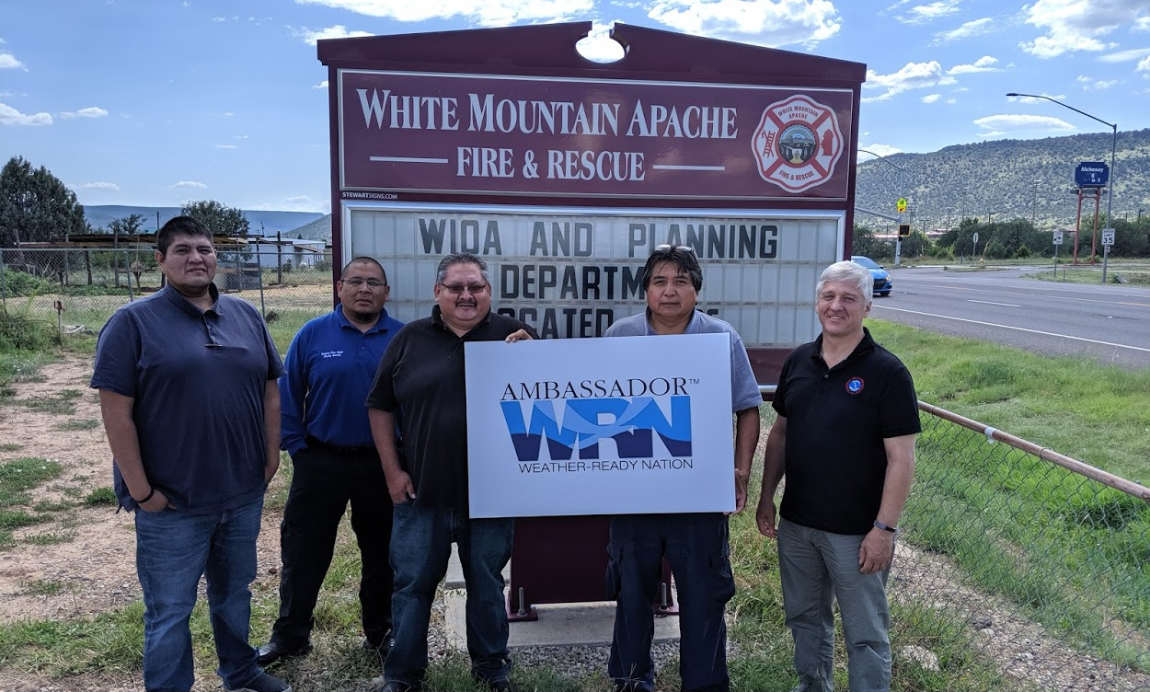
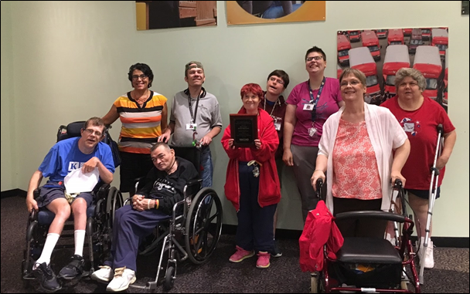
Equitable Services for a Weather-Ready Nation “Building a Weather-Ready Nation, One Community at a Time”
Service
Equity
Gaps
“One-Size” Services 🠞 Unequal Outcomes
Equitable Services 🠞 Equality of Outcomes

Slide 6
CORE ASSUMPTIONS:
People can receive the warning
People can understand the warning
People can act upon the warning
People are able and willing to evacuate
People have a safe shelter
Transforming Services from (One-Size-Fits-All)
HAZARDOUS WEATHER & FLOOD PROTECTION MATRIX
SHELTER
IN PLACE
WINTER STORM
TORNADO
CALL TO ACTION
HURRICANE
RIVER FLOOD
WILDFIRE
FLASH FLOOD
EVACUATE
LONG LEAD TIME
(Hrs-Days)
SHORT LEAD TIME
(Min)
WARNING TYPE

Slide 7
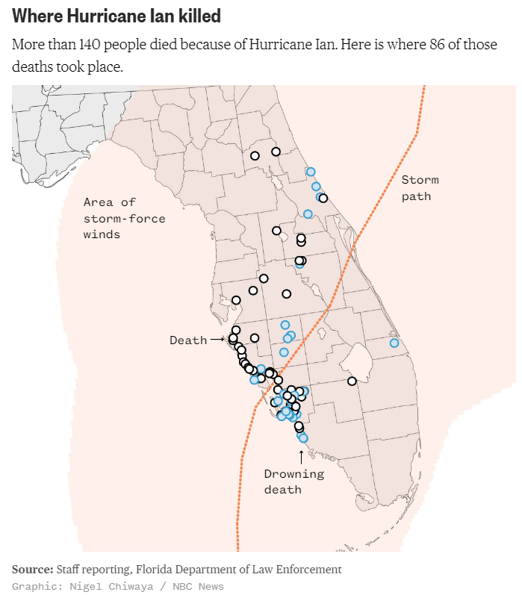
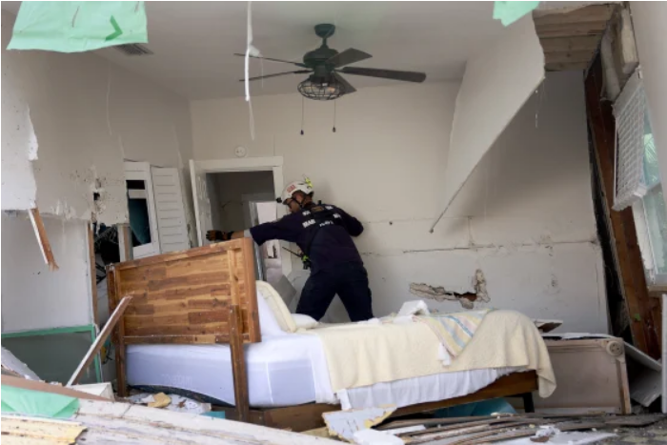
Delivering Our Services Equitably is Core to the NWS Mission

Slide 8
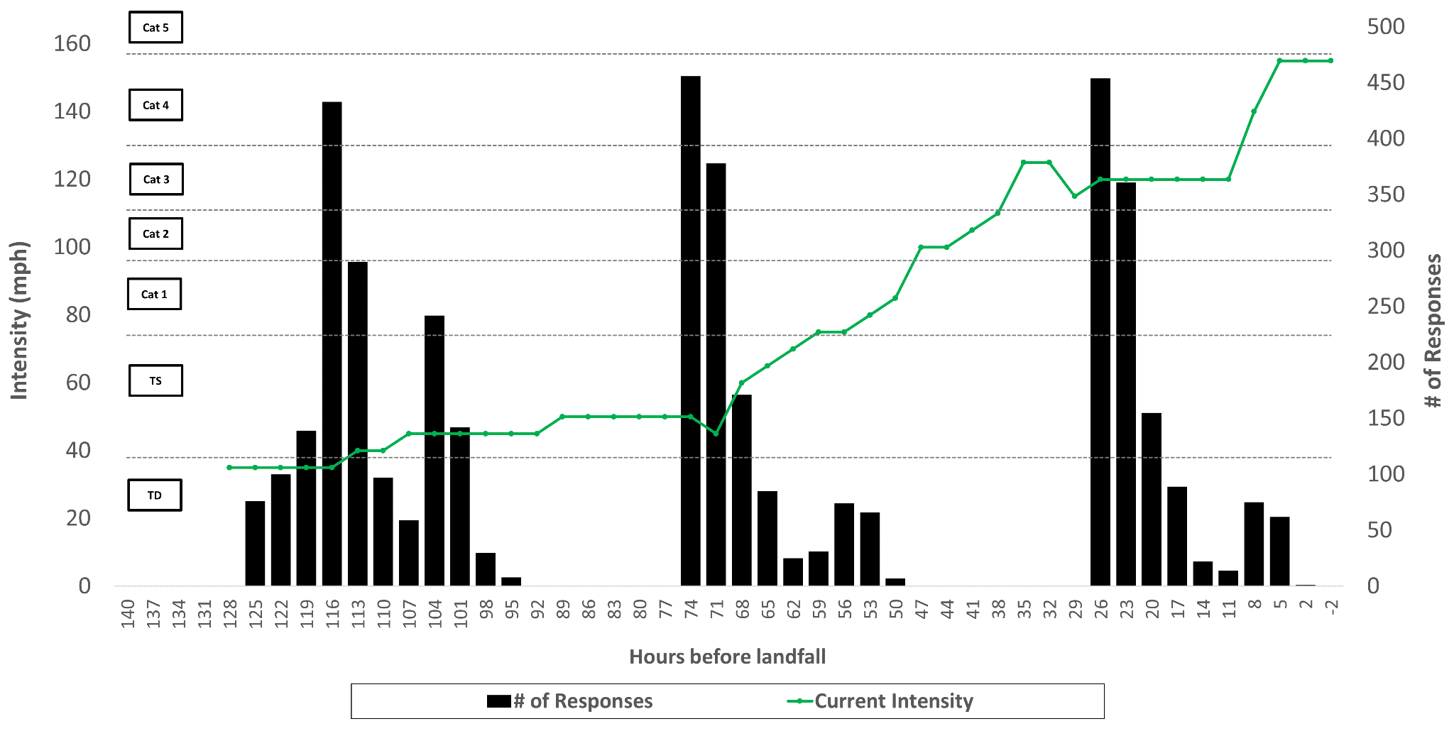
Timeline of survey waves for Ian (2022)
Survey Wave 1
Survey Wave 2
Survey Wave 3
9a ET Sep 23 (Fri) –
4p ET Sep 24 (Sat)
12p ET Sep 25 (Sun) - 12p ET Sep 26 (Mon)
12p ET Sep 27 (Tue) - 12p ET Sep 28 (Wed)
# of survey respondents in 3-hourly bins
current storm intensity

Slide 9
2 exposure levels: Exposed vs. not
Wave 1 survey
9a ET Sept 23 (Fri) - 4p ET Sept 24 (Sat)
Wave 2 survey
n(exposed) = 788
n(not exposed) = 826
12p ET Sept 25 (Sun) - 12p ET Sept 26 (Sun)
Wave 3 survey
n(exposed) = 743
n(not exposed) = 548
12p ET Sept 27 (Tues) - 12p ET Sept 28 (Wed)
n(exposed) = 1003
n(not exposed) = 230
TS = tropical storm
WSP = wind speed probability

Slide 10
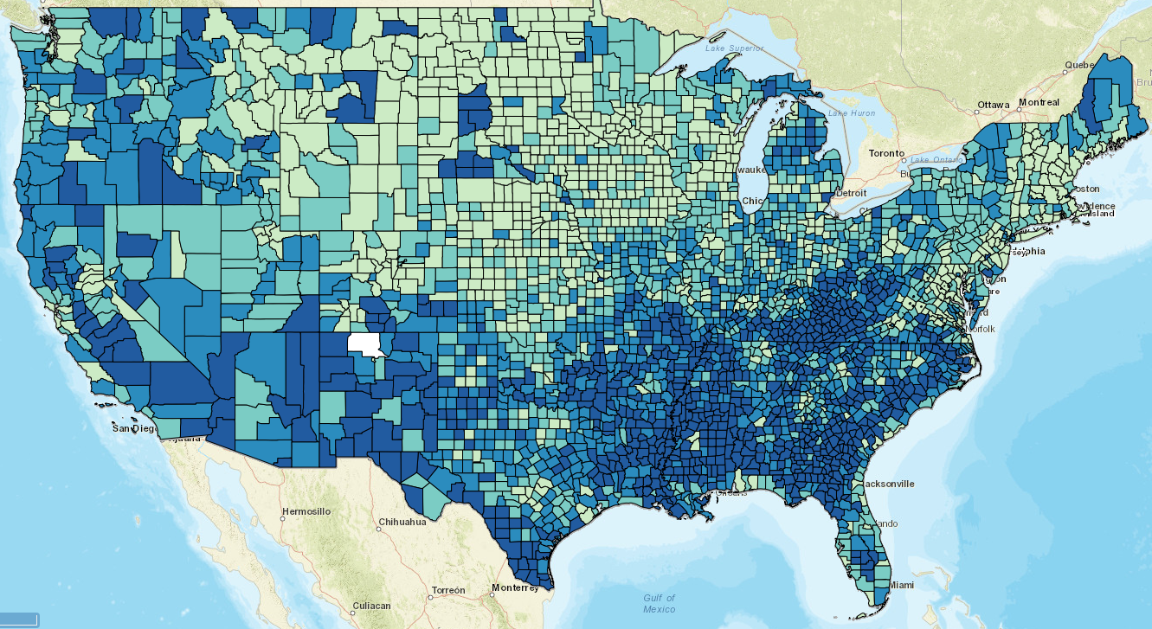
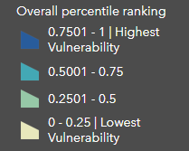
CDC Social Vulnerability Index
$104M excess damage
and 40 fatalities
annually (VSL $458M)

Slide 11
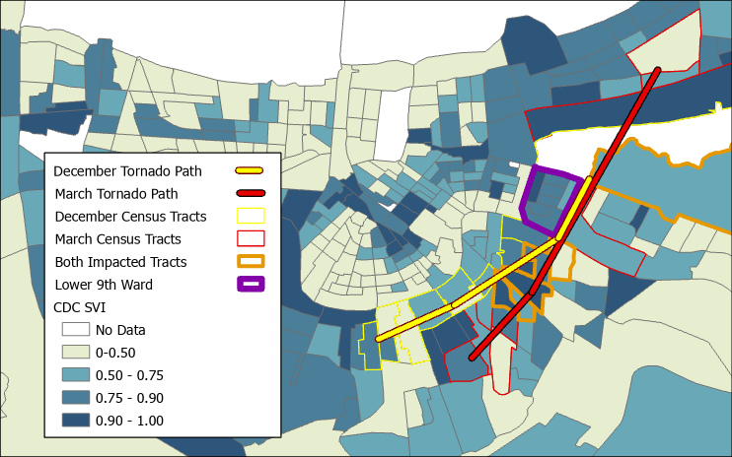
Case Study: Arabi, LA Tornadoes
March 22 and December 14, 2022
New Orleans, LA Metro Area

Slide 12
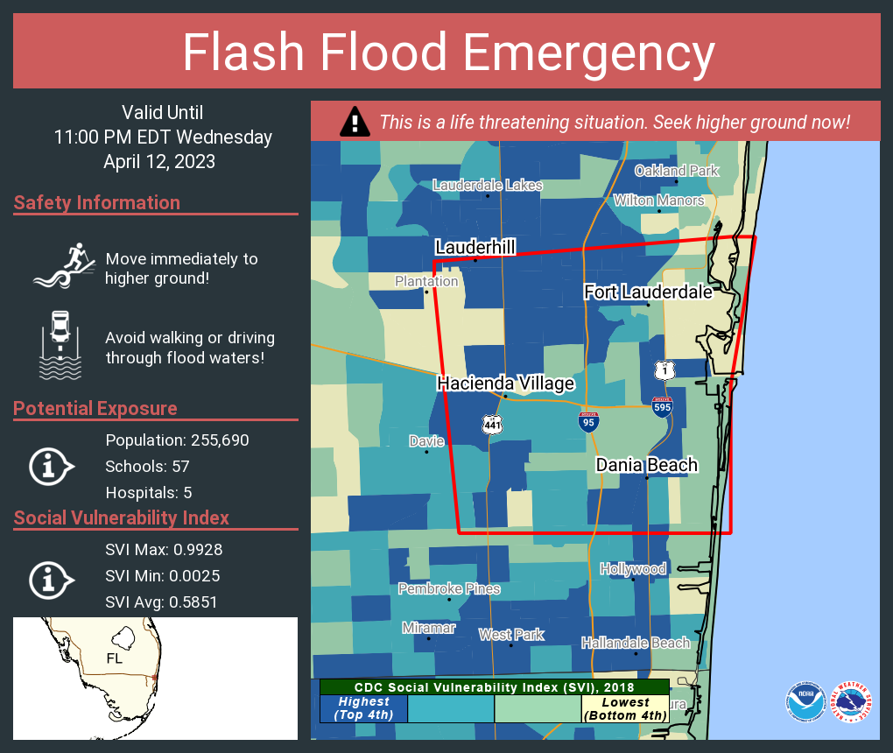
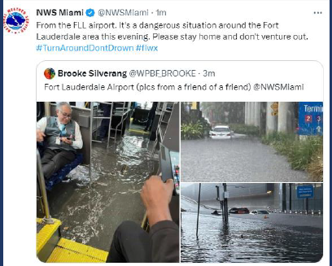
National

Slide 14
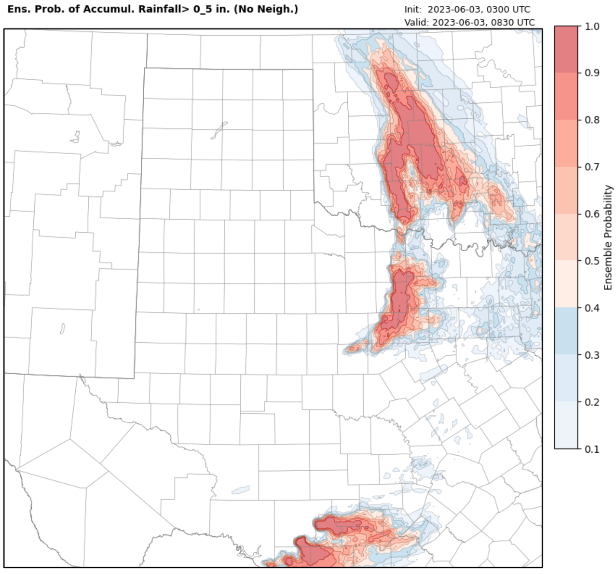
NSSL Warn on Forecast System (WoFS) ENSEMBLE:
Event-driven, hyper-local, modeling
for tactical, probabilistic IDSS
in the Last Critical Mile/Hour

