Slide 1
UIFCW 2023: Roundtable
Dr. John Ten Hoeve
Deputy Director
NOAA OAR Weather Program Office
July 26, 2023
Notes:
Good morning everyone. My name is John Ten Hoeve and I am the deputy director in the weather program office. Today I’ll be facilitating this roundtable discussion over the next few hours until the lunch break. This session is somewhat patterned after the reach to operations nexus events at AMS or NWA, where individuals with different experiences and positions across government, academia, and private industry come together to discuss difficult challenges in the field. So even if you didn’t have a talk or poster this week, and even if you did, this is your opportunity to contribute and share ideas and have your voice heard.
Cari, Aaron, Jen, Jessica, and Kelvin

Slide 2
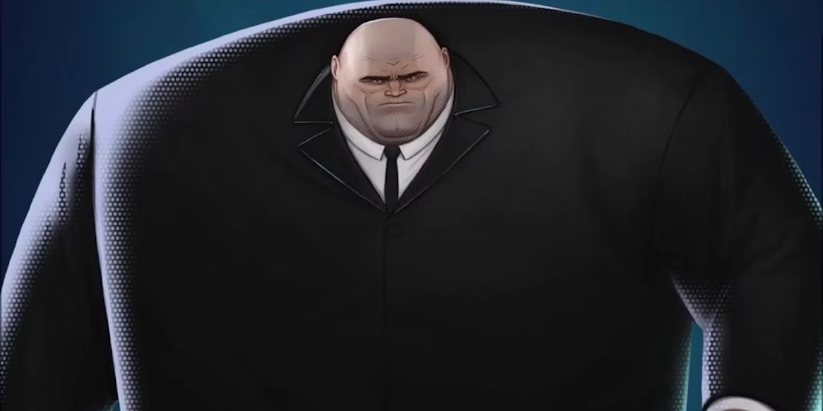
Roundtable Goals and Outcomes
Goal: Leverage the diverse perspectives and experiences of workshop attendees to tackle 6 challenging topics in community modeling (wisdom of the crowds)
Intended Outcomes of the Session:
Networking - get to know your colleagues in the room
Get as many ideas on the table as possible
Community earth system modeling
5
Notes:
But this morning we want to use the wisdom of the crowds principle where the collective opinion of a diverse independent group of individuals is greater rather than that of a single expert.
If in fact community earth system modeling is as tough as kingpin here, we need everyone’s help to be able to solve these challenging problems. We will be collecting the information from the moderators and report out later in the morning, along with what you write on your table paper here,, share them back with anyone who is interested, and then use them in future planning efforts within WPO and NOAA.

Slide 3
Questions for Discussion | Table Numbers
How can we diversify and incentivize participation across sectors, disciplines, and demographics in the UFS, including early career individuals? | 1 - 5
How can we overcome challenges with rapid code releases and various code management policies and practices across the UFS? | 6 - 9
How can the community better communicate the value of its code contributions and innovations? What metrics should we be using? | 10 - 13
How can we enhance knowledge transfer and collaboration across UFS contributors? What mechanisms should we use to accelerate R2O? | 14 - 17
What are the biggest science & engineering challenges we should be working on as a UFS community? | 18 - 21
What are the primary ways (use, develop, analyze, forecast/postprocess, validate/verify) you and your colleagues would like to work with the UFS? | 22 - 25
Community earth system modeling
5
Notes:
1. Had a good presentation and panel discussion on Monday where many of the challenges were highlighted, along with some potential ideas and solutions. What are some other ideas?
2. We talked yesterday about the organizational, cultural, funding, and trust issues associated with good code management practices, in addition to the challenges associated with trying to meet implementation deadlines. So how do we move past those challenges, because I think there seems to be some consensus that better adherence to code practices in this area would be beneficial for the community.
3. What does success look like and how do we talk about success? What are the key metrics we should use to talk about the value of the UFS framework? Is it just innovations? What about growing the community of users?
4. R2O process continues to be challenging for a number of reasons, and as we expand the community and bring in new members that are unfamiliar with how NOAA works, R2O may become more difficult before it becomes easier. So how do we enhance collaboration and knowledge transfer across the community to accelerate R2O?
5. What are the biggest science challenges we should be working on as a community. This question is a bit more straightforward, but just as important. We’ve identified some yesterday, particularly with respect to the RRFS, but there are other big science challenges out there across other applications as well. I would expand this to engineering and science challenges.
6. This last question is a bit different. What are the primary ways you and your colleagues would like to work with the UFS. This is a discussion around key priorities, which will help us in NOAA determine how we can best support the community. We may not have a perfectly representative sample of the full community here in the room, but we are curious where your interests lie.

Slide 4
Agenda
Time | Activity
9:30 AM | Pick a table associated with a topic you are interested in (but not yet!)
10:00 AM | Move to a different table with a different topic
10:25 AM | Move to yet another table with a third topic
10:50 AM | Break (moderators please discuss key themes with other moderators of the same topic for 10 minutes after we break)
11:30 AM | Brief report outs by moderators and open discussion
Community earth system modeling
5
Notes:
DON”T DO IT YET! I will keep everyone to this agenda and will let you know when to start.

Slide 5
Do’s and Don'ts
Do
Briefly introduce yourself at the beginning of each session
PARTICIPATE!
Write thoughts and ideas on the table paper
Build off others’ ideas
Bring forward your individual experiences and perspectives
Keep each comment to <1 min to let everyone at the table share
Don’t
Shoot down others’ ideas or comments (“yes, and”)
Stay with the same topic the entire time because it’s your favorite.
5
Notes:
SRW in the fall
Hurricane - unclear

Slide 6
Moderator Name | Question | Table No.
Claudia Womble | 1 | 1
Brian Gross | 4 | 14
Jennifer Vogt | 1 | 2
Tracy Fanara | 6 | 22
Tamara Battle | 1 | 3
Luke Peffers | 6 | 23
Fred Carr | 6 | 24
Dana Carlis | 5 | 18
Maoyi Huang | 2 | 6
Gillian Petro | 2 | 7
Hendrik Tolman | 1 | 4
Ligia Bernardet | 2 | 8
Dorothy Koch | 6 | 25
Moderator Name | Question | Table No.
Krishna Kumar | 3 | 10
Jessica Wheeler | 3 | 11
Vijay Tallapragada | 3 | 12
Henrique Alves | 1 | 6
Kevin Garrett | 4 | 15
Aaron Poyer | 4 | 16
Alekya Srinivasan | 4 | 17
Laura Dailey | 3 | 13
Gregory Frost | 5 | 19
Shawn Miller | 2 | 9
Christopher Spells | 5 | 20
Aaron Pratt | 5 | 21
5
Notes:
Thank all of the moderators ahead of time for volunteering. We have 25 tables in the room and planned for a total of 200 participants based on who registered. It looks like we don’t quite have that many, so if you find that there isn’t a sufficient number of people for each table, feel free to combine tables. It would be better to have full tables of 8 vs partially filled tables.

Slide 7
Questions | Table Numbers
How can we diversify and incentivize participation across sectors, disciplines, and demographics in the UFS, including early career individuals? | 1 - 5
How can we overcome challenges with rapid code releases and various code management policies and practices across the UFS? | 6 - 9
How can the community better communicate the value of its code contributions and innovations? What metrics should we be using? | 10 - 13
How can we enhance knowledge transfer and collaboration across UFS contributors? What mechanisms should we use to accelerate R2O? | 14 - 17
What are the biggest science & engineering challenges we should be working on as a UFS community? | 18 - 21
What are the primary ways (use, develop, analyze, forecast/postprocess, validate/verify) you and your colleagues would like to work with the UFS? | 22 - 25
Community earth system modeling
5

Slide 8
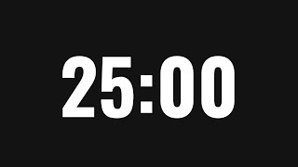
Ready to Go!
5
Notes:
SRW in the fall
Hurricane - unclear

Slide 9
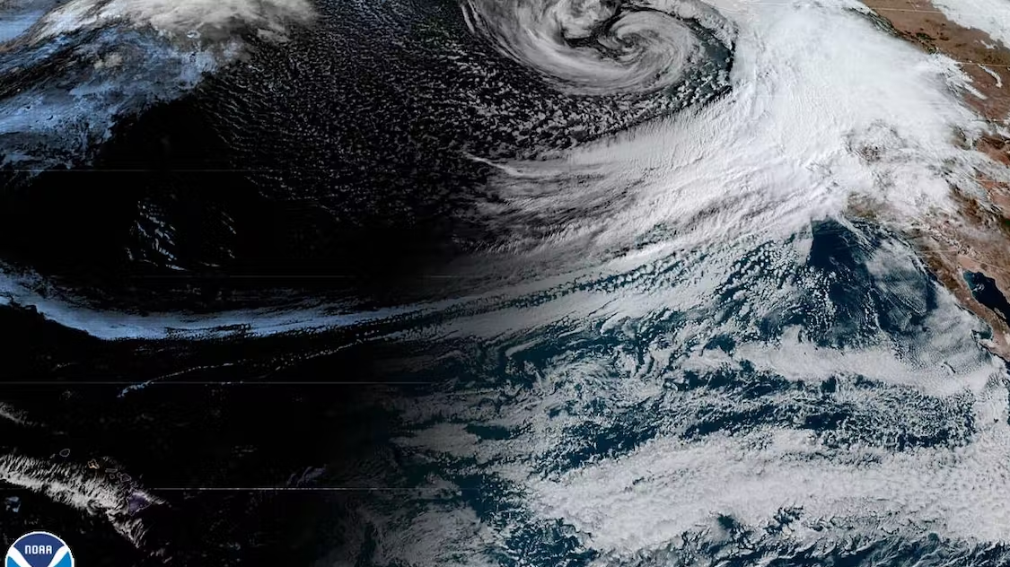
THANK YOU
wpo.noaa.gov
@NOAA_WPO
Department of Commerce // National Oceanic and Atmospheric Administration
Notes:
THANK YOU!

Slide 10
Moderator Email | Question No.
claudia.womble@noaa.gov | 1
brian.gross@noaa.gov | 4
jennifer.vogt@noaa.gov | 1
tracy.fanara@noaa.gov | 6
tamara.battle@noaa.gov | 1
luke.peffers@tomorrow.io | 6
fcarr@ou.edu | 6
dana.carlis@noaa.gov | 5
maoyi.huang@noaa.gov | 2
gillian.petro@noaa.gov | 2
Hendrik.Tolman@NOAA.gov | 1
ligia.bernardet@noaa.gov | 2
dorothy.koch@noaa.gov | 6
Moderator Email | Question No.
Krishna.Kumar@noaa.gov | 3
jessica.wheeler@noaa.gov | 3
vijay.tallapragada@noaa.gov | 3
henrique.alves@noaa.gov | 1
kevin.garrett@noaa.gov | 4
aaron.poyer@noaa.gov | 4
alekya.srinivasan@noaa.gov | 4
laura.dailey@noaa.gov | 3
gregory.j.frost@noaa.gov | 5
Shawn.W.Miller@rtx.com | 2
christopher.spells@noaa.gov | 5
aaron.pratt@noaa.gov | 5

