Slide 1
Unifying Innovations in Forecasting Capabilities Workshop
Opening Remarks
Dr. Michael C. Morgan
NOAA Assistant Secretary for Environmental Observation and Prediction
24 July 2023

Slide 2
NOAA Value Chain
Data to Information
Research and Development (Technology, Science, including Social Science)
Phenomena
Observations
Level 1-3 Products
Models / Analysis
Monitoring / Forecasting
Service Delivery
Societal Benefit
Data Processing and Transport Infrastructure / Data Management

Slide 4
Vision: Enable the most accurate and reliable operational numerical forecast model in the world.
Mission: To be the catalyst for community research and modeling system advances that continually inform and accelerate advances in our nation’s operational forecast modeling systems.
What EPIC is….
A virtual community model development environment
Management of cloud-ready code
Community access to NOAA observations, data & tools
Community support & engagement
Clear research & model transition to operations priorities
End-to-end testing for Unified Forecast System applications
Expand to support comprehensive NOAA Earth systems
Community
Engagement
EPIC
Cloud Use

Slide 5
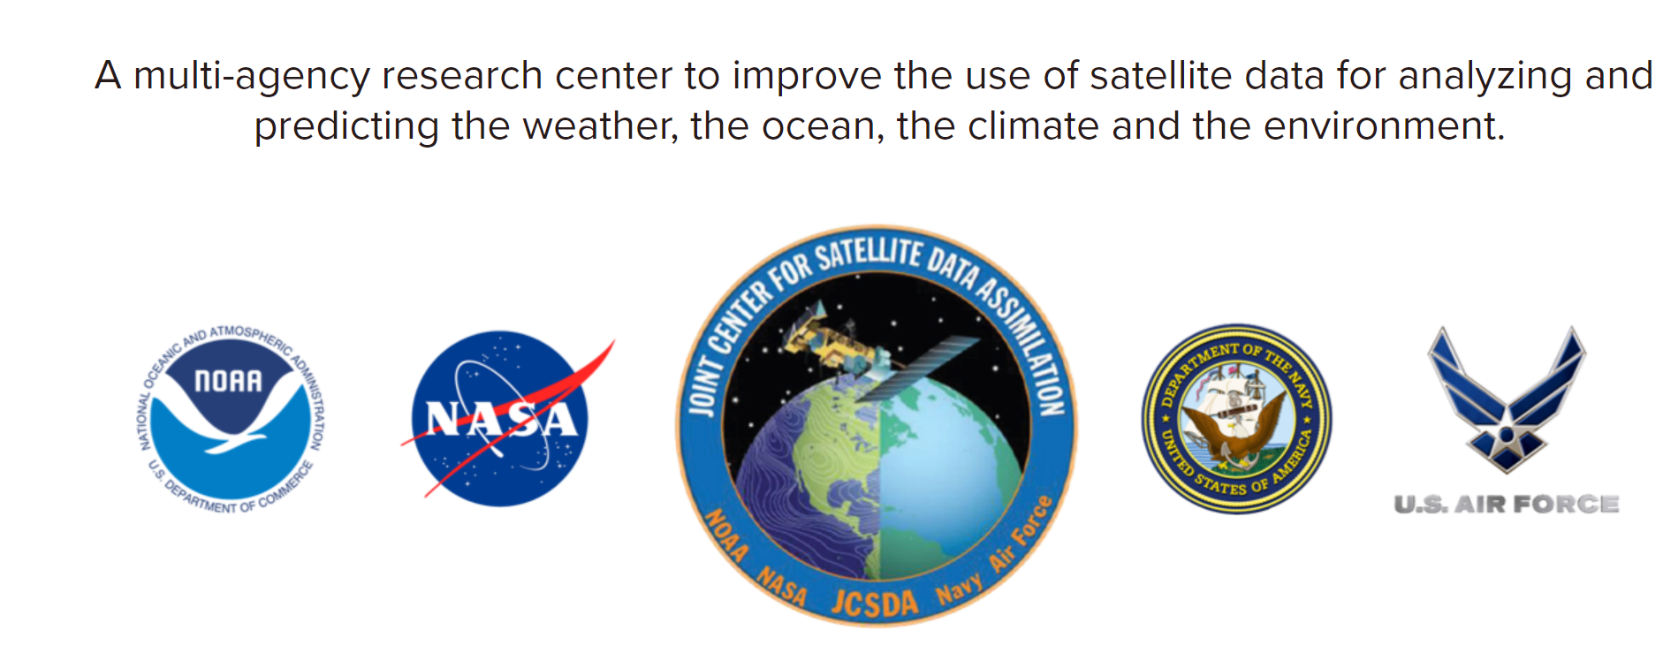
Data Assimilation: JCSDA’S JEDI
NOAA is transitioning to use the Joint Center for Satellite Data Assimilation Joint Effort for DA Integration (JEDI) system
JEDI provides a software infrastructure for data assimilation
JEDI is for scientific exploration and operational forecasting

Slide 6
What Does Epic Success Look Like?
Facilitate strong collaborations
Develop a publicly accessible end-to-end testing and development environment
Bring innovations to improve UFS performance

Slide 7
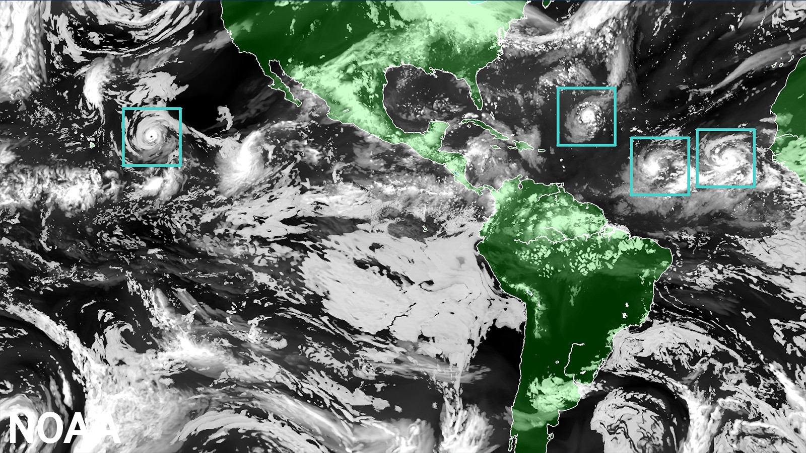
UFS Application HAFS Now Operational
Notes:
Global map showcasing land mass in green and water in black, clouds in white and tropical storms outlined in a green boxes representing the moving nest model. (Image credit: NOAA)

Slide 9
Strategic Directions
10-Year NOAA Modeling Strategy (Fall 2023)
10-Year NOAA Data Assimilation Strategy (Winter 2023/24)
Opportunities to build the workforce . . .
Journey to the cloud - For data storage and access (e.g. NODD), modeling, AI/ML, HPC computing, and collaboration

Slide 10
THANK YOU

