Slide 1
The origin and evolution of the Monsoon onset vortex and its subseasonal impacts: Integrating Theory and predictability studies using the UFS
Shreyas Dhavale
(sdhavale@ucar.edu / sdhaval2@ncsu.edu)
(WINGS Fellow and PhD Candidate at the Department of Marine, Earth and Atmospheric Sciences, North Carolina State University, working with Dr. Anantha Aiyyer)

Slide 2
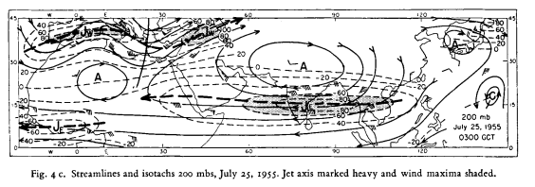
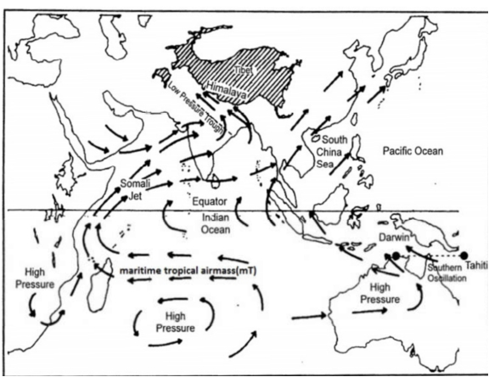
An overview of the Indian Summer Monsoon
Extends from June to September
Mascarene High
Somali Jet (low level jet at 850 hPa)
Tropical easterly jet (TEJ)
Tibetan High
Image from Koteswaram, P. (1958)

Slide 3
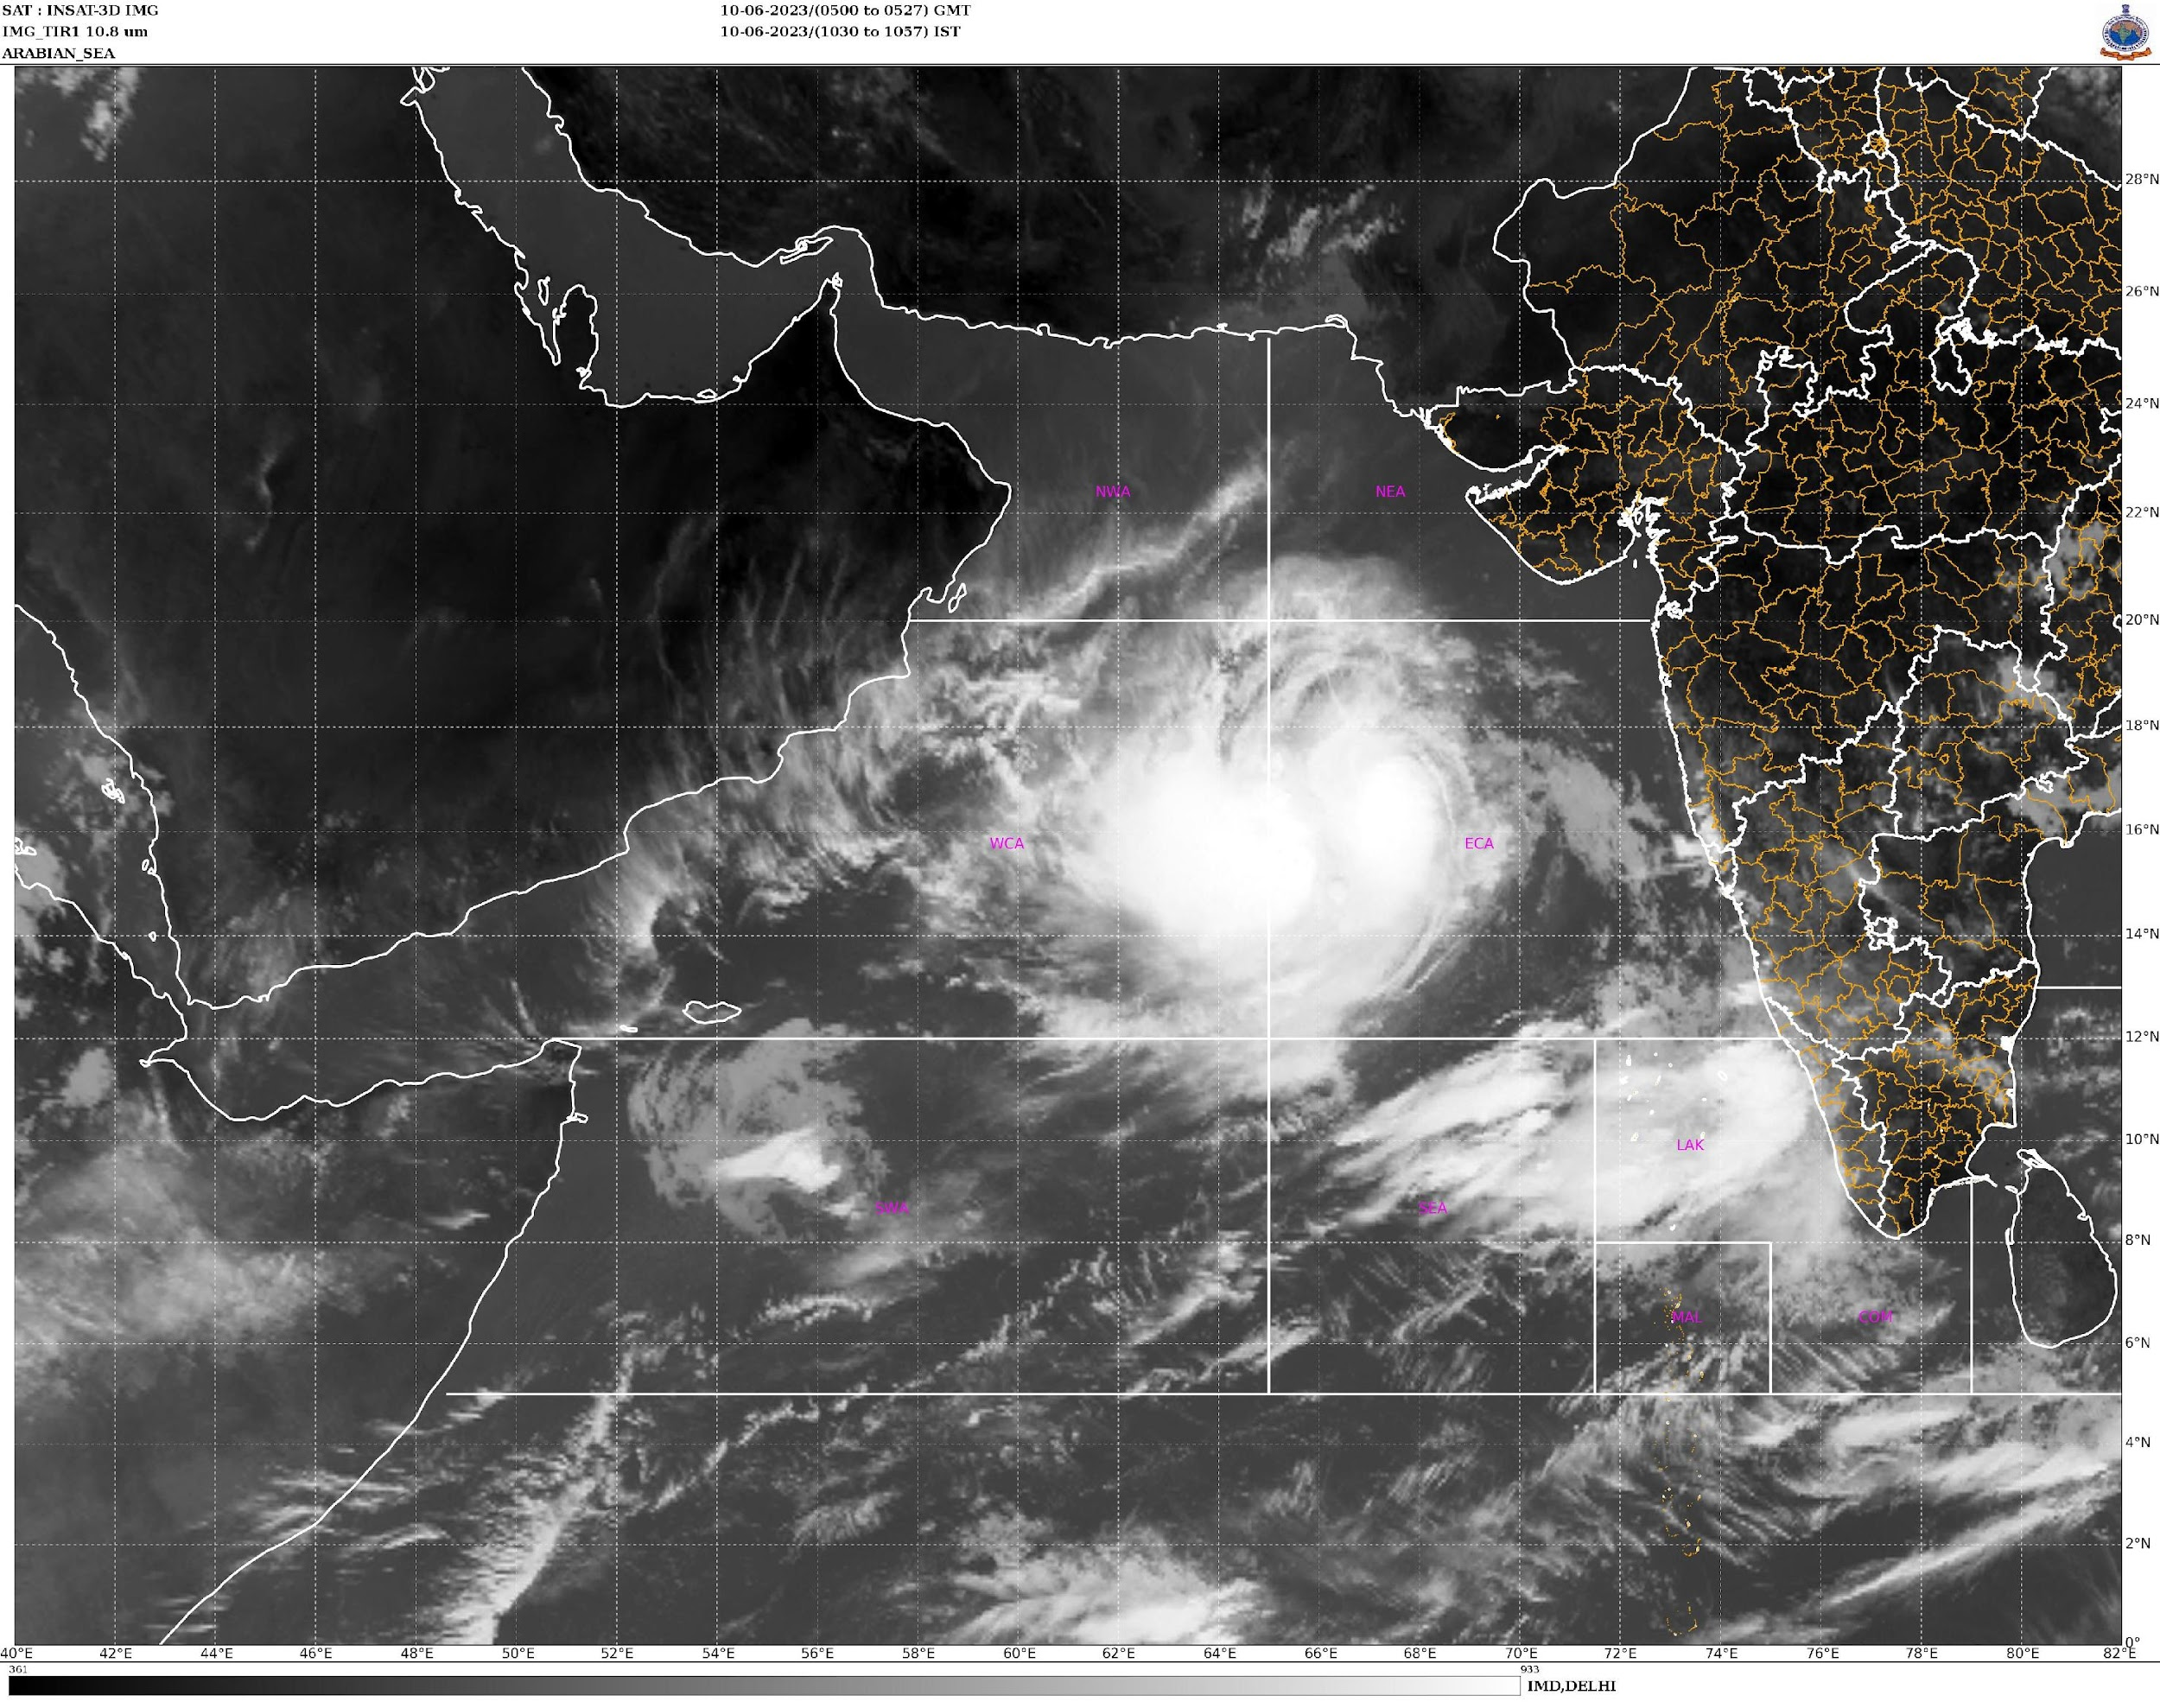
Background
Cyclone Biparjoy - Infrared image from INSAT 3D during June 10, 2023
The Monsoon is characterized by high vertical wind shear: low-level westerlies and upper-level easterlies
Tropical cyclogenesis is rare during the core monsoon period of July-August
However, during the Monsoon onset phase (late May-early June), a vortex forms in the Arabian Sea in ~60% of the years
This vortex is termed as the Monsoon Onset Vortex (MOV)
Recent example: Cyclone Biparjoy in the Arabian Sea, June 2023
(Image credits: India Meteorological Department)

Slide 4
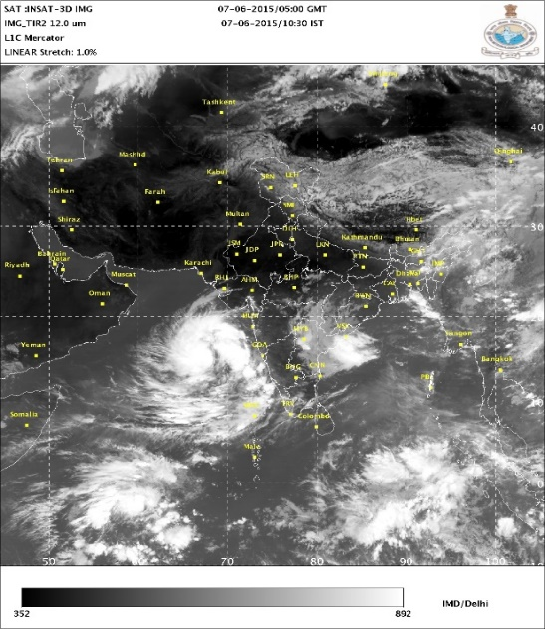
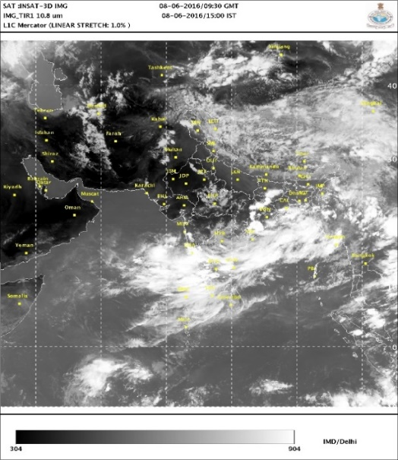
MOV during monsoon onset
No MOV during monsoon onset
INSAT 3D image dated 7th June 2015
INSAT 3D image dated 8th June 2016
(Image credits: India Meteorological Department)

Slide 5
Why study the MOV?
1. Affects the advance of the Monsoon
Helps set in the Monsoon over southern India (e.g., Krishnamurti et al., 1981)
The MOV track/intensity can possibly delay the monsoon progression over the west coast of India and in the interior peninsula
2. Considerable Socio-Economic impacts
MOVs often intensify into TCs (~78%), coastal hazards for densely populated coastline
Past MOVs have caused damages worth $4 billion (Evan and Camargo, 2011)
Agricultural and hydrological impacts through modulation of subseasonal monsoon rainfall

Slide 6
Previous Literature and Knowledge gaps
Idealized modeling experiments – single-layer barotropic model to study barotropic instability of Somali Jet (Krishnamurti et al., 1981)
Dry barotropic-baroclinic instability of basic state – idealized models with 2 or more atmospheric layers (e.g., Mak and Kao, 1982; Krishnakumar et al., 1993)
Some synoptic studies on the environment of the MOV – Arabian Sea mini-warm pool, Somali jet and east-west shear zone (Rao and Shivakumar, 1999, Deepa et. al., 2007)
No comprehensive study focusing on the Physical Mechanisms of MOV formation and its impact on subseasonal monsoon rainfall
Predictability - Need to evaluate the performance of operational models such as the UFS for the MOV

Slide 7
Preliminary Results
1. Identification of past MOVs
Combination of reports from the Joint Typhoon Warning Center (JTWC) and India Meteorological Department (IMD) – total 23 MOVs from 1982-2021
2. Role of the Madden-Julian Oscillation (MJO)
MJO is the leading source of predictability over the Indian Ocean
MOV’s response to the MJO is non-linear 🡪 convectively active MJO is neither a necessary nor a sufficient condition for MOV formation, but convectively suppressed MJO inhibits MOV more robustly (Dhavale and Aiyyer, 2023 – manuscript under review)

Slide 8
Preliminary Results
3. Flavors of the MOV
Presently working on analyzing MOV structure using high-resolution reanalysis datasets and satellite observations
Goal: To develop a synoptic model of the MOV
4. Model Simulations: WRF
Surface enthalpy fluxes essential for the MOV to sustain and intensify into a tropical cyclone
MOV simulations in WRF are sensitive to convective parameterization choices.

Slide 9
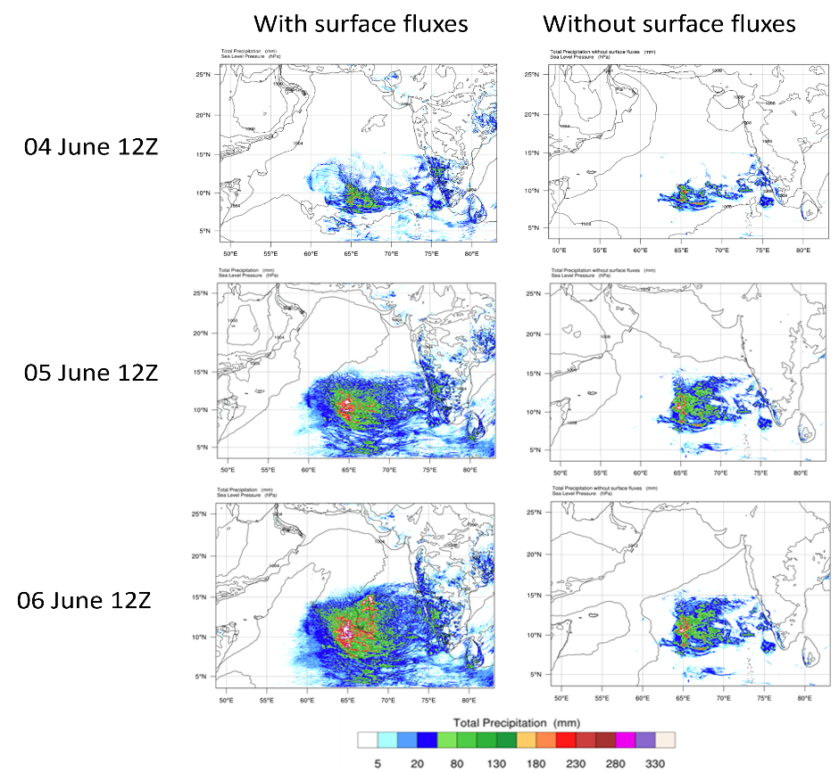
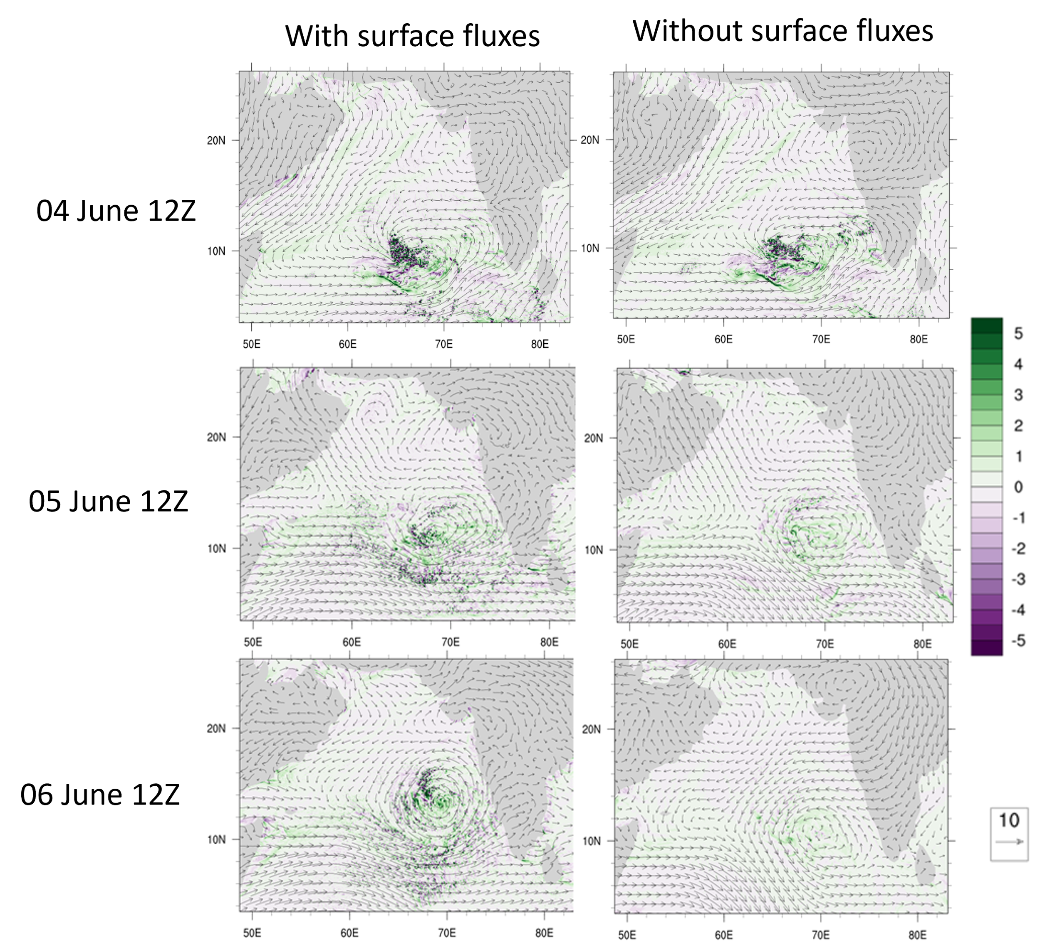
WRF Simulations: Importance of surface fluxes
Figure: Sea Level pressure (contours) and total accumulated precipitation (color) as observed in the WRF runs with and without the surface enthalpy fluxes for the 2015 MOV.
Figure: 850 hPa winds (vectors) and relative vorticity (color).

Slide 10
Proposed Work with the UFS
Working with Dr. Cristiana Stan and my advisor Dr. Anantha Aiyyer
Validating the UFS performance
Study the forecast skill of the UFS prototypes and compare them with reanalysis datasets/observations
E.g., Dynamic fields (wind, vorticity) and thermodynamic fields (temperature, SST), cloud properties, and rainfall
Identify the model bias
Potential Simulations using the UFS SRW/MRW
Check the predictability of the MOV
Study mechanisms governing its formation and intensification into a tropical cyclone

Slide 11
Impacts on Global Science, Meteorology and the Community
Help in improving the UFS – subseasonal predictions of tropical monsoon regions
A step towards achieving the objectives of the UFS and NOAA – to help improve skill and enhance the value of subseasonal weather forecasts
Most MOVs intensify into tropical cyclones - Understand a potential pathway to tropical cyclogenesis.
Potentially improve forecast skill for other regions of the world through teleconnections (tropical convection affects global weather through teleconnections, e.g., Beverly et al., 2021)
Improved subseasonal weather predictions – a great help to food and water security in South Asian countries 🡪 minimizing socio-economic impacts and benefitting a large section of humanity

Slide 12
Acknowledgements
I would like to thank CPAESS, UCAR, and NOAA WPO for this incredible opportunity.
I would like to thank my advisor Dr. Anantha Aiyyer, for his constant support and valuable guidance.
My PhD advisory committee (Dr. Gary Lackmann, Dr. Walter Robinson and Dr. Sarah Larson) at North Carolina State University, for their valuable feedback and guidance.
My mentor for the WINGS Fellowship, Dr. Cristiana Stan (George Mason University) for her guidance on the UFS.
Dr. Cindy Bruyère and Kate Rodd from CPAESS for their immense help over the last 4 months in the onboarding process of the first batch of WINGS Fellows.

Slide 13
References
Beverley, J. D., Woolnough, S. J., Baker, L. H., Johnson, S. J., Weisheimer, A., & O’Reilly, C. H. (2021). Dynamical mechanisms linking Indian monsoon precipitation and the circumglobal teleconnection. Climate Dynamics, 57(9), 2615-2636.
Deepa, R., Seetaramayya, P., Nagar, S. G., and Gnanaseelan, C. (2007). On the plausible reasons for the formation of onset vortex in the presence of Arabian Sea mini warm pool. Current Science, pages 794–800.
Evan AT, Camargo SJ. 2011. A climatology of Arabian Sea cyclonic storms. Journal of Climate, 24(1): 140–158. https://doi.org/10.1175/2010JCLI3611.1.
Koteswaram, P. (1958). The easterly jet stream in the tropics. Tellus, 10(1), 43-57.
Krishnakumar, V., V. S. Kasture, and N. R. Keshavamurty, 1993: Linear and Non-linear Studies of the Summer Monsoon Onset Vortex. Journal of the Meteorological Society of Japan, 71 (1), 1–20.
Krishnamurti, T. N., P. Ardanuy, Y. Ramanathan, and R. Pasch, 1981: On the Onset Vortex of the Summer Monsoon. Monthly Weather Review, 109 (2), 344.
Mak, M., & KAO, C. Y. J. (1982). An instability study of the onset‐vortex of the southwest monsoon, 1979. Tellus, 34(4), 358-368.
Rao, R. R. and Sivakumar, R. (1999). On the possible mechanisms of the evolution of a mini-warm pool during the pre-summer monsoon season and the genesis of onset vortex in the South-Eastern Arabian Sea. Quarterly Journal of the Royal Meteorological Society, 125(555):787–809

Slide 14
Thank You!

