Slide 1
Impacts of Surface Winds on Dust Emissions: Comparison of Measurements and Models to Improve Model Parameterization and Further Understanding of Sub-grid Processes.
Emily Faber^{1,2}
(efaber1@umbc.edu)
Dr. Adriana Rocha Lima¹, Dr. Barry Baker³ , Dr. Peter Colarco⁴
¹University of Maryland, Baltimore County
²GESTAR-II, Goddard Earth Sciences Technology and Research
³NASA Goddard Space Flight Center
⁴National Oceanic and Atmospheric Administration (NOAA)

Slide 2
Outline
Introduction & Motivation
Physical Introduction
• Model Introduction
• Motivation
Methods
•The W.I.IN.D study
Preliminary Results & Discussion
• Wind Observation Evaluation
• Identify Wind Seasonality, Diurnal Cycle, and Long-term Variability
• Investigation of Sub-grid Surface Wind Variability
• Dust Emission Impacts from Surface Wind Speed Differences
Conclusions & Future Work

Slide 3
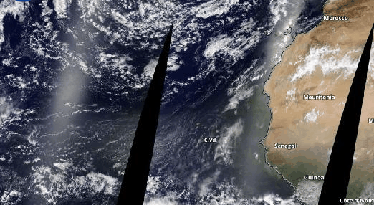
Physical Introduction
• Mineral dust can make up to 35% of the continental aerosol mass of particles <10 microns or less.
• Dust can be emitted from many sources, including both natural and anthropogenic sources
• Impacts hurricane formation, human health and activities and local weather.
• Desertification due to climate change has increased the need for adaptability and improving physical parameterizations of climate models
https://worldview.earthdata.nasa.gov – MODIS Corrected Reflectance
Boucher et al., 2013
Wong and Dessler, 2005
Jiménez et al., 2010
Moridnejad et al., 2015

Slide 4
Model Introduction - GOCART
Assimilated methods involve combining both calculated and measured data to better characterize the meteorological parameters.
• The GOCART (Global Ozone Chemistry Aerosol Radiation and Transport) model is a widely used scheme.
• It is used in the aerosol module of GEOS, which produces MERRA-2 reanalysis as a product.

Slide 5
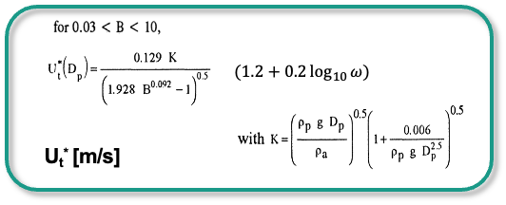
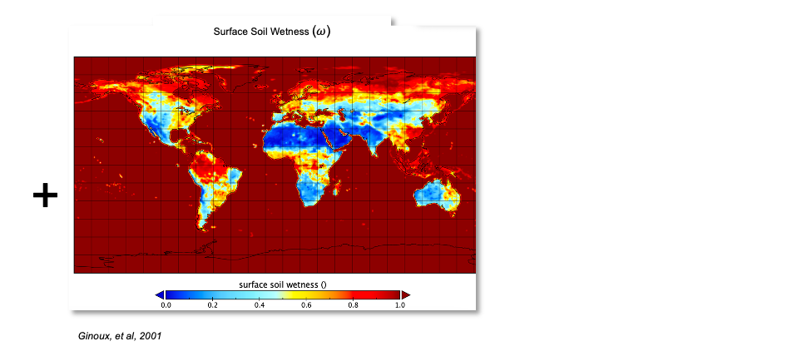
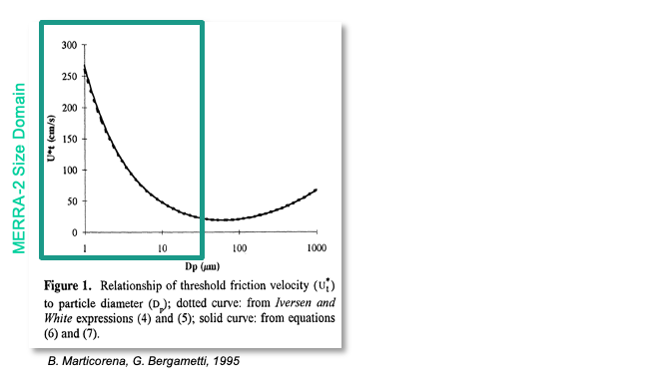
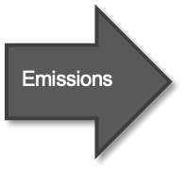
Model Introduction - GOCART

Slide 6
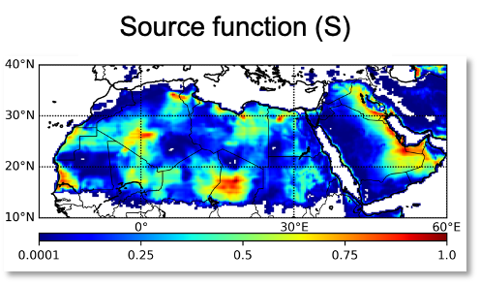
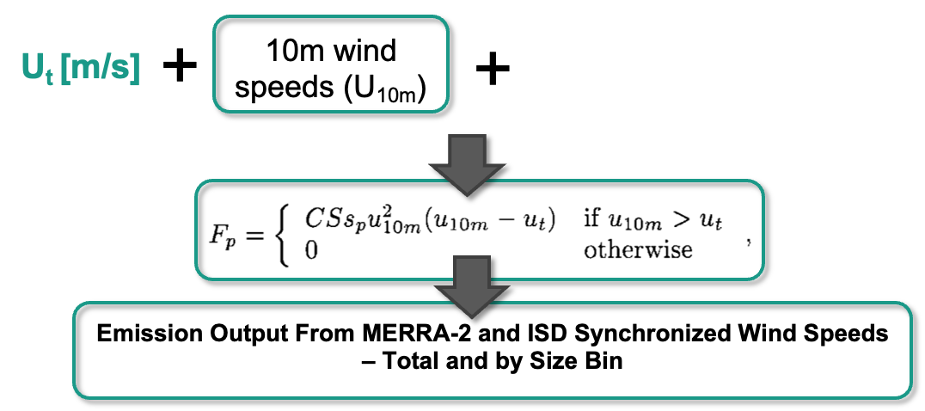
Model Introduction - GOCART
GOCART uses 10m wind speeds, U_{t} , and a source function to calculate the vertical flux of dust.
B. Marticorena, G. Bergametti, 1995
Ginoux, et al, 2001
Chin et al., 2004
Colarco et al., 2010

Slide 7
Model Introduction - FENGSHA
• FENGSHA, which is mandarin for wind blown dust, is operationally used in the UFS-Aerosols and GEFS v13 applications as well as the GOCART2G components and was developed at NOAA ARL.
• Instead of threshold friction velocity being dependent on particle size, FENGSHA utilizes soil composition to predict the total saltation flux.
α is the vertical to horizontal flux ratio,
S is the soil erosion potential and source,
u_{*T} is the surface friction velocity, and
u_{*t} is the threshold friction velocity

Slide 8
Motivation
The goal of this study aims to better understand the limits of current parameterizations of surface wind speed and dust emissions while quantifying sub-grid variability, trends, and cycles of surface wind and dust emission.
• Aerosolized dust and dust emissions are vital to understanding the Earth’s climate system, with the uncertainty in surface wind speed being one of the main sources of error in quantifying dust emissions.
• It is important to evaluate how well winds are represented in the model to better represent how dust is emitted, transported, and deposited as well as the long-term variability, sources of dust, and diurnal dust cycles.
• To better quantify how surface winds propagate to differences in model versus measurement dust emissions.

Slide 9
The W.I.IN.D. Study
Wind Observation Evaluation
Identify Wind Seasonality, Diurnal Cycle, and Long-term Variability
Investigation of Sub-grid Surface Wind Variability
Dust Emission Impacts from Surface Wind Speed Differences

Slide 10
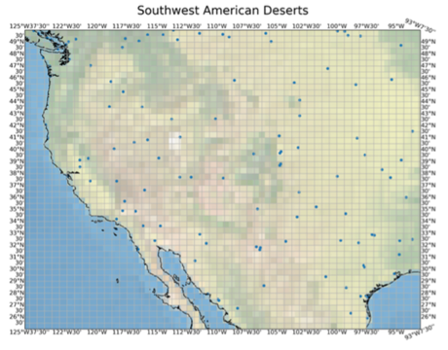
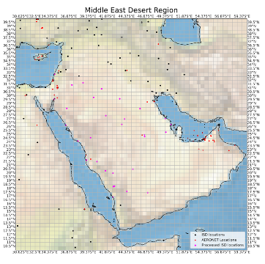
Wind Observation Evaluation
• Data points from ISD and MERRA-2 are aligned in space and time.
• The NOAA Integrated Surface Database (ISD) is a collection of meteorological sites that can be used as an independent data set of surface wind speeds to the Modern-Era Retrospective Analysis for Research and Applications, version 2 (MERRA-2).
• 33 Stations were selected in the US that have data for the 20-year study period and have wind speeds confirmed to be reported at 10m.

Slide 11
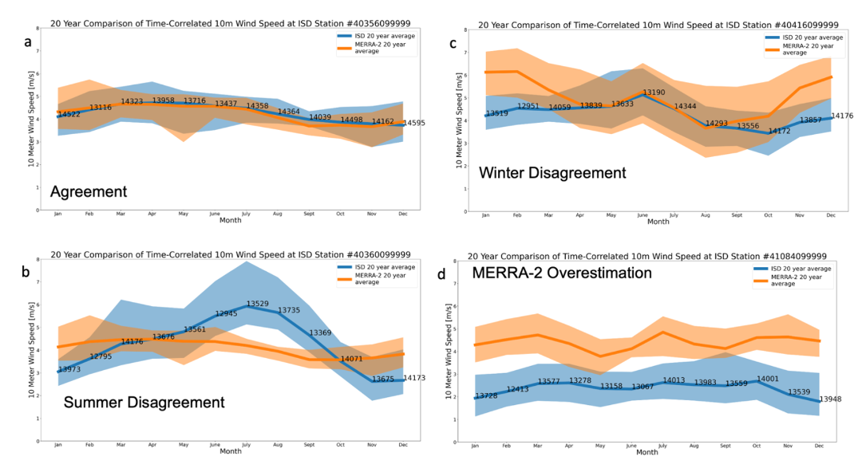
Identify Wind Seasonality, Diurnal Cycle, and Long-term Variability
Shows ISD and MERRA-2 10-m monthly wind speed averages. The standard deviation is shown by the shaded region and the number of measurements/data points included in each monthly average are shown on the ISD lines. Clear disagreement is shown in subfigures b-d and clear variability in the seasonal cycle is present.

Slide 12
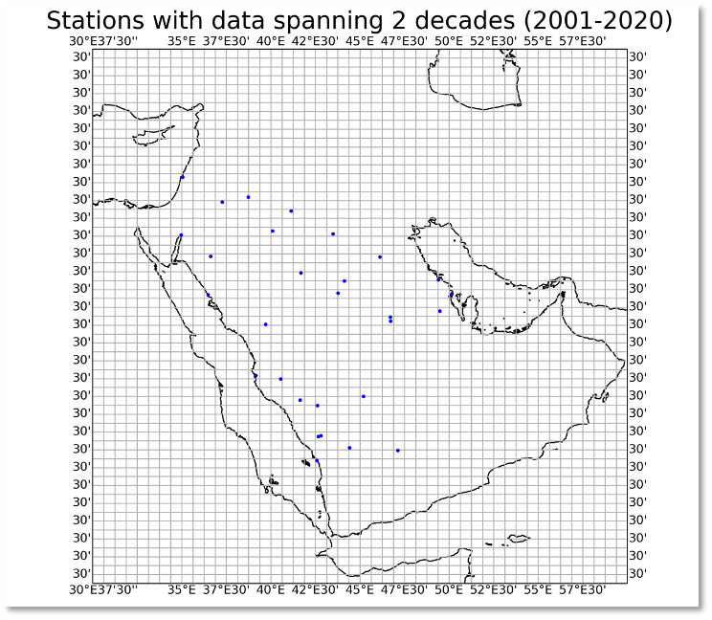
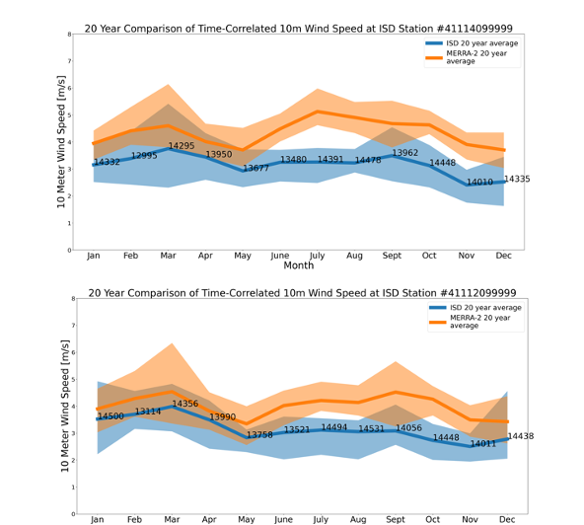
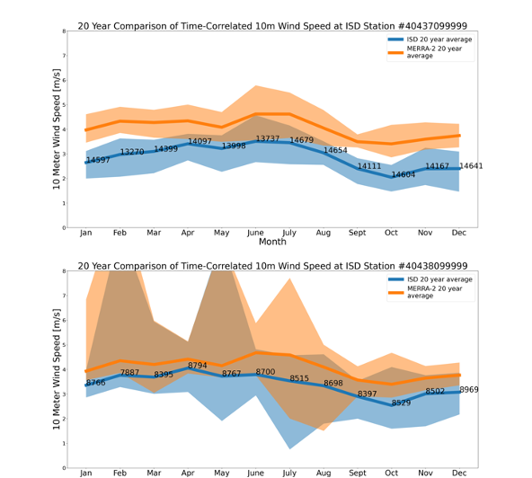
Investigation of Sub-grid Surface Wind Variability

Slide 13
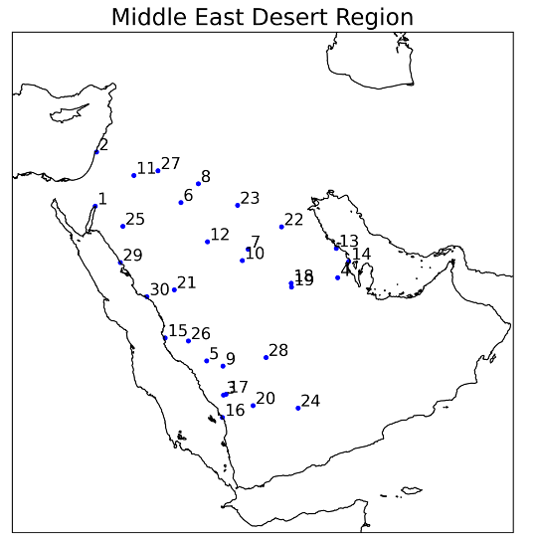
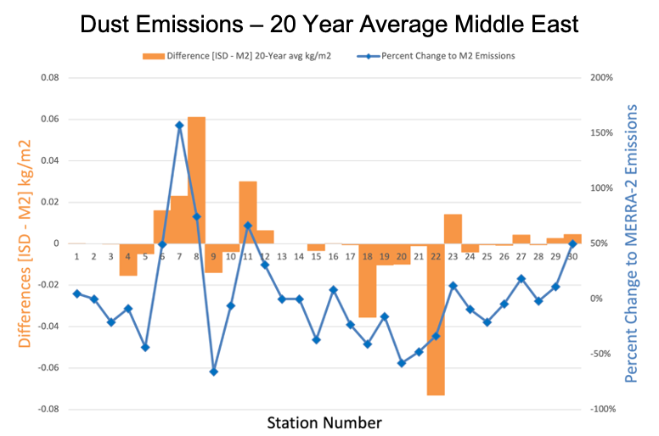
Dust Emission Impacts from Surface Wind Speed Differences
Station 8 grid box has an average difference of 0.0575 Tg of dust emission per year! That’s 61.1 grams per square meter per year!
Station 22 grid box has an average difference of 0.1827 Tg of dust emission per year! That’s 73.08 grams per square meter per year!

Slide 14
Conclusions & Future Work

Slide 15
Conclusions & Future Work
• This proposed study will strive to understand if dust emission difference driven by wind differences is a global or local bias by comparing to a different dust source regions of the planet - the American Southwest, the Sahara Desert, the Gobi Desert.
• Comparisons with a different schema of dust models is also proposed in order to find out what parameterizations may work best in a climate ready future.
• There are opportunities for sub-grid case studies. Using this approach within deserts to identify local discrepancies, and global intercomparisons of systematic issues within the model parameterizations will be identified.
• Additionally, a comparison with in-situ measurements of dust flux ispossible!
Have an in-situ data set you’d like to share? Please fill out this google form!

Slide 16
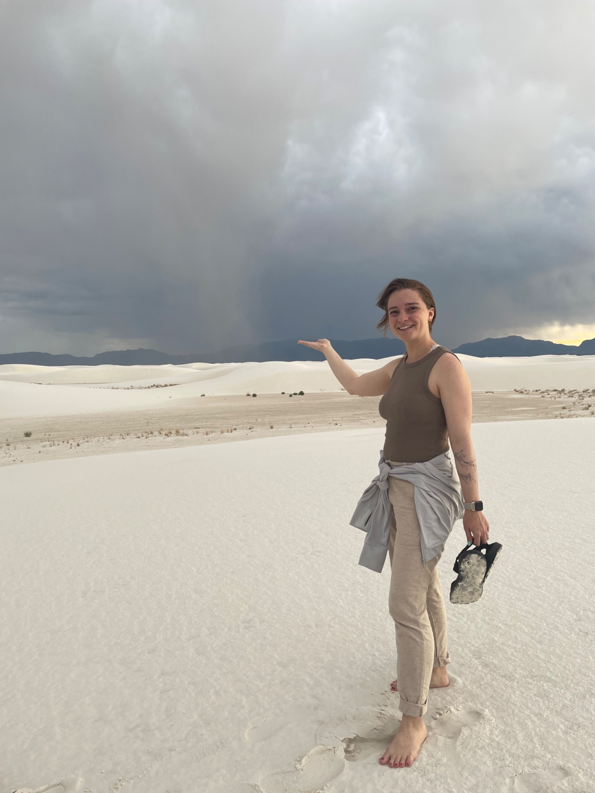
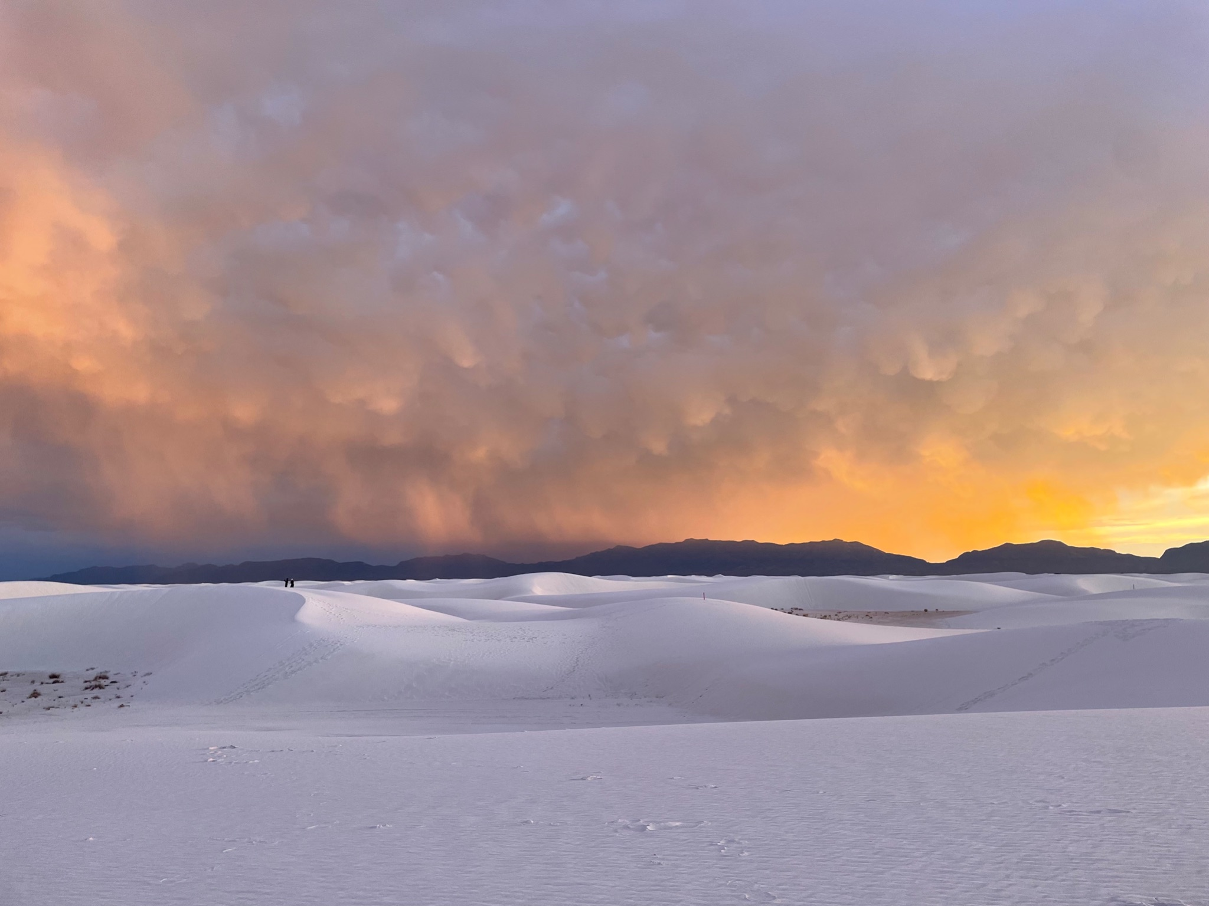
THANK YOU!

