Slide 1
Unifying Innovations in Forecasting Capabilities Workshop
A Unified Forecast System (UFS) Collaboration Powered by the Earth Prediction Innovation Center (EPIC)
JULY 24th, 2023
Center Green Auditorium, Boulder, CO
July 24-28, 2023

Slide 2
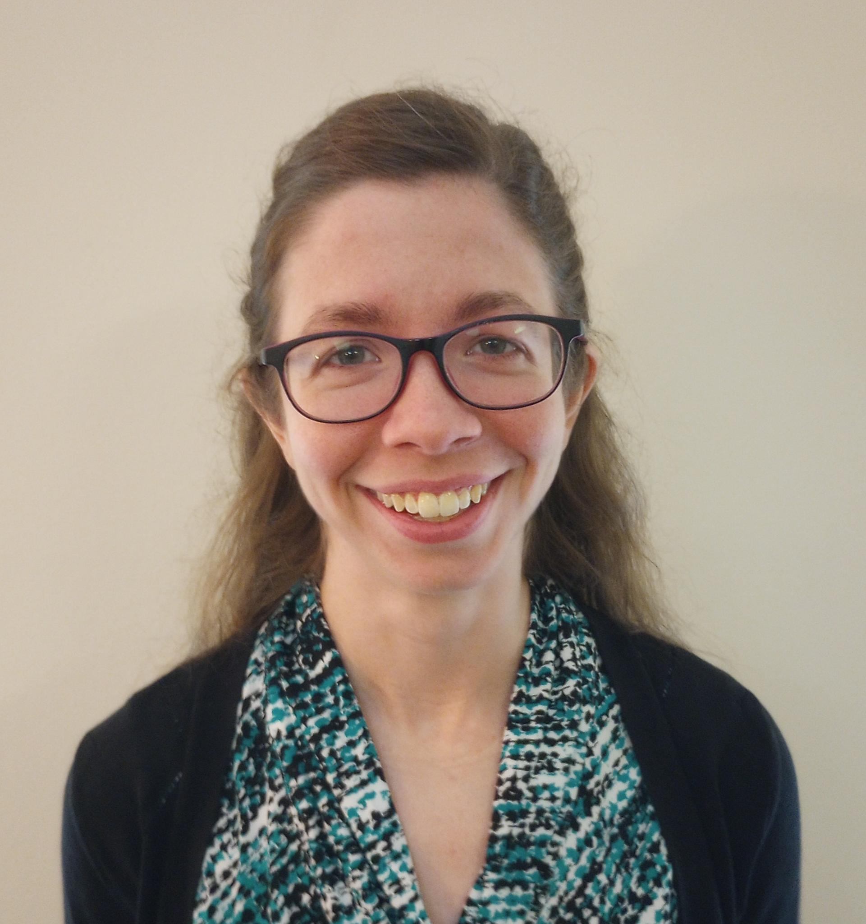
Today’s Moderator
Gillian Petro
Technical Writer
EPIC/STC

Slide 3
Monday, July 24th
1:00 – 1:10 – Welcome and Kickoff
1:15 – 1:30 – Opening Remarks by Dr. Michael Morgan
1:30 – 1:45 – Remarks from Dorothy Koch, Stephan Smith
1:45 – 2:30 – Overview: State of the Science of UFS
2:30 – 3:00 – Using UFS as a Teaching Tool in Academia
3:00 – 3:30 – Partnerships: How to Expand Our Community
3:30 – 4:00 – BREAK

Slide 4
Monday, July 24th
4:00 – 5:30 – Importance and Need for Diversity and Inclusion in Community Modeling
5:30 – 6:20 – Welcome event for WINGS Dissertation Fellows
6:20 – ADJOURN
7:00 – Networking Dinner at Avanti Food & Beverage
1401 Pearl St., Boulder, CO

Slide 5
Live Streaming Announcement
We are livestreaming the event, so please be aware of hot mics and video recording.
If you would like to be further from the microphone, we suggest sitting in the back of the room.

Slide 6
Connect with us!
Connect with us on Twitter and Instagram with #UIFCW23
Twitter: @NOAAEPIC & @ufs_community
Instagram: @NOAAEPIC
Wi-Fi: UCAR Visitor

